Slide 1
STEM Routes
Resumes, CVs, and Cover Letters
Joe Villanueva
April 23, 2021
Notes:
https://forms.gle/gVQH9iKWHjkcfcNv6

Slide 2
We are here for you!
Do you have questions about your future STEM Career and how to get there?
Email us at stem_routes@colorado.edu

Slide 3
Resume vs CV
Résumé – “to sum up” – 1 page
Summary of your education, work history, credentials, other accomplishments and skills
CV– Curriculum Vitae – “course of life” – 2-3 pages can be 10+
Complete summary of your experiences and skills
Includes detailed information about your education, professional career, publications, awards, honors, and other achievements
In the USA, is typically used for academic job applications

Slide 4
Résumé: What to Include- I am THE Candidate
Contact Information
Education
Work Experience
Skills
Additional Sections (Awards, Courses, Publications, Certificates, Conferences, etc.)

Slide 5
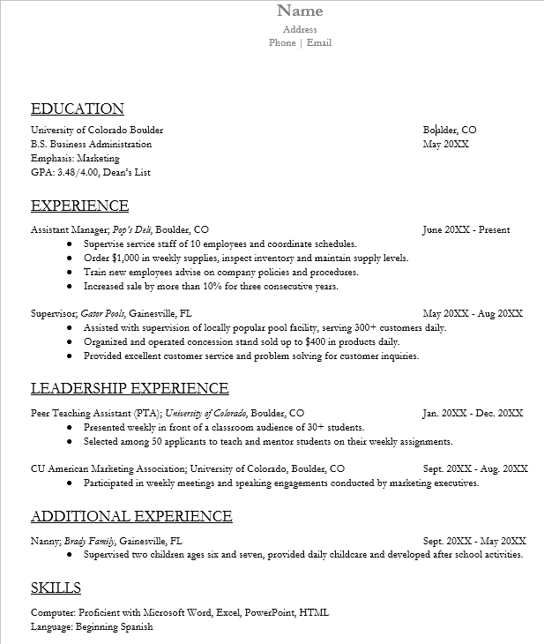
First- and Second-Year Resume Template

Slide 6
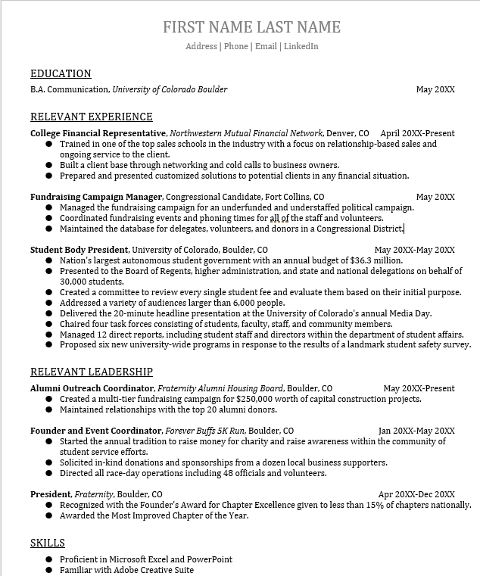
Third and Post Grad Resume Template

Slide 7
CV: What to Include – Your Life
Contact Information
Research Objective, Professional Profile, or Personal Statement
Education
Professional Academic Appointments
Books
Book Chapters
Peer-Reviewed Publications
Other Publications
Awards and Honors
Grants and Fellowships
Conferences
Leadership Experience
Research Experience / Lab Experience / Graduate Fieldwork
Non-Academic or Club Activities
Languages and Skills
Memberships
References

Slide 8
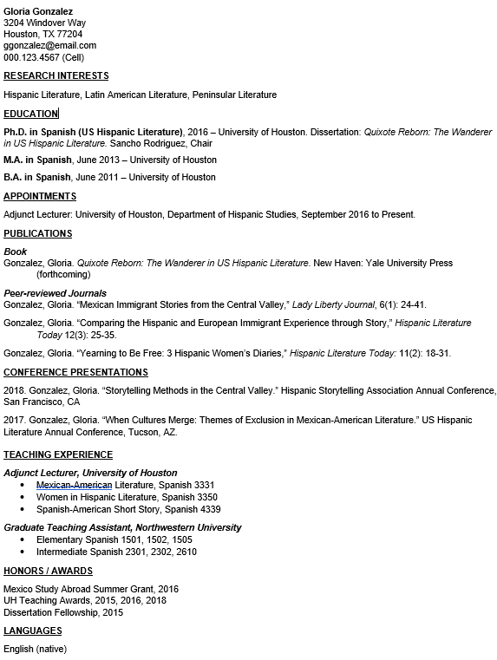
CV Template

Slide 9
Formatting Your CV
Dates- Present them in reverse chronological order-
your current experience comes first
Specify Education with Name of institution, city and country
Highlight skills and experience with bullet points
Use an easy-to-read font (not too small or big)
Use bold and italics to help the reader (not overwhelm them)

Slide 10
CV: Communicating Value
List 5 things you want to communicate to anyone who looks at your CV?
Example
1)Knowledge about URM issues and treads
2) Good at developing and delivering workshops and small 1-3 day conferences
3)Capable of building strong external partnerships
4) Driven to improve programs though assessments and planning
5)Proven track record of securing ‘the bag’
Take a few minutes and write them out
Consider your skills, knowledge, interests and experience
You should be able to back these up with examples in your CV.

Slide 11
Create ‘Dynamic’ Bullet Points
Go beyond simply listing your tasks and duties
Highlight what you know how to do and the impact you’ve had
Specific details
Quantify when possible
Accomplishments/ results (Show with examples, don’t kist list)
Focus on those that demonstrate your qualifications for the target position
Go beyond simply listing your tasks and duties
Nitty-Gritty
Bullet points should start with an action verb
No defined number of bullets (consider relevance and duration)
Current position = present tense, previous positions = past tense

Slide 12
Dynamic Bullets
List of Duties and Tasks
Responsible for data collection
Accomplishments (action verbs, qualify/quantify
Conducted a survey with >300 respondents in 3 regions of CO to build first ever dataset of youth engagement in natural resource governance

Slide 13
Dynamic Bullets
Facts
Collected sample species for company
Assisted in organizing conferences and public events
Lead team of software developers
Conducted research on the electoral volatility of Turkey
Collected and categorized over 100 different species of animals for Panamanian sustainable community
Coordinated the presentation schedule for one international research conference and two yearly chapter meeting, which included >50 speakers and saw and attendance of >2000 people
Lead a team of 6 software developers on a $2m, 12-month project, meeting deadlines and increasing productivity gains for users by 30%
Examined open source reports on violence associated with Turkish elections and conducted phone interviews with over 20 protesters and security personnel

Slide 15
Cover Letters – Expanding Beyond CV/ Resume
Your opportunity to tell employers how the information in your CV/Resume fits into their workplace
3-5 paragraph essay format that highlights specific experiences/ skills for a job

Slide 16
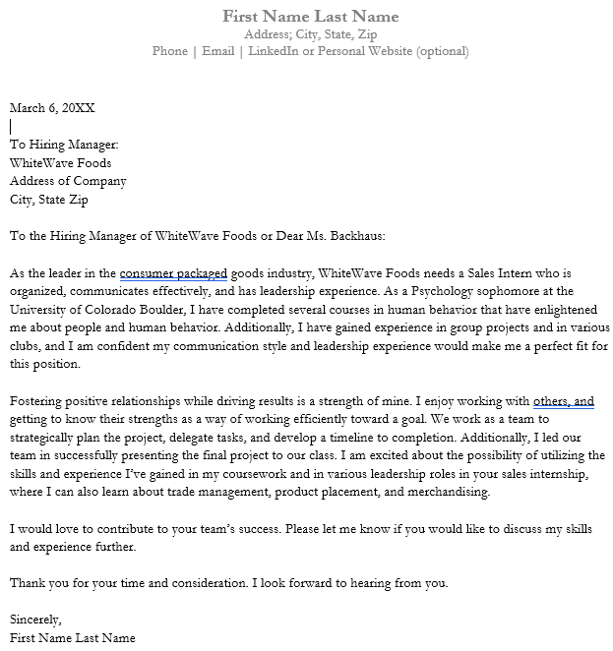
General Cover Letter Template

Slide 17
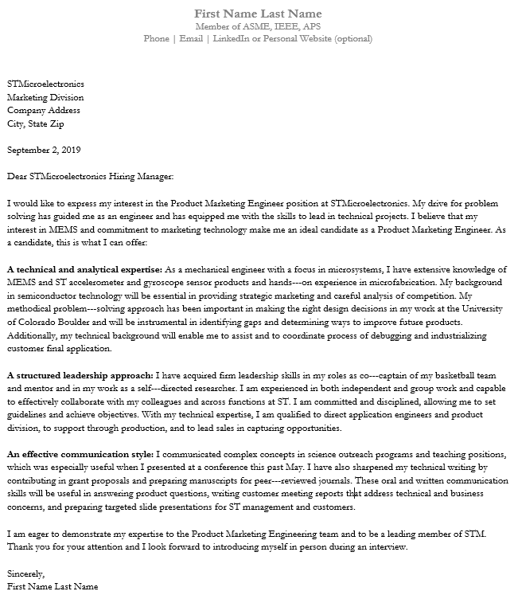
Engineering Cover Letter Template

Slide 18
Cover Letters – What to Include
Header – Use the same format/ info from your resume/ CV
This contains your contact information and the position you are applying to
Opening paragraph
Address someone directly – if you can not find someone, use, “To whom it may concern”
Describe how you found the position
If someone referred you, mention them here
Describe why you are interested in the job and why your 2-3 specific skills fit into the position / company

Slide 19
Cover Letters – What to Include
Middle Paragraphs
Expand on those 2-3 skills by giving concrete examples that demonstrate those skills through experience
Highlight your researched knowledge of the company by indicating how your experiences fit their company objectives
Address specific qualifications mentioned in the job description

Slide 20
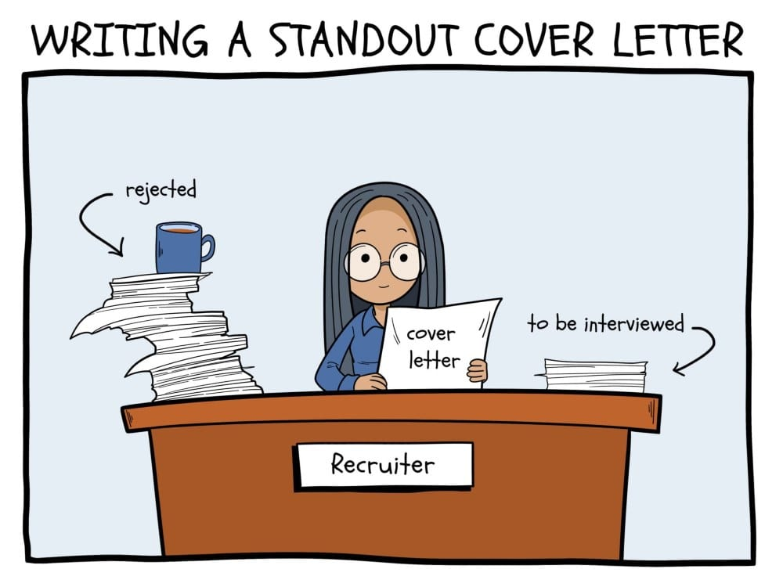
Cover Letters – What to Include
Closing Paragraph
Reiterate your interest in the position
Thank the employer for taking the time to read your cover letter
Indicate how and when the employer can contact you

Slide 21
LinkedIn and Recruiters Use Robots
Applicant Tracking Systems (ATS)
The robot that will read your resume
>75% of employers use ATS to find applicants, especially if they use a recruiter
Keys to matching algorithms:
Format – use .docx (PDF, pages, etc. are often not input types)
Avoid using headers/ footers. Format them within the body of the page
KEYWORDS! – read through job description and highlight any skills, tech, software or repeated words, especially in the ‘qualifications’ section, and match those directly (but do not copy and paste! It can catch that too!!)

Slide 23
Master Resume and Informational Interview
Master Resume
Maintain a record of ALL your activates, so you can pick and choose for your resume when the time comes
This document can also function as your CV
Informational Interview
Request from someone in management or in a hiring role
Allows you to get an idea of the workplace environment and a better chance to let the employer know who you are and might result in a job down the road

Slide 24
Take Aways
Resumes and CV contain the same information in different formats
Include a cover letter when applying for a position
Highlight how your skills match the job description
Format your resume for both computer and human readers
Obtain help at every step in the process

Slide 25
We are here for you!
Do you have questions about your future STEM Career and how to get there?
Email us at stem_routes@colorado.edu

Slide 26
Examples!
Internal Link

Slide 27
Example Resumes, CVs, and Cover Letters
Joe Villanueva
April 23, 2021

Slide 28
First- and Second-Year Resume Template

Slide 29
Third and Post Grad Resume Template

Slide 30
CV Template

Slide 31
General Cover Letter Template

Slide 32
Engineering Cover Letter Template

