Slide 2
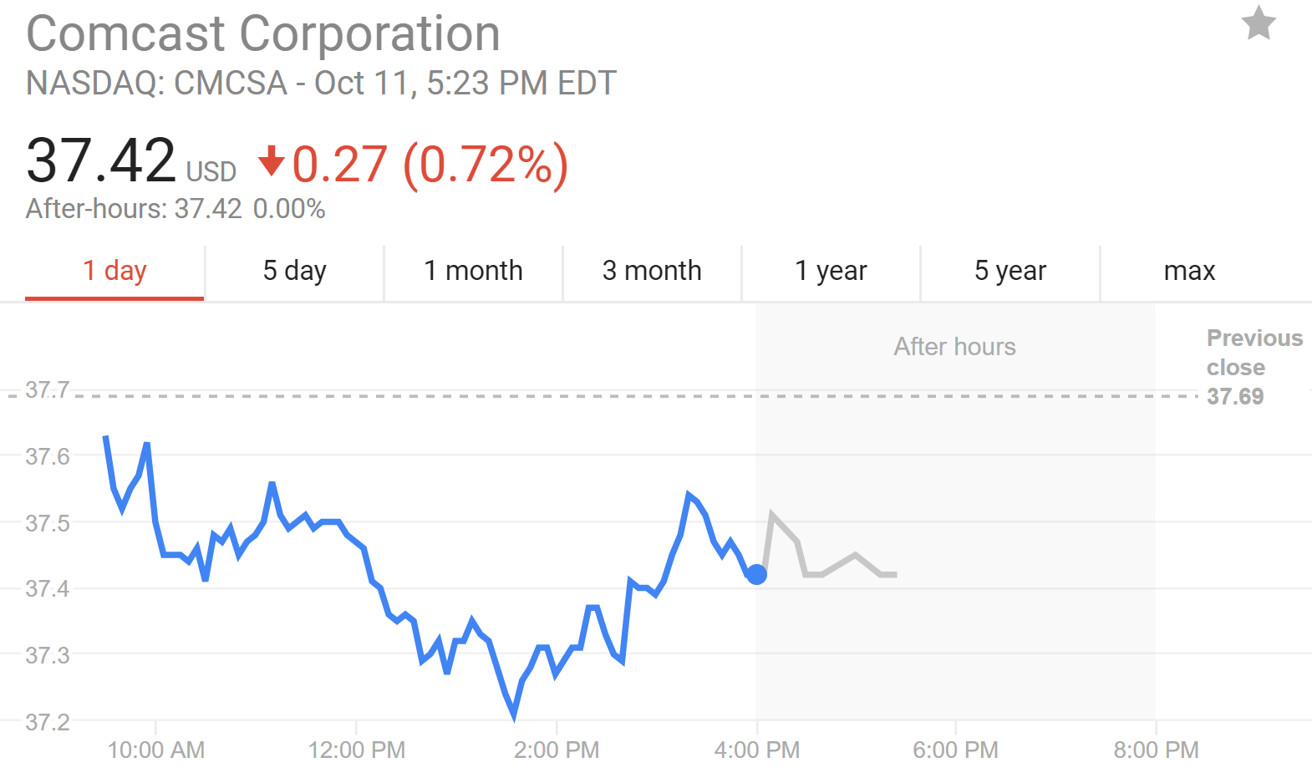

Slide 3
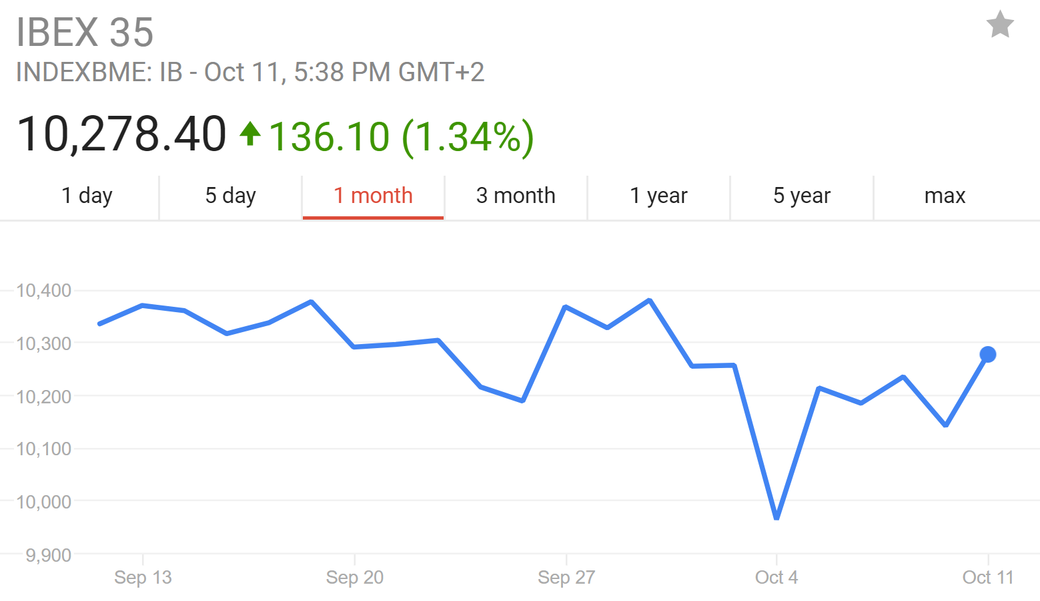
Catalan Referendum

Slide 4
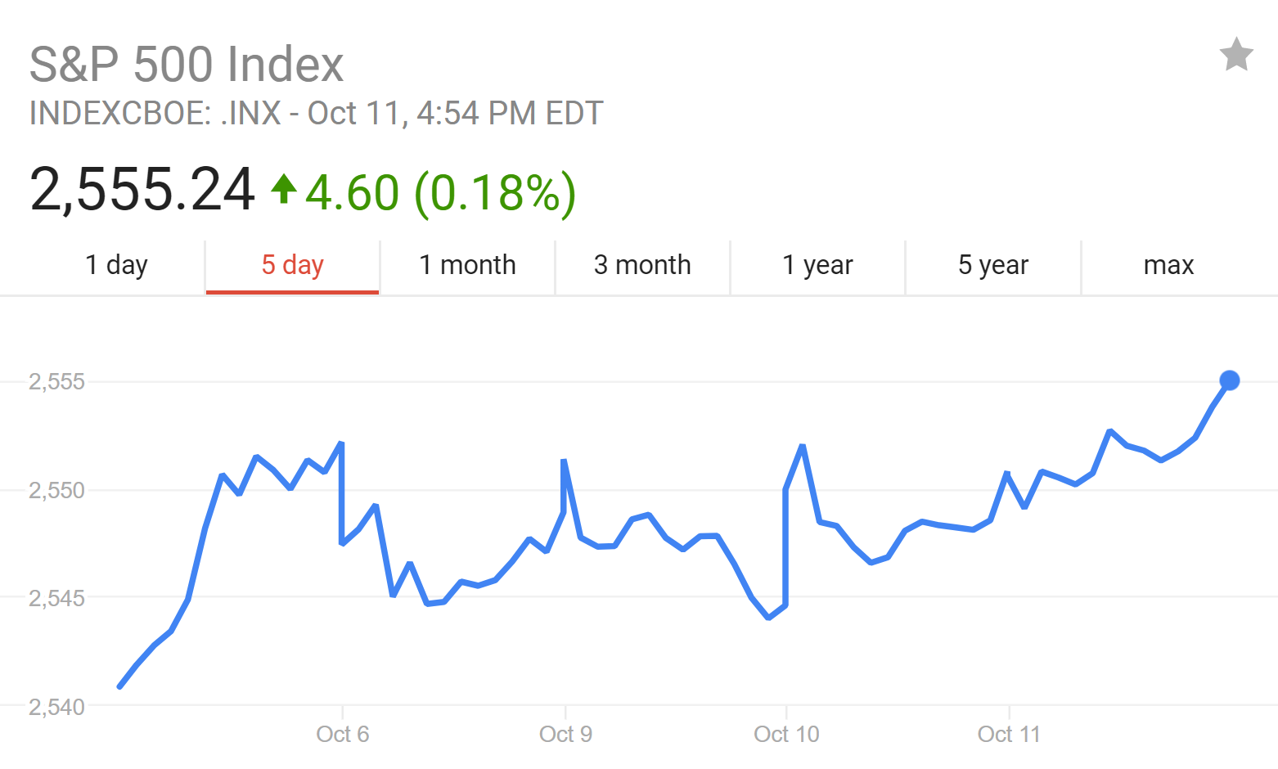
Relatively Flat Market
S&P has shown a 54 basis point increase over the last month

