Slide 1
Advancing the Frontiers of Social Science: Opportunities and Challenges
Jani Little, Executive Director
Katie Genadek, Expected Administrator
The Rocky Mountain Research Data Center (RMRDC)
https://www.colorado.edu/rocky-mountain-research-data-center/
Jani Little, Executive Director
jani.little@colorado.edu
Phil Pendergast, Administrator (Census)
philip.m.pendergast@census.gov
Kas McLean, GRA (Econ PhD Candidate)
kas.mclean@colorado.edu
The Rocky Mountain Federal Statistical Research Data Center
(RMRDC)
Jani Little
Executive Director

Slide 2
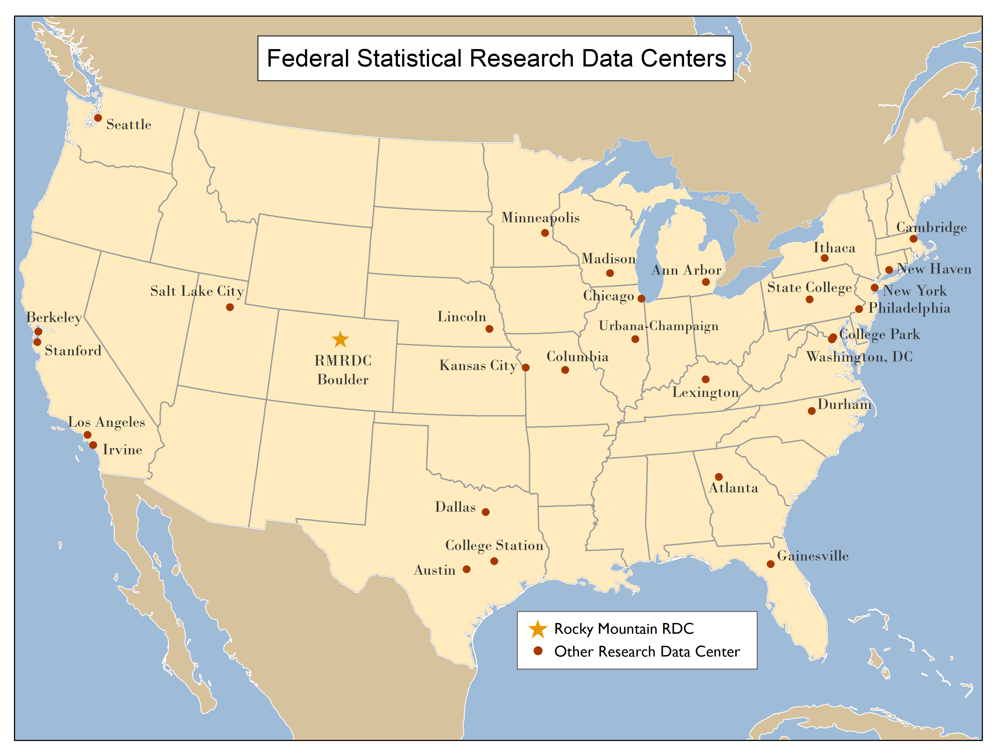
The RMRDC is part of a National Network of FSRDCs Providing Access to Restricted-Use Data Collected by Federal Statistical Agencies

Slide 3
RMRDC Membership Network *All faculty, staff, and graduate students associated with member universities have free access to the lab and services

Slide 4
RMRDC Consortium Member Contributions
Member Institution | FY16-17 | FY17-18 | FY18-19 | FY19-20 | FY20-21 | FY21-22 | FY22-23 | FY23-24
CU Boulder VCR | $125K | $100K | $100K | $100K | $100K |  | $40K | $40K
CU Boulder Provost | $25K | $50K | $50K | $50K | $50K |  | $35K | $35K
CU Denver Main | $20K | $20K | $20K | $20K | $20K | $20K
CU Denver Anschutz | $15K | $15K | $15K | $15K |  | $10K | $10K | $10K
University of Wyoming | $20K | $20K | $20K | $20K | $20K | $20K
University of Denver |  | $15K | $15K | $15K | $10K
Colorado School of Mines |  | $10K | $10K | $10K | $10K | $10K | $10K
Colorado State University | $30K | $30K | $30K |  | $20K | $20K | $20K
Rocky Mtn Poison and Drug Safety |  |  |  | $10K | $10K | $10K
University of Texas at El Paso |  |  |  |  |  | $10K | $10K | $10K

Slide 5
What RMRDC offers:
Access to federal restricted data and staff assistance in a secure facility
Staff assist with:
Successful proposal development and submission
Researchers must develop an agency-approved proposal to use the data.
“Special Sworn Status (SSS)” applications
Researchers undergo a background check which gets them lab access
Technical support
Disclosure review and statistical output approval
Results must be formally reviewed for disclosure violation before they leave the secure facility.

Slide 6
Bureau of the Census
Office of Research, Evaluation, and Statistics
(Social Security Administration)
Federal Statistical Agencies
National Center for Education Statistics
Bureau of Transportation Statistics
National Agricultural Statistics Service
National Center for Health Statistics
Bureau of Labor Statistics
Bureau of Justice Statistics
Bureau of Economic Analysis
Statistics of Income Division
(Internal Revenue Service)
Economic Research Service
National Center for Science and Engineering Statistics
(National Science Foundation)

Slide 7
Linkable, Restricted-Use Data to Investigate Society’s Most Pressing Challenges
International Trade Policies
Natural Hazards impacts on People and Business
Local Labor Markets
Immigration
impacts on People and Business
Rural vs Urban Disparities
Health Disparities
Business Sector
Growth and Decline
Crime
Victims and Consequences

Slide 8
Data for Sociologists, Demographers, Geographers:
Microdata on individuals and households -- full-count Decennial Censuses, sample surveys (ACS, CPS, AHS, SIPP, NCVS), and administrative records (e.g. Addresses, Births and Deaths)
Most data are linkable at the person level
Current topics of study at RMRDC:
Determinants of aging and migration in/out of rural, small-town USA
Long term impacts of crime victimization on employment, income, housing
Race/class differences in accessibility of public transit for workplace commuting

Slide 9
Data for Economists:
Economic Census and Survey Data – firm and establishment-level employment, expenditures, revenue, trade (e.g. ASM, CFS, LFTTD), longitudinal administrative records of business births and deaths (LBD), linked employer-employee data (LEHD)
BEA data on multinationals and trade, BLS data on injuries/fatalities
BEA and BLS charge additional fees for projects
Current topics of study at RMRDC:
Impacts of stimulus/shocks on local employment and labor markets
Healthcare coverage in minority-owned businesses
New energy development impacts on local economies by industry

Slide 10
Data for Public Health Researchers/Epidemiologists:
National Center for Health Statistics (NCHS) and Agency for Healthcare Research and Quality (AHRQ) data on health behaviors and nutrition, medical expenditures, family planning, natality/mortality (e.g. NHIS, NHANES, MEPS, NSFG, NVSS)
Some data linkable to death records (NDI)
Most NCHS and AHRQ projects charge additional fees
Current topics of study at RMRDC:
Black immigrant health and differences by country of origin/time in US
Immigration policy and enforcement impacts on immigrant and native health
Gender and racial/ethnic/count of origin differences in timing of HPV vaccination

Slide 11
Advantages of Restricted-Use Data
For Researchers:
Greatly expands the policy and basic questions that can be addressed
Builds on past research findings with richer data
Improves competitive edge for grants and publications
Improves graduate education (big data/statistical techniques) and placement
For Research:
Microdata not available in public-use data, e.g., business data
Variables not available in public-use versions of data sets, such as low-level geography
Full population counts or larger samples (Decennial Census, ACS, CPS) not available in public-use data
Able to link restricted-use Census data sets
Full range of response items (e.g., industry codes, occupational codes, detailed race answers, income is not top-coded, etc.)
Ability to make linkages

Slide 12
Health Data Course: Spring 2022
“Federal Statistical Data for Health Research and Policy”
1. Students develop the knowledge and skills required to effectively use a variety of federal statistical data sets for health research and policy analysis.
2. Students get “hands on” exercises using SAS to analyze public versions of the federal data sets
3. The semester project is a restricted data proposal.
Notes:
Idea is to teach students how about restricted data. The semester project is a restricted data proposal. Would like to make it possible for DU students to take this course for credit

Slide 13
Primary Health Data Sets Covered in the Course
NCHS:
National Vital Statistics System (NVSS)*
National Health and Nutrition Examination Surveys (NHANES)*
National Health Interview Survey (NHIS) linked with National Death Index (NDI)*
NHIS linked with Medical Expenditure Panel Survey (MEPS)*
Census:
American Community Survey (ACS)*
Current Population Survey (CPS)*
Bureau of Justice Stats (BJS):
National Crime Victimization Survey (NCVS)*
Bureau of Labor Stats (BLS):
Survey of Occupational Injuries and Illnesses (SOII)*
Census of Fatal Occupational Injuries (CFOI)
American Time Use Survey (ATUS)
*Very good source of data for disparities in health and nutrition

Slide 14
Selected data sets relevant for study of Hispanic health disparities and nutrition, by type of proposal required
Proposal to Census:
American Community Survey (ACS)
Current Population Survey (CPS)
Proposal to NCHS:
National Health and Nutrition Examination Surveys (NHANES)
National Health Interview Survey (NHIS) linked with National Death Index (NDI)
Proposal to AHRQ:
NHIS linked with Medical Expenditure Panel Survey (MEPS)

Slide 15
American Community Survey (ACS)
Annual, since 2005. The most comprehensive survey of U.S. households and individual residents
Helps local officials, community leaders, and businesses understand the changes taking place in their communities. It is the premier source for detailed population and housing data
Coverage provides reliable estimates for the nation, regions, states, counties, cities, tracts, block groups
Information from the survey generates data that help determine how more than $675 billion in federal and state funds are distributed each year.

Slide 16
ACS Initial Addresses and Sample Selected and Final Interviews
 | Housing Units |  | Group Quarters People
Year | Initial | Final | Initial | Final
 | Addresses | Interviews | Sample | Actual
 | Selected |  | Selected | Interviews
2018 | 3,544,000 | 2,143,000 | 166,000 | 150,000
2017 | 3,526,808 | 2,145,639 | 168,590 | 157,721
2016 | 3,527,047 | 2,229,872 | 206,415 | 160,572

Slide 17
ACS Questionnaires: https://www.census.gov/programs-surveys/acs/methodology/questionnaire-archive.2019.html
Household composition
Each person’s relationship to Person 1 (INCLUDING SAME-SEX PARTNER)
Age and date of birth
Hispanic origin
Race
Work
Occupation
Education
Detailed housing characteristics, e.g., receiving SNAP benefits
Other person characteristics (citizenship, language skill)

Slide 18
ACS Questionnaires:https://www.census.gov/programs-surveys/acs/methodology/questionnaire-archive.2019.html
Health Insurance: (Yes or No, what type, premiums, subsidy for premium)
Disability (deaf, blind, cognitive, walking, dressing, bathing, doing errands)
Veteran (when served, VA disability, VA disability rating)
Fertility (birth in the last year)

Slide 19
ACS Public-Use Microdata: created for protection of confidentiality
1. No obvious identifiers or PII (personally identifiable information)
2. Includes only a portion of the surveyed sample
3. Limits geographic detail to areas 250,000+
4. Limits the number and detailed breakdown of categories within variables on the file, e.g., race and ethnicity, exact dates of events
5. Truncate extreme codes for certain variables (top or bottom coding), e.g., income
ACS Restricted Access Microdata
1. PII replaced by PIK (Protected Identification Key) to allow linkages
2. Includes all microdata records
3. Geographic detail as precise as long/lat
4. Unlimited categories within variables on the file, e.g., race and ethnicity, exact dates of events.
5. No truncated extreme codes for certain variables (top or bottom coding), e.g., income

Slide 20
Current Population Survey (CPS) https://www.census.gov/programs-surveys/cps/technical-documentation/questionnaires.html
Conducted monthly for over 50 years. Data from approximately 54,000 households of 70,000 selected to represent U.S. and each state are interviewed every month.
Each household interviews for 4 consecutive months and again a year later for the same corresponding 4 consecutive months. This is the panel component of CPS and these data are restricted use only.
CPS provides monthly estimates of employment (farm and nonfarm); self-employed, domestics, unpaid workers in nonfarm enterprises, wage and salary employees and estimates of total employment.
Annual Social and Economic Supplements (ASEC), are annual data collected with the March interviews since 1962. Provides data on family structure, household composition, education, health insurance coverage, income sources, poverty, geographic mobility.

Slide 21
Current Population Survey (CPS): Supplement Topics: https://www.census.gov/programs-surveys/cps/about/supplemental-surveys.html
School Enrollment: Collected in October, every year
Fertility and Marriage: Collected in June, every even year
Voting and Registration: Collected in November, every even year
Food Security: Collected in December, every year
Tobacco Use: Collected more sporadically, last was July 2018

Slide 22
National Health and Nutrition Examination Surveys (NHANES)
https://www.cdc.gov/nchs/nhanes/index.htm
Is designed to assess the health and nutritional status of adults and children in the United States. The survey is unique in that it combines interviews, physical examinations, and lab tests.

Slide 24
NHANES
The interview includes demographic, socioeconomic, dietary, and health-related questions. The physical examination component consists of medical, dental, and physiological measurements, as well as laboratory tests administered by highly trained medical personnel.

Slide 25
NHANES
It began in the early 1960s and has been conducted as a series of surveys focusing on different population groups or health topics. In 1999, the survey became a continuous program that has a changing focus on a variety of health and nutrition measurements to meet emerging needs. The survey examines a nationally representative sample of about 5,000 persons each year. These persons are located in approximately 15 counties across the country each year.
Notes:
Notice small sample, and only 15 counties each year.

Slide 26
NHANES
Findings from NHANES are used to determine the prevalence of major diseases and risk factors for diseases.
NHANES findings are also the basis for national standards for such measurements as height, weight, and blood pressure.
Data from this survey will be used in epidemiological studies and health sciences research, which help develop sound public health policy, direct and design health programs and services, and expand the health knowledge for the Nation.

Slide 27
The sample for the survey is selected to represent the U.S. population of all ages. To produce reliable statistics, NHANES over-samples persons 60 and older, African Americans, and Hispanics. The diseases, medical conditions, and health indicators studied include:
Anemia
Cardiovascular disease
Diabetes
Environmental exposures
Eye diseases
Hearing loss
Infectious diseases
Kidney disease
Nutrition
Obesity
Oral health
Osteoporosis
Physical fitness and physical functioning
Reproductive history and sexual behavior
Respiratory disease (asthma, chronic bronchitis, emphysema)
Sexually transmitted diseases
Vision

Slide 28
National Health Interview Surveys (NHIS)
https://www.cdc.gov/nchs/nhis/about_nhis.htm
Began as a result of National Health Survey Act of 1956. It provided for a continuing survey and special studies to secure accurate and current statistical information on the amount, distribution, and effects of illness and disability in the United States and the services rendered for or because of such conditions.

Slide 29
National Health Interview Surveys
NHIS
NHIS data are used widely to monitor trends in illness and disability. The data are also used by the public health research community for epidemiologic and policy analysis of health problems, determining barriers to accessing and using appropriate health care, and evaluating Federal health programs.

Slide 30
National Health Interview Surveys
NHIS
A major strength of this survey lies in the ability to display health characteristics by many demographic and socioeconomic characteristics.
The NHIS sample is drawn from each state and the District of Columbia. Although the NHIS sample is too small to provide state-level data with acceptable precision for each state, selected estimates for most states may be obtained by combining data years.

Slide 31
Major Health Topics in the NHIS:
Physical and mental health status
Chronic conditions, including asthma and diabetes
Measures of functioning and disability
Access to and use of health care services
Health insurance coverage and type of coverage
Chronic pain, pain management, and prescription opioid use
Demographics and social determinants of health

Slide 32
NHIS
Supplements by Year and Topic:
https://www.cdc.gov/nchs/data/nhis/NHIS_Supplements_and_Sponsors.pdf

Slide 33
NHIS Special Topics:
https://www.cdc.gov/nchs/nhis/special_topics.htm
Adult Alcohol Use
Adult Physical Activity
Adult Tobacco use
Health Insurance
Injury and Poisoning
Race and Hispanic Origin
Sexual Orientation

Slide 34
NHIS vs NHANES
NHIS
Conditions AND Behaviors Self-reported
Utilization and Insurance
35,000 Households Annually
Nationally Representative Annually
State Estimates reliable if years combined
Extensive demographic detail with representation
NHANES
Conditions from Physical Exam and Lab results
Less Utilization and Insurance
5000 Households Annually
Nationally Representative Annually
State Estimates unreliable
Demographic detail but less representation

Slide 35
NHIS Linked with National Death INDEX (NDI) Mortality DATA
Restricted-Use Data:
https://www.cdc.gov/nchs/data-linkage/mortality-restricted.htm
Linked to 1999-2014 NHIS. More complete set of mortality variables. Linked for adult participants and children.

Slide 36
Agency for Healthcare Research and Quality (AHRQ) Data
All-Payer Claims Databases (APCDs): https://www.ahrq.gov/data/apcd/index.html
Healthcare Cost and Utilization Project (HCUP): https://www.ahrq.gov/data/hcup/index.html
Medical Expenditure Panel Survey (MEPS): https://www.ahrq.gov/data/meps.html

Slide 37
All-Payer Claims Databases (APCDs): https://www.ahrq.gov/data/apcd/index.html --All-payer claims databases (APCDs) are large State databases that include medical claims, pharmacy claims, dental claims, and eligibility and provider files collected from private and public payers. --There is national and local momentum to establish and implement APCDs. To date, 18 States have legislation mandating the creation and use of APCDs or are actively establishing APCDs, and more than 30 States maintain, are developing, or have a strong interest in developing an APCD.

Slide 38
The Healthcare Cost and Utilization Project (HCUP pronounced H-Cup): https://www.ahrq.gov/data/hcup/index.html --Nation’s most comprehensive source of hospital care data, including information on in-patient stays, ambulatory surgery and services visits, and emergency department encounters. --These databases enable research on a broad range of health policy issues, including cost and quality of health services, medical practice patterns, access to health care programs, and outcomes of treatments at the national, State, and local market levels.

Slide 39
Medical Expenditure Panel Survey (MEPS): https://www.ahrq.gov/data/meps.html --MEPS is the only national data source measuring how Americans use and pay for medical care, health insurance, and out-of-pocket spending. --Annual surveys of individuals and families, as well as their health care providers, provide data on health status, the use of medical services, charges, insurance coverage, and satisfaction with care. --Longitudinal--captures changes in health status, medical conditions, healthcare utilization, and healthcare expenditures

Slide 40
Components of the Medical Expenditure Panel Survey (MEPS): The MEPS Household Component (MEPS-HC) survey collects information from families and individuals that provides timely, comprehensive information on the health status of Americans, health insurance coverage, and access, use, and cost of health services. Includes information on medical expenditures, conditions, and events; demographics (for example, age, ethnicity, and income); health insurance coverage; access to care; health status; and jobs held. Each surveyed household is interviewed five times over a two-year period. The MEPS Medical Provider Component (MEPS-MPC) survey collects information from providers of medical care that supplements the information collected from persons in the MEPS-HC sample in order to provide the most accurate cost data possible. The MEPS Insurance Component (MEPS-IC) survey collects information from employers in the private sector and state and local governments on the health insurance coverage offered to their employees. Includes information on the number and types of private health insurance plans offered, benefits associated with these plans, annual premiums and contributions to premiums by employers and employees, copayments and coinsurance, by various employer characteristics (for example, State, industry and firm size).

Slide 41
The MEPS Household Component (MEPS-HC) A nationally representative survey of the U.S. civilian noninstitutionalized population. The sampling frame is drawn from respondents to the National Health Interview Survey (NHIS) Uses an overlapping panel design. A new panel of sample households is selected each year, and data for each panel are collected for two calendar years. The two years of data for each panel are collected in five rounds of interviews that take place over a two and a half year period.

Slide 42
Advancing the Frontiers of Social Science: Opportunities and Challenges
Jani Little, Executive Director
Katie Genadek, Expected Administrator
The Rocky Mountain Research Data Center (RMRDC)
https://www.colorado.edu/rocky-mountain-research-data-center/
Jani Little, Executive Director
jani.little@colorado.edu
Phil Pendergast, Administrator (Census)
philip.m.pendergast@census.gov
Kas McLean, GRA (Econ PhD Candidate)
kas.mclean@colorado.edu
The Rocky Mountain Federal Statistical Research Data Center
(RMRDC)
Jani Little
Executive Director

