Slide 1

The Rocky Mountain Research Data Center
Local Access to Unlimited Micro-Data Resources
Jani Little, Executive Director
Advancing the Frontiers of Social Science: Opportunities and Challenges
Jani Little, Executive Director
Katie Genadek, Expected Administrator
The Rocky Mountain Federal Statistical Research Data Center
(RMRDC)
Jani Little
Executive Director

Slide 2
What is a Federal Statistical Research Data Center
(FSRDC)?
--A secure computing lab where restricted data, collected by federal agencies, can be accessed FOR STATISTICAL PURPOSES ONLY
--Confidentiality is protected by Federal Laws and Regs
--The Census Bureau directs all FSRDCs and the FSRDC Program
--FSRDCs are managed by an on-site Census employee—the administrator—who guides researchers on proposal development, enforces security guidelines, and serves as liaison with the research community.

Slide 3
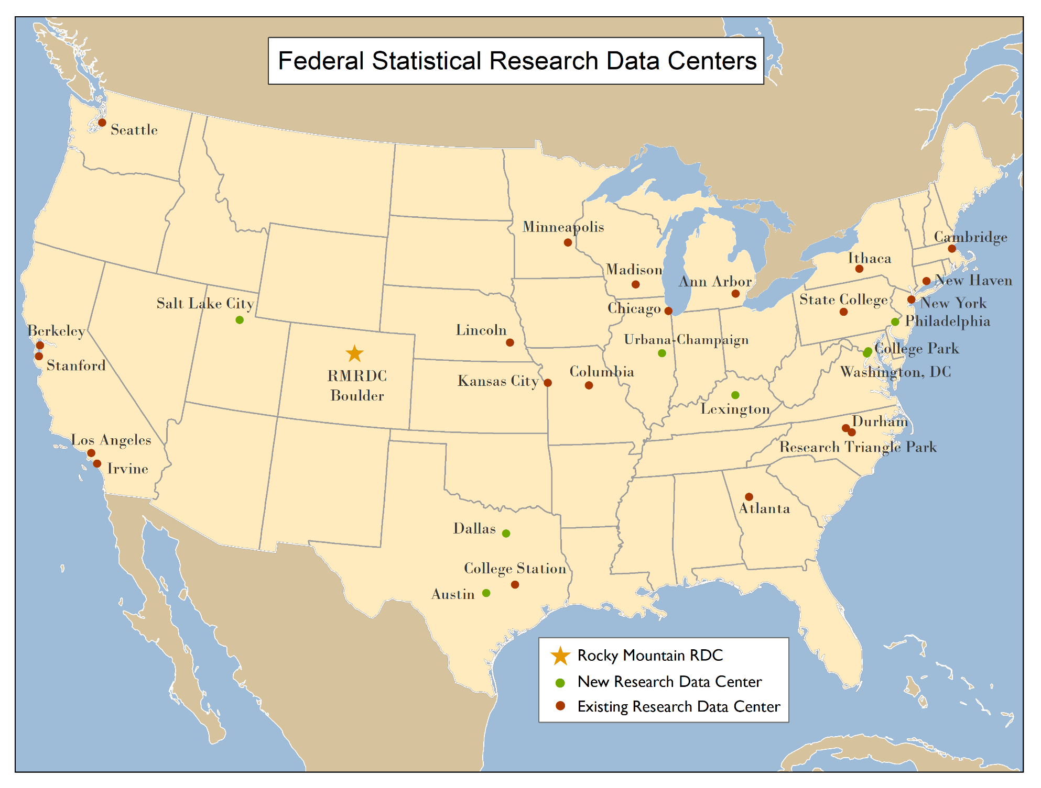
A National Network of Scholars
Notes:
9 in 2009 and 24 in 2016

Slide 4
Advancing the Frontiers of Social Science: Opportunities and Challenges
Jani Little, Executive Director
Katie Genadek, Expected Administrator
The Rocky Mountain Research Data Center (RMRDC)
Jani Little, Executive Director
jani.little@Colorado.edu
Phil Pendergast, Administrator (Census)
philip.m.pendergast@census.gov
Kas McLean, GRA (Econ)
kas.mclean@Colorado.edu
The Rocky Mountain Federal Statistical Research Data Center
(RMRDC)
Jani Little
Executive Director

Slide 5
Restricted Data to Investigate Society’s Most Pressing Challenges
Natural Hazards impacts on People and Business
International Trade Policies
Local Labor Markets
Immigration
impacts on People and Business
Rural vs Urban Disparities
Health Disparities
Business Sector
Growth and Decline
Crime
Victims and Consequences

Slide 6







A Regional Network of Scholars
Notes:
14 of the 30 active projects involve a researcher from one of our regional partners. 9 grad students active in the RMRDC across all of these partners.

Slide 7
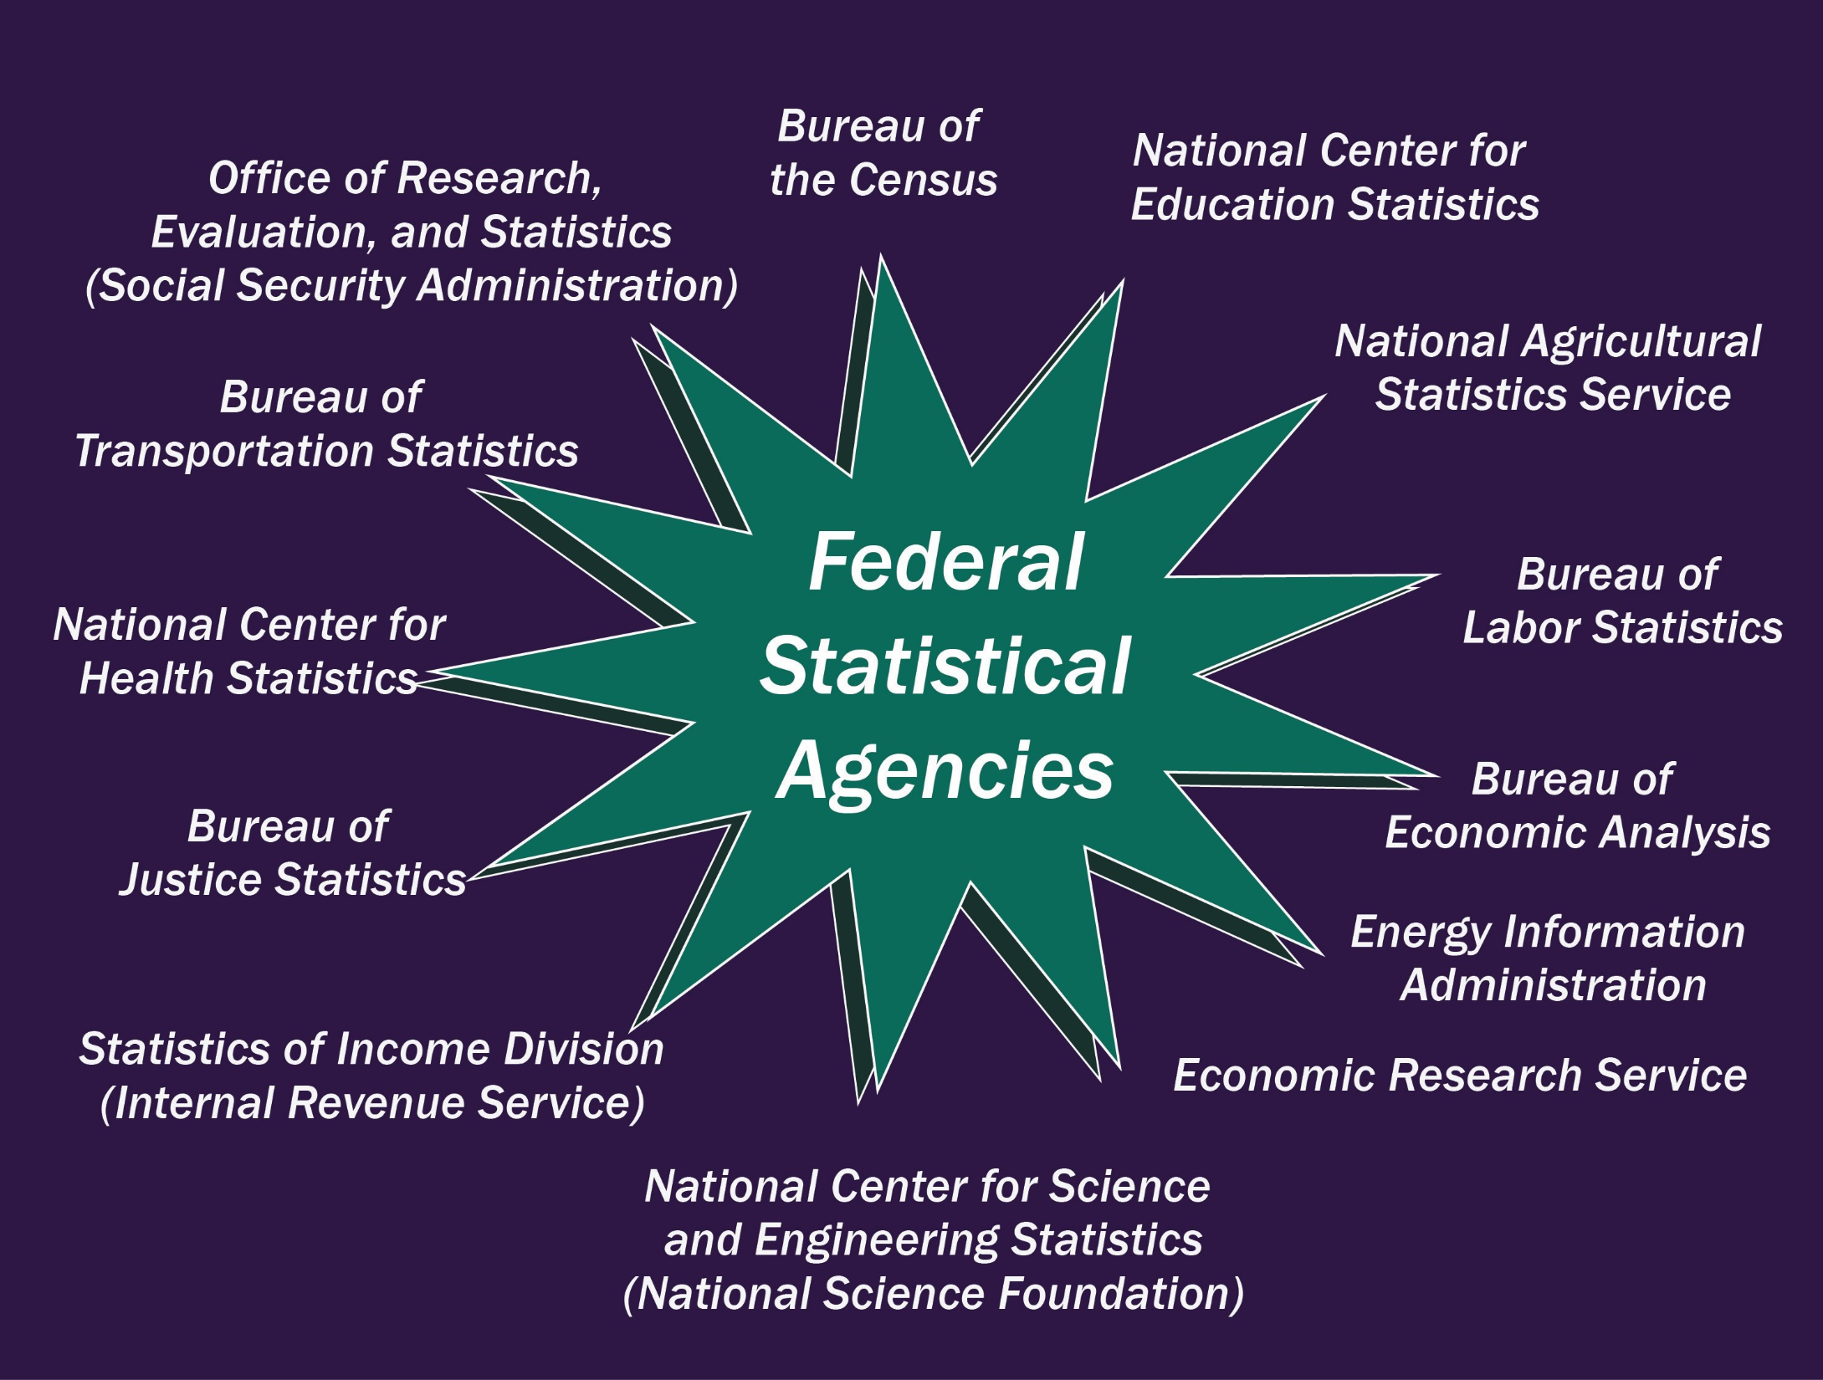
Notes:
Network started as Census RDCs. Because the Census Bureau administers surveys for many of these agencies and because the Census model for security and protection was endorsed by the EBPA. More and more restricted data are becoming available and formal agreements between agencies are in process.

Slide 8
Public-Use Microdata: created so that original records cannot be reproduced or linked to other databases
1. No obvious identifiers or PII (personally identifiable information)
2. Includes only a portion of the surveyed sample
3. Includes only a selection of variables. Sensitive variables removed.
4. Limit geographic detail
5. Limit the number and detailed breakdown of categories within variables on the file, e.g., race and ethnicity, exact dates of events
6. Truncate extreme codes for certain variables (top or bottom coding), e.g., income
7. Recode into intervals or round continuous variables
8. No unique or sensitive populations: disabled children, teenagers with STDs, LGBT, mixed race persons
9. No highly unique records
10. Perturbed values or noise added
Restricted Access Microdata
1. No obvious identifiers or PII (personally identifiable information) replaced by PIK (Protected Identification Key) to allow linkages
2. Includes all microdata records
3. Includes unlimited number of variables including sensitive variables and LINKED data records
4. Geographic detail as precise as original data
5. Unlimited categories within variables on the file, e.g., race and ethnicity, exact dates of events
6. No truncated extreme codes for certain variables (top or bottom coding), e.g., income
7. No recoding into intervals or rounded continuous variables
8. Unique and sensitive populations included
9. Highly unique records
10. Original records unperturbed and without added noise
Notes:
Federal agencies spend a lot of time and money on understanding disclosure risk. The theory has developed exponentially since the 1970’s when we only observed rule #1. Public-Use releases limit usefulness for research. #10 is the overall mosaic effect which might allow the record to be reproduced and then linked with other data to identify person. Every agency has different public-release data and restrictions on their restricted data.

Slide 9

Federal Statistical Data
for Health Research and Policy
Spring 2020
CU Denver|Main and Anschutz Medical Campus
Instructors: Jani Little, Phil Pendergast, Kas McLean
Fridays, 9am-12noon

Slide 10
Federal Statistical Data
for Health Research and Policy
Spring 2020
Students develop the knowledge and skills required to effectively use a variety of federal statistical data sets for health research and policy analysis.
Students get “hands on” exercises using SAS to analyze public versions of the federal data sets
The semester project is a restricted data proposal.
Notes:
Idea is to teach students how about restricted data. The semester project is a restricted data proposal. Would like to make it possible for DU students to take this course for credit

Slide 11
Federal Statistical Data
for Health Research and Policy
Spring 2020
Anyone at Colorado State University is invited to attend the lectures (9-10am) by zoom https://ucdenver.zoom.us/j/981548769

Slide 12
Federal Statistical Data
for Health Research and Policy
Data Collections Covered and Schedule

Slide 13
National Vital Statistics System (NVSS)
National Health and Nutrition Examination Surveys (NHANES)
National Health Interview Survey (NHIS) linked with National Death Index (NDI)
NHIS linked with Medical Expenditure Panel Survey (MEPS)
American Community Survey (ACS) and Current Population Survey (CPS)
National Crime Victimization Survey (NCVS)
Survey of Occupational Injuries and Illnesses (SOII), Census of Fatal Occupational Injuries (CFOI), American Time Use Survey (ATUS)
Jan 31
Feb 7
Feb 14
Feb 28
Mar 6
April 3
April 10

Slide 14
Federal Statistical Data
for Health Research and Policy
National Vital Statistics System (NVSS)

Slide 15
Figure 2. Injury death rates for children and adolescents aged 10–19 years, by intent: United States, 1999–2016
Notes:
Figure 2. Injury death rates for children and adolescents aged 10–19 years, by intent: United States, 1999–2016
Other issues—growing dementia, fire arms involved in deaths, drugs involved in deaths

Slide 16
CPR News (repost of Washington Post article) Benefits from NVSS:
Meth, Guns and Aggressive Tactics Combine to Give Colorado One of Nation’s Highest Police Shooting Rates
By Allison Sherry and Ben Markus
January 31, 2020
https://www.cpr.org/2020/01/31/meth-guns-aggressive-tactics-combine-to-give-colorado-one-of-nations-highest-police-shooting-rates/

Slide 17
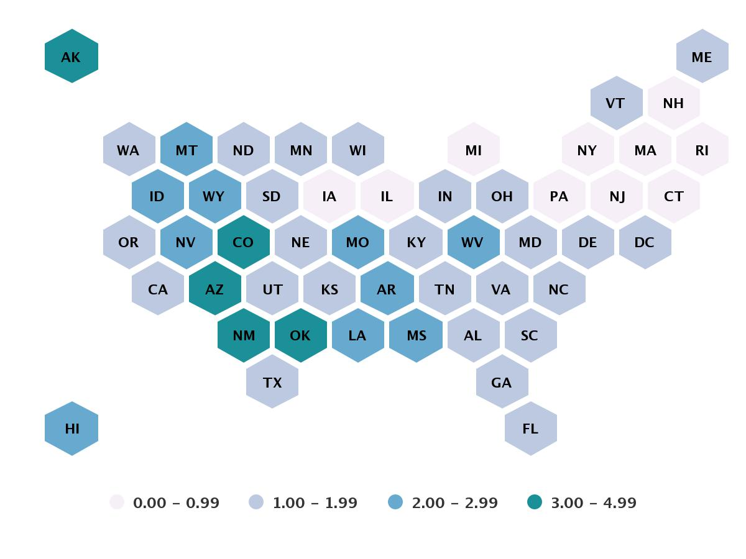
Officer-Involved Fatal Shootings Per 100,000 People

Slide 18
Federal Statistical Data
for Health Research and Policy
National Health and Nutrition Examination Surveys (NHANES)

Slide 19

National Health and Nutrition Examination Surveys (NHANES)
https://www.cdc.gov/nchs/nhanes/index.htm
Is designed to assess the health and nutritional status of adults and children in the United States. The survey is unique in that it combines interviews, physical examinations, and lab tests.

Slide 20
Examples of major NHANES contributions to knowledge and policy:
NHANES’ partnership with the U.S. Environmental Protection Agency allows continued study of the many important environmental influences on our health.
Blood lead data were instrumental in developing policy to eliminate lead from gasoline and in food and soft drink cans. Recent survey data indicate the policy has been even more effective than originally envisioned, with a decline in elevated blood lead levels of more than 70% since the 1970s.
Overweight prevalence figures have led to the proliferation of programs emphasizing diet and exercise, stimulated additional research, and provided a means to track trends in obesity.
Data have continued to indicate that undiagnosed diabetes is a significant problem in the United States. Efforts by government and private agencies to increase public awareness, especially among minority populations, have been intensified. These are just a few examples of what survey findings have meant. The current program promises continuing contributions and some new initiatives.
National programs to reduce hypertension and cholesterol levels continue to depend on NHANES data to steer education and prevention programs toward those at risk and to measure success in curtailing risk factors associated with heart disease, the Nation’s number one cause of death.
New measures of lung function will further our understanding of respiratory disease and better describe the burden of asthma in the United States.

Slide 21
NHANES
Guidelines for what is restricted NHANES data:
Sensitive data involving children/youth
Child physical exam data linked with parent’s data record
Geographic locations
Linked with National Death Index (NDI) or Medicare/Medicaid Claims
DNA
Link to more information:
https://www.cdc.gov/rdc/b1datatype/Dt1222.htm

Slide 22
NHANES
Survey, Physical Exam, and Lab Tests Contents: 1999-2020:
https://wwwn.cdc.gov/nchs/data/nhanes/survey_contents.pdf

Slide 23
Restricted data for Victim-Reported Crime
National Crime Victimization Survey (NCVS)
2006-2018
National Crime Victimization Survey (NCVS)
School Crime Supplement (SCS)
Odd Years
Notes:
Already talked about NVSS system and

Slide 24
National Crime Victimization Survey (NCVS) 2006-2018
  Approximately 135,000 households each year
  AND 240,000 individuals in the HH aged 12 or older
  Dwelling units remain in sample for 3.5 years, surveyed every 6 months
  Yields annual and change estimates of criminal victimization for persons age 12 or older
  Includes persons living in group quarters (e.g. dormitories) but excludes institutional settings (correctional or hospital facilities) and homeless
Notes:
CSU Econ Grad student: intimate partner violence victims' use of healthcare facilities and state-specific correlates associated with intimate partner violence (IPV) rates. impacts of mandatory physician reporting laws on healthcare utilization rates of IPV victims using a quasi-experimental framework.
Wyoming Psych Prof collaborating with Econ at CSM: quasi‐experimental methods to determine how violent victimization type influences changes in employment status, earnings, and housing after instances of reported victimization.

Slide 25
National Crime Victimization Survey (NCVS) 2006-2018
    Person Data
      Demographics (age, sex, race, ethnicity, marital status, education, income, employment)
      Nonfatal personal crimes (i.e., rape or sexual assault, robbery, aggravated and simple assault, and personal larceny)
      Yields potentially longitudinal personal data on marital status, education, income, employment
    Victimization incident:
      offender (e.g., age, race and Hispanic origin, sex, and victim-offender relationship),
      characteristics of the crime (e.g., time and place of occurrence, use of weapons, nature of injury, and economic consequences)
      crime was reported to police, reasons the crime was or was not reported, and victim experiences with the criminal justice system
      sought medical treatment
Notes:
The NCVS collects information on nonfatal personal crimes (i.e., rape or sexual assault, robbery, aggravated and simple assault, and personal larceny) and household property crimes (i.e., burglary/trespassing, motor-vehicle theft, and other theft) both reported and not reported to police. Survey respondents provide information about themselves (e.g., age, sex, race and Hispanic origin, marital status, education level, and income) and whether they experienced a victimization. For each victimization incident, the NCVS collects information about the offender (e.g., age, race and Hispanic origin, sex, and victim-offender relationship), characteristics of the crime (e.g., time and place of occurrence, use of weapons, nature of injury, and economic consequences), whether the crime was reported to police, reasons the crime was or was not reported, and victim experiences with the criminal justice system.

Slide 26
NCVS School Crime Supplement (SCS) 2005, 2007,…2013, 2015, 2017
Student experiences with and perceptions of . . .
crime and safety at school
preventive measures employed by schools
participation in after school activities
school rules and enforcement
presence of weapons, drugs, alcohol, and gangs in school
bullying
hate-related incidents
fear of victimization at school
Notes:
The primary purpose of the School Crime Supplement (SCS) is to obtain additional information about school-related victimizations so that policymakers; academic researchers; practitioners at the federal, state, and local levels; and special interest groups who are concerned with crime in schools can make informed decisions concerning policies and programs.

Slide 27
National Vital Statistics System (NVSS)
National Health and Nutrition Examination Surveys (NHANES)
National Health Interview Survey (NHIS) linked with National Death Index (NDI)
NHIS linked with Medical Expenditure Panel Survey (MEPS)
American Community Survey (ACS) and Current Population Survey (CPS)
National Crime Victimization Survey (NCVS)
Survey of Occupational Injuries and Illnesses (SOII), Census of Fatal Occupational Injuries (CFOI), American Time Use Survey (ATUS)
Jan 31
Feb 7
Feb 14
Feb 28
Mar 6
April 3
April 10

Slide 28
Federal Statistical Data
for Health Research and Policy
Spring 2020
Anyone at Colorado State University is invited to attend the lectures (9-10am) by zoom https://ucdenver.zoom.us/j/981548769

Slide 29
Examples of Economic Data
Data Sets | Frequency | Unit of Enumeration | Availability
Census of Auxiliary Establishments (AUX) | Every 5 Years | Establishment | 1977–2007
Census of Construction Industries (CCN) | Every 5 Years | Establishment | 1972–2017
Census of Finance, Insurance, and Real Estate (CFI) | Every 5 Years | Establishment | 1992–2017
Census of Manufactures (CMF) | Every 5 Years | Establishment | 1963, 1967–2017
Census of Mining (CMI) | Every 5 Years | Establishment | 1987–2017
Census of Retail Trade (CRT) | Every 5 Years | Establishment | 1977–2017
Census of Services (CSR) | Every 5 Years | Establishment | 1977–2017
Census of Transportation, Communications, and Utilities (CUT) | Every 5 Years | Establishment | 1987–2017
Census of Wholesale Trade (CWH) | Every 5 Years | Establishment | 1977–2017

Slide 30
Longitudinal Business Database (1976-2017)
Complete U.S. business establishment histories (with paid employees)
  Establishment birth and death dates
  All employer establishments in the Economic Censuses
  Detailed linkage documentation over time and very accurate histories
Basic establishment demographic data linkable to other business datasets by EIN, SEIN
  Establishment size
  Industry
  Location

Slide 31
Longitudinal Employer-Household Dynamics (LEHD) https://www.census.gov/ces/dataproducts/lehddata.html
Combines administrative data from states’Unemployment Insurance systems with Census Bureau business data and the individual demographic data using the Social Security Administration number database of encrypted identifiers.
  Workers--Employer history and wage history, Individual characteristics (sex, age, race, ethnicity, education, place of birth), Point in time residence
  Employers--Industry, # employees, firmage, total payroll, location
  Linkages between workers and employers
  Links to other Census data

Slide 32
Longitudinal Employer-Household Dynamics (LEHD) https://www.census.gov/ces/dataproducts/lehddata.html
      For external projects-only available from cooperating states
Option A: AZ AR DE DC IN IA KS ME MD NV OK TN
Option B: AL CA CO CT FL GA HI ID IL KY LA MA MI MN MO MT NE NH NJ NM NY NC ND OR PA RI SC TX UT VT VA WA WV WI WY

Slide 33
Census Longitudinal Infrastructure Project (CLIP)
Decennial Census and ACS datasets
1940
Census
2000
Census
2010
Census
2001-2015
ACS
Household survey datasets
CPS
SIPP
AHS
NCVS
Administrative
Records
External
Data Sources

Slide 34
Current projects making use of linked Census Data
Is racial identity influenced by neighborhood characteristics?
Interracial couples and children’s race – how are they reported, how does that change over time?
Gender identity. How prevalent is change??

Slide 35
Master Address File (MAF)
MAF Extract
  Complete list of addresses with lat/lon and geo information
MAF-Auxiliary Reference File (ARF)
  Links addresses to individuals
Notes:
The Master Address File Extract (MAFX) is a Census Bureau file that contains an accurate, up to date inventory of all known living quarters in the United States, Puerto Rico and associated island areas. The MAFX is used to support most of the census and surveys that the Census Bureau conducts including the decennial census, the American Community Survey and ongoing demographic surveys. The content of the MAFX includes address information, Census geographic location codes, as well as source and history data. The MAFX provides the longitude and latitude of each housing unit. "

Slide 36
Current projects making use of MAF Linked Data
Linking MAF with ACS data to get more precise estimates and characteristics of small areas and how they change over time.

Slide 37
Bureau of Labor Statistics (BLS) Offerings:
--Survey of Occupational Injuries and Illnesses (SOII)
--Census of Fatal Occupational Injuries (CFOI)
--American Time Use Survey (ATUS)

Slide 38
Current projects making use of ATUS
How child care costs affect time spent away from home with spouse?
How does smoking affect a single mother’s time with children?

Slide 39
Advancing the Frontiers of Social Science: Opportunities and Challenges
Jani Little, Executive Director
Katie Genadek, Expected Administrator
The Rocky Mountain Research Data Center
Jani Little, Executive Director
Jani.little@Colorado.edu
Phil Pendergast, Administrator (Census)
Kas McLean, GRA (Econ)
The Rocky Mountain Federal Statistical Research Data Center
(RMRDC)
Jani Little
Executive Director

