Slide 1



The Rocky Mountain (Federal Statistical) Research Data Center
RMRDC: https://www.colorado.edu/rocky-mountain-research-data-center/
Jani Little
Executive Director
jani.little@colorado.edu
Catherine Talbot
Administrator
catherine.b.talbot@census.gov
Haeseong Park
Grad Research Assistant
haeseong.park@colorado.edu

Slide 2
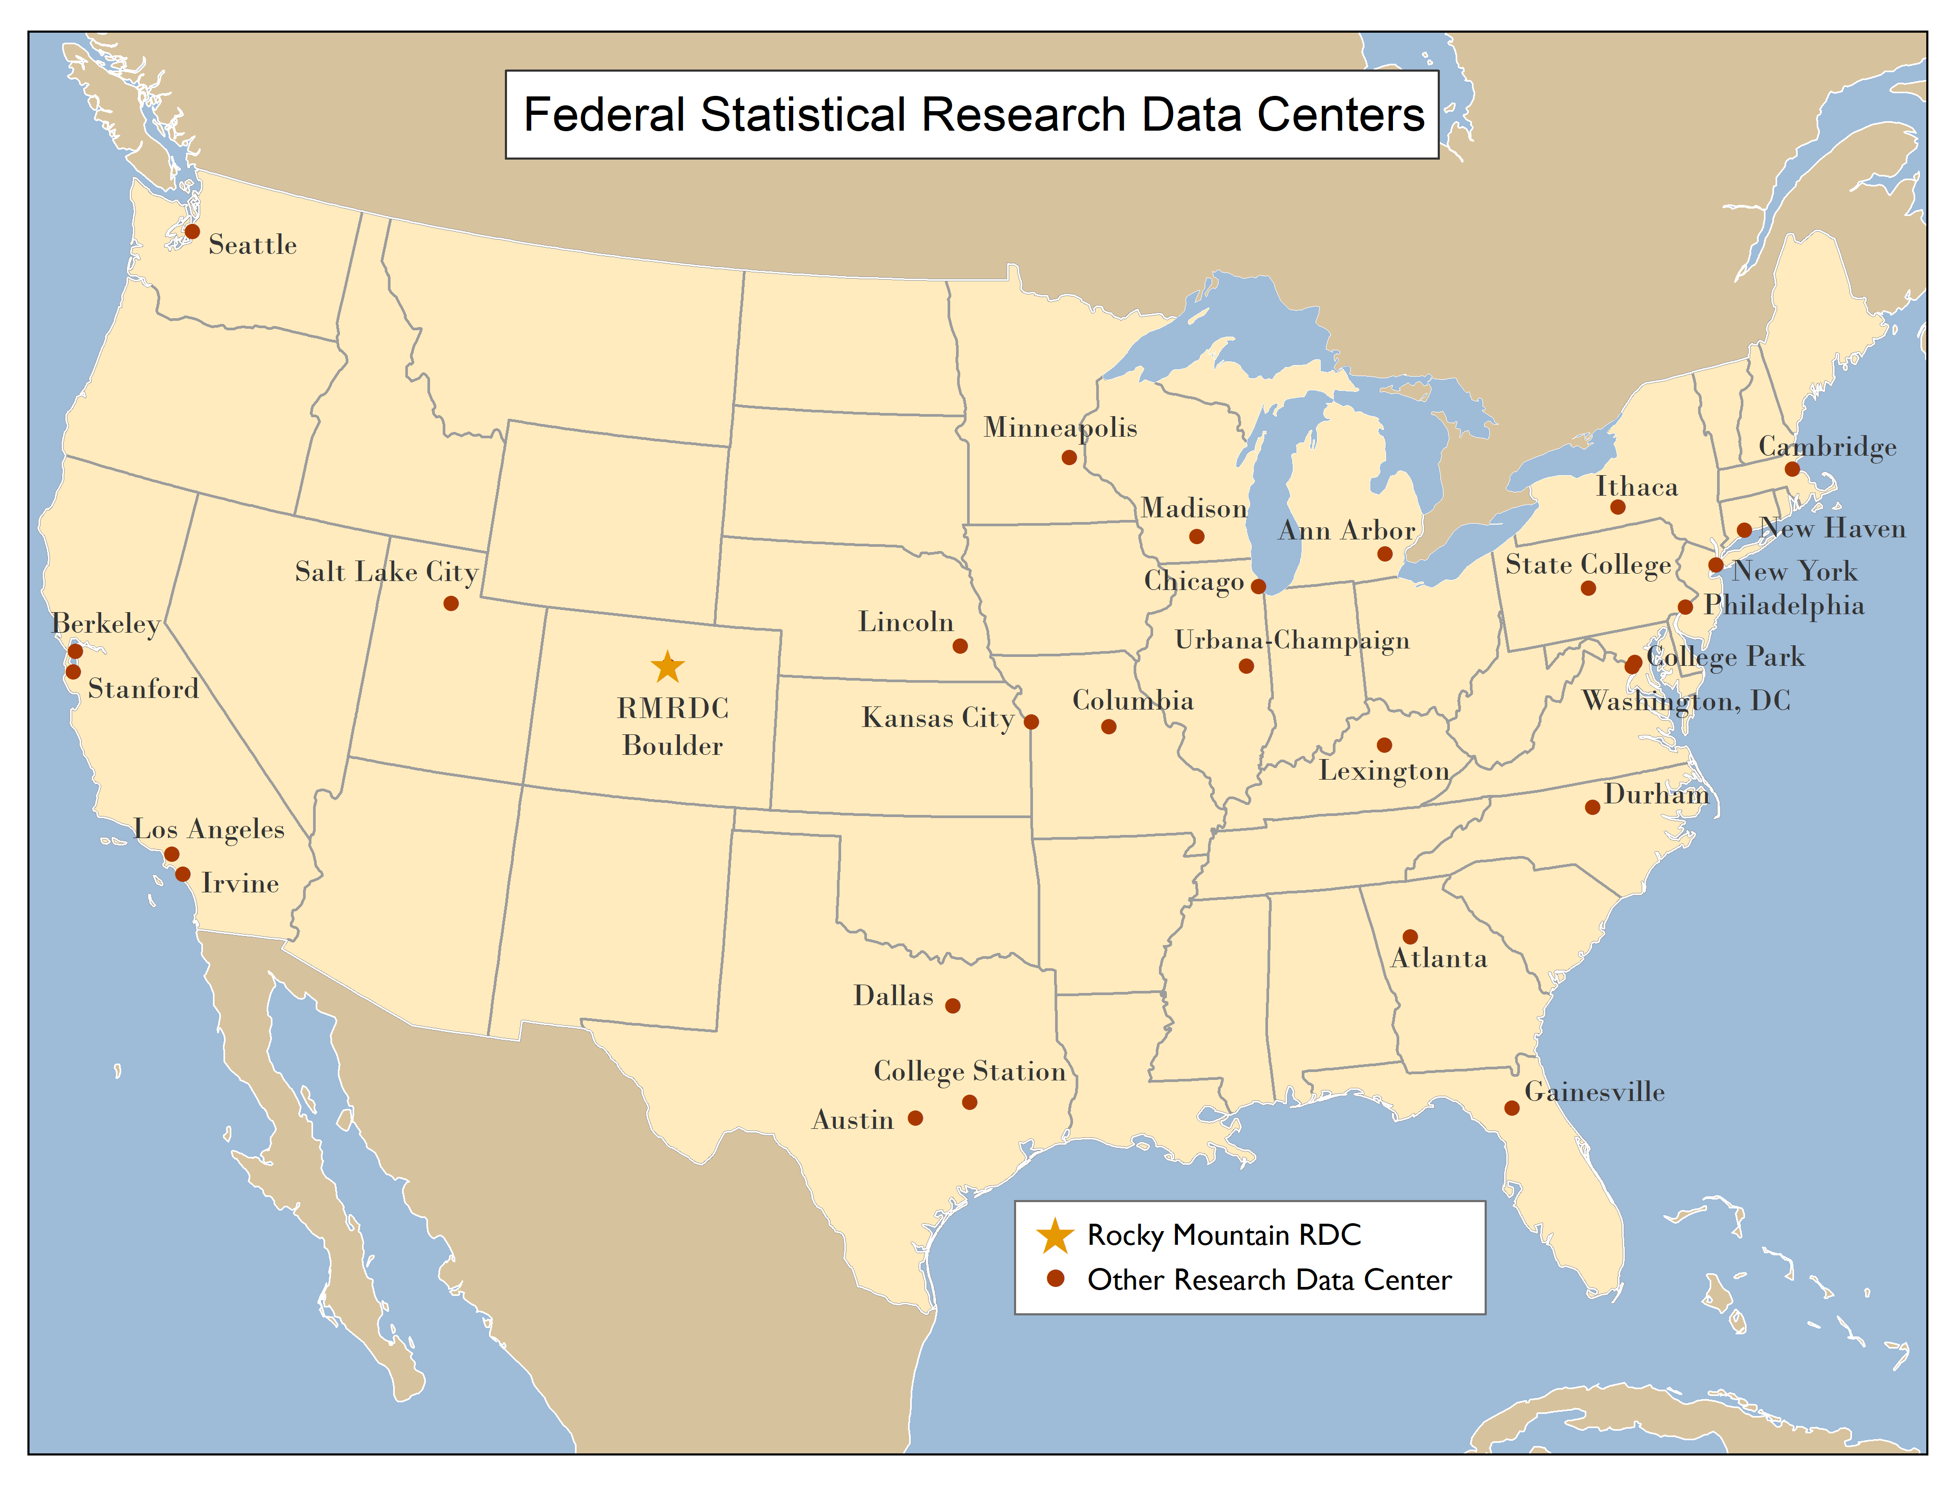
Federal Statistical Research Data Centers

Slide 3










RMRDC Membership Network
*All faculty, staff and graduate students associated with member universities have free access to all services.to the lab and its services

Slide 4
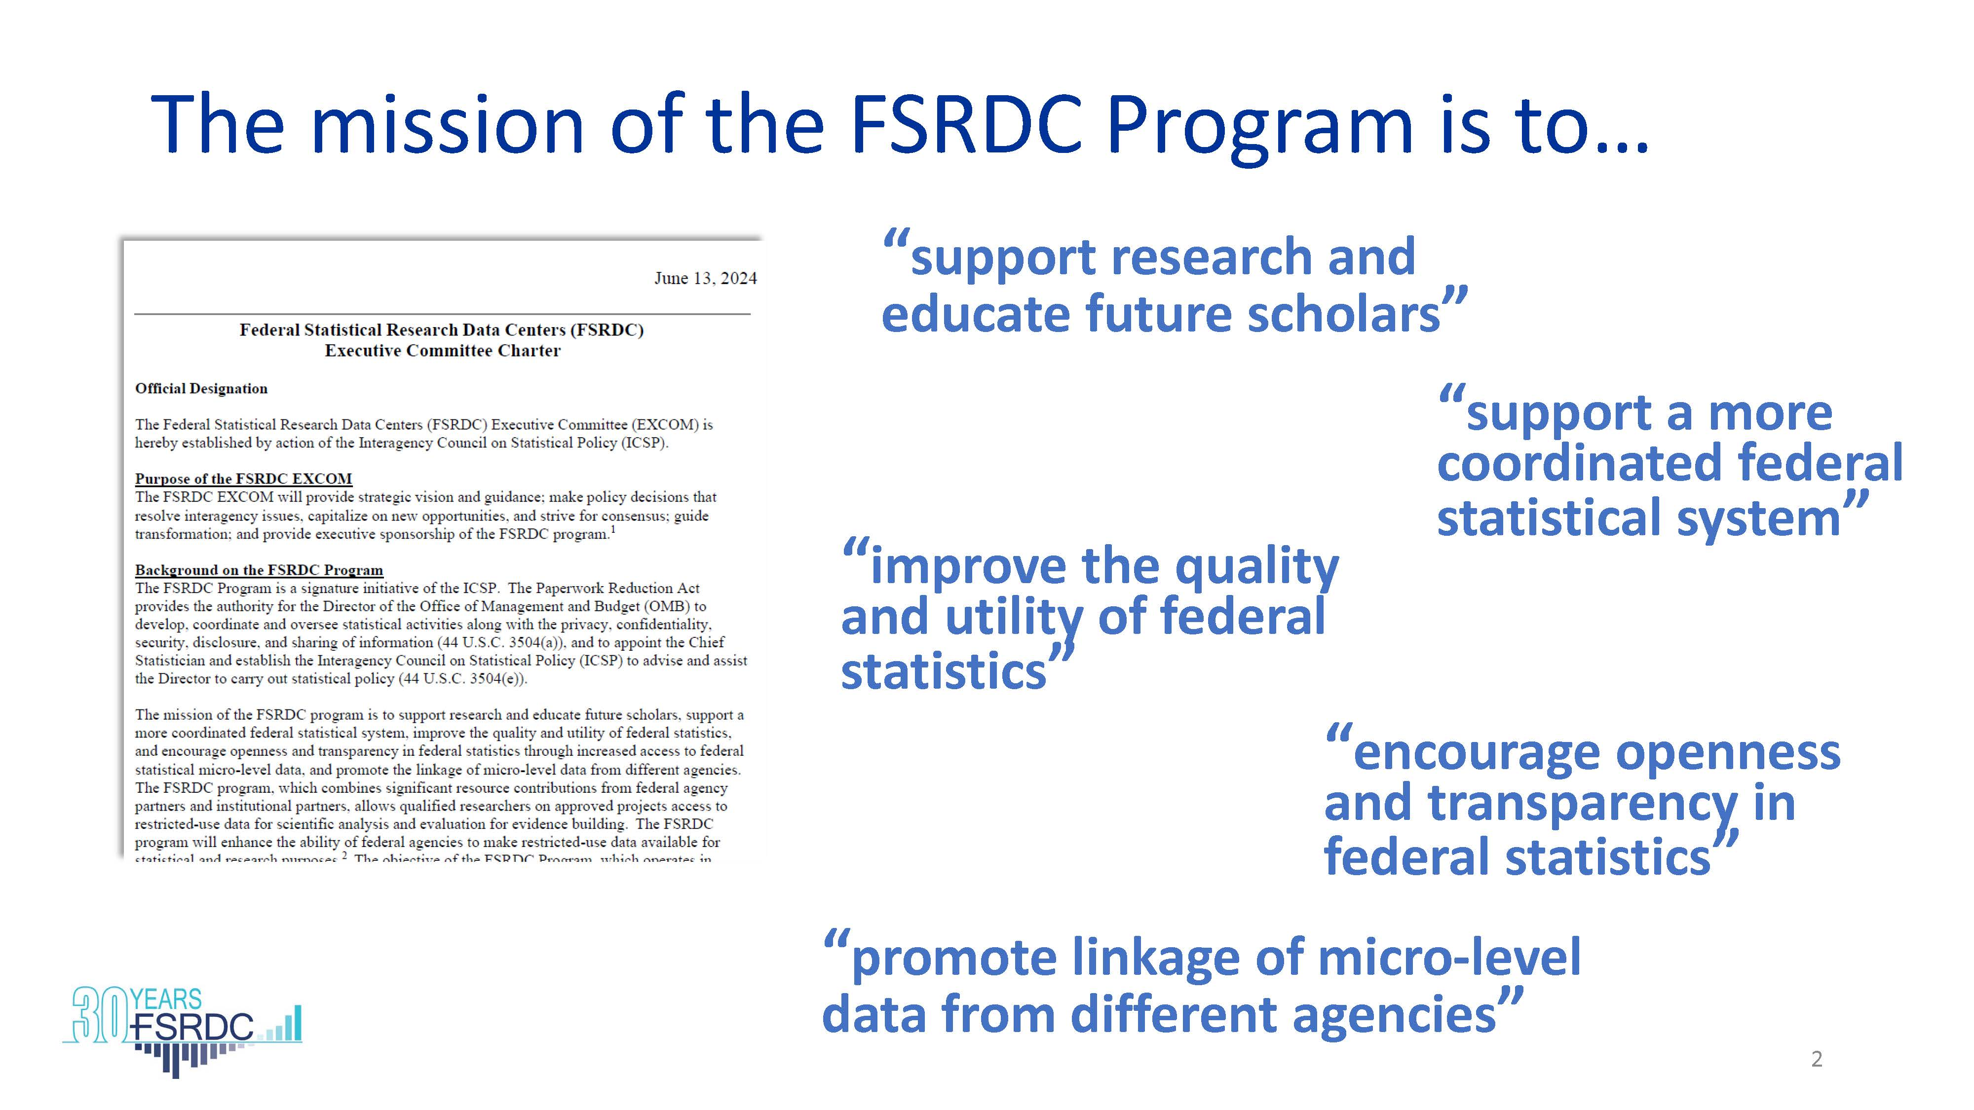
Federal Statistical Research Data Centers

Slide 5
Health Data Course: Spring 2025
Hosted by CU Denver
“Federal Data for Health Research and Policy”
Taught by CU Denver Econ Prof. Laura Argys, Jani Little, Catherine Talbot, Haeseong Park
No cost to member institutions, students register through independent study with UNM faculty for 1 or 3 credits
2. Taught entirely through Zoom, Fridays 10am
4. Designed for early-career graduate students
5. Students develop the knowledge and skills required to effectively use a variety of federal statistical data sets for health research and policy analysis.
6. The semester project is a restricted-use project proposal.
7. 3-credit option: Students get “hands on” exercises using SAS to analyze public versions of the federal data sets to reproduce results in published papers.

Slide 6
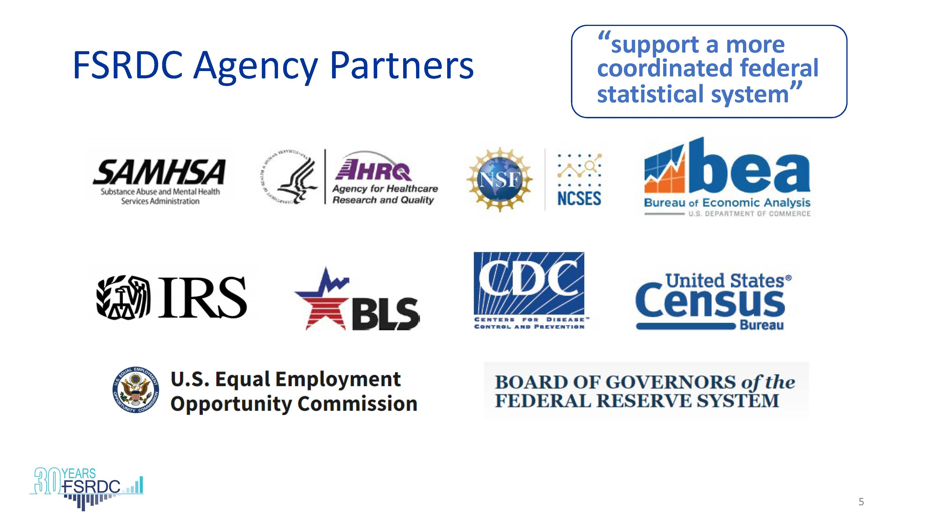

Slide 7
COLLAPSE ALL
FSRDC Collaborating Agencies:
Bureau of Justice Statistics
Centers for Medicare and Medicaid services (CMS)
Bureau of Transportation Statistics
Energy Information Administration
Environmental Protection Agency
Social Security Administration (SSA)
US Department of Agriculture, Economic Research Service
US Department of Housing and Urban Development

Slide 8
How Can I Learn about FSRDC Research Projects?
Download a spreadsheet of active and completed projects including:
Title
Abstract
Principal investigator and researchers
Year project started
Datasets requested
Download a spreadsheet containing bibliographic information on research outputs:
Working papers, published and unpublished
Journal Articles
Dissertations
Book chapters
Datasets
Technical notes
Software

Slide 9
Why use FSRDC business/economic data?
Only source of microdata for businesses and establishments
Access to register data
  Census Business Register
  Longitudinal Business Database (LBD)
Ability to link different Census datasets and external datasets, e.g., Compustat which contains financial and market data for over 80,000 companies.

Slide 10
Most Popular Economic Datasets
Data Set | Unit of Enumeration
Economic Censuses (Manufactures, Retail Trade, Services, etc.) | Establishment
Annual Surveys (Manufactures, Services, etc.) | Establishment/Firm
Standard Statistical Establishment List (SSEL)/Business Register | Establishment
Quarterly Financial Report (QFR) | Firm
Longitudinal Business Database | Establishment
Longitudinal Firm Trade Transactions Database (LFTTD) | Firm
Survey of Business Owners/Annual Survey of Businesses | Firm
Many more economic datasets! | Establishment/Firm

Slide 11
E
Economic Censuses (conducted every 5 years, e.g., 2017, 2022, 2027) using a different questionnaire for each sector.
E
Economic Sectors: health care and social assistance; manufacturing, retail trade, food services, transportation, construction, educational services, finance and insurance, utilities, and mining.
Topical Areas: provides revenue, employees, payroll, capital expenditures, rental payments, payments for supplies, heat, power, work done by contractors. Specific products and services sold and quantities.

Slide 12
Example Business Project: Measuring Injuries Along the Subcontracting Chain in the U.S. Construction Industry. Kevin Conner, Frederick Purifoy, Kevin Duncan, Peter Philips, Mark Prus, Jeff Waddoups
Datasets: Census Bureau’s Economic Census of Construction Industries linked with
Bureau of Labor Statistics Survey of Occupational Injuries and Illnesses
Key Findings:
Contractors receiving most of their work directly from project owners, who then either self-perform
or subcontract this work, tend to have lower injury rates.
Subcontractors in the middle and lower segments of subcontracting chains, who receive much of their work
from other contractors, tend to have higher injury rates.
Supports the notion that subcontracting often shifts dangerous work down subcontracting chains.
Up-chain contractors, who receive their work from project owners, decide which portions of the work to
retain and which to subcontract based on various factors, likely including the relative risk associated with different tasks

Slide 13
Census Linked Data Product – Longitudinal Employer-Household Dynamics (LEHD)
Links individual workers to place of employment
  Provides person’s quarterly income and some demographic information from Unemployment Insurance filings by states
Links place of employment to Census’s Economic datasets
Enables “Tracking” of a person’s employment history
Enables analysis of business hiring and firing practices
Available on a State-by-State basis—not all states share data

Slide 14
Example LEHD Project: Is Affirmative Action in Employment Still Effective in the 21st Century? Noriko Amano-Patino, Julian Aramburu, Zara Contractor
Datasets:
Federal Procurement Data System (FPDS) data is publicly available data containing the universe of
federal contracts that exceed $2,500.
LEHD, 2001 to 2014.
Finds the Executive Order 11246 ineffective as an employment-based affirmative action policy targeted
at firms holding contracts with the federal government.

Slide 15
FSRDC Demographic Restricted-Use Data Advantages
Less top-coding/censoring
Additional variables (e.g. DOB, ethnicities, countries of origin)
Larger samples
More detailed geography
Individual level linkages across time/surveys

Slide 16
Popular Demographic Data
Data | Lowest-level Geography
American Community Survey (ACS) | Block
American Housing Survey (AHS) | Tract
Current Population Survey– March Supplement | Tract
Decennial Census | Block
Mortality Disparities in Am Communities (MDAC) | Block
Numident (SSA) | County
Census Household Composition Key (CHCK) | Address
Master Address File Extract (MAFX) and MAF Auxiliary Reference File | Address

Slide 17
Example American Community Survey (ACS) Project
Does Tribal Gaming Generate Net Benefits? Laurel Wheeler
Provides sustained improvements in employment and wages on federal reservations
Gains concentrated for Indigenous people living on host reservations
Labor Market Effects of Casino Openings by Race

Slide 18
Popular Demographic Data, con’t
Data | Geography
SNAP / TANF / WIC (by state) | varies
National Survey of Children’s Health | Tract
Household Pulse Survey | Tract
Survey of Income and Program Participation (SIPP) | Tract/County
Moving to Opportunities (MTO) | Tract

Slide 19
National Survey of Child Health (NSCH): https://www.census.gov/programs-surveys/nsch.html
Primary source of information about physical and emotional health of children ages 0-17. Collected by U.S. Census Bureau and Health Resources and Services Administration (HRSA) since 2016.
Oversample children with special needs and youngest children (ages 0-5)
A substantive questionnaire of parent or caregiver of selected child
Three topical questionnaires tailored for three age groups: 0-5; 6-11, and 12-17.

Slide 20
NSCH topics include:
• Child and family characteristics
• Physical and mental health status, including current conditions and functional difficulties
• Health insurance status, type, and adequacy
• Access and use of health care services
• Medical, dental, and specialty care needed and received
• School readiness, school outcomes, and activities
• Family nutrition, housing, health and activities
• Impact of child’s health on family

Slide 21
Two Popular Crime Datasets
The National Crime Victimization Survey (NCVS) is collected by Census on behalf of the Bureau of Justice Statistics (BJS) to produce national estimates of crime incidence, reporting and victim characteristics.
  Sampling frame is potential crime victims, households in U.S..
The Criminal Justice Administrative Records System (CJARS) is a collaboration between State justice departments, the University of Michigan, and Census to link offender records to other demographic, economic, and administrative data collected by the federal government.
  Population is adults in the criminal justice system in participating States and sub-state entities.

Slide 22
Potential NCVS Research Questions
What services are sought after crime victimization? How does this vary by type of crime? By state or county of residence? By Urbanicity?
Do housing characteristics impact Intimate Partner Violence rates? Does reporting vary across collection method (phone vs. in-person)?
What types of crime are the most consistently under-reported? How does this differ by urban/rural, gender, race/ethnicity, immigration status?
What crimes are occurring in schools? How does this vary across school districts and by use of pro-social programs and policies?

Slide 23
Potential CJARS Research Questions
How much does incarceration or other criminal justice contact impact lifetime wages, job types and tenure? Does it vary by race/ethnicity?
Does criminal justice contact impact migration rates and types (in-county, out-of-county, interstate)?
How does criminal justice contact impact public program participation, such as use of TANF, SNAP, or WIC?
Do statutory differences in work programs in prisons impact offenders’ recidivism, employment and income after release?

Slide 24
National Center for Science and Engineering Statistics (NCSES)
Survey of Earned Doctorates (SED) annual registry of all PhDs
Survey of Doctoral Recipients (SDR) occupational achievements
Following the career paths of doctorate recipients can assist government agencies, academic researchers, and prospective students with decisions regarding policy, education, research, training, and salary.
PIK crosswalks will allow for links with other Census data
More information:
ncses.nsf.gov/about/licensing

Slide 25
Equal Employment Opportunity Commission (EEOC) Data
Employment discrimination charges filed by individuals
  Includes case information
    statute, issue, and basis for the charge, case resolution
  Employer information (geography, name, address)
  Anonymized demographic information plus PIKs
Employment Patterns for Minorities and Women—mandatory annual data collections for entities having employees:
  In private industry
  In referral local unions
  In state and local governments
  In elementary-secondary public schools

Slide 26

The Survey of Consumer Finances

Slide 27
Background
Special sample design
  Area probability sample – randomly selected households based on address
    Oversample of Black, Hispanic, and Asian families added in 2022
  List sample – specially selected wealthy households based on person(s)
  Provides better coverage of distribution of wealth

Slide 28
Household balance sheet
Assets
  Financial assets
    Transaction accounts
    CDs
    Stocks and bonds
    Mutual funds
    Retirement accounts
    Trusts, annuities & MIAs
  Nonfinancial assets
    Vehicles
    Houses / other property
    Businesses
Liabilities
  Mortgages
  Installment loans
    Car loans
    Student loans
    Other loans
  Credit card balances
  Lines of credit
Assets-Liabilities=Net Worth

Slide 29
National Center for Health Statistics Datasets
National Health Status Surveys National Health and Nutrition Examination Survey (NHANES) I, II, and III National Health Interview Survey (NHIS) Longitudinal Study on Aging I and II (LSOA) National Survey of Family Growth National Survey of Children's Health National Survey of Early Childhood Health National Survey of Children with Special Health Care Needs National Asthma Survey National Health Care Surveys National Ambulatory Medical Care Survey | National Hospital Ambulatory Medical Care Survey National Survey of Ambulatory Surgery National Hospital Discharge Survey National Nursing Home Survey (NNHS) National Home and Hospice Care Survey National Employer Health Insurance Survey National Health Provider Inventory National Immunization Survey Vital Statistics Mortality and Multiple Mortality Birth Fetal Death National Death Index Marriage and Divorce
More information: www.cdc.gov/rdc

Slide 30
Substance Abuse and Mental Health Services Administration (SAMHSA)
National Survey on Drug Use and Health (NSDUH)
Application process and project management facilitated by NCHS
More information:
www.samhsa.gov/data/data-we-collect/samhsa-rdc
www.cdc.gov/rdc
Notes:
National Survey on Drug Use and Health (samhsa.gov)

Slide 31
Agency for Healthcare Research and Quality
Medical Expenditure Panel Survey (MEPS) files include:
  Household Component
  Provider Component
  Insurance/Employer Component
  Nursing Home Component (1996 only)
  Area Health Resource File
  Two-year two panel file
  MEPS-NHIS linked data
Only Household Component and portions of Provider Component are publicly available
More information: meps.ahrq.gov/data_stats/onsite_datacenter.jsp

Slide 32
Let’s Talk!!
Jani Little
Executive Director
jani.little@colorado.edu
Catherine Talbot
Administrator
catherine.b.talbot@census.gov
Haeseong Park
Grad Research Assistant
haeseong.park@colorado.edu

Slide 33
Steps of the FSRDC Application Process
Visit the agency website
Apply for Special Sworn Status
Pay Fees*
Develop the proposal documents with RDC Admin guidance
Submit application via Standard Application Process
Begin research!
researchdatagov.org
* Not all project types have fees. Speak with your FSRDC administrator to get more
information about whether fees there will be fees for your proposed project.
Notes:
*Address that there are fees involved and other agencies may have fees as well.

Slide 34
Where to start
Contact Catherine Talbot, RMRDC administrator, or Jani Little, RMRDC director – we are here to support proposal development
brief summary
  Summary of research ideas
  Restricted-use data needs
  Key external datasets and linkages (if applicable)
  General idea of methodology
Learn all you can about the data
  ResearchDataGov.org
  Data pages on Census website
  Key papers, including Census Working Papers

Slide 35
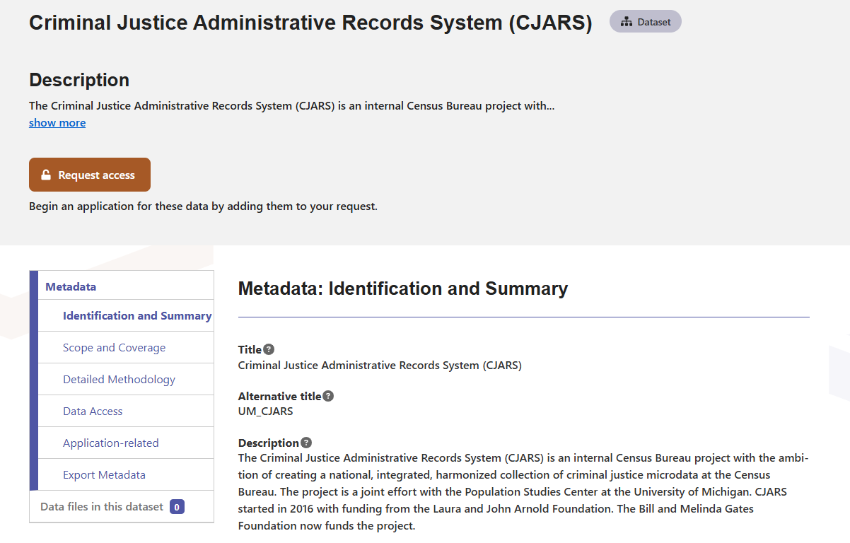
Getting Started: Browsing and Searching

Slide 36
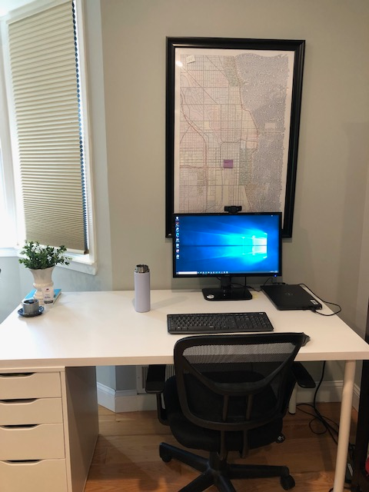
Remote Access: How it works
Eligibility
  Data owning agency approval to remotely access data
  Successful completion of remote access training
  Successful on-site FSRDC experience
Rules of Behavior
  Agreements
  Mimics FSRDC environment
Location
  Locked room inside researcher’s home
Regular inspections by Census Staff

Slide 37
Things to keep in mind
Model based output is the expectation
  Tabular output is limited to supporting model-based output
New data are being added all the time
Other agencies govern how their data are used and accessed
  Fees may apply to other agencies’ data
  Other agencies may limit the hours you are able to access the RDC
  Policy analysis is not allowed when using certain datasets
RDC work takes time – plan ahead!

