Slide 1
The Rocky Mountain (Federal Statistical) Research Data Center
RMRDC: https://www.colorado.edu/rocky-mountain-research-data-center/
Jani Little
Executive Director
jani.little@colorado.edu
Catherine Talbot
Administrator
catherine.b.talbot@census.gov
Haeseong Park
Grad Research Assistant
haeseong.park@colorado.edu

Slide 3
RMRDC Membership Network *All faculty, staff and graduate students associated with member universities have free access to the lab and its services

Slide 5
Health Data Course: Spring 2025
Hosted by CU Denver
“Federal Data for Health Research and Policy” Taught by CU Denver Econ Prof. Laura Argys and RMRDC staff
1. No cost to member institutions, students register through independent study with DU faculty for 1 or 3 credits
2. Taught entirely through Zoom, Fridays 10am
4. Designed for early-career graduate students
5. Students develop the knowledge and skills required to effectively use a variety of federal statistical data sets for health research and policy analysis.
6. The semester project is a restricted-use project proposal.
7. 3-credit option: Students get “hands on” exercises using SAS to analyze public versions of the federal data sets to reproduce results in published papers.

Slide 8
Why use FSRDC business/economic data?
Only source of microdata for businesses and establishments
Access to register data
Census Business Register
Longitudinal Business Database (LBD)
Master Address File
Ability to link different Census datasets and external datasets, e.g., Compustat which contains financial and market data for over 80,000 companies.

Slide 9
Most Popular Economic Datasets
Data Set | Unit of Enumeration
Economic Censuses (Manufactures, Retail Trade, Services, etc.) | Establishment
Annual Surveys (Manufactures, Services, etc.) | Establishment/Firm
Standard Statistical Establishment List (SSEL)/Business Register | Establishment
Quarterly Financial Report (QFR) | Firm
Longitudinal Business Database | Establishment
Longitudinal Firm Trade Transactions Database (LFTTD) | Firm
Survey of Business Owners/Annual Survey of Businesses | Firm
Many more economic datasets! | Establishment/Firm

Slide 10
Census Linked Data Product - LEHD
Links individuals to place of employment
Based on State unemployment insurance administrative records
Contains quarterly earnings for every company employee
“Tracks” a person’s employment history
Contains some demographic information on individuals
Can link LEHD to other Census business data via EIN
Can link LEHD to other Census personal data via PIK
Available on a State-by-State basis

Slide 11
FSRDC Demographic Restricted-Use Data Advantages
Less top-coding/censoring
Additional variables (e.g. DOB, ethnicities, countries of origin)
Larger samples
More detailed geography
Individual level linkages across time/surveys

Slide 12
Popular Demographic Data
Data | Geography | Linkage
American Community Survey (ACS) | Block | PIK, MAFID
American Housing Survey (AHS) | Tract | PIK, MAFID
Current Population Survey– March Supplement | Tract | PIK, MAFID
Decennial Census | Block | PIK, MAFID
Mortality Disparities in Am Communities (MDAC) | Block | PIK, MAFID
Numident (SSA) | County | PIK
Census Household Composition Key (CHCK) | Address | PIK
Master Address File Extract (MAFX) and MAF Auxiliary Reference File | Address | MAFID, PIK

Slide 13
Popular Demographic Data, con’t
Data | Geography | Linkage
SNAP / TANF / WIC (by state) | varies | PIK, MAFID
National Survey of Children’s Health | Tract | PIK
Household Pulse Survey | Tract | PIK, MAFID
Survey of Income and Program Participation (SIPP) | Tract/County | PIK
Moving to Opportunities (MTO) | Tract | PIK
National Crime Victimization Survey (NCVS) | Block | PIK, MAFID

Slide 14
Demographic Administrative Datasets
SSA data for ACS, CPS and SIPP respondents
Supplemental Security Record (SSR)
831 Disability File
Master Beneficiary Record (MBR)
Summary Earnings Record (SER)
Detailed Earnings Record (DER)
IRS Form 1040
From Individual Master File (IMF) 1969, 1974, 1979, 1984, 1989, 1994
Contain PIKs
Notes:
SER: Summarizes all earnings information found in the MEF for each year from 1951 to the present. All amounts reported on W-2s for jobs subject to FICA tax are added together, by year, and then capped at the FICA taxable maximum.
DER: Earnings from FICA, non-FICA, and self-employment income starting in 1987. Individual entries for each W-2. Also includes contributions to tax-exempt retirement account
831: research file created to determine medical eligibility for Old-Age, Survivors and Disability Insurance (OASDI) and Supplemental Security Income (SSI) benefits
SSR: track who is receiving Supplemental Security Income (SSI) benefits and the monthly benefit amounts payable

Slide 15
Other Demographic Datasets
Moving to Opportunity Survey (MTO)
Designed to help low-income families in public housing move to “opportunity” neighborhoods with vouchers and counseling.
Ran in five large cities between September 1994 and August 1998
Data collected on participants multiple times from 1994 through 2010
Individuals have been assigned PIKs
Project example:
Theresa Osypuk: Did those who were randomly assigned to MTO experience different life trajectories than those randomly assigned to public housing? Focused on mortality, family formation, and socioeconomic status outcomes.

Slide 16
Current Longitudinal Infrastructure
1850-1930 Censuses
1940 Census
1950-1990 Censuses
2000-2020 Censuses
2001-2022 ACS
Census Surveys
Current Population Survey (1973, 1978-present)
American Housing Survey (1983-present)
Survey of Income and Program Participation (1984-present)
Administrative Records
Examples: Numident, Medicare/Medicaid Enrollment
User-provided Data
Examples: clinical trials, administrative records, surveys

Slide 17
Linkage Options
Firm or Establishment
Link via name, address, EIN
Link economic Census datasets
Geography
Link via geographical identifiers such as county, FIPS, etc.
Link Census data to aggregated area-level external data
Person
Link via Protected Identification Key (PIK)
Link demographic and administrative datasets from Census Bureau
Link economic Census datasets to external datasets
Link Census data to external data (fee to add PIKs)

Slide 18
Linking by Address using the MAFID
Master Address File (MAF)
Created for 2000 Census
Complete list of addresses with lat/long and geography variables
MAF Extract is the yearly snapshot of MAF used for research
Linked to demographic datasets using address ID (MAFID)
Notes:
MAF-ARF Useful to study individual-level mobility

Slide 19
Agency for Healthcare Research and Quality
Medical Expenditure Panel Survey (MEPS) files include:
Household Component
Provider Component
Insurance/Employer Component
Nursing Home Component (1996 only)
Area Health Resource File
Two-year two panel file
MEPS-NHIS linked data
Only Household Component and portions of Provider Component are publicly available
More information: meps.ahrq.gov/data_stats/onsite_datacenter.jsp

Slide 20
National Center for Health Statistics Datasets
National Health Status Surveys National Health and Nutrition Examination Survey (NHANES) I, II, and III National Health Interview Survey (NHIS) Longitudinal Study on Aging I and II (LSOA) National Survey of Family Growth National Survey of Children's Health National Survey of Early Childhood Health National Survey of Children with Special Health Care Needs National Asthma Survey National Health Care Surveys National Ambulatory Medical Care Survey | National Hospital Ambulatory Medical Care Survey National Survey of Ambulatory Surgery National Hospital Discharge Survey National Nursing Home Survey (NNHS) National Home and Hospice Care Survey National Employer Health Insurance Survey National Health Provider Inventory National Immunization Survey Vital Statistics Mortality and Multiple Mortality Birth Fetal Death National Death Index Marriage and Divorce
More information: www.cdc.gov/rdc

Slide 21
Substance Abuse and Mental Health Services Administration (SAMHSA)
National Survey on Drug Use and Health (NSDUH)
Application process and project management facilitated by NCHS
More information:
www.samhsa.gov/data/data-we-collect/samhsa-rdc
www.cdc.gov/rdc
Notes:
National Survey on Drug Use and Health (samhsa.gov)

Slide 22
National Center for Science and Engineering Statistics (NCSES)
Survey of Earned Doctorates (SED) annual registry of all PhDs
Survey of Doctoral Recipients (SDR) occupational achievements
Following the career paths of doctorate recipients can assist government agencies, academic researchers, and prospective students with decisions regarding policy, education, research, training, and salary.
PIK crosswalks will allow for links with other Census data
More information:
ncses.nsf.gov/about/licensing

Slide 23
Equal Employment Opportunity Commission (EEOC) Data
Employment discrimination charges filed by individuals
Includes case information
statute, issue, and basis for the charge, case resolution
Employer information (geography, name, address)
Anonymized demographic information plus PIKs
Employment Patterns for Minorities and Women—mandatory annual data collections for entities having employees:
In private industry
In referral local unions
In state and local governments
In elementary-secondary public schools

Slide 24
CJARS Data Overview
The Criminal Justice Administrative Records System (CJARS) is a collaboration between State justice departments, the University of Michigan, and Census to link offender records to other demographic, economic, and administrative data collected by the federal government.
Sampling frame is adults entering criminal justice system in participating States.

Slide 25
Potential Research Questions (CJARS)
How much does incarceration or other criminal justice contact impact lifetime wages, job types and tenure? Does it vary by race/ethnicity?
Does criminal justice contact impact migration rates and types (in-county, out-of-county, interstate)?
Do offenders who are gang-involved have increased mortality, above and beyond additional mortality risks of incarceration?
How does criminal justice contact impact public program participation, such as use of TANF, SNAP, or WIC?
Are there differences in rates of Driving Under the Influence (DUIs) by State and local programs and policies?

Slide 26
Steps of the FSRDC Application Process
Visit the agency website
Apply for Special Sworn Status
Pay Fees*
Develop the proposal documents with RDC Admin guidance
Submit application via Standard Application Process
Begin research!
ResearchDataGov.org
* Not all project types have fees. Speak with your FSRDC administrator to get more
information about whether fees there will be fees for your proposed project.
Notes:
*Address that there are fees involved and other agencies may have fees as well.

Slide 27
Where to start
Contact Catherine Talbot, RMRDC administrator, or Jani Little, RMRDC director – we are here to support proposal development
brief summary
Summary of research ideas
Restricted-use data needs
Key external datasets and linkages (if applicable)
General idea of methodology
Learn all you can about the data
ResearchDataGov.org
Data pages on Census website
Key papers, including Census Working Papers

Slide 28
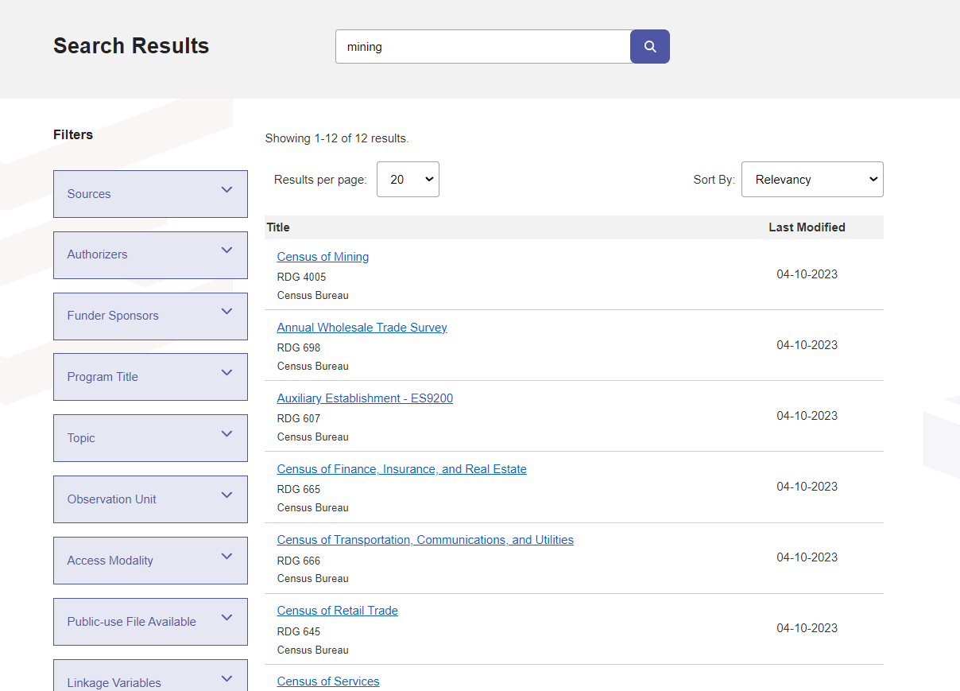
Getting Started: Browsing and Searching

Slide 29
Guidelines for Census proposal
Proposal must meet Basic Requirements
Need for Non-Public data
Maintains Confidentiality
Must emphasize statistical models vs. tabular output
Feasibility
Describes Census Benefits (LEGAL REQUIREMENT)
Scientific Merit
Work with Census Administrator to craft proposal

Slide 30
Timeframe – “Patience is a Virtue”
Census Data
Census review takes no more than 12 weeks
Additional agency review, if needed (up to 12 additional weeks)
Economic data (IRS), Numident (SSA), LEHD (states), CPS (BLS)
Other agency data
Same 12 week timeline. Some organizations may only accept applications during application window.
Census approval NOT required
Special Sworn Status
3 - 4 additional months for your security clearance and badging

Slide 31
Working in the FSRDC Lab
Majority of projects conducted entirely in the RMRDC lab
Data located on server in Maryland, not in the RMRDC
Access data via thin client terminals located in cubicles
No internet access or personal computers allowed in lab
Agency reviews output before releasing (~4-6 weeks)
Notes:
Might be worth specifying that the output release is after submitting the appropriate docs to CED DA
See additional slides for specific slide on VRDC if needed.

Slide 32
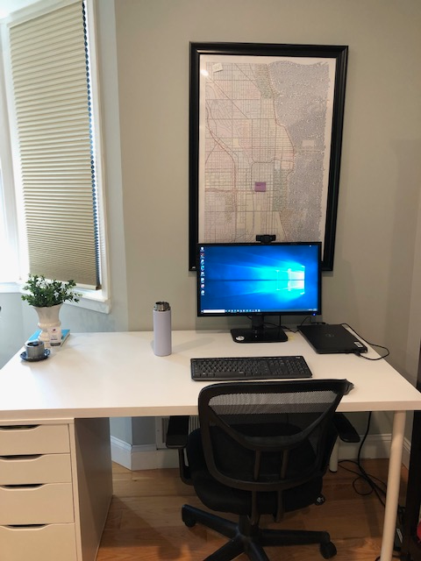
Remote Access: How it works
Eligibility
Data owning agency approval to remotely access data
Successful completion of remote access training
Successful on-site FSRDC experience
Rules of Behavior
Agreements
Mimics FSRDC environment
Location
Locked room inside researcher’s home
Regular inspections by Census Staff

Slide 33
Things to keep in mind
Model based output is the expectation
Tabular output is limited to supporting model-based output
New data are being added all the time
Other agencies govern how their data are used and accessed
Fees may apply to other agencies’ data
Other agencies may limit the hours you are able to access the RDC
Policy analysis is not allowed when using certain datasets
RDC work takes time – plan ahead!

Slide 34
For More Information…
Resources:
FSRDC website: www.census.gov/fsrdc
CES Working Paper Series: ideas.repec.org/s/cen/wpaper.html
Current RDC Projects: www.census.gov/about/adrm/fsrdc/about/ongoing-projects.html
ResearchDataGov – FSRDC application portal: researchdatagov.org

Slide 35
Let’s Talk!!
Jani Little
Executive Director
jani.little@colorado.edu
Catherine Talbot
Administrator
catherine.b.talbot@census.gov
Haeseong Park
Grad Research Assistant
haeseong.park@colorado.edu

