Slide 1
Advancing the Frontiers of Social Science: Opportunities and Challenges
Jani Little, Executive Director
Katie Genadek, Expected Administrator
The Rocky Mountain Research Data Center
https://www.colorado.edu/rocky-mountain-research-data-center/
Jani Little, Executive Director
jani.little@colorado.edu
Phil Pendergast, Administrator
philip.m.pendergast@census.gov
The Rocky Mountain Federal Statistical Research Data Center
(RMRDC)
Jani Little
Executive Director
Notes:
More and more data becoming available all the time.

Slide 2
What is a Federal Statistical Research Data Center (FSRDC)?
--A secure computing lab where restricted data, collected by federal agencies, can be accessed FOR STATISTICAL PURPOSES ONLY
--Made possible by a contractual agreement between a leading research institution and the U.S. Census Bureau
--The Census Bureau directs all FSRDCs and the FSRDC Program
--FSRDCs are managed by an on-site Census employee—the administrator—who guides researchers on proposal development, enforces security guidelines, and serves as liaison with the research community.

Slide 4
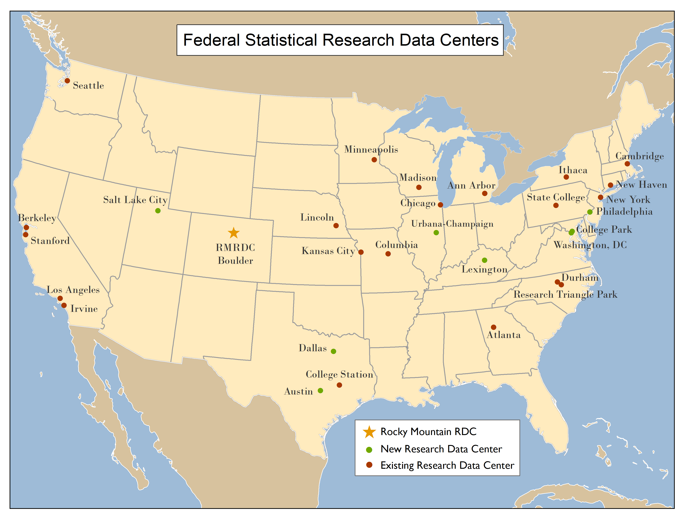
Notes:
Built to be a network of scholars—collaborating across universities, states, regions. Expansion slowing down. Demands on Census and other agencies. Discoveries in disclosure risk. Trying to catch up with new algorithms for disclosure avoidance.

Slide 5
The RMRDC Consortium Members

Slide 6
Partner Consortium Members Faculty, Grad Students, and Affiliated Researchers:
Free access to RMRDC services and secure laboratory

Slide 7
Requirements for Any FSRDC Project:
--Research projects must undergo a formal approval process with the agency that owns the data, e.g., Census, NCHS, BLS
--Researchers must go through a background investigation that qualifies them for “Special Sworn Status (SSS)” which makes them an unpaid Census Bureau employee.
--Results must be formally reviewed for disclosure violation before they leave the secure facility.
Notes:
Currently 260 active projects, 50% are Census

Slide 8
RMRDC: The Physical Facility
Location: IBS Building on CU Boulder Campus
--10 thin client workstations to access FSRDC servers
--Secure communications that tunnel over campus internet
--Contains the Administrator’s office
--Badge Reader at Entrance
--24/7 Security System with camera
--no electronic devices allowed
--NOTHING leaves the secure lab without approval

Slide 9
Advantages to Researchers:
--Greatly expands the policy and basic questions that can be addressed
--Builds on past research findings with richer data
--Improves competitive edge for grants and publications
--Improves graduate education (big data/statistical techniques) and placement

Slide 10
Advantages Provided to Research:
--Microdata not available publicly
firms and establishments
individuals and households
--Variables not available in public versions of data sets
(e.g., low level geography)
--Full population counts or larger samples (Decennial Census, ACS, CPS)
--Full range of response items (e.g., industry codes, occupational codes, detailed race answers, income is not top-coded, etc.)
--Ability to make linkages
with external data (e.g., via geocodes, establishment ID, etc.)
between multiple internal data sets via non-public link keys

Slide 11
Census Business/Economic Data https://www.census.gov/ces/dataproducts/economicdata.html
To find data relevant for a particular industry: https://www.census.gov/econ/isp/

Slide 12
Longitudinal Business Database (1976-2017)
Complete U.S. business establishment histories (with paid employees)
Establishment birth and death dates
All employer establishments in the Economic Census (Mining!)
Detailed linkage documentation over time and very accurate histories
Basic establishment demographic data linkable to other business datasets by EIN, SEIN
Establishment size
Industry
Location

Slide 13
Longitudinal Employer-Household Dynamics (LEHD) https://www.census.gov/ces/dataproducts/lehddata.html
Combines administrative data from states’Unemployment Insurance systems with Census Bureau business data and the individual demographic data using the Social Security Administration number database of encrypted identifiers.
Workers--Employer history and wage history, Individual characteristics (sex, age, race, ethnicity, education, place of birth), Point in time residence
Employers--Industry, # employees, firmage, total payroll, location
Linkages between workers and employers
Links to other Census data

Slide 14
Economic Census: 1987, 1992, 1997, 2002, 2007, 2012, 2017
Data Set
Construction Industries (CCN)
Finance, Insurance, Real Estate (CFI)
Manufacturers (CMF)
Mining (CMI)
Retail Trade (CRT)
Services (CSR)
Transportation, Communications, Utilities (CUT)
Wholesale Trade (CWH)
Notes:
Census because it surveys every sector of the economy.

Slide 15
Establishment Surveys, Annual
Data Set
Annual Survey of Manufacturers (ASM)
Current Industrial Reports (CIR)
Manufacturing Energy Consumption Survey (MECS)
Medical Expenditure Panel Survey – Insurance Component (MEPS-IC)
National Employer Survey (NES)
Quarterly Survey of Plant Capacity Utilization (QPC)
Survey of Manufacturing Technology (SMT)
Survey of Plant Capacity Utilization (PCU)
Survey of Pollution Abatement Costs and Expenditures (PACE)

Slide 16
Firm Surveys, Annual
Data Set
Annual Capital Expenditures Survey (ACES)
Annual Retail Trade Survey (ARTS)
Business Research & Development and Innovation Survey (BRDIS)
Enterprise Summary Report (ESR)
Exporter Database (EDB)
Quarterly Financial Report (QFR)
Service Annual Survey (SAS)
Survey of Business Owners (SBO) every 5 years

Slide 17
Transactions Data, Monthly
Data Set
Commodity Flow Survey (CFS) every 5 years
Foreign Trade Data - Export (EXP)
Foreign Trade Data - Import (IMP)
Longitudinal Foreign Trade Transactions Data (LFTTD)
Notes:
LFTTD links individual trade transactions with Firms that make them. Links exports to the exporting firm, and imports to the importing firm. Can link to LBD and Economic Census Survey data.
EXP and IMP contain the universe of trade transactions collected by Custom Bureau.

Slide 18
Demographic Data: https://www.census.gov/ces/dataproducts/demographicdata.html
Data Set | Frequency | Unit of Enumeration | Availability
Master Address File (MAF) | Annually | Occupied Living Quarters | 2017
American Community Survey (ACS) | Annually | Household | 2005-2017
Decennial Census | Every Ten Years | Household | 1950, 1960, 1970, 1980, 1990, 2000, 2010
Current Population Survey (CPS) | Annual (ASEC) | Household | 1976-2018
American Housing Survey (AHS) | Biennial | Household | Annual 1973-1981, Biennial 1985-2017
Notes:
CPS supplements: civic engagement; computer and internet use; fertility; food security; school enrollment

Slide 19
More Detailed Geography in FSRDCs
Data Set | Geography
Decennial Census | Block
American Community Survey (ACS) | address
Current Population Survey (CPS) – March ASEC Supplement | Tract
American Housing Survey (AHS) | Tract

Slide 20
American Community Survey data available in FSRDCs
All available Individual records-- 1.5% of U.S. Population Annually
Precise residential location--address
Precise geographic location of last year residence (addresses vs county)
Variables not censored (income, property taxes)
Additional detail within variables (race, ethnicity, occupation)
Citizenship
Notes:
Person: moves in last year, Work status, wages, other income, births, disability, health insurance, citizenship
HH: rent, mortgages, property taxes

Slide 21
Current Population Survey (CPS) Annual Social and Economic Supplement (ASEC)
92,139 HHs, 180,084 persons occupied households in 2018 sample
Detail on Work Activity, Wages, Earnings
Detail on Relationships among Person in HH
Detail on Earnings, Incomes, Nativity
Citizenship
Notes:
HH: detail on relationship among person in HH; lodgers or boarders; cohabitation;
Person: labor force and work activity; wages; earnings; income; nativity; citizenship;

Slide 22
Current Population Survey (CPS) Other Supplements
Civic Engagement;
Computer and Internet Use;
Fertility;
Food Security;
School Enrollment;
Tobacco Use;
Unbanked and Underbanked;
Volunteer
Voting and Registration
Notes:
HH: detail on relationship among person in HH; lodgers or boarders; cohabitation;
Person: labor force and work activity; wages; earnings; income; nativity; citizenship;

Slide 23
New Survey!! Rental Housing Finance Survey
National Sample of Rental Properties
Respondents: Owners and Property Managers
2012, 2015, biennial beginning 2018
Only source of data on Rental Housing Finance
Critical data for
addressing affordable housing problems
Informing and Evaluating Policy
Notes:
HH: detail on relationship among person in HH; lodgers or boarders; cohabitation;
Person: labor force and work activity; wages; earnings; income; nativity; citizenship;

Slide 24
Demographic Surveys (Continued)
American Housing Survey (AHS; 1984-2015)
The largest national housing sample survey in the United States
Conducted biennially in odd number years after 1985, of ~110,000 houses
U.S. housing inventory characteristics
Size and composition of houses, vacancies, physical condition, demographics of occupants
Produces indicators of neighborhood quality, mortgages and other housing costs, and characteristics of recent movers
Used by government to design housing programs for groups such as first time homebuyers and the elderly
Also occasionally collects topical data about commuting, evictions, emergency preparedness, food security, etc.
Notes:
Houses are interviewed every two years until a new sample is selected; sample rotates through different metropolitan areas.

Slide 25
Demographic Surveys (Continued)
National Crime Victimization Survey (NCVS; 2006-2016)
Collects data from approximately 135,000 households each year
Dwelling units remain in sample for 3.5 years, surveyed biannually
Yields potentially longitudinal data on
Demographics (age, sex, race, ethnicity, marital status, education, income, employment)
Victimization events (non-fatal crime and offender characteristics, whether reported to police, whether sought medical treatment, experiences with the criminal justice system)
Yields annual and change estimates of criminal victimization for persons age 12 or older
Includes persons living in group quarters (e.g. dormitories) but excludes institutional settings (correctional or hospital facilities) and homeless
Notes:
Topical interviews occasionally on topics such as school crime and safety

Slide 26
National Center for Health Statistics Data
National Health and Nutrition Examination Survey (NHANES)
Huge amount of detailed health data collected through medical examinations and interviews
Diagnoses for many different conditions, including cancer types and age of diagnosis
Anthropomorphic measures of obesity, cardiovascular health, diabetes
Treatments for specific diagnoses: surgery, radiation treatment, medicines
Geographic Identifiers (restricted data)
Latitude/Longitude coordinates for household
Census (2000, 2010) and postal geographies
Occupation/Industry Codes (restricted data)
4 digit codes for current and longest-held jobs
Linked to National Death Index
ICD codes for cause of death including many related to occupation (e.g. fumes and vapors)

Slide 27
National Center for Health Statistics Data
National Health Interviews Survey (NHIS)
Interview data focused on tracking access to healthcare and health status of the nation with larger yearly sample than NHANES
Geographic Identifiers (restricted data)
Latitude/Longitude coordinates for household
Census (2000, 2010) and postal geographies
Occupation/Industry Codes (restricted data)
4 digit codes for current and longest-held jobs
Linked to National Death Index
ICD codes for cause of death including many related to occupation (e.g. fumes and vapors)

Slide 28
National Center for Health Statistics Data
Restricted Medical Expenditure Panel Survey (MEPS) https://meps.ahrq.gov/mepsweb/data_stats/onsite_datacenter.jsp
Annual Household Sample Drawn from NHIS Sample (In 2016, 13,587 families, 33,259 persons)
Longitudinal: 5 different interviews over 2 years
Extensive information about medical care and expenses
Usual source of care, access to care and treatment, satisfaction with care, preventative care
Conditions and management
Prescription medications and dosage, disabilities and impacts on work, elderly care
Demographics
Linked to Medical Provider Surveys
Linked to NHIS data

Slide 29
Bureau of Labor Statistics Data
Census of Fatal Occupational Injuries (1992-2016)
Population information on fatal occupational injuries occurring in the U.S.
Employer: Basic establishment characteristics, industry, name
Employee: Employee status (wage/salary/self-employed), occupation, demographics
Injury: Date, incident details (activity performed, cause and nature of injury)
Survey of Occupational Injuries and Illnesses (1995-2016)
Nationally representative information on establishment-level injuries
Similar employer characteristics, including establishment name and address
Establishment AND injury/illness case-level data, including time missed and care records

Slide 30
Bureau of Labor Statistics Data
Consumer Expenditure Surveys (CEX; Forthcoming in RDC?)
A national household survey conducted by Census on behalf of BLS
Used to determine how Americans spend their money and to revise the relative importance of goods and services in the Consumer Price Index
Quarterly survey data on
Large and recurring expenses such as rent, mortgages, and utilities
Diary survey data on
Smaller, frequently purchased items such as food, clothing, and consumer goods

Slide 31
Components of Proposals:
--Personnel and Time frame
--Project Description (scientific merit, methods, feasibility, why requires restricted data)
--Dataset(s), Variables, Geography
--Results Expected and Disclosure Avoidance Strategies

Slide 32
How and When Do I Get Started?
--See materials at the RMRDC website, the CES website, and other relevant sites.
--Contact the RMRDC Director and Administrator for
--data availability
--project budget and timeline
--contact information
The Administrator will give invaluable guidance on
--the proposal development process
--the benefits to Census (PPS)
--help navigate the project approval process

Slide 33
Advancing the Frontiers of Social Science: Opportunities and Challenges
Jani Little, Executive Director
Katie Genadek, Expected Administrator
The Rocky Mountain Research Data Center
Jani Little, Executive Director
jani.little@colorado.edu
Phil Pendergast, Administrator
philip.m.pendergast@census.gov
The Rocky Mountain Federal Statistical Research Data Center
(RMRDC)
Jani Little
Executive Director
Notes:
More and more data becoming available all the time.

