Slide 1
Rocky Mountain Research Data Center (RMRDC):
Executive Director
jani.little@colorado.edu
Rocky Mountain Research Data Center (RMRDC):
Accessing Restricted Data Collected by Federal Statistical Agencies
https://www.colorado.edu/rocky-mountain-research-data-center/
Jani Little, Executive Director
jani.little@colorado.edu
Philip Pendergast, Administrator
philip.m.pendergast@census.gov
Kas McLean, GRA (Econ PhD Candidate)
kas.mclean@colorado.edu
/www.colorado.edu/rocky-mountain-research-data-center/

Slide 2
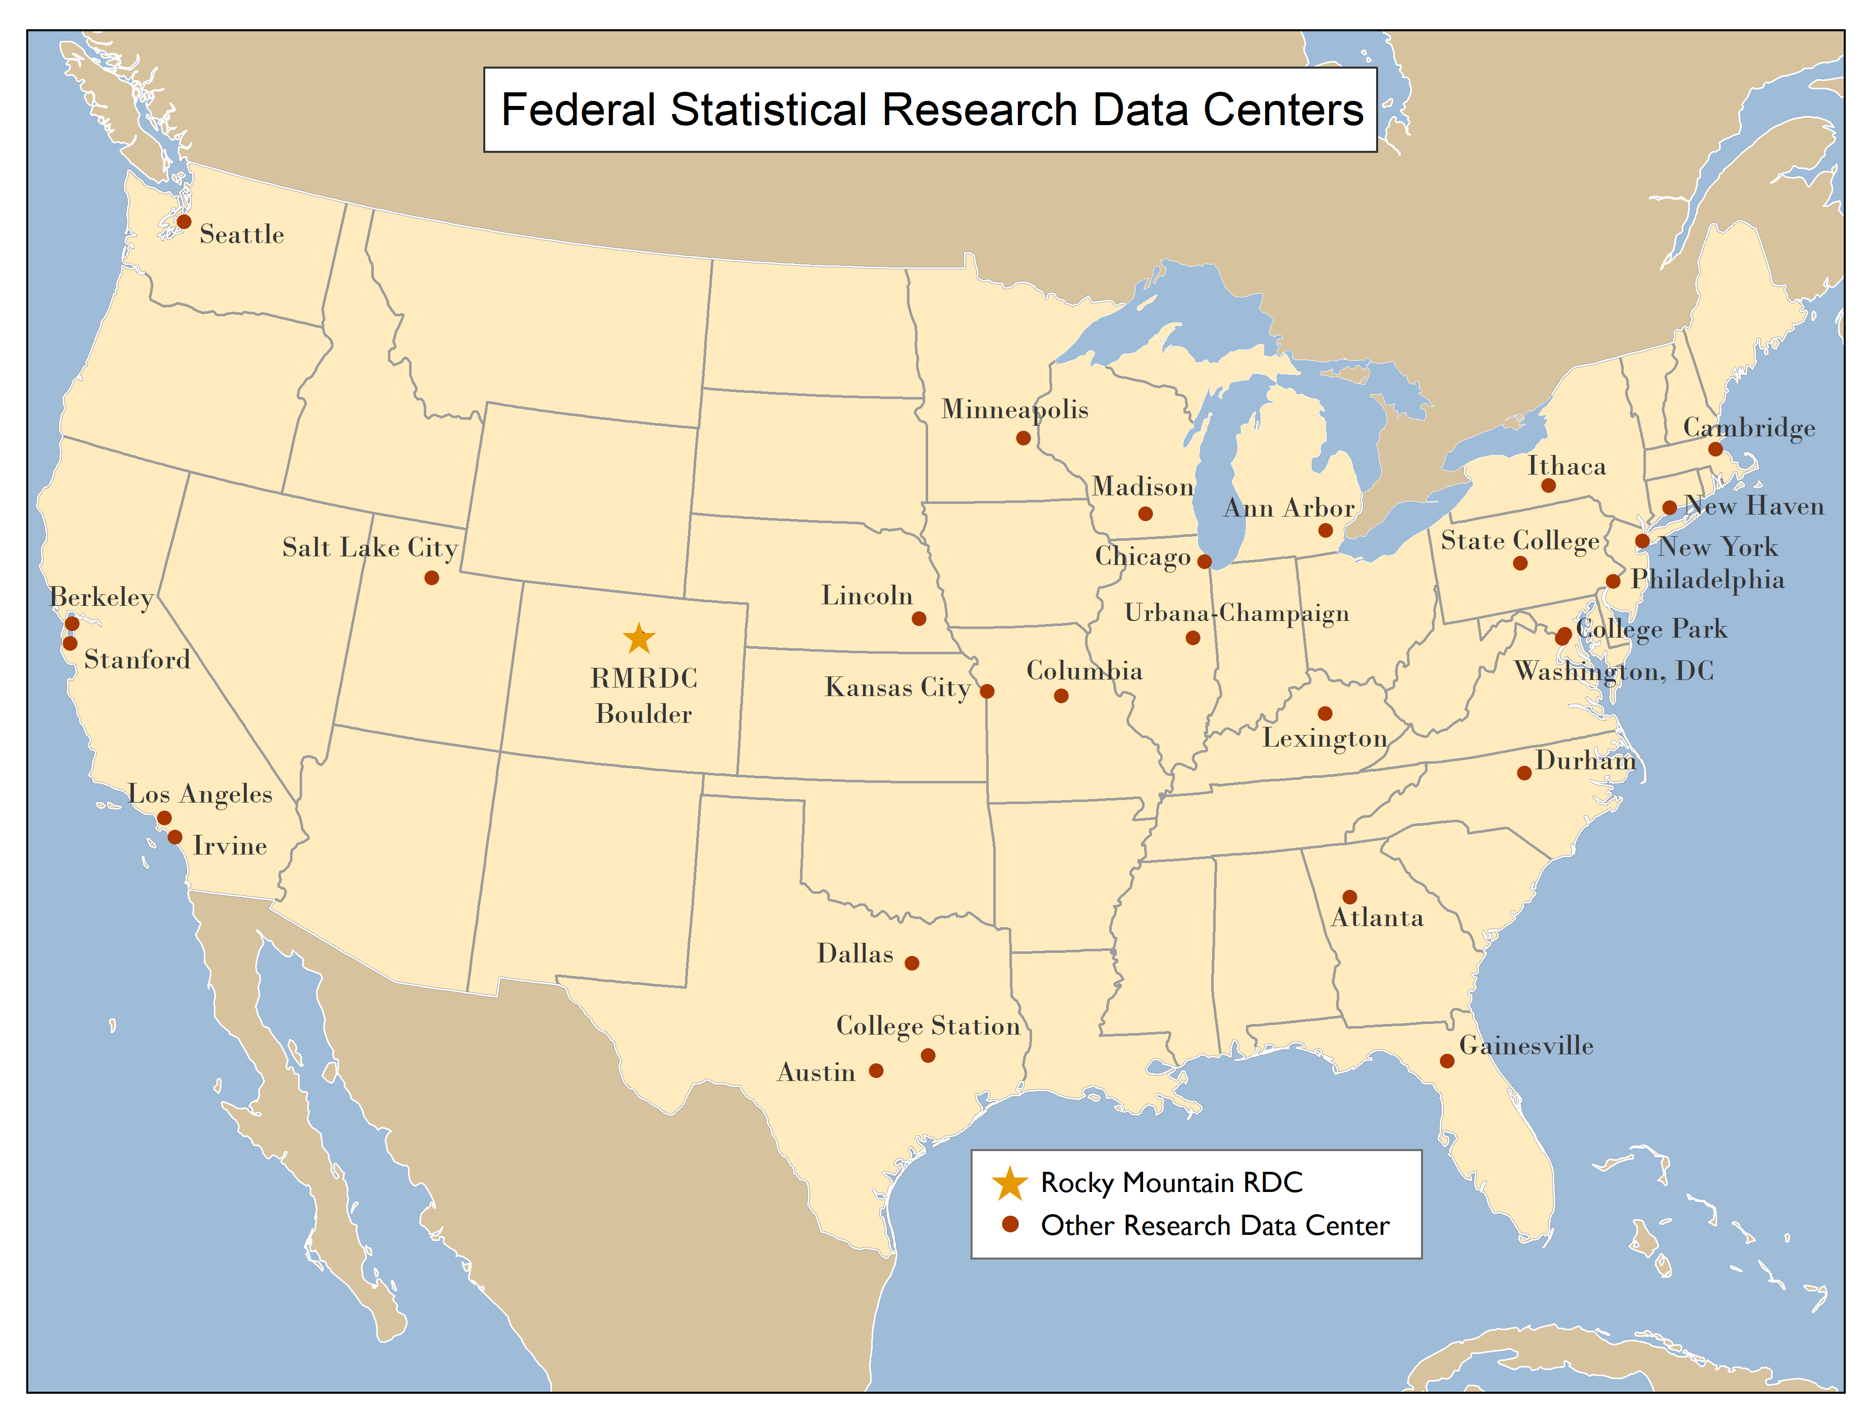
RMRDC is part of a National Network of FSRDCs Providing Access to Restricted-Use Data Collected by Federal Statistical Agencies

Slide 3
RMRDC Membership Network *All faculty, staff, and graduate students associated with member universities have free access to the lab and services

Slide 4
Bureau of the Census
Office of Research, Evaluation, and Statistics
(Social Security Administration)
Federal Statistical Agencies
National Center for Education Statistics
Bureau of Transportation Statistics
National Agricultural Statistics Service
National Center for Health Statistics
Bureau of Labor Statistics
Bureau of Justice Statistics
Bureau of Economic Analysis
Statistics of Income Division
(Internal Revenue Service)
Economic Research Service
National Center for Science and Engineering Statistics
(National Science Foundation)

Slide 5
What RMRDC offers:
Access to federal restricted data in a secure facility and through remote access (when authorized)
Staff assist with:
Successful proposal development and submission
Researchers must develop an agency-approved proposal to use the data.
“Special Sworn Status (SSS)” applications
Researchers undergo a background check which gets them lab access
Technical support
Disclosure review and statistical output approval
Results must be formally reviewed for disclosure violation before they leave the secure facility, and before they are shared in presentations or publications.

Slide 6
Current AMC restricted data projects:
Researchers | Affiliations | Project Title
Richard Dart | CU Anschutz, Medical School and Rocky Mountain Poison & Drug Safety | Analysis of Drug Induced Mortality Data for Stimulants
Joshua Black | Rocky Mountain Poison & Drug Safety | Multivariate Analysis of Polysubstance Mortality and Analysis of Buprenorphine Mortality
Karilynn Rockhill | CU Anschutz, PhD Cand
Ben Allshouse | CU Anschutz, CSPH | Oil and Gas Siting, Housing Choices, and Environmental Justice
Danielle Sansone-Poe | CU Anschutz, CSPH
Lisa McKenzie | CU Anschutz, CSPH
Kate Coleman-Minahan | CU Anschutz, Nursing | Social determinants of health and adolescent pregnancy in US Latinas
Fernando Riosmena | CU Boulder, Geography
Goleen Samari | Columbia University, Public Health | State Policies and Immigrant Sexual and Reproductive Health
Kate Coleman-Minahan | CU Anschutz, Nursing

Slide 7
Restricted-Use Health Data with RMRDC Access Added Recently
Census Bureau:
HH and Small Business COVID Pulse Surveys
National Survey of Children’s Health (NSCH)
National Sample Survey of Registered Nurses (NSSRN)
NCHS:
National Survey on Drug Use and Health (NSDUH)

Slide 8
New Restricted-Use Data Assets—COVID-related Census Data Collections
Household Pulse Survey: https://www.census.gov/programs-surveys/household-pulse-survey/datasets.html
20-minute online survey studying how the coronavirus pandemic is impacting households across the country from a social and economic perspective.
Asks questions about how childcare, education, employment, energy use, food security, health, housing, household spending, Child Tax Credit payments, and intention to receive a COVID-19 vaccination, have been affected by the ongoing crisis.
Eligible for remote access
Small Business Pulse Survey: https://www.census.gov/data/experimental-data-products/small-business-pulse-survey.html
Measures the effect of changing business conditions during the Coronavirus pandemic on our nation's small businesses.
Complements existing U.S. Census Bureau data collections by providing high-frequency, detailed information on the challenges small businesses are facing during the Coronavirus pandemic.

Slide 9
New Restricted-Use Data Asset—Child Health Related Census Data Collection (eligible for remote access)
National Survey of Child Health (NSCH): https://www.census.gov/programs-surveys/nsch.html
Oversampled Colorado rural areas
Annual, 2016-2020
Physical and emotional health of children ages 0-17
Factors related to the well-being of children
access to - and quality of - health care
family interactions
parental health
neighborhood characteristics
school and after-school experiences

Slide 10
New Restricted-Use Data Asset—Mental Health and Drug Use Related NCHS Data Collection
National Survey on Drug Use and Health (NSDUH):https://nsduhweb.rti.org/respweb/about_nsduh.html
Annually 70,000 people, 2014-2020
Aged 12 and older
Use of illegal drugs, prescription drugs, alcohol, and tobacco
Mental disorders, treatment, and co-occurring substance use and mental disorders

Slide 11
Advantages of Restricted-Use Microdata
For Researchers:
Greatly expands the policy and basic questions that can be addressed
Builds on past research findings with richer data
Improves competitive edge for grants, publications, recruitment
Improves graduate education (big data/statistical techniques) and placement
For Research:
Microdata not available in public-use data, e.g., business data
Longitudinal and/or linked person-level or household-level data
Variables not available in public-use versions of data sets, such as low-level geography
Full population counts or larger samples (Decennial Census, ACS, CPS) not available in public-use data
Full range of response items (e.g., ICD codes, industry codes, occupational codes, detailed race answers, income is not top-coded, etc.)

Slide 12
Health Data Course: Spring 2022
HSMP 6670 002 and HSPM 6670 003
“Federal Statistical Data for Health Research and Policy”
1. Offered to all RMRDC Consortium Member Institutions at no cost, taught remotely
2. Targets early-career graduate students
3. Students develop the knowledge and skills required to effectively use a variety of federal statistical data sets for health research and policy analysis.
4. The semester project is a restricted data proposal.
5. Students get “hands on” exercises using SAS to analyze public versions of the federal data sets to reproduce results in published papers.

Slide 13
Restricted-Use Health Data Sets Covered in the Course
by Dissemination Agency:
Census:
American Community Survey (ACS)
Current Population Survey (CPS)
National Survey of Children’s Health (NSCH)
National Crime Victimization Survey (NCVS)
NCHS:
National Vital Statistics System (NVSS)
National Health and Nutrition Examination Surveys (NHANES)
National Health Interview Survey (NHIS) linked with National Death Index (NDI)
National Survey of Family Growth (NSFG)
Behavioral Risk Factor Surveillance System (BRFSS)
National Survey on Drug Use and Health (NSDUH)
Agency for Health Research and Quality (AHRQ):
Medical Expenditure Panel Survey (MEPS)
Bureau of Labor Stats (BLS):
Survey of Occupational Injuries and Illnesses (SOII)
Census of Fatal Occupational Injuries (CFOI)

Slide 14
Current RMRDC grad student led health projects:
Black immigrant health and differences by country of origin/time in US
Gender and racial/ethnic/country of origin differences in timing of HPV vaccination
Death by Despair: Individual and Contextual Predictors of Suicide Mortality Risk
Did ACA Reduce Ethnic and Racial Disparities in Healthcare?
Do Sugar-Sweetened Beverage Taxes Work?
State Variation in Intimate Partner Violence Rates: Reporting and Healthcare Utilization

Slide 15
Important NCHS links:
A detailed description of NCHS restricted data: https://www.cdc.gov/rdc/b1datatype/dt122.htm
How to gain access through the RMRDC: https://www.cdc.gov/rdc/leftbrch/userestricdt.htm
Preparing an NCHS Proposal: https://www.cdc.gov/rdc/leftbrch/Presubmit.htm

Slide 16
Good News Flash!!
All Projects Using Individual and/or HH Restricted-Use Data from Census Bureau (like those mentioned in the next two slides) are eligible to access the data through Remote Access
Remote Access
Approved researchers get set up to use restricted data from home office
Undergo additional training and random audits
Only two required trips to RMRDC for training purposes

Slide 17
Other Restricted-Use Microdata on Individuals and Households Available from Census Bureau (eligible for Remote Access):
Full-count Decennial Censuses, e.g., 2000, 2010, 2020
Administrative records
Master Address File (MAF) includes Addresses of every HH in US
Sample surveys
American Community Survey (ACS)
Current Population Survey (CPS)
American Housing Survey (AHS)
Survey of Income Program Participation (SIPP)
National Crime Victimization Survey (NCVS)
Most data are linkable at the person level

Slide 18
Census Longitudinal Infrastructure
Decennial Census and ACS datasets
2000
Census
2010
Census
2020
Census
2005-2020
ACS
Household survey datasets
CPS
SIPP
AHS
NCVS
Administrative and other datasets
SSA Death and Earnings
Records
Address
Records
External
Data Sources

Slide 19
Local Use of Linked Data
Allshouse, Sansone-Poe, and McKenzie - “Oil and Gas Siting, Housing Choices, and Environmental Justice”
Uses a unique mosaic of datasets to determine population characteristics of those at risk of O&G development
American Community Survey (ACS) – Household characteristics
Master Address File (MAFx) – Location of households (address, lat/long)
External O&G well site data (lat/long)
External US Building footprints data (lat/long of residential units on lots)
Create fine-grained estimates of population mixing to assess possible association with childhood Acute Lymphocytic Leukemia (ALL)

Slide 20
Additional Census Data
Data for Criminological research:
National Crime Victimization Survey (NCVS)
Criminal Justice Administrative Records System (CJARS)
CMS Medicare/Medicaid Enrollment Data
Data for Economic research:
Economic Censuses and Surveys
Business Register and Longitudinal Business Database (LBD)
Longitudinal Employer-Household Dynamics data (LEHD)
BLS Data
All free to access through Anschutz consortium agreement!

Slide 21
Crime Data Overview
The National Crime Victimization Survey (NCVS) is collected by Census on behalf of the Bureau of Justice Statistics (BJS) to produce national estimates of crime incidence, reporting and victim characteristics.
Sampling frame is potential crime victims.
The Criminal Justice Administrative Records System (CJARS) is a collaboration between State justice departments, the University of Michigan, and Census to link offender records to other demographic, economic, and administrative data collected by the federal government.
Sampling frame is adult criminal offenders in participating States.

Slide 22
CMS Medicare and Medicaid Data
The Centers for Medicare & Medicaid Services (CMS) provide access to:
The Medicare Enrollment Database (EDB)
1999-2020
The Medicaid and Statistical Information System (MSIS & T-MSIS)
2000-2016
The National Plan & Provider Enumeration System (NPPES)
2018, only

Slide 23
CMS Medicare Enrollment Database (ERB)
CMS’ database of record for Medicare Beneficiary enrollment info, updated yearly 1999-2020
Beneficiary-level data with a subset of all variables collected:
Eligibility dates and statuses
Birth and death dates (where applicable)
Residence address and residence change dates
Basic demographic information
Beneficiary’s representative payee
PIK (for linkage to other Census survey data)

Slide 24
CMS Medicaid and Statistical Information System (MSIS) & Transformed MSIS (T-MSIS)
Used by CMS to gather key eligibility, enrollment, program, utilization, and expenditure data for Medicaid and Children’s Health Insurance Program (CHIP) from States each quarter
States transitioned to T-MSIS between 2014 and 2016, projects should request both datasets if looking at full span from 2000-2016
Medicaid enrollment data including:
Basic demographics
Length of eligibility period and health insurance coverage
CHIP and TANF usage

Slide 25
CMS National Plan and Provider Enumeration System (NPPES)
Serves as the national system for assigning unique ids (National provider Identifier –NPI) to health care providers and health plans
Includes physicians, pharmacists, physician assistants, nurse practitioners, nurse anesthetists, dentists, physical therapists, etc.
Contains the data that providers submit with their NPI application
Most of this data is public, but restricted data further contains:
Date of birth
State of birth
Country of birth

Slide 26
Data Overview – Census Economic
There are many data options for economic research available in the RDC
Census collects the Economic Censuses and Annual Surveys from business establishments every one or five years (years ending in 2 or 7)
Census also keeps a Business Register of all employer establishments in the US, which are linked over time in the Longitudinal Business Database (LBD)
For US-based businesses, trade/transaction data are also collected by Census and made available at the establishment and transaction level
Census works with State unemployment offices to make longitudinal, linked employer-employee data available as well (96% coverage of private sector)

Slide 27
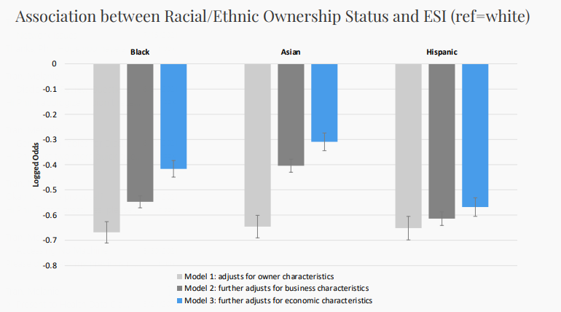
Local Example of Using Census Economic Data for Health Research
Tran and Krueger (CU Denver, CSPH) – “Small Businesses and Employer-Sponsored Health Insurance”
Unique in using business data to assess a health-related outcome
Uses a variety of newer small-business focused surveys to assess whether race/ethnicity and nativity of business owners, as well as local community, predicts whether businesses offer ESI
Survey of Business Owners (SBO)
Annual Survey of Entrepreneurs (ASE)
Annual Business Survey (ABS)

Slide 28
ANOTHER Local Example of Using Census Economic Data for Health Research
Van Sandt (U Wyo) – “Exploring the Impact of Comprehensive Health Care Access on Health Outcomes Across the US”
Assesses physical, financial, and social access to care across the US by disaggregating the types of care providers available at the same location (e.g. hospitals or clinics), as well as proximity to health-related industries like fitness and recreational sports centers, grocery stores, restaurants
Examines impacts on county-level cause-specific mortality, from NCHS data
Longitudinal Business Database (LBD)
County Business Patterns Business Register (CBPBR)
American Community Survey (ACS)
National Vital Statistics System (NVSS) Mortality Multiple Cause of Death file

Slide 29
BLS Injury and Fatality Data
The Bureau of Labor Statistics (BLS) collects the Survey of Occupational Illnesses and Injuries (SOII) and Census of Fatal Occupational Injuries (CFOI)
SOII contains a sample of establishments who report the number of illnesses or injuries suffered by workers as a result of their job
Only contains detail (injury severity, time out of work, employee race/ethnicity) for a sample of reported injuries if >15 reported
Establishment data is sufficient for linkage to Census business data
CFOI compiles comprehensive information on fatal accidents suffered on the job
Does NOT contain data necessary to link establishments to business data

Slide 30
Local Use of Injury and Fatality Data Linked to Census Economic Data
Duncan (CSU Pueblo) – “Effects of Subcontracting and other Contractor Characteristics on Injuries in the Construction Industry”
Examines the distribution and severity of injuries in the Constructor sector by Subcontractor types
Combines restricted BLS data with Census Economic Data to get better estimates of employer characteristics
Survey of Occupational Illnesses and Injuries (SOII)
Census of Construction Injuries (CCI)

Slide 31
Proposal Development
Researchers work closely with RMRDC administrator Phil to write successful proposals for Census projects (most data described here!)
Typically, 8-20 page project description and separate “Predominant Purpose Statement” (Phil helps draft this)
Focus on research questions, need for confidential data, methods, expected output and disclosure risk, and benefits to Census Bureau
Evaluated on feasibility, benefits, disclosure risk, and need for data
For assistance with other agency proposals (e.g. NCHS health projects), contact either Jani or Phil

Slide 32
Proposal Reviews and Timeline
The slowest part of the proposal process is often you; but it doesn’t have to be!
Final proposal review time with Census: ~3 months
If additional agency review is necessary (e.g. IRS): ~6 months
Background check/security clearance: ~3 months
Example timeline for most proposals:
3 months for Census review + 3 months for IRS review (optional) and/or 3 months for clearance (concurrent) = 6 months total before project start

Slide 33
Thank You!
Phil Pendergast
Administrator
philip.m.pendergast@census.gov
Kas McLean
Grad Research Assistant
kas.mclean@colorado.edu
Jani Little
Executive Director
jani.little@colorado.edu

