Slide 1
Rocky Mountain Research Data Center (RMRDC): https://www.colorado.edu/rocky-mountain-research-data-center/ Consortium Committee Meeting December 6, 2022
Jani Little, Executive Director
jani.little@colorado.edu
Philip Pendergast, Administrator
philip.m.pendergast@census.gov
Kas McLean, GRA (Econ PhD Candidate)
kas.mclean@colorado.edu

Slide 2
Agenda Item #1: National FSRDC Program Changes FSRDC Projects, 2012-2022
Compound Annual Growth Rate = 13.8%

Slide 3
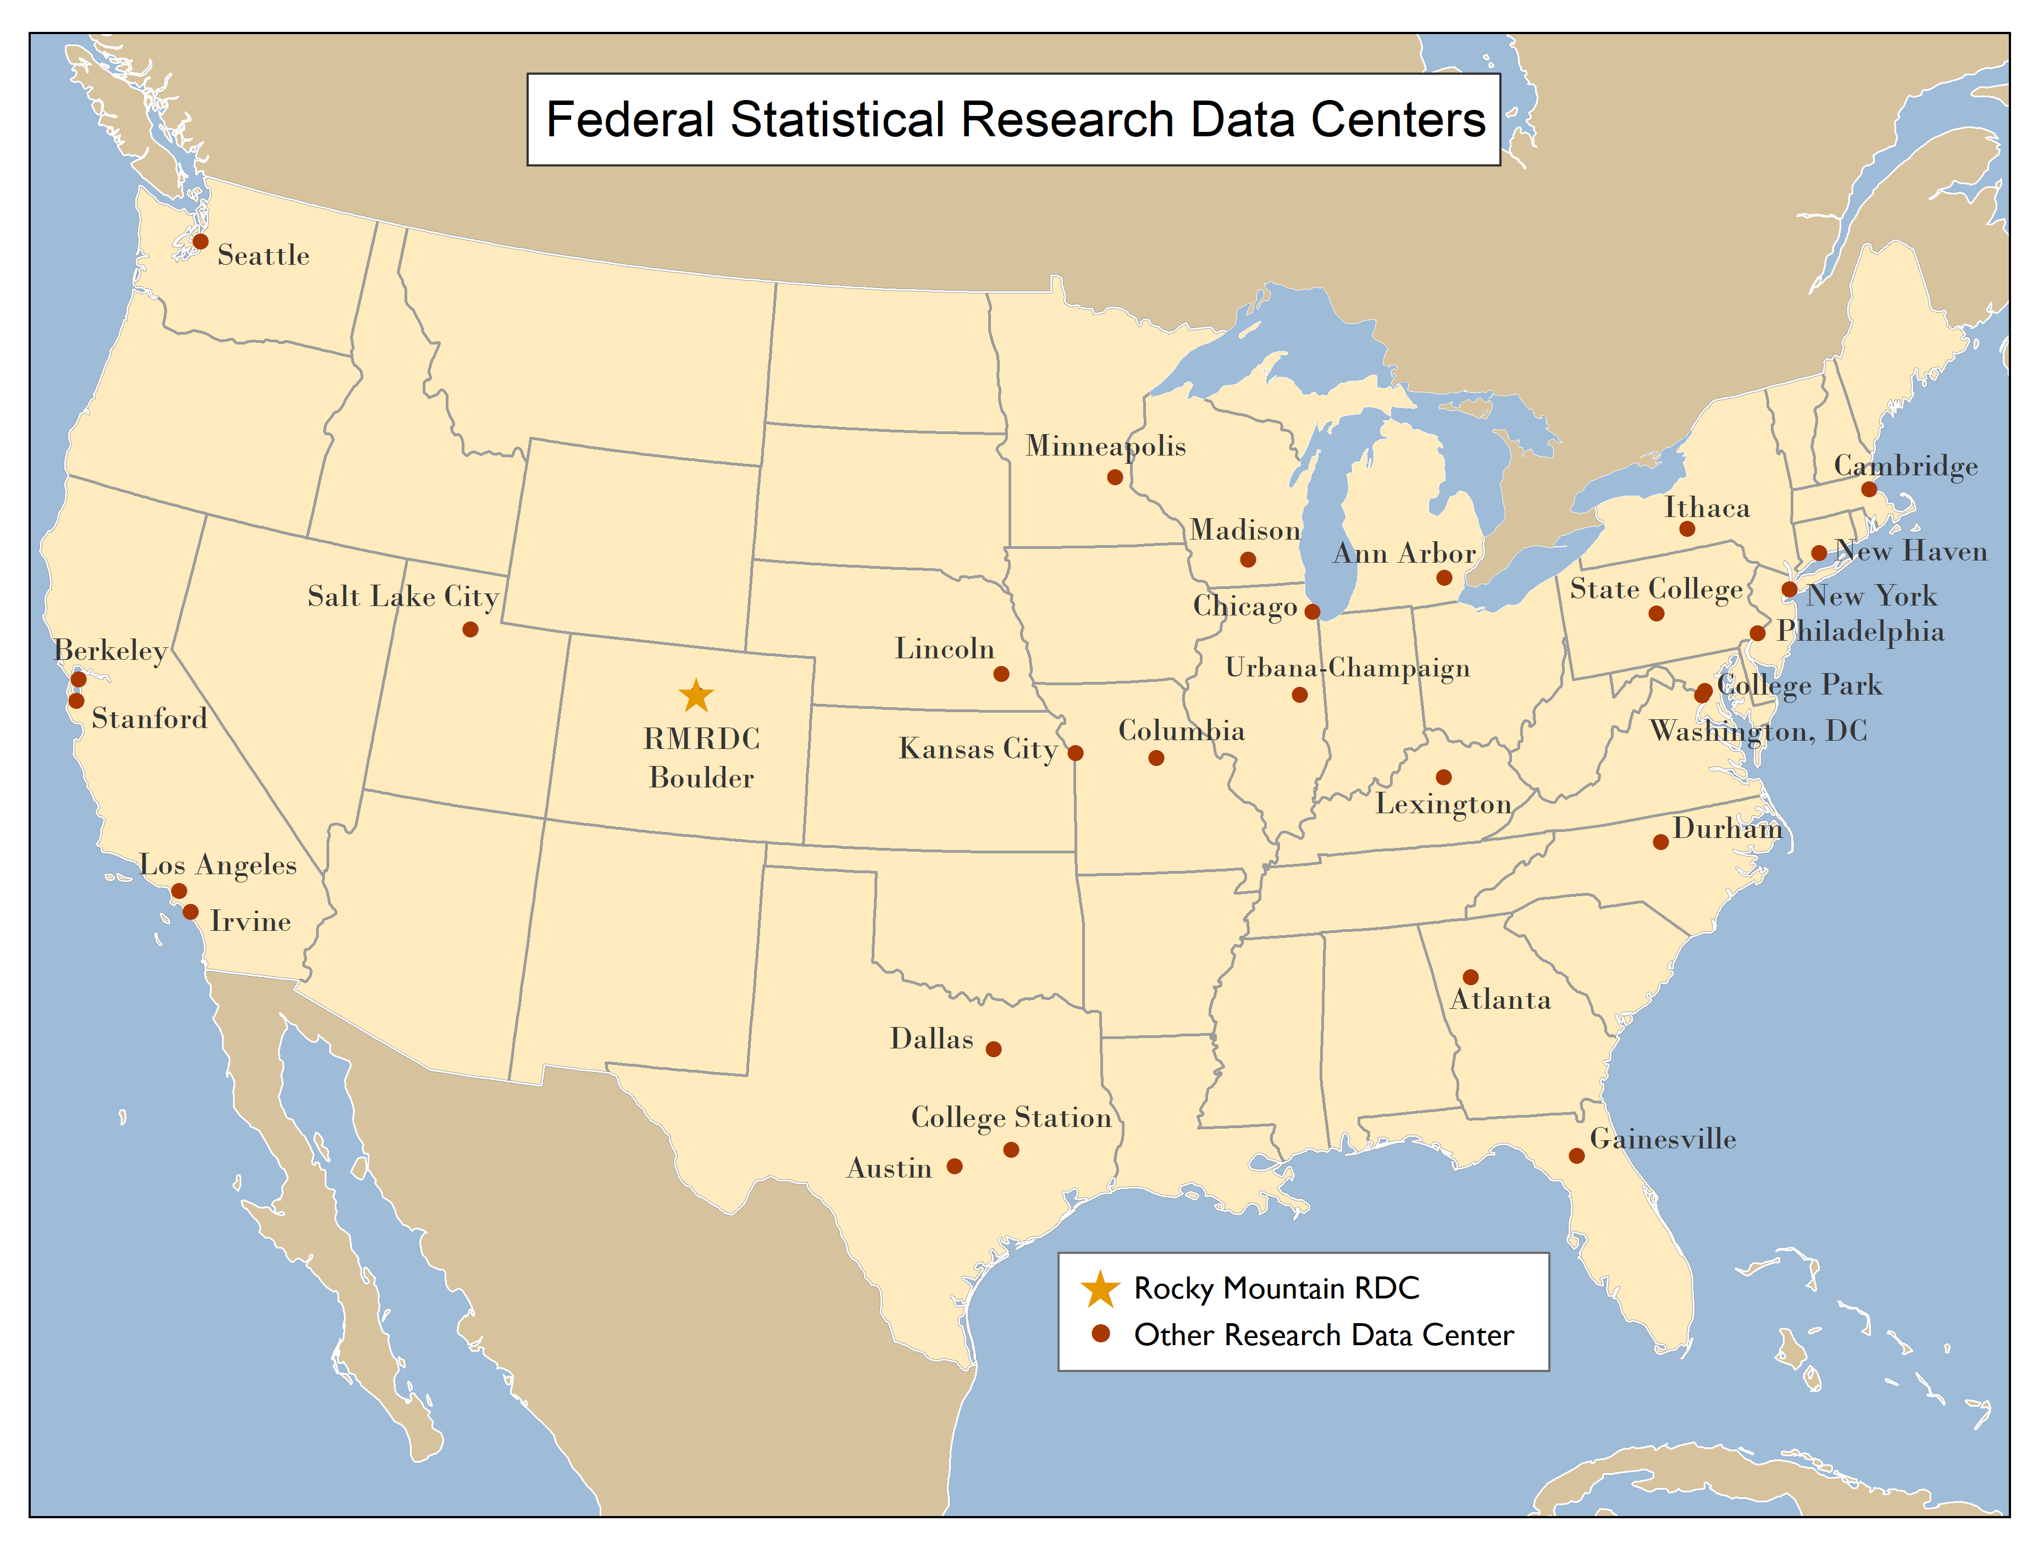
RMRDC is part of a National Network of 33 FSRDCs

Slide 4
The FSRDC Network
Auburn University | University of Oklahoma | Russell Sage Foundation | University of Colorado Denver
Emory University | University of Texas Dallas | State University of New York at Albany | University of Denver
Federal Reserve Bank of Atlanta | University of Texas Southwestern Medical Center | Syracuse University | University of Texas at El Paso
Georgia Institute of Technology | University of Texas at Arlington | University of Rochester | University of Wyoming
Georgia State University | Board of Governors of the Federal Reserve System | Yale University | Baylor University
Tulane University | Bureau of Economic Analysis | Baruch College | Rice University
University of Georgia | Florida State University | City University of New York | Texas A&M University
University of Tennessee, Knoxville | Moffitt Cancer Center | Columbia University | Texas A&M University System
Vanderbilt University | University of Central Florida | Cornell University | University of Houston
National Bureau of Economic Research | University of Florida | Federal Reserve Bank of New York | University of Texas at Austin
Public Policy Institute of California | American University School of Public Affairs | MDRC | University of Texas at San Antonio
Social Sciences Data Laboratory (D-Lab) | Georgetown University | National Bureau of Economic Research | Duke University
University of California - Berkeley | Massive Data Institute | New York University | RTI International
University of California - Davis | McCourt School of Public Policy | Princeton University | University of North Carolina at Chapel Hill
University of California - San Francisco | Virginia Tech | Russell Sage Foundation | Federal Reserve Bank of Chicago
University of California, Irvine | Federal Reserve Bank of Kansas City | State University of New York at Albany | Northwestern University
RAND Corporation | Kauffman Foundation | Syracuse University | University of Chicago
University of California, Los Angeles | University of Kansas | University of Rochester | University of Illinois
University of California, Stanford | University of Kansas Medical Center | Yale University | University of Illinois at Urbana-Champaign
University of Southern California | University of Missouri | Center for Studies in Demography and Ecology | University of Notre Dame
Iowa State University | University of Missouri – Kansas City | University of Washington | Baylor University
University of Iowa | Indiana University | Drexel University | Rice University
University of Nebraska Medical Center | The Ohio State University | Federal Reserve Bank of Philadelphia | Texas A&M University
University of Nebraska-Lincoln | University of Kentucky | Pennsylvania State University | Texas A&M University System
University of South Dakota | Robert H. Smith School of Business | University of Delaware | University of Houston
Federal Reserve Bank of Chicago | University of Maryland | University of Pennsylvania | University of Texas at Austin
Northwestern University | Institute for Social Research | University of Pittsburgh | University of Texas at San Antonio
Purdue University | Michigan State University | Drexel University | University of Wisconsin - La Cross
University of Chicago | University of Michigan | Federal Reserve Bank of Philadelphia | University of Wisconsin – Madison
University of Chicago: NORC | Federal Reserve Bank of Minneapolis | Pennsylvania State University | University of Wisconsin – Milwaukee
University of Illinois | University of Minnesota | University of Delaware | University of Wisconsin – Whitewater
University of Illinois: Urbana-Champaign | University of Missouri | University of Pennsylvania | Cowles Foundation at Yale University
University of Notre Dame | Baruch College | University of Pittsburgh | Yale Department of Economics
Dallas-Fort Worth Hospital Council Foundation | City University of New York | Colorado School of Mines | Yale Institution for Social and Policy Studies
Federal Reserve Bank of Dallas | Columbia University | Colorado State University | Yale School of Management
Southern Methodist University | Cornell University | Colorado State University – Pueblo | Brigham Young University
Texas Christian University | Federal Reserve Bank of New York | Denver Health and Hospital Authority | Utah Department of Health
Texas Tech University | National Bureau of Economic Research | Rocky Mountain Poison and Drug Safety | Utah State University
Texas Tech University Health Sciences Center | New York University | University of Colorado Anschutz Medical Campus
University of North Texas | Princeton University | University of Colorado Boulder
More than 150 institutions are (currently)
members of a consortium!
https://www.census.gov/about/adrm/fsrdc/about/partners.html

Slide 5
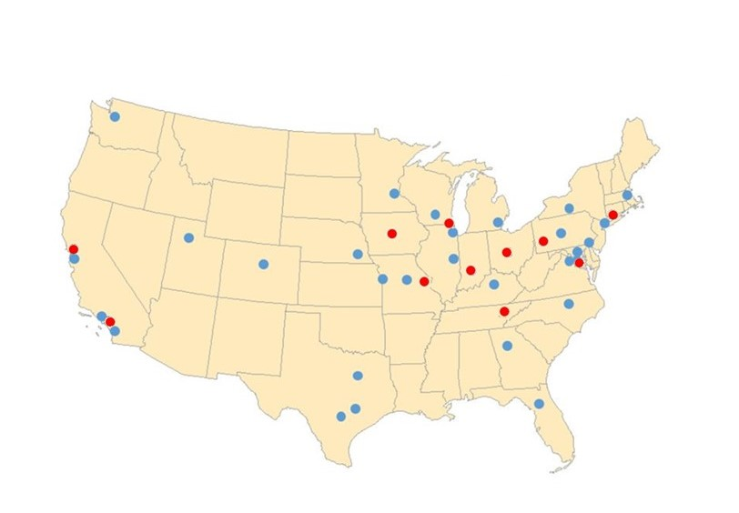
FSRDC Network Planned Expansion, 2024-26
2024 Planned Builds:
1. Ohio State University
2. Indiana University
3. Iowa State University
2025-26 Planned Builds:
4. University of Tennessee
5. University of Chicago
6. University of Pittsburgh
7. St. Louis Federal Reserve Bank

Slide 6
Two Initiatives Aimed at Equalizing and Diversifying Access to Restricted-Use Data (Equity-Focused Outreach)
NSF INCLUDES Proposal Under Development--Texas A&M (Due Oct 2023)
--Targets researchers at under-resourced institutions that support under-served populations,
e.g., HBCUs, MSIs, and State Health Agencies
--Existing FSRDCs would form a national alliance to
--build the infrastructure to foster collaboration and broaden participation in the FSRDC program
--build connections with outside organizations and expand the research network
--sponsor proposal development grants; joint project development grants
--encourage experienced FSRDC researchers to partner with researchers
from under-resourced institutions

Slide 7
Two Initiatives Aimed at Equalizing and Diversifying Access to Restricted-Use Data (Equity-Focused Outreach)
2. Graduate Course Provides Training in Research with Restricted-Use Data —CU Boulder
Federal Statistical Data for Health Research and Policy
--Targets early-career grad students in health econ, public health, pop studies
--Expands Individual Access to FSRDCs
--Provides a Grassroots Approach—Encourages Student-led Research
--Fully Remote-Access
--Recognized as a Prototype for the FSRDC Program

Slide 8
The Original Mission of the FSRDC program: --support research and educate future scholars --support a more coordinated federal statistical system --improve the quality and utility of federal statistics --increased access to federal statistical micro-level data --promote the linkage of micro-level data from different agencies
Evidence Act, 2018 (gives legislative teeth to the FSRDC Program)
Congress directed the 13 existing statistical agencies to come together, under a new set of policies, with an expanded mission:
to operate as a seamless system,
as trusted stewards of the public’s most sensitive data,
to enable evidence building.

Slide 9
The Standard Application Process (SAP) is a tremendous accomplishment for the Federal Statistical System, our partners, and our stakeholders

Slide 10
Current – Decentralized Application Processes
Multiple agency-specific processes
Federal
Restricted-Use Data Assets
EIA Data*
BEA Data
BJS Data
BLS Data
NCSES
Data
NCHS Data
IRS Data
NASS Data
ERS Data
NCES Data
BTS Data
FRB Data
SSA Data
SAMHSA Data
Census Data
USDA Enclave
USDA Enclave
BTS Onsite
FRB Onsite
FSRDCs
Secure Access Facilities
BEA Network;
FSRDCs
BJS NACJD;
FSRDCs
NCSES Enclave;
FSRDCs
NCHS RDC;
FSRDCs
IRS Onsite ;
IRS Laptops
Requester secure site;
NCES Remote Access
Requester secure site;
SSA Onsite
NCHS RDC;
FSRDCs
BLS Onsite;
BLS Enclave;
FSRDCs
*No current decentralized application process
Notes:
Currently, the federal statistical system uses a decentralized approach for individuals applying for access to federal confidential data assets. As you see in the graphic, each agency has their own agency-specific application process. This is represented by the doors. And you’ll see that many agencies make their data available in different access modalities. For example, within NCSES we make our data available through our own virtual data enclave and through the FSRDCs.
There is no designed standardization across agencies in terms of application forms, determination criteria, or review timeframes. If an individual would like to apply for access to data assets from two different agencies, they need to use two different application portals which can include different applications procedures.
EIA does not have a current decentralized application process showcased by a closed Single Application Portal door.

Slide 11
This week – Standard Application Process (SAP) Goes Live
Single Application Portal
Federal
Restricted-Use Data Assets
EIA Data*
BEA Data
BJS Data
BLS Data
NCSES
Data
NCHS Data
IRS Data
NASS Data
ERS Data
NCES Data
BTS Data
FRB Data
SSA Data
SAMHSA Data
Census Data
EIA Data Access System
USDA Enclave
USDA Enclave
BTS Onsite
FRB Onsite
FSRDCs
Secure Access Facilities
BEA Network;
FSRDCs
BJS NACJD;
FSRDCs
NCSES Enclave;
FSRDCs
NCHS RDC;
FSRDCs
IRS Onsite;
IRS Laptops
Requester secure site;
NCES Remote Access
Requester secure site;
SSA Onsite
NCHS RDC;
FSRDCs
BLS Onsite;
BLS Enclave;
FSRDCs
*Future data access system TBD
Notes:
The Standard Application Process (SAP) will create a SINGLE application portal that individuals can use to apply for access to federal confidential data assets from ALL federal statistical agencies at any of the access modalities or locations.
The SAP standardizes the application forms, determination criteria, and review timeframes across agencies when applying for access to any federal restricted-use data asset.
EIA’s data access system is currently being built showcased by a blueprint/house under construction.

Slide 12
SAP Components as Required by the Evidence Act
An identical process across statistical agencies
Common application form
Review criteria for access determination
Timeframes for prompt determinations
Standards for transparency
An appeals process for adverse decisions
Notes:
This slide is a reminder of the Evidence Act requirements for the SAP components. The Evidence Act requires an identical process, to the extent allowable by law, regardless of the data being requested, regardless of the data owner, and regardless of the access modality where individuals are requesting access to the data.

Slide 13
FSRDC Agency Partners, 2022

Slide 14
Restricted Data Available from Additional Agencies
Bureau of Justice Statistics
National Center for Education Statistics (NCES)
National Agricultural Statistics Service (NASS)
Energy Information Administration
Bureau of Transportation Statistics
Office of Research, Evaluation and Statistics (Social Security Administration)

Slide 15
Economic Datasets
Economic Censuses
Data Set
Census of Auxiliaries (AUX)
Census of Construction Industries (CCN)
Census of Finance, Insurance, Real Estate (CFI)
Census of Manufacturers (CMF)
Census of Mining (CMI)
Census of Retail Trade (CRT)
Census of Services (CSR)
Census of Transportation, Communications, Utilities (CUT)
Census of Wholesale Trade (CWH)
Details of Available Economic Data
Includes surveys for various industries, as well as administrative data from Census and other agencies (e.g., IRS)
Data vary on whether the firm or establishment is surveyed
Detailed measures of revenue, management practices, technological advancements, and other establishment-/firm-level dynamics
Ability to link across surveys using unique establishment and firm-level identifiers
Business Register Data
Data Set
Compustat-SSEL Bridge (CSB)
Form 5500 Bridge File
Integrated Longitudinal Business Database (ILBD)
Longitudinal Business Database (LBD)
Ownership Change Database (OCD)
Standard Statistical Establishment List / Business Register/County Business Patterns and Business Register (CBPBR)

Slide 16
Demographic Survey Datasets
Decennial Surveys 1940-2010
American Community Survey (annual microdata, 1996-2015)
Current Population Survey (selected supplements)
Survey of Income and Program Participation
National Longitudinal Study of Mortality
American Housing Survey/ Rental Housing Finance Survey (HUD)
Notes:
Decennial Census - long form micro data through 2000
1950 – 1% PUMS sample
Geography: Census tract but lowest level is enumeration district (roughly 600 people)
1960 – 25% sample (densest ever)
Geography: Census tract and other sub-county geographies (Census place) but lowest level is enumeration district (roughly 600 people)
Harmonized coding across 1950 and 1960
ACS -replaces the long form (annual survey, 250,000 households each month; 3m households per year); full national coverage starting in 2005
Key Features
No top-coding of income and wealth
Fine geographic detail (block group)
Additional variables like “birthdate”
Consistent Personal Identification Keys (PIKs)
=> able to link to other Census data

Slide 17
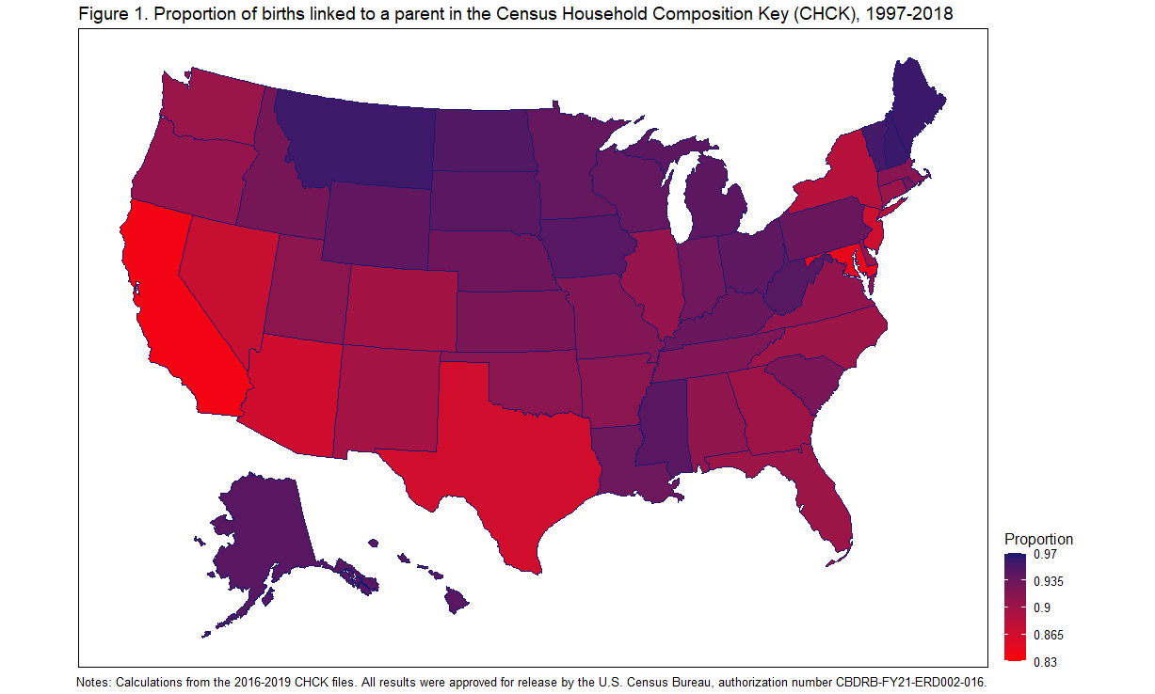
Data on Fertility and Children
Census Household Composition Key (CHCK)
Child-level file that links the child (born from 1997-onward) to their (birth/adoptive) parents
National Survey of Children’s Health (2016-2020)
Information on the (physical and mental) health and well-being of children
Image retrieved from Genadek, Katie R., Joshua Sanders, and Amanda Jean Stevenson. 2021. “Measuring U.S. Fertility using Administrative Data from the Census Bureau.” Associated Directorate for Economic Programs, U.S. Census Bureau, Working Paper 2021-02.

Slide 18
Educational Data
National Survey of College Graduates
Includes detailed data on individuals with a B.A. or more, including institution of receipt
Survey of Earned Doctorates/Survey of Doctoral Recipients
Demographic, education, and career history information of doctoral recipients
UMETRICS University Research Data
Data on university employee and vendors paid by (non)federal research grants (~31 universities)
Contains individual data, business names, and output-related data (e.g., publications, patents)

Slide 19
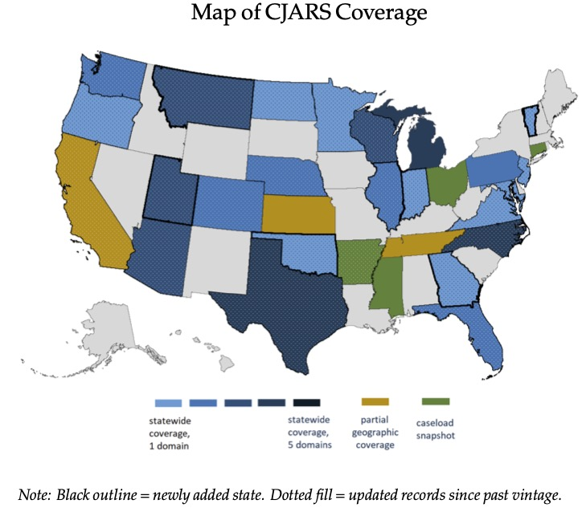
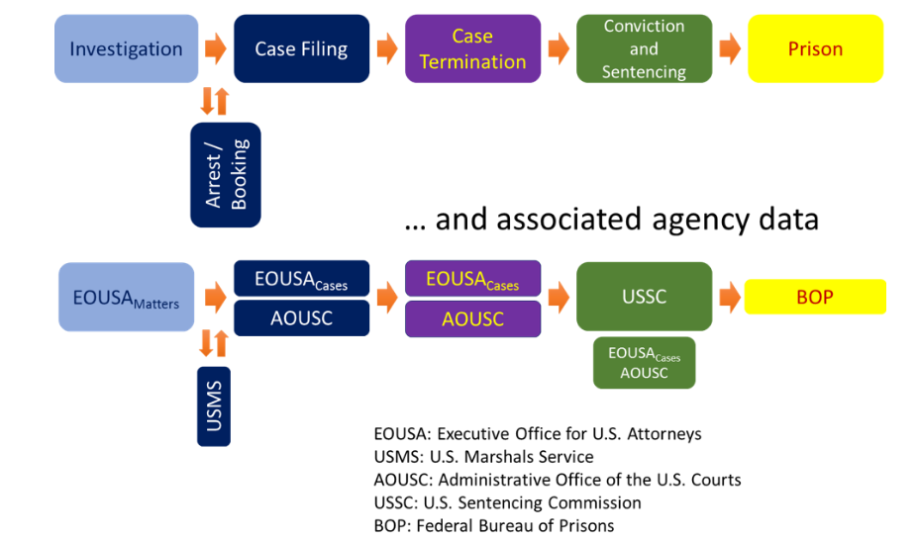
Criminological Data
National Crime Victimization Survey
Includes detailed geography (down to block group)
Supplemental datasets available (e.g., Police-Public Contact)
Criminal Justice Administrative Records System (CJARS)
Administrative data of people who have had contact with the carceral system (ranging from arrest to incarceration/parole)
Able to be linked to other Census datasets
Data availability varies substantially at the state-level
Federal Justice Statistics Program (FJSP)
Data on workload, activities, and outcomes with federal criminal cases
Map retrieved from Finlay, Keith and Michael Mueller-Smith. 2022. “Criminal Justice Administrative Records System (CJARS).” Retrieved from https://cjars.isr.umich.edu/data-documentation-download/

Slide 20
Linking - the Power of the PIK
PIK – a unique Census identifier assigned to individuals using name, birthdate, address information, and social security number.
Many restricted Census demographic datasets are PIKed
PIK crosswalks permit linking restricted demographic datasets together:
1940 Decennial Census to 2000 Decennial Census
2000 Decennial Census to 2010, 2020 Decennial Census
American Community Survey to Decennial Census
Notes:
1940 Decennial Census – about 40% PIK rate overall, 72% for children

Slide 21
Linking to the Master Address File (MAF)
Master Address File (MAF)
Created for 2000 Census
Complete list of addresses with lat/long and geography variables
MAF Extract
Yearly snapshot of MAF can be used for research
MAF Auxiliary Reference File (ARF)
Links address ID (MAFID) to individuals’ PIKs so can track annual residence beginning in 2000
Notes:
Census uses MAF for sample frame for household surveys.
Keeps up to date.
Comes from administrative sources

Slide 22
SSA-Survey Linked Data
Master Beneficiary Record: Entitlement and payment data for retirement and disability
Master Earnings File: Individual earnings records since 1951
Payment History Update System: Monthly payment records
Summary Earnings Record: Lifetime earnings. Total earnings from 1937-1950, annual earnings from 1951-present
Supplemental Security Record: Data for SSI program

Slide 23
CeLongitudinal Linkage Infrastructure
Decennial Census and ACS datasets
2000
Census
2010
Census
2020
Census
2005-2020
ACS
Household Surveys datasets
CPS
SIPP
AHS
NCVS
Administrative SourcesCound other datasets
SSA Death and Earnings
Records
Address
Records
External
Data Sources

Slide 24
Linked Data - LEHD
Links individuals to place of employment
Based on unemployment insurance administrative records
Contains quarterly earnings for every company employee
“Tracks” a person based on their place of employment
Contains some demographic information on individuals
Can link LEHD to other Census business data via firm identifier
Can link LEHD to other Census household data via individual identifier
Data availability varies by state
Notes:
LEHD = Longitudinal Employer-Household Dynamics

Slide 25
Linked Health Data on Vets
Data Linkage Program at NCHS
Dept of Veterans Affairs administrative data
military service history
VA benefit program utilization
Linked with
2005-2018 National Health Interview Surveys (NHIS) data
Linked data maximizes scientific value of both data sets by enabling access to a wide range of health–related topics for Veterans

Slide 26
Agenda Item #2: RMRDC Growth and Expansion Active Projects by Agency by FSRDC

Slide 27
All Collaborations
All points of collaboration included.
External projects only.
Node size and shade indicate number of projects.
Line thickness indicates number of collaborations.

Slide 28
Demographic and Economic Data Collaborations
Demographic and Economic project points of collaboration included.
External projects only.
Node size and shade indicate number of qualifying projects.
Line thickness indicates number of collaborations.

Slide 29
Health Project Collaborations
NCHS, AHRQ, SAMHSA project points of collaboration included.
External projects only.
Node size and shade indicate number of qualifying projects.
Line thickness indicates number of collaborations.

Slide 30
Agenda Item #3: New and Innovative RMRDC Projects Phil Pendergast

Slide 31
FSRDC Program Evaluation
Phil Pendergast & Bryce Hannibal (Rocky Mountain and Wasatch Front RDCs)
Internal project investigating impact of RDCs on PhD student outcomes
Post-graduation employment and income trajectories
Job tenure and placement
Grant funding and publications (limited)
Intent-to-treat impacts
Students at universities with RDC access compared to those without
Match schools on observables and motivation
Placebo group of students at RDC institutions in unrelated fields
Help quantify FSRDC system benefits!
Survey of Doctoral Recipients & Earned Doctorates LEHD OPM LEHD UMETRICS

Slide 32
Population-Level Assessment of Early Childhood Vaccination Timeliness, Parental Vaccine Hesitancy, and Immunization Schedule Adherence
Sophia Newcomer (University of Montana) & Matthew Daley (CU Anschutz) et al.
Collaboration between former CU Anschutz grad student and advisor
Examine childhood vaccination trends by varying urban/rural definitions
Census vs. NCHS vs. other measures (e.g. Index of Relative Rurality)
Zip code and county-level definitions
Test for differences by geographic and socioeconomic context
Validate vaccination trends against parental concerns data
Uncover whether and where trends are due to:
Vaccine hesitancy vs. healthcare access barriers
National Immunization Survey – Child

Slide 33
Effects of Subcontracting and other Contractor Characteristics on Injuries in the Construction Industry
Kevin Duncan (CSU Pueblo) & Peter Phillips (U of Utah) et al.
First joint BLS and Census restricted data project in FSRDC system
Assess differences in severity and frequency of contractor injuries by job and worker characteristics
Proposals and disclosure must be approved by both agencies
Works on BLS clock (yearly access and fees)
Complicated but possible!
BLS Survey of Occupational Injuries and Illnesses Census of Construction Industries

Slide 34
Sub-state Analysis of the National Survey of Children's Health (NSCH) Colorado Oversample for State and Local Public Health Planning & Assessment
Rickey Tolliver, Ashley Juhl & Erika Iisa (CDPHE)
First project in partnership with State government for public health
Use NSCH data to assess prevalence of childhood health issues in CO
Physical, mental and behavioral health
Illness and disability
Differences across public health service regions
Examine access to and availability of care providers across regions
Evaluate health interventions and related outcomes
Developmental screening and referral effectiveness
National Survey of Children’s Health

Slide 35
Develop Novel Methods to Identify and Characterize Family Relationships from Electronic Health Record Data
Toan Ong & Lisa Schilling (CU Anschutz)
Awarded funding by Patient-Centered Outcomes Research Institute to help improve methods for conducting patient-centered outcomes research
Help better identify complex family structures in patient data to improve care coordination
Restricted ACS, Decennial and CPS data will be linked to patient data from Children’s Hospital Colorado and UCHealth to:
Evaluate performance of novel family linkage methods identifying:
Mother-child & father-child
Twin and non-twin siblings
Spousal relationships
Other household members
American Community Survey Current Population Survey Decennial Census

Slide 36
Agenda Item #4: RMRDC Financial Summary

Slide 37
RMRDC Membership Network *All faculty, staff and graduate students associated with member universities have free access to the lab and its services

Slide 38
 | Actual | Actual | Actual | Projected | Projected | Projected | Projected
Revenue Sources: | FY19-20 | FY20-21 | FY21-22 | FY22-23 | FY23-24 | FY24-25 | FY25-26
NSF Direct | $45,833
CU Boulder - OVCR | $100,000 | $100,000 | $0 | $40,000 | $40,000 | $40,000 | $40,000
CU Boulder - Provost | $50,000 | $50,000 | $0 | $35,000 | $35,000 | $35,000 | $35,000
CU Boulder - Funded Projects |  | $12,000 | $6,000
CU Boulder - Economics Dept |  | $5,000 | $5,000 | $5,000
CU Boulder - Leeds School of Business
CU Boulder - CARTSS and Grad School | $935 |  | $2,500
CU Denver - Main | $20,000 | $20,000 | $20,000
CU Denver - Funded Projects | $8,000
CU Denver - Anschutz | $15,000 |  | $10,000 | $10,000 | $10,000
CSU (7.85% charge, 8.19% in FY23) | $18,430 |  | $18,430 | $18,362 | $18,362
U Wyoming (7.85% charge,8.19% in FY23) | $18,430 | $18,430 | $18,430 | $18,362
University of Denver (7.85% charge,8.19% in FY23) | $13,823 |  | $9,215 | $9,181 | $9,215
Colo. School of Mines (7.85% charge,8.19% in FY23) | $9,215 | $9,215 | $9,215 | $4,591 | $9,181
Rocky Mountain Poison and Drug Safety (7.85% charge) |  | $9,215 | $9,215 | $9,215
University of Texas at El Paso(7.85% charge) |  |  | $9,215 | $9,215 | $9,215
External Project (7.85% charge, 8.19% in FY23) | $4,608 |  |  | $4,591
Total Revenue: | $304,274 | $223,860 | $117,220
Expected Revenue-Expenses | $65,188 | $21,182 | ($128,054)
Carry over to next FY |  |  | $213,917

Slide 39
 | Actual | Actual | Actual | Projected | Projected
Expenses | FY19-20 | FY20-21 | FY21-22 | FY22-23 | FY23-24
Disclosure Review, Research Support | $24,000 | $24,000 | $24,000 | $24,000 | $24,000
NCHS Data Fees | $4,500 |  | $22,350 | $8,000
Adjustment for credit | ($1,800)
Student SSS fees |  |  | $7,200 | $3,600
Travel | $1,011 | $1,000 | $608 | $1,000 | $1,000
Supplies/Marketing/Seminars | $258 |  | $856 | $1,000 | $1,000
Monitors, Computer, Printers | $0 |  | $1,035 | $1,000 | $1,000
FedEx | $37 | $100
Safe Systems | $800 | $1,000 | $644 | $750 | $1,000
Executive Director Salary | $36,633 | $37,732 | $38,864 | $40,030 | $41,231
Adjustment for other funding | ($14,428) | ($12,513) | ($30,664) | ($30,664)
Administrator Salary | $157,927 | $174,874 | $180,120 | $185,524 | $191,090
Adjustment for other funding | ($2,488) | ($60,447) | ($45,030) | ($46,381)
Graduate Research Assistant | $32,636 | $36,932 | $45,291 | $35,000 | $35,000
Total Expenses | $239,086 | $202,678 | $245,274 | $222,859 | $295,320
Total Revenue | $304,274 | $223,860 | $117,220

Slide 40
Agenda Item #5: RMRDC Outreach Initiatives --Info Sessions --Class Presentations --Health Data Course Let’s Talk!!

Slide 41
Health Data Course: Spring 2022
UC Denver: ECON; HBSC; SOCY; GEOG
Anschutz: HSMP
“Federal Statistical Data for Health Research and Policy”
1. No cost to member institutions, students take for 1 or 3 credits
2. For advice on listing the course, contact Laura Argys (Laura.Argys@ucdenver.edu)
3. Taught remotely, Fridays 9am
4. Designed for early-career graduate students
5. Students develop the knowledge and skills required to effectively use a variety of federal statistical data sets for health research and policy analysis.
6. The semester project is a restricted-use data proposal.
7. 3-credit option: Students get “hands on” exercises using SAS to analyze public versions of the federal data sets to reproduce results in published papers.

Slide 42
Documented Advantages of RMRDC Health Data Course
Journal publications—1
Admission to prestigious PhD programs—3
RMRDC Approved Projects—2
RMRDC Projects in Development—2
Employment on Existing RMRDC Projects—2
Mentorship on grad research--all

Slide 43
Agenda Item #6: SAP Portal Demonstration
https://rdg-ui-rdg-uat.apps.cluster0.ocp.icpsr.umich.edu/

Slide 44
Thank You!
Phil Pendergast
Administrator
philip.m.pendergast@census.gov
Kas McLean
Grad Research Assistant
kas.mclean@colorado.edu
Jani Little
Executive Director
jani.little@colorado.edu

