Slide 1
The Rocky Mountain (Federal Statistical) Research Data Center
RMRDC
Jani Little
Executive Director
jani.little@colorado.edu
Catherine Talbot
Administrator
catherine.b.talbot@census.gov
Haeseong Park
Grad Research Assistant
haeseong.park@colorado.edu

Slide 2
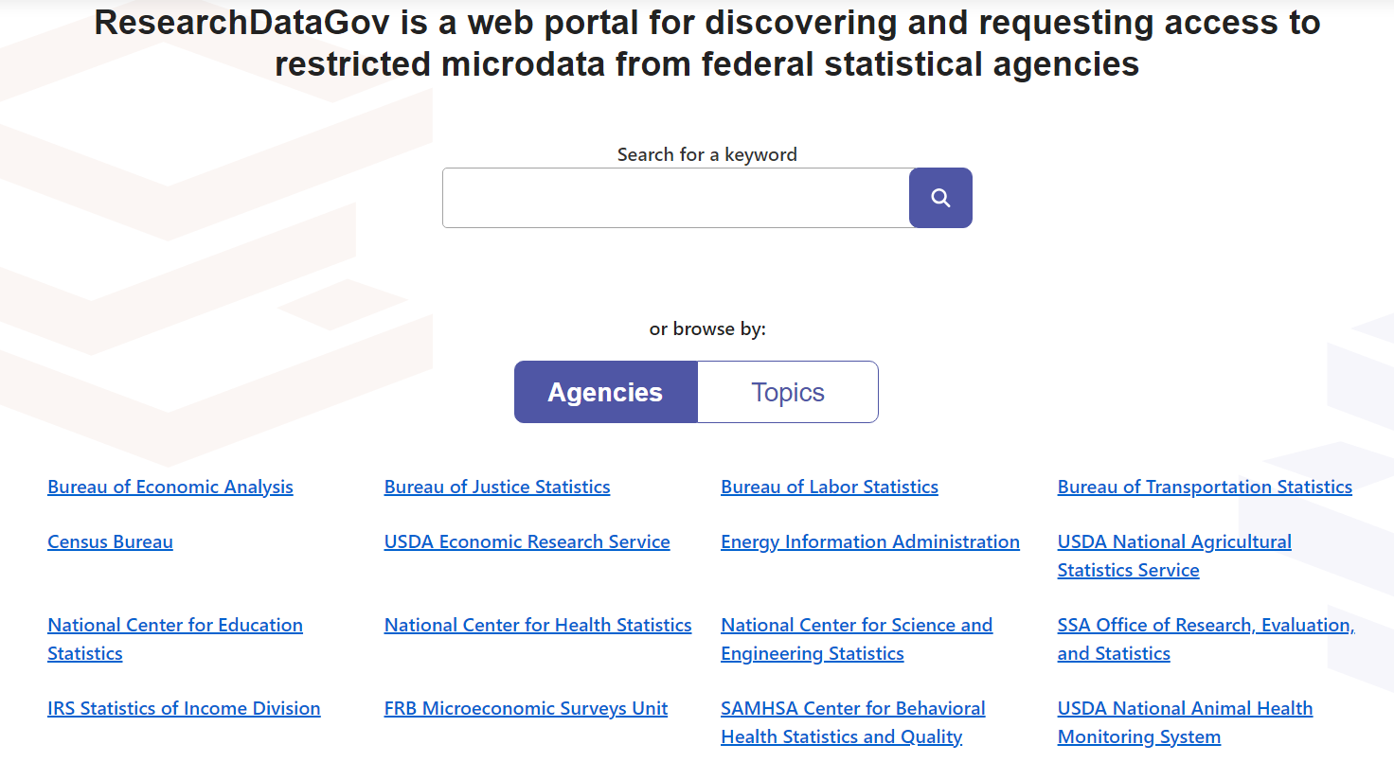

Slide 3
Census Longitudinal Infrastructure
Decennial Census and ACS datasets
2000
Census
2010
Census
2020
Census
2005-2020
ACS
Household survey datasets
CPS
SIPP
AHS
NCVS
NSCH
Administrative and other datasets
SSA Death and Earnings
Records
Address
Records
External
Data Sources

Slide 4
The Census-Enhanced Health and Retirement Study (CenHRS): New Linked Data on Older Workers and Their Employers
John Abowd, Joelle Abramowitz, Margaret Levenstein, et al.
FSRDC Research Conference September 22, 2023

Slide 5
CenHRS: Creates the infrastructure to study older people and work
HRS respondents in their household context:
--How do they respond to labor demand based on business variables?
--How do household variables impact labor force participation?
--How are health and quality of life related to labor force participation?
How do firm dynamics affect older workers?
--Technology, imports, public policy?
--Layoffs, wages, health and well-being?
Period and Cohort effects?
--Wage and age distribution?
--Retirement norms?

Slide 6
10/23/23, 11:54 AM
Building the Prototype Census Environmental Impacts Frame | NBER
Home Research Books & Chapters
Measuring and Accounting for Environmental Public Goods: A National Accounts Perspective Building the Prototype Census…
Building the Prototype Census Environmental Impacts Frame
John L. Voorheis, Jonathan M. Colmer, Kendall A.
Houghton, Eva Lyubich, Cameron Scalera & Jennifer R. Withrow
This is a preliminary draft and may not have been subjected to the formal review process of the NBER. This page will be updated as the chapter is revised.
https://www.nber.org/books-and-chapters/measuring-and-accounting-environmental-public-goods-national-accounts-perspective/building-prototype-census-environmental-impacts-frame
1/5

Slide 7
--Census Bureau surveys, administrative records, and Decennial censuses linked to create individual-level demographic, economic, address-level histories --Linked to spatial and temporal environmental conditions --Nearly all residents of U.S. from 1990 forward (6 billion observations) --Advances study of exposure to environmental amenities and hazards: who? how long? at what point in life cycle? --Advances study of environmental inequality (holding constant environmental exposure, can address how the characteristics of individuals determine outcomes)
Environmental Impacts Frame (EIF):
A Prototype of Microdata Infrastructure

Slide 8
Health Data Course: Spring 2024
Taught by RMRDC women and Econ Prof. Laura Argys
“Federal Statistical Data for Health Research and Policy”
--Designed for early-career graduate students
--1-credit option: 1-hour lecture; Taught remotely, Fridays 10am
--3-credit option: 1-hour lecture + 2-hour SAS lab to learn how to analyze public versions of federal data collections, Taught remotely, Fridays 11am-1pm.

Slide 9
Let’s Talk!!
Jani Little
Executive Director
jani.little@colorado.edu
Catherine Talbot
Administrator
catherine.b.talbot@census.gov
Haeseong Park
Grad Research Assistant
haeseong.park@colorado.edu

