Slide 1
Rocky Mountain Research Data Center (RMRDC): Accessing Restricted-Use Data Collected by Federal Agencies https://www.colorado.edu/rocky-mountain-research-data-center/
Jani Little, Executive Director
jani.little@colorado.edu
Philip Pendergast, Administrator
philip.m.pendergast@census.gov
Kas McLean, GRA (Econ PhD Candidate)
kas.mclean@colorado.edu

Slide 2
What RMRDC Offers:
Access to federal restricted-use data in a secure facility and through remote access (when authorized)
Outreach to Early-Career Grad Students (i.e., Preach)
--YOU are RIGHT NOW making important decisions about your future research agendas
--Restricted-use data extremely valuable in informing policy decisions
--Restricted-use data projects are associated with prestigious job placement and publications
--YOU are in the pipeline of future researchers for gov’t agencies
Outreach to Early-Career Grad Students (i.e., Teach)
Virtual Grad Course in Spring: “Federal Statistical Data for Health Research and Policy” (1 or 3 credits)
Restricted-use data projects enhance graduate education (big data/statistical techniques)

Slide 3
Restricted-Use Data Enhances Investigations of Society’s Most Pressing Challenges
International Trade Policies
Drug Use and Mental Health
Natural Hazards Impacts on People and Business
Local Labor Markets
Rural vs Urban Divide
Immigration
Impacts on People and Business
Income Inequality
Health Disparities
Business Sector
Growth and Decline
Crime
Impacts on Victims and Incarcerated

Slide 4
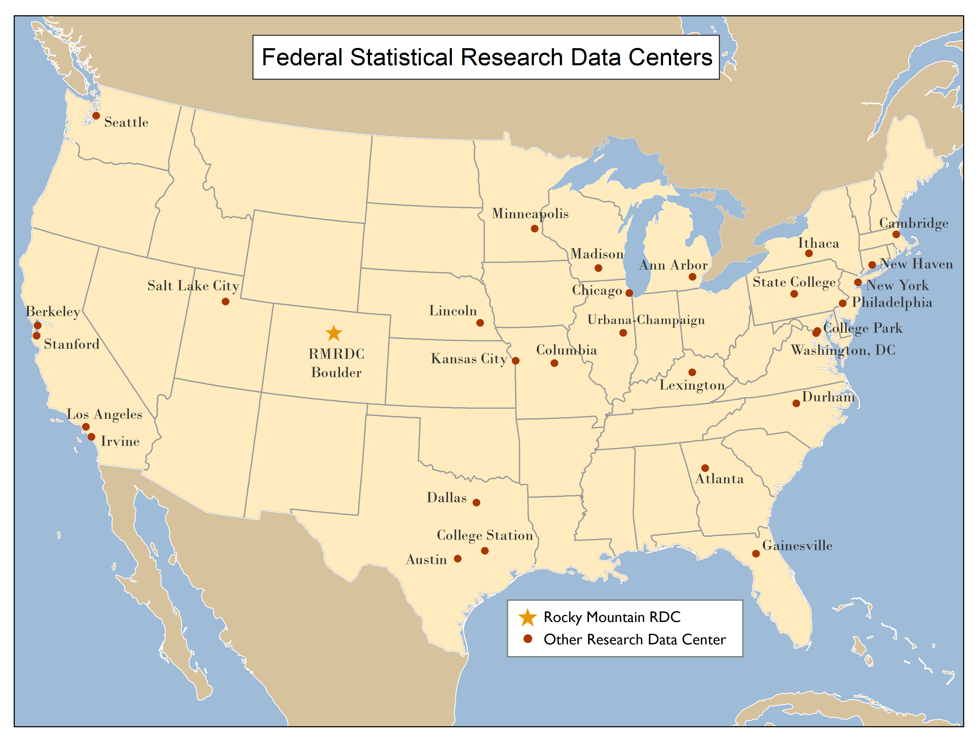
RMRDC is part of a National Network of FSRDCs Providing Access to Restricted-Use Data Collected by Federal Statistical Agencies

Slide 5
RMRDC Membership Network *All faculty, staff and graduate students associated with member universities have free access to the lab and its services

Slide 6
Bureau of the Census
Office of Research, Evaluation, and Statistics
(Social Security Administration)
Federal Statistical Agencies
National Center for Education Statistics
Bureau of Transportation Statistics
National Agricultural Statistics Service
National Center for Health Statistics
Bureau of Labor Statistics
Bureau of Justice Statistics
Bureau of Economic Analysis
Statistics of Income Division
(Internal Revenue Service)
Economic Research Service
National Center for Science and Engineering Statistics
(National Science Foundation)

Slide 7
Advantages of Federal Restricted-Use Microdata
National data collections representative of demographic subpopulations and sub-national geographic areas
Longitudinal and/or linked person-level or household-level data
Includes variables not available in public-use versions of data sets, e.g., low-level geography, precise income, specific race and national origins, sexual orientation, contraception history
Greatly expands the policy and basic questions that can be addressed
Provides ability to build on past research findings with richer data

Slide 8
What is Restricted-Use Micro-Data and Why is it so great??
Does it contain Direct Identifiers like name, address, SSN?
No! Never!!
Are you able to identify Precise Geographic Locations of Persons, HHs, Businesses?? YES!!
Are you able to link Persons, HHs, Businesses across time and across different data sets? YES!!
Do you get more observations to detect rare events? YES!!
Is it for everyone? NO!!

Slide 9
Why is it not so great?? Time and Money!!
Requires developing a proposal to use the data
Requires you to complete a Dept of Commerce security clearance/background check (called Special Sworn Status)
Foreign Nationals must have been in U.S. for 3 years
Some Federal Agencies charge data fees

Slide 10
Proposal Reviews and Timeline
The slowest part of the proposal process is often you; but it doesn’t have to be!
Proposal review time: ~3 months
Background check/security clearance: ~3 months
Example timeline for most proposals after submission:
3 months for review + 3 months for security clearance = 6 months total before project start

Slide 11
Four Illustrative Data Collections (with journal articles demonstrating uses of the restricted data):
The American Community Survey (ACS): Annually since 2005, it is the most comprehensive survey of U.S. households and individuals. Helps local officials, community leaders, businesses understand the change taking place in communities and neighborhoods.
The National Crime Victimization Survey (NCVS) is collected by Census on behalf of the Bureau of Justice Statistics (BJS) to produce national estimates of crime incidence, reporting and victim characteristics.
The National Health Interview Survey (NHIS): Since 1956, collected by Census for the National Center for Health Statistics. It provides a continuing survey that is widely used to monitor trends in illness and disability; to determine barriers to health care; and to evaluate Federal health programs.
The National Vital Statistics System (NVSS): A national administrative data collection efforts that records information about ALL births, deaths, marriages and divorces.

Slide 12
American Community Survey (ACS)
Annual, since 2005. The most comprehensive survey of U.S. households and individual residents
Helps local officials, community leaders, and businesses understand the changes taking place in their communities. It is the premier source for detailed population and housing data
Coverage provides reliable estimates for the nation, regions, states, counties, cities, tracts, block groups
Information from the survey generates data that help determine how more than $675 billion in federal and state funds are distributed each year.

Slide 13
ACS Initial Addresses and Sample Selected and Final Interviews
 | Housing Units
Year | Initial | Final
 | Addresses | Interviews
 | Selected
2019 | 3,544,301 | 2,059,945
2018 | 3,544,000 | 2,143,000
2017 | 3,526,808 | 2,145,639
2016 | 3,527,047 | 2,229,872

Slide 14
ACS Questionnaires: https://www.census.gov/programs-surveys/acs/methodology/questionnaire-archive.2019.html
Household composition
Each person’s relationship to Person 1 (INCLUDING SAME-SEX PARTNER)
Age and date of birth
Hispanic origin
Race
Work
Occupation
Education
Detailed housing characteristics, e.g., receiving SNAP benefits
Other person characteristics (citizenship, language skill)

Slide 15
ACS Questionnaires:https://www.census.gov/programs-surveys/acs/methodology/questionnaire-archive.2019.html
Health Insurance: (Yes or No, what type, premiums, subsidy for premium)
Disability (deaf, blind, cognitive, walking, dressing, bathing, doing errands)
Veteran (when served, VA disability, VA disability rating)
Fertility (birth in the last year)

Slide 16
American Community Surveys (ACS) Paper: Hong, Sok Chul, Dongyoung Kim, and Eutteum Lee. 2021a. "The long-term human toll of natural disasters: a study of fetal exposure to the 1974 Tornado super outbreak." Applied Economics 53(4):469-81.
Restricted-Use Data Underutilized in Natural Hazards Research
This paper:
--Uses Public-Use ACS data
--Uses a DifnDif Design which compares treatment states (experienced the 1974 Super Tornados) to control states
--identifies in utero fetuses whose mother’s lived in states that experienced the Super Tornados. Shows they had relatively more pronounced negative outcomes in adulthood (2008-2017) compared to in utero fetuses in other years and in control states.
Restricted-Use Data Improvements:
--more precise geography--identification of counties affected instead of states
--more observations in each year-- fewer years required (maybe only ACS 2008-2010 when 1974 in utero babies are 34-36 years old
--actual birth dates so in utero determination at time of Super Tornados is more precise

Slide 17
National Crime Victimization Survey (NCVS)
Annually, since 2005. Most comprehensive data on crime in the US.
Yearly, nationally representative sample of 160,000 people age 12+ in 95,000 households. Interviews total ~240,000, annually
Interviews encompass sociodemographics, criminal victimization instances, offender/crime characteristics, reporting, medical response, and criminal justice system experiences
Information from the survey supplements official crime reports to estimate likelihood of under-reported crimes

Slide 18
NCVS Sample Design
Longitudinal household data from a rotating sampling frame
Housing units remain in sample for 3.5 years, comprising 7 total interviews occurring every 6 months
Update of sampling frame in 2016 to deliver representative state-level estimates; prior years not designed to yield

Slide 19
Potential Research Questions
Do household characteristics impact Intimate Partner Violence rates?
Are there long-lasting impacts of violent victimization on employment and income?
What types of crime are the most consistently under-reported? How does this differ by urban/rural residence, gender, and race/ethnicity?

Slide 20
National Crime Victimization Surveys (NCVS) Paper: Xie, Min, and Eric P. Baumer. 2019a. "Neighborhood immigrant concentration and violent crime reporting to the police: A multilevel analysis of data from the National Crime Victimization Survey*." Criminology 57(2):237-67.
This paper:
--Restricted-Use because of geographic precision of households surveyed—neighborhood and county
--Are able to look at immigrant composition of neighborhood as it related to the likelihood of individual reporting a violent crime
--neighborhood immigrant composition comes from the Decennial Censuses and the ACS and is merged with NCVS individual observations
--traditional immigrant county vs non-traditional immigrant county comes from 1990 county data and is merged with individual observations
Findings:
--violent crime reporting decreases dramatically in non-traditional immigrant counties when the neighborhood percent foreign born is above 40%, regardless of victim race/ethnicity

Slide 21
National Health Interview Surveys
Conditions AND Behaviors Self-reported
Utilization and Insurance
35,000 Households Annually
Nationally Representative Annually
State Estimates reliable if years combined
Extensive demographic detail with representation

Slide 22
Major Health Topics in the NHIS:
Physical and mental health status
Chronic conditions, including asthma and diabetes
Measures of functioning and disability
Access to and use of health care services
Health insurance coverage and type of coverage
Chronic pain, pain management, and prescription opioid use
Demographics and social determinants of health

Slide 23
NHIS Supplements by Year and Topic:
https://www.cdc.gov/nchs/data/nhis/NHIS_Supplements_and_Sponsors.pdf
NHIS Special Topics:
https://www.cdc.gov/nchs/nhis/special_topics.htm
Adult Alcohol Use
Adult Physical Activity
Adult Tobacco use
Health Insurance
Injury and Poisoning
Race and Hispanic Origin
Sexual Orientation

Slide 24
National Health Interview Surveys (NHIS) Paper: Doran, Elizabeth L., Ann P. Bartel, Christopher J. Ruhm, and Jane Waldfogel. 2020. "California's paid family leave law improves maternal psychological health." Social Science & Medicine 256:113003.
This paper:
--Restricted-Use because of state identifiers linked with individuals
--Uses a DifnDif design to compare the relative improvements in mother’s post-partem psychological health in California after the implementation of the Paid Family Leave Policy as compared to states without a Paid Family Leave Policy.
Findings:
--significant improvements in psychological health of women after childbirth in California as compared to a synthetic control built from states without a Paid Family Leave Policy.

Slide 25
National Vital Statistics System (NVSS) Paper:Steelesmith, Danielle L., Cynthia A. Fontanella, John V. Campo, Jeffrey A. Bridge, Keith L. Warren, and Elisabeth D. Root. 2019. "Contextual Factors Associated With County-Level Suicide Rates in the United States, 1999 to 2016." JAMA Network Open 2(9):e1910936-e36.
This paper:
--Restricted-Use (but available through a contract) because of county identifiers linked with characteristics of every death in the U.S.
--Identifies the number of suicides in each county/year and merges county-level contextual data such as populations at risk, rural-urban continuum, social capital, % with health insured, prevalence of gun shops, etc.
Findings:
--suicide rates increased the most in rural counties; high social capital associated with lower suicide rates.

Slide 26
Health Data Course: Spring 2023
UC Denver: ECON 6060; HBSC 5999; SOCY 5022; GEOG 5052
“Federal Statistical Data for Health Research and Policy”
1. Taught remotely, Fridays 9am
2. Designed for early-career graduate students
3. Students develop the knowledge and skills required to effectively use a variety of federal statistical data sets for health research and policy analysis.
4. The semester project is a restricted-use data proposal.
5. 3-credit option: Students get “hands on” exercises using SAS to analyze public versions of the federal data sets to reproduce results in published papers.

Slide 27
Current RMRDC grad student-led health projects:
Black immigrant health and differences by country of origin/time in US
Gender and racial/ethnic/country of origin differences in timing of HPV vaccination
Death by Despair: Individual and Contextual Predictors of Suicide Mortality Risk
Did ACA Reduce Ethnic and Racial Disparities in Healthcare?
Do Sugar-Sweetened Beverage Taxes Work?
State Variation in Intimate Partner Violence Rates: Reporting and Healthcare Utilization

Slide 28
Thank You!
Phil Pendergast
Administrator
philip.m.pendergast@census.gov
Kas McLean
Grad Research Assistant
kas.mclean@colorado.edu
Jani Little
Executive Director
jani.little@colorado.edu

