Slide 1
Rocky Mountain Research Data Center (RMRDC): Accessing Restricted Data Collected by Federal Agencies https://www.colorado.edu/rocky-mountain-research-data-center/
Jani Little, Executive Director
jani.little@colorado.edu
Philip Pendergast, Administrator
philip.m.pendergast@census.gov
Kas McLean, GRA (Econ PhD Candidate)
kas.mclean@colorado.edu

Slide 2
Advantages of Restricted-Use Microdata
For Researchers:
Greatly expands the policy and basic questions that can be addressed
Builds on past research findings with richer data
Improves competitive edge for grants, publications, recruitment
Improves graduate education (big data/statistical techniques) and placement
For Research:
National data collections representative of demographic subpopulations and sub-national geographic areas
Longitudinal and/or linked person-level or household-level data
Variables not available in public-use versions of data sets, such as low-level geography

Slide 3
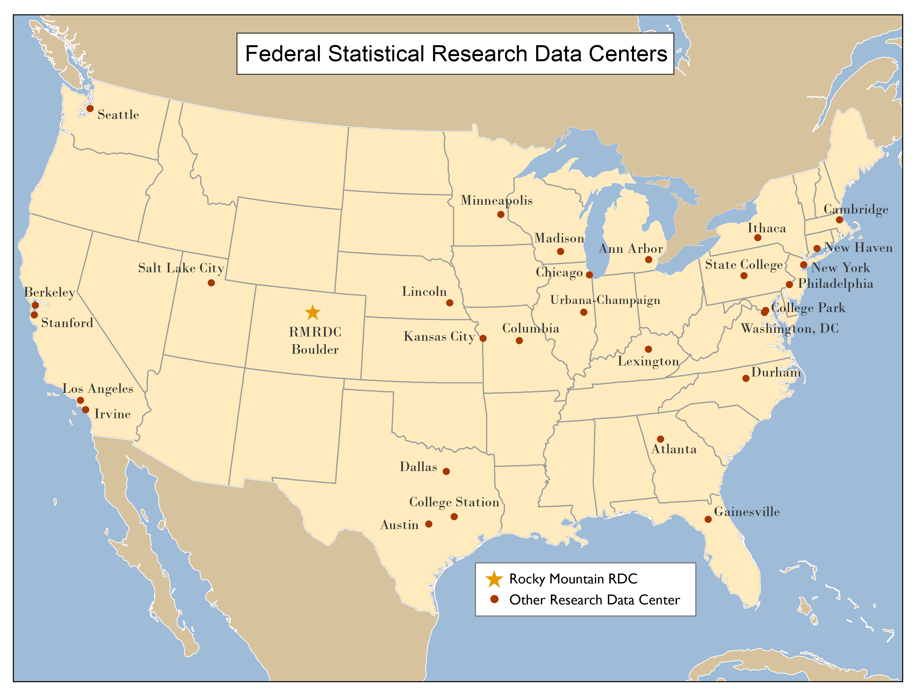
RMRDC is part of a National Network of FSRDCs Providing Access to Restricted-Use Data Collected by Federal Statistical Agencies

Slide 4
RMRDC Membership Network *All faculty, staff and graduate students associated with member universities have free access to the lab and its services

Slide 5
Bureau of the Census
Office of Research, Evaluation, and Statistics
(Social Security Administration)
Federal Statistical Agencies
National Center for Education Statistics
Bureau of Transportation Statistics
National Agricultural Statistics Service
National Center for Health Statistics
Bureau of Labor Statistics
Bureau of Justice Statistics
Bureau of Economic Analysis
Statistics of Income Division
(Internal Revenue Service)
Economic Research Service
National Center for Science and Engineering Statistics
(National Science Foundation)

Slide 6
What RMRDC Offers
Access to federal restricted data in a secure facility and through remote access (when authorized)
Staff assist with:
Successful proposal development and submission
Researchers must develop an agency-approved proposal to use the data.
“Special Sworn Status (SSS)” applications
Researchers undergo a background check which gets them lab access
Technical support
Disclosure review and statistical output approval
Results must be formally reviewed for disclosure violation before they leave the secure facility
Instruction of virtual “Federal Statistical Data for Health Research and Policy” grad course (1 or 3 credit), offered to member institutions at no cost.

Slide 7
AMC Restricted Data Projects – Active Projects
Researchers | Affiliations | Project Title
Richard Dart | CU Anschutz, Medical School and Rocky Mountain Poison & Drug Safety | Analysis of Drug Induced Mortality Data for Stimulants
Joshua Black | Rocky Mountain Poison & Drug Safety | Multivariate Analysis of Polysubstance Mortality and Analysis of Buprenorphine Mortality
Karilynn Rockhill | CU Anschutz, PhD Cand
Ben Allshouse | CU Anschutz, CSPH | Oil and Gas Siting, Housing Choices, and Environmental Justice
Danielle Sansone-Poe | CU Anschutz, CSPH
Lisa McKenzie | CU Anschutz, CSPH
Kate Coleman-Minahan | CU Anschutz, College of Nursing | Adolescent reproductive health outcomes among Mexican-origin women on both sides of the U.S.-Mexico border
Fernando Riosmena | CU Boulder, Geography
Kas McLean | CU Boulder, Econ and RMRDC
Goleen Samari | Columbia University, Public Health | State Policies and Immigrant Sexual and Reproductive Health
Kate Coleman-Minahan | CU Anschutz, College of Nursing

Slide 8
AMC Restricted Data Projects – In Development
Researchers | Affiliations | Project Title
Shaowei Wan | CU Anschutz, Medical School, Internal Medicine, Research Fellow in Palliative Care and Aging | Does Better Care Coordination Reduce Rural Disparities in Access to End-of-Life Care among Older Adults with Advanced Cancer?
Sophia Newcomer | University of Montana, School of Public and Community Health Sciences, Epidemiology | Rural-Urban Differences in Child Immunization Schedule Adherence
Jason Glanz | CU Anschutz, CSPH, Epidemiology
Matthew Daley | CU Anschutz, Medical School, Dept of Pediatrics, Kaiser
Notes:
Shaowei Wan: Use National Cancer Statistics and Medicare Provider of Service files to a) estimate the prevalence of patients aged 65+ with the most commonly diagnosed advanced cancers (breast, prostate, lung and colorectal cancer) living in rural areas, and b) map the distribution and extent of services of existing Medicare-certified hospice practices and health professionals.
Sophia Newcomer: National Immunization Survey - Child (NIS-Child) 2011-2020
1) Identify trends in vaccine timeliness, immunization schedule adherence, and undervaccination patterns indicative of vaccine hesitancy or other barriers to vaccination in early childhood.
2) Determine whether trends in and factors associated with Aim #1 immunization schedule adherence and specific undervaccination patterns are modified by rurality.

Slide 9
Restricted-Use Health Data with RMRDC Access Added Recently
Census Bureau:
HH and Small Business COVID Pulse Surveys
National Survey of Children’s Health (NSCH)
National Sample Survey of Registered Nurses (NSSRN)
NCHS:
National Survey on Drug Use and Health (NSDUH)

Slide 10
New Restricted-Use Data Assets—COVID-related (Census Data Collections)
Household Pulse Survey: https://www.census.gov/programs-surveys/household-pulse-survey/datasets.html
20-minute online survey studying how the coronavirus pandemic is impacting households across the country from a social and economic perspective.
Asks questions about how childcare, education, employment, energy use, food security, health, housing, household spending, Child Tax Credit payments, and intention to receive a COVID-19 vaccination, have been affected by the ongoing crisis.
Small Business Pulse Survey: https://www.census.gov/data/experimental-data-products/small-business-pulse-survey.html
Measures the effect of changing business conditions during the Coronavirus pandemic on our nation's small businesses.
Complements existing U.S. Census Bureau data collections by providing high-frequency, detailed information on the challenges small businesses are facing during the Coronavirus pandemic.
Remote Access Eligible!

Slide 11
New Restricted-Use Data Asset—Child Health-Related (Census Data Collection)
National Survey of Children’s Health (NSCH): https://www.census.gov/programs-surveys/nsch.html
Oversampled Colorado Health Service Areas (including rural areas)
Annual, 2016-2020
Information collected by adults (1 or 2) who know about child’s health
Physical and emotional health of children ages 0-17
Do children with special health care needs (CSHCN) have medical homes, adequate health insurance, access to needed services, and adequate care coordination?
Factors related to the well-being of children
access to - and quality of - health care
family interactions
parental health
neighborhood characteristics
school and after-school experiences
Remote Access Eligible!

Slide 12
National Survey of Children’s Health (NSCH) 2020 Public-Use Data: https://www.census.gov/programs-surveys/nsch/data/datasets.html
Codebook: https://www.census.gov/data-tools/demo/uccb/nschdict
Parent in the Military Questions: Active in Military; Ever deployed during child’s life?
Parent’s Mental/Emotional Health
Parent Domestic Violence: Has child EVER saw or heard parents (or adults) slap, hit, kick, punch one another in the home?
Child Victim of Violence: Has child EVER been a victim of violence or witnessed violence in the neighborhood?
Child EVER Lived with Mentally Ill; or adults with Alcohol/Drug Problem
Child EVER Been Bullied: or Bullies?
Child Special Conditions: ADHD, Allergies, Autism, Obesity, Blindness, Blood Disorder; Respiratory Problems; Brain Injury; Arthritis
Time Spent Providing Health Care for Child; and Time Spent Arranging Medical Care;
Child Healthcare NOT Received/Not Available when Needed
Notes:
If two adults are present both are interviewe

Slide 13
New Restricted-Use Data Asset—COVID-related (Census Data Collections)
National Sample Survey of Registered Nurses (NSSRN)
Largest survey of Registered nurses in the U.S. Approximately, 50,000 per year.
Used to Assess Current Challenges and Predict Trends in U.S. Nursing Workforce
Every 4 years since 1980--Most recent 2018—Next 2022
Use to Assess Resources for Epidemic and Pandemic Response
2018 Questionnaire: nssrn-questionaire.pdf (hrsa.gov)
More Information: National Sample Survey of Registered Nurses (NSSRN) | Bureau of Health Workforce (hrsa.gov)
Remote Access Eligible!
Notes:
Health Resources and Services Administration (HRSA)

Slide 14
New Restricted-Use Data Asset—Mental Health and Drug Use Related (NCHS Data Collection)
National Survey on Drug Use and Health (NSDUH):https://nsduhweb.rti.org/respweb/about_nsduh.html
Annually 70,000 people, 2014-2020
Aged 12 and older
Use of illegal drugs, prescription drugs, alcohol, and tobacco
Mental disorders, treatment, and co-occurring substance use and mental disorders
Notes:
Collected by SAMSHA.

Slide 15
Health Data Course: Spring 2022
HSMP 6670 002 and HSMP 6670 003
“Federal Statistical Data for Health Research and Policy”
1. Offered to all RMRDC Consortium Member Institutions at no cost, taught remotely
2. Targets early-career graduate students
3. Students develop the knowledge and skills required to effectively use a variety of federal statistical data sets for health research and policy analysis.
4. The semester project is a restricted data proposal.
5. Students get “hands on” exercises using SAS to analyze public versions of the federal data sets to reproduce results in published papers.

Slide 16
Restricted-Use Health Data Sets Covered in the Course by Dissemination Agency:
Census:
American Community Survey (ACS)
Current Population Survey (CPS)
National Survey of Children’s Health (NSCH)
National Crime Victimization Survey (NCVS)
NCHS:
National Vital Statistics System (NVSS)
National Health and Nutrition Examination Surveys (NHANES)
National Health Interview Survey (NHIS) linked with National Death Index (NDI)
National Survey of Family Growth (NSFG)
Behavioral Risk Factor Surveillance System (BRFSS)
National Survey on Drug Use and Health (NSDUH)
Agency for Health Research and Quality (AHRQ):
Medical Expenditure Panel Survey (MEPS)
Bureau of Labor Stats (BLS):
Survey of Occupational Injuries and Illnesses (SOII)
Census of Fatal Occupational Injuries (CFOI)

Slide 17
Local Project Using National Survey of family Growth (NSFG)
Examines adolescent reproductive health outcomes among Mexican-origin women on both sides of the U.S.-Mexico border
Female survey respondents aged 15-44 who are
US-born Latina of Mexican origin (NSFG)
Foreign-born Latina of Mexican origin (NSFG)
US-born non-Latina white (NSFG)
Mexican residing in Mexico (ENADID)
Outcomes of interest
Adolescent birth: Birth before age 20 and number of births before age 20
Age at first sex: no prior sexual activity at time of survey, < 15, 15-17, 17-19, 20 or later
Contraceptive method used at first sex: most effective methods (male or female sterilization, intrauterine device, implant); moderately effective methods (short-acting hormonal methods, diaphragm); least effective methods (condoms, sponge, spermicide, emergency contraception, withdrawal, fertility awareness); none
Access to and use of effective contraception rather than timing of initiation of sexual activity is a key determinant of observed Latina adolescent birthrates
Notes:
National Survey of Family Growth (NSFG) and Encuesta Nacional de la Dinámica Demográfica (ENADID) (National Survey of Demographic Dynamics)

Slide 18
Current RMRDC grad student-led health projects:
Black immigrant health and differences by country of origin/time in US
Gender and racial/ethnic/country of origin differences in timing of HPV vaccination
Death by Despair: Individual and Contextual Predictors of Suicide Mortality Risk
Did ACA Reduce Ethnic and Racial Disparities in Healthcare?
Do Sugar-Sweetened Beverage Taxes Work?
State Variation in Intimate Partner Violence Rates: Reporting and Healthcare Utilization

Slide 19
Local Children’s Health (NSCH) Project Currently In Development
Led by Colorado Department of Public Health and Environment (CDPHE)
Make use of the 2020 and future NSCH data’s oversample to:
Create estimates of Maternal and Child health for Colorado Health Service Regions about:
Adverse childhood experiences
Food insecurity
Mental, emotional, developmental, and behavioral problems
Family Centered Care
Supportive neighborhoods/amenities and built environment
Special health care needs and Autism Spectrum Disorder prevalence
Access and barriers to care (physical, social, economic)
Positive youth development
Prosocial connections

Slide 20
Linkable Demographic Data for Spatial Research
Full-count Decennial Censuses, e.g., 1990, 2000, 2010, 2020
Administrative records (SNAP/TANF/WIC, SSA Earnings, SSA Births and Deaths)
Master Address File (MAF) includes Addresses and geo-ids of every HH in US
Auxiliary Reference File contains past addresses linked to person identifiers
Sample surveys
American Community Survey (ACS)
Current Population Survey (CPS)
American Housing Survey (AHS)
Survey of Income Program Participation (SIPP)
National Crime Victimization Survey (NCVS)
Nearly all available via remote access, from your home office!

Slide 21
Census Longitudinal Infrastructure
Decennial Census and ACS datasets
2000
Census
2010
Census
2020
Census
2005-2020
ACS
Household survey datasets
CPS
SIPP
AHS
NCVS
Administrative and other datasets
LEHD Employer Files
Address
Records
External
Data Sources

Slide 22
More Local Use of Spatial (Linked) Data
Allshouse, Sansone-Poe, and McKenzie (CU Anschutz) - “Oil and Gas Siting, Housing Choices, and Environmental Justice”
Uses a unique mosaic of datasets to determine population characteristics of those at risk of O&G development
American Community Survey (ACS) – Household characteristics
Master Address File (MAFx) – Location of households (address, lat/long)
External Oil & Gas well site data (lat/long)
External US Building footprints data (lat/long of residential units on lots)
Create fine-grained estimates of population mixing to assess possible association with childhood Acute Lymphocytic Leukemia (ALL)

Slide 23
“Oil and Gas Siting, Housing Choices, and Environmental Justice”

Slide 24
Data Overview – Census Economic Data
There are many data options for economic research available in the RDC
Census collects the Economic Censuses (every five years) and Annual Surveys from business establishments every year
Census also keeps a Business Register of all employer establishments in the US, which are linked over time in the Longitudinal Business Database (LBD)
For US-based businesses, trade/transaction data are also collected by Census and made available at the establishment and transaction level
Census works with State unemployment offices to make longitudinal, linked employer-employee data available as well (96% coverage of private sector)

Slide 25
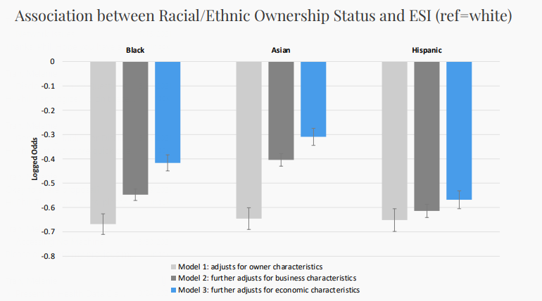
Local Example of Using Census Economic Data for Health Research
Tran and Krueger (CU Denver, CSPH) – “Small Businesses and Employer-Sponsored Health Insurance”
Unique in using business data to assess a health-related outcome
Uses a variety of newer small-business focused surveys to assess whether race/ethnicity and nativity of business owners, as well as local community, predicts whether businesses offer ESI
Survey of Business Owners (SBO)
Annual Survey of Entrepreneurs (ASE)
Annual Business Survey (ABS)

Slide 26
Census Economic Data
Establishment-level microdata from Economic Censuses and Surveys:
Establishment name and address
Ownership information and franchise indicators
Revenues, employment, payroll
Industry
Customer types (consumers, contractors, government, etc.)
Sales by item codes
Business Register (derived from IRS, BLS, SSA and Census data)
Comprehensive snapshot of employer business universe
Longitudinal Business Database (LBD)
Establishment births, deaths, mergers and acquisitions over time

Slide 27
ANOTHER Local Example of Using Census Economic Data for Health Research
Van Sandt (U Wyo) – “Exploring the Impact of Comprehensive Health Care Access on Health Outcomes Across the US”
Assesses physical, financial, and social access to care across the US by disaggregating the types of care providers available at the same location (e.g. hospitals or clinics), as well as proximity to health-related industries like fitness and recreational sports centers, grocery stores, restaurants
Examines impacts on county-level cause-specific mortality, from NCHS data
Longitudinal Business Database (LBD)
County Business Patterns Business Register (CBPBR)
American Community Survey (ACS)
National Vital Statistics System (NVSS) Mortality Multiple Cause of Death file

Slide 28
Economic Data Linkage
Projects may request data from a variety of sources, and match businesses according to tax reporting identifiers, names, or addresses
Can also look at some employee outcomes, by linking to LEHD data
Cross-agency projects are possible
BLS or BEA Data
Economic Census
LBD
Business Register
LEHD
Employer
&
Employee
Name
Address
Tax IDs

Slide 29
Local Use of Linked Economic Data
Duncan (CSU Pueblo) – “Effects of Subcontracting and other Contractor Characteristics on Injuries in the Construction Industry”
Examines the distribution and severity of injuries in the Constructor sector by Subcontractor types
Combines restricted BLS data with Census Economic Data to get better estimates of employer characteristics
Survey of Occupational Illnesses and Injuries (SOII)
Census of Construction Injuries (CCI)

Slide 30
BLS Injury and Fatality Data
The Bureau of Labor Statistics (BLS) collects the Survey of Occupational Illnesses and Injuries (SOII) and Census of Fatal Occupational Injuries (CFOI)
SOII contains a sample of establishments who report the number of illnesses or injuries suffered by workers as a result of their job
Only contains detail (injury severity, time out of work, employee race/ethnicity) for a sample of reported injuries if >15 reported
Establishment data is sufficient for linkage to Census business data
CFOI compiles comprehensive information on fatal accidents suffered on the job
Does NOT contain data necessary to link establishments to business data

Slide 31
Proposal Development
Researchers work closely with RMRDC administrator Phil to write successful proposals for Census projects (most data described here!)
Typically, 8-20 page project description and separate “Predominant Purpose Statement” (Phil helps draft this)
Focus on research questions, need for confidential data, methods, expected output and disclosure risk, and benefits to Census Bureau
Evaluated on feasibility, benefits, disclosure risk, and need for data
For assistance with other agency proposals (e.g. NCHS health projects), contact either Jani or Phil

Slide 32
Proposal Reviews and Timeline
The slowest part of the proposal process is often you; but it doesn’t have to be!
Final proposal review time with Census: ~3 months
If additional agency review is necessary (e.g. IRS): ~6 months
Background check/security clearance: ~3 months
Example timeline for most proposals:
3 months for Census review + 3 months for IRS review (optional) and/or 3 months for clearance (concurrent) = 6 months total before project start

Slide 33
Thank You!
Phil Pendergast
Administrator
philip.m.pendergast@census.gov
Kas McLean
Grad Research Assistant
kas.mclean@colorado.edu
Jani Little
Executive Director
jani.little@colorado.edu

