Slide 1
Rocky Mountain Research Data Center (RMRDC): Accessing Restricted Data Collected by Federal Agencies https://www.colorado.edu/rocky-mountain-research-data-center/
Jani Little, Executive Director
jani.little@colorado.edu
Philip Pendergast, Administrator
philip.m.pendergast@census.gov
Kas McLean, GRA (Econ PhD Candidate)
kas.mclean@colorado.edu

Slide 2
RMRDC Membership Network *All faculty, staff and graduate students associated with member universities have free access to the lab and its services

Slide 3
What RMRDC Offers
Access to federal restricted data in a secure facility and through remote access (when authorized)
Staff assist with:
Successful proposal development and submission
Researchers must develop an agency-approved proposal to use the data.
“Special Sworn Status (SSS)” applications
Researchers undergo a background check which gets them lab access
Technical support
Disclosure review and statistical output approval
Results must be formally reviewed for disclosure violation before they leave the secure facility.
Instruction of virtual “Federal Statistical Data for Health Research and Policy” grad course (1 or 3 credit), offered to member institutions at no cost

Slide 4
Bureau of the Census
Office of Research, Evaluation, and Statistics
(Social Security Administration)
Federal Statistical Agencies
National Center for Education Statistics
Bureau of Transportation Statistics
National Agricultural Statistics Service
National Center for Health Statistics
Bureau of Labor Statistics
Bureau of Justice Statistics
Bureau of Economic Analysis
Statistics of Income Division
(Internal Revenue Service)
Economic Research Service
National Center for Science and Engineering Statistics
(National Science Foundation)

Slide 5
Advantages of Restricted-Use Microdata
For Researchers:
Greatly expands the policy and basic questions that can be addressed
Builds on past research findings with richer data
Improves competitive edge for grants, publications, recruitment
Improves graduate education (big data/statistical techniques) and placement
For Research:
Microdata not available in public-use data, e.g., establishment and firm-level data
Longitudinal and/or linked person-level or household-level data
Variables not available in public-use versions of data sets, such as low-level geography
Full population counts or larger samples (Decennial Census, ACS, CPS) not available in public-use data
Full range of response items (e.g., ICD codes, industry codes, occupational codes, detailed race answers, income is not top-coded, etc.)

Slide 6
Data for Spatial, Economic, and Environmental Justice Research
Spatial Data – Datasets with geographically-identified spatial units at very low levels
Decennial Census
Annual Census surveys
Any other data linkable to Master Address File and its Auxiliary Reference File
Economic Data – Establishment or Firm-level data on business characteristics, including geo-ids
Economic Censuses (Census of Mining, Census of Manufacturing, Census of Construction Industries, etc.)
Annual Surveys of Industries, Capital Expenditures
Linked Employer-Employee data (LEHD)
Business Register and Longitudinal Business Database (LBD)
Manufacturing Energy Consumption Survey (MEC/MECS)
Health Data – Datasets often have geo-ids and measure health characteristics of population
National Health Interviews Survey (NHIS)
National Health and Nutrition Examination Survey (NHANES)
National Survey of Children’s Health (NSCH)
National Vital Statistics System (NVSS) and linked data

Slide 7
Linkable Demographic Data for Spatial Research
Full-count Decennial Censuses, e.g., 1990, 2000, 2010, 2020
Administrative records (SNAP/TANF/WIC, SSA Earnings, SSA Births and Deaths)
Master Address File (MAF) includes Addresses and geo-ids of every HH in US
Auxiliary Reference File contains past addresses linked to person identifiers
Sample surveys
American Community Survey (ACS)
Current Population Survey (CPS)
American Housing Survey (AHS)
Survey of Income Program Participation (SIPP)
National Crime Victimization Survey (NCVS)
Nearly all available via remote access, from your home office!

Slide 8
Census Longitudinal Infrastructure
Decennial Census and ACS datasets
2000
Census
2010
Census
2020
Census
2005-2020
ACS
Household survey datasets
CPS
SIPP
AHS
NCVS
Administrative and other datasets
LEHD Employer Files
Address
Records
External
Data Sources

Slide 9
Local Use of Spatial Data
Jared Carbone, Ben Gilbert and Hannah Kamen (Mines) - “How to Households Relocate in Response to Changes in Moving Costs?”
Uses fine geographic detail in 1990 Decennial Census to indirectly evaluate whether lowered moving costs predict proximity to pollutants
Regression discontinuity design using changes in California legislation and age to proxy for moving costs
Using Census Block allows for:
Finer resolution of variation in air quality pollutants
Better capturing variation of in-state migration rates
Higher top-coding of property taxes, which create variation in moving costs

Slide 10
Census Longitudinal Infrastructure
Decennial Census and ACS datasets
2000
Census
2010
Census
2020
Census
2005-2020
ACS
Household survey datasets
CPS
SIPP
AHS
NCVS
Administrative and other datasets
LEHD Employer Files
Address
Records
External
Data Sources

Slide 11
More Local Use of Spatial (Linked) Data
Allshouse, Sansone-Poe, and McKenzie (CU Anschutz) - “Oil and Gas Siting, Housing Choices, and Environmental Justice”
Uses a unique mosaic of datasets to determine population characteristics of those at risk of O&G development
American Community Survey (ACS) – Household characteristics
Master Address File (MAFx) – Location of households (address, lat/long)
External Oil & Gas well site data (lat/long)
External US Building footprints data (lat/long of residential units on lots)
Create fine-grained estimates of population mixing to assess possible association with childhood Acute Lymphocytic Leukemia (ALL)

Slide 12
“Oil and Gas Siting, Housing Choices, and Environmental Justice”

Slide 13
Data Overview – Census Economic Data
There are many data options for economic research available in the RDC
Census collects the Economic Censuses and Annual Surveys from business establishments every one or five years (years ending in 2 or 7)
Census also keeps a Business Register of all employer establishments in the US, which are linked over time in the Longitudinal Business Database (LBD)
For US-based businesses, trade/transaction data are also collected by Census and made available at the establishment and transaction level
Census works with State unemployment offices to make longitudinal, linked employer-employee data available as well (96% coverage of private sector)

Slide 14
Local Use of Economic Data
Ben Gilbert, Steven Dahlke, Hannah Gagarin (Mines) - “Economic Data Aggregation Bias: Evidence from the Energy Sector”
Estimates the economic impact of new energy development investments in local economies, by industry
Business Register and LBD – Birth and Death of Businesses, Revenue
LEHD – Worker and workplace characteristics and addresses, Payroll
External data – Energy development sites (e.g. wind turbine locations)
Annual Capital Expenditures Survey (ACES) – Firm capital expenditures

Slide 15
Census Economic Data
Establishment-level microdata from Economic Censuses and Surveys:
Establishment name and address
Ownership information and franchise indicators
Revenues, employment, payroll
Industry
Customer types (consumers, contractors, government, etc.)
Sales by item codes
Business Register (derived from IRS, BLS, SSA and Census data)
Comprehensive snapshot of employer business universe
Longitudinal Business Database (LBD)
Establishment births, deaths, mergers and acquisitions over time

Slide 16
Manufacturing Energy Consumption Survey (MEC/MECS)
NEW!!!
Sample mostly drawn from establishments included in the Census of Manufacturers, though other industries are sampled with probability proportional to total energy costs
~15,000 establishments
Separate surveys by industry:
Petroleum refiners
Chemical, paper, metal, and wood product producers
All manufacturers
Generally, data on capability of manufacturers to:
Substitute alternate fuels for those typically consumed
End uses of energy consumption
Extent to which energy-related technologies are used by the manufacturer

Slide 17
Longitudinal Business Database (LBD)
Universe of U.S. employer establishments
Linkable to other datasets at firm or establishment level
Unique establishment ID follows through acquisitions, mergers, and firm death
Unique firm ID persists through periods of inactivity
Annual data
Total employees
Total payroll
6 digit NAICS industry
High precision geography
Total revenue

Slide 18
Linked Employer-Employee Data
State unemployment insurance data is linked to Census and IRS business info to produce the Longitudinal Employer-Household Dynamics (LEHD)
Links individuals to their place(s) of employment, over time
Address-level data for both places of employment and places of residence
Quarterly earnings for every company employee and various business characteristics
Contains some demographic information for employees
Can link to Census business data via firm identifiers
Can link to Census household data via person identifiers (PIK)
Projects are approved on a state-by-state basis; On avg., ~25 states approve

Slide 19
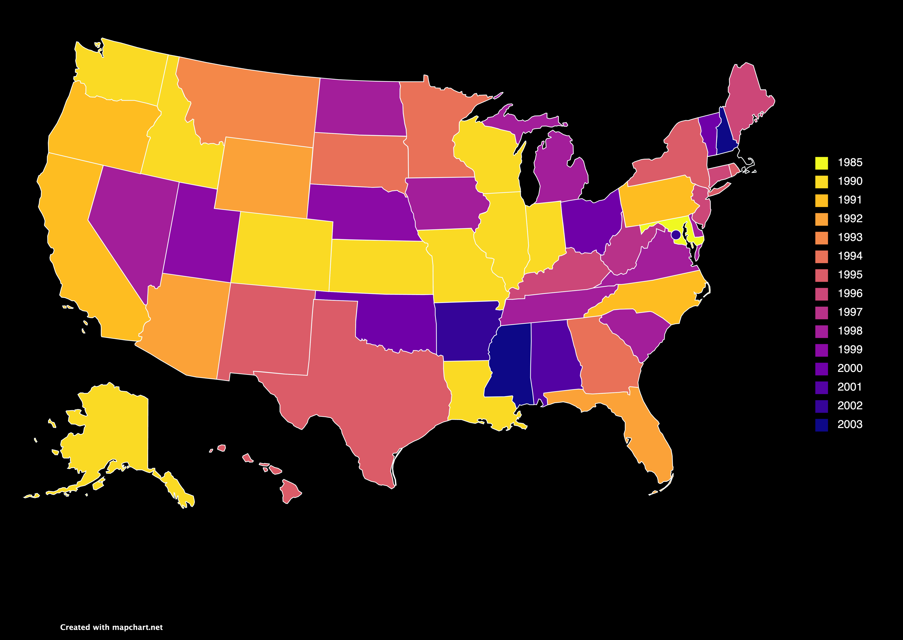
First Year of LEHD Data Availability

Slide 20
LEHD Structure
Geocoded Address List (GAL)
Unit To Worker (U2W)
GAL ID
SEIN
SEINUNIT
PIK*
Census
Business Data
Census
Household
Data
Employer
Characteristics
File (ECF)
Employment
History
File (EHF)
Individual
Characteristics
File (ICF)
SEIN
PIK
PIK
SEIN
SEIN
PIK
Firm ID
Title 26 Components
(ECF T26)
Successor
Predecessor
File (SPF)
Title 26 Components
(ICF T26)
Employers
Workers

Slide 21
LEHD Project Considerations
LEHD projects require a direct benefit to the LEHD program
In some cases, IRS approval is necessary
Additional 3 month review time after Census has approved (6 months total)
The Social Security Administration (SSA) must also approve
Review is concurrent with Census review - always gets approved
Individual states cannot be singled out in results – standard output must include at least three states with one state not comprising more than 50% of the sample
LEHD does not contain firm or establishment names
Can be linked to other Economic datasets with other tax data in most cases
Data are extremely large and linkages can be cumbersome
SAS programming skills may be required to work effectively with these data

Slide 22
Environmental Justice/Health Data
Many options for examining health disparities due to pollution, energy development, proximity to industry
National Health Interviews Survey (NHIS)
Large, yearly nationally representative sample (~35,000 households, 87,500 persons)
Self-reported indicators of sociodemographic and health
Detailed race/ethnicity/country of origin codes
Precise geographic identification
National Health and Nutrition Examination Survey (NHANES)
Annual, nationally representative sample (~5,000 persons) of selected areas across the country
Very detailed data on health, behaviors, and nutrition, including lab measures, and geo-ids
Blood assays give information about exposure to pollutants and heavy metals
Also collect genome-wide data to study interactions of gene and environment

Slide 23
Environmental Justice/Health Data
National Survey of Children’s Health (NSCH)
Large, nationally representative sample of children ages 0-17 and their families
Oversampled CO health service regions (thanks, CDPHE!)
Physical and emotional health and impacts on families
Access to - and quality of - health care
Family interactions
Parental health
Neighborhood characteristics
School and after-school experiences
Eligible for Remote Access!!!
National Vital Statistics System (NVSS) and linked data
Birth/deaths at low levels of aggregation for linking with other data

Slide 24
Proposal Development
Researchers work closely with RMRDC administrator Phil to write successful proposals for Census projects (most data described here!)
Typically, 8-20 page project description and separate “Predominant Purpose Statement” (Phil helps draft this)
Focus on research questions, need for confidential data, methods, expected output and disclosure risk, and benefits to Census Bureau
Evaluated on feasibility, benefits, disclosure risk, and need for data
For assistance with other agency proposals (e.g. NCHS health projects), contact either Jani or Phil
Important NCHS links:
Proposal preparation
How to gain access

Slide 25
Proposal Reviews and Timeline
The slowest part of the proposal process is often you; but it doesn’t have to be!
Final proposal review time with Census: ~3 months
If additional agency review is necessary (e.g. IRS): ~6 months
Background check/security clearance: ~3 months
Example timeline for most proposals:
3 months for Census review + 3 months for IRS review (optional) and/or 3 months for clearance (concurrent) = 6 months total before project start

Slide 26
Thank You!
Phil Pendergast
Administrator
philip.m.pendergast@census.gov
Kas McLean
Grad Research Assistant
kas.mclean@colorado.edu
Jani Little
Executive Director
jani.little@colorado.edu

