Slide 1
Rocky Mountain Research Data Center (RMRDC):
Executive Director
jani.little@colorado.edu
Rocky Mountain Research Data Center (RMRDC):
Accessing Restricted Data Collected by Federal Statistical Agencies
https://www.colorado.edu/rocky-mountain-research-data-center/
Jani Little, Executive Director jani.little@colorado.edu
Philip Pendergast, Administrator
philip.m.pendergast@census.gov
Kas McLean, GRA (Econ PhD Candidate)
kas.mclean@colorado.edu
/www.colorado.edu/rocky-mountain-research-data-center/

Slide 2
RMRDC Membership Network *All faculty, staff, and graduate students associated with member universities have free access to the lab and services

Slide 3
Advantages of Restricted-Use Microdata
For Researchers:
Greatly expands the policy and basic questions that can be addressed
Builds on past research findings with richer data
Improves competitive edge for grants, publications, recruitment
Improves graduate education (big data/statistical techniques) and placement
For Research:
National data collections representative of demographic subpopulations and sub-national geographic areas
Longitudinal and/or linked person-level or household-level data
Variables not available in public-use versions of data sets, such as low-level geography

Slide 4
Bureau of the Census
Office of Research, Evaluation, and Statistics
(Social Security Administration)
Federal Statistical Agencies
National Center for Education Statistics
Bureau of Transportation Statistics
National Agricultural Statistics Service
National Center for Health Statistics
Bureau of Labor Statistics
Bureau of Justice Statistics
Bureau of Economic Analysis
Statistics of Income Division
(Internal Revenue Service)
Economic Research Service
National Center for Science and Engineering Statistics
(National Science Foundation)

Slide 5
What RMRDC offers:
Access to federal restricted data in a secure facility and through remote access (when authorized)
Staff assist with:
Successful proposal development and submission
Researchers must develop an agency-approved proposal to use the data.
“Special Sworn Status (SSS)” applications
Researchers undergo a background check which gets them lab access
Technical support
Disclosure review and statistical output approval
Results must be formally reviewed for disclosure violation before sharing
Health Data Grad Course

Slide 6
Current University of Denver restricted data projects:
Researchers | Affiliations | Project Title
Markus Schneider | University of Denver, Econ | Labor Market Segmentation and the Distribution of Income
Ellis Scharfenaker | University of Utah
Joe Chestnut | University of Denver, Geog grad | Estimating Commuting Accessibility by Income and Departure Time
Eric Boschmann | University of Denver, Geog advisor

Slide 7
Relevant Restricted-Use Data for School of Social Work
Jani
Early Childhood Health—Family Structures, Nutrition, Stress Levels
Suicide---Youth, Workplace, Mental Health Services
Mental Health--Opioids and Substance Abuse
Mental Health Services--Access and Utilization
COVID-19
Jani and Kas
Health Data Course
Phil:
Criminal Justice System—Vocational programs, Impacts of statutory changes
Crime Victimization—Domestic Violence, Health and Economic outcomes
Social Services Utilization

Slide 8
Early Childhood Health—Family Structures, Parental Characteristics, Child Nutrition, Stress Levels, Immunizations, and Health Care Utilization
NCHS disseminated:
National Health and Nutrition Examination Surveys (NHANES) https://www.cdc.gov/nchs/nhanes/index.htm
Interviews, physical exams, lab tests, 24-hour nutrition recall
Parent characteristics, lab results, nutrition intake linked to child’s
Effects on early-life mortality NHANES linked to National Death Index
National Health Interview Surveys (NHIS) https://www.cdc.gov/nchs/nhis/about_nhis.htm
Annually 35,000 HHs, 85,000 Persons
Physical and mental health status
Access to and use of health care services
Health insurance coverage and type of coverage
Demographics and social determinants of health
Effects on early-life mortality-- NHIS linked to National Death Index
Health care utilization--NHIS linked with Medicaid claims
National Immunizations Survey (NIS) https://www.cdc.gov/vaccines/imz-managers/coverage/nis/child/index.html
NIS are conducted annually and used to obtain national, state, and selected local area estimates of vaccination coverage rates for U.S. children
19–35 months (NIS-Child)
adolescents 13–17 years (NIS-Teen)
Includes a HH questionnaire and a provider questionnaire
Census disseminated (eligible for remote access)
National Surveys of Child Health (NSCH)

Slide 9
Child Health Related Census Dissemination (eligible for remote access)
National Survey of Child Health (NSCH): https://www.census.gov/programs-surveys/nsch.html
Oversampled Colorado Rural Areas (contracted with CDPHE)
Annual Ongoing
Physical and emotional health of children ages 0-17
Factors related to the well-being of children
access to - and quality of - health care
family interactions
parental health
neighborhood characteristics
school and after-school experiences

Slide 10
Suicide---Youth, Workplace, Mental Health Services
NCHS disseminated:
National Vital Statistics System (NVSS) https://www.cdc.gov/nchs/nvss/index.htm
Demographics of decedents
All causes ICD-10
State and County Identifiers
Drug-Involved Mortality (DIM) Files https://www.cdc.gov/rdc/b1datatype/dt1229.html
National Violent Death Recording System (NDVRS) https://www.cdc.gov/violenceprevention/datasources/nvdrs/index.html
All Suicides in participating states, 2014 to present
Method of Suicide
Demographics including occupation
Mental Health Diagnosis
Treatment
Circumstances
Precipitating Life Events
Substance use and abuse
Health Interview Surveys (NHIS) linked with National Death Index https://www.cdc.gov/nchs/data-linkage/mortality-restricted.htm
Personal demographics and social context of suicide
Occupation context of suicide
Geographic contextual effects on suicide
Mental health and treatment context of suicide

Slide 11
Mental Health--Opioids and Substance Abuse, Access and Utilization of Services
NCHS disseminated:
Health Interview Surveys (NHIS)
Physical and mental health status
Chronic pain, pain management, and prescription opioid use
Health insurance coverage and type of coverage
NHIS linked with Medicare and Medicaid Claims https://www.cdc.gov/nchs/data-linkage/medicare.htm
and https://www.cdc.gov/nchs/data-linkage/medicaid.htm
National Survey on Drug Use and Health (NSDUH):https://nsduhweb.rti.org/respweb/about_nsduh.html
Annually 70,000 people, 2014-2020
Aged 12 and older
Use of illegal drugs, prescription drugs, alcohol, and tobacco
Mental disorders, treatment, and co-occurring substance use and mental disorders

Slide 12
COVID-related Census Dissemination:
Household Pulse Survey: https://www.census.gov/programs-surveys/household-pulse-survey/datasets.html
20-minute online survey studying how the coronavirus pandemic is impacting households across the country from a social and economic perspective.
Asks questions about how childcare, education, employment, energy use, food security, health, housing, household spending, Child Tax Credit payments, and intention to receive a COVID-19 vaccination, have been affected by the ongoing crisis.
Eligible for remote access
COVID-related NCHS Dissemination:
NHIS 2020 https://www.cdc.gov/nchs/nhis/2020nhisdata.htm#:~:text=In%20March%202020%2C%20NHIS%20shifted%20from%20in-person%20to,the%20survey%20mostly%20by%20telephone%20through%20December%202020
Family support and care; Job support and distancing measures at work
A longitudinal component to compare adults 2019 to 2020

Slide 13
Health Data Course: Spring 2022
“Federal Statistical Data for Health Research and Policy”
1. Offered to all RMRDC Consortium Member Institutions at no cost, taught remotely
2. Targets early-career graduate students
3. Students develop the knowledge and skills required to effectively use a variety of federal statistical data sets for health research and policy analysis.
4. The semester project is a restricted data proposal.
5. Students get “hands on” exercises using SAS to analyze public versions of the federal data sets to reproduce results in published papers.

Slide 14
Restricted-Use Health Data Sets Covered in the Course
by Dissemination Agency:
Census:
American Community Survey (ACS)
Current Population Survey (CPS)
National Survey of Children’s Health (NSCH)
National Crime Victimization Survey (NCVS)
NCHS:
National Vital Statistics System (NVSS)
National Health and Nutrition Examination Surveys (NHANES)
National Health Interview Survey (NHIS) linked with National Death Index (NDI)
National Survey of Family Growth (NSFG)
Behavioral Risk Factor Surveillance System (BRFSS)
National Survey on Drug Use and Health (NSDUH)
Agency for Health Research and Quality (AHRQ):
Medical Expenditure Panel Survey (MEPS)
Bureau of Labor Stats (BLS):
Survey of Occupational Injuries and Illnesses (SOII)
Census of Fatal Occupational Injuries (CFOI)

Slide 15
Current RMRDC grad student led health projects:
Black immigrant health and differences by country of origin/time in US
Gender and racial/ethnic/country of origin differences in timing of HPV vaccination
Death by Despair: Individual and Contextual Predictors of Suicide Mortality Risk
Did ACA Reduce Ethnic and Racial Disparities in Healthcare?
Do Sugar-Sweetened Beverage Taxes Work?
State Variation in Intimate Partner Violence Rates: Reporting and Healthcare Utilization

Slide 16
Good News Flash!!
All Projects Using Individual and/or HH Restricted-Use Data from Census Bureau (like those mentioned in the next slides) are eligible to access the data through Remote Access
Remote Access
Approved researchers get set up to use restricted data from home office
Undergo additional training and random audits
Only two required trips to RMRDC for training purposes

Slide 17
Census Longitudinal Infrastructure
Decennial Census and ACS datasets
2000
Census
2010
Census
2020
Census
2005-2020
ACS
Household survey datasets
CPS
SIPP
AHS
NCVS
Administrative and other datasets
SSA Death and Earnings
Records
Address
Records
External
Data Sources

Slide 18
Additional Census Data
Data for Delinquency and Criminal Justice research:
National Crime Victimization Survey (NCVS)
Criminal Justice Administrative Records System (CJARS)
Data for Family Health Programs, Social Services Utilization research:
Survey of Income and Program Participation (SIPP)
SNAP/TANF/WIC Data
Centers for Medicare and Medicaid Services (CMS) Enrollment Data
All free to access through DU consortium agreement!

Slide 19
Crime Data Overview
The National Crime Victimization Survey (NCVS) is collected by Census on behalf of the Bureau of Justice Statistics (BJS) to produce national estimates of crime incidence, reporting and victim characteristics.
Sampling frame is potential crime victims.
The Criminal Justice Administrative Records System (CJARS) is a collaboration between State justice departments, the University of Michigan, and Census to link offender records to other demographic, economic, and administrative data collected by the federal government.
Sampling frame is adult criminal offenders in participating States.

Slide 20
National Crime Victimization Survey (NCVS)
Annually, 2005-2015 (for now). Most comprehensive data on personal crime in the US given limitations with reported crime
E.g. Uniform Crime Reports (UCR). What is missing from these data?
Yearly, nationally representative sample of 160,000 people age 12+ in 95,000 households. Interviews total ~240,000, annually. Longitudinal!
Interviews encompass sociodemographics, criminal victimization instances, offender/crime characteristics, reporting, medical response, and criminal justice system experiences
Information from the survey supplements official crime reports to estimate likelihood of underreported crimes

Slide 21
Local NCVS Projects
State Variation in Intimate Partner Violence Rates, Reporting and Healthcare Utilization – Sarah Small, Anita Pena (CSU)
Examines IPV victims’ experiences to evaluate victim outcomes by state and temporal variation in mandatory reporting laws
The Social and Economic Consequences of Violent Victimization in the NCVS – Joshua Clapp, Ben Gilbert, Phil Pendergast (UWy, CSM, CU-B)
Estimates longitudinal impacts of violent victimization on victim employment, earnings, housing stability with quasi-experimental methods

Slide 22
NCVS Research Questions
What services are sought after crime victimization? How does this vary by type of crime? By state or county of residence? By Urbanicity?
Do housing characteristics impact Intimate Partner Violence rates? Does reporting vary across collection method (phone vs. in-person)?
What types of crime are the most consistently under-reported? How does this differ by urban/rural residence, gender, and race/ethnicity?
What crimes are occurring in schools? How does this vary across school districts and by use of pro-social programs and policies?

Slide 23
Criminal Justice Administrative Records System (CJARS)
Event-level criminal justice data on a national scale
26 states provide data (inc. Colorado) or are in the process of contributing data
>150 million criminal justice events, >30 million unique individuals
Coverage of 43% of the US population in at least one domain
Arrestees, criminal defendants, inmates, probationers/parolees
Allows for:
Harmonization of criminal involvement across multiple jurisdictions and over time
Assessing how criminal episodes progress through the justice system and into the community

Slide 24
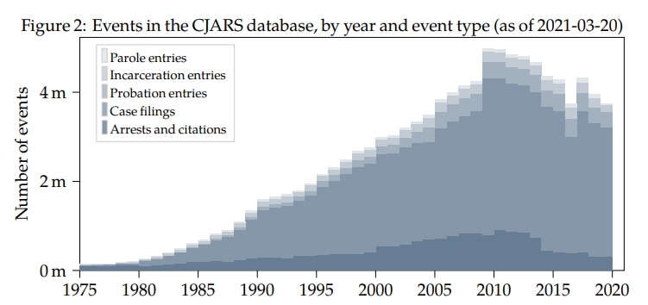
Criminal Justice Administrative Records System (CJARS)
Includes data on:
Adult offenders for a variety of criminal offenses (including statutory charges)
Records of arrests, bookings, criminal court filings, probation, prison, parole terms
Does not include:
Minors (unless juvenile cases are
transferred to adult court), crimes
not resulting in arrest, civil court
cases, traffic cases, tracking of
employees in justice system

Slide 25
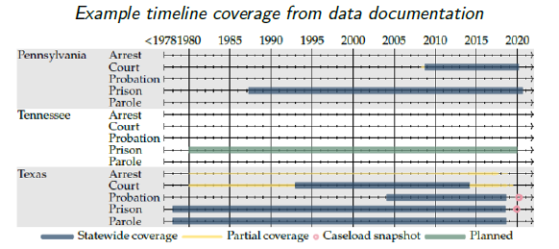
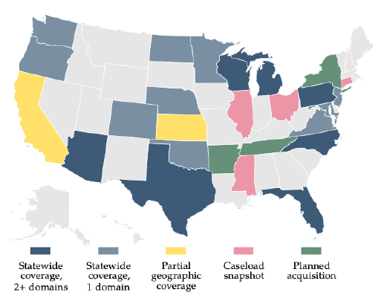
Criminal Justice Administrative Records System (CJARS)
Data are complex and multifaceted! There is extensive and comprehensive documentation available here: https://cjars.isr.umich.edu/wp-content/uploads/CJARS_data_docs_2021_03_22_14_40.pdf

Slide 26
CJARS Research Questions
How much does incarceration or other criminal justice contact impact lifetime wages, job types and tenure? Does it vary by race/ethnicity?
Do offenders who are gang-involved have increased mortality, above and beyond additional mortality risks of incarceration?
How does criminal justice contact impact public program participation, such as use of TANF, SNAP, or WIC?
Are there differences in rates of Driving Under the Influence (DUIs) by State and local programs and policies?
How do neighborhood characteristics impact criminal involvement?

Slide 27
Data Overview – Public Programs and Service Utilization
The Survey of Income and Program Participation (SIPP) provides comprehensive information on the dynamics of income, employment, household composition and government program participation
Large sample of households interviewed over a two or four-year period
Supplemental Nutrition Assistance Program (SNAP & WIC) and Temporary Assistance for Needy Families (TANF) microdata availability varies over time
Centers for Medicare and Medicaid Services (CMS) provides access to administrative data on beneficiaries

Slide 28
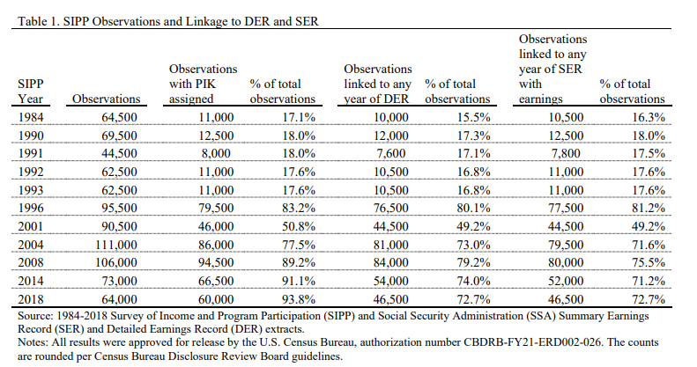
SIPP Overview
SIPP panel data are currently available between 1984 and 2020
Covers 14,000 to 52,000 households in each panel
Linkable to all other Census data collections (inc. NCVS or CJARS data)
Social Security Administration (SSA) provides lifetime earnings data for the SIPP sample

Slide 29
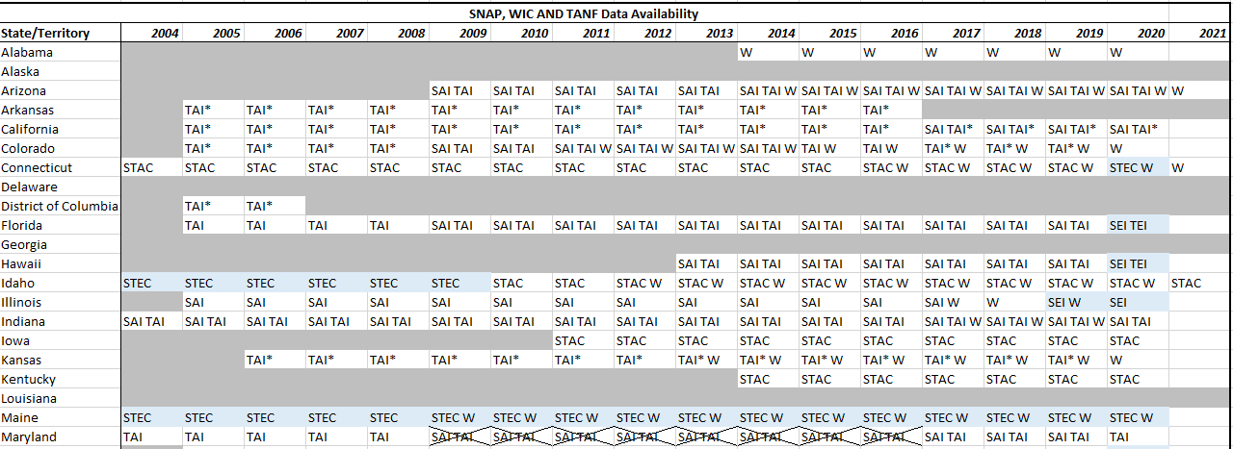
SNAP/WIC/TANF Data
Availability of SNAP/WIC/TANF data varies by state and over time
Can be linked at recipient-level to other Census microdata by PIK

Slide 30
CMS Medicare and Medicaid Data
The Centers for Medicare & Medicaid Services (CMS) provide access to:
The Medicare Enrollment Database (EDB)
1999-2020
The Medicaid and Statistical Information System (MSIS & T-MSIS)
2000-2016

Slide 31
CMS Medicare Enrollment Database (ERB)
CMS’ database of record for Medicare Beneficiary enrollment info, updated yearly 1999-2020
Beneficiary-level data with a subset of all variables collected:
Eligibility dates and statuses
Birth and death dates (where applicable)
Residence address and residence change dates
Basic demographic information
Beneficiary’s representative payee
PIK (for linkage to other Census survey data)

Slide 32
CMS Medicaid and Statistical Information System (MSIS) & Transformed MSIS (T-MSIS)
Used by CMS to gather key eligibility, enrollment, program, utilization, and expenditure data for Medicaid and Children’s Health Insurance Program (CHIP) from States each quarter
Medicaid enrollment data including:
Basic demographics
Length of eligibility period and health insurance coverage
CHIP and TANF usage

Slide 33
The Big Picture – Possibilities of Data Linkage
CJARS Criminal Justice Involvement
SSA Detailed Earnings Histories
LEHD Employment History
GeoID
PIK
PIK
EIN
PIK
Census Neighborhood Characteristics
SIPP Panel Data and Participation
Census Employer Characteristics
PIK
PIK
CMS Medicaid Enrollment
SNAP/TANF/WIC Utilization

Slide 34
Proposal Development
Researchers work closely with RMRDC administrator Phil to write successful proposals for Census projects (most data described here!)
Typically, 8-20 page project description and separate “Predominant Purpose Statement” (Phil helps draft this)
Focus on research questions, need for confidential data, methods, expected output and disclosure risk, and benefits to Census Bureau
Evaluated on feasibility, benefits, disclosure risk, and need for data
For assistance with other agency proposals (e.g. NCHS health projects), contact either Jani or Phil

Slide 35
Proposal Reviews and Timeline
The slowest part of the proposal process is often you; but it doesn’t have to be!
Final proposal review time with Census: ~3 months
If additional agency review is necessary (e.g. IRS): ~6 months
Background check/security clearance: ~3 months
Example timeline for most proposals:
3 months for Census review + 3 months for IRS review (optional) and/or 3 months for clearance (concurrent) = 6 months total before project start

Slide 36
Thank You!
Phil Pendergast
Administrator
philip.m.pendergast@census.gov
Kas McLean
Grad Research Assistant
kas.mclean@colorado.edu
Jani Little
Executive Director
jani.little@colorado.edu

