Slide 1
NCVS and CJARS data for Criminal Justice Research
Philip Pendergast
Rocky Mountain FSRDC
US Census Bureau

Slide 2
Data Overview
The National Crime Victimization Survey (NCVS) is collected by Census on behalf of the Bureau of Justice Statistics (BJS) to produce national estimates of crime incidence, reporting and victim characteristics.
Sampling frame is potential crime victims.
The Criminal Justice Administrative Records System (CJARS) is a collaboration between State justice departments, the University of Michigan, and Census to link offender records to other demographic, economic, and administrative data collected by the federal government.
Sampling frame is adult criminal offenders in participating States.

Slide 3
Potential Research Questions
Do local policing practices (like Cross-Deputization) impact crime reporting rates? Are there differences by race/ethnicity?
Do housing characteristics impact Intimate Partner Violence rates? Does reporting vary across collection method (phone vs. in-person)?
Are there differences in rates of Driving Under the Influence (DUIs) by State and local programs and policies?
Are there long-lasting impacts of violent victimization on employment and income?
What types of crime are the most consistently under-reported? How does this differ by urban/rural residence, gender, and race/ethnicity?

Slide 4
Potential Research Questions (NCVS)
Do local policing practices (like Cross-Deputization) impact crime reporting rates? Are there differences by race/ethnicity?
Do housing characteristics impact Intimate Partner Violence rates? Does reporting vary across collection method (phone vs. in-person)?
Are there differences in rates of Driving Under the Influence (DUIs) by State and local programs and policies? Offender-Focused
Are there long-lasting impacts of violent victimization on employment and income?
What types of crime are the most consistently under-reported? How does this differ by urban/rural residence, gender, and race/ethnicity?

Slide 5
Potential Research Questions (CJARS)
How much does incarceration or other criminal justice contact impact lifetime wages, job types and tenure? Does it vary by race/ethnicity?
Does criminal justice contact impact migration rates and types (in-county, out-of-county, interstate)?
Do offenders who are gang-involved have increased mortality, above and beyond additional mortality risks of incarceration?
How does criminal justice contact impact public program participation, such as use of TANF, SNAP, or WIC?
Are there differences in rates of Driving Under the Influence (DUIs) by State and local programs and policies?

Slide 6
National Crime Victimization Survey (NCVS)
Annually, 2005-2015 (for now). Most comprehensive data on personal crime in the US given limitations with reported crime
E.g. Uniform Crime Reports (UCR). What is missing from these data?
Yearly, nationally representative sample of 160,000 people age 12+ in 95,000 households. Interviews total ~240,000, annually
Interviews encompass sociodemographics, criminal victimization instances, offender/crime characteristics, reporting, medical response, and criminal justice system experiences
Information from the survey supplements official crime reports to estimate likelihood of underreported crimes

Slide 7
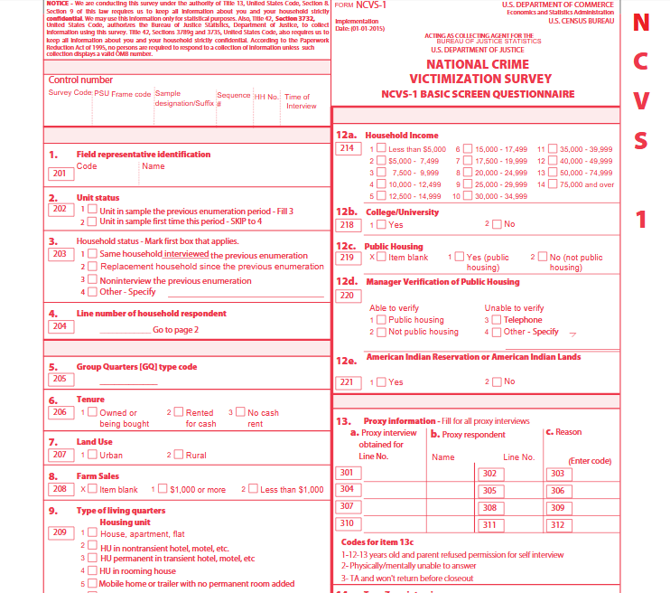

Slide 8
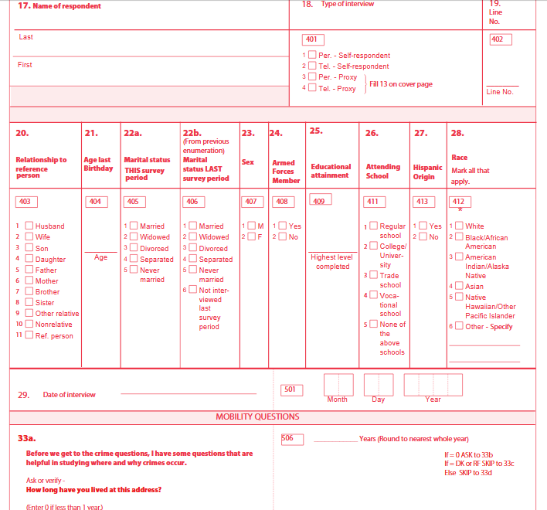

Slide 9
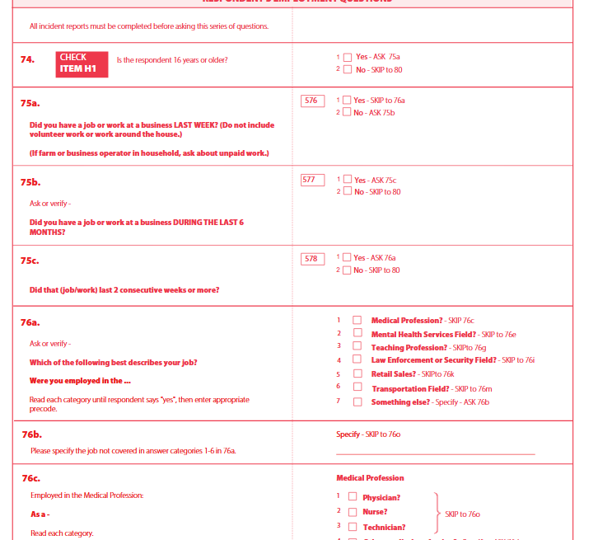

Slide 10
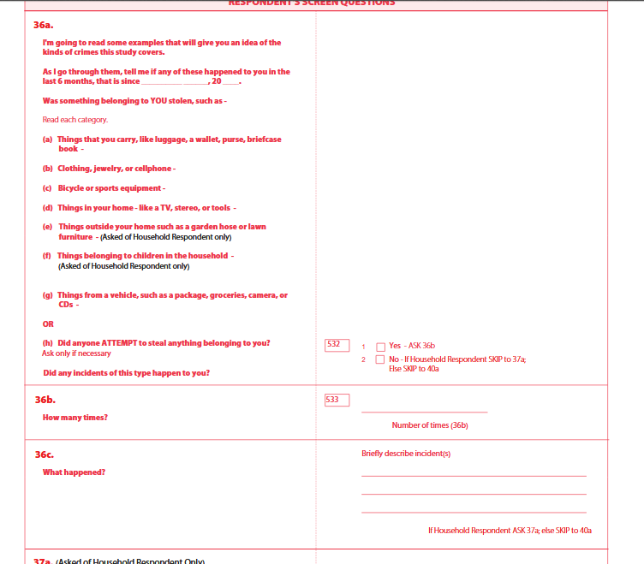

Slide 11
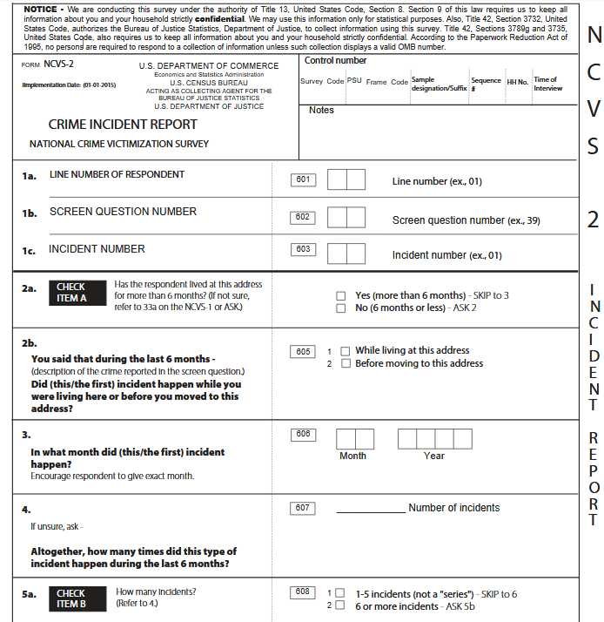

Slide 12
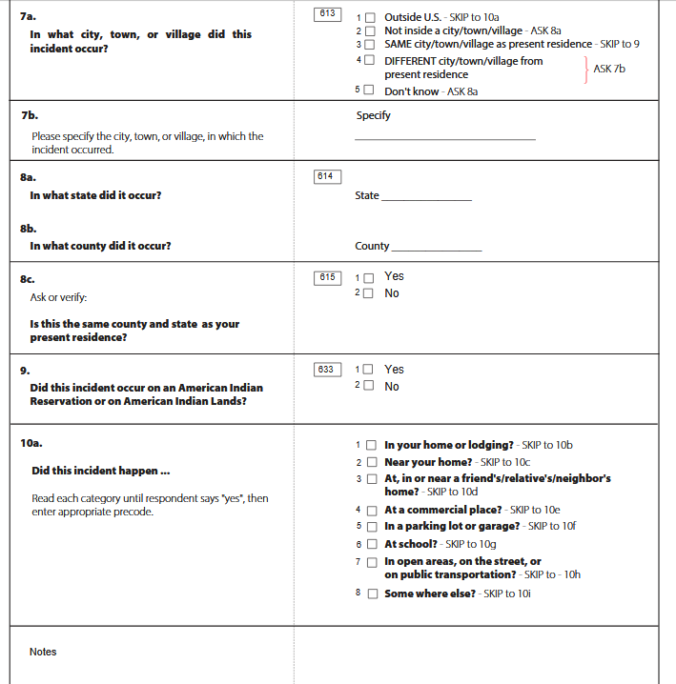

Slide 13
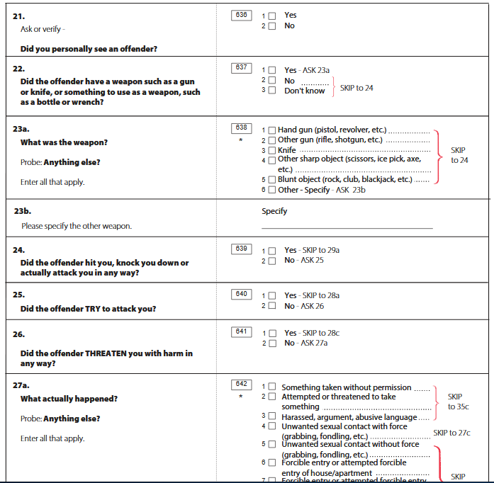

Slide 14
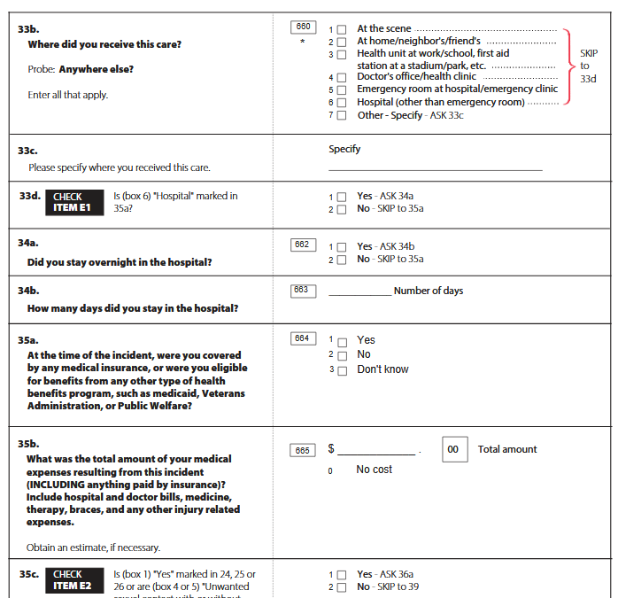

Slide 15
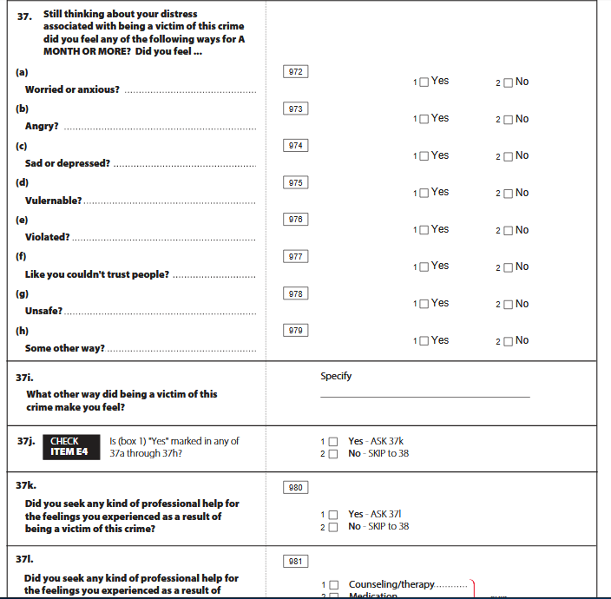

Slide 16
For full Questionnaires, visit:
https://www.bjs.gov/index.cfm?tv=dcdetail&iid=245

Slide 17
NCVS Sample Design
Longitudinal household data from a rotating sampling frame
Housing units remain in sample for 3.5 years, comprising 7 total interviews occurring every 6 months
Initial interview is performed in-person with all household members age 12+, proxy interviews with incapacitated persons
Subsequent interviews typically performed over the phone
Update of sampling frame in 2016 to deliver representative state-level estimates; prior years not designed to yield
Though experimental weighting/pooling of years allowed estimation of state-level victimization rates for about half of states with largest populations

Slide 18
Local NCVS Projects
State Variation in Intimate Partner Violence Rates, Reporting and Healthcare Utilization – Sarah Small, Anita Pena (CSU)
The Social and Economic Consequences of Violent Victimization in the NCVS – Joshua Clapp, Ben Gilbert, Phil Pendergast (UWy, CSM, CU-B)
Cross-Deputization of Local Law Enforcement and Crime Underreporting – Diane Charlton, Genti Kostandini (UMt)

Slide 19
Criminal Justice Administrative Records System (CJARS)
Event-level criminal justice data on a national scale
26 states provide data (inc. Texas) or are in the process of contributing data
>150 million criminal justice events, >30 million unique individuals
Coverage of 43% of the US population in at least one domain
Arrestees, criminal defendants, inmates, probationers/parolees
Allows for:
Harmonization of criminal involvement across multiple jurisdictions and over time
Assessing how criminal episodes progress through the justice system
Does not include:
Minors, crimes not resulting in arrest, tracking of employees in justice system

Slide 20
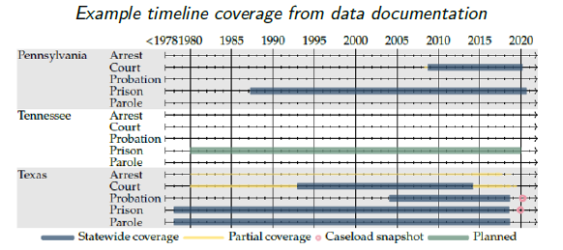
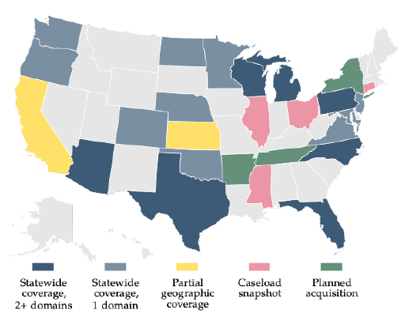
Criminal Justice Administrative Records System (CJARS)
Data are complex and multifaceted! There is extensive and comprehensive documentation available here: https://cjars.isr.umich.edu/data-documentation-download/

Slide 21
Accessing Crime Data
Many avenues of criminal justice research are possible with the NCVS and CJARS data!
Both datasets are currently available for researchers in the FSRDC
Eligible for virtual access from El Paso after initial visits!
No additional charges for accessing these data
Apply through Census for access!
Email to discuss: philip.m.pendergast@census.gov
Review time for final proposals: ~3 months
Time for background check and badging/FSRDC access: ~3 months

