Slide 1
Rocky Mountain Research Data Center (RMRDC):
Executive Director
jani.little@colorado.edu
Rocky Mountain Research Data Center (RMRDC):
Accessing Restricted Data Collected by Federal Statistical Agencies
https://www.colorado.edu/rocky-mountain-research-data-center/
Jani Little, Executive Director
jani.little@colorado.edu
Philip Pendergast, Administrator
philip.m.pendergast@census.gov
Kas McLean, GRA (Econ PhD Candidate)
kas.mclean@colorado.edu
/www.colorado.edu/rocky-mountain-research-data-center/

Slide 2
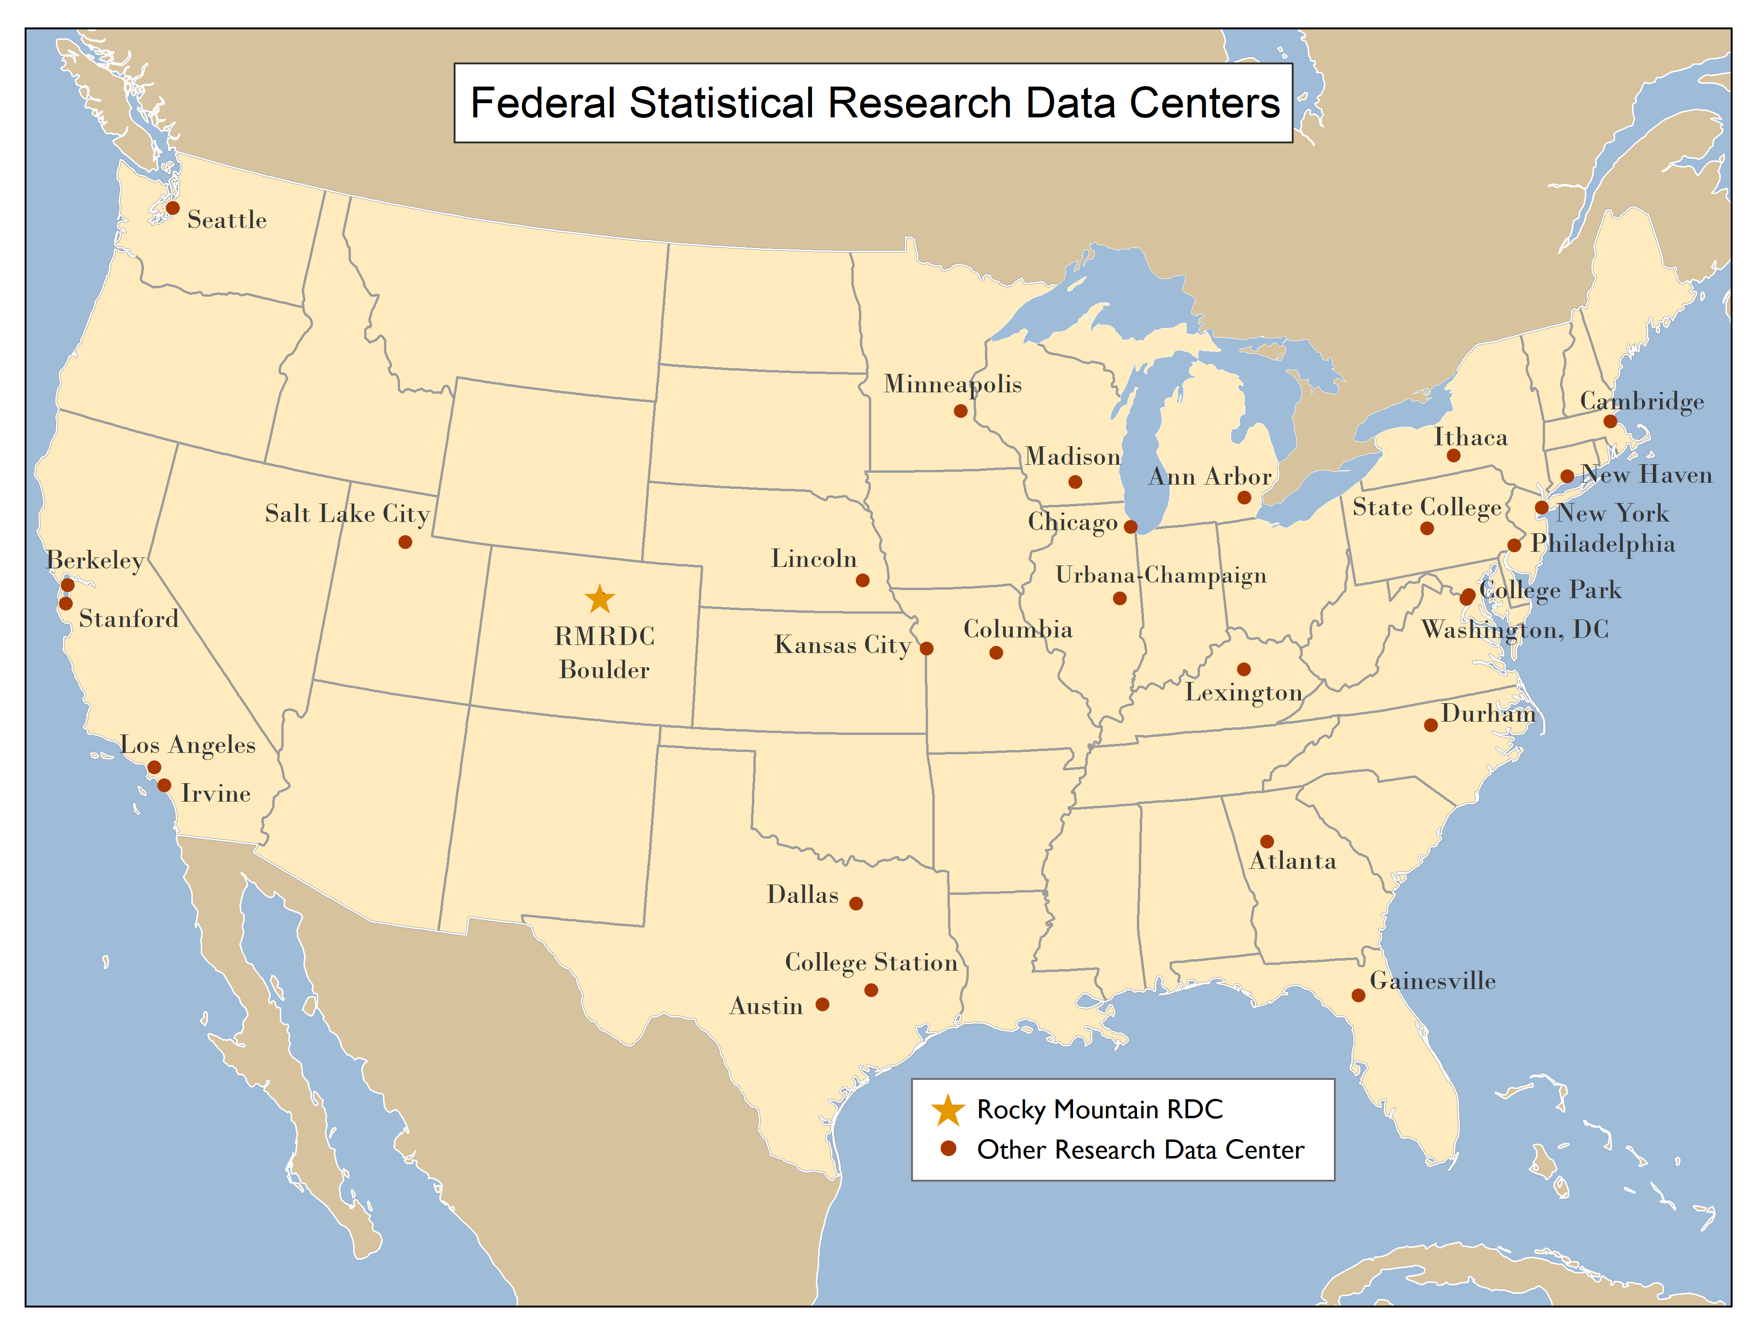
RMRDC is part of a National Network of FSRDCs Providing Access to Restricted-Use Data Collected by Federal Statistical Agencies

Slide 3
RMRDC Membership Network *All faculty, staff, and graduate students associated with member universities have free access to the lab and services

Slide 4
What RMRDC offers:
Access to federal restricted data and staff assistance in a secure facility
Staff assist with:
Successful proposal development and submission
Researchers must develop an agency-approved proposal to use the data.
“Special Sworn Status (SSS)” applications
Researchers undergo a background check which gets them lab access
Technical support
Disclosure review and statistical output approval
Results must be formally reviewed for disclosure violation before they leave the secure facility.

Slide 5
Bureau of the Census
Office of Research, Evaluation, and Statistics
(Social Security Administration)
Federal Statistical Agencies
National Center for Education Statistics
Bureau of Transportation Statistics
National Agricultural Statistics Service
National Center for Health Statistics
Bureau of Labor Statistics
Bureau of Justice Statistics
Bureau of Economic Analysis
Statistics of Income Division
(Internal Revenue Service)
Economic Research Service
National Center for Science and Engineering Statistics
(National Science Foundation)

Slide 6
Foundation of Evidence-Based Policymaking Act of 2018
--Requires agency data to be accessible and requires agencies to plan to develop statistical evidence to support policymaking.
--Establishes in the OMB a Chief Data Officer Council for establishing government-wide best practices for the use, protection, dissemination, and generation of data and for promoting data sharing agreements among agencies.
--Greatly relies on the FSRDC system for implementation of law
--Suggests continued expansion of FSRDC data resources

Slide 7
Restricted-Use Data with FSRDC Access Added Recently
Census Bureau:
HH and Small Business COVID Pulse Surveys
National Center for Science and Engineering Statistics (NCSES):
Survey of Doctorate Recipients (SDR)
Survey of Earned Doctorates (SED)
Equal Employment and Opportunity Commission (EEOC):
Enforcement and Litigation Statistics
Social Security Administration (SSA):
Personal Income Data
Bureau of Justice Statistics (BJS):
Criminal Justice Administrative Records System (CJARS)
Substance Abuse and Mental Health Services Administration (SAMHSA):
National Survey on Drug Use and Health (NSDUH)

Slide 8
Restricted-Use Data Enhances Investigations of Society’s Most Pressing Challenges
International Trade Policies
Drug Use and Mental Health
Natural Hazards Impacts on People and Business
Local Labor Markets
Rural vs Urban Divide
Immigration
Impacts on People and Business
Income Inequality
Health Disparities
Business Sector
Growth and Decline
Crime
Impacts on Victims and Incarcerated

Slide 9
Advantages of Restricted-Use Microdata
For Researchers:
Greatly expands the policy and basic questions that can be addressed
Builds on past research findings with richer data
Improves competitive edge for grants, publications, recruitment
Improves graduate education (big data/statistical techniques) and placement
For Research:
Microdata not available in public-use data, e.g., business data
Longitudinal data collections, e.g., NCES and NLS
Variables not available in public-use versions of data sets, such as low-level geography
Full population counts or larger samples (Decennial Census, ACS, CPS) not available in public-use data
Linked restricted-use Census data sets
Full range of response items (e.g., ICD codes, industry codes, occupational codes, detailed race answers, income is not top-coded, etc.)
Ability to make linkages

Slide 10
Public-Use Microdata: created so that individual records cannot be linked to PII or to other databases
1. No obvious identifiers or PII (personally identifiable information)
2. Includes only a portion of the surveyed sample
3. Includes only a selection of variables. Sensitive variables removed.
4. Limits geographic detail
5. Limits the number and detailed breakdown of categories within variables on the file, e.g., race and ethnicity, exact dates of events, ICD-10 codes
6. Truncate extreme codes for certain variables (top or bottom coding), e.g., income
Restricted-Access Microdata
1. No obvious identifiers or PII (personally identifiable information) replaced by PIK (Protected Identification Key) to allow linkages
2. Includes all microdata records
3. Includes unlimited number of variables including sensitive variables and LINKED data records
4. Geographic detail as precise as original data
5. Unlimited categories within variables on the file, e.g., race and ethnicity, exact dates of events, ICD-10 codes
6. No truncated extreme codes for certain variables (top or bottom coding), e.g., income

Slide 11
Restricted-Use Microdata on Individuals and Households Available from Census Bureau:
Full-count Decennial Censuses, e.g., 2000, 2010, 2020
Administrative records
Master Address File (MAF) includes Addresses of every HH in US
Sample surveys
American Community Survey (ACS)
Current Population Survey (CPS)
American Housing Survey (AHS)
Survey of Income Program Participation (SIPP)
National Crime Victimization Survey (NCVS)
HH COVID Pulse Surveys
Most data are linkable at the person level

Slide 12
Census Longitudinal Infrastructure
Decennial Census and ACS datasets
1940
Census
2000
Census
2010
Census
2001-2019
ACS
Household survey datasets
CPS
SIPP
AHS
NCVS
Administrative
Records
External
Data Sources

Slide 13
Good News Flash!!
All Projects Using Individual and/or HH Restricted-Use Data from Census Bureau (i.e., mentioned in the previous two slides) are eligible to access the data through Remote Access
Remote Access
Approved researchers get set up to use restricted data from home office
Undergo additional training and random audits
Only one required trip to RMRDC for training purposes

Slide 14
American Community Survey (ACS)
Annual, since 2005. The most comprehensive survey of U.S. households and individual residents
Helps local officials, community leaders, and businesses understand the changes taking place in their communities. It is the premier source for detailed population and housing data
Coverage provides reliable estimates for the nation, regions, states, counties, cities, tracts, block groups
Information from the survey generates data that help determine how more than $675 billion in federal and state funds are distributed each year.

Slide 15
ACS Initial Addresses and Sample Selected and Final Interviews
 | Housing Units
Year | Initial | Final
 | Addresses | Interviews
 | Selected
2019 | 3,544,301 | 2,059,945
2018 | 3,544,000 | 2,143,000
2017 | 3,526,808 | 2,145,639
2016 | 3,527,047 | 2,229,872

Slide 16
ACS Questionnaires: https://www.census.gov/programs-surveys/acs/methodology/questionnaire-archive.2019.html
Household composition
Each person’s relationship to Person 1 (INCLUDING SAME-SEX PARTNER)
Age and date of birth
Hispanic origin
Race
Work
Occupation
Education
Detailed housing characteristics, e.g., receiving SNAP benefits
Other person characteristics (citizenship, language skill)

Slide 17
ACS Questionnaires:https://www.census.gov/programs-surveys/acs/methodology/questionnaire-archive.2019.html
Health Insurance: (Yes or No, what type, premiums, subsidy for premium)
Disability (deaf, blind, cognitive, walking, dressing, bathing, doing errands)
Veteran (when served, VA disability, VA disability rating)
Fertility (birth in the last year)

Slide 18
Current Population Survey (CPS) https://www.census.gov/programs-surveys/cps/technical-documentation/questionnaires.html
Conducted monthly for over 50 years. Data from approximately 54,000 households of 70,000 selected to represent U.S. and each state are interviewed every month.
Each household interviews for 4 consecutive months and again a year later for the same corresponding 4 consecutive months. This is the panel component of CPS and these data are restricted use only.
CPS provides monthly estimates of employment (farm and nonfarm); self-employed, domestics, unpaid workers in nonfarm enterprises, wage and salary employees and estimates of total employment.
Annual Social and Economic Supplements (ASEC), are annual data collected with the March interviews since 1962. Provides data on family structure, household composition, education, health insurance coverage, income sources, poverty, geographic mobility.

Slide 19
Current Population Survey (CPS): Supplement Topics: https://www.census.gov/programs-surveys/cps/about/supplemental-surveys.html
School Enrollment: Collected in October, every year
Fertility and Marriage: Collected in June, every even year
Voting and Registration: Collected in November, every even year
Food Security: Collected in December, every year
Tobacco Use: Collected more sporadically, last was July 2018

Slide 20
Some Active Research Topics Using Restricted Census Population and Housing Data:
Race Response Decisions and Response Changes Due to Context
Race/class differences in accessibility of public transit for workplace commuting
Determinants of aging and migration in/out of rural, small-town USA

Slide 21
Stay Tuned, More Restricted-Use Data to Come:
10:00-11:00am Health Data and the Health Data Course
11-11:30am Law and Criminal Justice Data
11:30-1pm break
1:00-2:00pm Economic and Longitudinal Employer-Household Dynamics (LEHD) Data
2:00-4:00pm Individual/Small-Group Researcher Meetings

