Slide 1
Meiji Era: Change or Continuity?
Was modernization the dominant feature of daily life during the Meiji era?
© 2015 Program for Teaching East Asia, University of Colorado

Slide 2
Late Meiji Era (20th century)
Source: Silk Museum, Japan

Slide 3
Taisho era (1912-1926)
Source: Silk Museum, Japan

Slide 4
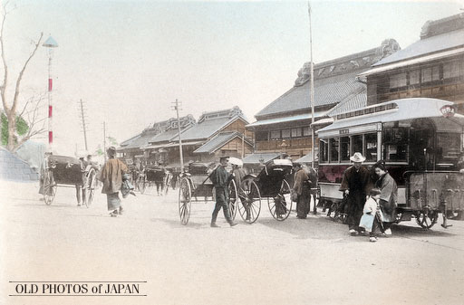
Street Car in Ueno, Tokyo, 1890s Source: http://www.oldphotosjapan.com/en/photos/765/streetcar-in-ueno#.VK7mT3uK22E Courtesy of Kjeld Duits Collection/MeijiShowa.com

Slide 5
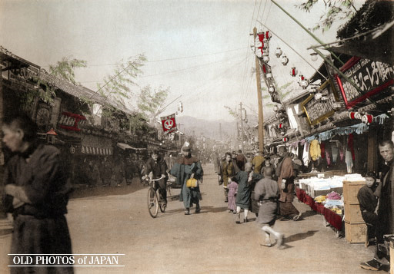
New Year Celebrations 3, Kobe, 1906 Source: http://www.oldphotosjapan.com/en/photos/680/new-year-celebrations-3#.VTrEwZN58UM Courtesy of Kjeld Duits Collection/MeijiShowa.com

Slide 6
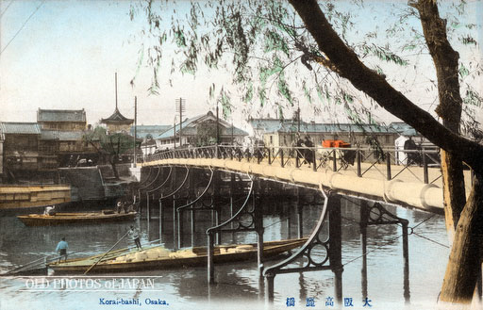
Koraibashi, Osaka, 1910s Source: http://www.oldphotosjapan.com/en/photos/248/koraibashi#.VTrGlpN58UM Courtesy of Kjeld Duits Collection/MeijiShowa.com

Slide 7
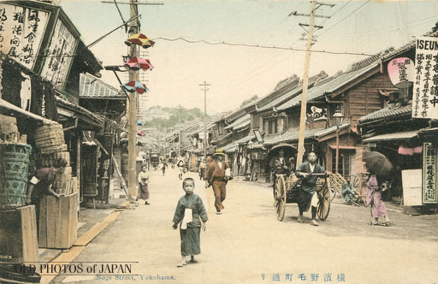
Nogemachi-dori, Yokohama, 1900s Source: http://www.oldphotosjapan.com/en/photos/155/nogemachi-dori#.VTqyvZN58UM Courtesy of Kjeld Duits Collection/MeijiShowa.com

Slide 8
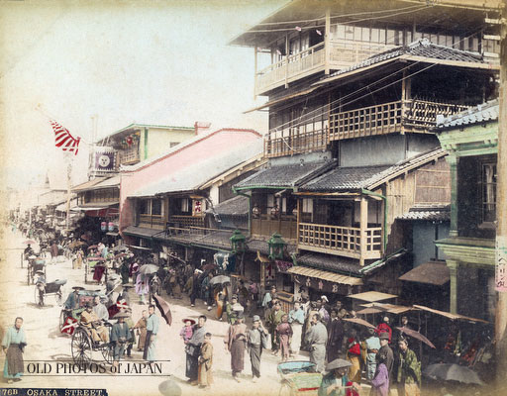
Dotonbori Theater Street, Osaka, 1890s Source: http://www.oldphotosjapan.com/en/photos/90/dotonbori-theater-street#.VTqzF5N58UM Courtesy of Kjeld Duits Collection/MeijiShowa.com

Slide 9
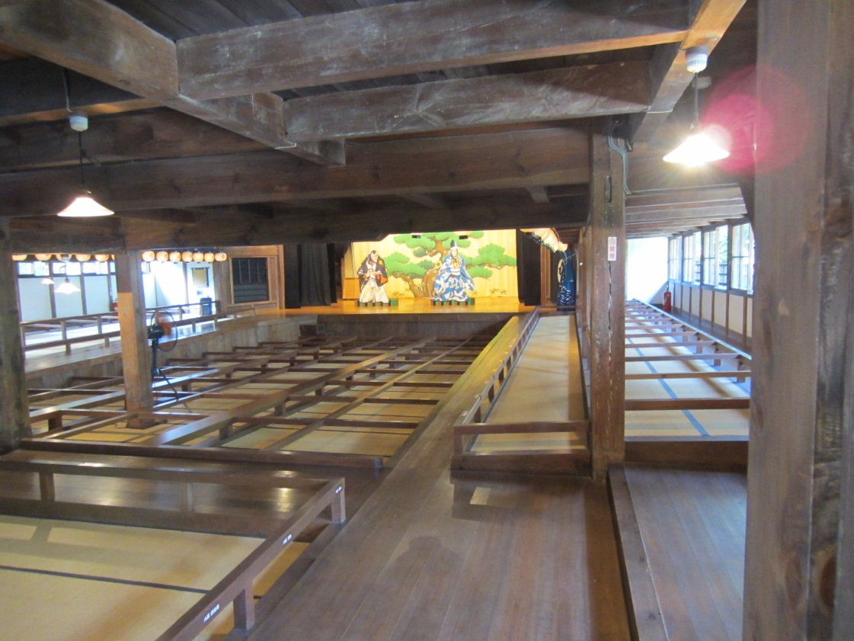
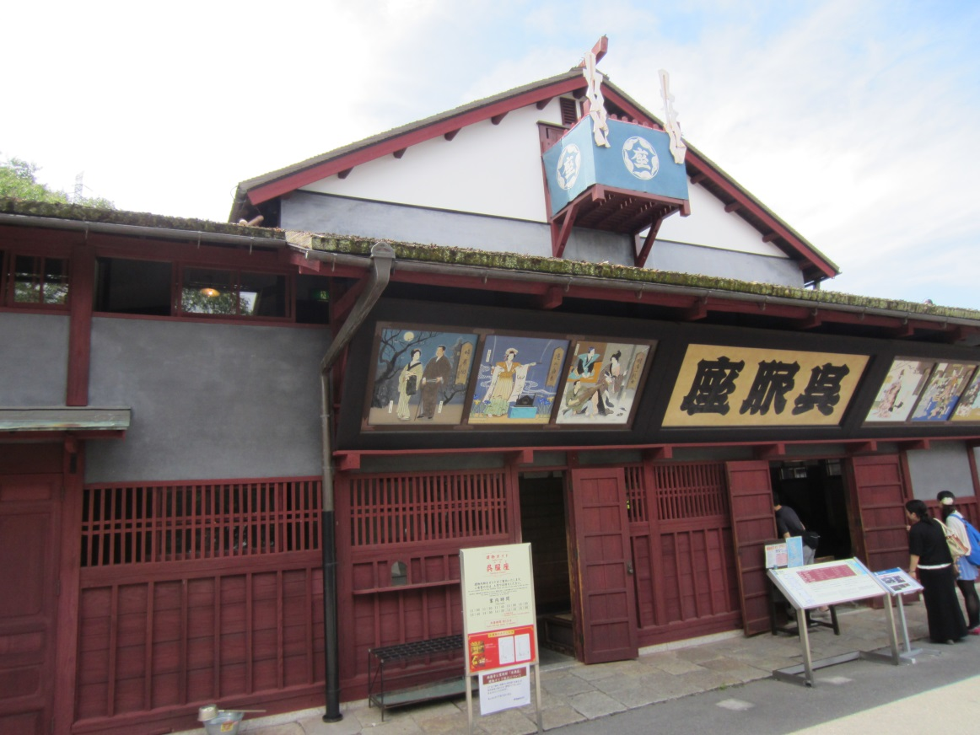
Kureha-za Theater
Built in 1868 in Osaka (Nishihonmachi Ikeda neighborhood), this theater is recognized by the Japanese government as an Important Cultural Property.
Photos by Catherine Mein.
“Kureha-za Theater is a playhouse widely loved by people as a place of entertainment. [The] theater follows the style of playhouses of the Edo period. In addition to Kabuki, plays were performed here [as well as political speeches given]. [The] theater is equipped with a Revolving Stage, Trapdoor, ‘flower way’ (a stage passage through the audience), etc.”
Permanent museum exhibition. The Museum Meiji-mura, n.d.

Slide 10
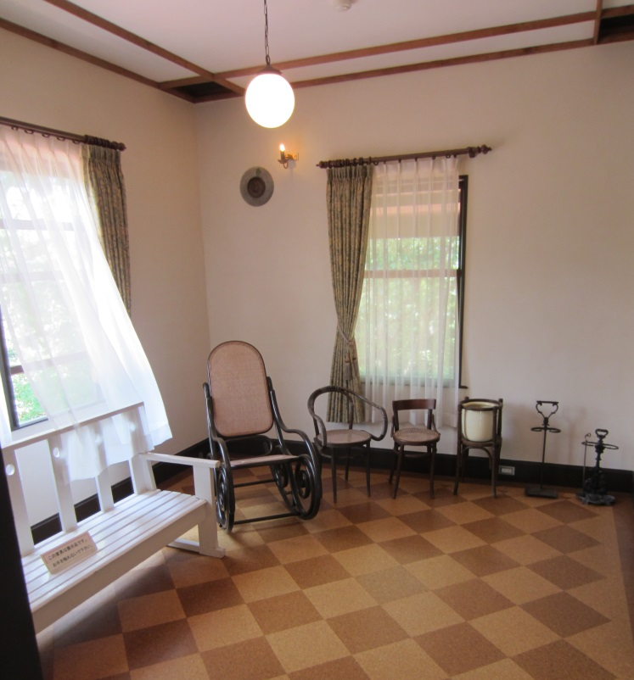
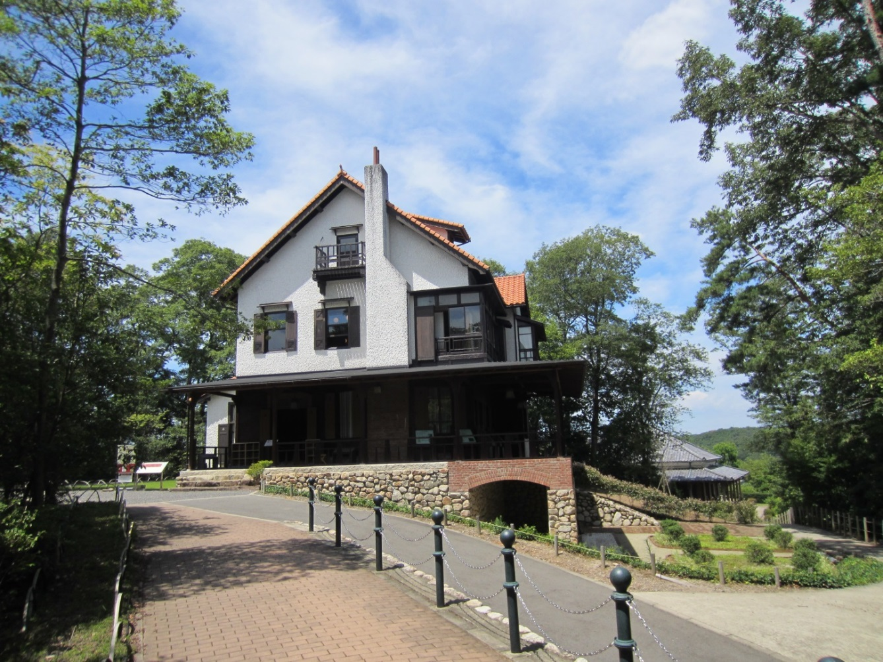
Villa of Mataemon Shibakawa
Built in 1911 in
Hyogo-prefecture
Photos by Catherine Mein.
“The Villa of Mataemon Shibakawa was built in the orchard of Koto-En located mid-way between Kobe and Osaka as a [weekend] villa for Mataemon Shibakawa, a business tycoon of Osaka…. It was designed by Goichi Takeda, [an] architect who played an active part in the turn of the 20th century. This building, a happy combination of Japanese [traditional] house style and that of western buildings, was hit severely by the Hanshin Awaji Earthquake [1995] and had to be dismantled.”
Permanent museum exhibition. The Museum Meiji-mura, n.d.

