Slide 1
Mongol Wall in Hakata Bay
© 2014 Program for Teaching East Asia, University of Colorado

Slide 2
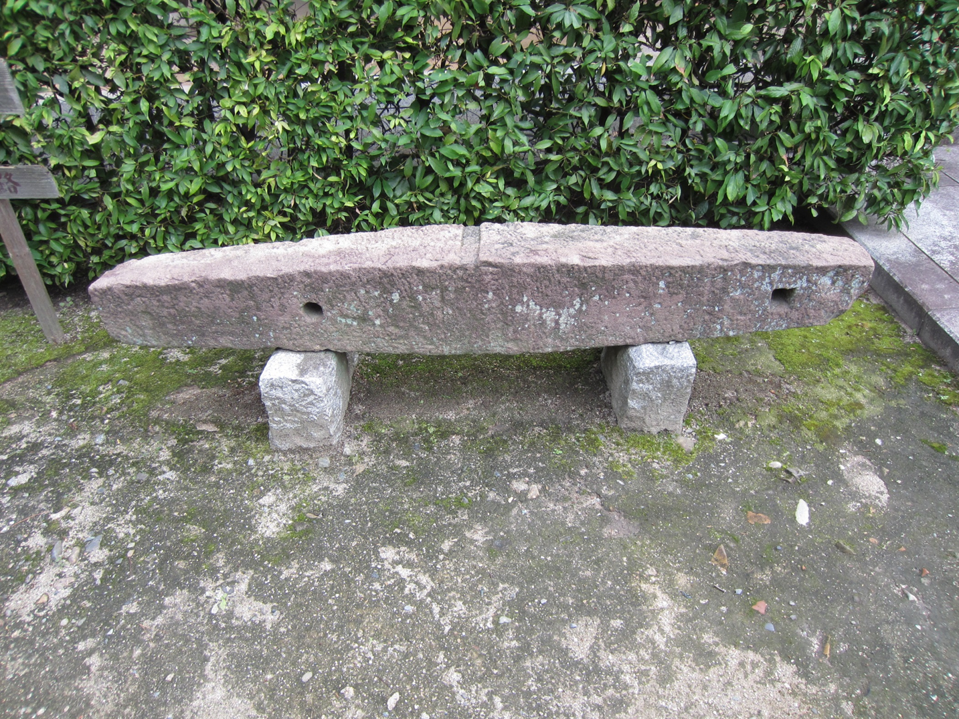
Notes:
This is an anchor stone from a Chinese ship. It was found in Hakata Bay and is labeled as an anchor stone from one of the invasion ships. Most likely this is an anchor stone from a Chinese merchant ship that was trading at Hakata in the period after the Mongol invasions. However, this is the kind of anchor stone that would have been used by the Chinese on the ships that sailed from southeast China during the 1281 invasion. It is remembered in Fukuoka (formerly Hakata) as from a Mongol ship.

Slide 3
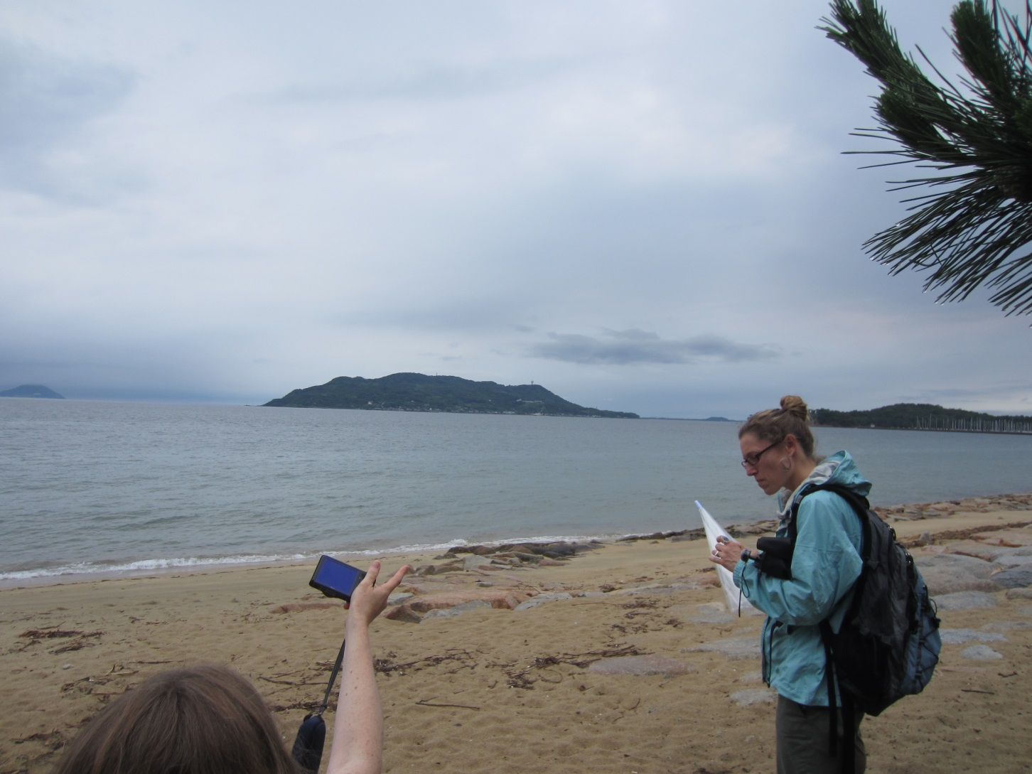
Notes:
This is a view of Hakata Bay where the Mongols landed in 1274, but were unable to land in 1281. The land in the middle is an island in the harbor.

Slide 4
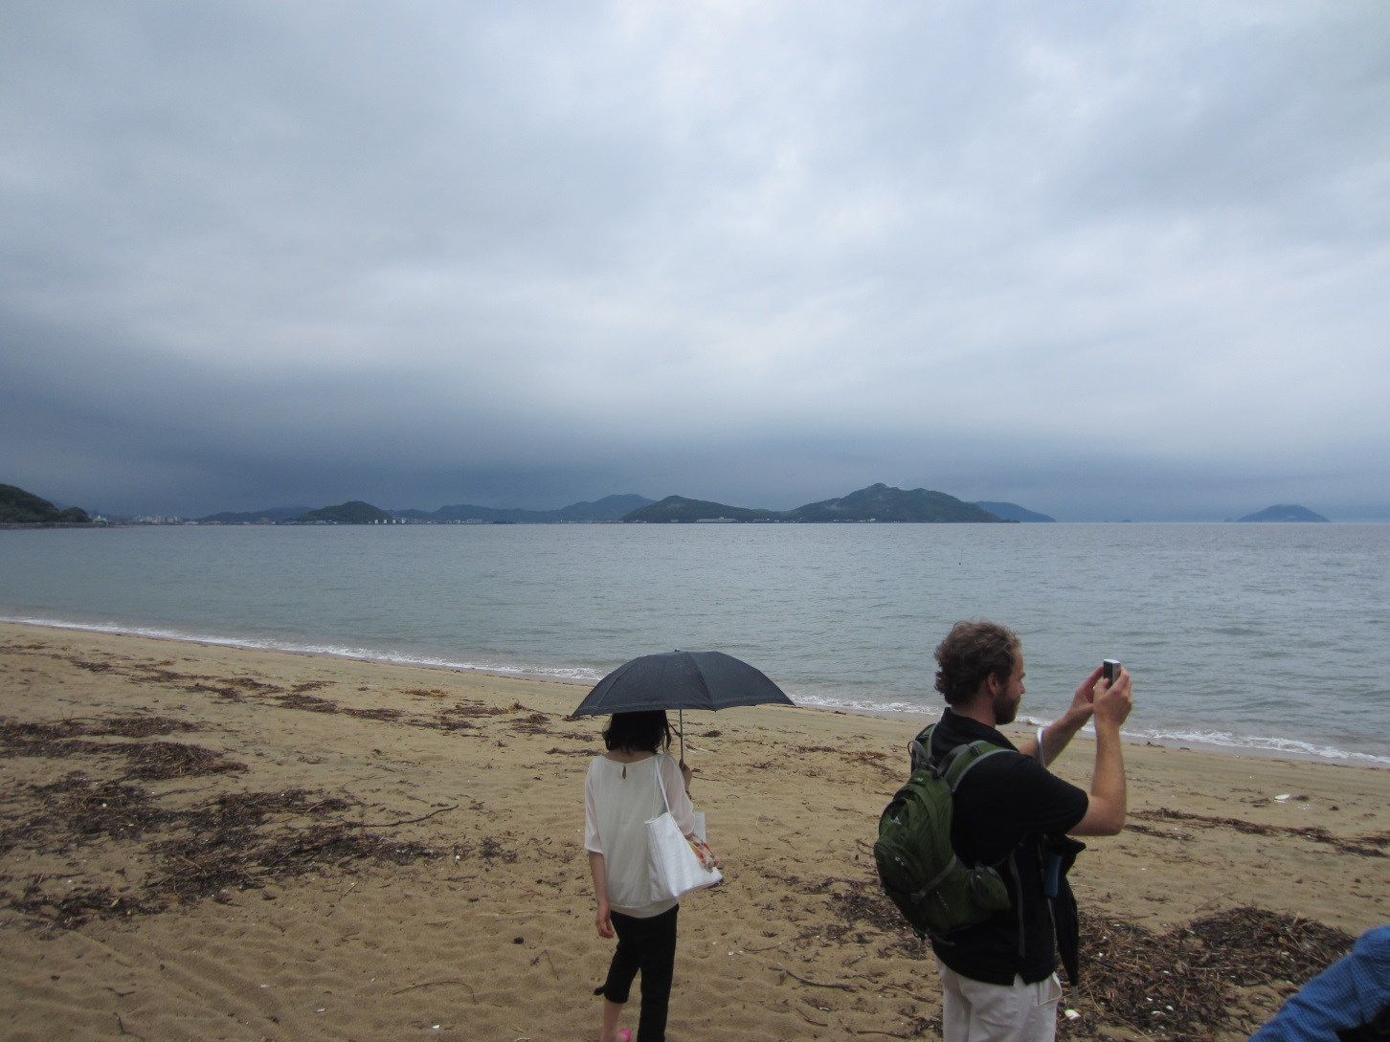
Notes:
Another view of Hakata Bay. The mainland curves around to the left. In the center and to the right are two islands.

Slide 5
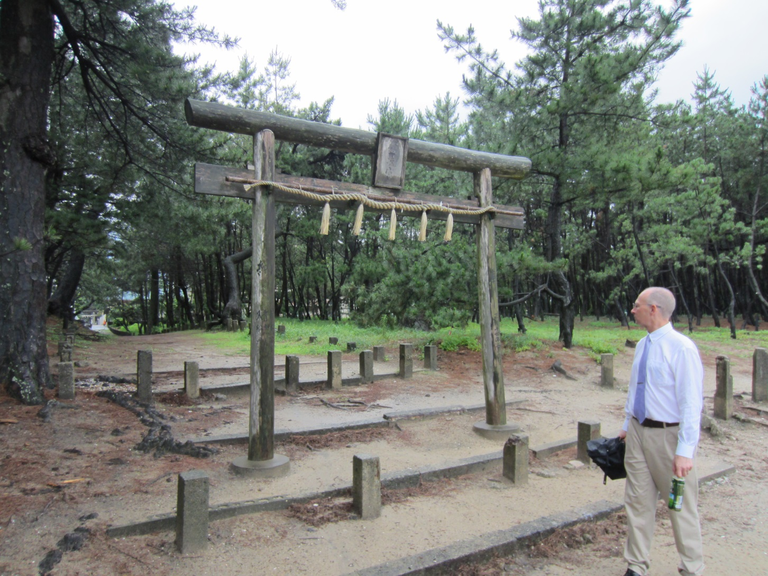
Notes:
This is a torii gate to a Shintō shrine that is located just off the beach. A torii gate and the twisted rope on the gate are used to mark off the entrance to sacred space, such as a shrine.

Slide 6
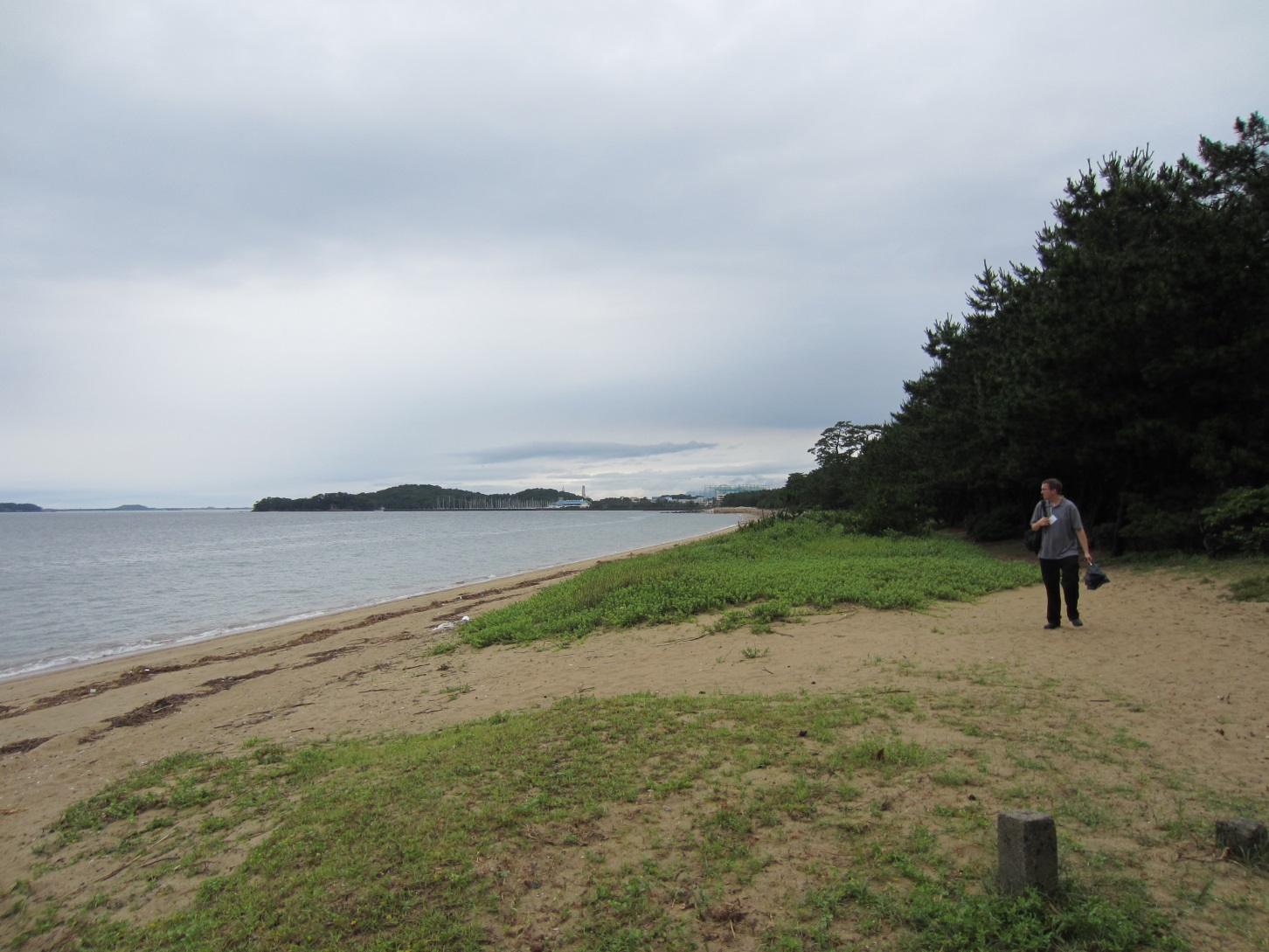
Notes:
Another view of Hakata Bay. The land on the right is the mainland. On the left are islands.

Slide 7
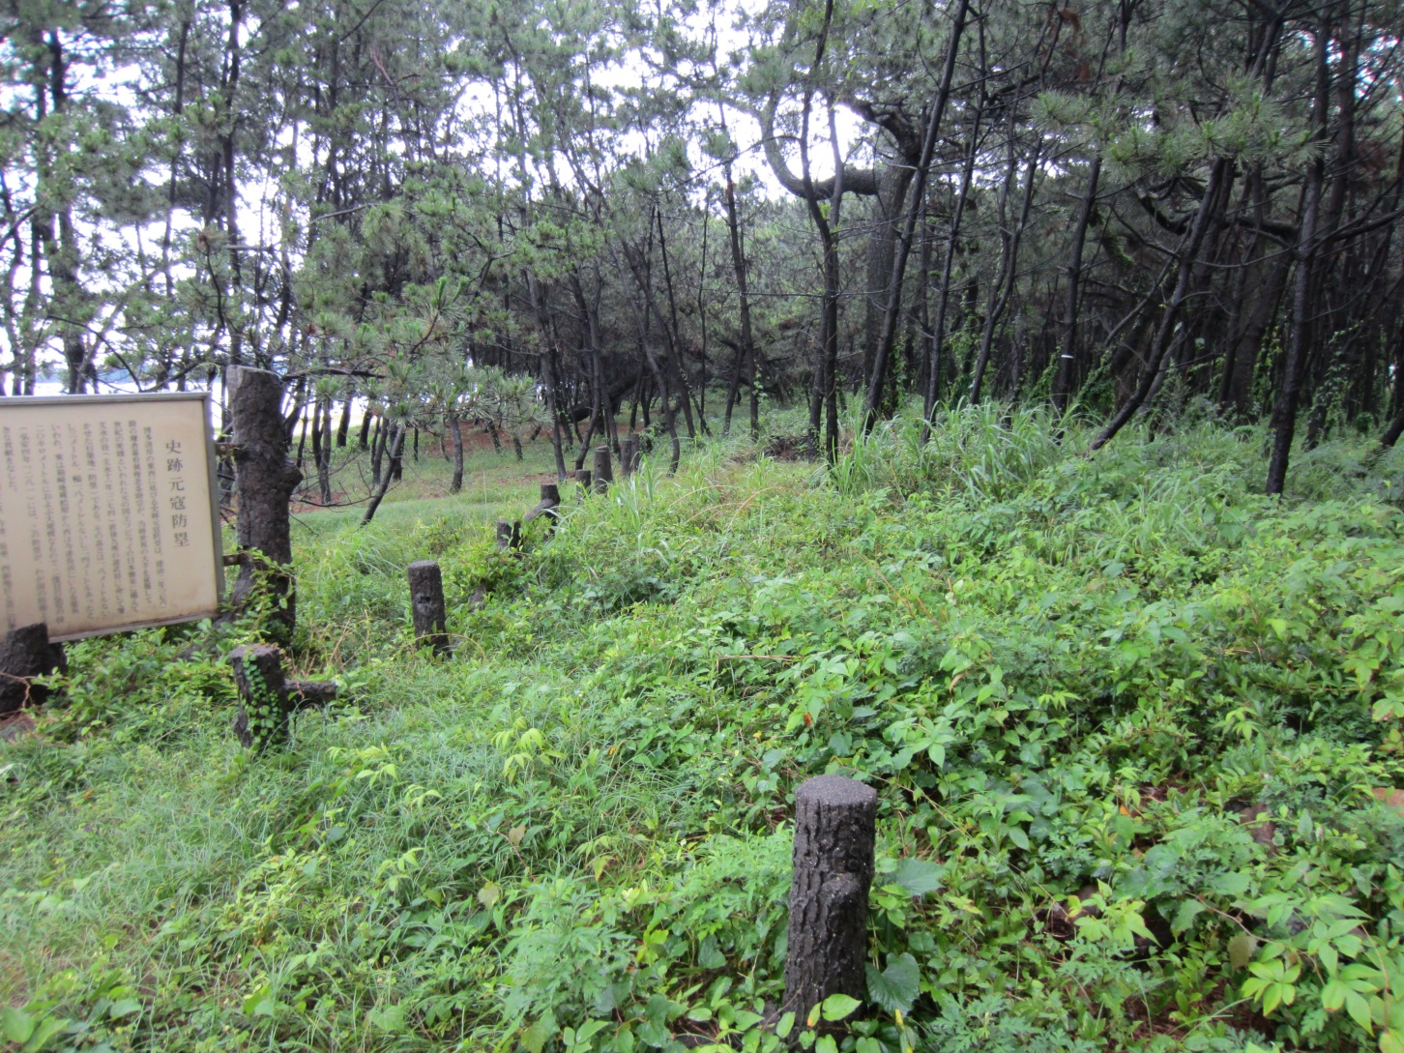
Notes:
This mound is where the Mongol wall was built after the 1274 invasion, in preparation for a second invasion. Over the centuries, the wall has been buried; this is what can be seen today without excavation.

Slide 8
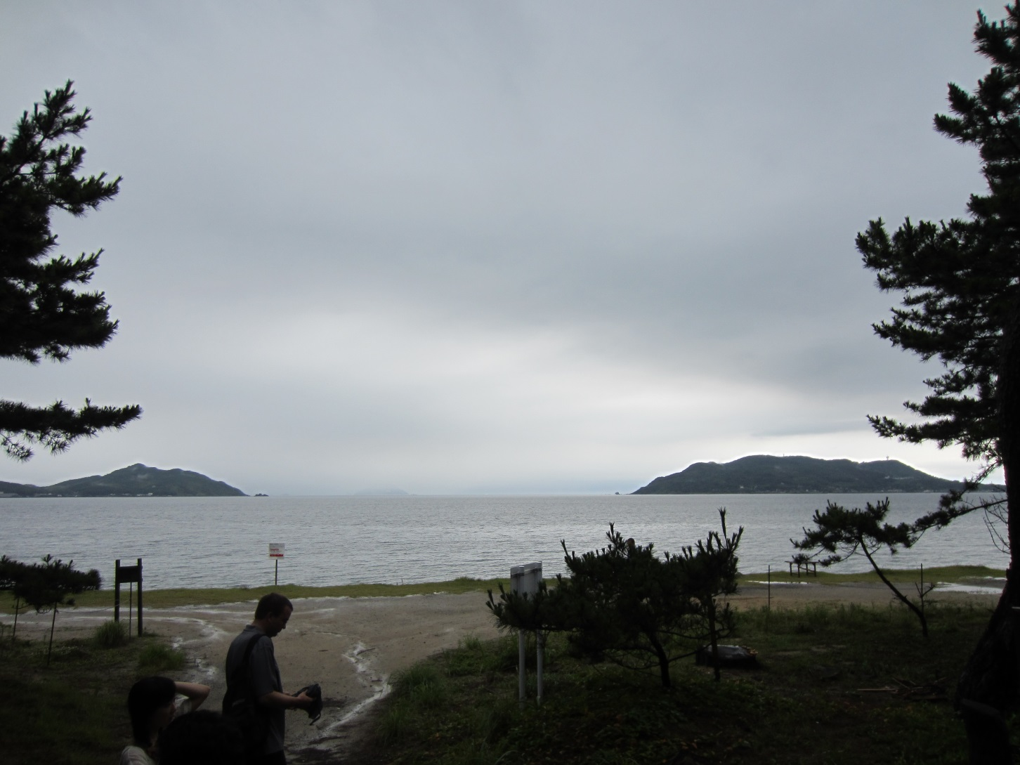
Notes:
Another view of Hakata Bay with two islands visible.

Slide 9
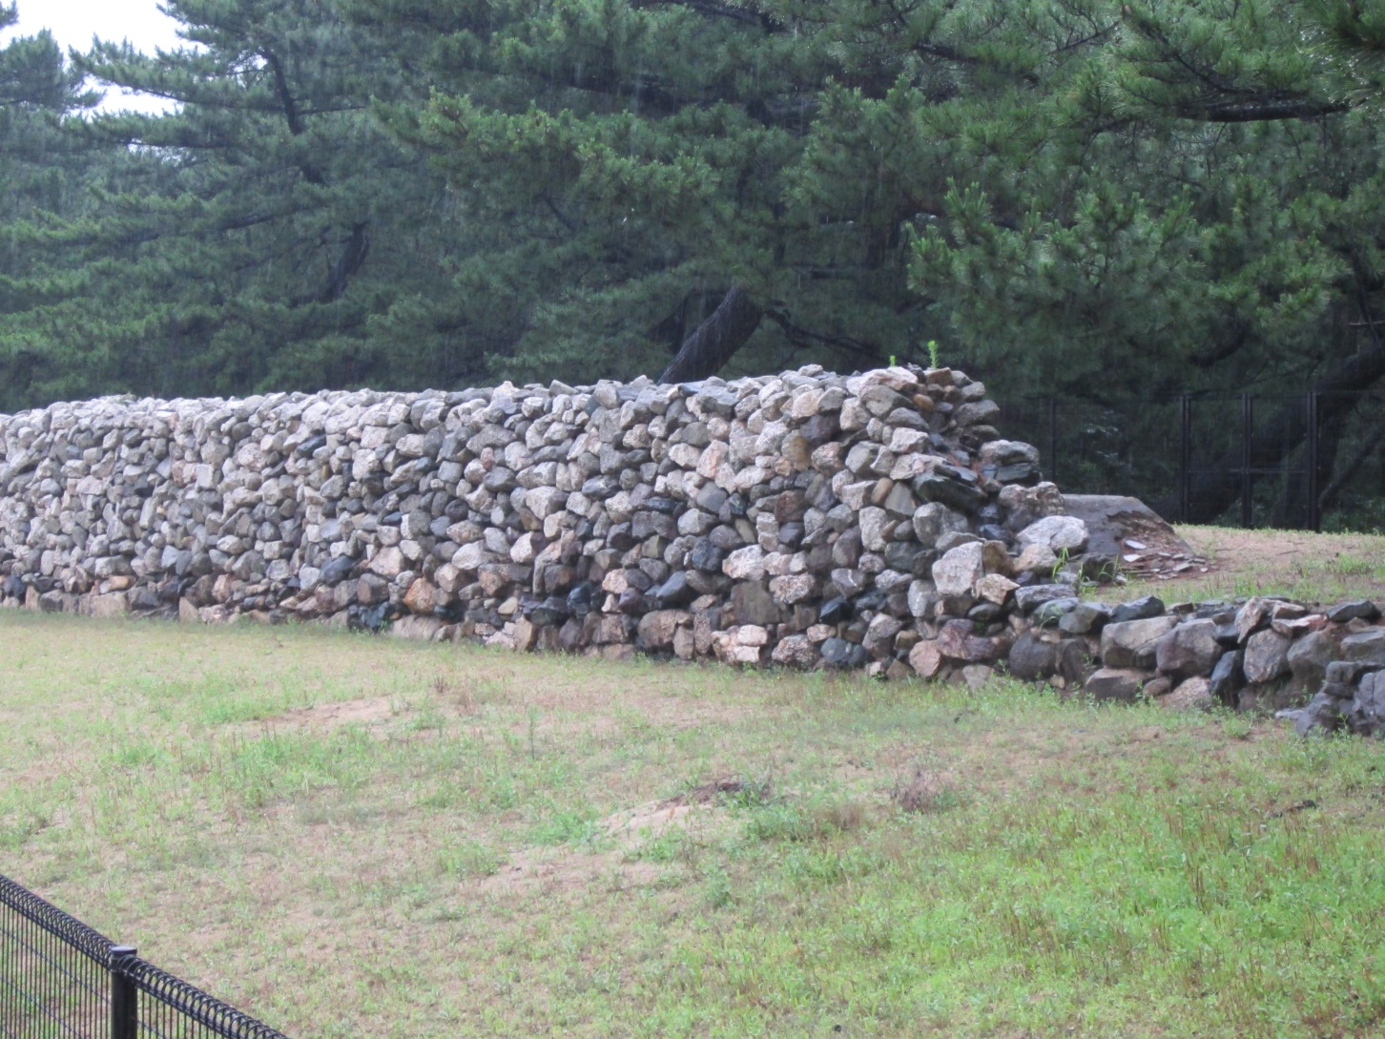
Notes:
This is a portion of the Mongol wall that has been excavated and partially reconstructed so that it looks like it would have in 1281. The walls prevented the Mongols from landing on all suitable beaches in Hakata Bay, as they had been able to in 1274. (Conlon, In Little Need of Divine Intervention: Takezaki Suenaga’s Scrolls of the Mongol Invasions of Japan, 2001, p. 267).

Slide 10
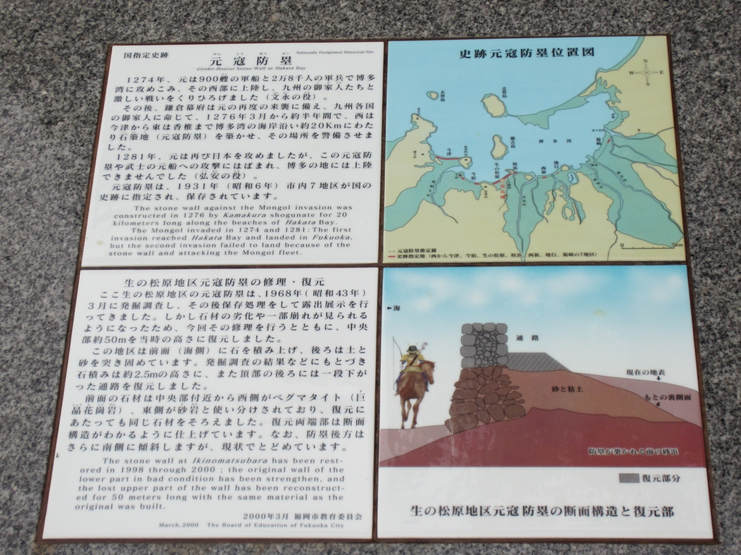
Notes:
The map on the upper right shows Hakata Bay and the location of the walls (red) that were built in preparation for a second Mongol invasion. The image in the bottom right shows how the wall would have looked in 1281.

Slide 11
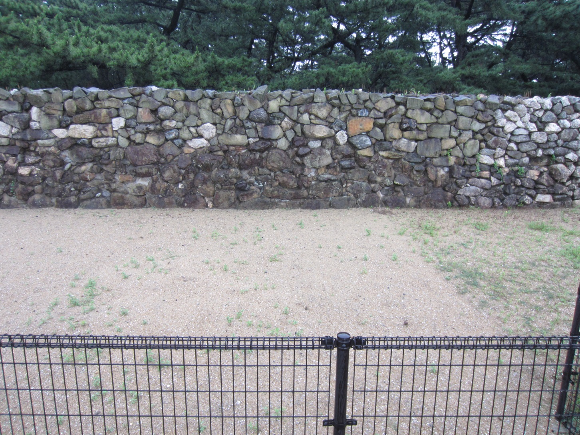
Notes:
This is another view of the excavated and reconstructed wall. The different colors of the stone indicate the portion that is original and the portion that has been reconstructed.

Slide 12
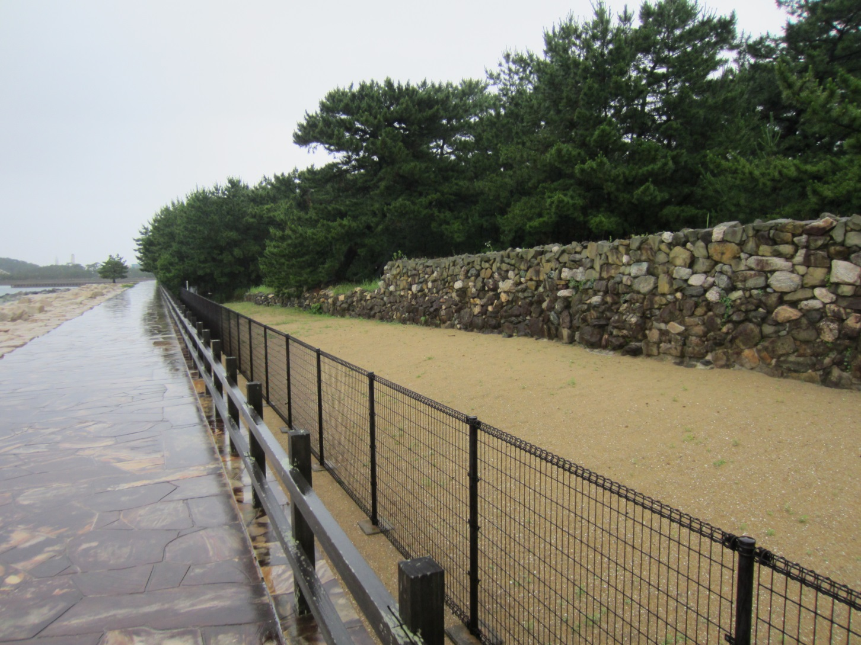
Notes:
Another view of the excavated and reconstructed section, looking back toward the city of Fukuoka (formerly Hakata).

Slide 13
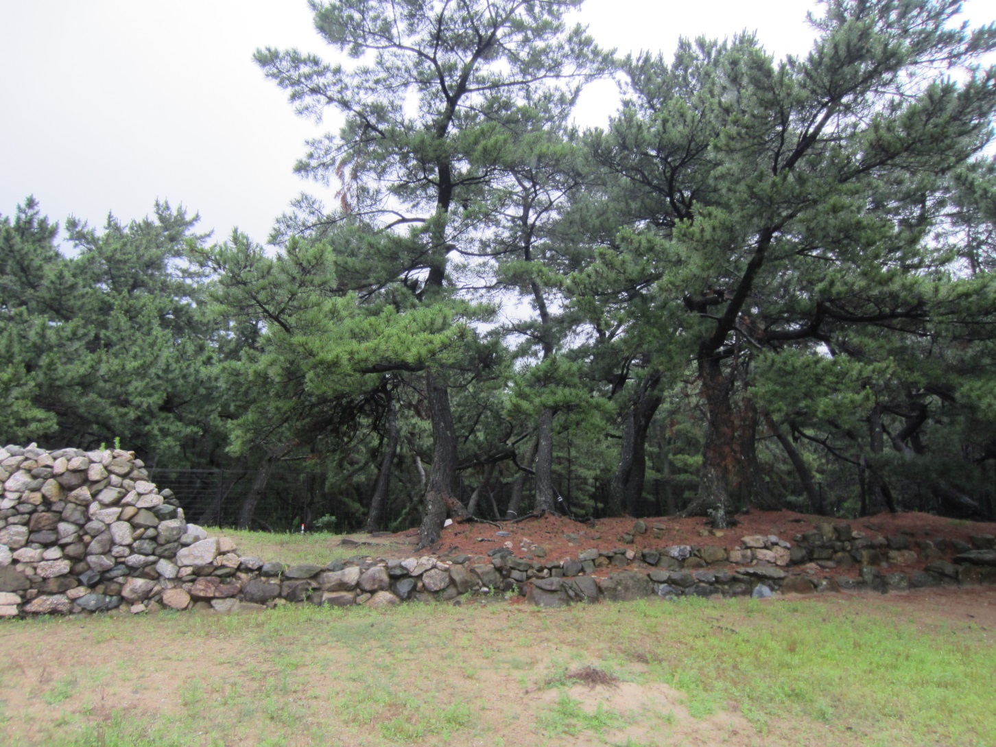
Notes:
A view of the wall comparing a portion that has been excavated and not reconstructed to a section that has been reconstructed.

