Slide 1
BUILDING TōDAI-JI
Was building the Great Buddha and its hall a good use of Nara Japan’s resources?
© 2014 Program for Teaching East Asia, University of Colorado

Slide 2
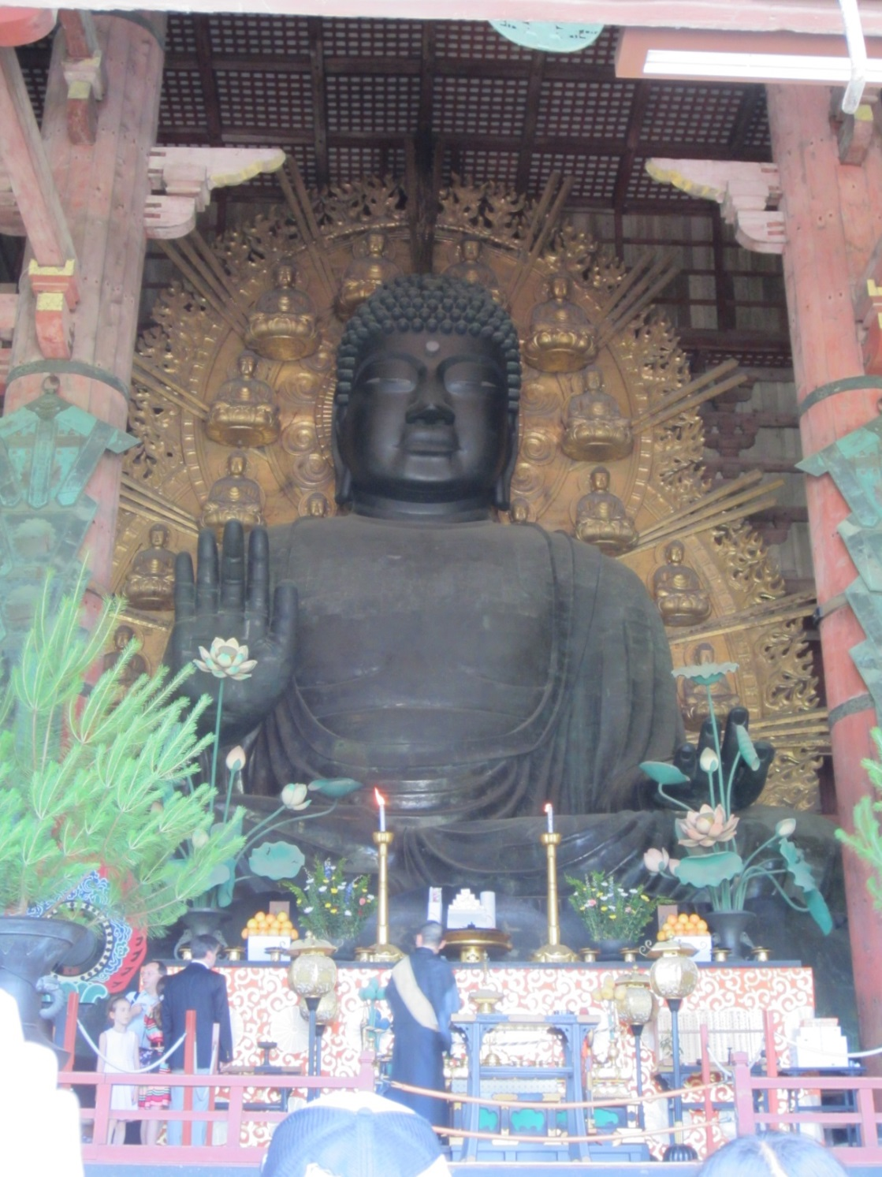
Notes:
The first Buddhist image was brought to Japan in the middle of the 6th century CE. Buddhism did not gain a strong foothold in Japan until the late 6th century with the arrival of large waves of immigrants from Korea, where Buddhism was already established. This picture shows the Daibutsu at Tōdai-ji Temple in Nara. Tōdai-ji was built in the second half of the 8th century by the Emperor Shōmu. While Buddhism had been becoming increasingly popular in Japan, Emperor Shōmu was the first emperor to rule with Buddhism as the state religion. This is the Dainichi or Vaicorana Buddha. In Mahayana Buddhism, this is the Cosmic Buddha from whom all other Buddhas emanate. Emperor Shōmu was thus choosing to associate himself with this powerful Buddha. The smaller Buddhas that encircle the larger figure on the halo represent all the other Buddhas.

Slide 3
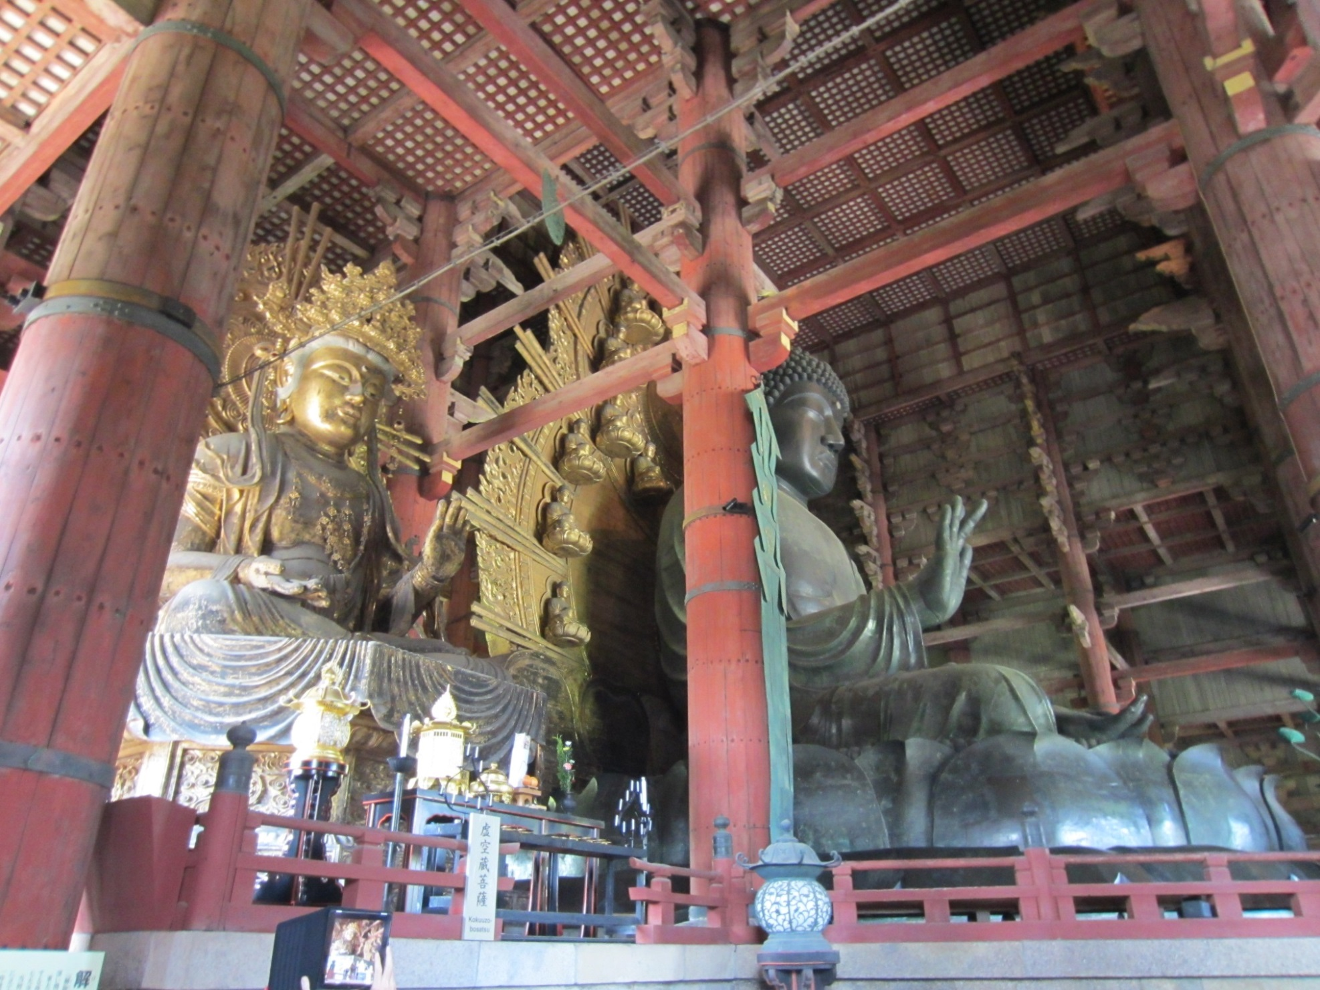
Notes:
Buddhists believe in karma, the idea that actions have consequences both in this lifetime and the next—they also believe in reincarnation. The primary goal for Buddhists is to understand the Truth of Reality, thus achieving nirvana and escaping the cycle of rebirth. Those individuals most actively seeking the Truth usually join monasteries and devote their lives to their search. For Buddhists who do not separate themselves from the world as monks or nuns, their goal is to accumulate good karma so their next life will be better than this one. Building temples and making donations to temples or monasteries is one of the primary ways that these Buddhists could accumulate good karma. The building of Tōdai-ji and its Daibutsu would have banked enormous amounts of karma for everyone involved, but particularly for Emperor Shōmu.

Slide 4
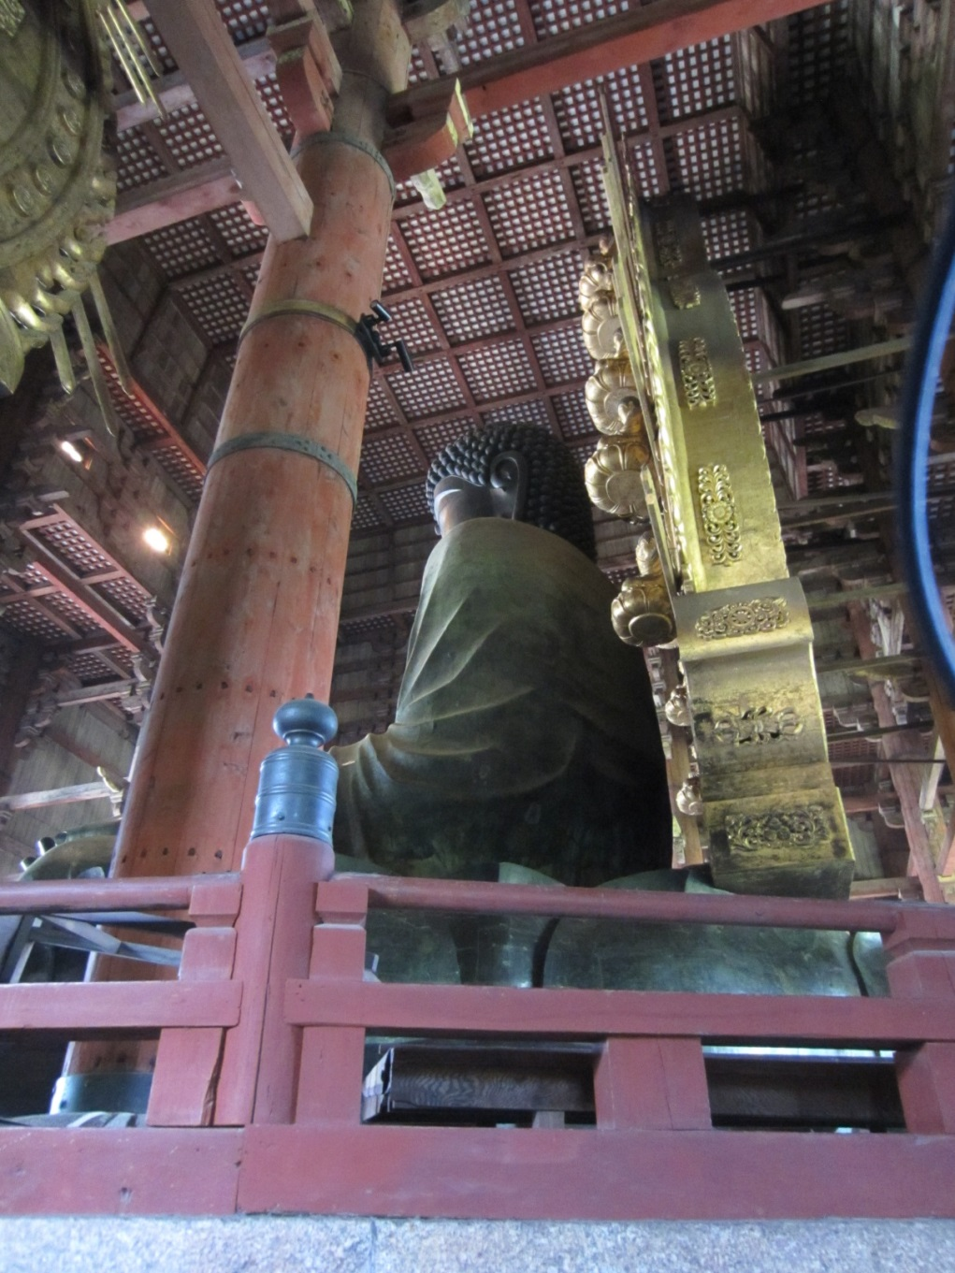
Notes:
The current structure and statue (with the exception of the base) are not the originals from the 8th century. The Great Hall has burned down and been rebuilt at least twice. The statue is cast in bronze and the building is all wood. Not only was wood used in constructing the Great Hall; it was also used as charcoal for the casting process.

Slide 5
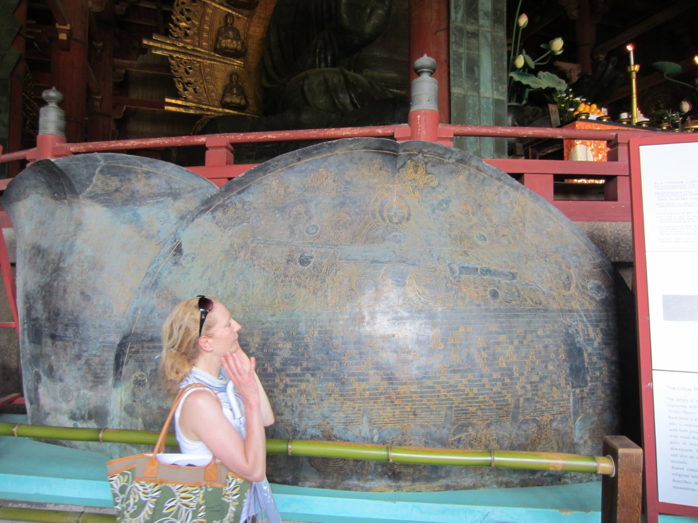
Notes:
These are replicas of the lotus petals that surround the Daibutsu. This provides some idea as to the size of the statue. One of the postcards available at the gift shop shows two workers standing in the palm of the statue’s right hand to clean it. Slide 2 shows a monk and guests at the altar at the foot of the Daibutsu.

Slide 6
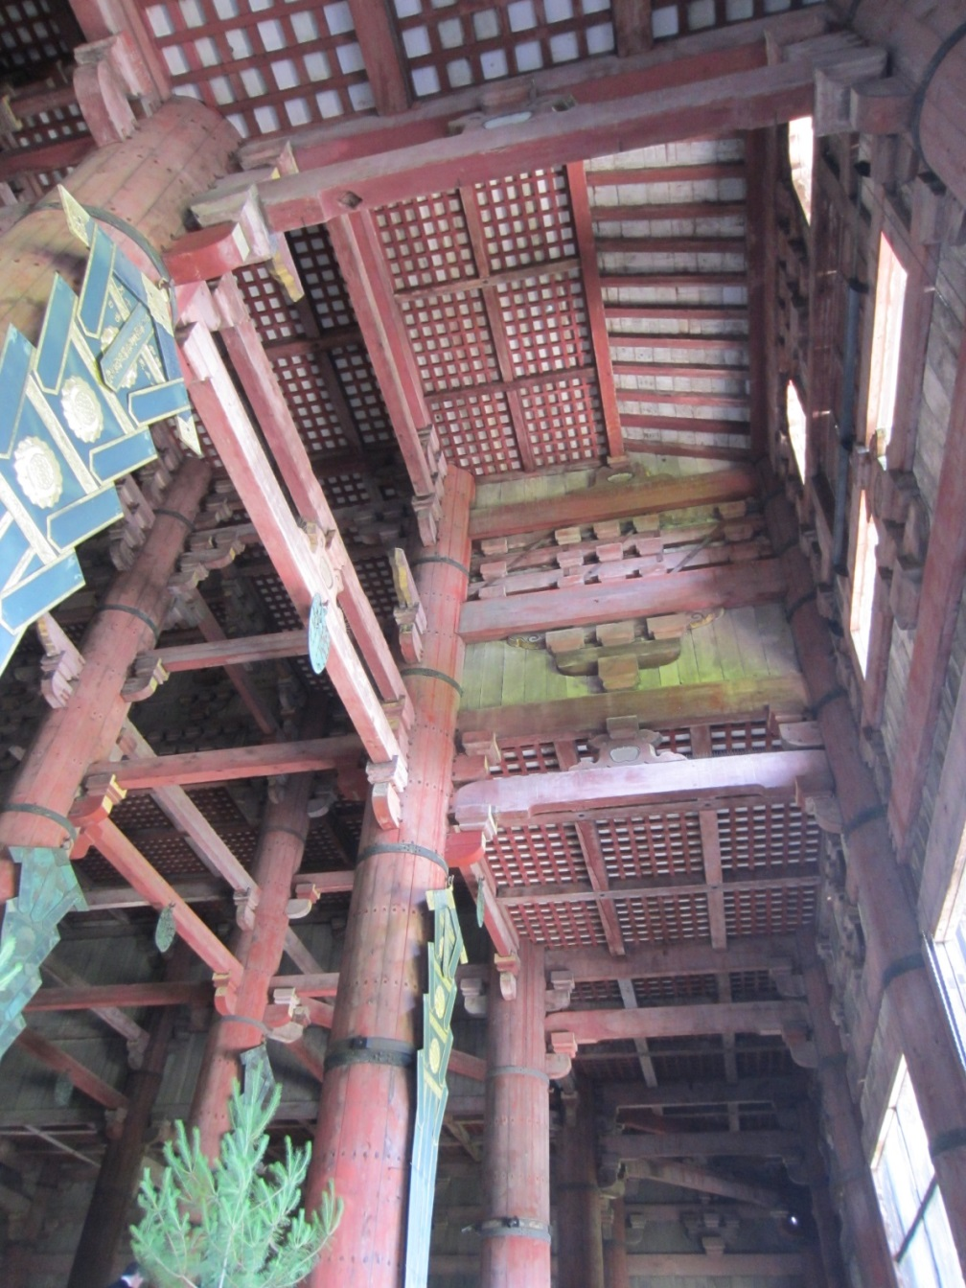
Notes:
This image is of the area immediately in front of the statue and shows details of the building’s construction.

Slide 7
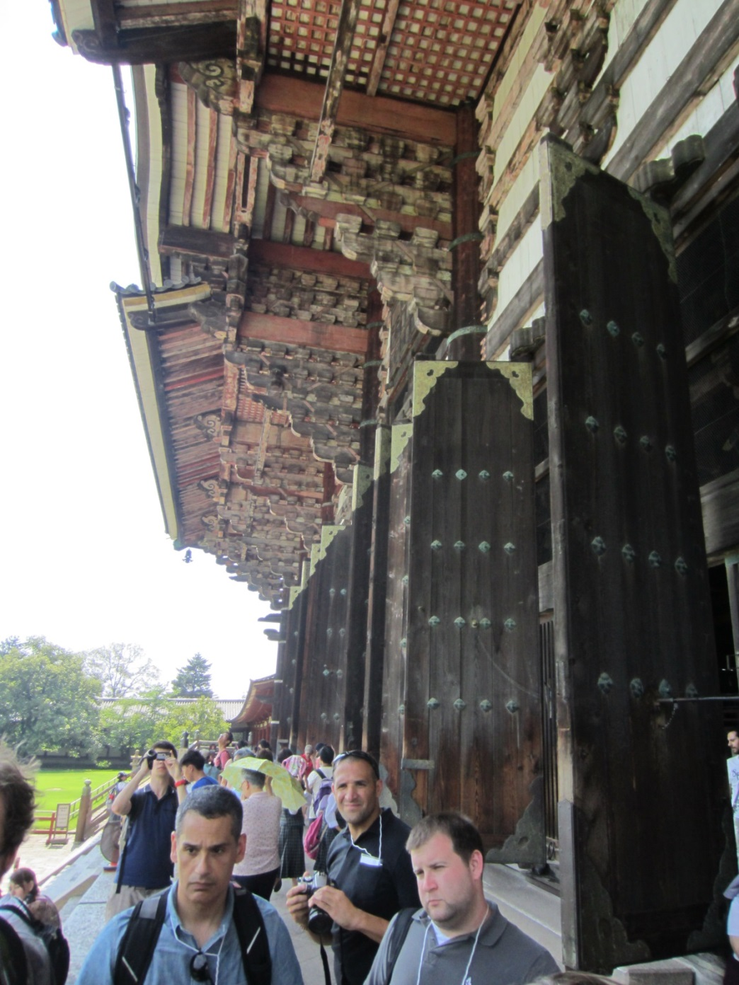
Notes:
The three people in the foreground are members of a group of teachers who traveled to Japan on a study tour. The doors behind them are the entrance to the hall.

Slide 8
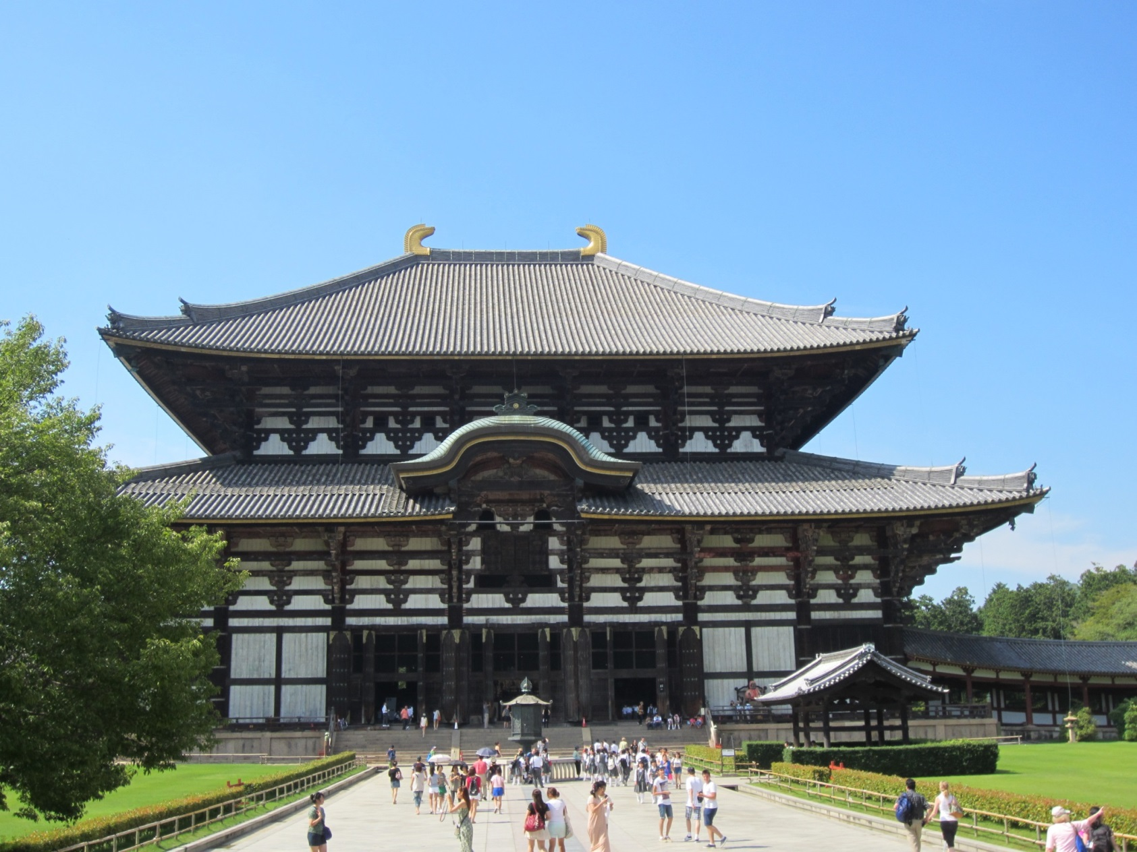
Notes:
This is the main hall at Tōdai-ji, which houses the Daibutsu. Today, this building is described as the largest wooden building in the world. It is not as wide as the original building constructed in the 8th century. The original Great Buddha Hall was 11 bays wide; the current building is 7 bays wide.

Slide 9
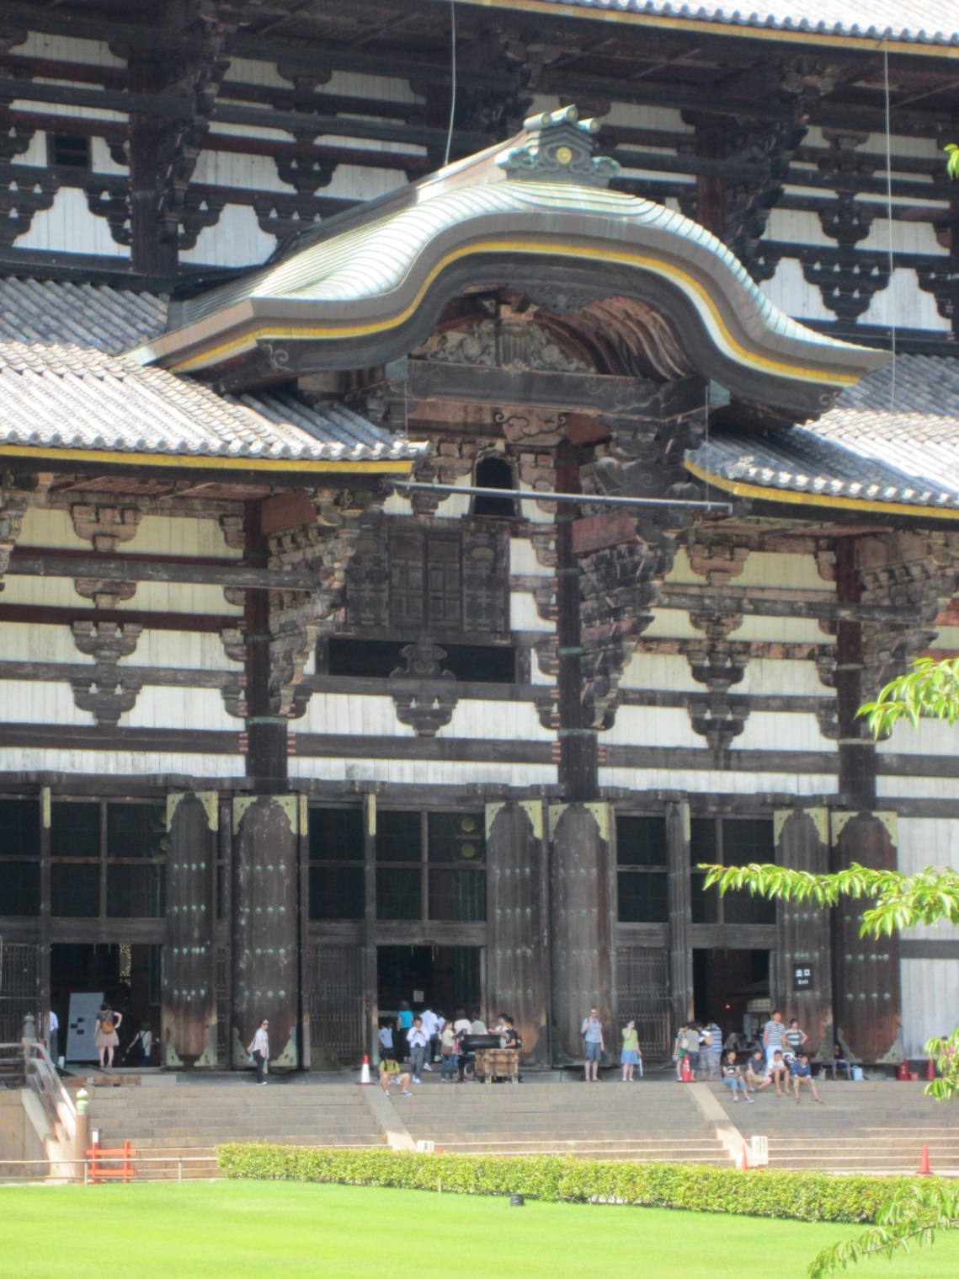
Notes:
The Daibutsu sits directly behind these main doors. The hall was built to be large enough to accommodate the Daibutsu. For New Year, the smaller doors above the central doors are opened and the Daibutsu’s face is visible.

Slide 10
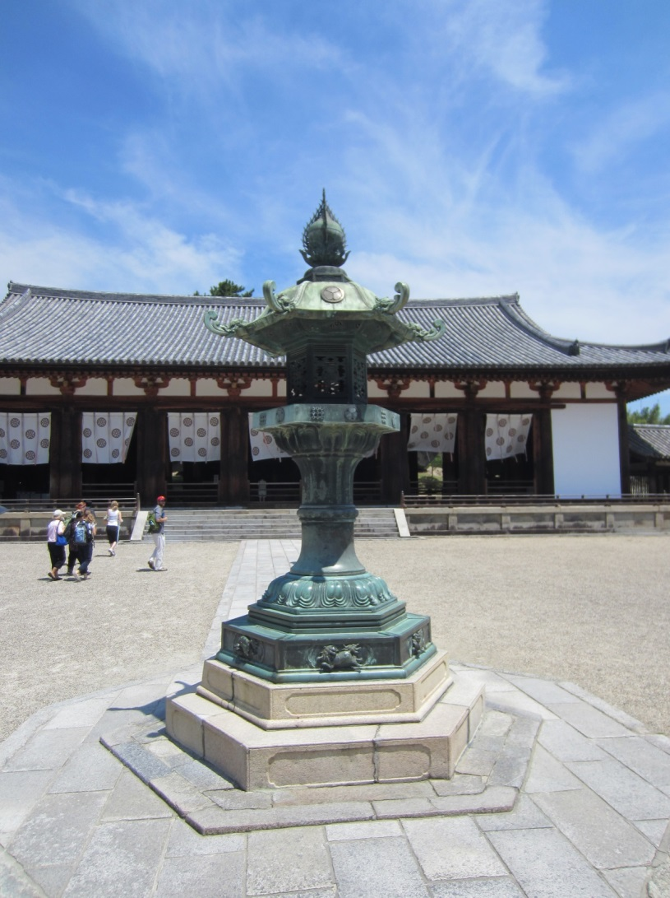
Lecture Hall at
Hōryū-ji Temple
Notes:
This lecture hall is part of another temple complex, and this image is included to provide some comparison of scale with the main hall at Tōdai-ji. In particular, compare the size of the people in this and the two previous images.

