Slide 1
“Picturing” the Invention of the Modern Japanese Man
PowerPoint compiled by Matthew Sudnik and Ted Pierce for Becoming Modern: Early 20th-Century Japan through Primary Sources. The Program for Teaching East Asia, University of Colorado Boulder, 2015.

Slide 2
Image 1: Sugoroku (Board Game) Entitled “Progression of Education for Men,” 1890.
From the collection of the Program for Teaching East Asia, University of Colorado Boulder

Slide 3
Image 2:
A Happy Worker Makes a Happy Home (Labor Welfare Association, 1932)
From Pink Tentacle, a Creative Commons site,
http://pinktentacle.com/2010/07/proletarian-posters-from-1930s-japan/

Slide 4
Image 3: The Great Disturbances in Tokyo, 1905
From The Tokyo Riot Graphic, No. 66, Sept. 18, 1905 / trg004_pg4_18Sept1905. From the collection of Andrew Gordon; used courtesy of Andrew Gordon.
http://ocw.mit.edu/ans7870/21f/21f.027/social_protest_japan/trg_gallery.html

Slide 5
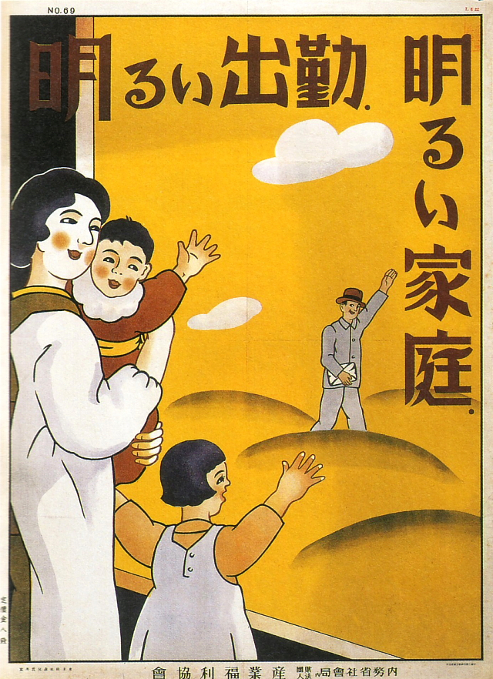
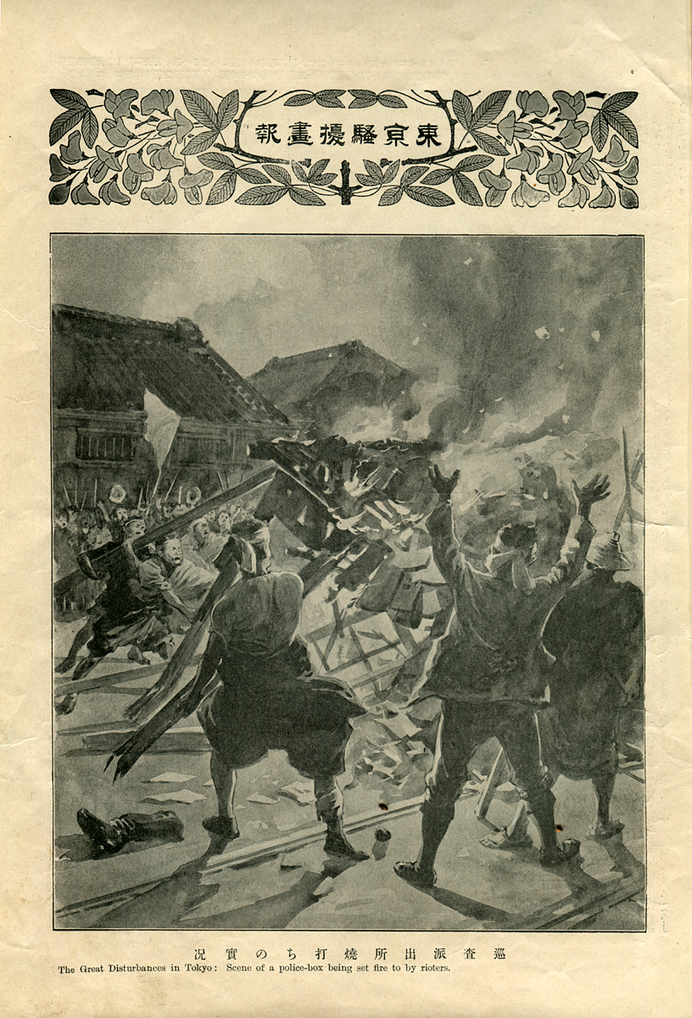
Comparing Views

Slide 6
Image 4: Labor Protest Poster, 193_
From Ohara Institute for Social Research, Hosei University Collection,
http://oohara.mt.tama.hosei.ac.jp/poster/pos_e152.html

Slide 7
Image 5: Nikke business clothing poster ad by Gihachiro Okayama
From Pink Tentacle, a Creative Commons site,
http://pinktentacle.com/2011/02/japanese-graphic-design-from-the-1920s-30s/

Slide 8
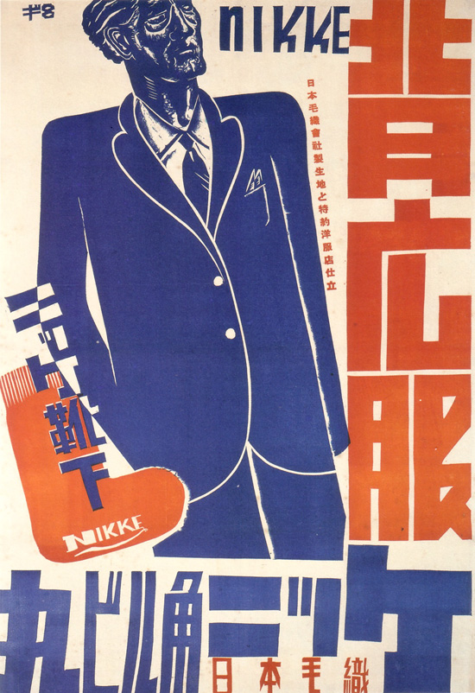
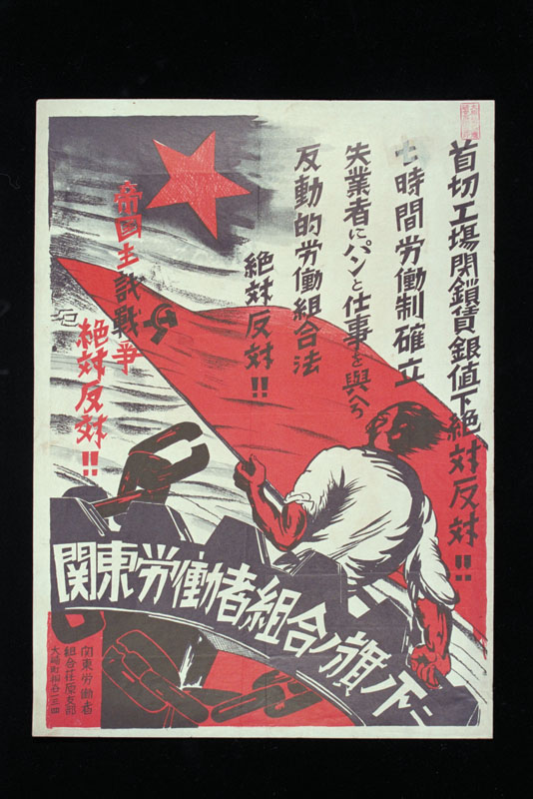
Comparing Views

Slide 9
Image 6: Nikke summer clothing poster ad by Gihachiro Okayama, 1937
From Pink Tentacle, a Creative Commons site,
http://pinktentacle.com/2011/02/japanese-graphic-design-from-the-1920s-30s/

Slide 10
Image 7: National Defense and Resources Exposition - Himeji, 1936
From Pink Tentacle, a Creative Commons site,
http://pinktentacle.com/2010/02/vintage-japanese-industrial-expo-posters/

Slide 11
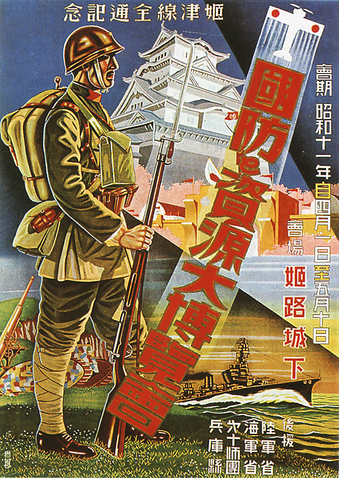
Comparing Views

