Slide 1
Taishō Women
PowerPoint compiled by Rebecca Hong, Catherine Mein, and Johanna Wintergerst for Becoming Modern: Early 20th-Century Japan through Primary Sources. Program for Teaching East Asia, University of Colorado Boulder, 2015.

Slide 2
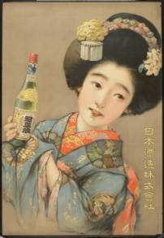
Nippon Shuzō Kabushiki Kaisha (sake brewery) 1915-1917 http://digitallibrary.usc.edu/cdm/singleitem/collection/p15799coll58/id/31484/rec/12
Notes:
Used by permission of the University of Southern California Libraries. East Asian Library.
http://digitallibrary.usc.edu/cdm/singleitem/collection/p15799coll58/id/31484/rec/12.

Slide 3
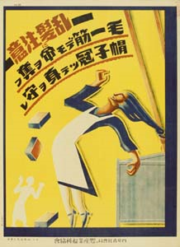
Industrial Welfare Association Poster “Pay attention to unkept hair. A single strand could take your life. Protect yourself by wearing a hat.” 1929 http://oohara.mt.tama.hosei.ac.jp/sangyofukuri/enpos1352.html
Notes:
Ohara Institute for Social Research Poster Exhibition
Industrial Welfare Association Posters http://oohara.mt.tama.hosei.ac.jp/sangyofukuri/enpos1352.html
Permission requested.

Slide 4
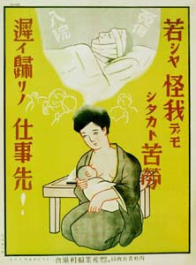
Industrial Welfare Association Poster “Coming home late from work! “She’s worrying whether you were injured at work.” 1931 http://oohara.mt.tama.hosei.ac.jp/sangyofukuri/enpos1373.html
Notes:
Ohara Institute for Social Research Poster Exhibition
Industrial Welfare Association Posters http://oohara.mt.tama.hosei.ac.jp/sangyofukuri/enpos1373.html
Permission requested.

Slide 5
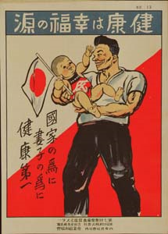
Industrial Welfare Association Poster “Health is the mother of happiness.” “For the nation, for the wife and children, health is the number one priority.” 1927 http://oohara.mt.tama.hosei.ac.jp/sangyofukuri/enpos1332.html
Notes:
Ohara Institute for Social Research Poster Exhibition
Industrial Welfare Association Posters
http://oohara.mt.tama.hosei.ac.jp/sangyofukuri/enpos1332.html
Permission requested.

Slide 6
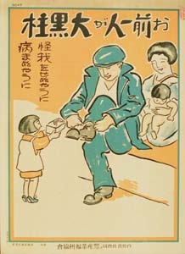
Industrial Welfare Association Poster “You’re the pillar supporting this family.” “Don’t get injured, don’t get sick.” 1930 http://oohara.mt.tama.hosei.ac.jp/sangyofukuri/enpos1362.html
Notes:
Ohara Institute for Social Research Poster Exhibition
Industrial Welfare Association Posters http://oohara.mt.tama.hosei.ac.jp/sangyofukuri/enpos1362.html
Permission requested.

Slide 7
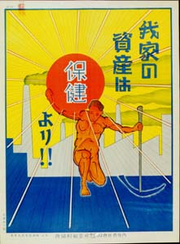
Industrial Welfare Association Poster “Our family’s assets are in our health.” 1931 http://oohara.mt.tama.hosei.ac.jp/sangyofukuri/enpos1370.html
Notes:
Ohara Institute for Social Research Poster Exhibition
Industrial Welfare Association Posters http://oohara.mt.tama.hosei.ac.jp/sangyofukuri/enpos1370.html

Slide 8
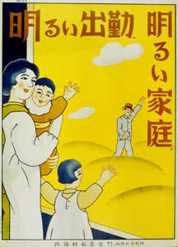
Industrial Welfare Association Poster “Happy going to work, a cheerful family.” 1932 http://oohara.mt.tama.hosei.ac.jp/sangyofukuri/enpos1384.html
Notes:
Ohara Institute for Social Research Poster Exhibition
Industrial Welfare Association Posters http://oohara.mt.tama.hosei.ac.jp/sangyofukuri/enpos1384.html

Slide 9
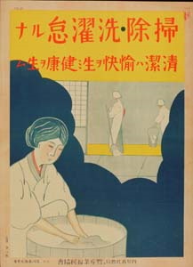
Industrial Welfare Association Poster “Do not neglect cleaning and laundry. Cleanliness/sanitation breeds a happiness and health.” 1929 http://oohara.mt.tama.hosei.ac.jp/sangyofukuri/enpos1354.html
Notes:
Ohara Institute for Social Research Poster Exhibition
Industrial Welfare Association Posters http://oohara.mt.tama.hosei.ac.jp/sangyofukuri/enpos1354.html
Permission requested.

Slide 10
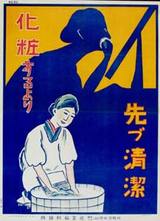
Industrial Welfare Association Poster “Before cosmetics, first be clean.” 1932 http://oohara.mt.tama.hosei.ac.jp/sangyofukuri/enpos1385.html
Notes:
Ohara Institute for Social Research Poster Exhibition
Industrial Welfare Association Posters http://oohara.mt.tama.hosei.ac.jp/sangyofukuri/enpos1385.html
Permission requested.

Slide 11
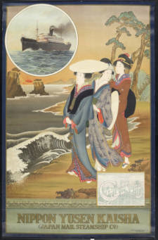
Nippon Yusen Kaisha (Japan Mail Steamship Co.) 1919 http://digitallibrary.usc.edu/cdm/singleitem/collection/p15799coll58/id/31448/rec/5
Notes:
Used by permission of the University of Southern California Libraries, East Asian Library.
http://digitallibrary.usc.edu/cdm/singleitem/collection/p15799coll58/id/31448/rec/5

Slide 12
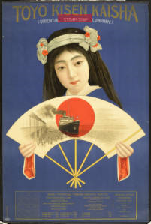
Toyo Kisen Kaisha (Oriental Steamship Co.) 1917 http://digitallibrary.usc.edu/cdm/singleitem/collection/p15799coll58/id/31444/rec/8
Notes:
Used by permission of the University of Southern California Libraries, East Asian Library.
http://digitallibrary.usc.edu/cdm/singleitem/collection/p15799coll58/id/31444/rec/8

Slide 13
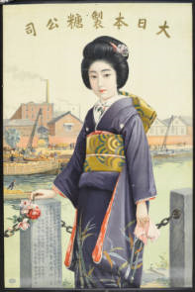
Dai Nippon Seitō Kōshi (sugar refining company) 1914/1943 http://digitallibrary.usc.edu/cdm/singleitem/collection/p15799coll58/id/31468/rec/1
Notes:
Used by permission of the University of Southern California Libraries, East Asian Library.
http://digitallibrary.usc.edu/cdm/singleitem/collection/p15799coll58/id/31468/rec/1

Slide 14
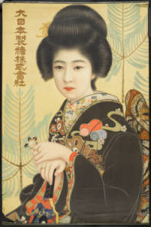
Dai Nippon Seitō Kabushiki Kaisha (sugar refining company) 1914/1919 http://digitallibrary.usc.edu/cdm/singleitem/collection/p15799coll58/id/31470/rec/2
Notes:
Used by permission of the University of Southern California Libraries, East Asian Library.
http://digitallibrary.usc.edu/cdm/singleitem/collection/p15799coll58/id/31470/rec/2

Slide 15
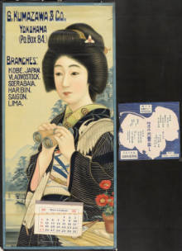
G. Kumazawa and Co. (Textile merchants) 1921 http://digitallibrary.usc.edu/cdm/singleitem/collection/p15799coll58/id/31475/rec/10
Notes:
Used by permission of the University of Southern California Libraries, East Asian Library.
http://digitallibrary.usc.edu/cdm/singleitem/collection/p15799coll58/id/31475/rec/10

Slide 16
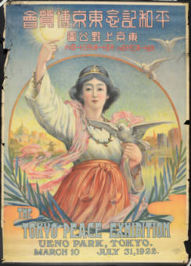
Tokyo Peace Exhibition:Ueno Park, Tokyo. March 10 July 31, 1922.
1922
http://digitallibrary.usc.edu/cdm/singleitem/collection/p15799coll58/id/31483/rec/4
Notes:
Used by permission of the University of Southern California Libraries, East Asian Library.
http://digitallibrary.usc.edu/cdm/singleitem/collection/p15799coll58/id/31483/rec/4

Slide 17
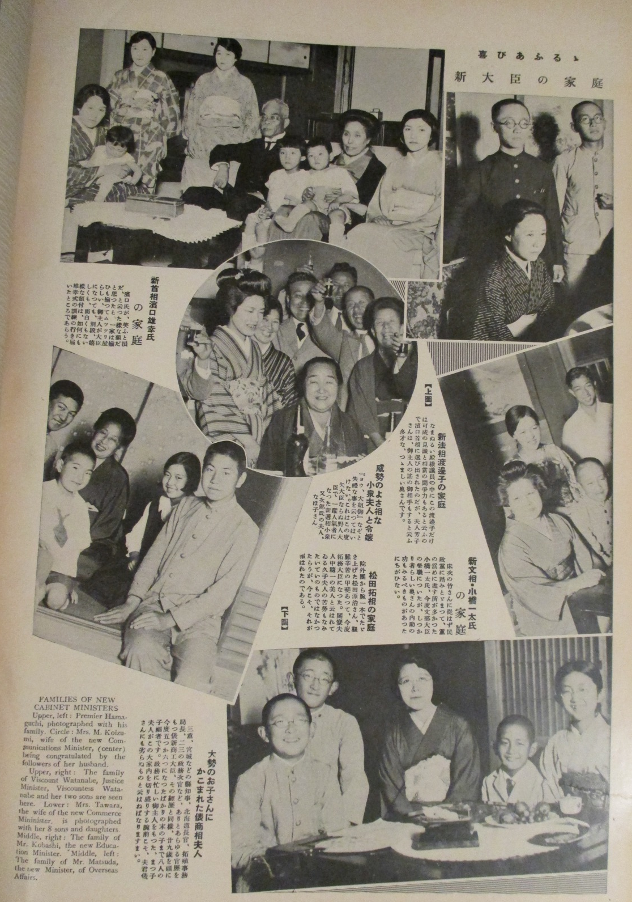
Families of New Cabinet Ministers The International Graphic, Vol. VIII, No. 8 January 1930
Notes:
From the collection of the Program for Teaching East Asia at the University of Colorado Boulder.

Slide 18
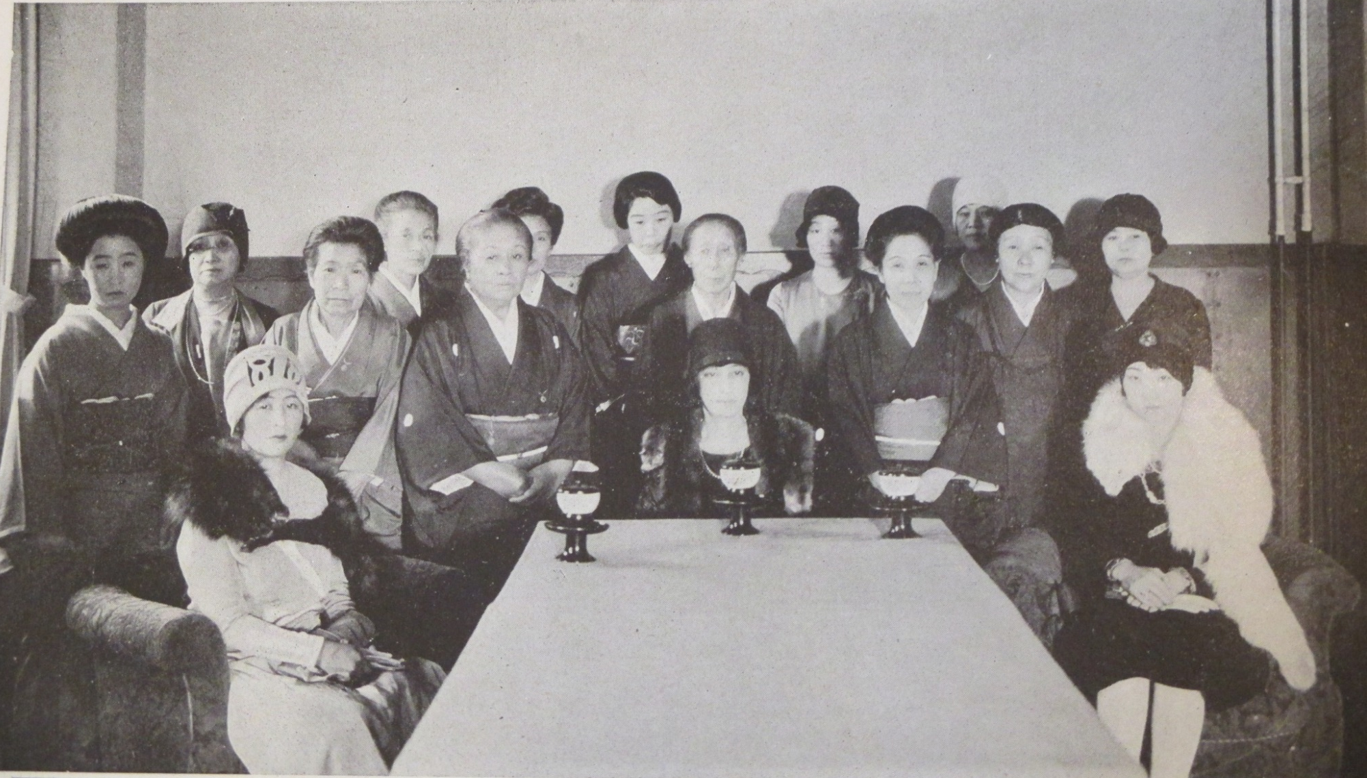
40th Anniversary Meeting of the Educational Society of All Japan Women Attended by Imperial Princesses and Noted Women Educators The International Graphic, Vol. IX, No. 1 January 1931
Notes:
From the collection of the Program for Teaching East Asia at the University of Colorado Boulder.

Slide 19
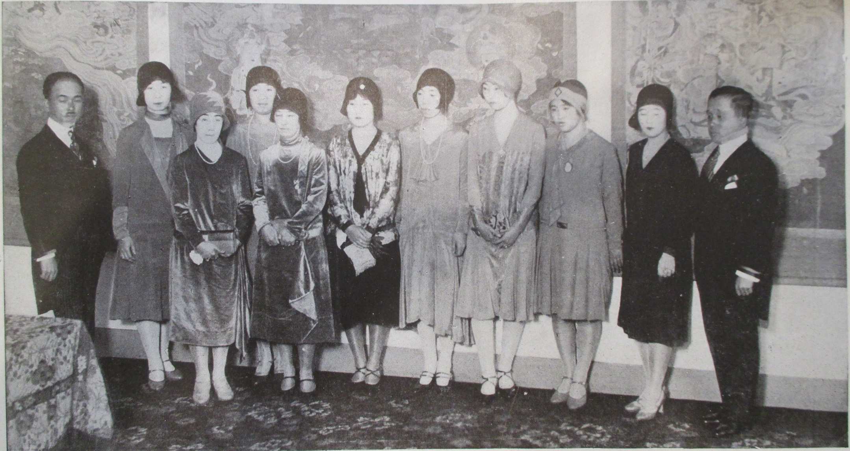
50th Anniversary of the Establishment of the Tokyo Music Academy, with All Imperial Princes and Princesses in Attendance The International Graphic, Vol. IX, No. 1 January 1931
Notes:
From the collection of the Program for Teaching East Asia at the University of Colorado Boulder.

Slide 20
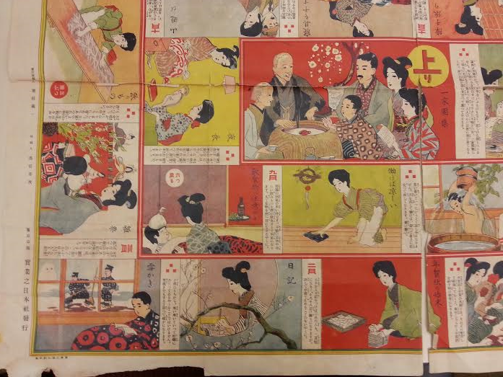
Sugoroku (Board Game) Distributed with Fujin Sekai (Women’s World magazine), New Year’s Free Edition Gift, part 1
Notes:
From the collection of the Program for Teaching East Asia at the University of Colorado Boulder.

Slide 21
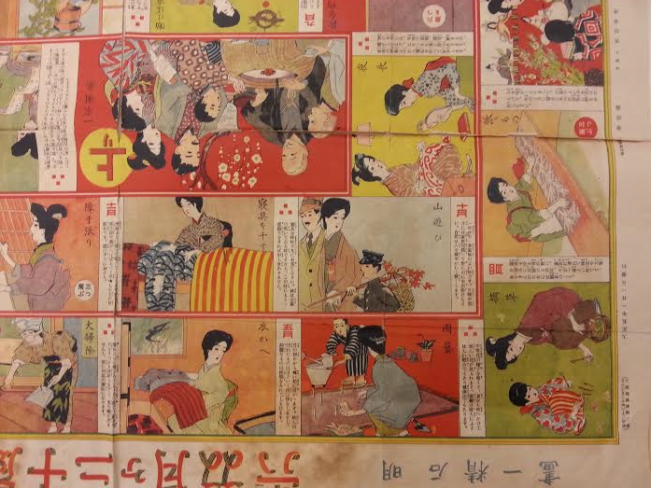
Sugoroku (Board Game) Distributed with Fujin Sekai (Women’s World magazine), New Year’s Free Edition Gift, part 2
Notes:
From the collection of the Program for Teaching East Asia at the University of Colorado Boulder.

Slide 22
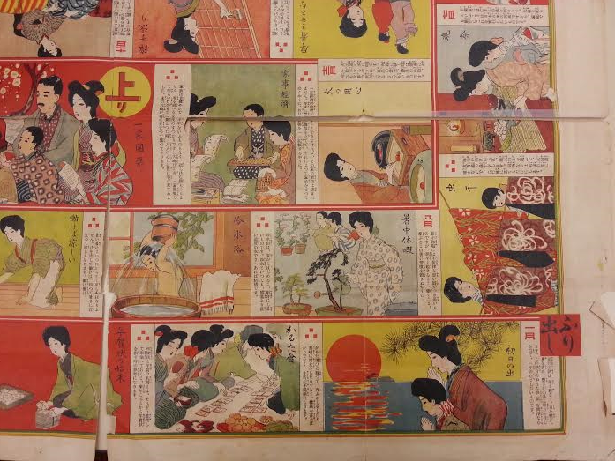
Sugoroku (Board Game) Distributed with Fujin Sekai (Women’s World magazine), New Year’s Free Edition Gift, part 3
Notes:
From the collection of the Program for Teaching East Asia at the University of Colorado Boulder.

Slide 23
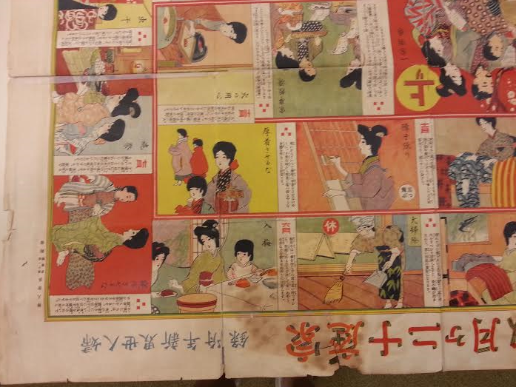
Sugoroku (Board Game) Distributed with Fujin Sekai (Women’s World magazine), New Year’s Free Edition Gift, part 4
Notes:
From the collection of the Program for Teaching East Asia at the University of Colorado Boulder.

