Slide 2
Home
Welcome!
Here you can explore the CU Boulder Political Science Department. We offer courses in the following six subfields led by our award-winning faculty:
American Politics
International Relations
Political Theory
Methodology
Comparative Politics
Public Policy
Or you can go through our interactive roadmap, simulating what the next four years may look for you! PSCI Choose Your Own Adventure

Slide 3
American Politics
This field focuses on the domestic politics of the United States, ranging from constitutional law to judicial law to campaign policy.
We offer a wide range of courses in this area, including (but not limited to):
Introduction to American Politics
The American Presidency and the Executive Branch
U.S. Campaigns and Elections
The American Congress
National Security Organizations and Policy Making
The Politics of Economic Inequality in the United States
Gender, Sexuality, and the U.S. Law
Political Parties and Interest Groups
Law and Society: Legal Institutions and Human Behavior
Political Psychology
Next
Home

Slide 4
American Politics
CU faculty who specialize in this are: | Vanessa Baird | Kenneth Bickers | Nancy Billica
Janet Donavan | Srinivas Parinandi | Anand Sokhey | Joshua Strayhorn
Back
Home
Next

Slide 5
International Relations
This field focuses on how countries interact with each other and the broader global community, focusing on issues like diplomacy, conflict, cooperation, and international organizations.
We offer a wide range of courses in this area, including (but not limited to):
Introduction to International Relations
War, Peace, and Strategic Defense
Current Affairs in International Relations
International Law
International Political Economy
International Migration and Policy
International Law
International Behavior
Europe and the International System
International Organizations
Next
Home

Slide 6
International Relations
CU faculty who specialize in this are: | Aysegul Aydin | Carew Boulding | Joe Jupille
Clara Park | Megan Shannon | Adrian Shin | Jaroslav Tir
Back
Home
Next

Slide 7
Political Theory
This field focuses on how ideas and concepts shape politics, including justice, power, and governance. It explores various ideologies and theories to understand political systems and behavior.
We offer a wide range of courses in this area, including (but not limited to):
Survey of Western Political Thought
American Political Thought
Sex, Power, and Politics
Race, Power, and Politics
Capitalism and It’s Critics
Free Speech and Dangerous Ideas
Liberalism and It’s Critics
Theory of Identity
Environmental Political Theory
Politics and Literature
Next
Home

Slide 8
Political Theory
CU faculty who specialize in this are: | Janet Donavan | Michaele Ferguson
 | Tamar Malloy | Steve Vanderheiden
Back
Home
Next

Slide 9
Methodology
This field focuses on how to develop and apply different research methods to study political phenomena, using techniques like statistics and experiments to understand political behavior and institutions.
We offer a wide range of courses in this area, including (but not limited to):
Quantitative Research Methods
Applied Political Science Research
Designing Social Inquiry
Survey Design and Analysis
Undergraduate Research Fellowship
Strategy and Politics
Honors Seminar in Political Science
Political Science Honors Thesis
Advance Political Data Analysis
Qualitative Methods
Next
Home

Slide 10
Methodology
CU faculty who specialize in this are: | Vanessa Baird | Andrew Philips | Alexandra Siegel
 | Anand Sokhey | Joshua Strayhorn
Back
Home
Next

Slide 11
Comparative Politics
This field focuses on how to develop and apply different research methods to study political phenomena, using techniques like statistics and experiments to understand political behavior and institutions.
We offer a wide range of courses in this area, including (but not limited to):
Quantitative Research Methods
Applied Political Science Research
Designing Social Inquiry
Survey Design and Analysis
Undergraduate Research Fellowship
Strategy and Politics
Honors Seminar in Political Science
Political Science Honors Thesis
Advance Political Data Analysis
Qualitative Methods
Next
Home

Slide 12
Comparative Politics
CU faculty who specialize in this are: | Vanessa Baird | Carew Boulding | Jennifer Fitzgerald
 | Joe Jupille | Andrew Philips | Sarah Sokhey
Back
Home
Next

Slide 13
Public Policy
This field focuses on how governments tackle societal issues through decision-making, implementation, and evaluation, drawing from multiple disciplines to inform governance.
We offer a wide range of courses in this area, including (but not limited to):
Introduction to Public Policy
Introduction to Environmental Policy
Environment and Public Policy
Politics of Social Policy
Inequality and Public Policy in the US and Europe
Next
Home

Slide 14
Public Policy
CU faculty who specialize in this are: | Kenneth Bickers | Srinivas Parinandi
 | Adrian Shin | Steve Vanderheiden
Back
Home

Slide 15
Choose Your Own Adventure
Congratulations on joining CU as a political science major! We are so excited to have you. Here is a choose-your own adventure game featuring your next four years at CU!
Onwards!
Home

Slide 16
Terms to Know
Before you start, here’s some helpful terminology!
Lower-division courses: courses that begin with 1000 or 2000, typically taken by freshmen and sophomores
Upper-division courses: courses that begin with 3000 or 4000, typically taken by juniors and senior
Credits: “points” that count towards your degree. PSCI classes are worth 3 credits; you need 42 PSCI credits to major, and 120 credits to graduate. These are based on the number of hours spent in class during the week. Also referred to as credit hours.
Recitation: Supplementary class to main lecture.
Gold underlined text will lead you to a different place in the pathway. Gray underlined text will take you to an external site.
Freshman Year
Home
Notes:
Prereqs, coreqs?

Slide 17
Freshman Year
Freshman year for most political science majors will look relatively similar. There are five required lower-division classes for the political science major:
PSCI 1101:Intro to American Politics
PSCI 2012: Intro to Comparative Politics
PSCI 2223: Introduction to International Relations
PSCI 2004: Survey of Western Political Thought
PSCI 2075: Quantitative Research Methods
You may take these in any order at any point you wish, but it's generally recommended you have completed these by the end of your sophomore year, as many upper-division classes require these as prerequisites. These classes also have a recitation component besides the large lecture.
Next
Home

Slide 18
Freshman Year
Additionally, you will most likely need to take general education requirements in the following areas:
World Language
Quantitative Reasoning and Mathematical Skills
Written Communication (upper and lower division)
Arts and Humanities (12 credits)
Natural Sciences (12 credits including a lab)
Social Sciences (12 credits)
U.S. Perspective (3 credits)
Global Perspective (3 credits)
These can be completed via transfer credits (AP/IB, community college, etc)! In addition, some courses count for both the PSCI major and gen ed requirements. The remaining credits are a great way to learn more and gain skills outside the PSCI field!
Next
Home

Slide 19
Freshman Year
Don't forget to get involved on campus! Clubs and extracurriculars are a great way to find like-minded people on campus. In addition, they look great on college resumes. We offer multiple political science-focused clubs, plus many more!
CU Political Science Club
Pi Sigma Alpha
Colorado Political Science Review
CSI Be Involved Club List
Sophomore Year
Home

Slide 20
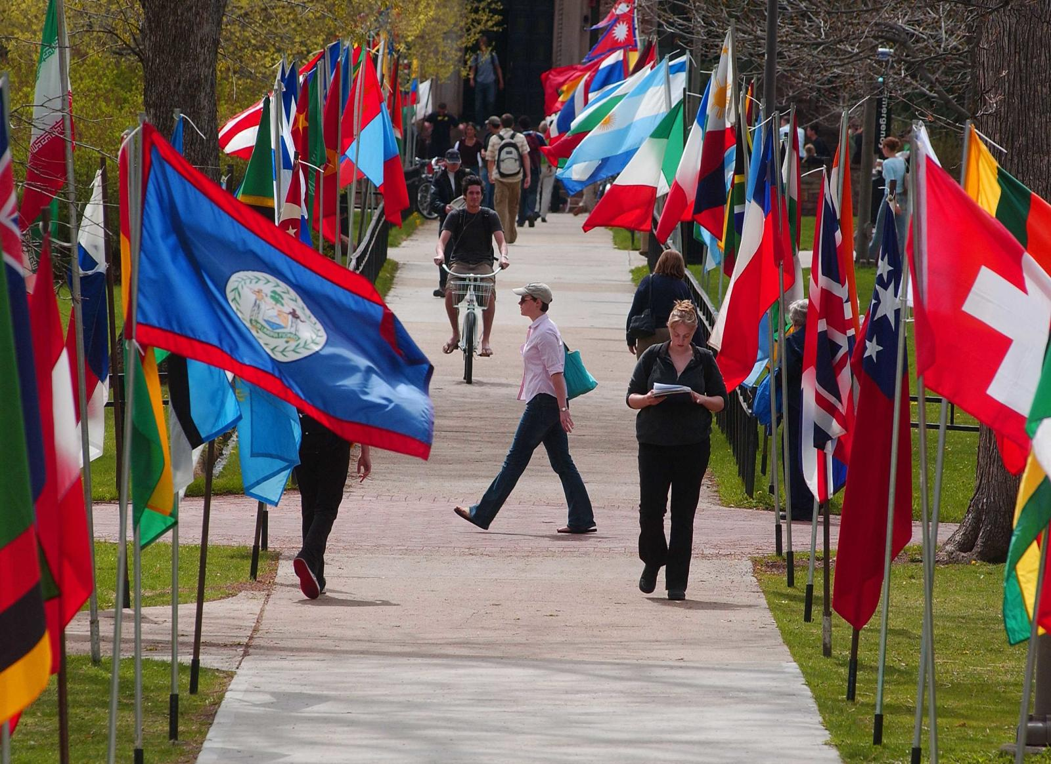
Sophomore Year
This year, you may continue to finish your required classes as well as continue knocking out some more gen eds. People often pick up a minor at this point as well. In addition, students are avble to continue applying to scholarships through the CU Boulder Scholarship Application.
Minors
Scholarships
Junior Year
Home

Slide 21
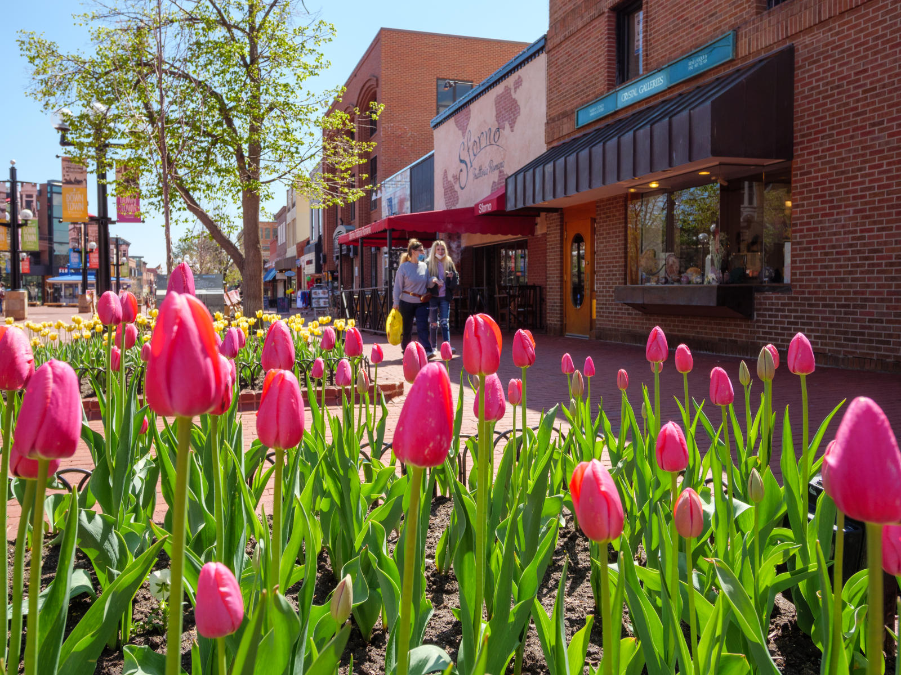
Junior Year
This year, you are beginning to focus more on a field you're interested in, as well as the different careers you may want after school. Were you particularly engaged by Dr. Tir's intro to international relations course? Take an upper division course! Are looking for more research experience? Take one of our methods classes. Make sure to consider outside experiences, like and internship or study abroad course.
Internships
Study Abroad
Senior Year
Home

Slide 22
Senior Year
Congrats, you made it! Graduation is closing in. Make sure you check your degree audit in BuffPortal to see what classes you have left to take.
It’s time to decide what you want to do after graduation. Enter the workforce? Go to law school or grad school? Take a gap year?
Next
Home

Slide 23
Senior Year
Don’t worry, we are here to help! Check out the following sites for inspiration for life after graduation:
Pathways of Political Science
Next
Home

Slide 24
Congratulations!
You made it to the end! You are now a college graduate with a B.A. in Political Science. It’s time for you to go forth in the world and do great things.
This is the end of this adventure, however. Click ‘Home’ to return to the main page and explore some of the other features.
Home

Slide 25
CU Political Science Club
The CU Political Science Club is a place for students to meet and discuss national, state, and local politics. Meetings feature lively discussions of current events, and we frequently host guest speakers from local and statewide offices, as well as campaign operatives and political appointees. This is a great place to meet your fellow students and we welcome anybody with views all across the political spectrum.
Find more here: CU PSCI Club
Back

Slide 26
Pi Sigma Alpha
Pi Sigma Alpha is the National Political Science Honors Society. A 100 year old organization, Pi Sigma Alpha has over 800 chapters across the United States. One president, three Supreme Court Justices and dozens of congresspeople have been a part of the organization.
Both Political Science majors and minors are eligible for membership. By joining, you are given access to a number of resources such as scholarship opportunities, leadership opportunities, recognition of academic excellence and much more!
Find more here: CU Pi Sigma Alpha
Back

Slide 27
Colorado Political Science Review
CPSR is a student-written and student-edited journal bringing political science perspectives to important issues of the day. The opinions and perspectives in the CPSR are those of the individual authors. We seek to generate thoughtful discussion and analysis rooted in social science theory and supported by research and data. The CPSR is housed in the Political Science Department at the University of Colorado Boulder and is supported by the American Politics Research Lab and the LeRoy Keller Center for the Study of the First Amendment.
Find more here: Colorado Political Science Review
Back

Slide 28
CSI Be Involved Club List
The CU Boulder Center for Student Involvement maintains a directory of all student organizations and involvement opportunities here: Involvement Directory
Back

