Slide 1
English is the Hottest New Programming Language
The AI Catalyst Model for Advanced Computing Ambassadorship
Liza Long — Director of Digital Learning & AI, Idaho State Board of Education,
Ph.D. Student, English, Idaho State University

Slide 2

What happens when a computer learns to write and Code?
Writing and coding are the two fields LLMs disrupted most — and the two where expertise still matters most
For decades, we taught humans to speak machine: Assembly, C, Python, SQL
LLMs flipped the script
“Vibe coding” is describing intent, not writing syntax
The question for both fields: how do we train the next generation of experts?

Slide 3
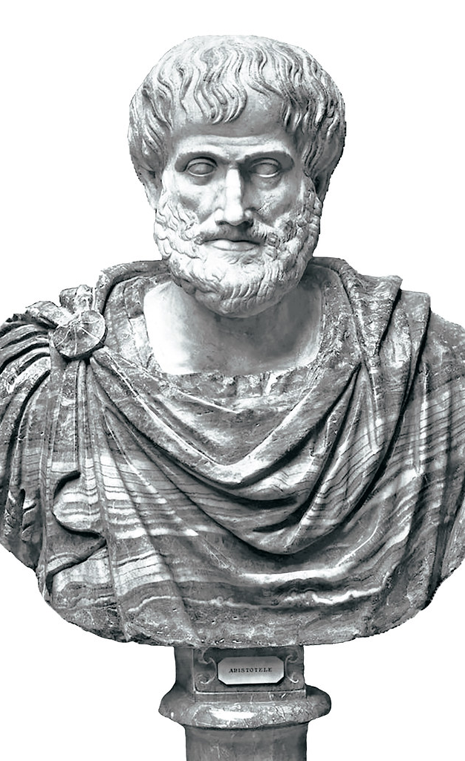
Prompt engineering is rhetoric
Aristotle called it: logos (task/reasoning structure), ethos (role/authority frame), pathos (audience and stakes)
Knowing your audience means knowing your model
Iteration, revision, argumentation — this is what English teachers have always taught

Slide 4
Your infrastructure runs on language now
HPC workflows increasingly involve LLM layers
The technical how is automating — the conceptual what and ethical why are the new scarce skills
Two bottlenecks, both linguistic: prompt quality (can you formulate the problem?) and discernment (is the output true, sound, usable?)
Who on your team is trained to evaluate an argument?

Slide 5

Idaho had to figure out AI literacy partnerships fast
8 public colleges and universities
Significant rural, first-generation, workforce-focused population
2025: new statewide Director of Digital Learning & AI (that’s me)
No playbook. No staff. $1.5M federal grant. Go.
This Photo by Unknown Author is licensed under CC BY

Slide 6
Accelerate Idaho:
A vision for Idaho’s digital future
FIPSE-funded statewide initiative
Co-developed with Jason Blomquist, BSU Nursing Professor and former AI Fellow, and Joel Gladd, CWI Department Chair of Integrated Studies and AI Statewide Lead
Faculty development + curriculum integration across all 8 institutions
Built on a core premise: AI fluency is a humanities problem as much as a technical one
Bottom-up, faculty-led — not a top-down mandate
Funding technical innovation too — AI Innovation Awards designed to support work like Boisestate.ai and U of Idaho local language model efforts
Year 1 goal: seed every institution with an AI Catalyst cohort

Slide 7

AI Catalysts:
Faculty ambassadors
Ambassadors translate between worlds — here, between technical infrastructure and ethical, literate practice
They model the “human in the loop” — the critical inquiry that keeps AI accountable to truth and purpose
They redesign courses for an AI-present world, using AI tools critically and ethically
They bridge their disciplines to institutional change — humanities faculty especially, bringing rhetoric and discernment to the work
They share back: case studies, frameworks, peer teaching

Slide 8
How our Catalyst cohort works
Year 1 (2025-2026): statewide AI lead (Joel Gladd) + 1 faculty catalyst at each of 8 public IHEs
With grant (Year 2): Director of AI manages the program; 2 faculty catalysts per institution
Catalysts are faculty champions — not staff
Bi-weekly meetings alternating with bi-weekly virtual webinars/show and tell sessions
Paired with the statewide Teaching & Learning with Technology Committee (TLTC) for staff, instructional design, LMS, CTE
Biweekly cohort meetings, peer “show and tell” webinars, annual symposium
Conduit of best practices and information for knowledge sharing among institutions

Slide 9
In their own words: AI Catalysts
“Our North Star is to empower faculty with AI implementation.”
— Joel Gladd, Statewide AI Lead
“There’s no way you could plan for those sorts of things [rapid shifts in AI capabilities]… that’s part of why we do these regular, convenient meetings.”
— Bert Baumgaertner, University of Idaho Philosophy professor
“I still feel like I’ve got some people who are AI skeptics… it’d be nice to have more things that take less for someone less inclined to get excited about AI to figure out, oh, they actually have some things that are useful.”
— Abraham Romney, Idaho State University English professor
“Run a webinar every so often (quarter?) giving state and national level updates; like your weekly drop in but more formal and sent to wider audience. Hearing directly from OSBE has a strong impact.”
— Jillana Finnegan, CWI Strategic Projects Executive Director

Slide 10

What’s next for AI Catalyst program
Refocused webinar program — fewer, more workflow-driven sessions
Dedicated AI Catalyst YouTube channel — full recordings + short clips, “get ready with me” workflow videos
Centralized wiki / resource hub; expanded Idaho AI Alliance Google Group
Stronger onboarding for new Catalysts — reach the AI-skeptical faculty too
In-person hybrid statewide conference — travel funding secured
Measuring what matters — assessment plan built on a baseline survey of faculty AI perceptions across disciplines, plus a successful small-scale Boodlebox pilot to build on

Slide 11
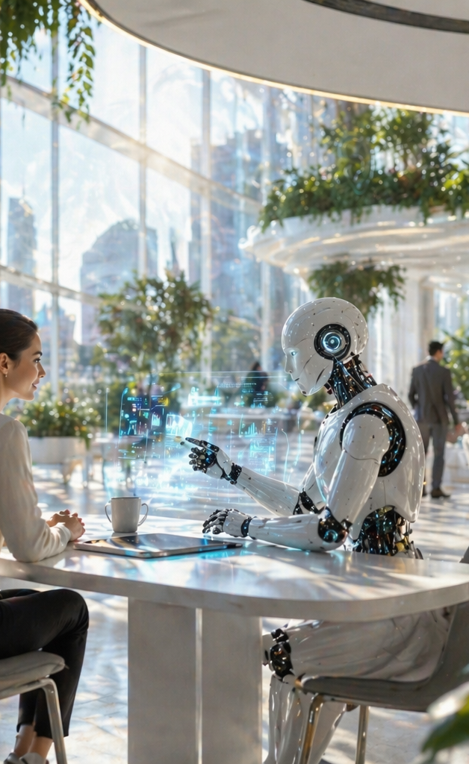
What employers actually need
Technical skills have a 2–3 year half-life in AI
Industry expects graduates ready to perform at Level 2/3 from day one — deeper industry-education partnership needed
Durable skills: critical thinking, communication, ethical reasoning, adaptability
The employee who can direct an AI system outperforms the one who only operates it
The durable skill is problem formulation — and humanities faculty teach it
Executive Summary from April 2026 Innovate Idaho Industry Leader Panel
Image created by ChatGPT 5.3, April 23, 2026

Slide 12

STEM+Humanities=AI Future
Humanities: rhetoric, discernment, ethical reasoning, problem formulation
Computer science: systems thinking, computational rigor, debugging mindset, formal logic
Humanities faculty have as much to learn from CS as the reverse — this is reciprocal, not hierarchical
The student who can code and argue and question is the one who matters
Institutions that figure out this integration first will win
Image created by ChatGPT 5.3, May 12, 2026

Slide 13

Building partnerships
Start talking with humanities faculty — informally, before the meetings
Involve them in curriculum decisions, not just consultation
Find ways to teach AI across the curriculum, not in silos
Identify your AI ambassadors in English, philosophy, history, communication
Ask the harder question: who’s missing from the table?

Slide 14

Intertwined futures
HPC needs the humanities. The humanities need HPC. Neither survives this era alone
The AI Catalyst model is one structure for that partnership — replicable, faculty-led, built for the institutions you already have
Idaho is betting on humanities partnerships. The question is who you’ll partner with — and when you’ll start

Slide 15
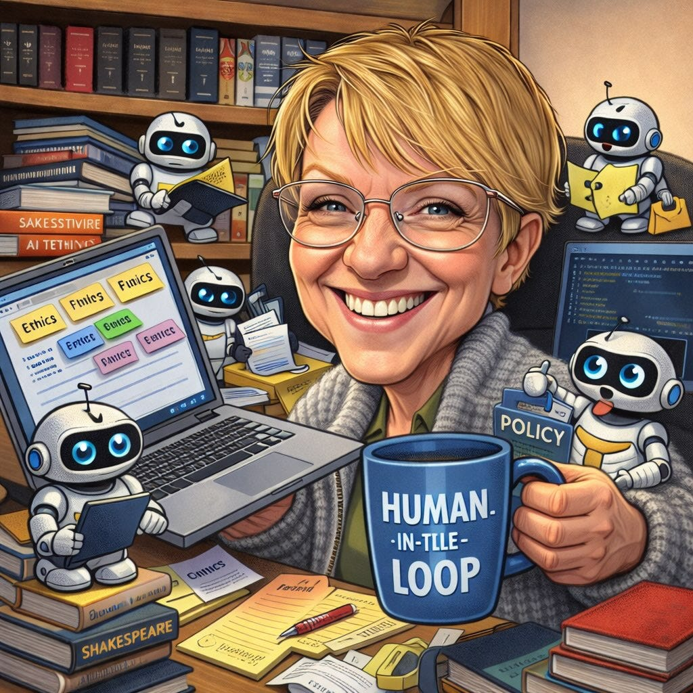
Let’s Talk!
Liza Long llong@edu.idaho.gov
Artisanal Intelligence on Substack
LinkedIn
Teaching and Learning with Artificial Intelligence
Cyborgs and Centaurs: Writing in the Age of AI
Critical Worlds: A Targeted Approach to Literary Analysis
Policy Priorities for Generative AI and Open Education (DOERS)
Accessibility by Design

