Slide 1


Welcome!
We’ll get started very shortly…
Workshop link: https://tinyurl.com/rmacc2026

Slide 2



Intro to Large Language Models
Michaela Buchanan
Mark III Systems

Slide 3
Goals for this session
Prerequisite: Prior knowledge of neural networks and Python recommended
Just a starting point
  Will require more study on transformers
More practical than academic
  Will have concepts first and then workshop

Slide 4
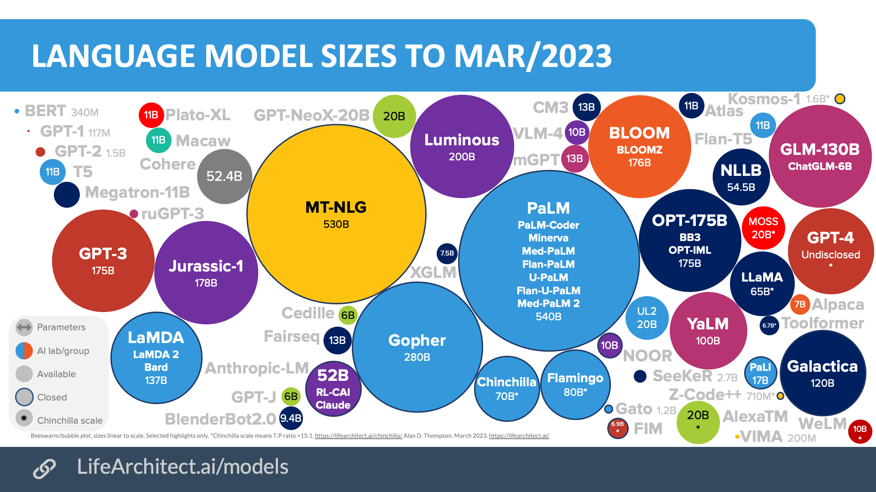
What is a LLM?
Large – often billions of parameters
# billion parameters * 2 = GPU VRAM for 16-bit model
Trained on enormous datasets
Generates what it thinks is the best sequence of next words for a given prompt
https://www.analyticsinsight.net/wp-content/uploads/2019/04/Computer-Vision12.png https://miro.medium.com/max/1576/1*OCsh4qf4lLoRAY-rlSZmJw.png

Slide 5
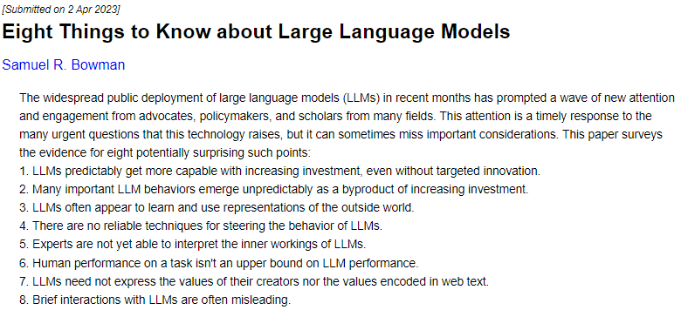
8 Things to Know about LLMs
arXiv:2304.00612 [cs.CL]

Slide 6
How to use LLMs
Pretrained
Finetuned
Blank slate
Falcon-7B that can answer questions about courses at your university
Falcon-7B
Custom dataset

Slide 7
Input Preprocessing
Input:
What is the state bird of Oregon?
Tokenization
Tokens:
What | is | the | state
43 | 3 | 14 | 642
input_ids
…
+
What | is | the | state
1 | 1 | 1 | 1
…
attention_mask
optional
+
What | is | the | state
1 | 1 | 1 | 1
…
token_type_ids

Slide 8
QLoRA
LoRa
  Low-ranking adapters
  Add additional parameters that are finetuned while freezing original parameters
  Much more efficient while preventing “catastrophic forgetting”
  Easier to deal with logistically
Quantization
  Reduce memory requirements by decreasing precision of parameters
  16 bit → 4 bit = ¼ the GPU RAM required
  “without degrading the runtime or predictive performance” of the model
Papers linked in workshop

Slide 9

American company started in 2017
Hub which hosts lots of models and datasets
transformers
  API to download and train transformer models
  Flexibility to work with PyTorch, TF, and JAX
Datasets
  Library for handling and sharing datasets
  Uses the Hugging Face hub

Slide 10
What is RAG
Retrieval Augmented Generation
Who is the principal?
With RAG
No RAG
+ prompt
just prompt
Documents with School Info
LLM (eg Falcon 7B, Llama 7B, etc.)
Response specific to documents with school info
Generic response from pretraining data

Slide 11
Embeddings
Can’t feed all documents into model with prompt
  Context window too small
  Model overwhelmed with information
Embeddings allow us to find dataset entries similar to our prompt
Text is projected to a high-dimensional space
  768 dim vector in model we will use
  Position of vector in space depends on content of text
  Distance between vectors determines how similar they are
I walked my cat
I took my dog on a walk
Salem is the capitol of Oregon

Slide 12
Embeddings
Text Chunks:
John Smith is the principal…
The school hours are …
…
Embedding Vectors:
[0.4, 0.2, 0.1, …]
[0.2, 0.7, 0.9, …]
…
Embedding Model
Documents with School Info
Compare prompt embedding to dataset embeddings
Embedding Vector:
[0.9, 0.5, 0.1, …]
Relevant dataset entries
+
prompt
Prompt:
Who is the principal?
Embedding Model
LLM

Slide 13
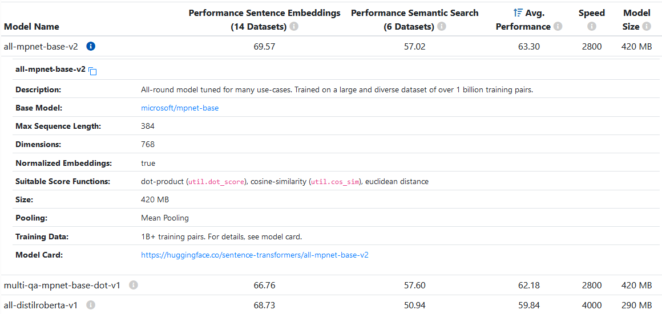
Embedding Model
Want to balance accuracy with embedding time
  Bigger models may perform better but take a lot more time to embed queries
See Sentence Transformers documentation for list of all models

Slide 14
Reranking Model
If you have trouble retrieving the correct info a reranking model could help
Dataset Chunks:
The school is 25 years old…
Principal Smith started in 2002…
School holidays are…
John Smith is the principal…
The principal, John Smith, announced…
2022 valedictorians are…
Ranked Dataset Chunks:
John Smith is the principal…
Principal Smith started in 2002…
The principal, John Smith, announced…
The school is 25 years old…
School holidays are…
2022 valedictorians are…
Who is the principal?
Embedding Vectors:
[0.4, 0.2, 0.1, …]
[0.2, 0.5, 0.7, …]
[0.5, 0.4, 0.9, …]
[0.1, 0.5, 0.6, …]
[0.4, 0.5, 0.7, …]
[0.3, 0.8, 0.7, …]
Convert back to text
Reranking Model

Slide 15
Dataset
How are you going to split up your dataset into entries you can reference?
Make your entries as similar as possible to your queries
Formulating Question Answer Pairs:
Q: Who is EMPLOYEE NAME (ie John Smith)?
A: He is the JOB TITLE (ie principal) at Sunshine School.
Q: When did EMPLOYEE NAME (ie Jane Doe) start at Sunshine School?
A: She started in START DATE (ie July 2023).
Q: Tell me about EMPLOYEE NAME (ie John Smith)
A: DESCRIPTION (ie John Smith is passionate about education…)
Employee Name | Job Title | Description | Start Date
John Smith | Principal | John Smith is passionate about education… | May 2002
Jane Doe | Assistant Principal | Jane Doe has an extensive background in… | July 2023
… | … | … | …

Slide 16
RAG vs Finetuning
RAG |  | Finetuning
Pros | Cons | Pros | Cons
No training required | Less effective for controlling style or format of response | Good at changing response style or format | Risk of catastrophic forgetting
Better at preventing hallucinations | More complex at inference time | No need for additional embedding or reranking models / faster inference | Not as good for preventing hallucinations
Can add/change data provided any time |  |  | Will need retraining if you want to add/change data it “knows”
Remember that both strategies can be used together!

