Slide 2
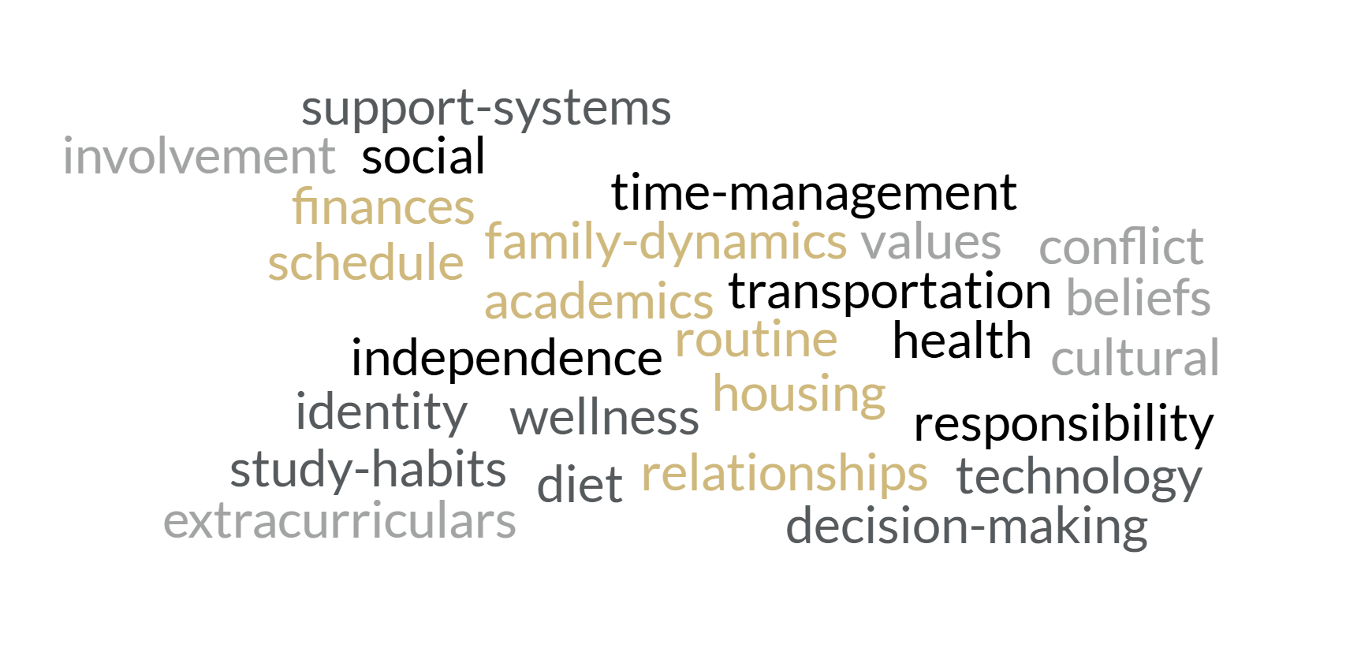
Transition = Change
Notes:
Macy

Slide 3
Discussion
Find a buddy ☺
Where is your student transferring from?
What are some differences between that university/college and CU Boulder?
Are there things your student would be interested in getting involved with here?
Is there a way you can help them achieve that?

Slide 4
Zeller & Mosier W-Curve
Acceptance & Integration
Honeymoon
Initial Adjustment
Culture Shock
Mental Isolation
Week 1
Week 6
Weeks 8 - 10
Weeks 10 - 12
Week 16
Notes:
Zeller and Mosier. Predictable pattern of stages that a person encounters when they enter a new culture. Based on study abroad research, but applicable to the first-year experience.
Honeymoon – before arrival, during the summer, planning and preparing. Nervous, but sense of excitement and anticipation. First arrival at orientation or welcome week – lots of support, making friends, away from parents/family. That new-book feel.
Culture Shock – the moment you realize you have a roommate. And you might be stuck with them. The dining halls aren’t quite as exciting as they were at first. You hit the first round of exams. The dissonance between high school academic expectations and the ambiguity of college professors’ expectations has caught up to you. The homesickness that may have existed even in the honeymoon phase has fully blossomed. Laundry is hard. Finances and budgeting is more difficult than you thought. The sheer number of decisions that one has to make can create a feeling that autonomy isn’t all it was cracked up to be. While this is a period of positive change and adaptation- it can lead to increased anxiety
Initial Adjustment – but with time and support, you come through the initial culture shock and with that can come a great sense of relief. You made it! Midterms are over. A sense of control and normalcy settles a bit.
Mental Isolation – However, now that some of the physical/daily chaos is settling, you’ve got more time for introspection (Maslow’s Hierarchy of Needs!). Maybe you go home for Thanksgiving break, or the winter holidays, and you’re reminded of the old familiar setting, usually the unique sense of belonging or the old paradigm for identity. And then you’re back. Feeling maybe caught between worlds. The folks you met at orientation and were super jazzed about, they’re not the same as your high school friends… students may doubt the decision to attend the institution or attempt college at all. Beliefs, values, preconceived ideas are being challenged in the classroom or through interpersonal experiences. With all of that mental whirl going, it’s essential for moving forward that students are able to integrate their history and past with the current paradigm and institution.
Acceptance & Integration – as students involve themselves in campus culture and opportunities, and gain history with newly-made friends, with faculty, with staff, they start to feel connection. We’ve come back to a more balanced view of the university and their situation. It may shift so that college begins to feel like home, and original home culture can take a back seat and even feel somewhat foreign.
How can you help coach your student through some of these ups and downs? Help them understand that it’s very normal and that transition takes time.

Slide 5
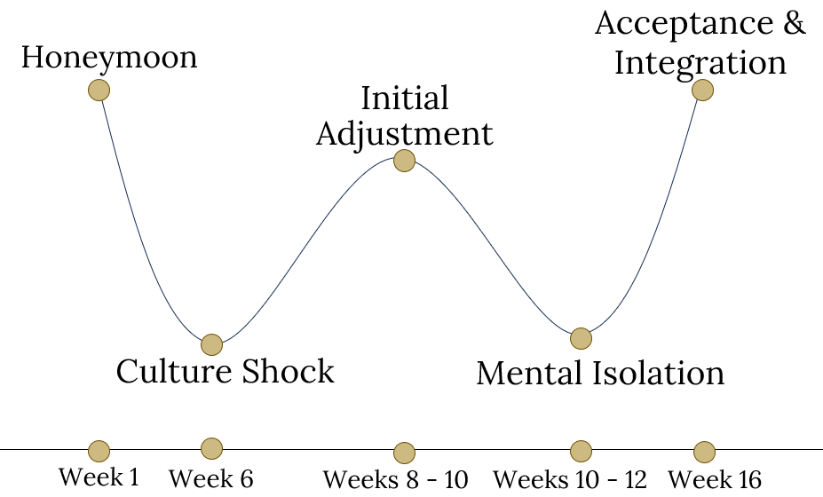
Honeymoon
Students feel: Excited, optimistic, eager nervousness How to respond:
Ask and listen about their new experiences
Encourage and celebrate little wins- positive messaging
Communication may be inconsistent as they figure out schedule
Notes:
Zeller and Mosier. Predictable pattern of stages that a person encounters when they enter a new culture. Based on study abroad research, but applicable to the first-year experience.
Honeymoon – before arrival, during the summer, planning and preparing. Nervous, but sense of excitement and anticipation. First arrival at orientation or welcome week – lots of support, making friends, away from parents/family. That new-book feel.
Culture Shock – the moment you realize you have a roommate. And you might be stuck with them. The dining halls aren’t quite as exciting as they were at first. You hit the first round of exams. The dissonance between high school academic expectations and the ambiguity of college professors’ expectations has caught up to you. The homesickness that may have existed even in the honeymoon phase has fully blossomed. Laundry is hard. Finances and budgeting is more difficult than you thought. The sheer number of decisions that one has to make can create a feeling that autonomy isn’t all it was cracked up to be. While this is a period of positive change and adaptation- it can lead to increased anxiety
Initial Adjustment – but with time and support, you come through the initial culture shock and with that can come a great sense of relief. You made it! Midterms are over. A sense of control and normalcy settles a bit.
Mental Isolation – However, now that some of the physical/daily chaos is settling, you’ve got more time for introspection (Maslow’s Hierarchy of Needs!). Maybe you go home for Thanksgiving break, or the winter holidays, and you’re reminded of the old familiar setting, usually the unique sense of belonging or the old paradigm for identity. And then you’re back. Feeling maybe caught between worlds. The folks you met at orientation and were super jazzed about, they’re not the same as your high school friends… students may doubt the decision to attend the institution or attempt college at all. Beliefs, values, preconceived ideas are being challenged in the classroom or through interpersonal experiences. With all of that mental whirl going, it’s essential for moving forward that students are able to integrate their history and past with the current paradigm and institution.
Acceptance & Integration – as students involve themselves in campus culture and opportunities, and gain history with newly-made friends, with faculty, with staff, they start to feel connection. We’ve come back to a more balanced view of the university and their situation. It may shift so that college begins to feel like home, and original home culture can take a back seat and even feel somewhat foreign.
How can you help coach your student through some of these ups and downs? Help them understand that it’s very normal and that transition takes time.

Slide 6
Culture Shock
Students feel: Overwhelmed, homesick, doubt How to respond:
Validate feelings that feel normal for transition
Encourage them to seek support
Check in with empathy, not just curiosity
Notes:
Zeller and Mosier. Predictable pattern of stages that a person encounters when they enter a new culture. Based on study abroad research, but applicable to the first-year experience.
Honeymoon – before arrival, during the summer, planning and preparing. Nervous, but sense of excitement and anticipation. First arrival at orientation or welcome week – lots of support, making friends, away from parents/family. That new-book feel.
Culture Shock – the moment you realize you have a roommate. And you might be stuck with them. The dining halls aren’t quite as exciting as they were at first. You hit the first round of exams. The dissonance between high school academic expectations and the ambiguity of college professors’ expectations has caught up to you. The homesickness that may have existed even in the honeymoon phase has fully blossomed. Laundry is hard. Finances and budgeting is more difficult than you thought. The sheer number of decisions that one has to make can create a feeling that autonomy isn’t all it was cracked up to be. While this is a period of positive change and adaptation- it can lead to increased anxiety
Initial Adjustment – but with time and support, you come through the initial culture shock and with that can come a great sense of relief. You made it! Midterms are over. A sense of control and normalcy settles a bit.
Mental Isolation – However, now that some of the physical/daily chaos is settling, you’ve got more time for introspection (Maslow’s Hierarchy of Needs!). Maybe you go home for Thanksgiving break, or the winter holidays, and you’re reminded of the old familiar setting, usually the unique sense of belonging or the old paradigm for identity. And then you’re back. Feeling maybe caught between worlds. The folks you met at orientation and were super jazzed about, they’re not the same as your high school friends… students may doubt the decision to attend the institution or attempt college at all. Beliefs, values, preconceived ideas are being challenged in the classroom or through interpersonal experiences. With all of that mental whirl going, it’s essential for moving forward that students are able to integrate their history and past with the current paradigm and institution.
Acceptance & Integration – as students involve themselves in campus culture and opportunities, and gain history with newly-made friends, with faculty, with staff, they start to feel connection. We’ve come back to a more balanced view of the university and their situation. It may shift so that college begins to feel like home, and original home culture can take a back seat and even feel somewhat foreign.
How can you help coach your student through some of these ups and downs? Help them understand that it’s very normal and that transition takes time.

Slide 7
Initial Adjustment
Students feel: Finding routines, settling in, gaining confidence How to respond:
Celebrate progress and support growth
Show genuine interest in their new friends, routines, etc.
Notes:
Zeller and Mosier. Predictable pattern of stages that a person encounters when they enter a new culture. Based on study abroad research, but applicable to the first-year experience.
Honeymoon – before arrival, during the summer, planning and preparing. Nervous, but sense of excitement and anticipation. First arrival at orientation or welcome week – lots of support, making friends, away from parents/family. That new-book feel.
Culture Shock – the moment you realize you have a roommate. And you might be stuck with them. The dining halls aren’t quite as exciting as they were at first. You hit the first round of exams. The dissonance between high school academic expectations and the ambiguity of college professors’ expectations has caught up to you. The homesickness that may have existed even in the honeymoon phase has fully blossomed. Laundry is hard. Finances and budgeting is more difficult than you thought. The sheer number of decisions that one has to make can create a feeling that autonomy isn’t all it was cracked up to be. While this is a period of positive change and adaptation- it can lead to increased anxiety
Initial Adjustment – but with time and support, you come through the initial culture shock and with that can come a great sense of relief. You made it! Midterms are over. A sense of control and normalcy settles a bit.
Mental Isolation – However, now that some of the physical/daily chaos is settling, you’ve got more time for introspection (Maslow’s Hierarchy of Needs!). Maybe you go home for Thanksgiving break, or the winter holidays, and you’re reminded of the old familiar setting, usually the unique sense of belonging or the old paradigm for identity. And then you’re back. Feeling maybe caught between worlds. The folks you met at orientation and were super jazzed about, they’re not the same as your high school friends… students may doubt the decision to attend the institution or attempt college at all. Beliefs, values, preconceived ideas are being challenged in the classroom or through interpersonal experiences. With all of that mental whirl going, it’s essential for moving forward that students are able to integrate their history and past with the current paradigm and institution.
Acceptance & Integration – as students involve themselves in campus culture and opportunities, and gain history with newly-made friends, with faculty, with staff, they start to feel connection. We’ve come back to a more balanced view of the university and their situation. It may shift so that college begins to feel like home, and original home culture can take a back seat and even feel somewhat foreign.
How can you help coach your student through some of these ups and downs? Help them understand that it’s very normal and that transition takes time.

Slide 8
Mental Isolation
Students feel: Stress, distanced, fatigued, academic pressure How to respond:
Communication may be inconsistent
Encourage and remind them of strengths
Encourage self-care
Might be a good time for snail mail!
Notes:
Zeller and Mosier. Predictable pattern of stages that a person encounters when they enter a new culture. Based on study abroad research, but applicable to the first-year experience.
Honeymoon – before arrival, during the summer, planning and preparing. Nervous, but sense of excitement and anticipation. First arrival at orientation or welcome week – lots of support, making friends, away from parents/family. That new-book feel.
Culture Shock – the moment you realize you have a roommate. And you might be stuck with them. The dining halls aren’t quite as exciting as they were at first. You hit the first round of exams. The dissonance between high school academic expectations and the ambiguity of college professors’ expectations has caught up to you. The homesickness that may have existed even in the honeymoon phase has fully blossomed. Laundry is hard. Finances and budgeting is more difficult than you thought. The sheer number of decisions that one has to make can create a feeling that autonomy isn’t all it was cracked up to be. While this is a period of positive change and adaptation- it can lead to increased anxiety
Initial Adjustment – but with time and support, you come through the initial culture shock and with that can come a great sense of relief. You made it! Midterms are over. A sense of control and normalcy settles a bit.
Mental Isolation – However, now that some of the physical/daily chaos is settling, you’ve got more time for introspection (Maslow’s Hierarchy of Needs!). Maybe you go home for Thanksgiving break, or the winter holidays, and you’re reminded of the old familiar setting, usually the unique sense of belonging or the old paradigm for identity. And then you’re back. Feeling maybe caught between worlds. The folks you met at orientation and were super jazzed about, they’re not the same as your high school friends… students may doubt the decision to attend the institution or attempt college at all. Beliefs, values, preconceived ideas are being challenged in the classroom or through interpersonal experiences. With all of that mental whirl going, it’s essential for moving forward that students are able to integrate their history and past with the current paradigm and institution.
Acceptance & Integration – as students involve themselves in campus culture and opportunities, and gain history with newly-made friends, with faculty, with staff, they start to feel connection. We’ve come back to a more balanced view of the university and their situation. It may shift so that college begins to feel like home, and original home culture can take a back seat and even feel somewhat foreign.
How can you help coach your student through some of these ups and downs? Help them understand that it’s very normal and that transition takes time.

Slide 9
Acceptance & Integration
Students feel: Confidence, belonging, excitement How to respond:
Celebrate the accomplishment!
Reflection & prepare for next semester
Notes:
Zeller and Mosier. Predictable pattern of stages that a person encounters when they enter a new culture. Based on study abroad research, but applicable to the first-year experience.
Honeymoon – before arrival, during the summer, planning and preparing. Nervous, but sense of excitement and anticipation. First arrival at orientation or welcome week – lots of support, making friends, away from parents/family. That new-book feel.
Culture Shock – the moment you realize you have a roommate. And you might be stuck with them. The dining halls aren’t quite as exciting as they were at first. You hit the first round of exams. The dissonance between high school academic expectations and the ambiguity of college professors’ expectations has caught up to you. The homesickness that may have existed even in the honeymoon phase has fully blossomed. Laundry is hard. Finances and budgeting is more difficult than you thought. The sheer number of decisions that one has to make can create a feeling that autonomy isn’t all it was cracked up to be. While this is a period of positive change and adaptation- it can lead to increased anxiety
Initial Adjustment – but with time and support, you come through the initial culture shock and with that can come a great sense of relief. You made it! Midterms are over. A sense of control and normalcy settles a bit.
Mental Isolation – However, now that some of the physical/daily chaos is settling, you’ve got more time for introspection (Maslow’s Hierarchy of Needs!). Maybe you go home for Thanksgiving break, or the winter holidays, and you’re reminded of the old familiar setting, usually the unique sense of belonging or the old paradigm for identity. And then you’re back. Feeling maybe caught between worlds. The folks you met at orientation and were super jazzed about, they’re not the same as your high school friends… students may doubt the decision to attend the institution or attempt college at all. Beliefs, values, preconceived ideas are being challenged in the classroom or through interpersonal experiences. With all of that mental whirl going, it’s essential for moving forward that students are able to integrate their history and past with the current paradigm and institution.
Acceptance & Integration – as students involve themselves in campus culture and opportunities, and gain history with newly-made friends, with faculty, with staff, they start to feel connection. We’ve come back to a more balanced view of the university and their situation. It may shift so that college begins to feel like home, and original home culture can take a back seat and even feel somewhat foreign.
How can you help coach your student through some of these ups and downs? Help them understand that it’s very normal and that transition takes time.

Slide 10
W-Curve Takeaways
It is a predictive model, but everyone's transition is different
Transition takes time – for you and your student!
Utilize the model to frame conversations with your student
Ask questions!
Lead with listening ear and empathy
Let your student guide the way

Slide 11
Transfer Shock
Similar to the W-Curve phenomenon
Most research done on community college to 4-year institution transfers
First term GPA of transfer class typically will underperform general student body
Usually only temporary as student adjusts
Notes:
Jason

Slide 12
Good News!
An extremely positive indicator is on-campus involvement
(Johnson 2005, Laanan, 2007, Miller 2013)
CU Boulder transfer graduation rates are above the national average and in line with first year students
Notes:
Jason

Slide 13
Good News (Resources)!
Academics: ASAP Tutoring
Community: Transfer events, Student Organizations
Self-Care: Counseling and Psychiatric Services (CAPS), Health & Wellness
AND MUCH MORE
Notes:
Jason

Slide 14
Discussion
How are you feeling about the transition?
In what ways are you preparing for the transition?
Notes:
Jason

Slide 15
FERPA & Finances

Slide 16
FERPA
Family Educational Rights and Privacy
A federal law that protects the privacy of student education records
Gives your student the right to inspect and request corrections to their own education records
Protects your student from the release of personal information in their education records without written consent, except in specific situations
FERPA applies even if your student is a minor and even if you are paying the bill
Goes into effect on the first day of classes of their first semester
Notes:
Jason

Slide 17
FERPA What information can be shared?
Name
Hometown
Campus email
Attendance dates
Previous institutions
School/college
Classification (sophomore, graduate student, etc)
Major(s)/ minor(s)
Honors and awards
Degree status
Enrollment status
Student employment status
Athletic participation
Photos/videos taken by the university
Notes:
Jason

Slide 18
FERPA What information is protected?
Advising records
Financial aid
Bills/payments
Tuition classification
Tax records (including yours)
GPA and grades
Degree Progress
Academic standing
Holds
Class schedule
Transcript request
Notes:
Jason

Slide 19
Financial Life at CU Boulder
Bursar’s Office Bills ▪ Payments ▪ Refunds
Office of Financial Aid Loans ▪ Grants ▪ Scholarships
Notes:
Macy

Slide 20
Financial Life at CU Boulder
The Bursar’s Office and Financial Aid are often confused.
Financial Aid – offer various types of financial aid – loans, grants and scholarships. Federal, state, and Institutional. Once processed these funds are credited to the student account.
Bursar’s Office – primarily generates bills, processes payments, and issues refunds.

Slide 21
Financial Life at CU Boulder
Tuition and fees begin to calculate for fall around the middle of July after a student is registered for classes.
Although many students have agreements with their parents to pay the tuition and fees, the payment of all tuition, fees and charges becomes an obligation of the student upon registration at the University of Colorado Boulder

Slide 22
Authorized Payers
Students can set up parents or other to view the tuition bill, current account activity, pay online, enroll in payment plans, and discuss the bill with the Bursar’s Office over the phone and in-person after identity verification.
Authorized payers (AP) can be anyone a student designates
Students and AP’s receive email notification when bill is available online

Slide 23
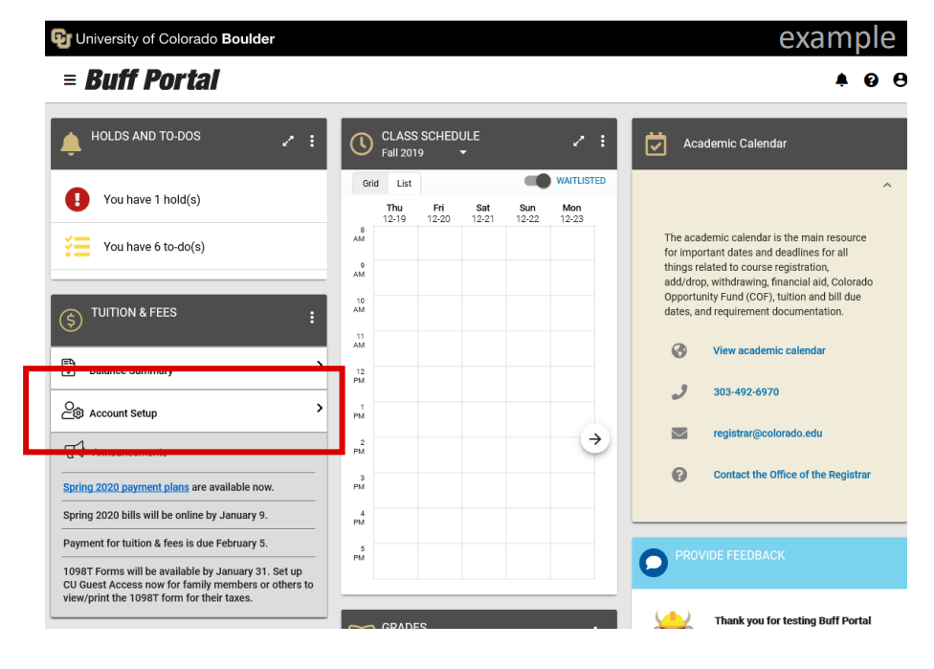

Slide 24
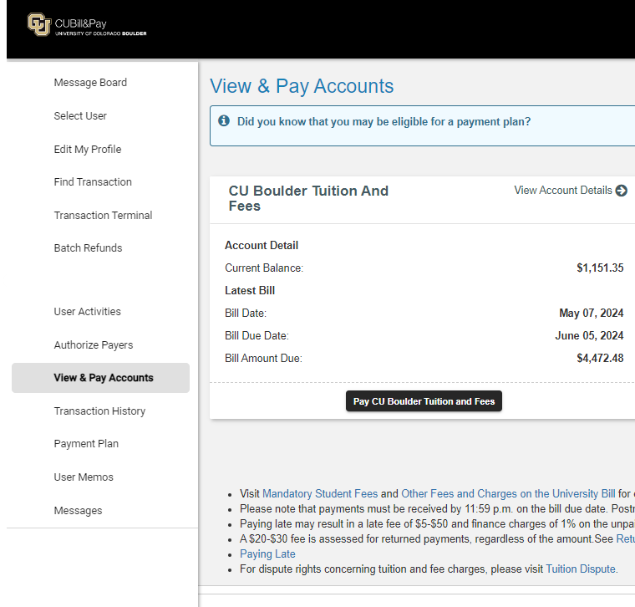
Students – Log in to Buff Portal
Authorized Payer- Log into CUBill&Pay

Slide 25
Billing
First fall bills are available in mid-August. First spring bills are available in mid-January.
Email notifications are sent to students and anyone they have designated as an Authorized Payer.
Financial aid is applied to the bill beginning on the Monday before the first day of class for fall and spring or 7 days before the start of summer classes.

Slide 26
What’s on the Bill
Tuition
Mandatory fees
Health Insurance
CU Book Access/Book Store charges
Optional Fees
Payments
On-campus housing
Meal plans
Parking permits
Optional Fees
Grants, loans, and scholarships

Slide 27
Billing/Due Dates
Term | Tuition Due Date
Fall | Sept. 5
Spring | Feb. 5
Summer | June 5, July 5, Aug. 5, Sept. 5

Slide 28
Payment Options
Credit or Debit Card
2.85% Service Fee
Bank Account (eCheck)
Regular checking or savings account
Payment Plans
Equal monthly payments per semester
By Mail & Drop Box
College Savings Plan (529)
3rd Party Sponsors
RA/TA Waivers

Slide 29
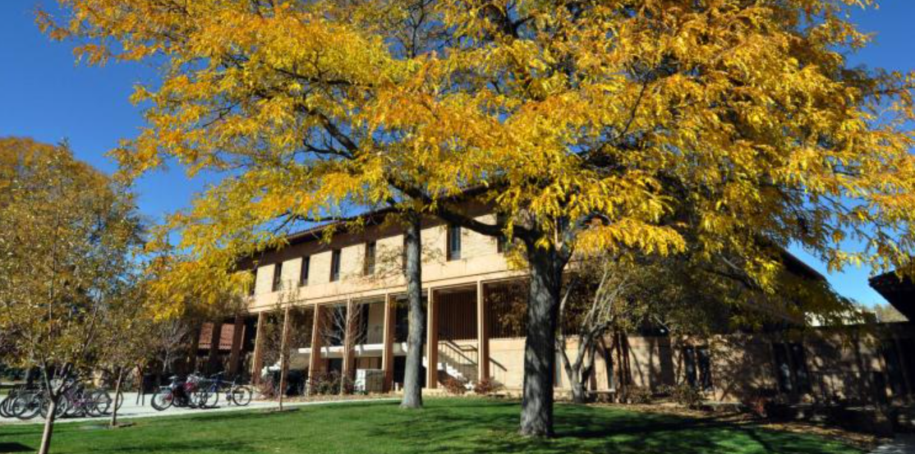
Bursar, Financial Aid and Scholarships Offices
Located on the first floor of the Regent Administrative Building
No appointment is necessary
In Summer the lobby is open 9:00am-4:30pm.
Phone hours are 9:00am to 4:00pm
In Fall/Spring the lobby is open 9:00am-5:00pm.
Phone hours are 9:00am to 4:30pm

Slide 30
Family Resources
Resources we provide for families:
Buff Family Resource Hub
Buff Family Webinars
Buff Family Coffee Hours
Buff Family Newsletter
Family Fall Welcome
Family Weekend
September 18 - 21st
Packages will be available for purchase later this month

Slide 31
What NOW?
Orientation technically done at 5pm
Different colleges will end at different times
This afternoon
Visit offices
Take a campus tour
Check out the bookstore
Do whatever you want

Slide 32
What NOW?

Slide 33
Where to?
University Memorial Center (UMC)
Off-Campus Life (UMC 313)
Center for Student Involvement (UMC 330)
CU Bookstore (1st floor, north entrance)
The Connection (1st floor)
Center for Community (C4C)
Residence Life / University Housing
Center for Cultural Connections & Community
Regent Building
Financial Aid
Bursar’s Office
Office of the Registrar

Slide 34
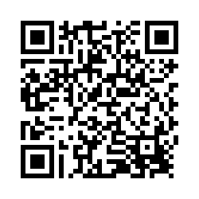
Feedback

Slide 36
Transition = Change

