Slide 2
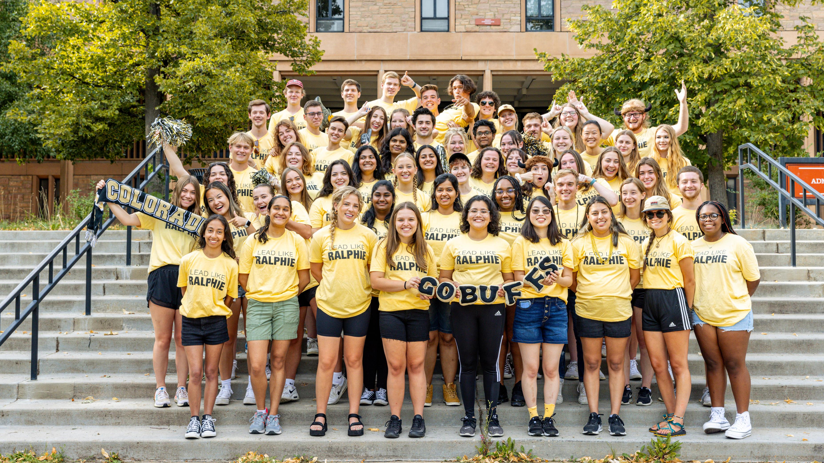
Welcome from New Student & Family Programs!
Notes:
What’s up
Who am I
Who are the staff in the room
Sko buffs

Slide 3
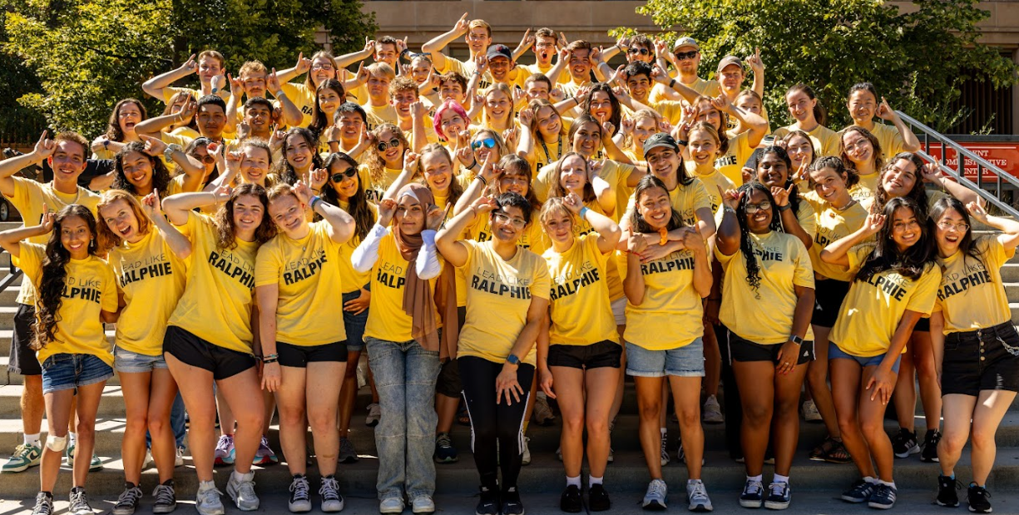
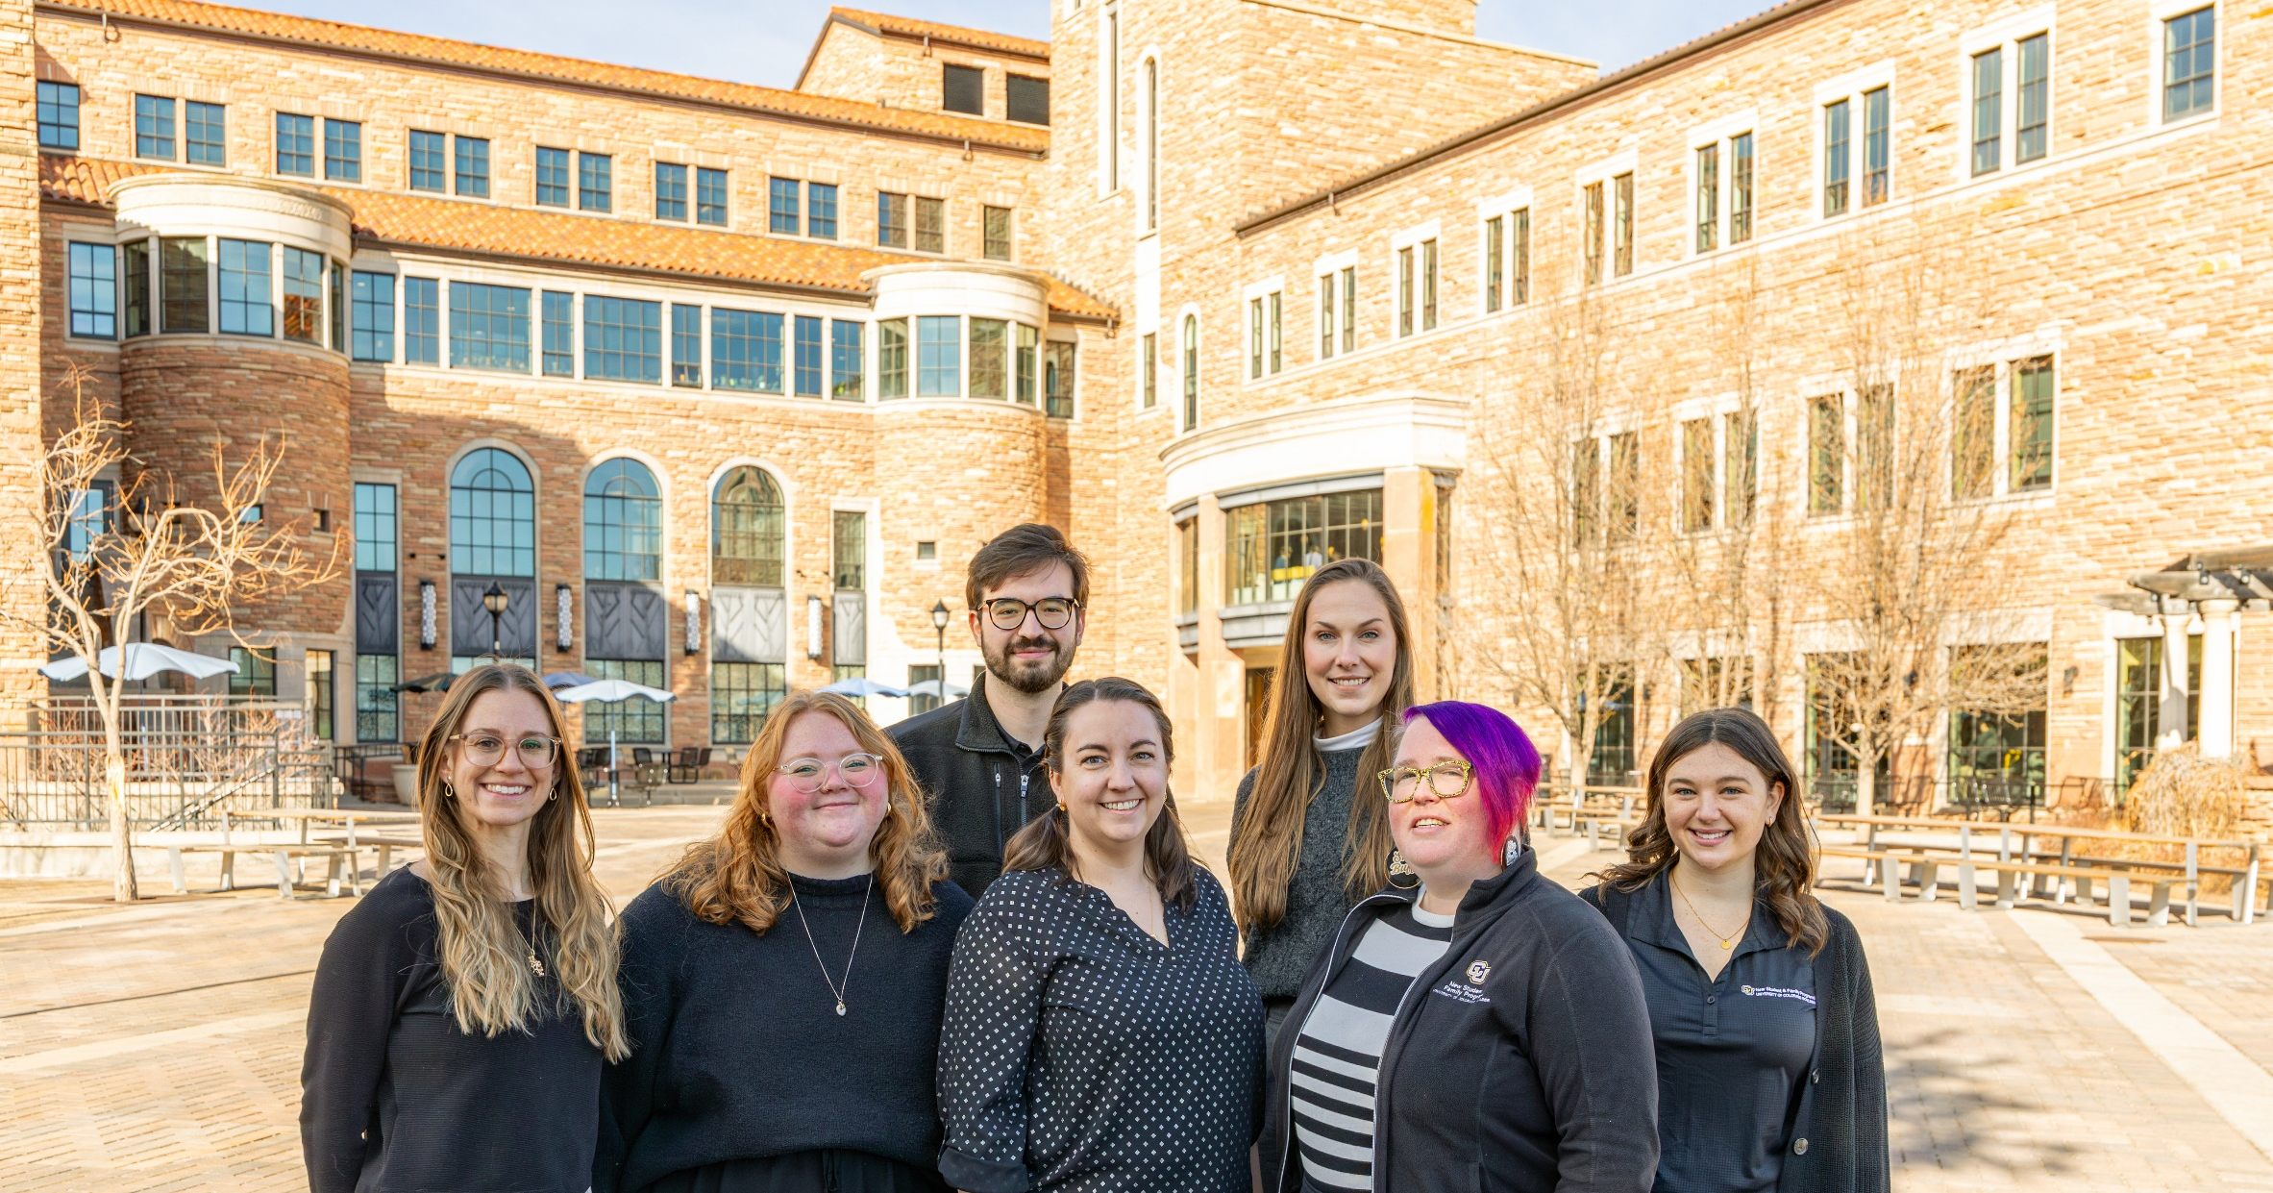
New Student & Family Programs
Pro Staff
Office Assistants
Journey Leaders and Mentors
Transfer Peer Mentors
ASAP Tutor Mentors

Slide 4
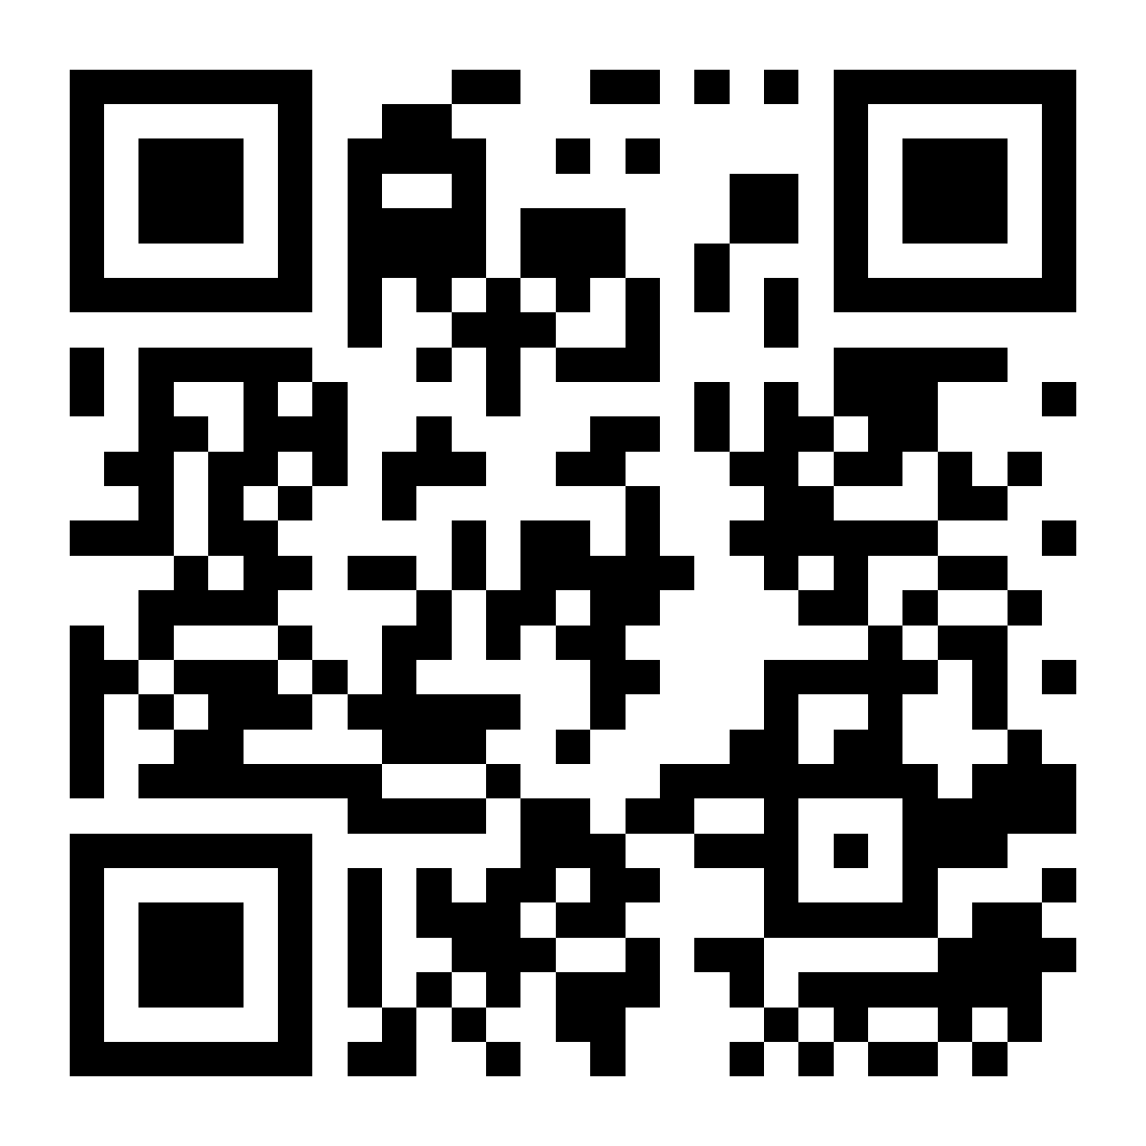
Today’s Orientation Schedule
10-10:15 a.m. | Welcome
10:15-11:30 a.m. | Housing Sessions
Off-campus housing and commuting students
Still looking for off-campus housing
On-campus housing students
11:30 a.m.-12:15 p.m. | Lunch/NSFP Session Rotation 1
Half will go to lunch and half will stay in this room
Veteran and Military Affairs session
12:15-1 p.m. | Lunch/NSFP Session Rotation 2
Second lunch rotation
1 p.m. | Advising & Class Registration

Slide 5
Today’s Orientation Schedule
We will escort you everywhere you need to be
Feel free to ask anyone with a nametag questions
Parents/guests stay with your student until advising
We will host an additional session for you in this room after your student departs
Once you leave Alferd Packer Grill you cannot re-enter
We’ll make announcements when to head back into this room
Lunches will have a 10-minute passing period
Advising is happening all over campus
Once you are finished and registered you are free to head out

Slide 6
Housing Sessions
10:15-11:30 a.m. | Housing Sessions
Off-campus housing and commuting students
Housing already secured for upcoming academic year
Still looking for off-campus housing
Local rental property managers just outside this building
Includes students on waitlist for on-campus housing
Whenever you are finished with the housing fair, come back to this room
On-campus housing students
Bear Creek residents (including Transfer Buffs LLC)
First year housing residence halls

Slide 7
New Student & Family Programs
And more!

Slide 8
CU Boulder Transfer Data
2100+ students transfer to CU Boulder each academic year
1600+ in the fall, 500+ in the spring
65% from 4-year, 35% from 2-year institutions
6000+ transfers on campus on any given semester
CU Boulder Office of Data Analytics, Transfer Student Dashboard

Slide 9
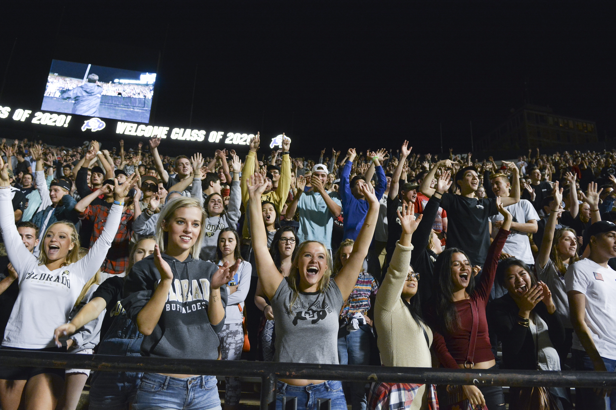
Welcome to Our Herd
College Days
Beginning August 17
Residential Programming
Be Involved Fair
Welcomefest Concert
CU Kickoff
Connect at the Rec
Notes:
And once you’re here, we’ll have a ton of events to help you get acquainted with campus! Welcome to Our Herd is your official kick off to being at CU. Durinng college days, you’ll get to connect with other students who are studying what you’re studying, as well as faculty and advisors. Wherever you live, we’ll have some programing targeted for you – either in your residence hall or special events for commuter students.
These events range from large events to smaller events, so we hope to hit on something that’s a good fit for everyone.

Slide 10
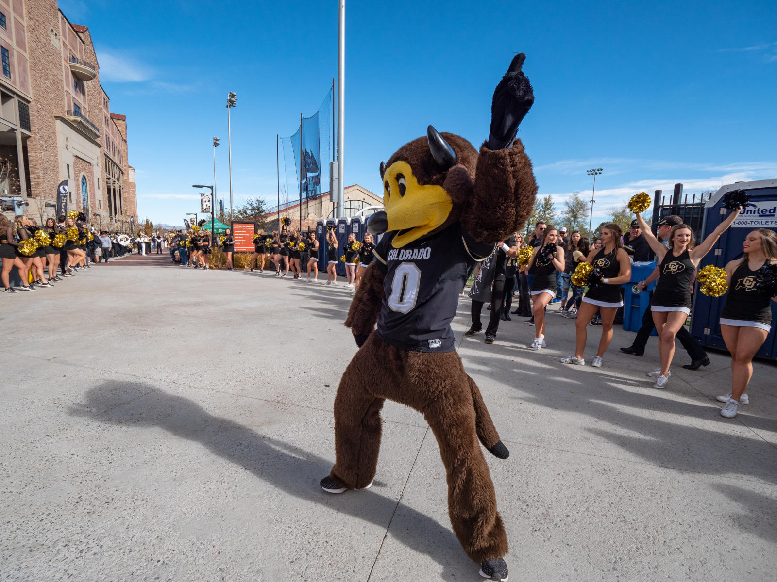
Transfer Student College Day
Tuesday, August 19th
Get ready for classes to begin on August 21st
Meet other incoming transfer buffs
Learn about campus resources
Research opportunities, on-campus jobs, student organizations, and much more
Meet with your academic college staff
Free CU goodies!
Notes:
Next few slides are all about finding community on campus and the resources we have for transfer students

Slide 11
FYXP 3000 – Transfer Success Seminar
1 credit, 7-week course to help you transition to CU Boulder and the buffs community
Evaluate your skills, interests, strengths and education as they relate to overall career goals
Establish an encouraging transfer student community
Taught by a CU Boulder staff member who can help get you connected in your first semester
COEN 3100 - Engineering Transfer Success Seminar is a similar class for College of Engineering and Applied Sciences students

Slide 12
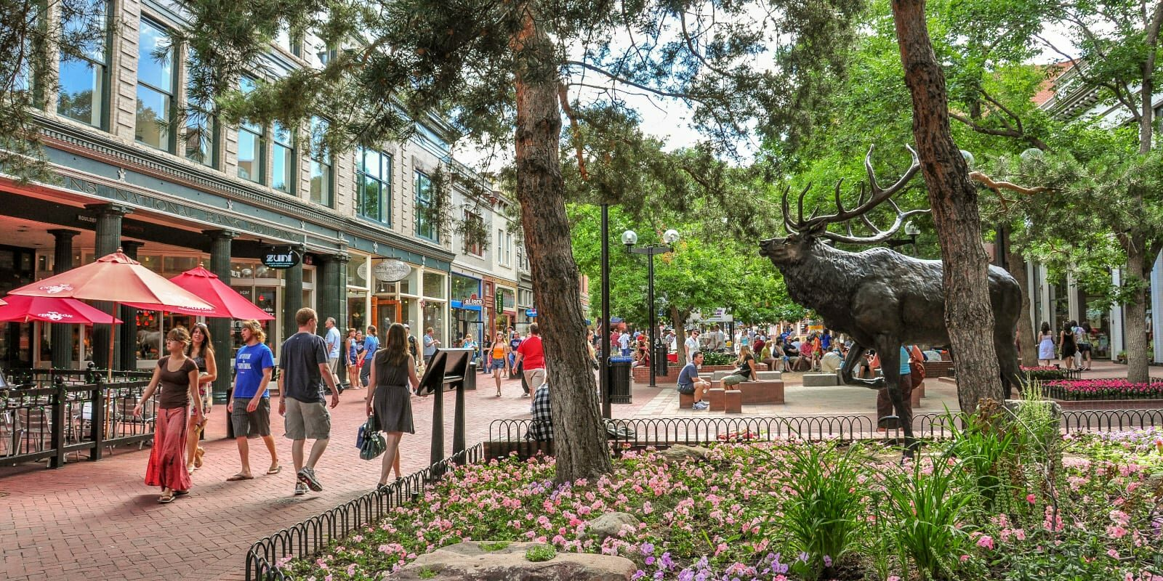
Transfer Events at CU Boulder
Transfer Buff Meetup during Fall Welcome
Monthly transfer events throughout fall and spring semesters
September 14th Pearl Street and Farmer’s Market
October 21st – 25th National Transfer Student Week

Slide 13
National Transfer Student Week
Events in collaboration with all academic colleges
FREE FOOD (and CU gear)!

Slide 14
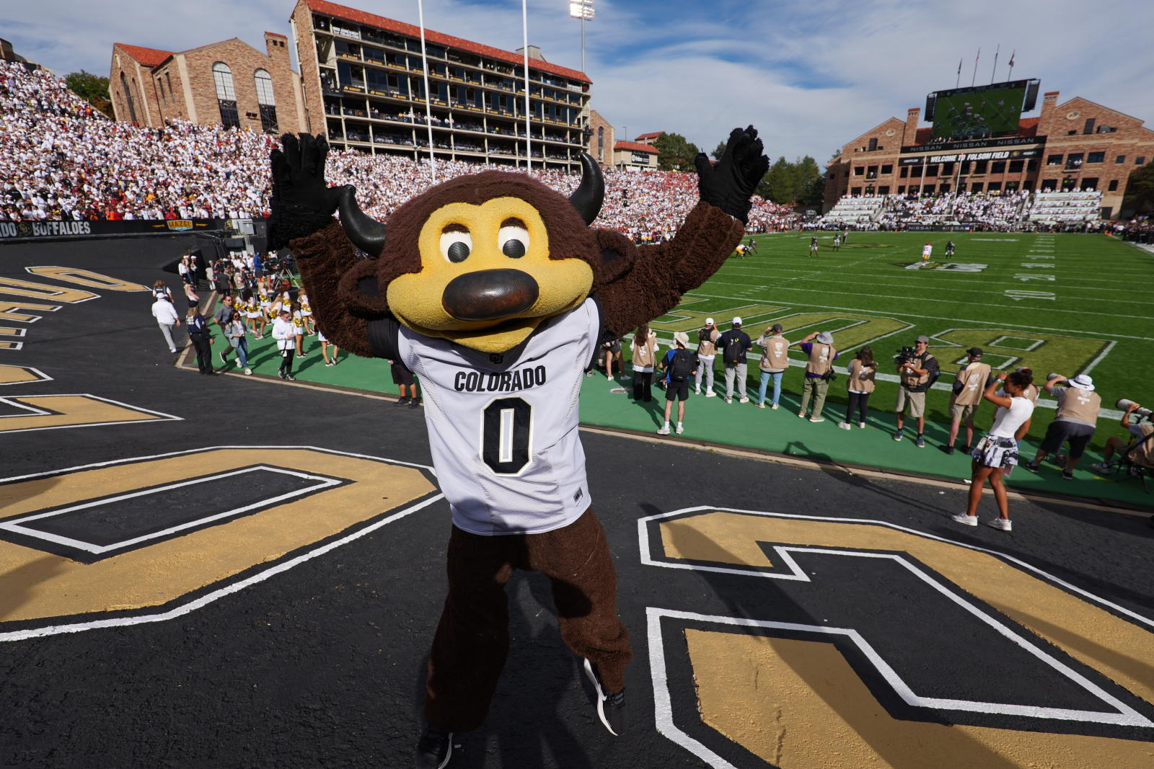
Make A Buddy!
Find a neighbor to chat with
Where are you transferring from?
How did you choose CU Boulder?
What is your current (or eventual) major?
What are your goals for your first semester on campus?
Are there any clubs or student organizations you’d like to join?
Where will you be living this academic year? (pls not specific addresses)

Slide 15
ASAP Tutoring
One time or recurring sessions
1:1 or group sessions
Virtual & in-person options
Trained peer mentors who have recently excelled in the course
Study tips, exam preparation, and support transitioning to university-level academics
Lending library in Center for Community (C4C)

Slide 16
Basic Needs Center
Buff pantry & mobile food pantry events to assist CU Boulder students fight food insecurity
Emergency housing and financial assistance for students experiencing housing insecurity
Basic needs beyond housing and food including a Student Emergency Fund
Has helped tens of thousands of students through challenges that threaten their educational goals

Slide 17
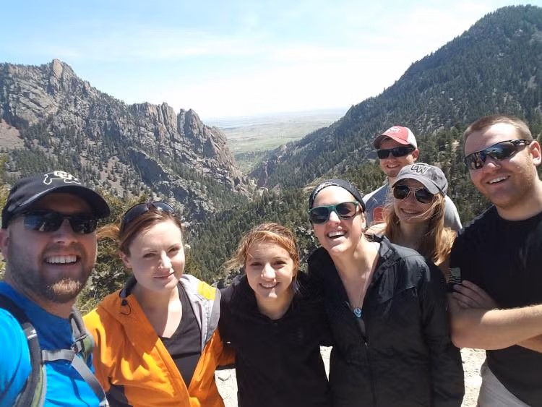
Association of Non-Traditional Students (ANTS)
Non-traditional is typically defined as students age 22+
Open to all, 22+ is not a requirement
Events have included hiking meetups, skiing outings, and other social gatherings for “non-traditional” students to find community
Resource sharing for those returning to school
Email me if you’re interested!
Jason.Benton@colorado.edu

Slide 18
Tau Sigma National Honor Society
Recognize and promote the academic excellence and involvement of transfer students
Members have opportunities to earn scholarships, hold leadership positions, serve others at the University and in our community, and connect with fellow Transfer Buffs
Invites based on first-semester GPA
Sent in Spring ’26

Slide 19
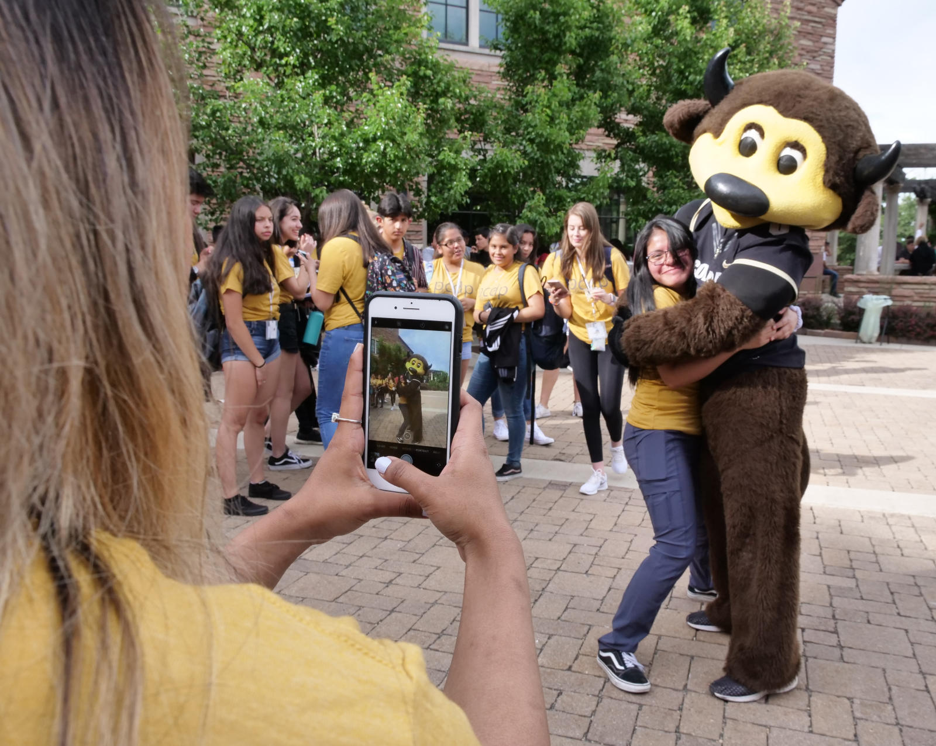
Important Dates
July: Parking pass & sports pass (July 10)
September 1st: Labor Day
September 5th: Tuition due
November 24th-28th: Fall break
December 6th-7th: Reading days
December 8th-12th: Finals week

