Slide 2
On-Campus Living

Slide 3
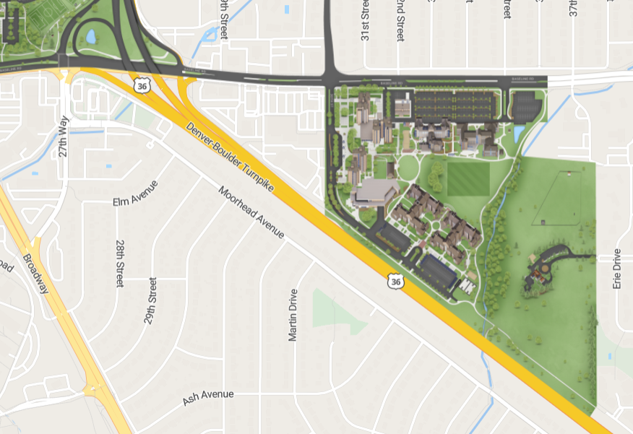
Weber Hall & Bear Creek
Apartment-style living
Williams Village neighborhood
Transportation to campus

Slide 4
Living Experience
In-Hall staff available for 24/7 residential support
Resident Advisors [RAs] available on each floor
Complex/Hall Director [CD/HD] available for higher-level support
Tons of Events!
RAs host events on their floor, in the building, and the whole Bear Creek & Weber area
Hall Directors put on events geared toward personal and social development
Neighborhood programs to help you connect with the rest of WillVill
Buff Agreements | Let's talk about it!
Required for all residents to complete with their roommates
Set boundaries and understanding for getting to know each other, standards of living, and communication regarding conflict
Meal Plan Options | Not Required for Apartment-Style Living
Block Meal Plans | 25, 50, or 80 meals per semester
Campus Cash | Money on your BuffOne Card for any campus dining center & more!

Slide 5
Move-in Logistics | Apartments
Move-in Appointments | Wednesday, June 25th @ 9 am – Tuesday, July 8th @ 11:59 pm via MyCULiving Portal
First-come, first-served basis – limited appointments each day
Residence Life staff cannot add additional appointments
Accommodations available through the Center for Disability & Access
Weber Hall Appointments | Saturday, August 16th – Wednesday, August 20th
Unable to support Drop-Off Days :(
Weber Hall is used for Summer Housing. Because students and conference guests may be present in the space, UPS is unable to perform the drop-off.
Contact The UPS Store to discuss Home2Home Shipping
Parking Permit available through BuffPortal

Slide 6
Move-in Logistics | Residence Halls
Move-in Appointments | Wednesday, June 25th @ 9 am – Tuesday, July 8th @ 11:59 pm via MyCULiving Portal
First-come, first-served basis – limited appointments each day
Residence Life staff cannot add additional appointments
Accommodations available through the Center for Disability & Access
Residence Hall Appointments | Sunday, August 17th – Tuesday, August 19th
Drop-Off Days | Tuesday, August 12th 9 am – 3 pm [$20 non-refundable] [Except Kitt Central :( ]
Self selection via MyCULiving Portal; you'll be automatically redirected to the Drop Off Day appointment page after selecting a move-in appointment.
Contact The UPS Store to discuss Home2Home Shipping
Parking Permit available through BuffPortal

Slide 7
What Not to Bring
Adjustable Bed
Adhesive LED light strips
Air conditioners, swamp coolers, and space heaters
Weber Hall is equipped with central A/C and heating
Candles & bean bag chairs
Doorbell cameras & other security recording devices
Tapestries larger than 3x3 feet
Firearms/weapons
Pets [ESAs – Contact Center for Disability & Access]
Wi-Fi routers

Slide 8
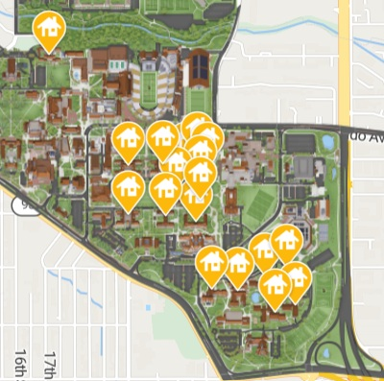
Residence Halls
Traditional hall living
Central, Kittredge, and WillVill
In the heart of campus

Slide 9
Hall Living Experience
In-Hall staff available for 24/7 residential support
Resident Advisors [RAs] available on each floor
Complex/Hall Director [CD/HD] available for higher-level support
Tons of Events!
RAs host events on their floor and in the building
Hall Directors put on events geared toward personal and social development
Neighborhood programs to help you connect with the rest of Central & Kit
Buff Agreements | Let's talk about it!
Required for all residents to complete with their roommates
Set boundaries and understanding for getting to know each other, standards of living, and communication regarding conflict
Meal Plan Options | Required for Residence Hall living
Options | 15 meals/ week & $200/semester OR 19 meals/week & $150/semester
Cost of both plans are the same and included in your room & board bill.

Slide 10
Transfer Buffs LLC

Slide 11
Community within Community
Most likely living with other Transfer students in the LLC
Participate in FYXP 3000 together
Connect with Transfer RAs & Transfer Peer Mentors
Attend events to meet other Transfer students
Transfer Lounge | Northside of Weber Hall

Slide 12
Transportation Options
Parking pass
Go on sale end of July – early August
Bus
Will Vill routes run every 10ish minutes during fall/spring
Bcycle
Free bike use under 1hr per ride

Slide 13
Requirements
FYXP 3000: Transfer Success Seminar
Should be on your class schedule already
Miki Brooks (Miki.Brooks@colorado.edu)
Attend LLC Welcome & events during the semester
3 hours of community service
Volunteer week in Spring

Slide 14
Transfer Buffs LLC Welcome
Saturday, August 23rd
All Transfer Buffs LLC folks together!
Meet the Transfer Peer Mentors
Free lunch!

Slide 15
Make a pal
Students
Get in a group of 3-4 and chat:
Where are you living on-campus next year?
What are you planning to bring for your room?
Will you get a meal plan?
What’s on your bucket list for your first semester?
Guests
Get in a group of 3-4 and chat:
Where are you coming in from?
Have you been to Boulder before?
What are ways you’re planning on being involved in your student’s journey?

Slide 16
Questions?

