Slide 2
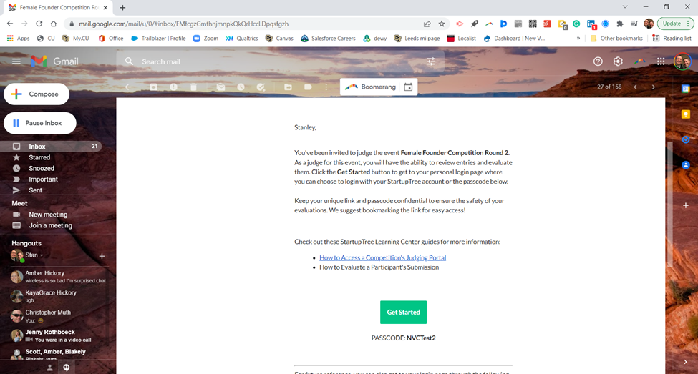
StartupTree Email Invitation
Help Guide
Click to get started
Copy this to paste on the portal

Slide 3
Log in with your passcode
Paste code here
Click here to log in.

Slide 4
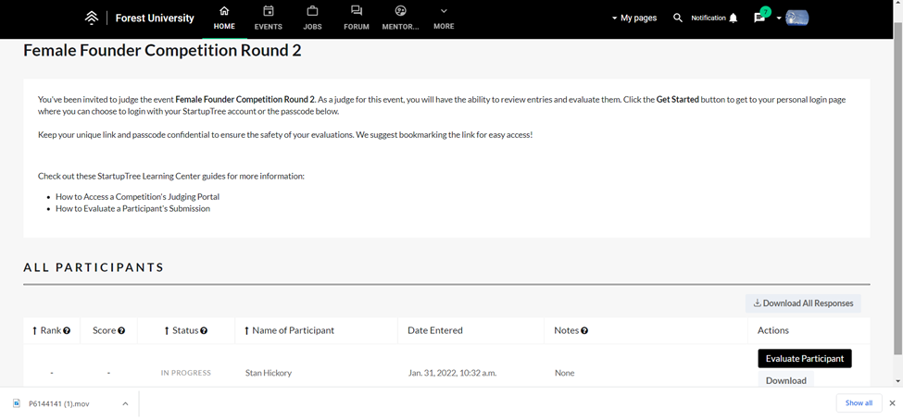
Start your evaluation
Venture or owner’s name
Click here to evaluate this venture

Slide 5
Venture Info Page
Venture profile on Startuptree
Scroll Down To Evaluate
Click here to download the executive summary
Click here to download the video pitch

Slide 6
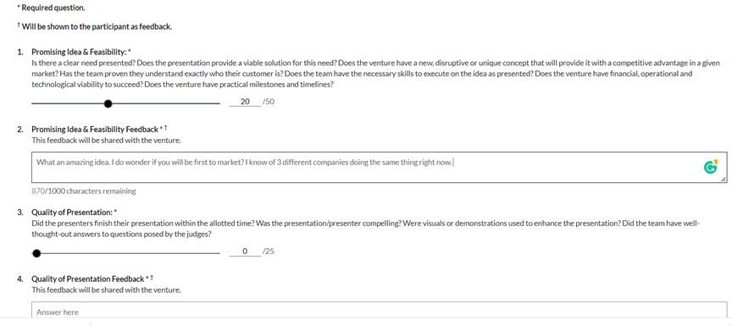
Input your scores and feedback
Use the slider to input your score. These scores are NOT shared with the ventures.
Total points for this category
Feedback: NOTE THAT FEEDBACK HERE GOES TO THE VENTURE AFTER THE JUDGING WINDOW CLOSES.
Total points for this category
Scroll Down

Slide 7
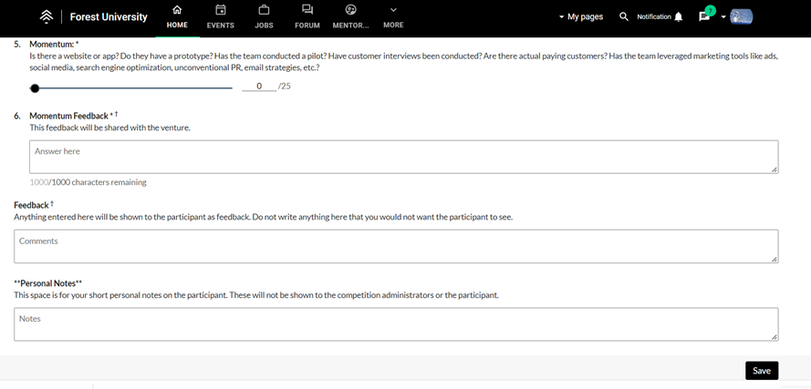
Final feedback and SAVE
Note: There are 6 questions; 3 are slider scores and 3 are for feedback
Overall feedback for the venture. THIS WILL BE SHARED WITH THE VENTURE
You can type in any feedback or notes you want us to have. THIS IS NOT SHARED WITH THE VENTURE.
Click save to submit your scores. Note: You can go back and change your scores at anytime before the judging window closes.

Slide 8
Notes
Thank you for being a part of the New Venture Challenge community
Judging window will open 1:00 pm 2/23/22
Judging window closes at 11:59pm 2/27/22
You can revise your scores until the judging window closes
Be kind and substantive with feedback
Email Stan Hickory with any issues: hickorys@colorado.edu
Link to Judging resource page
Link to judging rubric

