Slide 1

A look at the role of aspect in reasoning about events
Teenie Matlock
Professor of Cognitive Science and McClatchy Chair of Communications
Cognitive and Information Sciences Program
University of California, Merced
Beyond time workshop
CU Boulder Linguistics Department
April 7-8, 2017

Slide 2
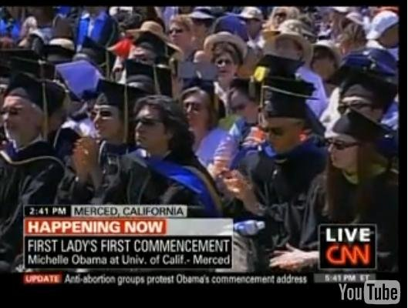
Notes:
SLIDE 5

Slide 3

Today
→ background
studies on aspect & framing
wrap up
Notes:
Today I’m going to talk to you about I did a few years ago on framing. Not framing in the Kahnemann and Tversky sense of framing.
I’m concerned with semantic framing---how linguistic details, especially the “small” seemingly semantic detail, of messages can shift our attitudes and thoughts about things in the world, and how they can lead us to act in the world.
I’ll start with some background on framing and say a few words about metaphor and aspect. I’ll then tell you about some studies I have done on framing. Then I’ll wrap things up.

Slide 4
Background

Slide 5
Aspect in communication
Many ways to talk about events
Verbs drive, run, dance
Nouns driver, runner, dancer
Prepositions through, into, off
Adverbs quickly, completely, continuously
What does aspect do?
gives info about how events unfold over time, including onset, duration, and completion (Comrie, 1976)
Notes:
There are many ways to talk about events in any given language. You use verbs, …. And of course you use tense… and you use ASPECT to provide information about how events are unfolding in time.

Slide 6
Aspect
Perfective versus imperfective
important distinction across languages
sometimes marked grammatically
English:
Imperfective Perfective
Past progressive Simple past
Tom was hiking yesterday Tom hiked yesterday
was VERB+ing VERB +ed
Imperfective ~ ongoing nature of events Perfective ~ completion of events
Notes:
Perfective – imperfective = a major distinction in languages.

Slide 7
Aspect
Linguistics a lot of research
analytical work, what aspect is, how it interacts with tense, mood, etc.
comparative work, language A versus language B
diachronic development of aspect, including grammaticalization
Psycholinguistics little research
why not more?
aspect meshes with other linguistic systems
experimentalists focus on words and sentences
aspect varies a lot across languages
“The terminology used in aspect analyses is hopelessly confused.” (Croft, 2009)

Slide 8
What we know
Some psychological experiments show
that aspect constrains how we understand events
involves viewpoint – internal versus external
influences memory for details
Ferretti, Kutas, & McRae (2007); Magliano & Schleich (2000); Madden & Zwaan (2003); Morrow (1985)
Notes:
So, we know that grammatical aspect plays an important role in language use, understanding, and its diachronic development.
We also know that it is ubiquitous in language.
We know it expresses information about the temporal flow..
We know that it varies a good deal from language to language, and that in English is it marked on the verb.

Slide 9
What we know
don’t
How aspect influences the process of reasoning about events, the inferences we make, what actions we take
Notes:
But we don’t know a lot about how grammatical aspect is processed yet, even though some experimental work has been done
In my work, I try to look at HOW aspect shapes the understanding of events, and what it means for reasoning.

Slide 10
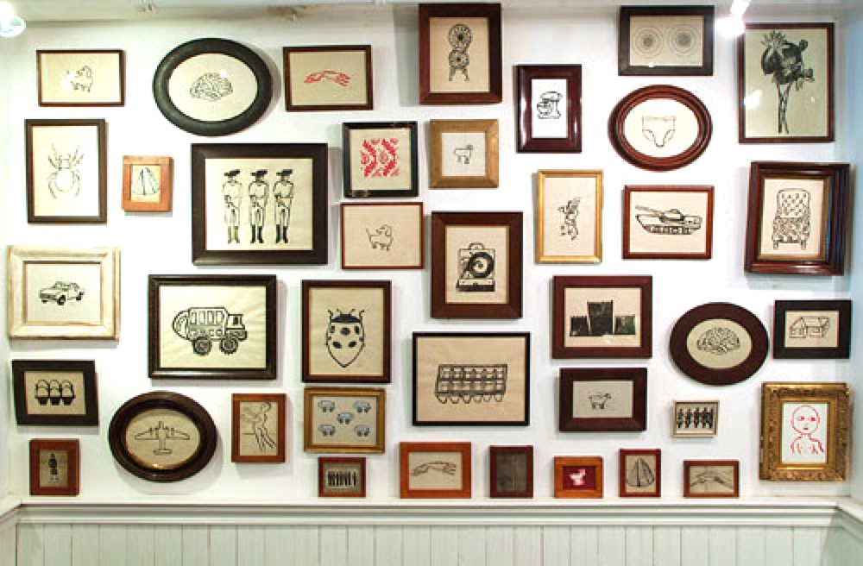
Framing
“A frame can refer to words, images, phrases, and presentation styles a speaker uses to relay information” and “the frame that the speaker chooses reveals what the speaker believes is most relevant to the topic at hand.”
Klar, Robson, & Druckman
Framing creates bias
Influences attitudes, decisions, and actions
Notes:
Framing means a lot of diff things. It’s studied from different angles and for different purposes.
In the social sciences, there’s a lot of high-level work on framing. It is often characterized as cognitive bias, in which people react differently to a choice, depending on whether it is presented as a loss or as a gain. Although many valuable insights have evolved from that work, it tends to ignore language.
Semanticist Chuck Fillmore did pioneering work on framing over 40 years ago, and that work has spawned many lines of research in cognitive linguistics and communication, and more recently psycholinguistics. Lakoff…

Slide 11
Framing
What about semantics?
How does framing (really) work in communication?
What about ASPECT and its role?
How does framing affect inferences about events?
Notes:
The high level questions I’m interested in are things like---

Slide 12
Experiments

Slide 13
Aspectual Framing 6 experiments the big picture
What role does aspect play in everyday language use, especially framing? Central role
Consequences for everyday thought?
As can influence how people reason
How does this work?
Aspect constrains simulation
Notes:
Argument: Grammatical aspect plays a fundamental role in constructing meaning in linguistic expressions of actions and states.

Slide 14

Experiment 1

Slide 15

Experiment 1
Students read 1 sentence + answered 1 question (N = 88)
PP John was driving last weekend
SP John drove last weekend
How many hours? _____________
→ Would estimates for driving time vary? Larger with PP?
Matlock (2011). The conceptual motivation of aspect
Notes:
These students filled out a packete of materials (Qday). They read either John was driving… or John drove… And were asked, “How many hours?” We wanted to know whether there would be more action conceptualized with PP. All students were UCM undergraduates.
ATELIC, UNBOUNDED

Slide 16
Experiment 1
Average number of hours
About 9 more hours with PP than SP
t(83) =2.23, p > .03
All responses coded as hours

Slide 17
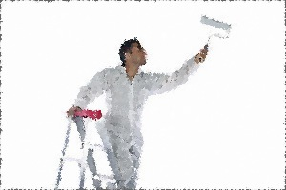
Experiment 2
Notes:
SLIDE 17

Slide 18

Experiment 2
Students read 1 sentence + answered 1 question (N = 88)
PP John was painting houses last summer
SP John painted houses last summer
How many houses? _____________
→ Different estimates?
Matlock (2011) The conceptual motivation of aspect
Notes:
WANTED TO CONSIDER TELIC VERBS – PAINT, WITH DIRECT OBJECT. Events that involve the creation of an end state or state change.

Slide 19
Experiment 2
t(80) =2.59, p > .01
About 8 more houses with PP than SP

Slide 20

Experiment 3
Notes:
More implicit measure, linear extension.

Slide 21
Experiment 3
1 sentence + 2 questions (N = 253)
SP Bob planted pine trees along his driveway last week
PP Bob was planting pine trees along his driveway last week
Questions
Acceptable sentence or not? Yes ___ No ____
How long is the driveway? ___________
→ Would driveway lengths vary? Higher estimates with PP than SP?
Matlock (2010). Abstract motion is no longer abstract, Language and Cognition
Notes:
Wanted to get at the more indirect influences of aspect. Wanted to see how people would conceptualize driveway length and how aspect would influence this.

Slide 22
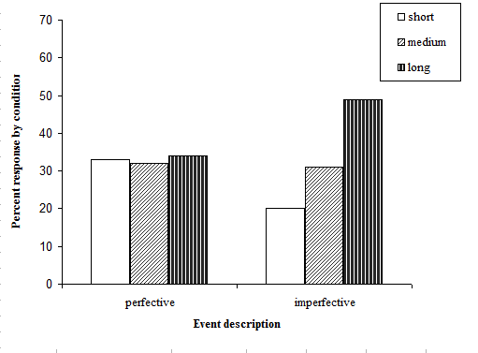
Experiment 3
Scores grouped into
short 1 to 14 ft.
medium 15 to 29 ft.
long 30 +
Simple past
Progressive
χ²(1) = 6.5, p = .01
Past progressive pushed people toward greater length estimates
Notes:
For the analysis, I grouped responses into short, medium, and long, and found that the past progressive biased people toward longer driveways in general.

Slide 23
Experiments 1,2,3 summary
More action conceptualized with past progressive
Suggests enhanced simulation of action
OK, but---
Need converging evidence – more tasks, different domains, closer look at dynamics
Implications for reasoning in real world situations?
Notes:
More action with PP: More hours driving, more houses painted, longer driveways

Slide 24
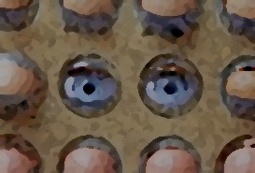
Experiment 4 eye movements
Notes:
Important to use different measures, especially some online measures.

Slide 25
Experiment 4 eye movements
Eye tracking study
Students (N=63) listened to 22 stories (3-4 sentences) while staring at blank computer screen (seemingly irrelevant)
Stories framed with SP or PP
PP John was walking to the store and buying some bread…
SP John walked to the store and bought some bread…
--> How would eye movements with PP descriptions differ from those with SP?
Huette, Winter, Matlock, Spivey & Ardell (2012) Cognitive Processing
Notes:
Blank visual world task with eye tracker
Here we were interested in the dynamics of aspect in event descriptions.

Slide 26
Experiment 4 Results
t(61) = -2.8, p=.006
PP led to many short fixations, distributed over space
Notes:
Past progressive showed many short, fleeting fixations, all over the screen. The eyes move more when the emphasis is on ongoing motion, similar to how the eyes move more when following actual motion.
This is a good 150ms difference, with non-overlapping error, which is a rather large difference.

Slide 27
So far
More action associated with past progressive
IN COMPREHENSION
What about aspectual framing in natural discourse, specifically, with leading questions?
How do people talk about past events?

Slide 28
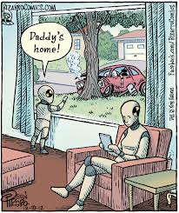
Experiment 5 natural discourse

Slide 29
Experiment 5
Aspectual framing and leading questions
→ More action details with past progressive?
Students (N=22) watched 6 car accidents, given one of these prompts
PP “Tell what was happening in the video”
SP “Tell what happened in the video”
Videotaped while describing the accidents
Matlock, Sparks, Matthews, Hunter & Huette (2012). Smashing new results on aspect, Studies in Language
Notes:
Here we did an experiment that investigated aspect in questions.
We wanted to see how different aspectual framings would affect people’s descriptions of car accidents they had seen. Beth Loftus…
Specifically, we were interested in seeing whether the past progressive (VERB+ing) would lead to more attention to detail in descriptions, including attention to action details. This would be consistent with the idea of more action with PP.

Slide 30

Experiment 5
Stimuli: Videos from youtube.com
Scene | Video Description
1 | Car speeding down freeway sideswipes a van, which then smashes into a truck, causing it to crash into the center divide.
2 | Person hops on a moped, and topples over after riding a few feet.
3 | Truck spins out of control on an icy road, barely avoids hitting nearby vehicles.
4 | Pair of trucks are racing. One flips over, destroying a sign and two police cars before exploding.
5 | Car suddenly crashes into a tow truck parked on the side of the road.
6 | Police car is pursuing a truck that swerves off the road and crashes into an overpass.

Slide 31
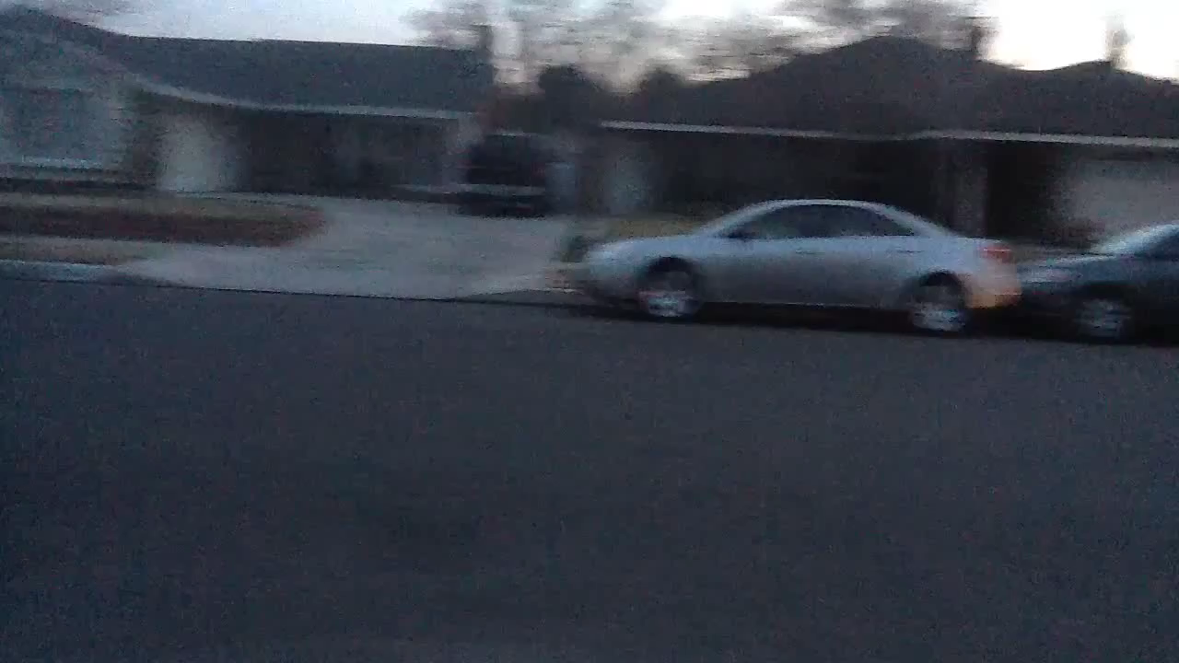
Experiment 5

Slide 32
Experiment 5
Transcribed and coded speech + gesture for each description
Words
Motion verbs drive, come, go
Non-motion verbs see, think, decide
Reckless driving language swerve, speed, cut off
Gestures
Iconic gestures
Beat gestures
Initial analyses:
Amount of PP and SP in participants’ descriptions did not vary
Word count was about the same

Slide 33
Speech Results: Motion verbs
Examples: “There’s a guy driving a truck on an icy road…”
“Another car came.”
“A police car was following a truck.”
Average motion verbs
Past progressive
Simple past
p =.004
PP Proportionally more motion verbs (drive, come, follow)

Slide 34
Speech Results: Non-motion verbs
Examples: “It looked like the white car …”
“A lady decided to try.”
“I don’t know what they call it.”
Average non-motion verbs
Past progressive
Simple past
p =.01
PP Fewer non-motion verbs (think, decide, know, look)

Slide 35
Speech Results: Reckless language
Examples: “The truck was speeding”
“She was swerving”
“He tried to cut off the car next to him”
Average reckless driving language
p = .05
Past progressive
Simple past
PP More reckless driving language (crash, lose control, slam into)

Slide 36
Gesture Results: Iconic gestures
Examples: path gesture away from body to show forward motion
circular motion to show a car spinning out
hands smacked together to show a crash
Average iconic gestures
p<.001
Past progressive
Simple past
PP More iconic gestures

Slide 37
Gesture Results: Beat gestures
Examples: made a fist with, “Ok, in the video…”
Average beat gestures
Past progressive
Simple past
p = .05
PP Fewer beat gestures

Slide 38
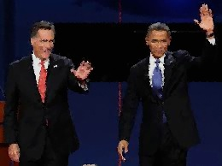
framing in politics campaign messages

Slide 39
Experiment 6
Political messages influence how people think about candidates, including electability, and they influence voting behavior
Example:
Negative framing captures attention but if too negative, low voter turn out
UCM undergrads (N=354)
Fausey & Matlock 2011, Political Psychology

Slide 40
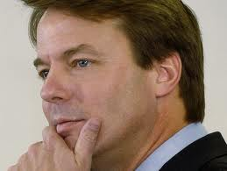
Edwards was having an affair with
Rielle Hunter, a former campaign worker… (National Enquirer)
So John Edwards had an affair –
Grow up, adultery is not a political issue.
(Huffington Post)
Notes:
We were never really taught to pay much attention to differences like the ones we see here. On the top you see having an affair and on the bottom—SAME MESSAGE BUT DIFFERENT GRAMMAR---you see had an affair.
40

Slide 41
 | Simple Past | Past Progressive
Negative | Mark Johnson is a Senator in the United States Senate. He is up for re-election. He graduated from the University of Texas, Austin with a degree in political science. Mark’s first term as a United States Senator is almost complete. Last year, Mark had an affair with his assistant and took hush money from a prominent constituent. (N=92) | Mark Johnson is a Senator in the United States Senate. He is up for re-election. He graduated from the University of Texas, Austin with a degree in political science. Mark’s first term as a United States Senator is almost complete. Last year, Mark was having an affair with his assistant and was taking hush money from a prominent constituent. (N=96)
Positive | Mark Johnson is a Senator in the United States Senate. He is up for re-election. He graduated from the University of Texas, Austin with a degree in political science. Mark’s first term as a United States Senator is almost complete. Last year, Mark rekindled his relationship with his wife and collected donation money for the American Cancer Society. (N=85) | Mark Johnson is a Senator in the United States Senate. He is up for re-election. He graduated from the University of Texas, Austin with a degree in political science. Mark’s first term as a United States Senator is almost complete. Last year, Mark was rekindling his relationship with his wife and was collecting donation money for the American Cancer Society. (N=81)
Stimuli

Slide 42
Stimuli
 | Simple Past | Past Progressive
Negative | Mark Johnson is a Senator in the United States Senate. He is up for re-election. He graduated from the University of Texas, Austin with a degree in political science. Mark’s first term as a United States Senator is almost complete. Last year, Mark had an affair with his assistant and took hush money from a prominent constituent. (N=92) | Mark Johnson is a Senator in the United States Senate. He is up for re-election. He graduated from the University of Texas, Austin with a degree in political science. Mark’s first term as a United States Senator is almost complete. Last year, Mark was having an affair with his assistant and was taking hush money from a prominent constituent. (N=96)
Positive | Mark Johnson is a Senator in the United States Senate. He is up for re-election. He graduated from the University of Texas, Austin with a degree in political science. Mark’s first term as a United States Senator is almost complete. Last year, Mark rekindled his relationship with his wife and collected donation money for the American Cancer Society. (N=85) | Mark Johnson is a Senator in the United States Senate. He is up for re-election. He graduated from the University of Texas, Austin with a degree in political science. Mark’s first term as a United States Senator is almost complete. Last year, Mark was rekindling his relationship with his wife and was collecting donation money for the American Cancer Society. (N=81)

Slide 43
Stimuli
 | Simple Past | Past Progressive
Negative | Mark Johnson is a Senator in the United States Senate. He is up for re-election. He graduated from the University of Texas, Austin with a degree in political science. Mark’s first term as a United States Senator is almost complete. Last year, Mark had an affair with his assistant and took hush money from a prominent constituent. (N=92) | Mark Johnson is a Senator in the United States Senate. He is up for re-election. He graduated from the University of Texas, Austin with a degree in political science. Mark’s first term as a United States Senator is almost complete. Last year, Mark was having an affair with his assistant and was taking hush money from a prominent constituent. (N=96)
Positive | Mark Johnson is a Senator in the United States Senate. He is up for re-election. He graduated from the University of Texas, Austin with a degree in political science. Mark’s first term as a United States Senator is almost complete. Last year, Mark rekindled his relationship with his wife and collected donation money for the American Cancer Society. (N=85) | Mark Johnson is a Senator in the United States Senate. He is up for re-election. He graduated from the University of Texas, Austin with a degree in political science. Mark’s first term as a United States Senator is almost complete. Last year, Mark was rekindling his relationship with his wife and was collecting donation money for the American Cancer Society. (N=81)
1. Will this candidate be re-elected? (yes, no)
2. How confident are you about your decision regarding re-election? (1-7)
3. Please estimate the total amount of money (in US dollars)

Slide 44
Stimuli
 | Simple Past | Past Progressive
Negative | Mark Johnson is a Senator in the United States Senate. He is up for re-election. He graduated from the University of Texas, Austin with a degree in political science. Mark’s first term as a United States Senator is almost complete. Last year, Mark had an affair with his assistant and took hush money from a prominent constituent. (N=92) | Mark Johnson is a Senator in the United States Senate. He is up for re-election. He graduated from the University of Texas, Austin with a degree in political science. Mark’s first term as a United States Senator is almost complete. Last year, Mark was having an affair with his assistant and was taking hush money from a prominent constituent. (N=96)
Positive | Mark Johnson is a Senator in the United States Senate. He is up for re-election. He graduated from the University of Texas, Austin with a degree in political science. Mark’s first term as a United States Senator is almost complete. Last year, Mark rekindled his relationship with his wife and collected donation money for the American Cancer Society. (N=85) | Mark Johnson is a Senator in the United States Senate. He is up for re-election. He graduated from the University of Texas, Austin with a degree in political science. Mark’s first term as a United States Senator is almost complete. Last year, Mark was rekindling his relationship with his wife and was collecting donation money for the American Cancer Society. (N=81)
Most people said “no” regardless of condition
1. Will this candidate be re-elected? (yes, no)
2. How confident are you about your decision regarding re-election? (1-7)
3. Please estimate the total amount of money (in US dollars)
NEG: More confident with PP
NEG: More $ with PP

Slide 45
Experiment 6 summary
Aspect differentially influenced inferences about political candidates’ past actions and their electability
Past progressive enhanced attitudes about candidates and electability, depending on valence, type of event and so on
Another study replicated effect with topic of imminent domain

Slide 46
Wrap up

Slide 47
Aspectual Framing 6 experiments the big picture
What role does aspect play in everyday language use, especially framing? Central role
Consequences for everyday thought?
Aspect can influence how people reason
How does this work?
Aspect constrains simulation
Aspect deserves far more attention in psycholinguistics
Notes:
Argument: Grammatical aspect plays a fundamental role in constructing meaning in linguistic expressions of actions and states. It

Slide 48

People mentally simulate all sorts of things
perception of motion
Kourtzi & Kanwisher (2000)
the future trajectories of moving objects
Freyd (1987)
motion in reasoning and problem-solving
Schwartz & Black (1999), Hegarty (2004)
movement from one point in space to another
Morrow & Clark (1988)
places where things are happening
Spivey & Geng (2001)
They do this with language
Barsalou (1997, 2009), Bergen (2012), Gibbs & Matlock (2008),Zwaan & Pecher (2012), Zwaan & Radvansky (1998)
Notes:
Let me say a few words about mental simulation.

Slide 49
Future work
Look closer at aspectual distinctions across a wide range of contexts
Examine verb semantics
Look at various dimensions of TAMs
Not just English!
Not just literal language!

Slide 50
Take home message
Aspect is an important dimension of framing
We need to inspect the semantic details of everyday language
→ inform our work as language theorists
→ provide new insights into how language can/should work
Use our expertise to explore language in real world situations to help shed light on real world problems

Slide 51
THANKS
Caitlin Fausey, Stephanie Huette, Jeremy Hunter, Justin Matthews, David Sparks
Ben Bergen, Herb Clark, Eve Sweeter, Elisabeth Wehling, Bodo Winter, Rolf Zwaan
IARPA and NSF
End of the road
→ background
studies on aspect & framing
wrap up
Notes:
We talked about some work I recently did on aspect and motion metaphors.

Slide 52
A look at the role of aspect in reasoning about events
Teenie Matlock
Professor of Cognitive Science and McClatchy Chair of Communications
Cognitive and Information Sciences Program
University of California, Merced
Beyond time workshop
CU Boulder Linguistics Department
April 7-8, 2017

Slide 53
Abstract A Look at the Role of Aspect in Reasoning about Events
Communication would be impossible without the ability to describe and interpret
everyday events in the world. An important dimension of this, in any language and in
any situation, involves the temporal dynamic of events. Is an event described as long
and ongoing, or as short and instantaneous? Is it described as a single or repeated
instance? Differences like these matter a great deal to how an event is interpreted, and
ultimately, to what opinions and attitudes are formed.
Aspect has been studied in depth by linguists, especially those with an interest in the
semantics and structure of linguistic form of relevance to temporality. This includes how
aspect interacts with tense and modality, how it is realized within a single language or
across languages, and how it evolves over time (e.g., Bybee, Perkins, & Pagliuca, 1994;
Comrie, 1976; Croft, 2012; Michaelis, 2004). Despite a wealth of knowledge about how
aspect works synchronically and diachronically, there is still much to learn about how it
influences everyday reasoning about events in the world.
In the presentation, I report some of my experimental semantics research on the role of
aspect in reasoning about events. One line of research investigates how aspect can
bring on shifts in attitude toward political candidates’ in campaign messages (Fausey &
Matlock, 2011). Another line of research examines how aspect in queries about
accidents affects how they are described in speech and gesture (Matlock, Sparks,
Matthews, Hunter, & Huette, 2012). Yet another line of research uses eye-tracking to
investigate how and when aspect brings on shifts in eye movements during the
comprehension of action stories (Huette, Winter, Matlock, Ardell, & Spivey, 2014). I end
by discussing how behavioral research is valuable to gaining a clearer, more nuanced
understanding of aspect in everyday communication of events.

Slide 54
Experiment 6 Results confidence about electability
Negative actions
More people were very confident about “no” decisions when actions were described with past progressive (77%) vs. those in the simple past condition (47%)
Positive actions
No difference
χ2(2, N = 147) = 18.27, p < .001

Slide 55
Experiment 6 Results money in transaction
Negative
People gave higher hush-money estimates in PP versus people in SP (58% above overall median versus 37% above overall median)
Positive
No difference
χ2(1, N = 147) = 6.74, p = .009.

