Slide 1
Event structure and event duration in language comprehension
Silvia Gennari
University of York
Collaborators:
Marta Coll-Florit, Gitte Joergensen, Yaqi Wang

Slide 2
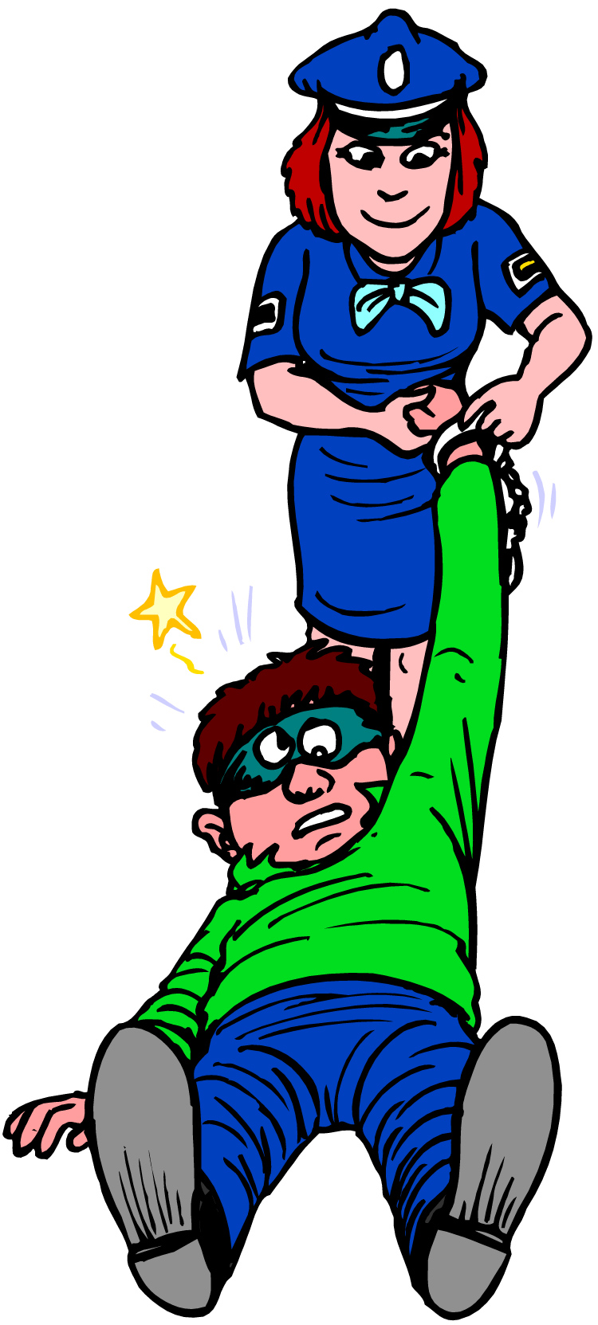
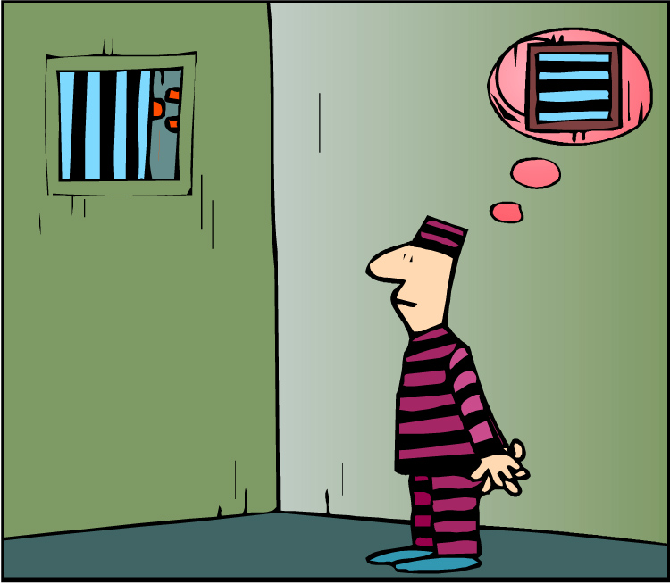
Time and change
Main aspect of cognition: we conceive of events as taking time
Language
The police held a suspect
The police arrested a suspect
Main question: how do we represent the duration and causal structure of events in language comprehension?
Notes:
How do we understand the duration of these events? What knowledge underpins such duration representations?
It can be extended to cognition more generally

Slide 3
The puzzle
Representations of event duration appear analogical
more temporal distance/duration = more processing times (Kelter et al. 2004, Gennari, 2004; Richardson & Matlock, 2007)
Jane disagrees with her husband and throws a tantrum. Then, she goes into the kitchen and takes out / bakes some cookies. Now she regrets the tantrum.
But how analogical? They cannot be exhaustive mental re-playing, as in simulation theories, but compressed in time
John searched for the right woman all his life
John built a house / a Lego house
What aspects of the representations are activated as we read?
Notes:
Bowers and Morrow 1990 takes 3 sec to retrieve things from another building

Slide 4
Outline
1. Processing correlates of event structure and event duration
2. What aspects of semantic memory are linked to event representations?

Slide 5
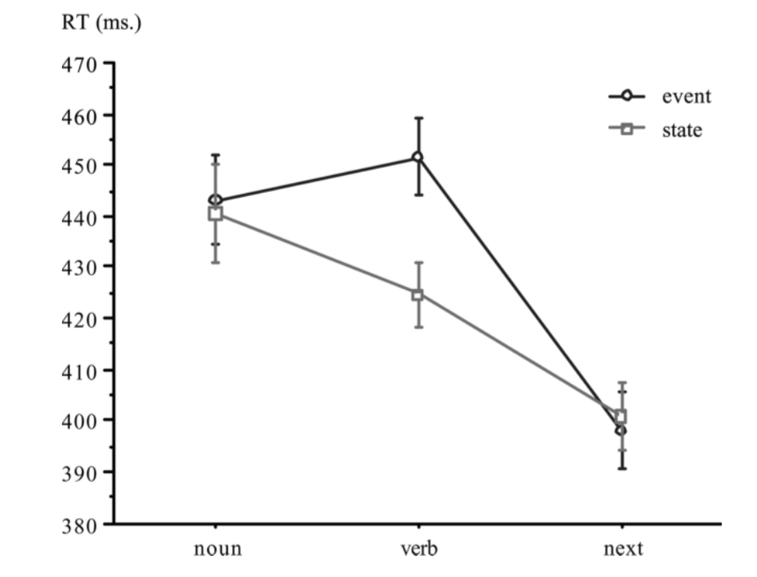
Processing correlates of event structure
States vs. events
Events have internal causal structure and may activate richer associated knowledge (schemas) than states
The retired musician loved his second child very much
The retired musician built his second house from scratch
Processing correlates
(Gennari & Poeppel, 2003)

Slide 6
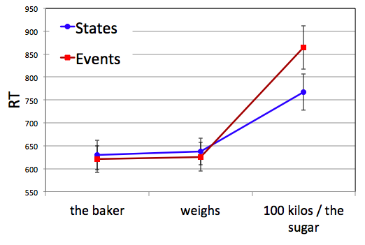
States and events
Same verb = different interpretations
The baker weighs 100 kilos
The baker weights the sugar
Causality/complexity makes a difference for processing cost

Slide 7
Processing correlates of event duration
Starting big:
Durative states | Punctual events
To owe 50 euros | To lose 50 euros
To own a pool | To fall in a pool
Tasks
Make-sense judgment
Estimated duration
Processing correlates
(Coll-Florit & Gennari, 2011)
Notes:
How long does the event last in a scale from 1 to 7?
If there are indeed different in the knowledge associated with durative and punctual events, and these differences have to do with duration

Slide 8
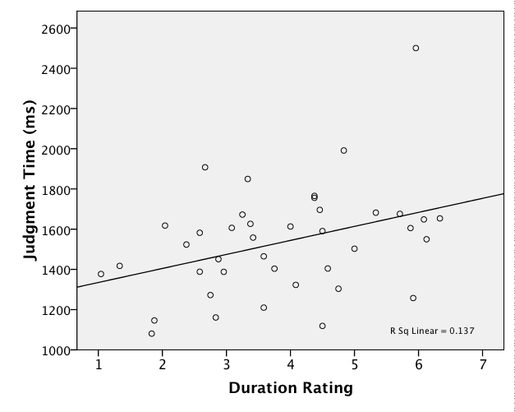
Processing correlates of event duration
Event duration plays a role in processing
At odds with previous event type effects (events > states)
Processing correlates
(Coll-Florit & Gennari, 2011)

Slide 9
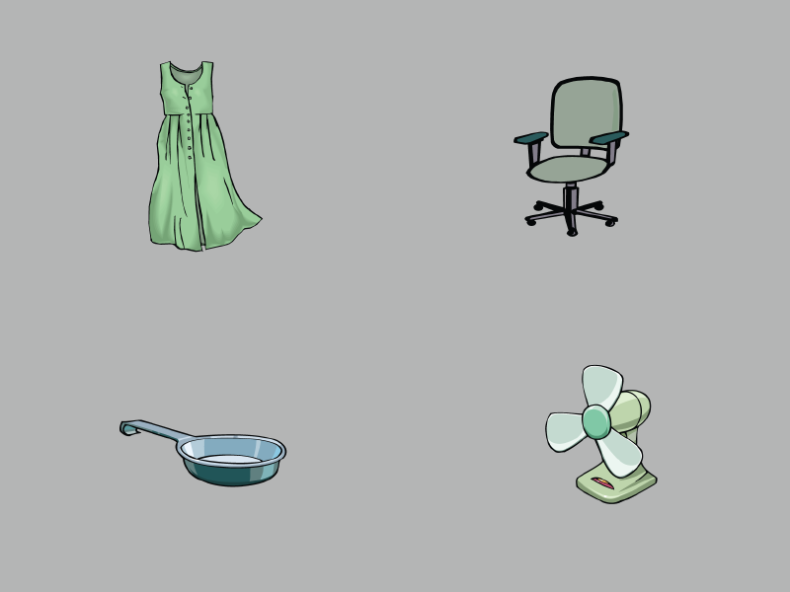
Events of different duration (1)
Is the same event processed differently as a function of duration?
Molly felt like doing some work around the house.
She had three hours to spare before her appointment - Long
She had an hour to spare before her appointment - Short
She spent all that time altering her dress.
Visual world paradigm
Processing correlates
(Joergensen & Gennari, in prep)
Notes:
Visual world paradigm: people fixate the objects being named in concurrent auditory sentence
In these paragraphs events do not progress in sequence, unlike narrative. Events refer to same time.

Slide 10
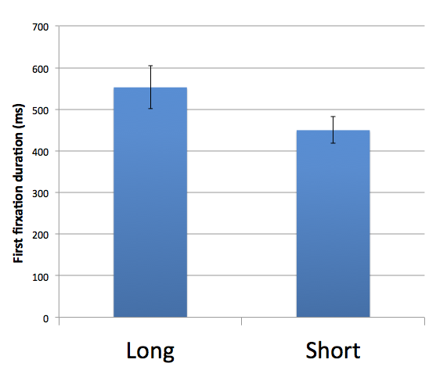
Events of different duration (1)
While hearing the critical noun (dress), first fixation duration
Same verbs show processing correlates as a function of duration
Processing correlates
(Joergensen & Gennari, in prep)

Slide 11
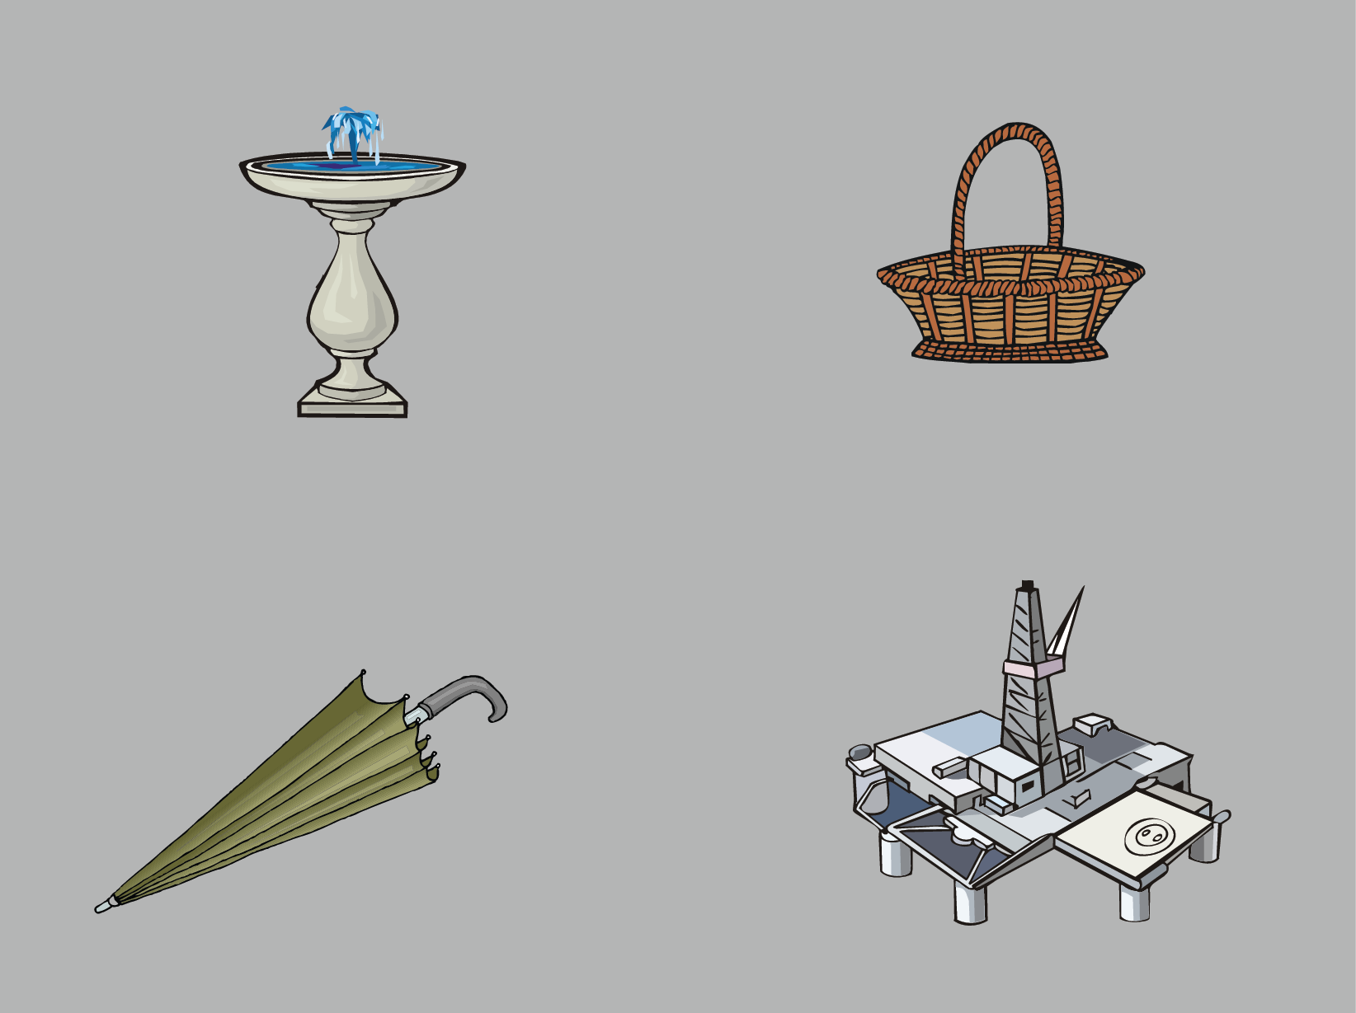
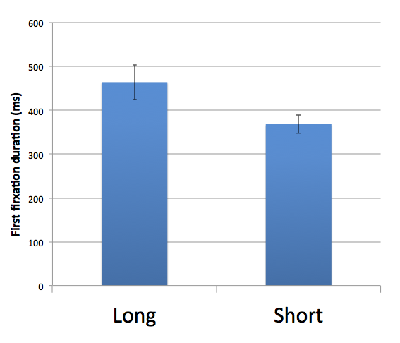
Large-scale vents of different duration (2)
Extended previous eye-tracking effect to a different time scale
Tim worked for an engineering company
He was stationed in Russia for a week – Short
He was stationed in Russia for a month – Long
It took him all that time to refurbish an oil rig
For small and large temporal scale, we find duration effect
Processing correlates
Notes:
In the next experiment, we used large-scale events to see whether the previous results can be replicated and extended to a different time scale.
This experiment was exactly the same as the previous one, except this time participants heard events differing on a large scale duration.
So they would hear something like (read example)

Slide 12
Event duration and event type
States:
Juan es muy serio – John is very serious (temporary)
Juan está muy serio – John is very serious (stable)
Esto le da un aspecto de intelectual – “This makes him look smart”
Events
Juan ate a stake (long)
Juan ate an olive (short)
Esto le despertó/satisfizo el apetito
“This whetted/satisfied his appetite”
Processing correlates

Slide 13
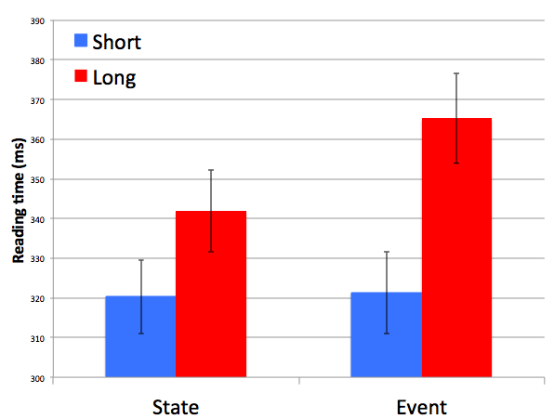
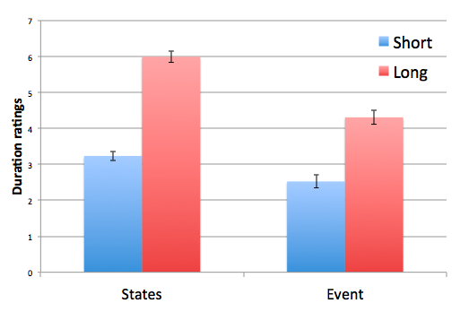
Event duration and event type
Reading times
Duration Ratings
Processing correlates

Slide 14
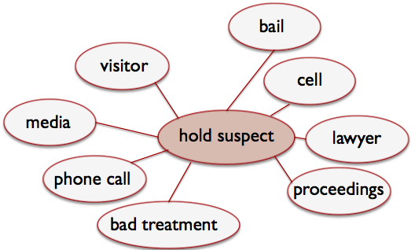
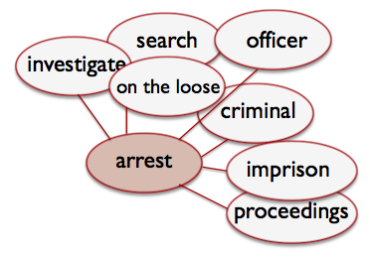
Event structure and duration
Duration can separately influence states and events
But it may not influence each event type in the same way
Long events take longer to process than the long states, even if states are permanent
Where do these effects come from?
Knowledge-based view:
Understanding events depends on retrieving knowledge of other events associated with it, learned dependencies in the world
The diversity of these dependencies determines reading times
Processing Mechanism: retrieving more distributed meaning is costly
Semantic representations
(Coll-Florit & Gennari, 2011)

Slide 15
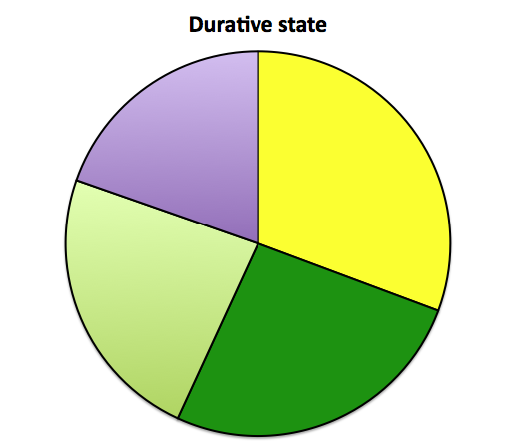
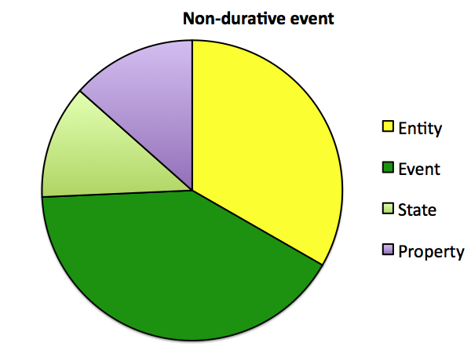
Eliciting associations for verb phrases
to owe 50 euros = slow to pay, worried, loan, gratitude
to lose 50 euros = money, gambling, mistake, drop
Coding: event, states, entities and properties
Correlation: more diversity, longer RTs
Diversity of associations plays a role in processing
Semantic representations
(Coll-Florit & Gennari, 2011)

Slide 16
Examining associated knowledge in corpus: durative vs. punctual verbs
The situations in which we experience durative/punctual events should be reflected in the contexts of verbs (lose vs. owe)
The company lost money this year. Jane lost her child. The team lost the game.
Hypothesis:
Durative verbs’ contexts = less similar to others, more disperse
Corpus Study – durative vs. punctual verbs
Measure of semantic similarity across the verbs’ contexts = semantic diversity
Semantic representations
(Coll-Florit & Gennari, 2011)
Notes:
Examples: The socialist leader lost the elections, The dealer caused the company to lose millions

Slide 17
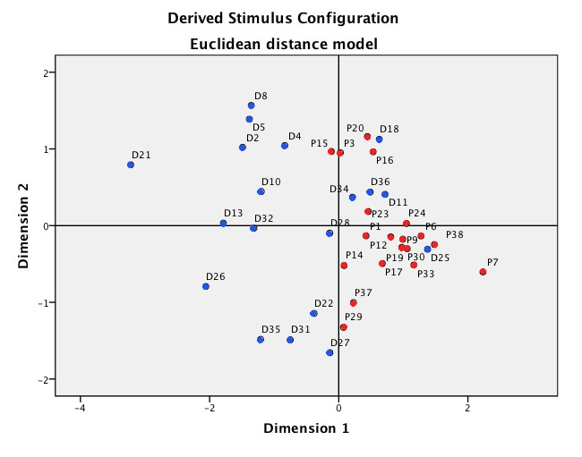
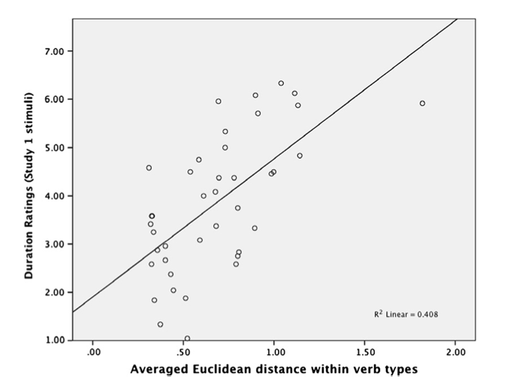
Examining corpus distributions
Distance predicts RTs
Diversity of associated knowledge plays a role in comprehension
Associated knowledge
(Coll-Florit & Gennari, 2011)
Notes:
Correlations: the higher the duration rating and the more diverse associations, the more the distance between the verbs’ contexts

Slide 18
Discussion
Summary:
Reading cost can be associated with either causal structure or duration
Reading cost of durative vs. non-durative events is explained by differences in associated knowledge
Outstanding question
Event structure might also be associated knowledge
States tend to overlap other event or states
Events tend to establish causal relations between them

Slide 19
Back to the puzzle
What aspects of the events are retained in memory which make them appear analogical with the real world?
Representing events = retrieving associations from semantic memory
More diverse associations are retrieved for
long states > punctual events
long events > short states
Associated knowledge in semantic memory might explain why processing cost differ
Discussion
Notes:
Not external clock time

Slide 20
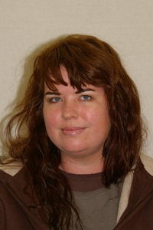
Thank you
Marta Coll-Florit
Gitte Joergensen
Yaqi Wang

Slide 21
Processing correlates of event duration
Moving away from event types:
perfective vs. imperfective morphology changing interpretation of same verb: durative vs. non-durative
Question: does duration influence both states and events?
(Coll-Florit & Gennari, 2011)

Slide 22
Event duration for short/long causal events (3)
Retrieving words after reading story: distinguishing critical events from others
Reading task with final probe: was the word in the story?
Early probe: company Late probe: oil rig
Tim worked for an engineering company
He was stationed in Russia for a week – Short
He was stationed in Russia for a month – Long
It took him all that time to refurbish an oil rig
He was very happy with the pay.
Processing correlates

Slide 23
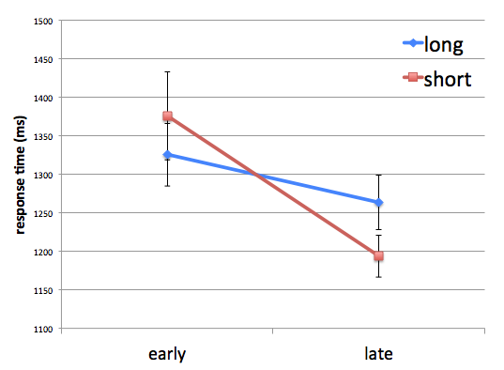
Event duration for short/long causal events (3)
Longer events take longer to retrieve from memory
Processing correlates

Slide 24
Eliciting associations for short stories
Hypothesis: long events should elicit more semantically diverse associations due to internal complexity
Example: Molly sitting naked cutting, measuring, finding the right thread, adjusting sleeves, she’s skillful, industrious, excited, wants to save money, wants to look good.
Multidimensional scaling: euclidian distance between items
Molly felt like doing some work around the house.
She had three hours/an hour to spare before her appointment
She spent all that time altering her dress.
What does Molly altering her dress bring to mind?
Associated knowledge

Slide 25
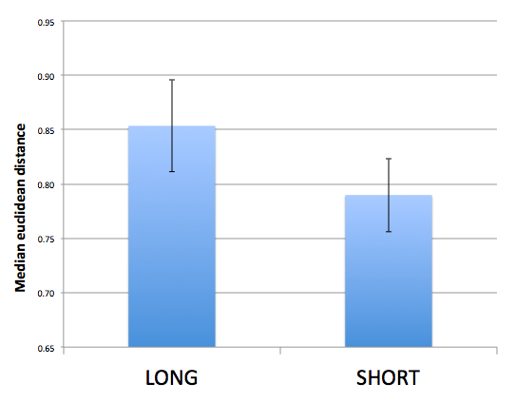
Examining associated knowledge for short stories
Difference in semantic distance between long vs. short events for small-scale events but not large-scale events
Diversity of associated knowledge may explain differences in RT for small-scale events
Why are there differences in processing time for large-scale events?
Associated knowledge

