Slide 1
Learning from Drought Crisis in Federations: Tools and Institutions for Dealing with Water Scarcity and Sustained Droughts
The Colorado and Murray-Darling
Panel Discussion
Brad Udall
Senior Scientist/Scholar
Colorado State University
Bradley.Udall@colostate.edu

Slide 2
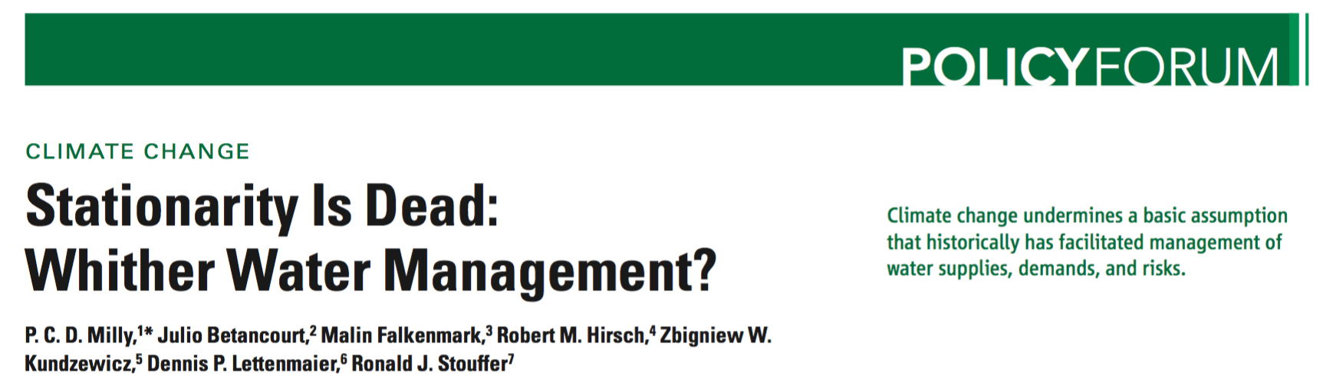
Climate Change is Water Change
Too Much
Too Little
Wrong Timing
Wrong Form
Wrong Quality

Slide 3
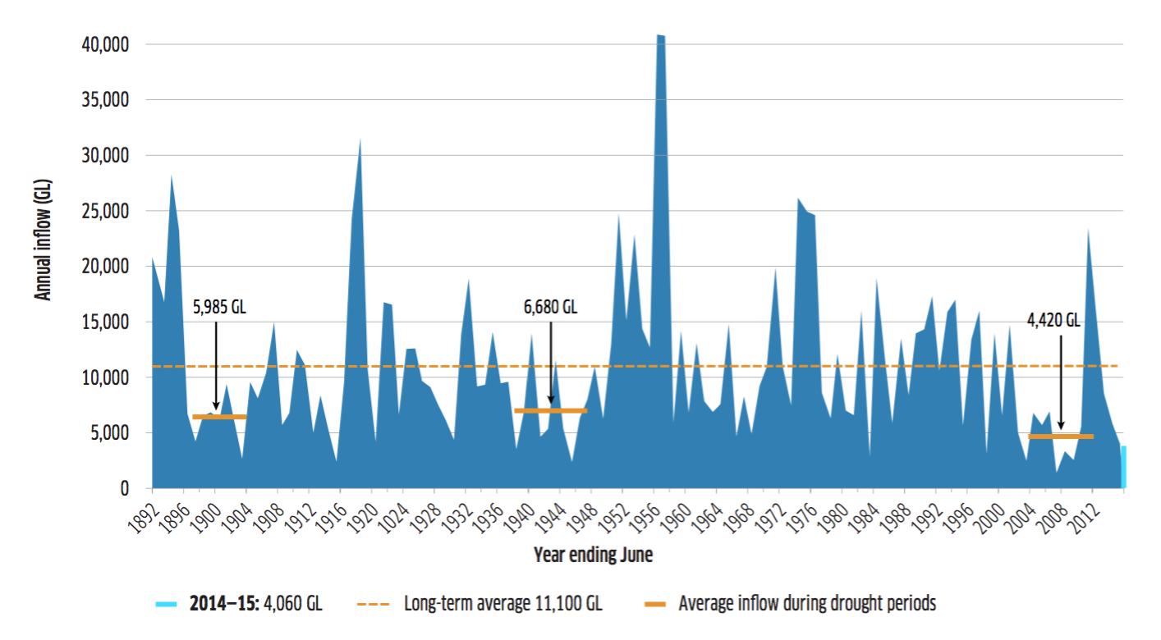
River Murray Natural Flows

Slide 4
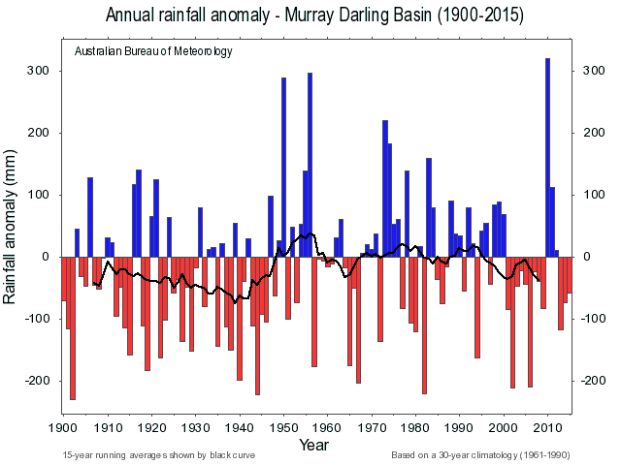

Slide 5
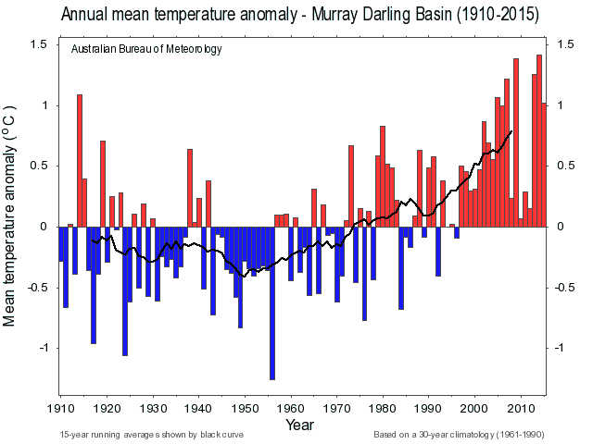

Slide 6
Colorado River Natural Flows

Slide 7
Colorado River Precipitation

Slide 8
Colorado River Temperatures

Slide 9
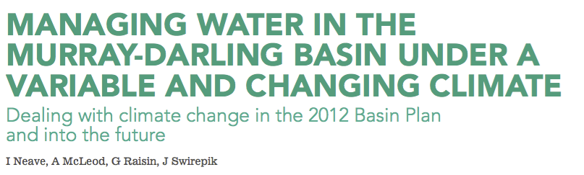
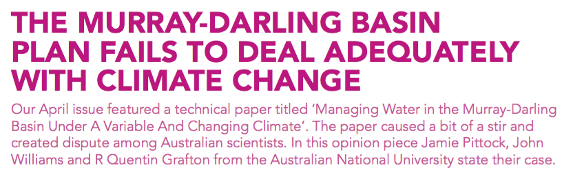
Australian Climate Change Risk Model
Water, April 2015
Water, September 2015

Slide 10
Colorado River Compact III(d)
“The States of the Upper Division will not cause the flow of the river at Lee Ferry to be depleted below an aggregate of 75,000,000 acre-feet for any period of ten consecutive years reckoned in continuing progressive series beginning with the first day of October next succeeding the ratification of this compact.”

Slide 11
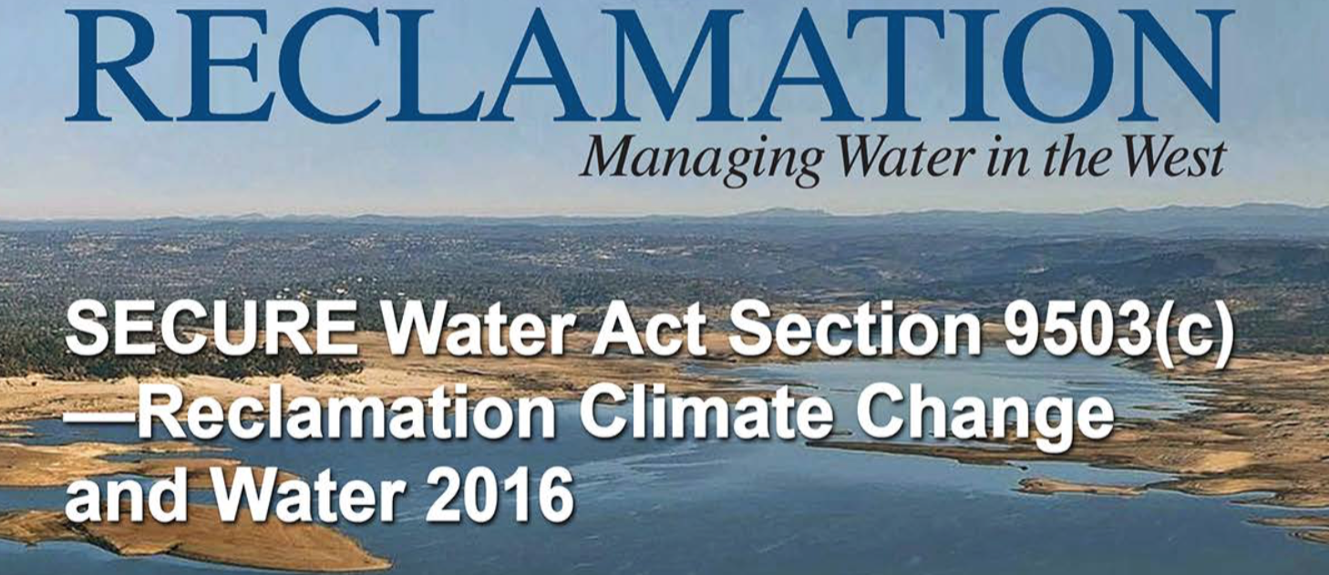
US Climate Change Approach
Federal Planning and Modeling
Fixation on Median Model Results
Next to nothing on Extremes
  MDB Failure
  CRB Failure

Slide 12
Question of the Day
Is it time for the Colorado River Basin states to discuss where climate change flow risk should fall outside of III(d)?
My answer:
  Absolutely YES.
  Climate Change Impacts already being felt but not acknowledged outside of hand waving
  III(d) wholly inadequate
  Part of Structural Deficit is a Climate Change Problem

