Slide 1
Indigenous Peoples’
Legal Research in Context
Lunch & Learn
Notes:
As “traditional” a presentation as a non-native law librarian can make – Rights v. Relationships

Slide 2
What we’ll cover
Overview of the topic – International, Foreign, Domestic
Resources for
  International
  Foreign
  Domestic
  Tribal
Notes:
Me… worked on the KI classification for law
Kate at norlin now working on the E classification, Jim…

Slide 3
Considerations
  Languages / Translations
  Spellings
  Currency of Information
  Translations
  Dates
  All of these have heightened importance when dealing with research concerning indigenous peoples and nations

Slide 4
Keep in mind…
Interdisciplinary nature of law today
Complexity of the topic and the materials;
The challenge of locating and accessing materials issued by a variety of organizations.
The researcher needs to be resourceful, creative, and never become daunted by the task.
Just when you are ready to give up is when you might find the needed material.
- Marci Hoffman, ASIL ERG Human Rights http://www.asil.org/humrts1.cfm

Slide 5
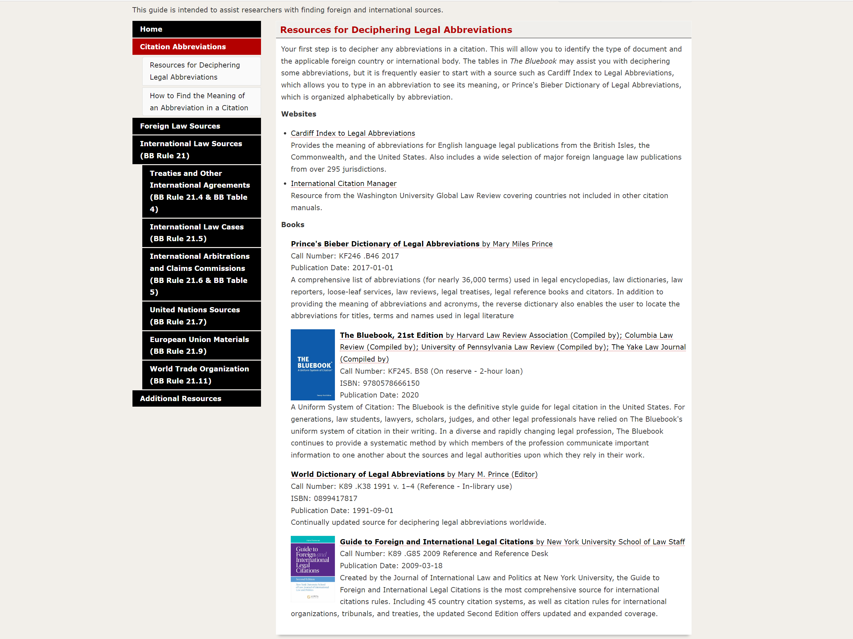
Abbreviations
Notes:
Cardiff Index to Legal Abbreviations; International Citation Manager, Prince’s Bieber Dictionary of Legal Abbreviations, The Bluebook, Guide to Foreign and International Legal Citations

Slide 6
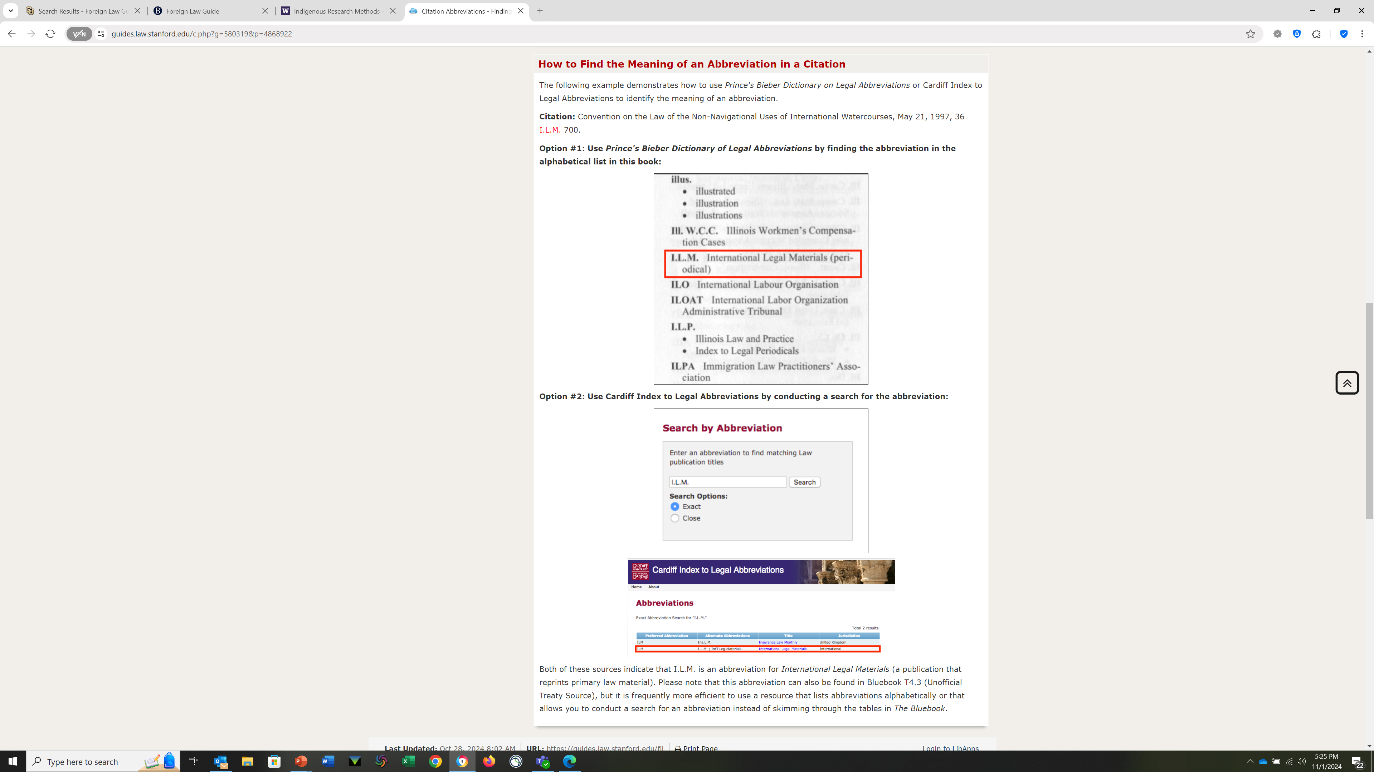
How to find the Meaning of an Abbreviation in a Citation
Notes:
Examples of Print (Prince’s Bieber) and online Cardiff Index to legal abbreviations

Slide 7
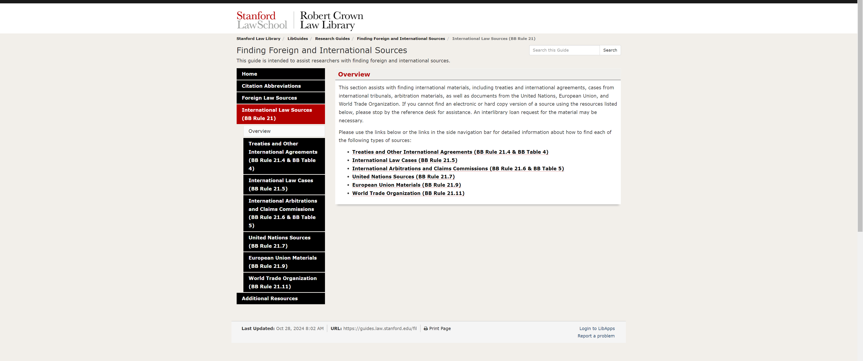
International Law and the BlueBook

Slide 8
Citations – How to Cite
Stanford https://guides.law.stanford.edu/fil
Georgetown https://guides.ll.georgetown.edu/c.php?g=365734&p=2471175
Frequently cited treaties
https://libguides.law.umn.edu/frequentlycitedtreaties
Legal Citations in a Nutshell (2021)
  KF245 T47 2021 – on Reserve

Slide 9
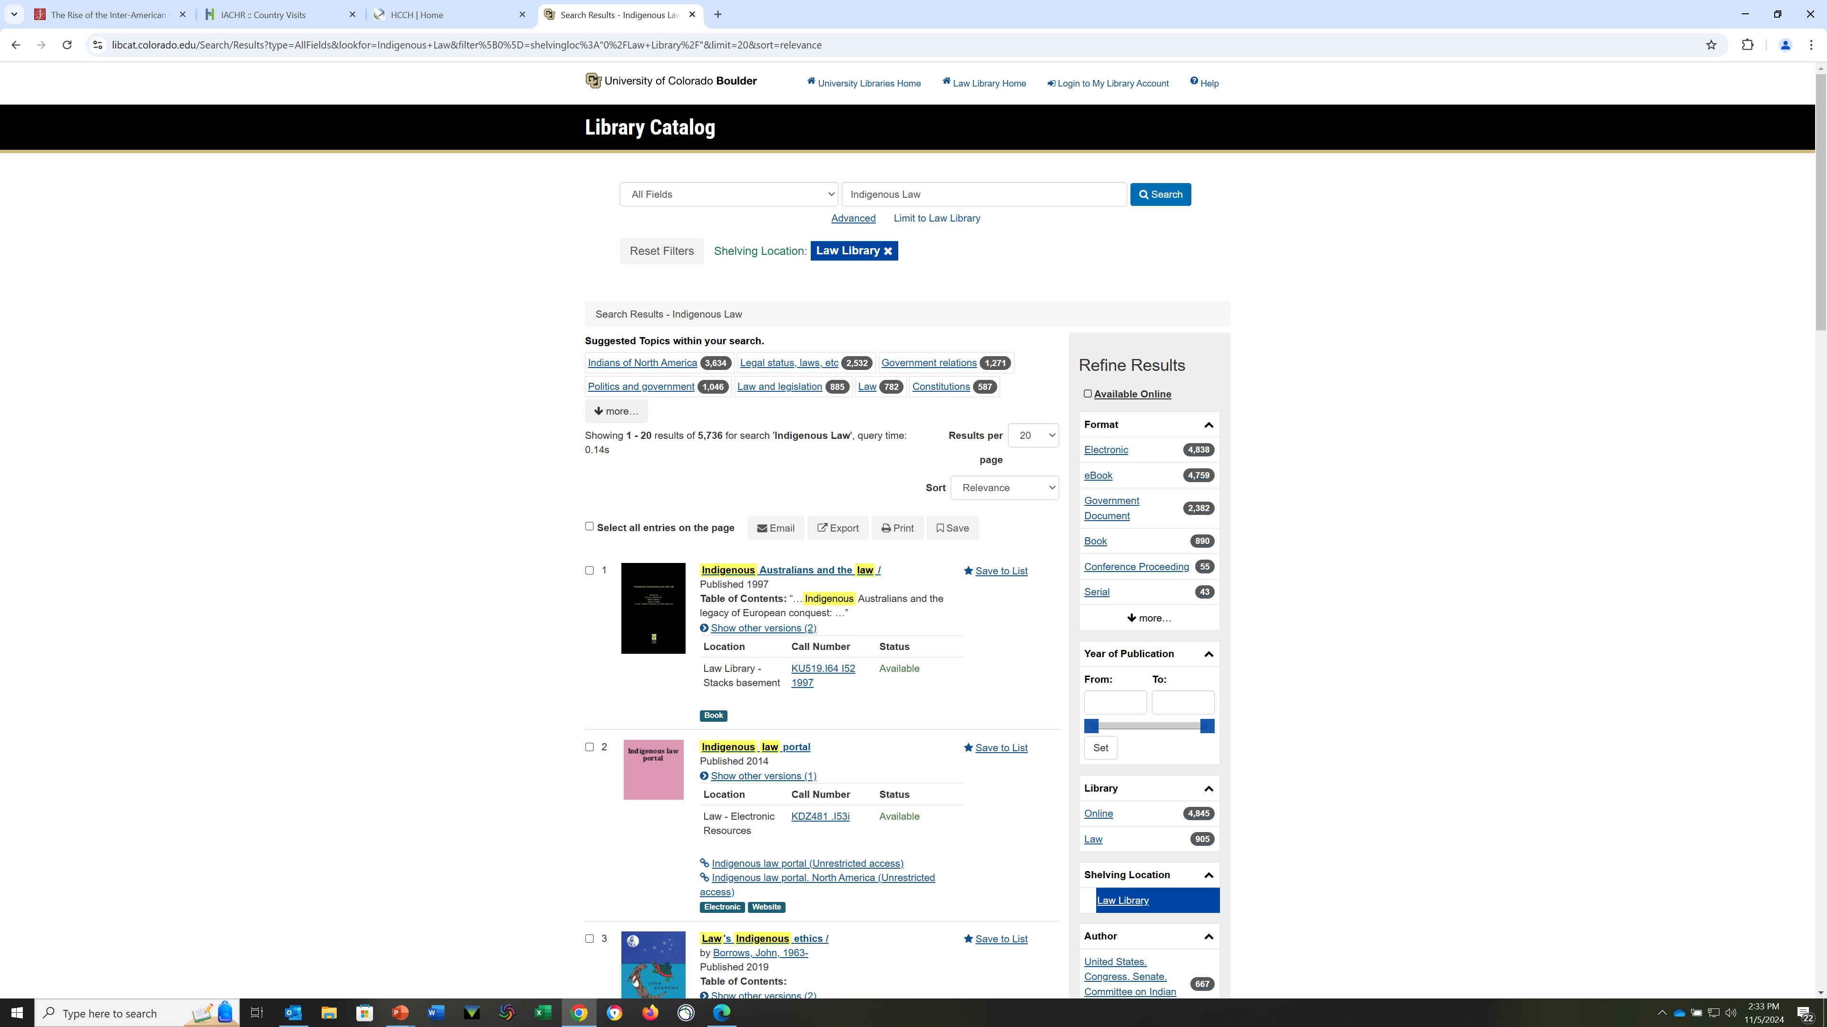
The Catalog Search
Law Library
The default is to the law library.
If you’d like to see more results and/or the holdings at the University Libraries, click the X at the top of the page
Research Guides by topic
Don’t Neglect to search University Libraries – particularly when researching indigenous peoples.
Notes:
Explain the relationship – We do Law – try not to duplicate…
Be sure to be on VPN if you are off campus!

Slide 10
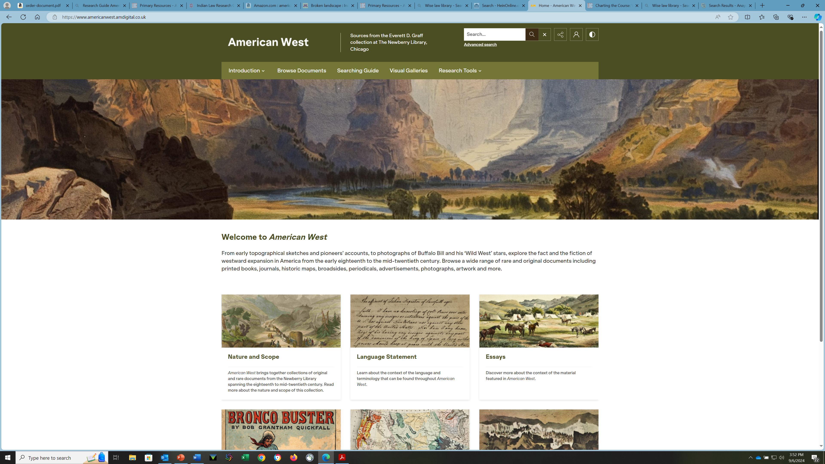
University Libraries – Adam Mathews “Explorer”
(find in A-Z databases)
Notes:
Don’t Forget to search Norlin

Slide 11
Secondary Resources
Monographs (books) & Treatises
International Encyclopedias
International Yearbooks
Law Journal Articles
Subject Guides, Indexes, Bibliographies
Digests
Notes:
As with US law, secondary sources are

Slide 12
Law Library Databases
Max Plank Encyclopedia of Public International Law Online
Oxford Reports on International Law:
  International Law in Domestic Courts
  International Criminal Law
  International Human Rights Law
  International Courts of General Jurisdiction
OECD iLibrary

Slide 13
Journals – Law Library
LegalTrac https://go-gale-com.colorado.idm.oclc.org/ps/dispAdvSearch.do?userGroupName=fleming_law&prodId=LT
SSRN https://www.ssrn.com/index.cfm/en/
Index to Legal Periodicals
LLMC https://llmc-com.colorado.idm.oclc.org/searchResultVolumes2.aspx?ext=true&catalogSet=54066
HeinOnline https://heinonline-org.colorado.idm.oclc.org/HOL/Index?index=lbr/ilpera&collection=journals
Index to Foreign Legal Periodicals
https://heinonline-org.colorado.idm.oclc.org/HOL/Index?index=journals/ininfor&collection=journals
Elgar Journal of Human Rights and the Environment https://guides.ll.georgetown.edu/c.php?g=365734&p=2471175

Slide 14
Journal Databases
Law Library Databases - Journals
  Hein Online
  LegalTrac (in-library use only)
  LexisNexis Academic Universe
  Index to Legal Periodicals
  Index to Foreign Legal Periodicals
  Legal Scholarship Network

Slide 15
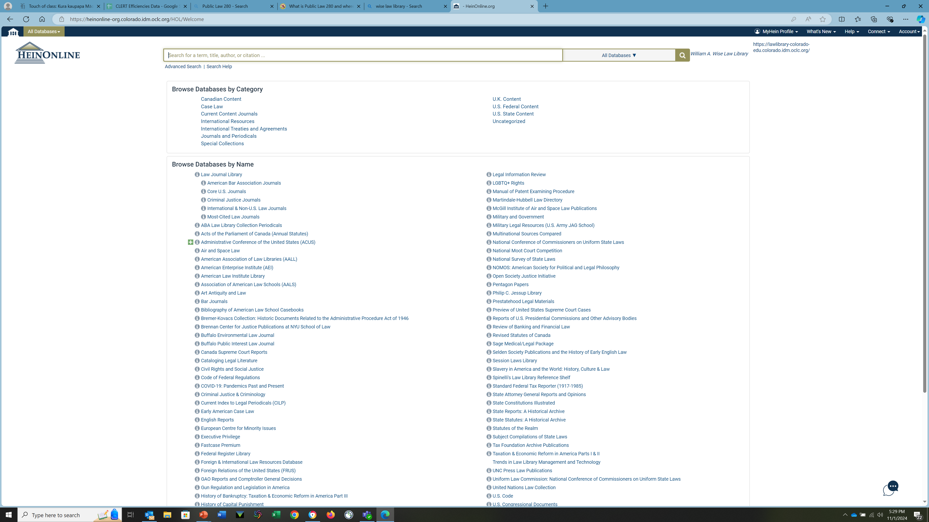
HeinOnline – One-Stop Research
Notes:
Index to foreign legal periodicals
Law Journals
Constitutions

Slide 16
HeinOnline
Law Journal Library
Indigenous Peoples of the Americas – History, Culture & Law
Treaties & Agreements Library
World Trials Database
Journals and Yearbooks
United Nations

Slide 17
U.S. Treaties: Full-Text Online
HeinOnline
  U.S.T. (1950 - 1984)
  T.I.A.S. (1982 - 2003)
  International Legal Materials (1962 - 2008)
  U.S. Statutes at Large (1789 - 2007)
Lexis
  U.S. Treaties on Lexis (1776 – current)
Thomas (1995 – current)
  http://thomas.loc.gov/home/treaties/treaties.html
Westlaw
  USTREATIES (1778 – current), ILM
Status of Treaties – Treaties in Force
  HeinOnline, Lexis, State Dept. & Westlaw
Notes:
ILM – now thru 2008 in HeinOnline…note, can ignore the date on the Record (says to 2004) – over 90K results for “Treaties” can sort by date, title, relevance….
State Dept. FOIA site: 1700 agreement since mid-1980s….also Treaties in Force page, explains US view of/def of a Treaty v. Executive Agmt…page covers both
Go to State Dept. “Treaty Affairs” page if interested in current treaties…
http://foia.state.gov/SearchColls/CollsSearch.asp
HeinOnline…Guide to….
TIAS just updated three years…to 1999 (Treaties and International ACT Series)

Slide 18
International Treaties
Is the U.S. a signatory?
Bilateral or Multilateral
  Vienna Convention on Consular Relations, April, 24, 1963, 596 U.N.T.S. 261, 21 U.S.T. 77
  Vienna Convention on the Law of Treaties May 23, 1969, 1155 U.N.T.S. 331; 8 I.L.M. 679 (1969)
Notes:
Treaty – the most basic international document … and when you’ve had a bit of experience you will be able to tell from the citation that this is a UN Treaty (UNTS) and the United States is a party (US) … you don’t even have to know anything about the treaty..
May not always be called a Treaty…other terms are: Agreements, Covenants, Accords, Conventions, Charters, Protocols, Memoranda of Understanding, Exchange of Notes – the term can indicate certain things about the understanding between the parties, but terms may mean different things in different time periods or in different situations. Treaty…defined at citation above?
Could do this as a question to the students….
There is a lot of information you are going to want to know about a treaty…Who are the parties? When was it signed? Is it in force? Was it ratified? Were there Reservations? How do you cite it?
Keep that in mind as we go through the next slides.

Slide 19
International Encyclopedias
Max Planck Encyclopedia of Public International Law
Encyclopedia of the United Nations and International Agreements
Parry & Grant Encyclopaedic Dictionary of International Law

Slide 20
Introduction to Legal Research –
Indigenous Peoples
Brief History
  Deskaheh – The League of Nations (1923)
  1978 Geneva Delegation
  2007 – The United Nations Declaration on the Rights of Indigenous Peoples
  Why the “s”
Notes:
Minority rights / self-determination
165 views Jul 23, 2023
In 1923 Deskaheh, Chief of the Iroquois League, representing the Six Nations of the Iroquois Confederacy, left Canada to go on a mission to Geneva (Switzerland). He hoped to attend the League of Nations (now the United Nations) in order to have it recognize the sovereignty of the Iroquois: "The constituent members of the State of the Six Nations of the Iroquois, that is to say, the Mohawk, the Oneida, the Onondaga, the Cayuga, the Seneca and the Tuscarora, now are, and have been for many centuries, organised and self-governing peoples, respectively, within domains of their own, and united in the oldest League of Nations, the League of the Iroquois...". Read on: https://www.docip.org/en/oral-history... On July 18, a photo exhibition titled 'Deskaheh in Geneva 1923-2023: Defending Haudenosaunee Sovereignty' was inaugurated on the banks of Lake Geneva following a solidarity march of Indigenous Peoples in attendance at the 16th session of the UN's Expert Mechanism on the Rights of Indigenous Peoples. Read more: https://www.geneve.ch/en/themes/inter...

Slide 21
What is International Law
Public International Law
  Sovereignty
  Human Rights
  Humanitarian Law
  War and Peace
  International Environmental Law
  International Intellectual Property
  International Trade / Arbitration
  International Organizations
  IGOs and NGOs
Private International Law (conflict of laws)
  Family Law
  Business

Slide 22
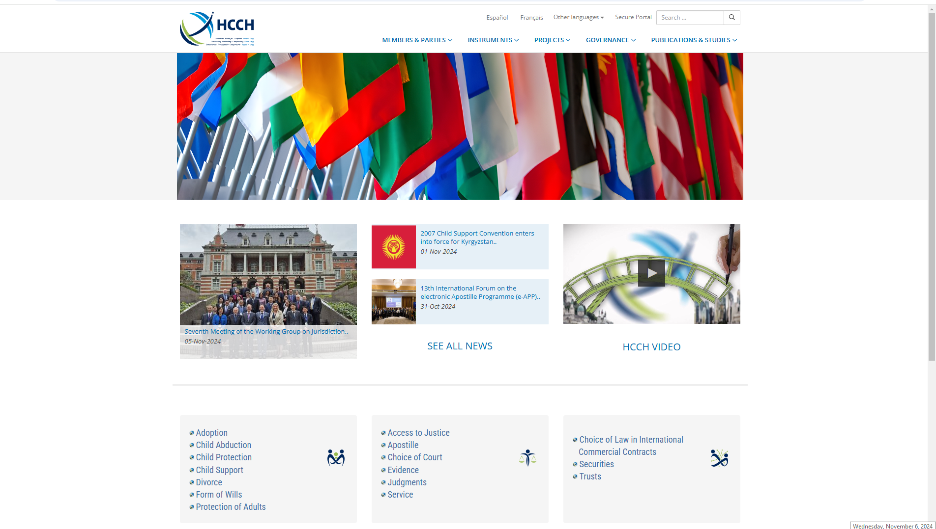
Private International Law

Slide 23
International Law
Private International Law
  https://www.hcch.net/en/home
Adoption
Child Abduction
Child Protection
Child Support
Divorce
Form of Wills
Protection of Adults
Access to Justice
Apostille
Choice of Court
Evidence
Judgments
Service
Choice of Law in International
Commercial Contracts
Securities
Trusts
Public International Law
International law is a set of rules and principles governing the relations and conduct of sovereign states with each other, as well as with international organizations and individuals. Issues that fall under international law include trade, human rights, diplomacy, environmental preservation, and war crimes, etc.
Customary Law
Notes:
Customary Law – Important in the indigenous context for several reasons: it is a recognized form of law; UN Declaration is not a Treaty; many issues covered in the Declaration are related to existing treaties, but not all, Customary Law and Human Rights Law are the 2 general categories of law cited in connection with indigenous rights.

Slide 24
Customary International Law
Jus cogens
Latin meaning "compelling law." This "higher law" must be followed by all countries. For example, genocide or slave trade may be considered to go against jus cogens, due to peremptory norms. The 1986 Vienna Convention on the Law of Treaties affirmed jus cogens as an accepted doctrine in international law.
States have used the concept of jus cogens in their efforts to achieve reforms in the existing law and international legal order. In international criminal law, jus cogens refers to the legal duties that arise in connection with high profile crimes, including the duty to prosecute or extradite, the non-applicability of statutes of limitations, the non-applicability of any immunities up to and including Heads of State, the non-applicability of the defense of "obedience to superior orders", and universal jurisdiction over perpetrators of such crimes
From http://definitions.uslegal.com/j/jus-cogens/
Notes:
Next Slide begins the UN – Higher levels
Will want to know about State practices that create/constitute CIL --- will talk about those resources …. Yearbooks, state publications…later

Slide 25
Sources of International Law
Article 38 of the ICJ Statute
International Conventions
International Custom
General Principles of Law
Judicial Decisions
Writings of International Law Jurists
Notes:
OK…Where would you look for article 38?
Decisions & Resolutions of IGOs & NGOs
So, we refer to international law and it sounds as if it is “singular” but its not…no Wexis to organize it so have to do more organizing and analyzing before you start … remember, no single sources… different sources, different terms, variations on terms…
We will be looking at resources that discuss all these sources
Conventions, Treaties, etc.
Article 38
1. The Court, whose function is to decide in accordance with international law such disputes as are submitted to it, shall apply:
a. international conventions, whether general or particular, establishing rules expressly recognized by the contesting states;
b. international custom, as evidence of a general practice accepted as law;
c. the general principles of law recognized by civilized nations;
d. subject to the provisions of Article 59, judicial decisions and the teachings of the most highly qualified publicists of the various nations, as subsidiary means for the determination of rules of law.
International custom – the practice of states – how do you know what these are? (one useful place to start is with yearbooks…)
General principles of law, Judicial decisions
of ICJ,….
Writings of international law jurists – (remember we just looked at the Courses of the Hague…we’ll see some Legal Classics on HeinOnline)
Let’s start by talking about Treaties….

Slide 26
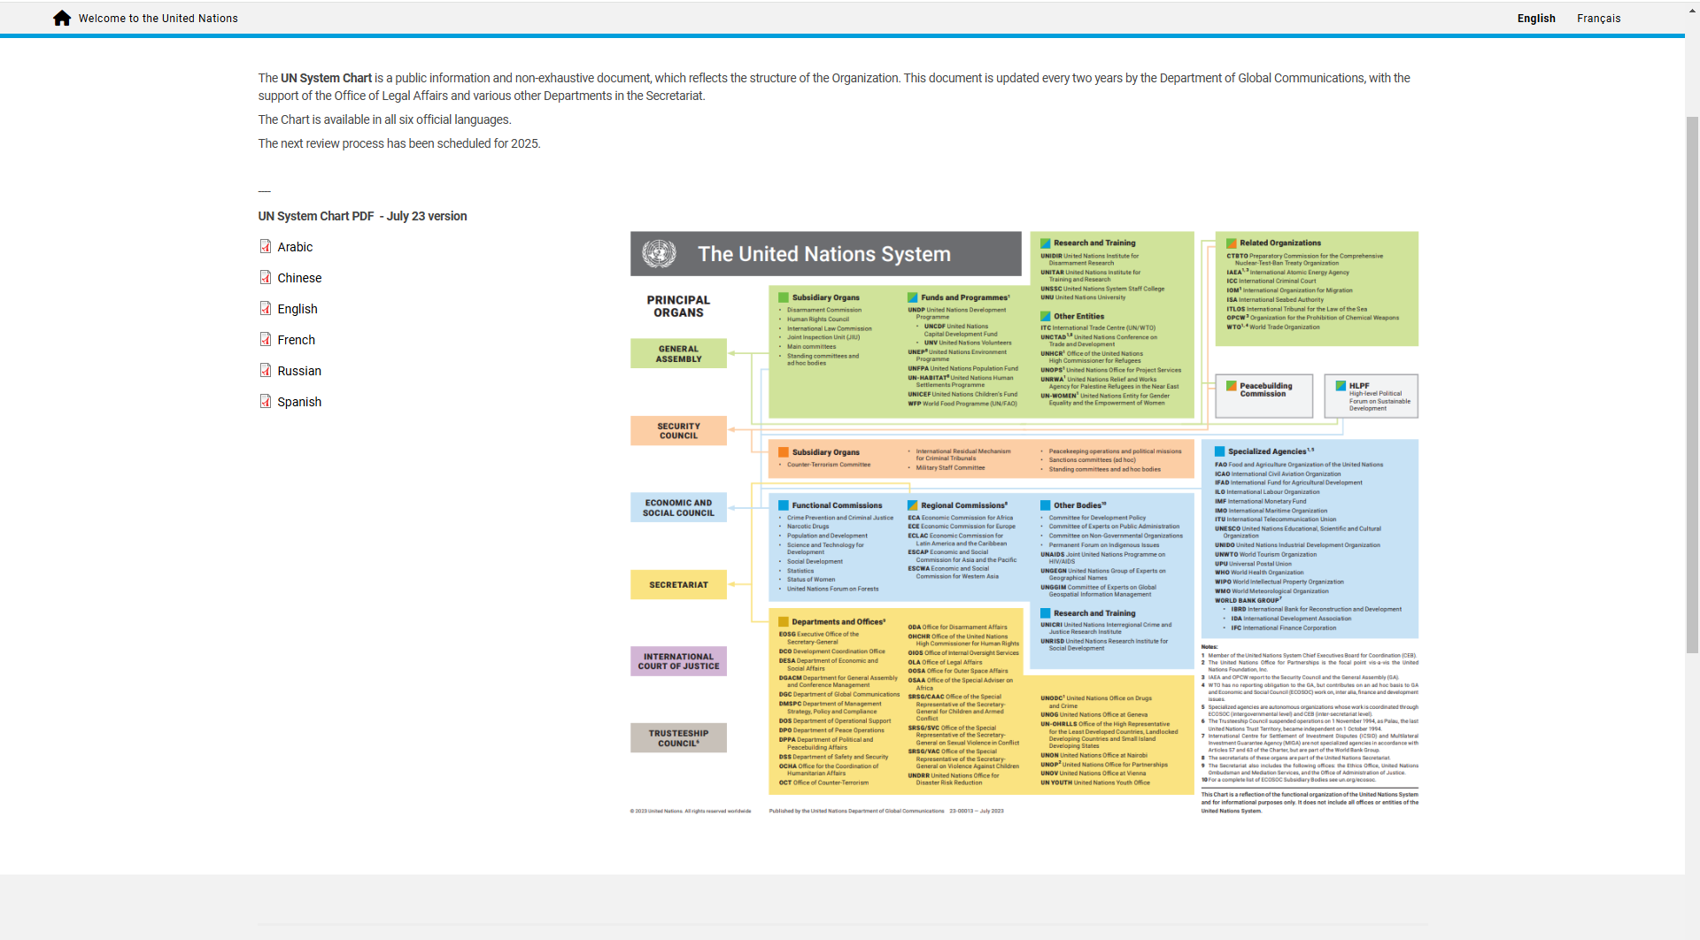
UN Organizational Chart
Notes:
General Assembly, Security Council, Economic and Social Council, Secretariat, ICJ, Trusteeship Council

Slide 27
United Nations & Organization of American States
International Covenant on Civil and Political Rights: This document discusses self-determination and recognizes the rights of indigenous peoples as a group with respect to their culture, religion, and language.
International Covenant on Economic, Social, and Cultural Rights: This covenant asserts the right of self-determination and affords “rights to health, education, and an adequate standard of living.”
American Declaration on the Rights of Indigenous Peoples: Organization of American States (OAS) - asserts indigenous peoples’ right to independently govern their populations and demands recognition of their laws as a part of the larger nation’s legal system. In addition, it specifies economic and land rights as well as protection from abuse and discrimination.

Slide 28
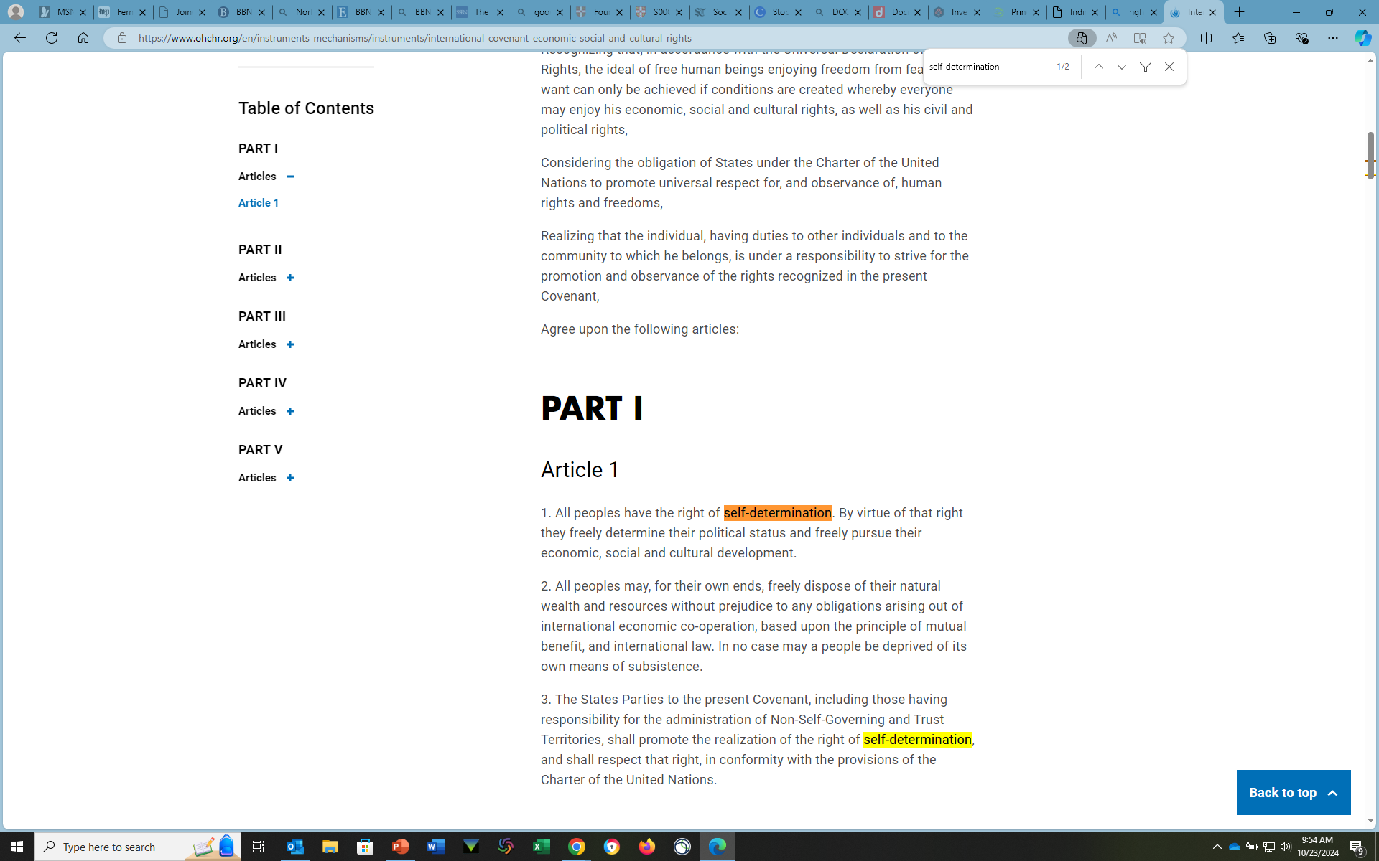
International Covenant on Economic, Social and Cultural Rights
(ICESCR)
ADOPTED 16 December 1966
BY General Assembly resolution 2200A (XXI)

Slide 29
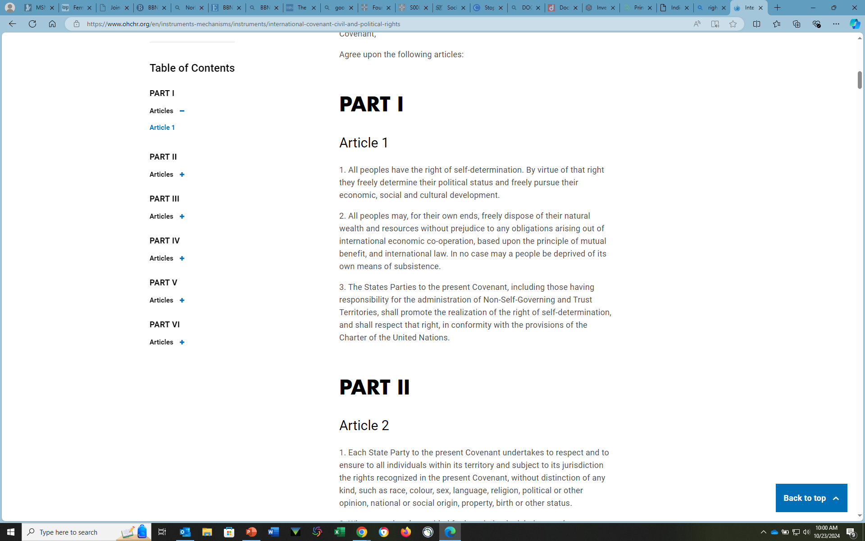
International Covenant on Civil and Political Rights
(ICCPR)
ADOPTED 16 December 1966
BY General Assembly resolution 2200A (XXI)

Slide 30
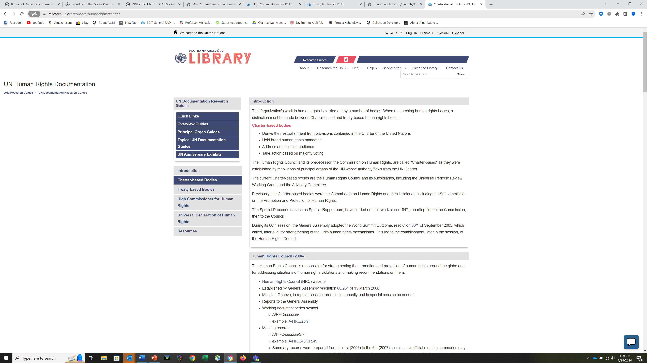
UN Charter-based Documents

Slide 31
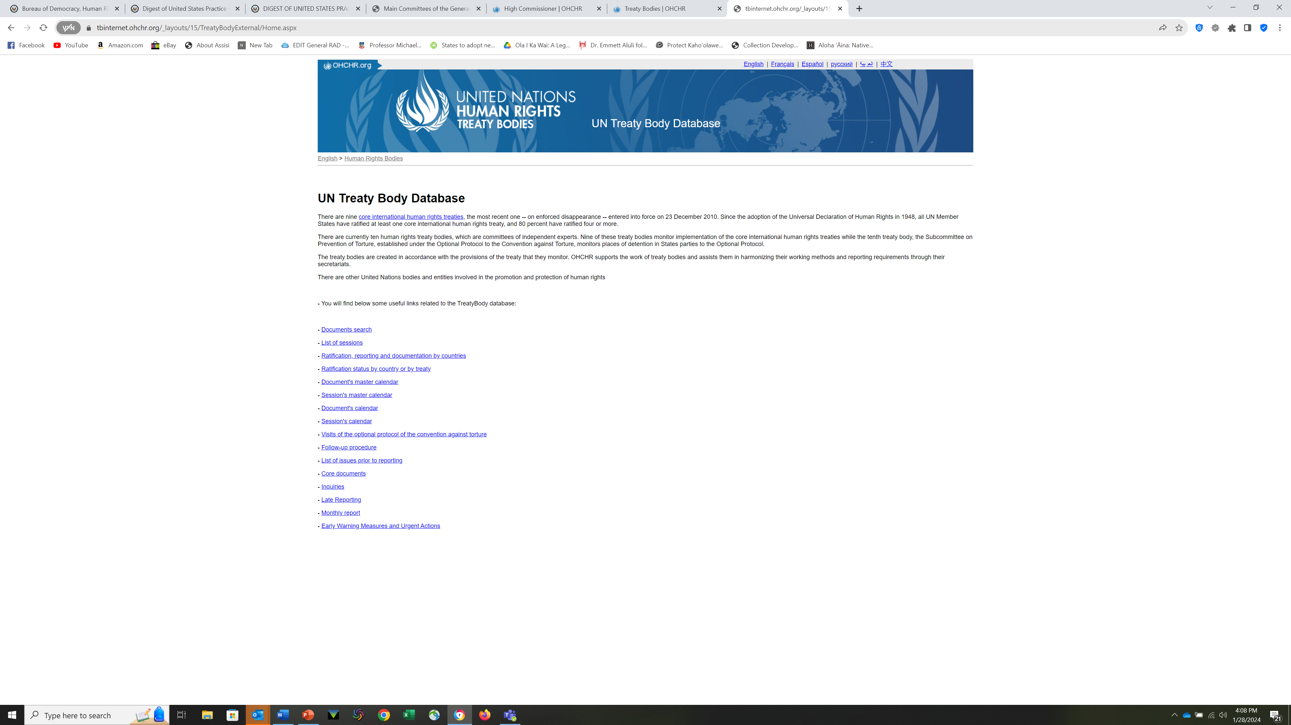
Treaty Body Database

Slide 32
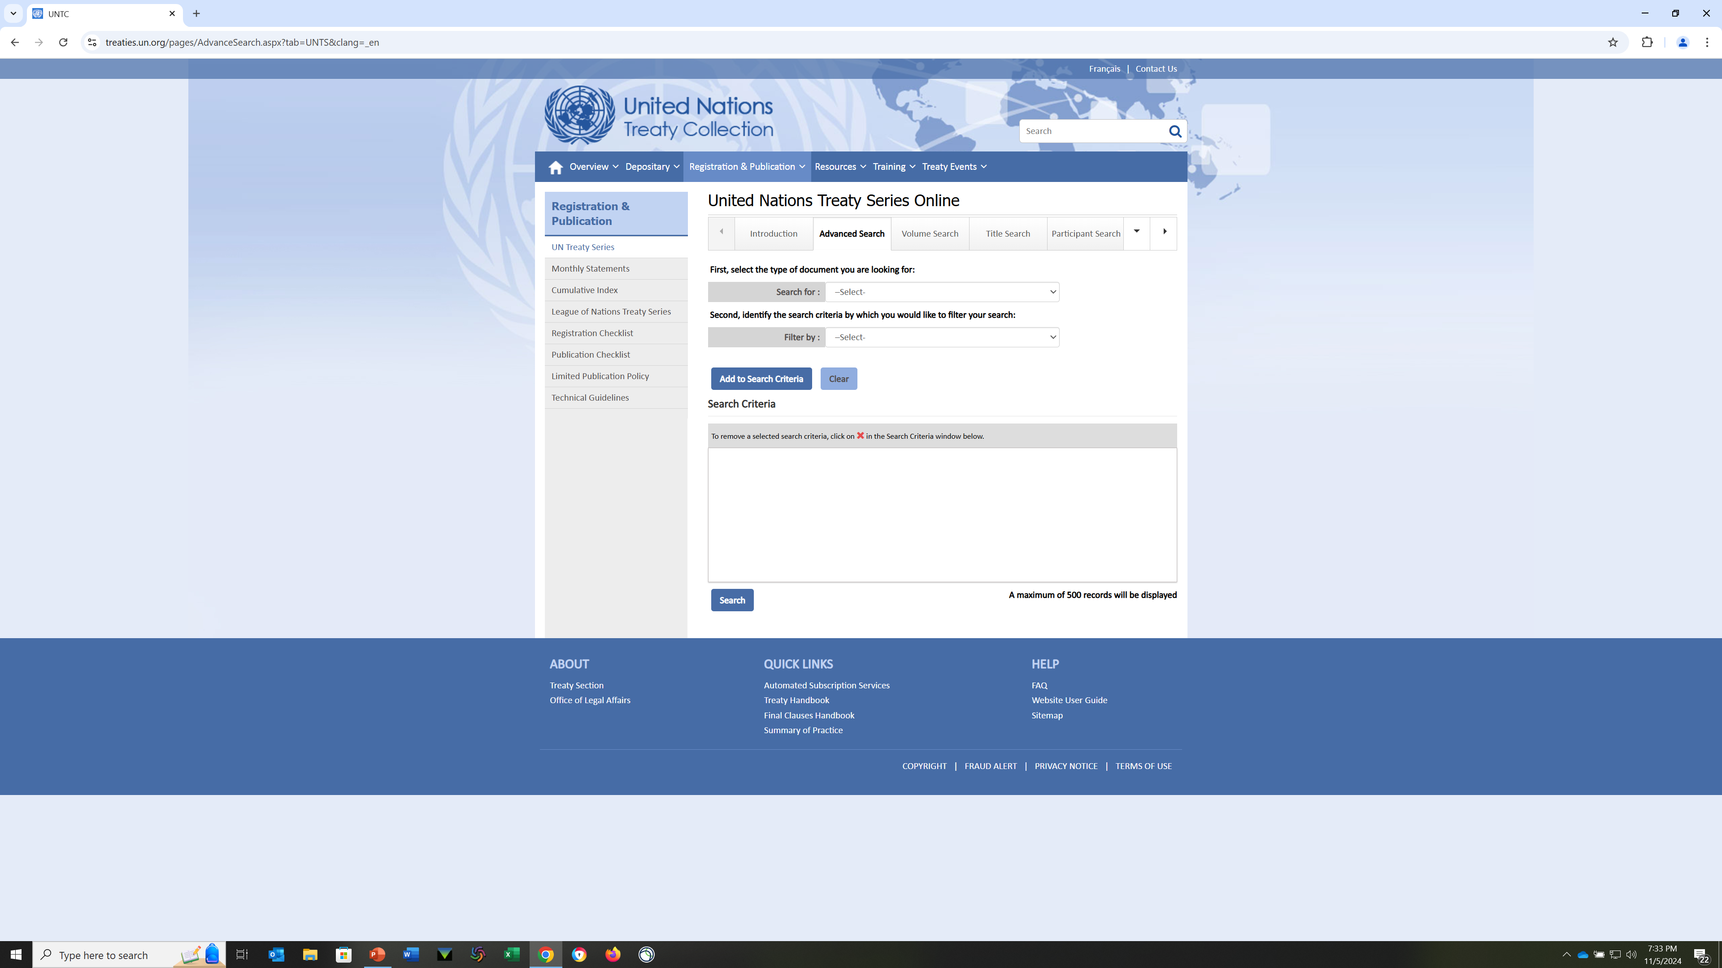
United Nations Treaty Series
Notes:
This site will allow you to search treaties for detailed information such as the parties, the date in effect, reservations, ratifications, etc. But each treaty will also have its own page

Slide 33
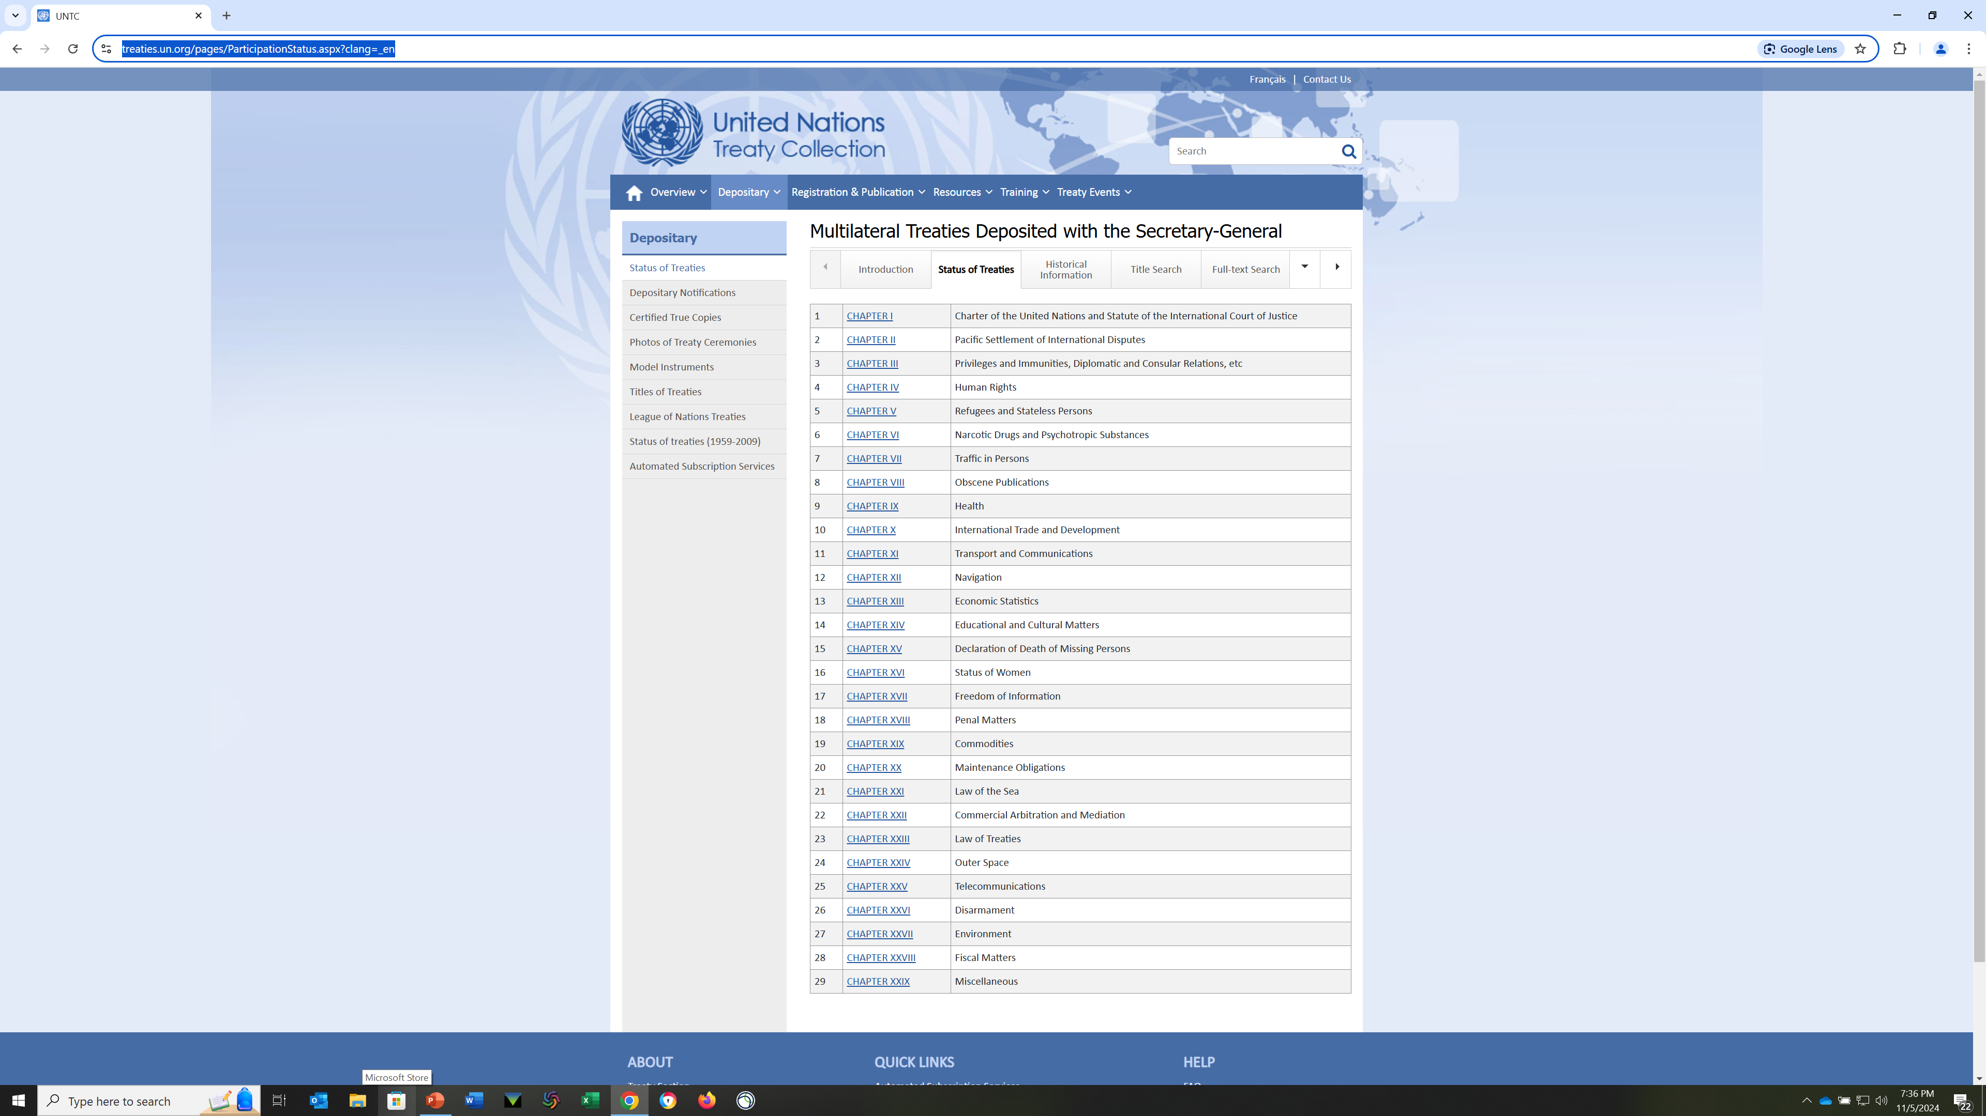
Status of Treaties

Slide 34
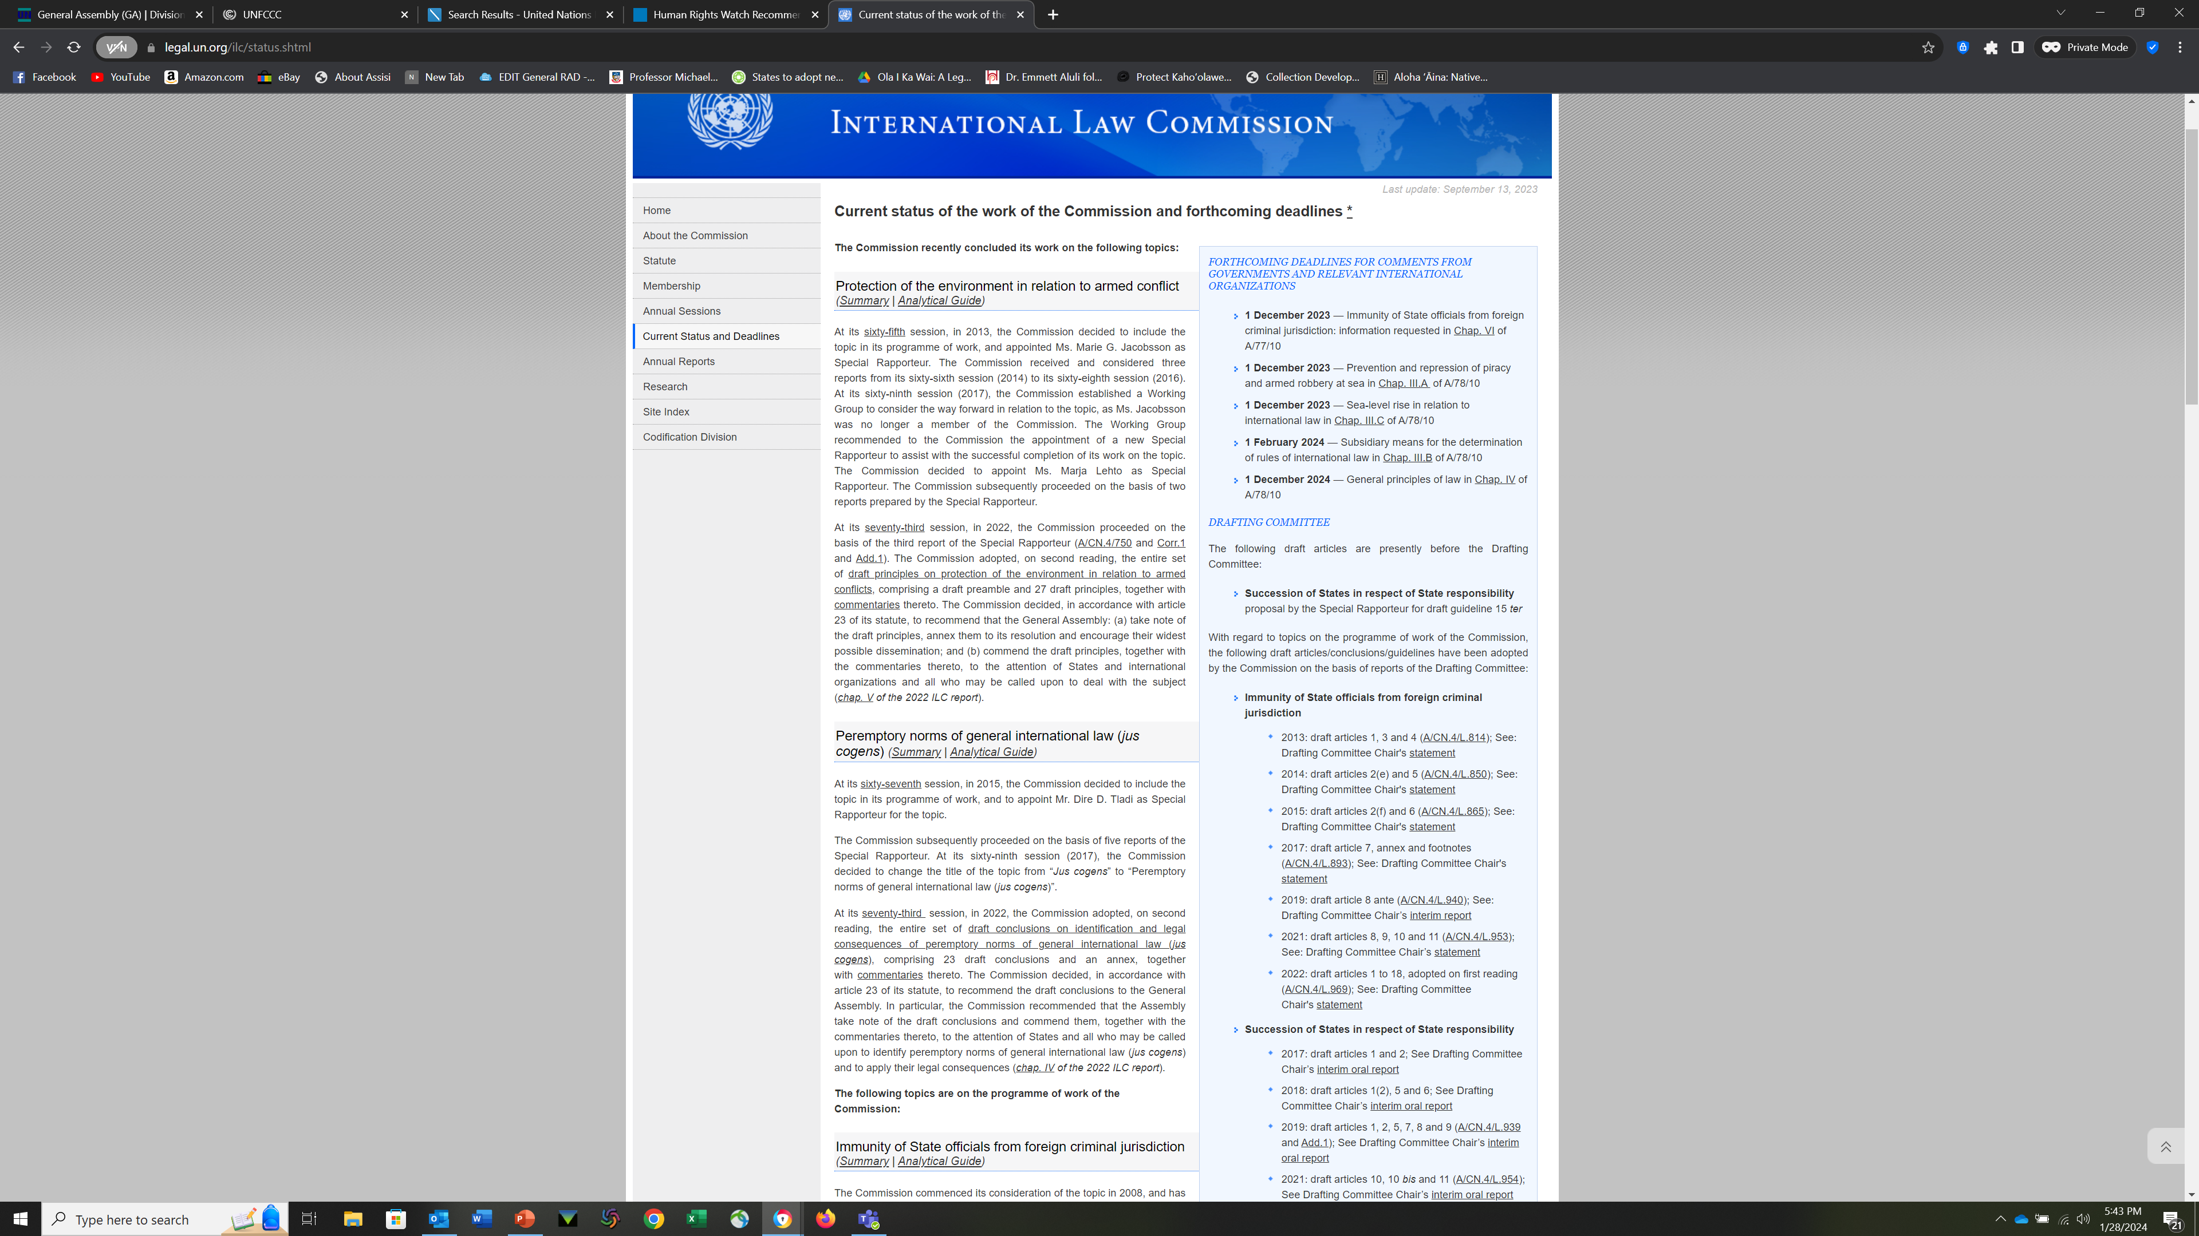
International Law Commission Research

Slide 35
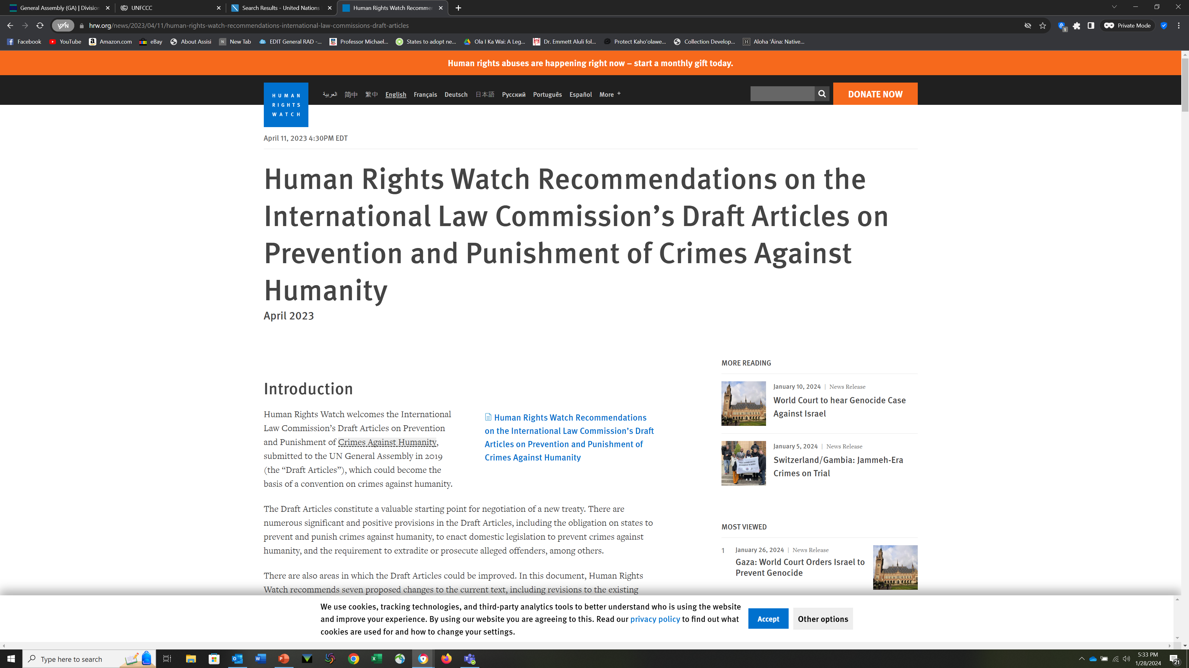
International Law Commission

Slide 36
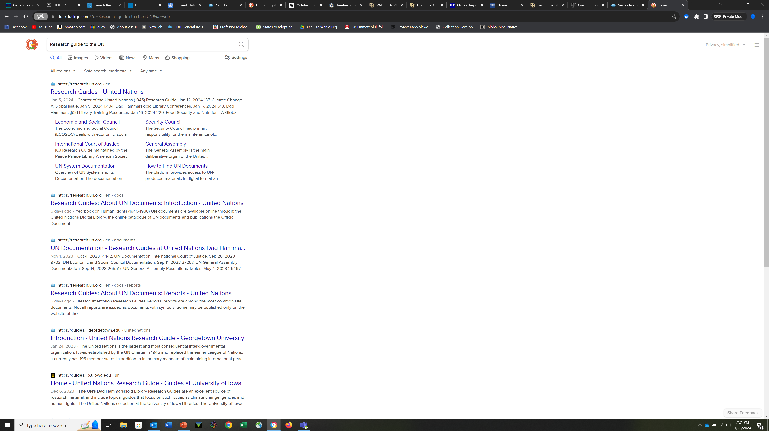
United Nations Research Guides

Slide 37
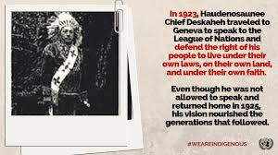
History (patience required)
When Cayuga Chief Deskaheh traveled to Geneva in 1923 to address the League of Nations about the right of his people to live freely on their own lands, practice their own religion and follow their own laws, the door was shut in his face by what he called ''cruel indifference.'' Deskaheh's courageous attempt to bring justice to his Haudenosaunee people was the first step in an ongoing quest that reached a benchmark almost 85 years later when the U.N. General Assembly adopted the Declaration on the Rights of Indigenous Peoples on Sept. 13. One hundred and forty-three member states voted yes, 11 states abstained, and four voted against the adoption.
Indian Country Today
https://www.indianlaw.org/sites/default/files/resources/ICT_Declaration_marks_end_of_first_step_9-21-07.pdf
Notes:
Deskaheh, Original modern delegation
Cobo Report
Roberto Stavenhagen

Slide 38
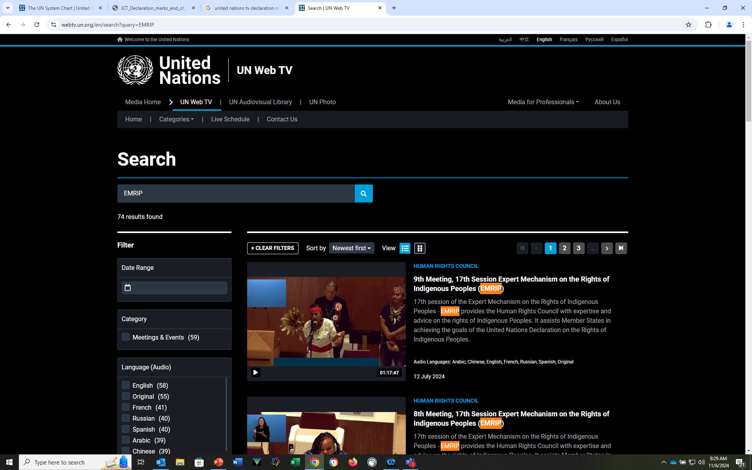
United Nations – UN Web TV

Slide 39
United Nations
Economic and Social Council
Human Rights Council
Permanent Forum on Indigenous IssuesCommittee on the Elimination of Racial Discrimination
International Court of Justice
International Labor Organization
Office of the High Commissioner for Human Rights Expert Mechanism on the Rights of Indigenous Peoples
World Health Organization
World Intellectual Property Organization (WIPO)
International Indian Treaty Council
Working Group on Article 8(j) of the Convention on Biological Diversity

Slide 40
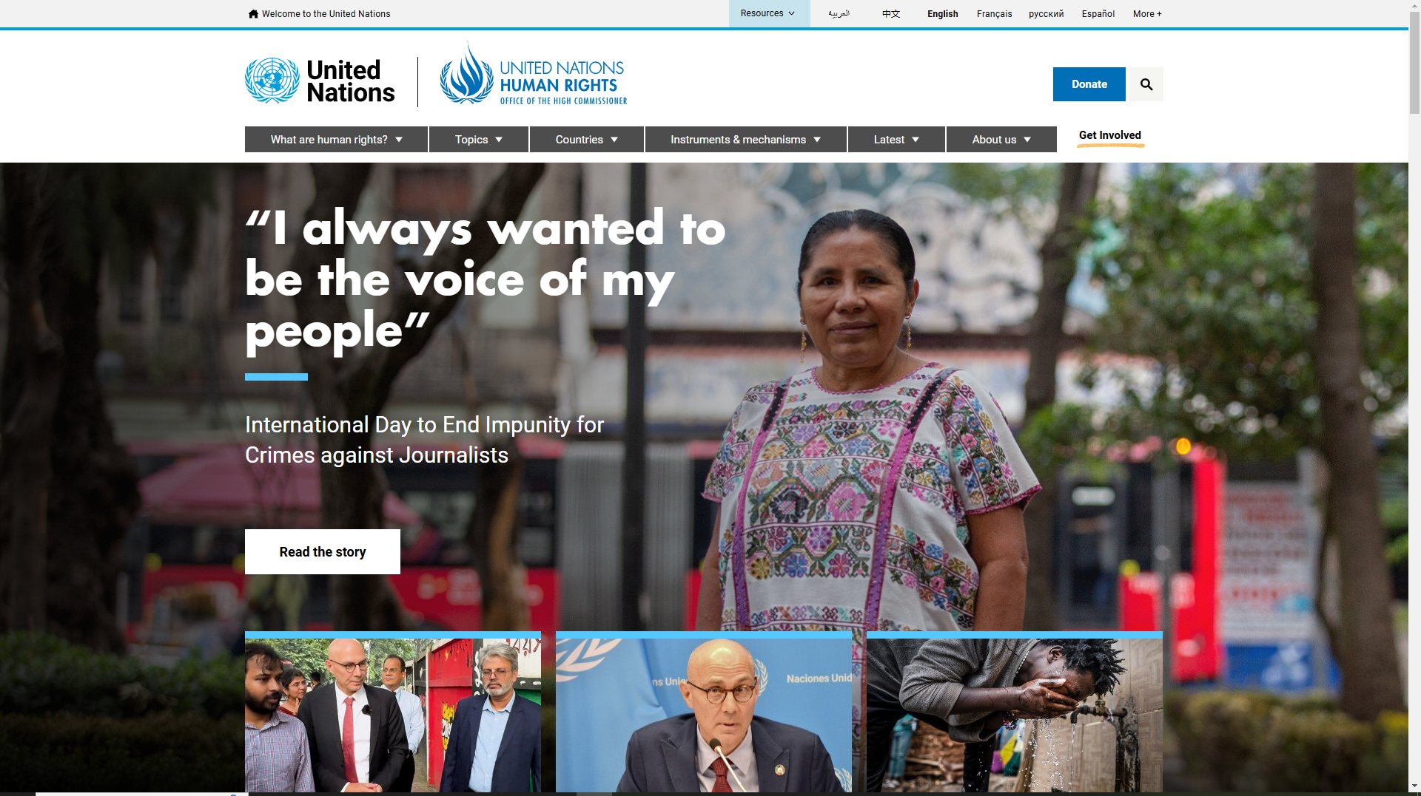
Office of the High Commissioner on Human Rights
Notes:
Indigenous Peoples falls under the topic of Equality and Non-Discrimination – Cannot show all the places you can find Indigenous issues discussed. Last I heard there were almost 40 different sites… many areas of interest

Slide 41
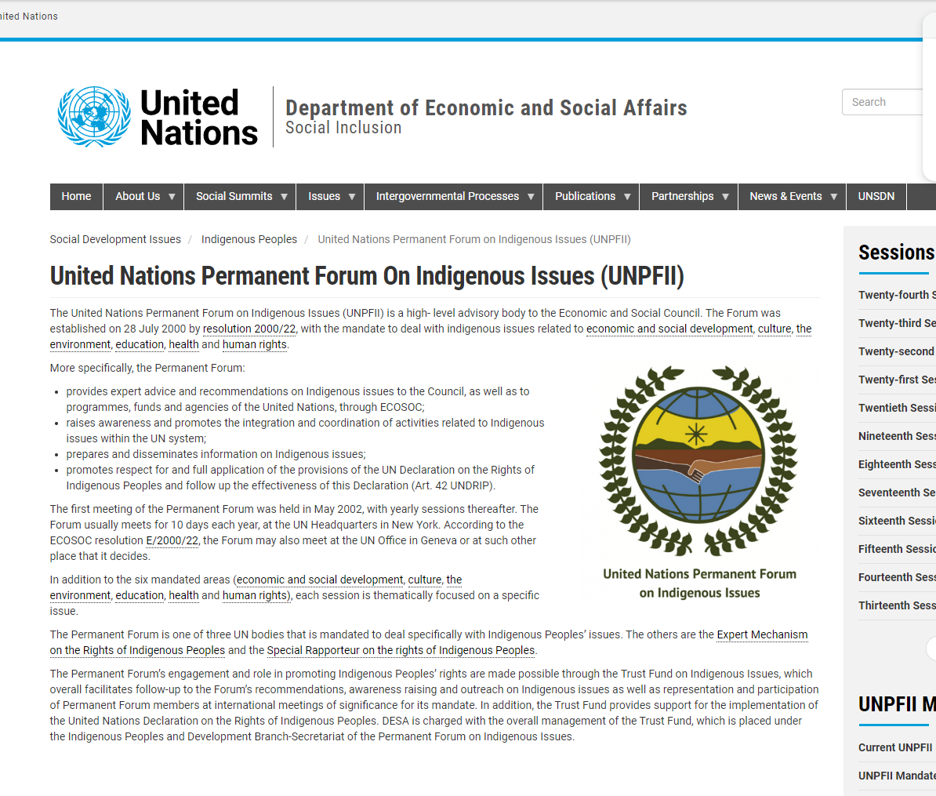
Notes:
UNPFII is the primary agency that deals only with Indigenous issues - a high level legal advisory body to ECOSOC (the primary UN org) Annual meeting
WIPOLex
FAOLex
ECOLex

Slide 42
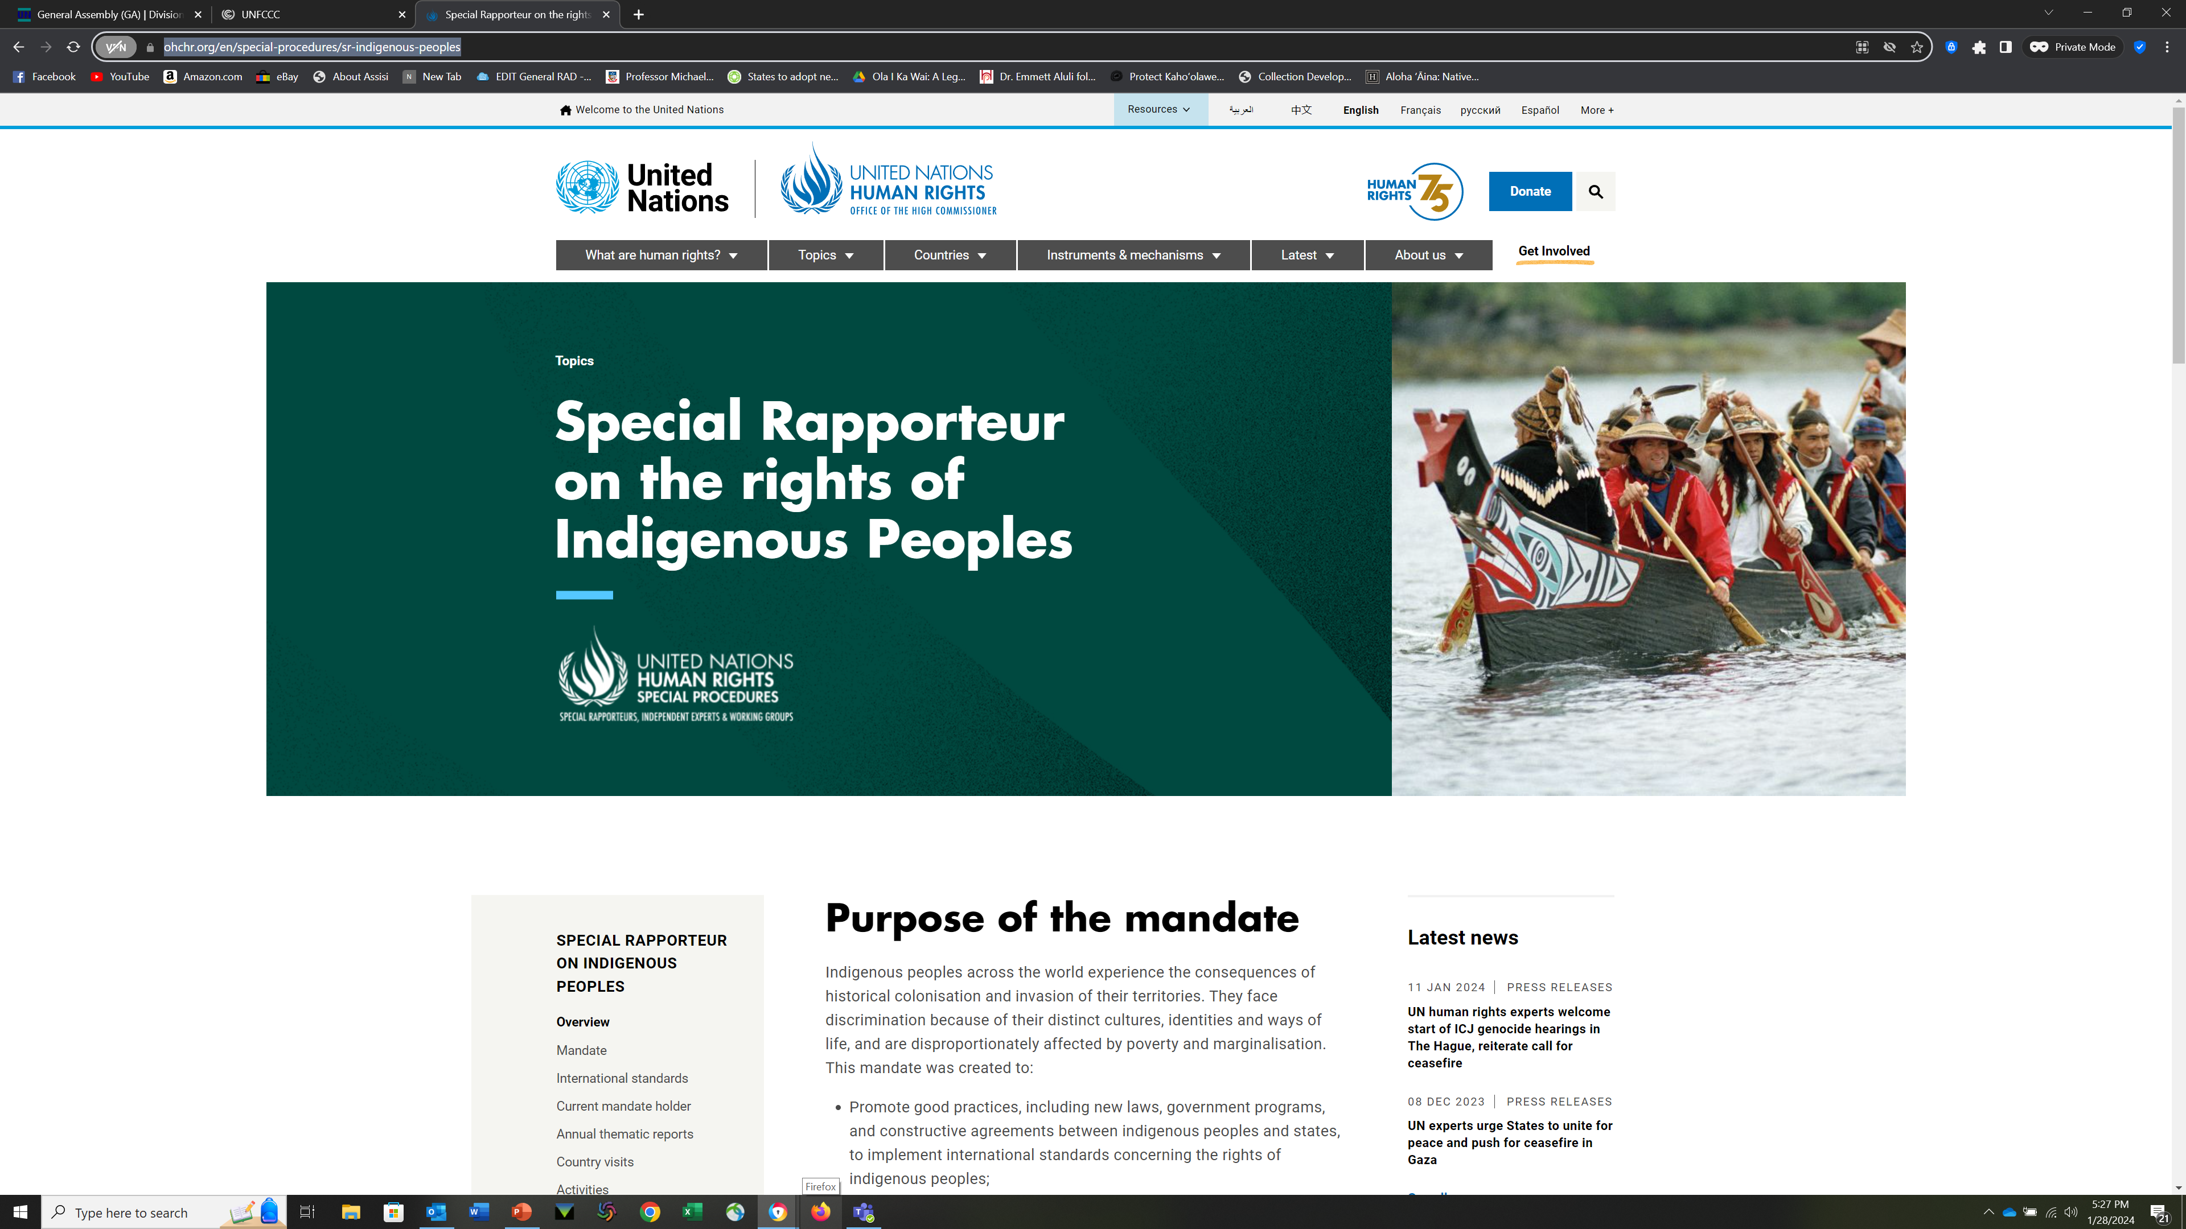
Special Rapporteur
Notes:
First outreach – a single individual – issues country reports – Interacts with Human Rights Council extensively - First was Rudolfo Stavenhagen, Jim Anaya served 2 terms in this role prior to becoming Dean at CU Law.

Slide 43
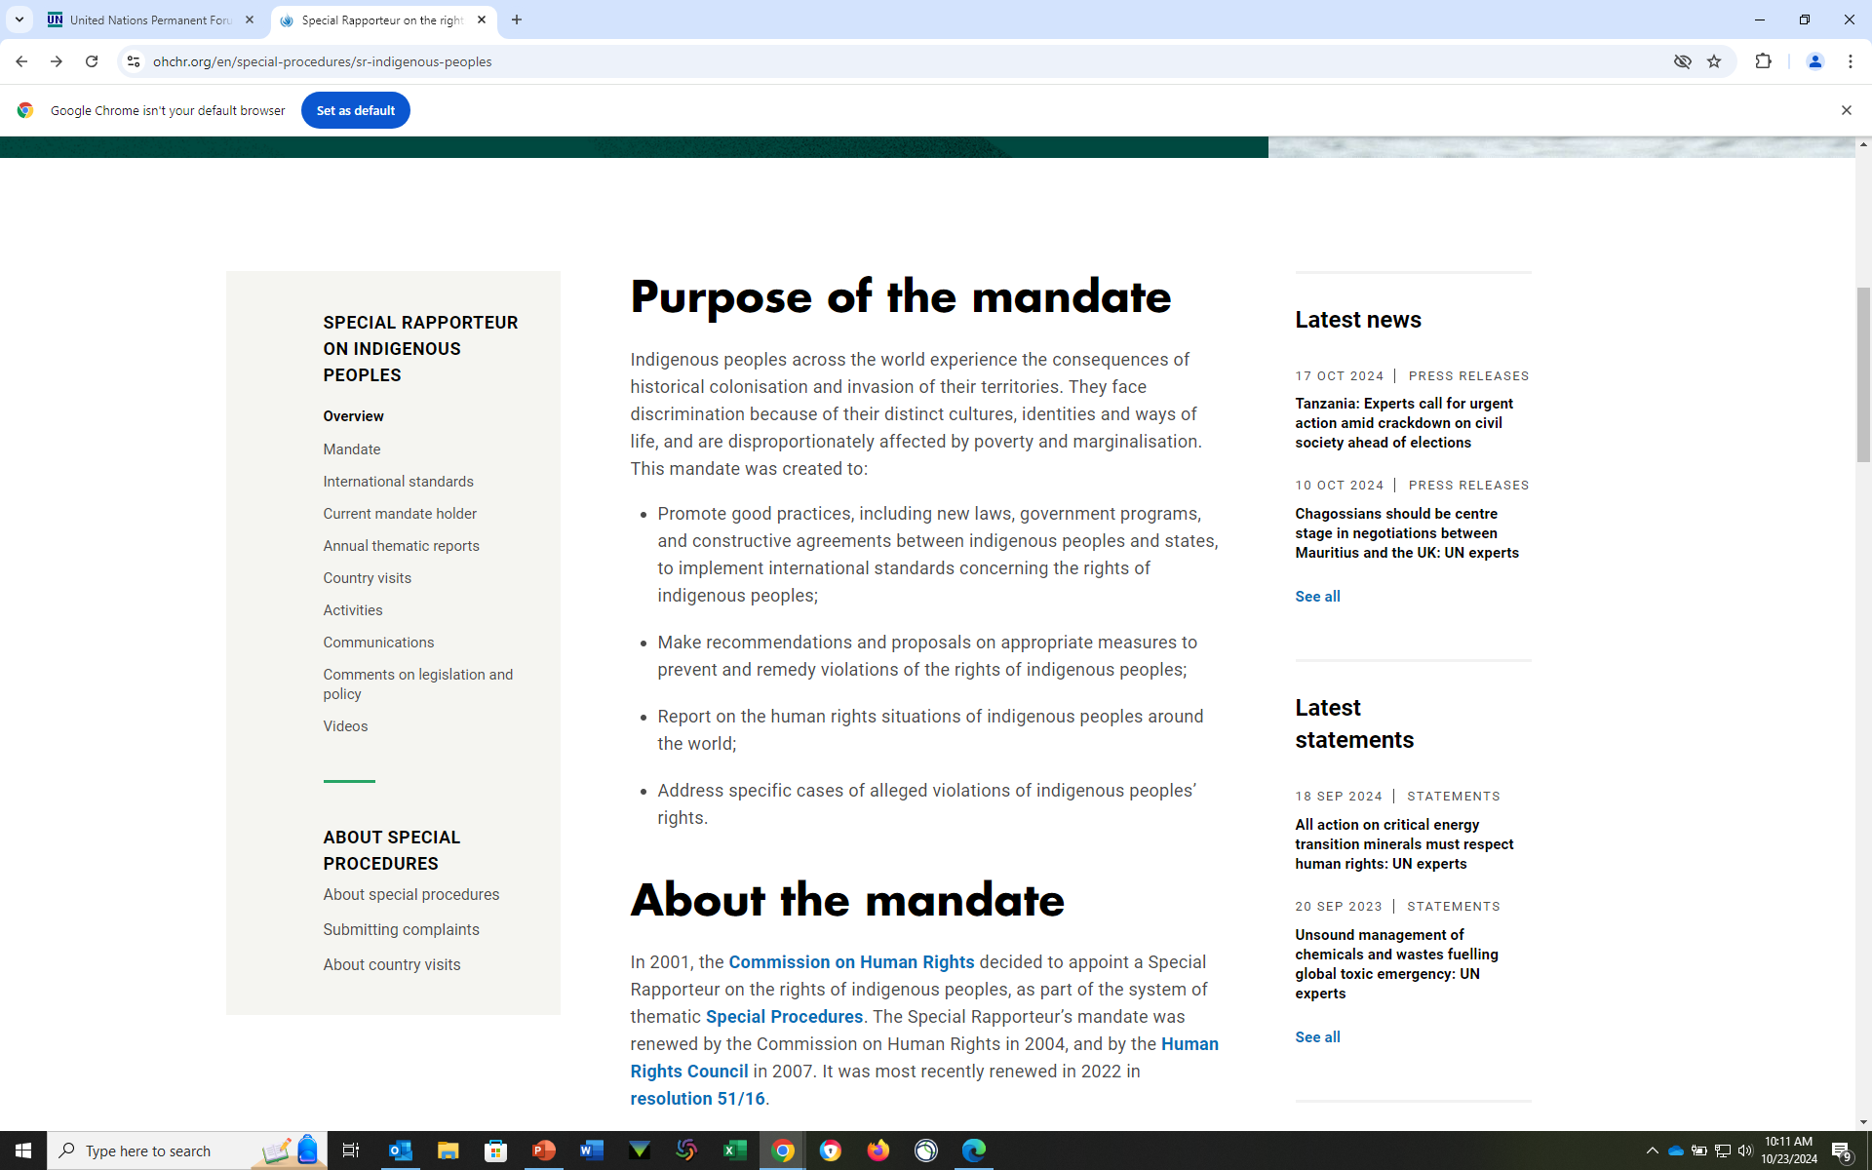
UN Special Rapporteur on the Rights of Indigenous Peoples

Slide 44
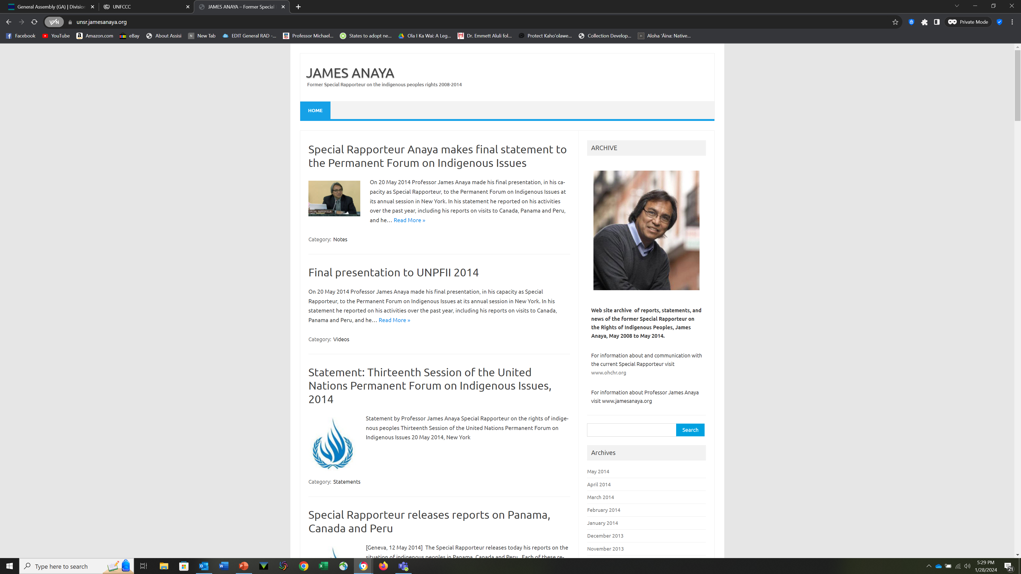
Individual Pages for the Special Rapporteur

Slide 45
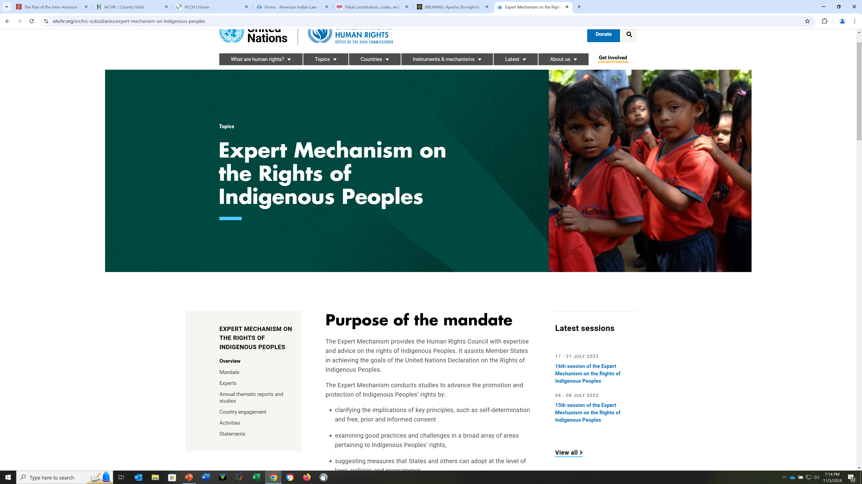
Expert Mechanism on the Rights of Indigenous Peoples
(EMRIP)
Notes:
7 experts appointed by the Human Rights Council – deals with thematic issues, annually, and also with specific issues in countries. (Prof. Carpenter spent 2 terms on this committee)

Slide 46
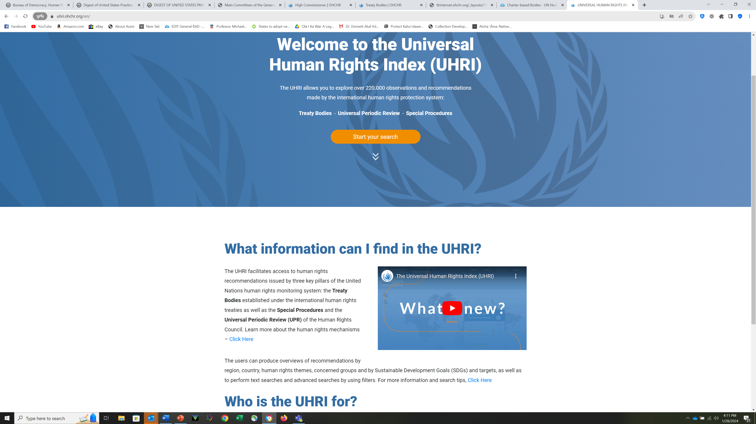
Universal Human Rights Index
Notes:
The UN has many sites that will provide much useful information. This is just one sample.

Slide 47
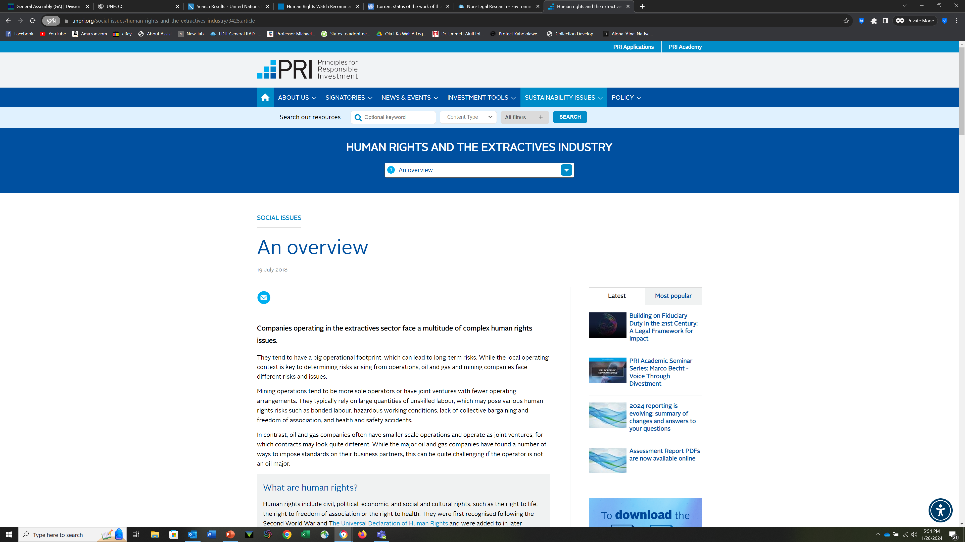
Extractive Industries
Notes:
Indigenous issues come up in so many agencies of the UN. While the term “Indigenous Peoples” has been established for common use by the UN DRIP, earlier conversations/committees/agencies may use terms such as “minority” or
Again…so may places The Refugee site is great, WIPO is currently one of the more active agencies and just concluded a treaty on genetic resources (after decades) and there are still important issues under discussion for future treaties….odd mix of topics, term “biopiracy” is useful for an indigenous perspective.

Slide 48
Selected Topics
Self-Determination
Land Rights
Cultural Rights
Religious Rights
Gender Issues
Trafficking
Notes:
While these subjects are applicable in both the international and domestic contexts, they are addressed considerably differently in individual countries. If looking at separate countries, remember to consult the Foreign Law Guide.

Slide 49
Great resources for specific areas or issues, or…
American Society of International Law Interest Group – Newsletter
International Work Group on Indigenous Issues (IWGIA)
Indian Law Resource Center (Washington, D.C.)
The Implementation Project (CU/NARF joint project)
  The Indigenous Peoples’ Guide to the United Nations
  Tribal Implementation Toolkit

Slide 50
Resources – International
United Nations
  UNPFII
International Labour Organization
International Working Group on Indigenous Affairs (IWGIA)
DOCIP
First Peoples Worldwide (CU/Cultural Survival)
Research Guides
  GlobaLex
    International, Foreign, Comparative
    Georgetown University Research Guides
Notes:
DOCIP is very practical and useful on Indigenous Issues…easy to see what Treaties or other instruments are applicable right now. Comes out weekly.

Slide 51
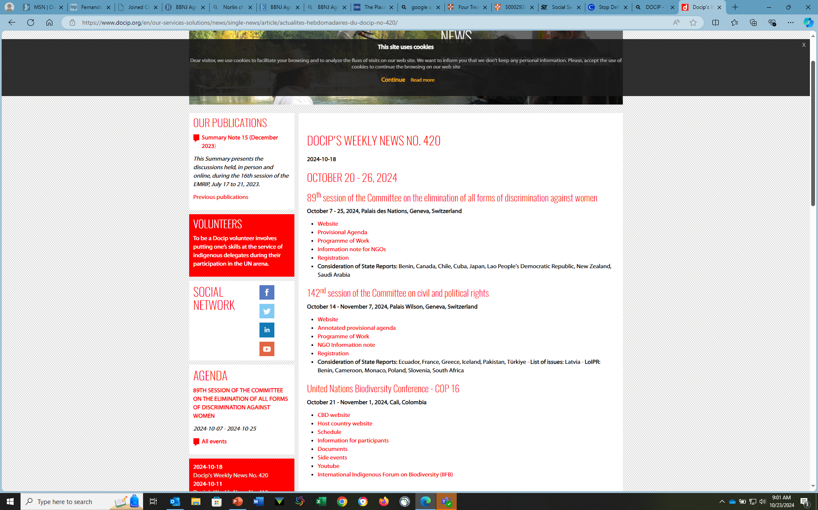
DOCIP

Slide 52
International Organizations - NGOs
International Work Group on Indigenous Affairs
  The Indigenous World
Amnesty International
Survival International
Amazon Watch
Mongabay
Notes:
IWGIA is one of the oldest organizations to focus on Indigenous Issues. Annual review of different countries. Free online.
Mongabay is oriented to Latin America and primarily Environmental Issues…

Slide 53
Regional Organizations
African Union
American Indian Law Alliance
Asian Indigenous and Tribal Peoples Network
National Congress of American Indians
European Court of Human Rights Foundation for Aboriginal & Islander Research Action
Grand Council of the Crees (Quebec) Inuit Circumpolar Council (Canada)
Inter-American Commission on Human Rights (Washington, D.C.)
Inter-American Court of Human Rights (San Jose, Costa Rica, Spanish is the first language
Organization of American States (OAS)
Russian Association of Indigenous Peoples of the North, Siberia and Far East (RAIPON)
Notes:
There are several important land rights cases out of the African Union

Slide 54
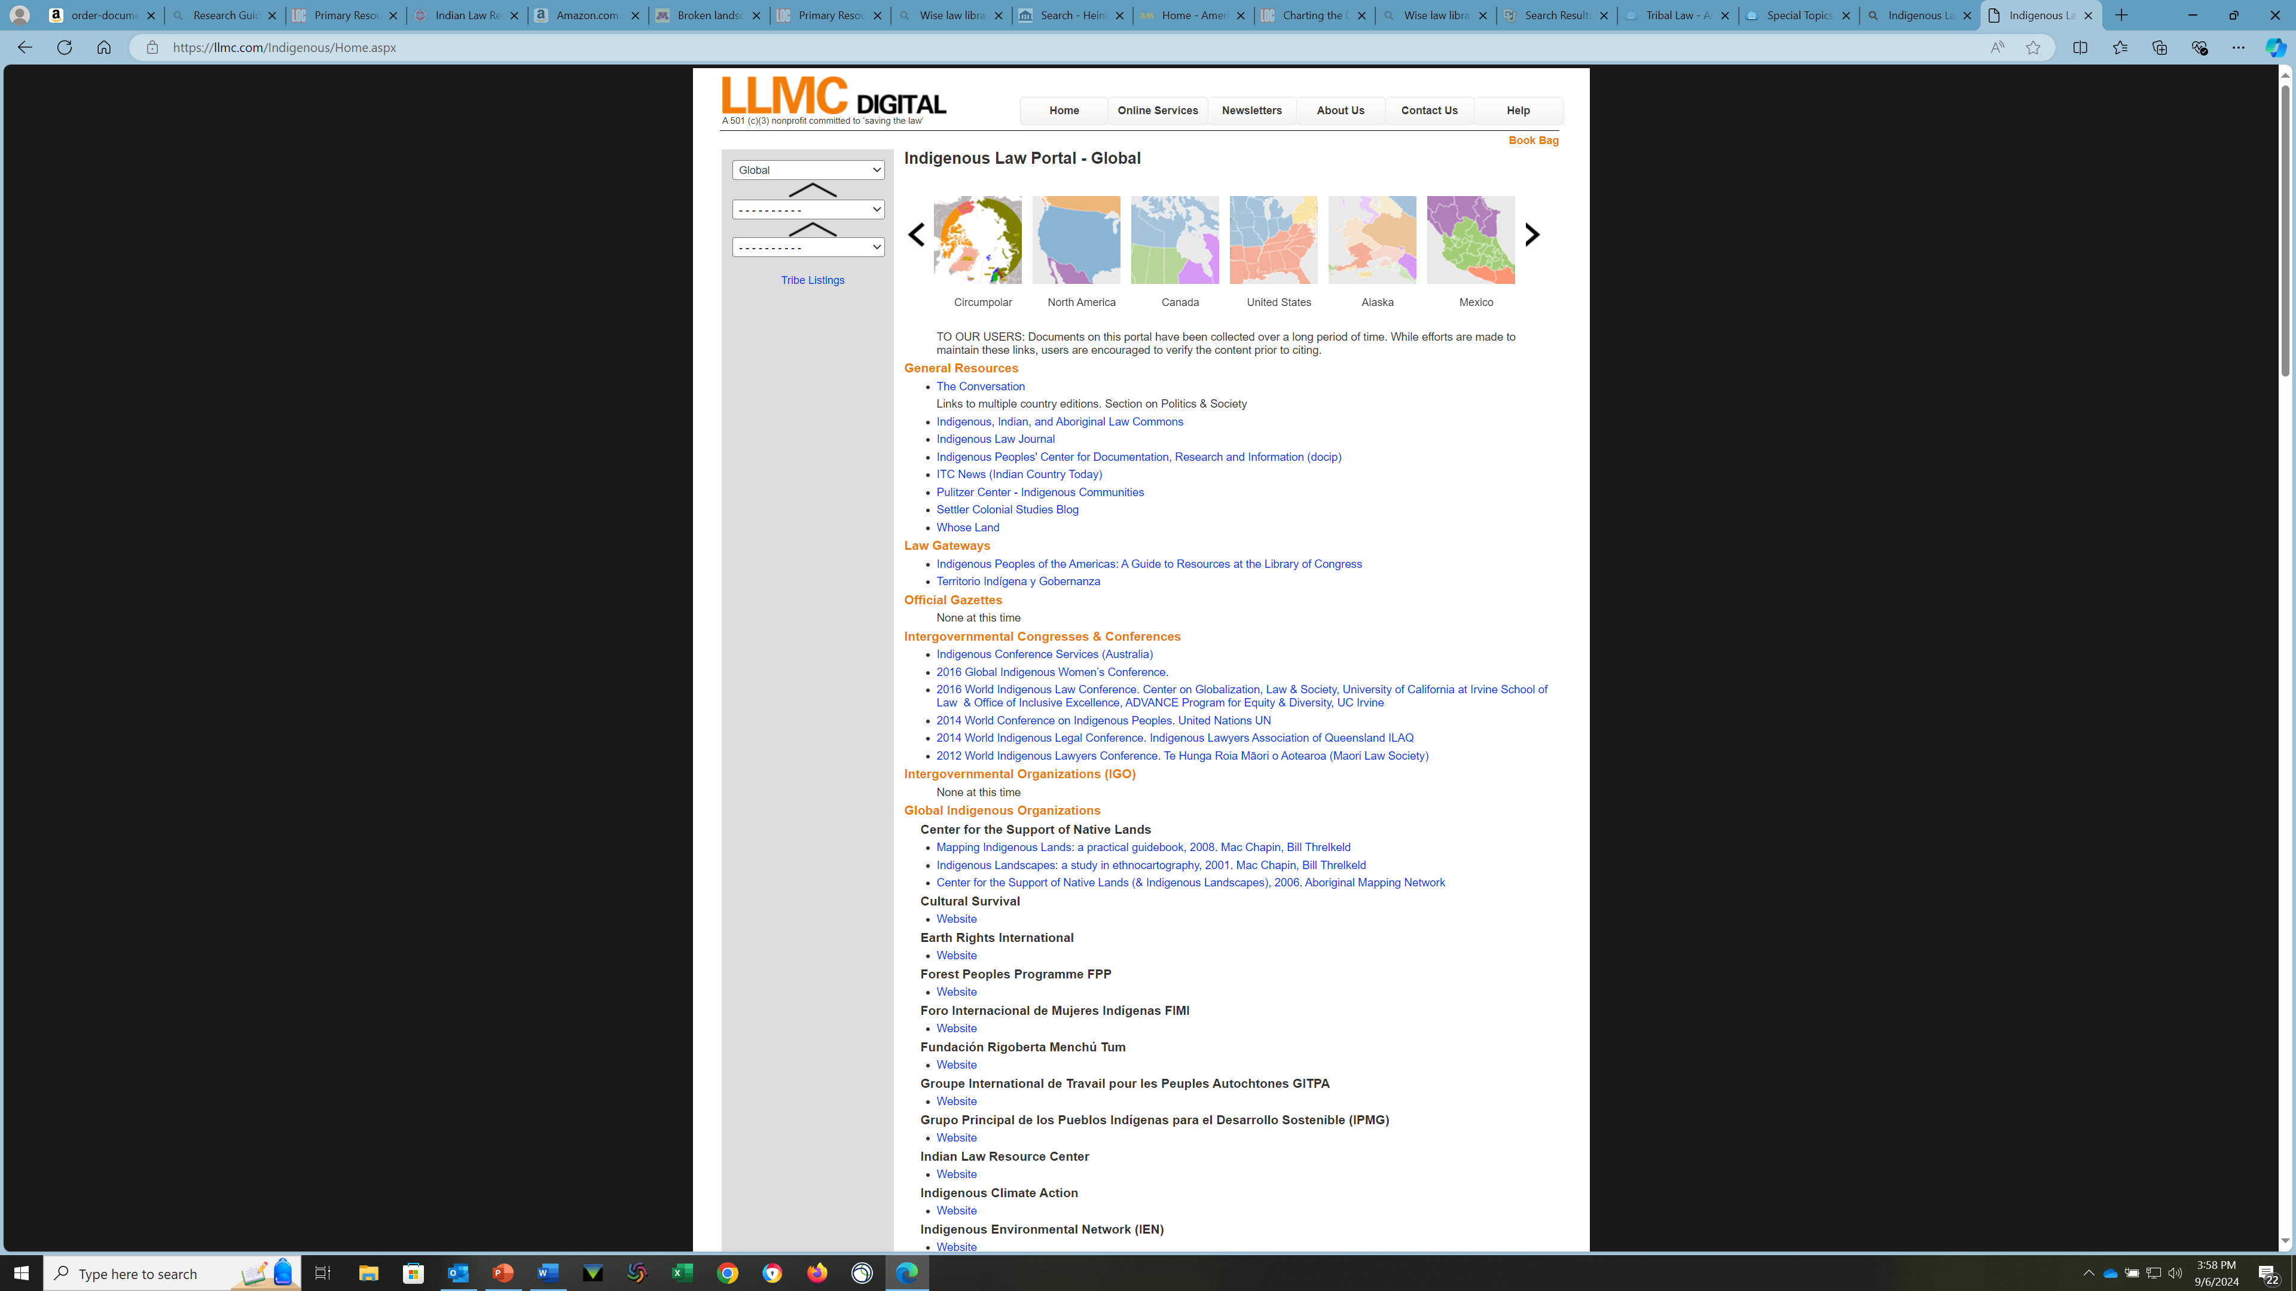
Indigenous Law Portal
Notes:
This is really Tribal Law, in the Americas…so foreign tribal law and U.S. Nations tribal codes. This was developed by the Library of Congress in conjunction with the development of the KI classification. This is part of the effort to decolonize the LoC classification and reflect/respect the/an indigenous world view.

Slide 55
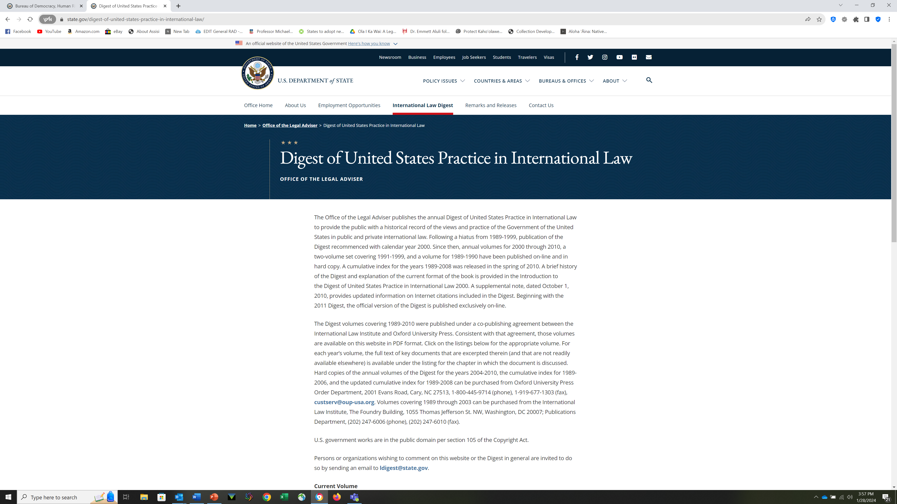
U.S. State Department
Digest of International Law
Notes:
Other reports…Human Rights…there is so much information on the U.S. Dept of State site…also good for research on country policies

Slide 56
Resources - Foreign
Globalex Research Guides (Free)
Foreign Law Guide
Organizations
  International Labor Organization (ILO 169)
  Organization of American States
    American Declaration of Indigenous Rights
    Inter-American Court of Human Rights (San Jose, Costa Rica)
    Inter-American Commission on Human Rights (Washington, D.C.
Notes:
I do not recommend the Globalex guide on Indigenous Peoples – Language is important – see last slide… use of term “group” is not supportive of the UN DRIP, the description of the history is not very strong, The word “plight” is often an indication of old thinking (at best), can be seen as patronizing or just lazy.

Slide 57
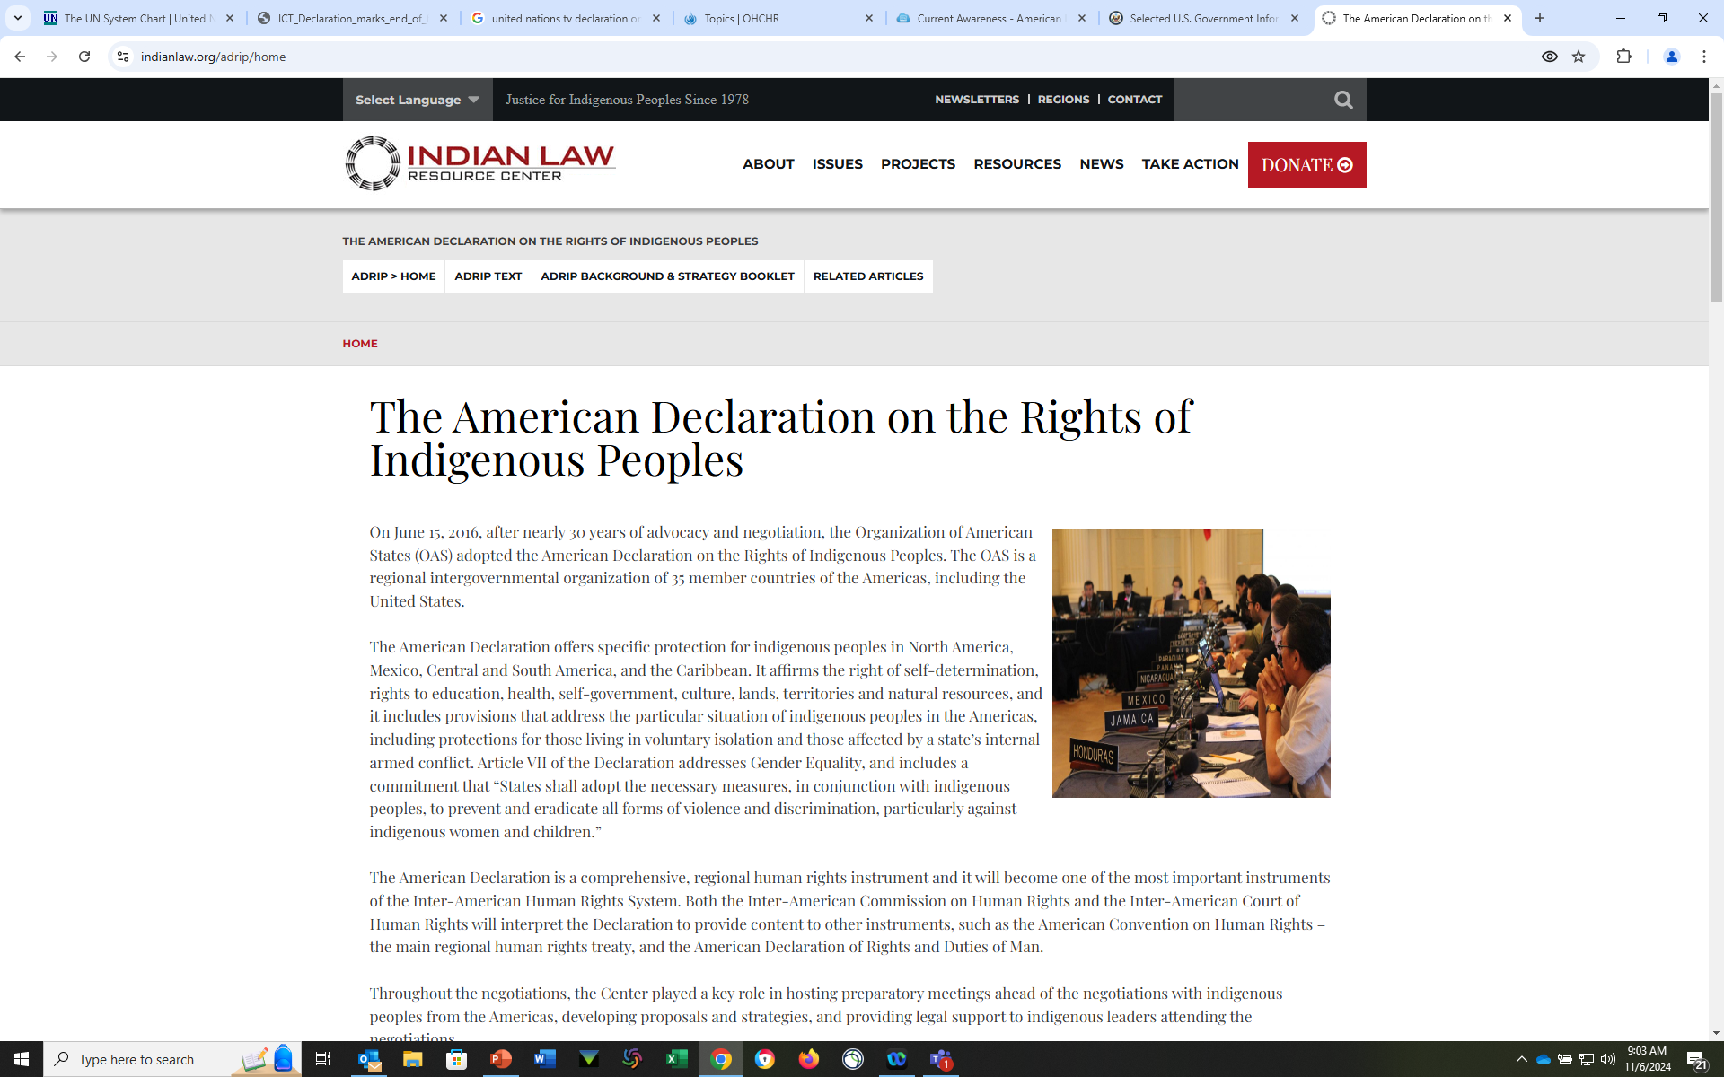
Indian Law Resource Center
Notes:
Indian Law Resource Center

Slide 58
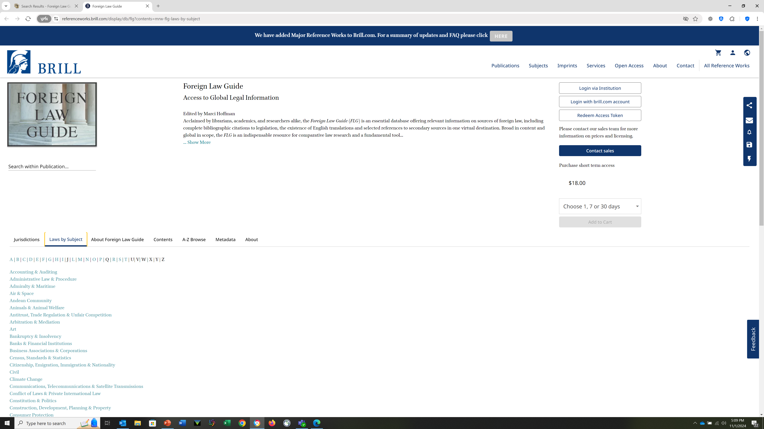
Foreign Law Guide – Indigenous Peoples
Notes:
Not only is this an excellent resource for Indigenous research, but it is the initial “go to” research for all foreign law research. It is highly authoritative and provides concise, but extensive information on the legal system of different countries and also tells what resources are available and how to access them, as well as identifying areas that may be a challenge. (I liked the old version better, before Brill bought it.)

Slide 59
Federal Indian Law
Tribal Law
As you begin your research in American Indian Law, it is important to distinguish between Tribal Law and Federal Indian Law. Tribal Law is the laws of the individual Indian Nations. Federal Indian Law is the law of the United States as it has developed in the U.S. Constitution, by Congress, and in the Courts.
American Indian Nations are referred to as the "third sovereign" in the United States, despite being the original sovereign, historically. The legal relationship between the indigenous nations of the northern hemisphere and what would become The United States of America began with a series of Treaties starting in 1722 and the Congress of the United States ended treating making with Indian Nations in 1871.
Notes:
Read Ned Blackhawk’s Book, the Rediscovery of America for more on the early treaty making and IL in early American History.

Slide 60
Domestic – United States
American Indians are the Third Sovereign
  A Political designation, not a racial category
    Sovereignty Symposium - Conference Proceeding
Federal Indian Law primarily found at CFR 25 (and CFR 18)
Notes:
We subscribe to the symposium volumes, print.

Slide 61
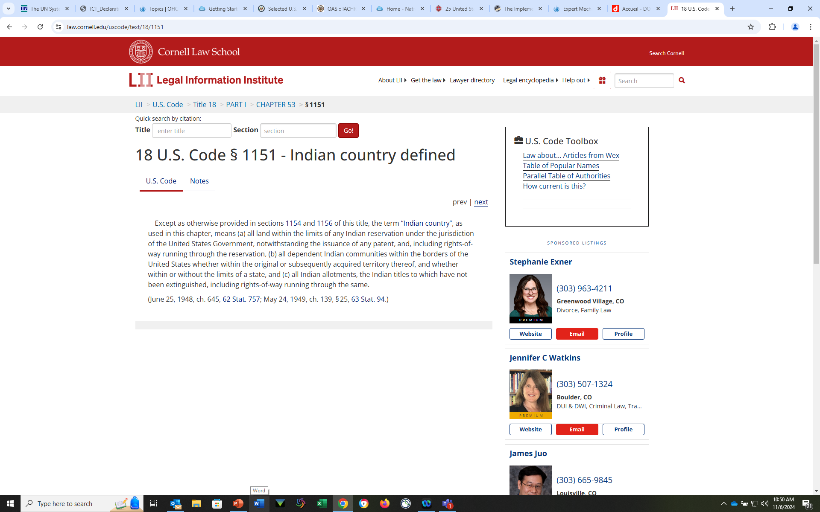
Definition of “Indian Country”
Notes:
Except as otherwise provided in sections 1154 and 1156 of this title, the term “Indian country”, as used in this chapter, means (a) all land within the limits of any Indian reservation under the jurisdiction of the United States Government, notwithstanding the issuance of any patent, and, including rights-of-way running through the reservation, (b) all dependent Indian communities within the borders of the United States whether within the original or subsequently acquired territory thereof, and whether within or without the limits of a state, and (c) all Indian allotments, the Indian titles to which have not been extinguished, including rights-of-way running through the same.
(June 25, 1948, ch. 645, 62 Stat. 757; May 24, 1949, ch. 139, § 25, 63 Stat. 94.)

Slide 62
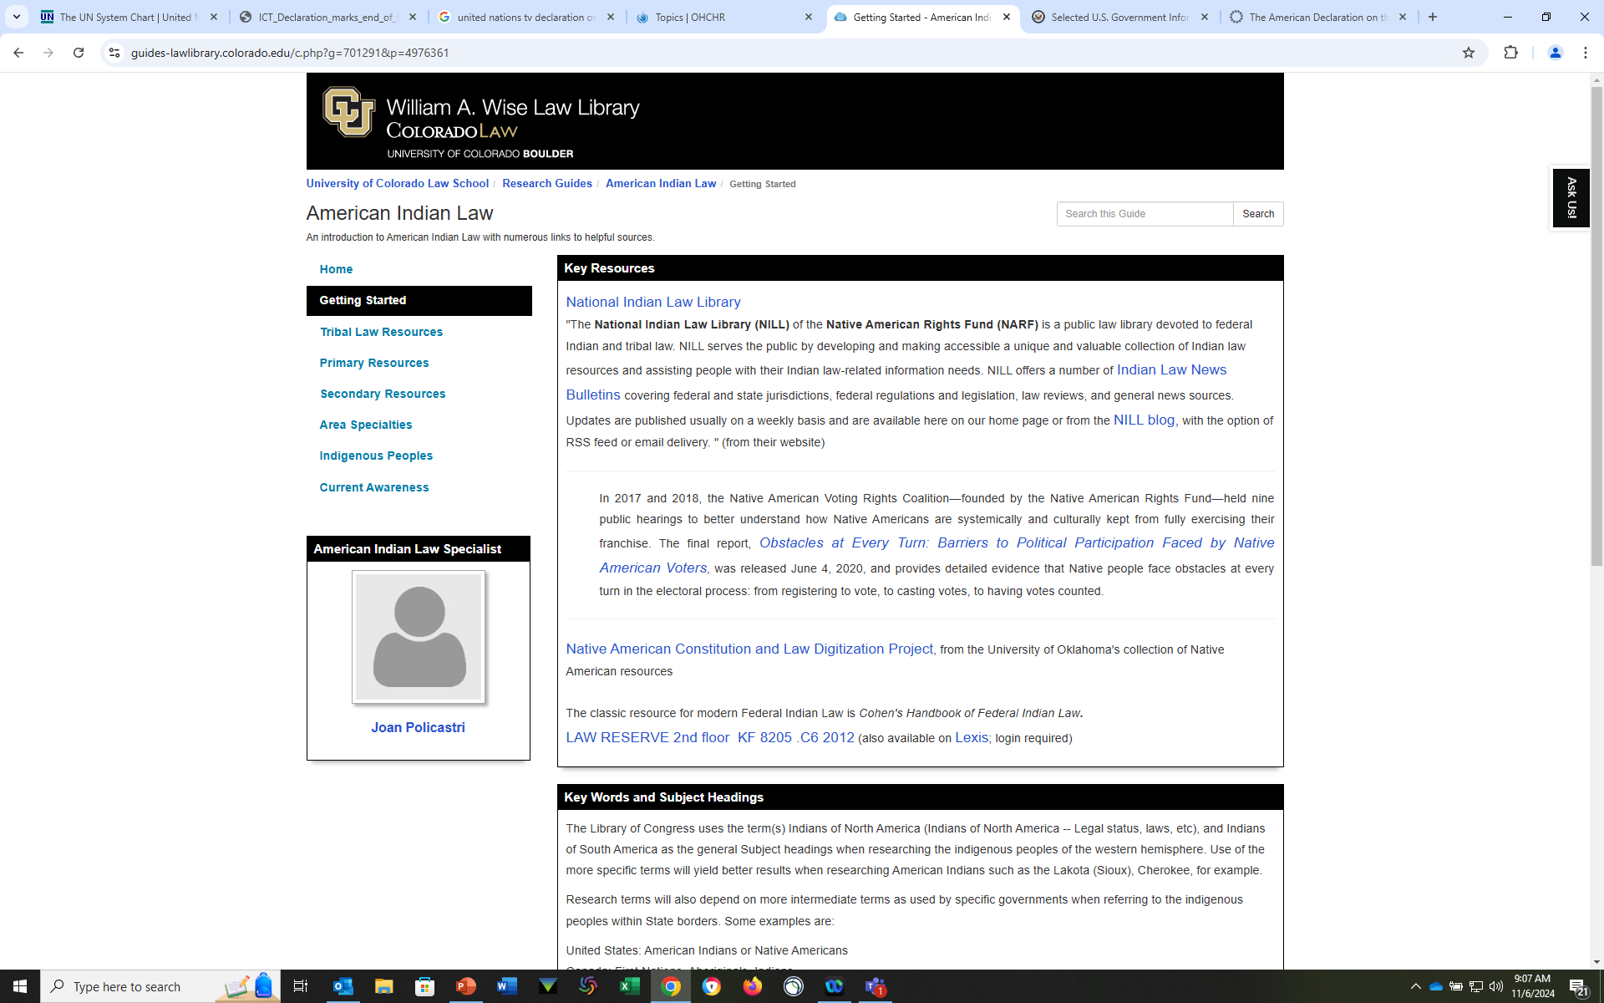
Wise Law Library Guide – American Indian Law
Notes:
Small print for Cohen??? Good grief… The law library has an original typed copy (multi volume) in the RBR…need to mention editions, who is updating

Slide 63
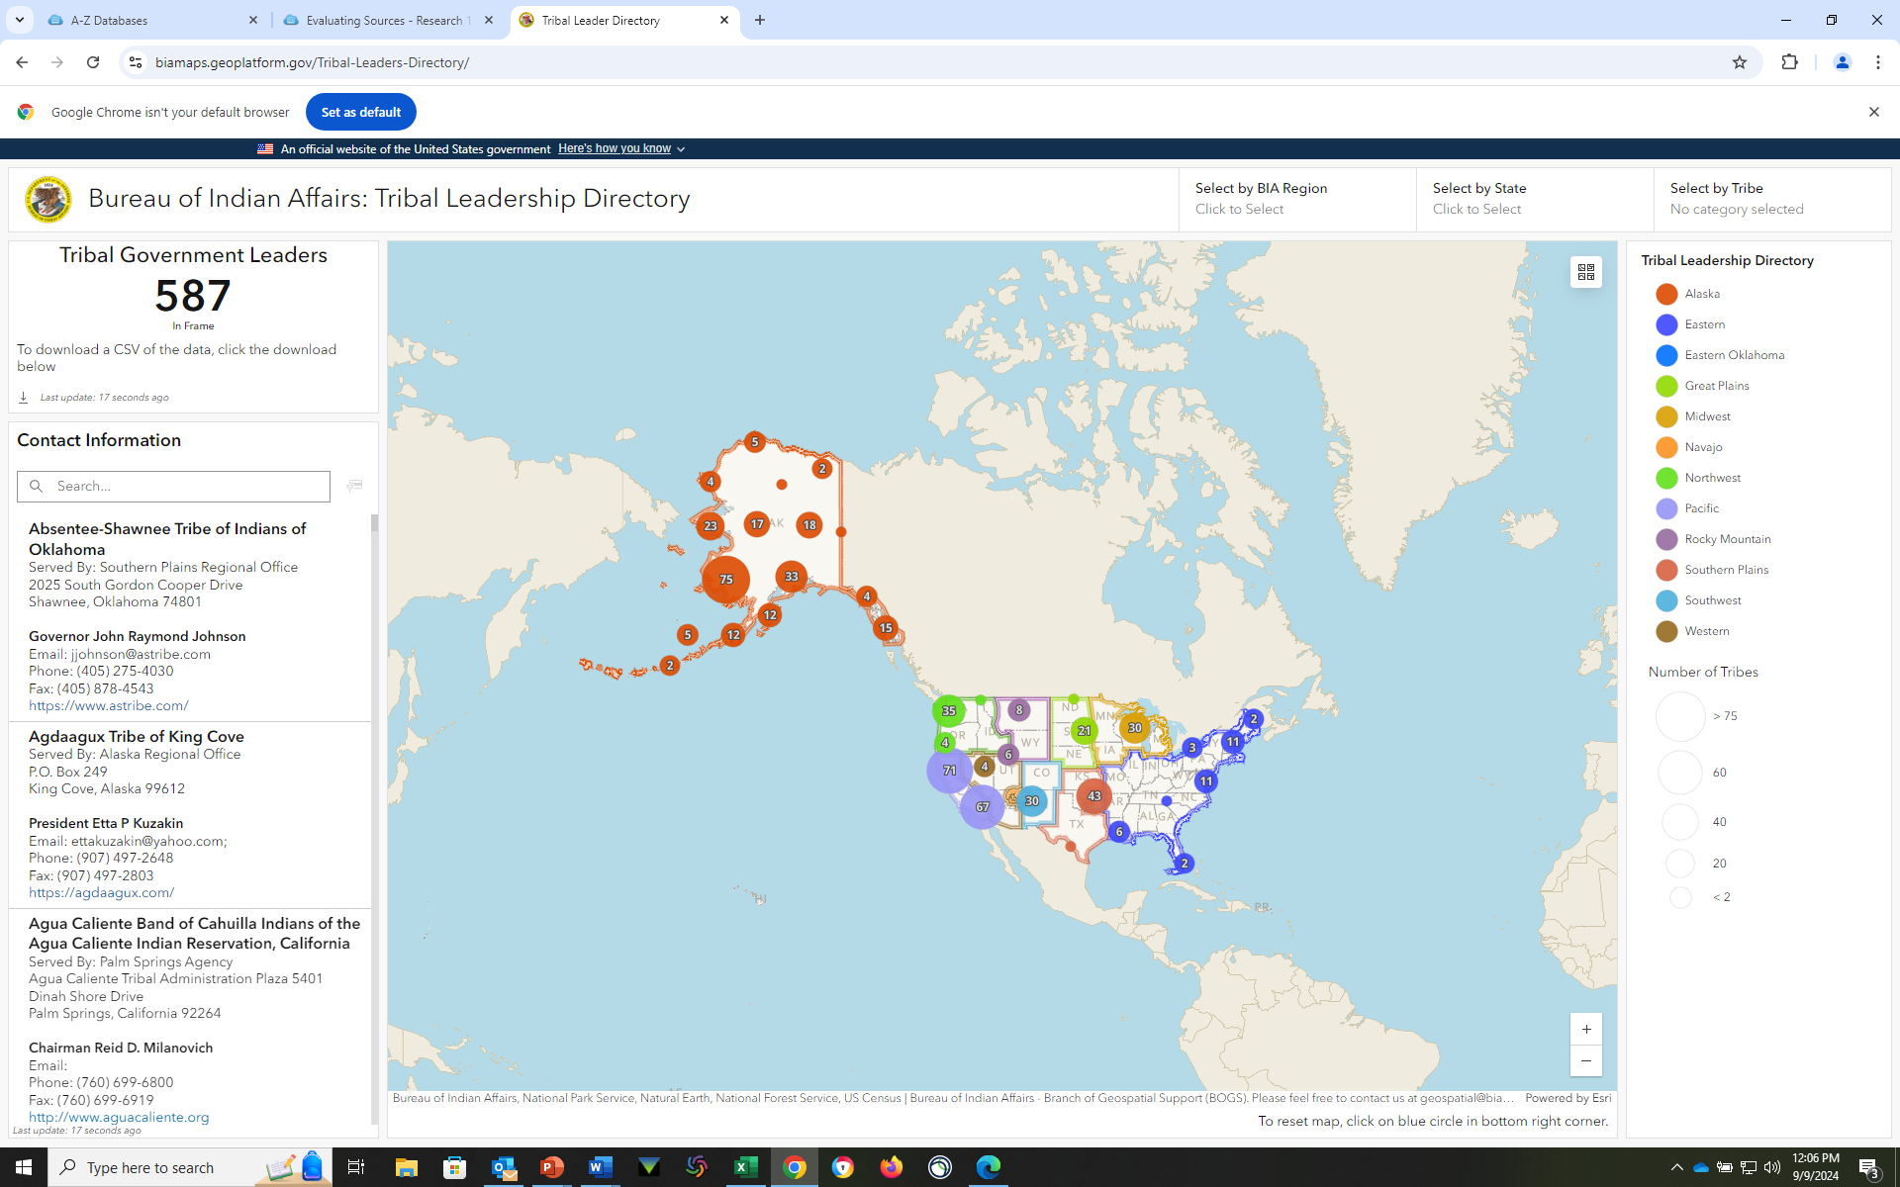
There are over 560 official Federally recognized tribal nations, the list of these is maintained by the US Dept. of Interior:
Federally Recognized Tribes.

Slide 64
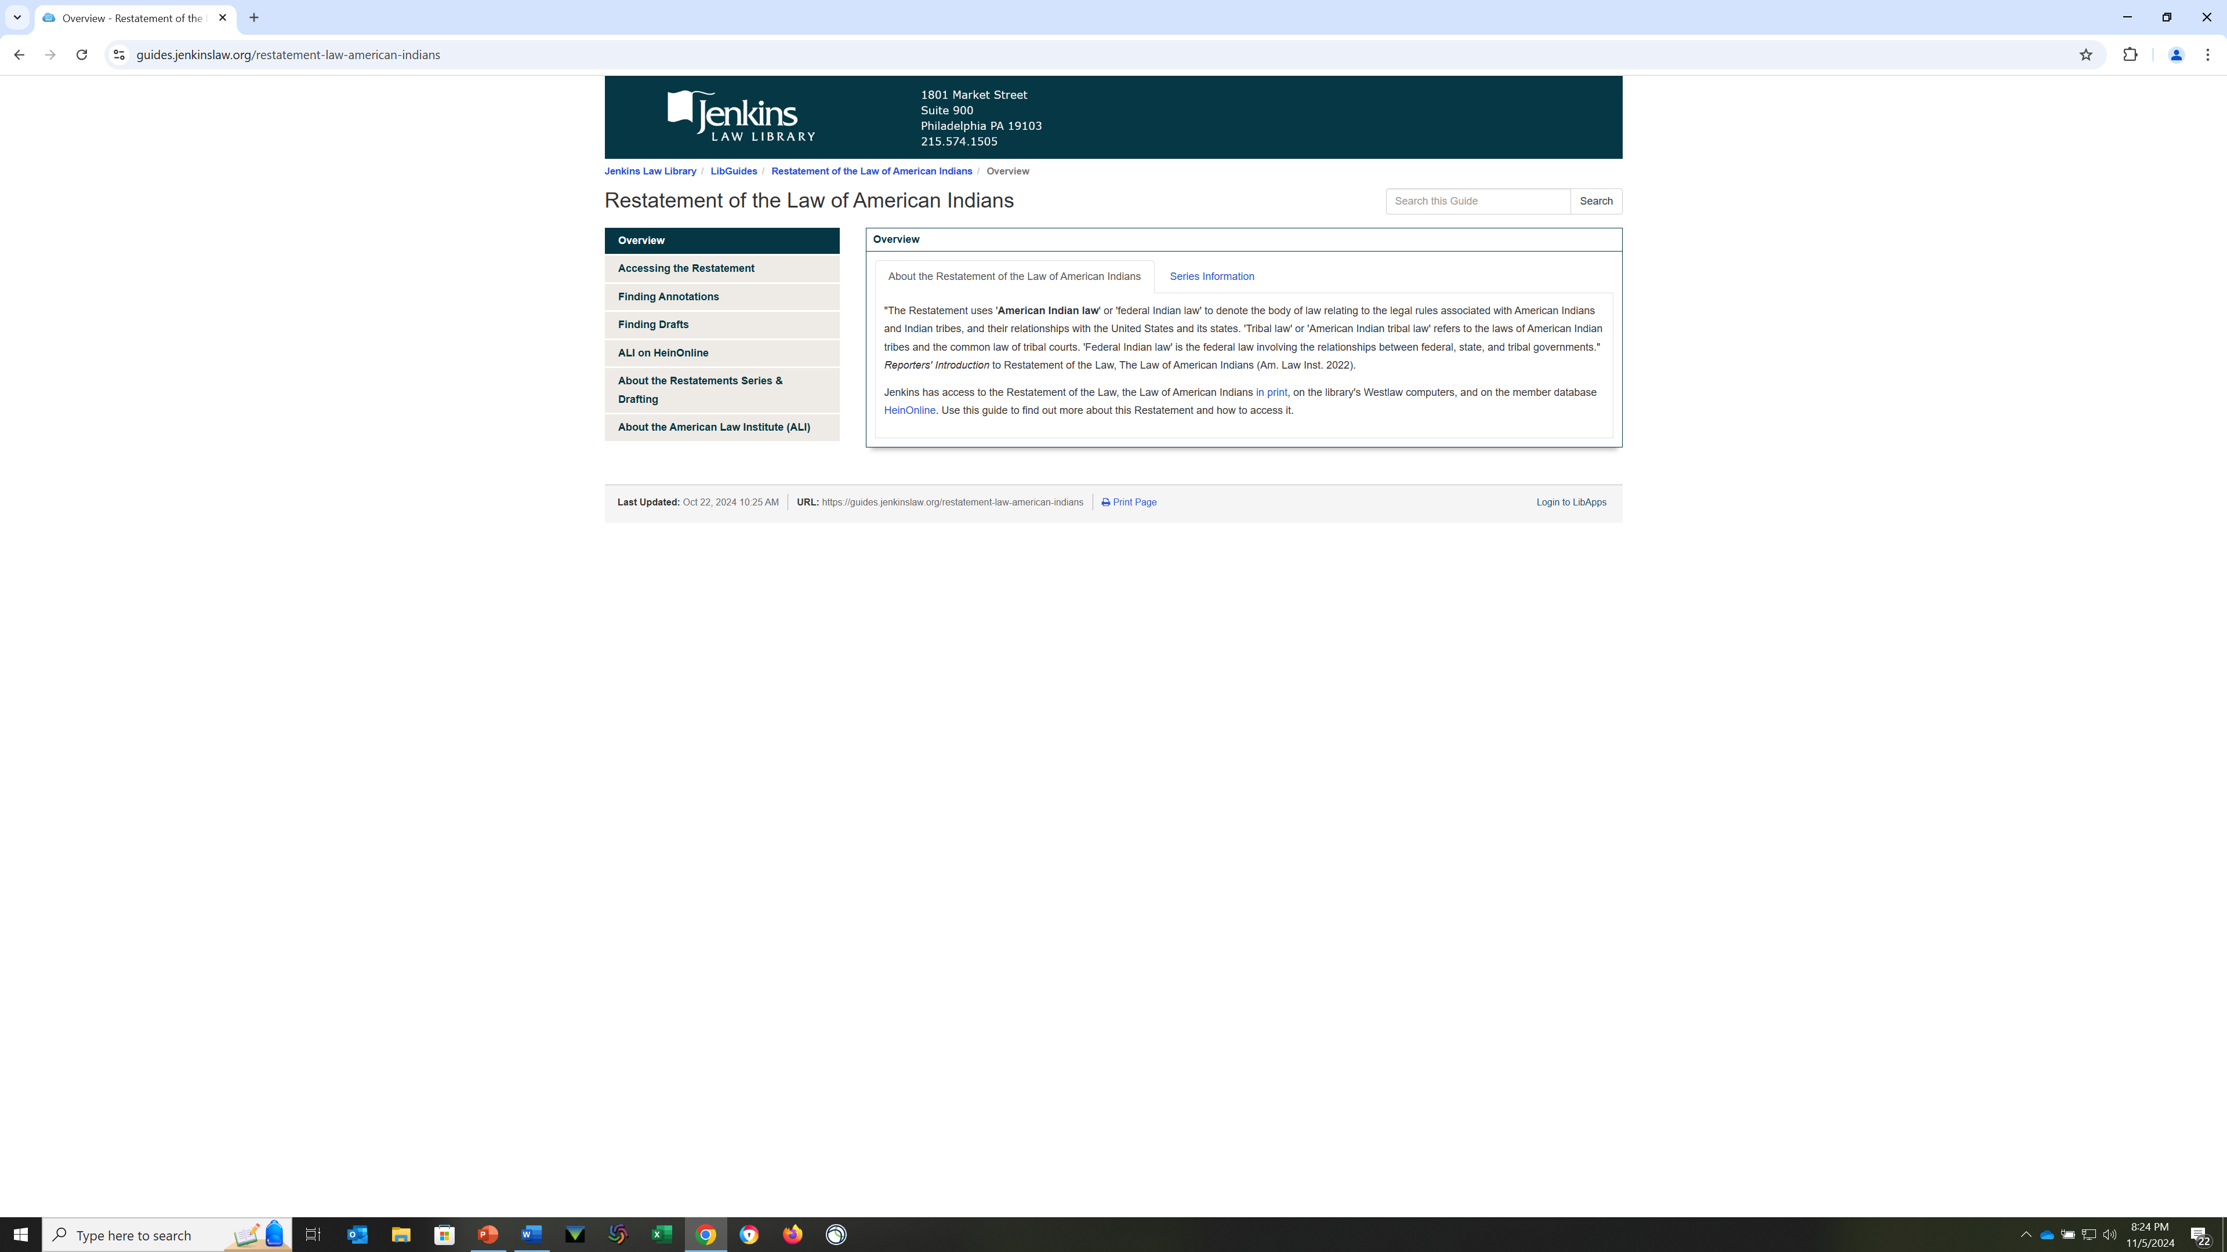
Restatement of the Law of American Indians
Notes:
Member Databases
Westlaw
Print
The member database HeinOnline includes access to the Restatements. Many drafts may also be available on HeinOnline. HeinOnline is also available in the library. For more HeinOnline Restatement access directions and search tips, see the ALI on HeinOnline page of this guide.
Restatement of the Law, Law of American Indians
Available on HeinOnline. Coverage begins with 2013.
Official Text Direct Access: Law of American Indians.
Once in HeinOnline, select American Law Institute Library > Restatements & Principles of the Law > Law of American Indians
Select Preliminary, Council, Discussion, Tentative, and Proposed Final Drafts. Full text may not be available for all drafts. The most recent case citations are also available. For more information about case citations, see the Finding Annotations page of this guide.
Restatement of the Law, The Law of American Indians
Available on the library's Westlaw computers.
Select archive materials (drafts) also available. From the Restatement of the Law, The Law of American Indians table of contents page, see the "Tools & Resources" option on the right.

Slide 65
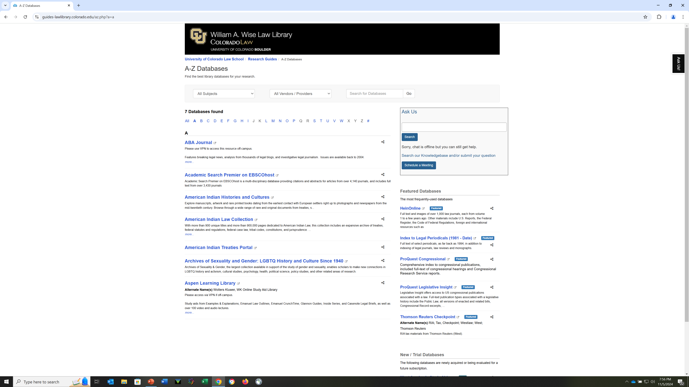
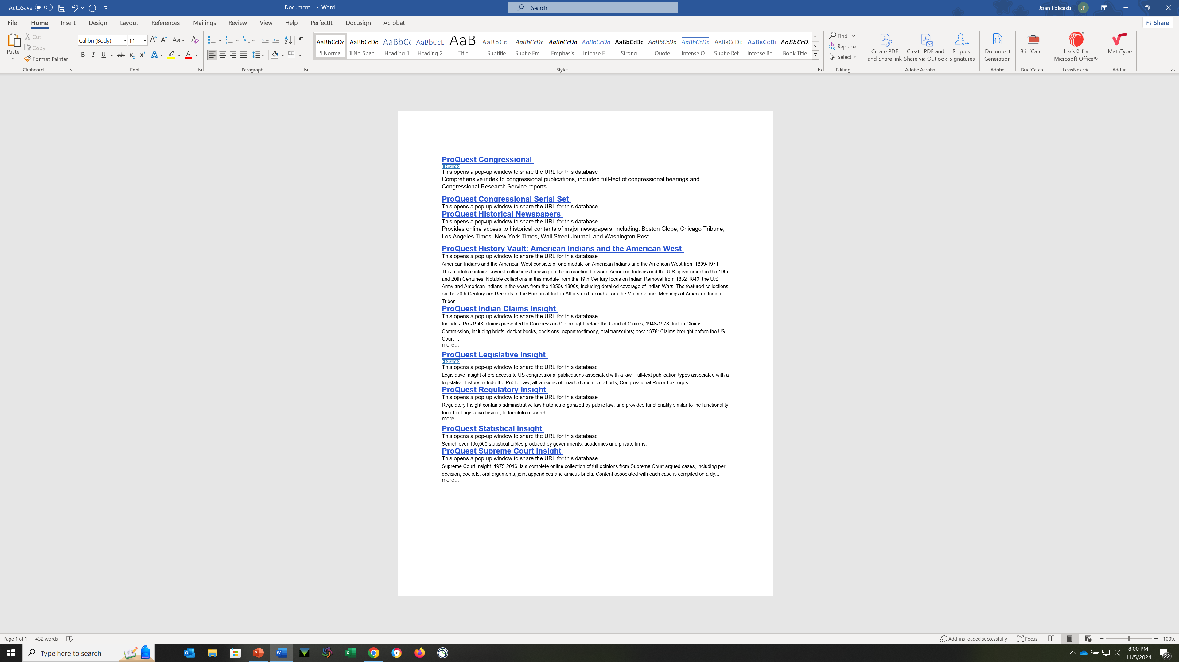
From the Law Library’s A-Z list of databases
Notes:
American Indian Histories and Culture, American Indian Law Collection
American Indian Treaties Portal

Slide 66
American Indians and the American West
ProQuest History Vault: American Indians and the American West
American Indians and the American West consists of one module on American Indians and the American West from 1809-1971. This module contains several collections focusing on the interaction between American Indians and the U.S. government in the 19th and 20th Centuries. Notable collections in this module from the 19th Century focus on Indian Removal from 1832-1840, the U.S. Army and American Indians in the years from the 1850s-1890s, including detailed coverage of Indian Wars. The featured collections on the 20th Century are Records of the Bureau of Indian Affairs and records from the Major Council Meetings of American Indian Tribes.

Slide 67
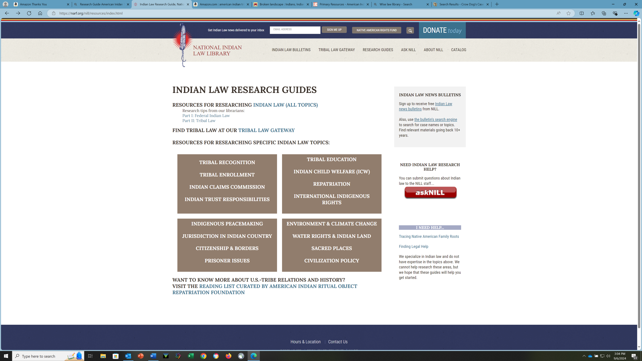
National Indian Law Library
Notes:
Sign up for the newsletter; great resource for tribal codes, specific topics, cases with subject identification, NARF specializes in ICWA . Will be coming out with an FPCI guide.

Slide 68
U.S.
Eras
  Treaties
  War
  Assimilation / Dawes Act
  Indian Reorganization Act / IRA Constitutions
  Termination
  Self-Determination
Notes:
Look at the era of when something was enacted and is will give you more context, always remembering that unless repealed, it is still in effect today and is available to the Courts to use in any way they want (see Williams, Like a Loaded Weapon)

Slide 69
The 1950’s - An AI view
House Concurrent Resolution 108 (HCR 108), passed in 1953, marked the beginning of the Termination Era, a period when the federal government revoked the status of many Native American tribes:
Purpose
The resolution's intent was to end the special relationship between the federal government and tribes, and to make Native Americans subject to the same laws and responsibilities as other US citizens.
Effects
Termination ended federal aid and services to tribes, and ended federal trust status for their reservations. It also transferred federal jurisdiction over civil and criminal matters on reservations to state authorities.
Tribes affected
The Flathead, Klamath, Menominee, Potawatomi, and Turtle Mountain Chippewa tribes were immediately terminated, along with all tribes in California, New York, Florida, and Texas.
Individual members
Individual members of terminated tribes became full US citizens.
Other consequences
The termination policy led to the removal of approximately 1,365,000 acres of land from trust protection, affecting 11,000 Indians.
Some tribes were able to successfully testify before Congress and avoid termination, including the Iroquois Confederation of the Six Nations and the Flathead Tribes.
Public Law 83-280, also known as Public Law 280 (PL 280),
is a law that was passed by Congress in 1953 to change
the distribution of criminal jurisdiction in Indian Country:
Transfer of jurisdiction: PL 280 transferred criminal jurisdiction
over most crimes in Indian Country from the federal government
to six states: Alaska, California, Minnesota, Nebraska, Oregon, and Wisconsin.
Civil jurisdiction: PL 280 also allowed state courts to handle civil litigation
that had previously been under the jurisdiction of tribal or federal courts.
Optional adoption: Adoption of PL 280 was optional for other states.
PL 280 did not give states the power to:
Regulate tribes or lands held in trust by the United States
Impose state taxes
Violate federally guaranteed tribal hunting, trapping, and fishing rights
Interfere with basic tribal governmental functions like domestic relations and enrollment
Some say that PL 280 limits Native nations' ability to make decisions about their own safety.
Others say that research is needed to understand how PL 280 impacts crime victimization
and police response times in Indian Country.
Notes:
108 is Termination
208 is about criminal jurisdiction in Indian Court
Applicable, some modifications, some rollbacks/repeal…be aware if you are working with a potentially effected jurisdiction.

Slide 70
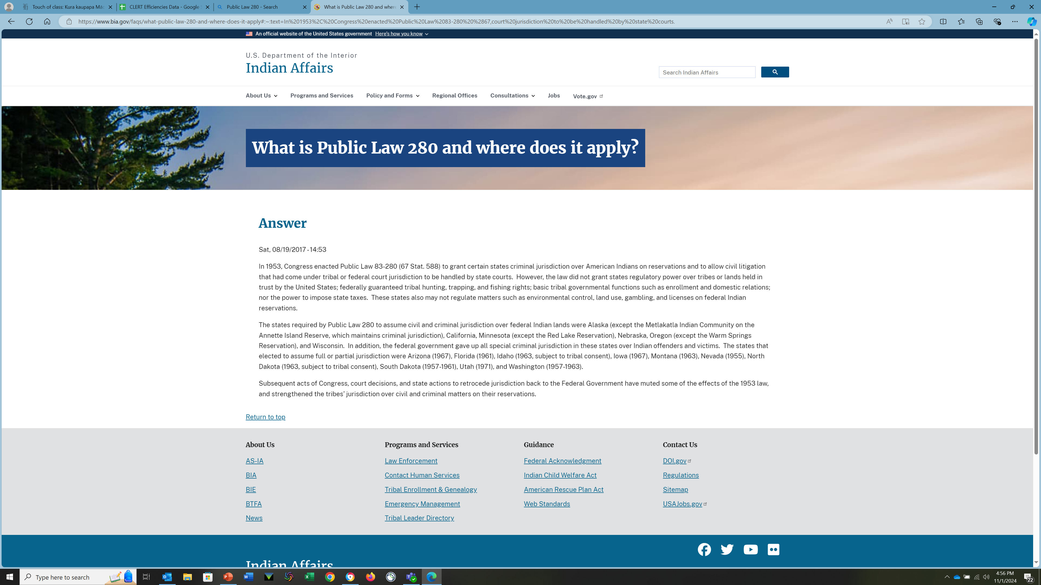
Termination

Slide 71
Indian Claims Insight
ProQuest Indian Claims Insight Includes: Pre-1948: claims presented to Congress and/or brought before the Court of Claims; 1948-1978: Indian Claims Commission, including briefs, docket books, decisions, expert testimony, oral transcripts; post-1978: Claims brought before the US Court ...
Indian Claims Insight
Notes:
Includes Exhibits

Slide 72
Suggested Readings - 1973 to present
Vine Deloria, Jr.
  Custer Died for Your Sins
  Behind the Trail of Broken Treaties : an Indian Declaration of Independence
  Red Earth, White Lies
Peter Matthiessen
  In the Spirit of Crazy Horse
Robert A. Williams, Jr.
  The American Indian In Western Legal Thought
  Like a Loaded Weapon
  Linking Arms Together
Lindsay Robertson
  Conquest by Law (Johnson v. Mc’Intosh)
Steven T. Newcomb
  Pagans in the Promised Land
Notes:
Also, Anthony Anghie, Imperialism, Sovereignty, and the making of International Law (a TWAIL perspective)
Leonard Peltier (In the Spirit of Crazy Horse)
Like a loaded weapon – racist language in Supreme Court decisions
Linking Arms together - Wampum
Newcomb – Domination

Slide 73
Major Issues – Domestic
Missing & Murdered Women & Girls
Free Prior and Informed Consent
Implementation of the United Nations Declaration on the Rights of Indigenous Peoples
Voting Rights
Book Bans
National Archives
Gaming
Citizenship
Notes:
These are primarily domestic issues – FPIC is more international, primarily used with mining/development issues, but can be used in other contexts…see First Peoples guide and anticipate NARF guide (Walter Echohawk)

Slide 74
U.S. Constitution
While the history of Indian/Settlor relations pre-dates the creation of the United States, primary U.S. resources begin with the United States Constitution:
United States Constitution, Art. 1, § 8 "The Congress shall have Power To regulate Commerce with foreign nations, and among the several States, and with the Indian Tribes..."
Congressional Representation: Article 1 "Representatives...shall be apportioned among the several States...according to their respective Numbers, which shall be determined by adding to the whole Number of free Persons,...excluding Indians not taxed, three fifths of all other Persons."
Amendment XIV - Section 2: "Representatives shall be apportioned among the several States according to their respective numbers, counting the whole number of persons in each State, excluding Indians not taxes." (1868)
In addition, primary U.S. resources include the United States Code: Title 25 - Indians and Title 18 Crimes and Criminal Procedure The Major Crimes Act - 18 U.S.C. §1153 (see also, Titles 5, 28, and 42).
You may also refer to the Senate Committee on Indian Affairs: Senate Indian Affairs Committee.

Slide 75
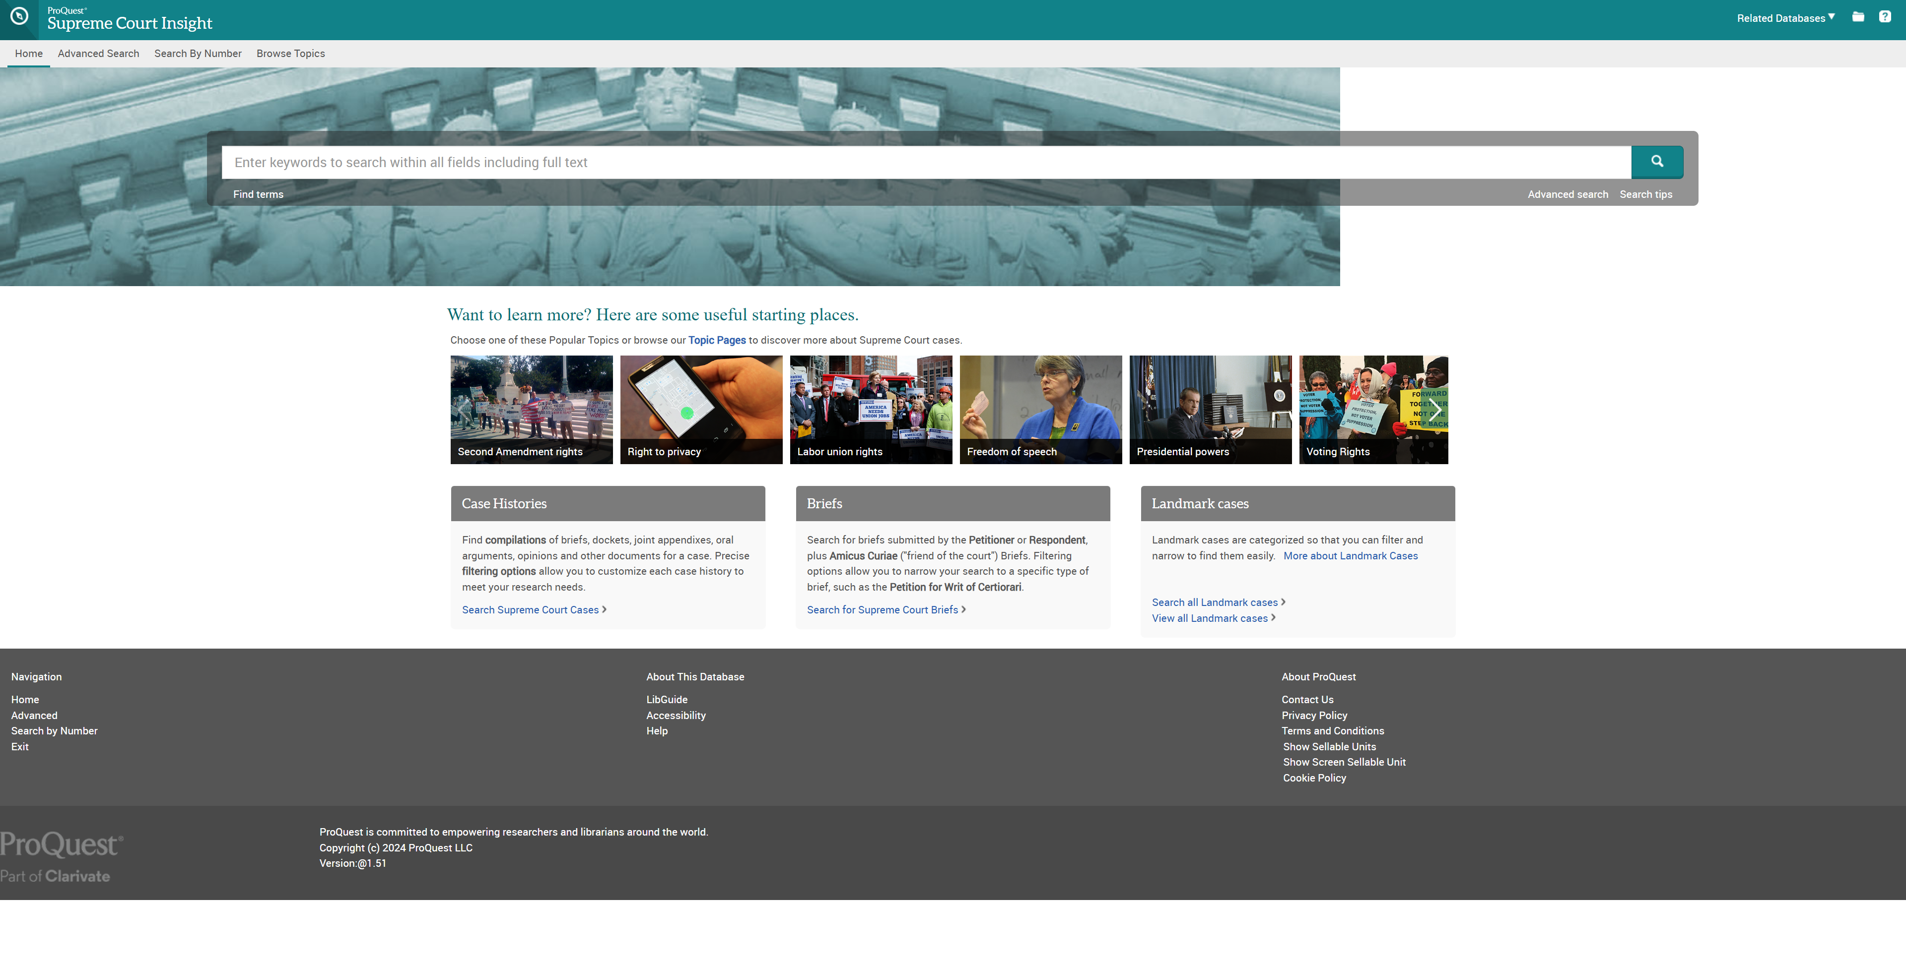
The Supreme Court of the United States
Notes:
Cornell site https://www.law.cornell.edu/

Slide 76
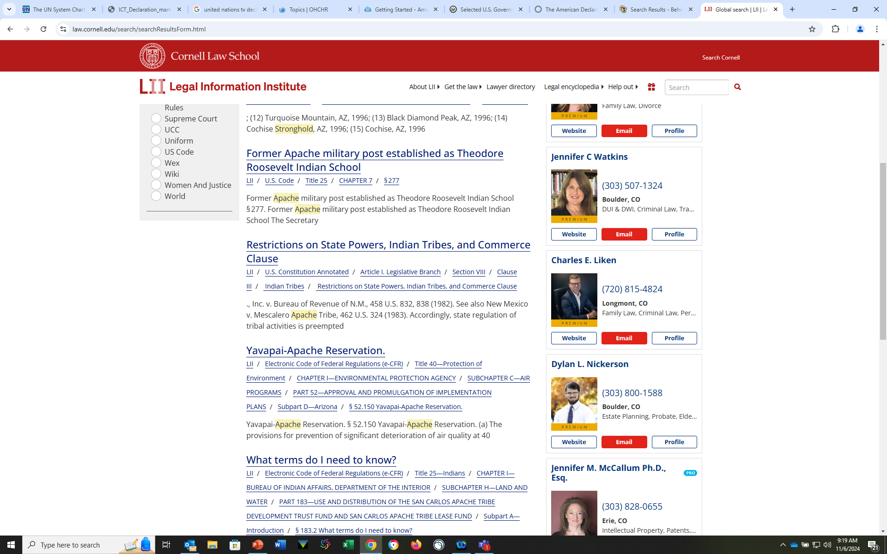
Cornell Legal Information Institute
Notes:
Search for “Apache Stronghold” Very Impt current case… mining, Cert just denied by S Ct. What happens now? Sacred site of the Apache, religious freedom case… How the “green” economy is being built on the backs of indigenous peoples…Nevada… foreign ownership, resources to be exported.

Slide 77
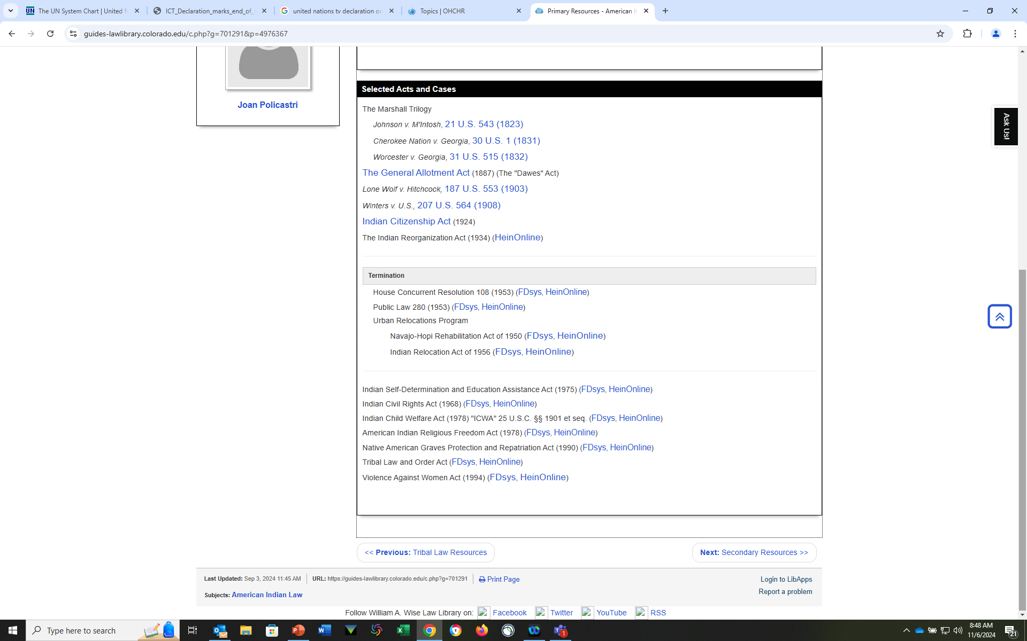
Major Acts and Cases
Notes:
From Wise Law Library’s Guide – Needs more information by each case, as well as an expansion of the cases…No Ex Parte Crow Dog???? Mischaracterization of Navajo/Hopi, and no cite to PL 93-531 , no Lyng (religious Freedom), etc. Winters is the major water rights case in the Western US, Each Marshall case had a specific effect, … Needs expansion and explanation – Why is only Termination highlighted? Need Eras…end of Treaty-making, ect.

Slide 78
Major U.S. Cases and Legislation and…
EX Parte Crow Dog
Merriam Report
Felix Cohen
  Cohen’s Handbook of Federal Indian Law
  Termination
Major legislation
NAGPRA
ICWA – See NARF’s work
Notes:
The top 3 need to be added to the WLL guide

Slide 79
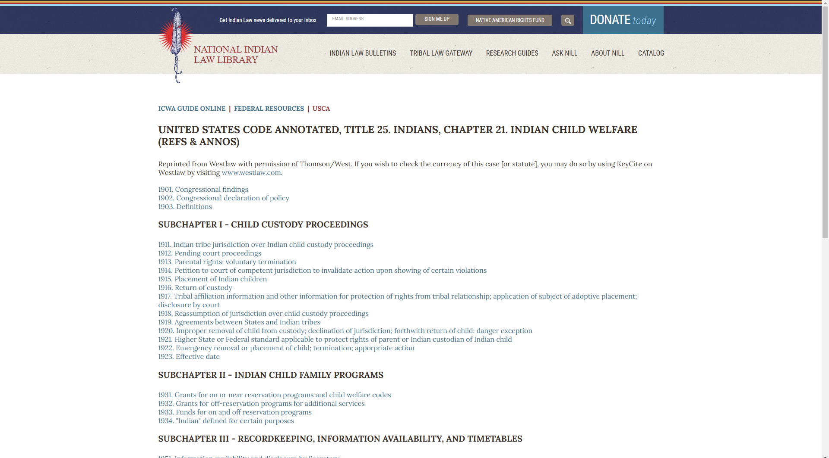
NARF on ICWA
Notes:
Sample page…

Slide 80
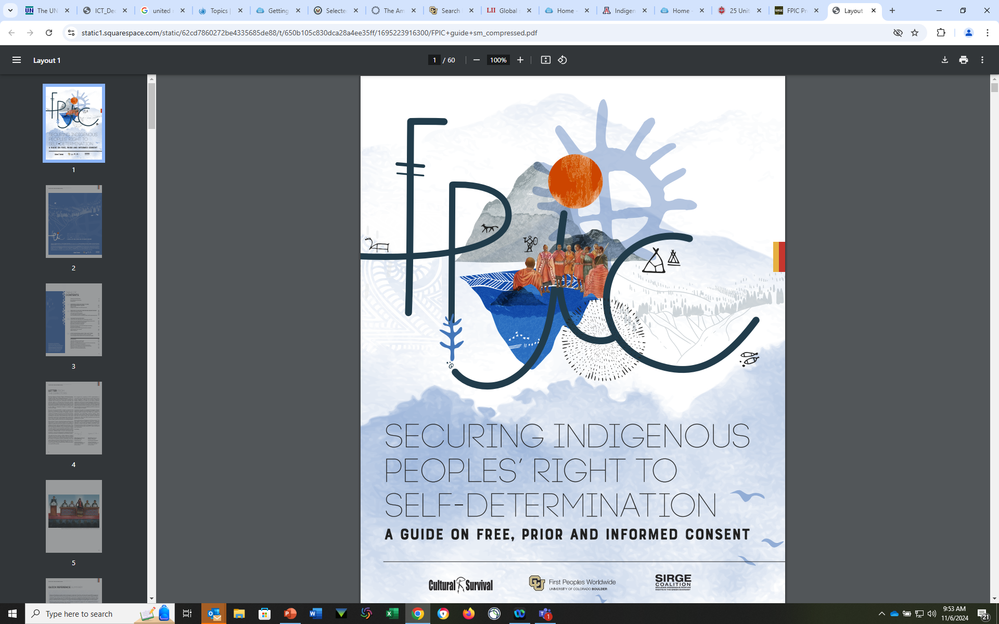
First Peoples Worldwide

Slide 81
Tribal Law
Tribal Codes and Constitutions
  Website of each nation
  National Indian Law Library (NILL/NARF)
  Westlaw
  Lexis
  And The Indigenous Law Portal
Notes:
Can be chanllenging
Might be in Codes, or Constitutions, or Custom (not for public, or everyone)

Slide 82
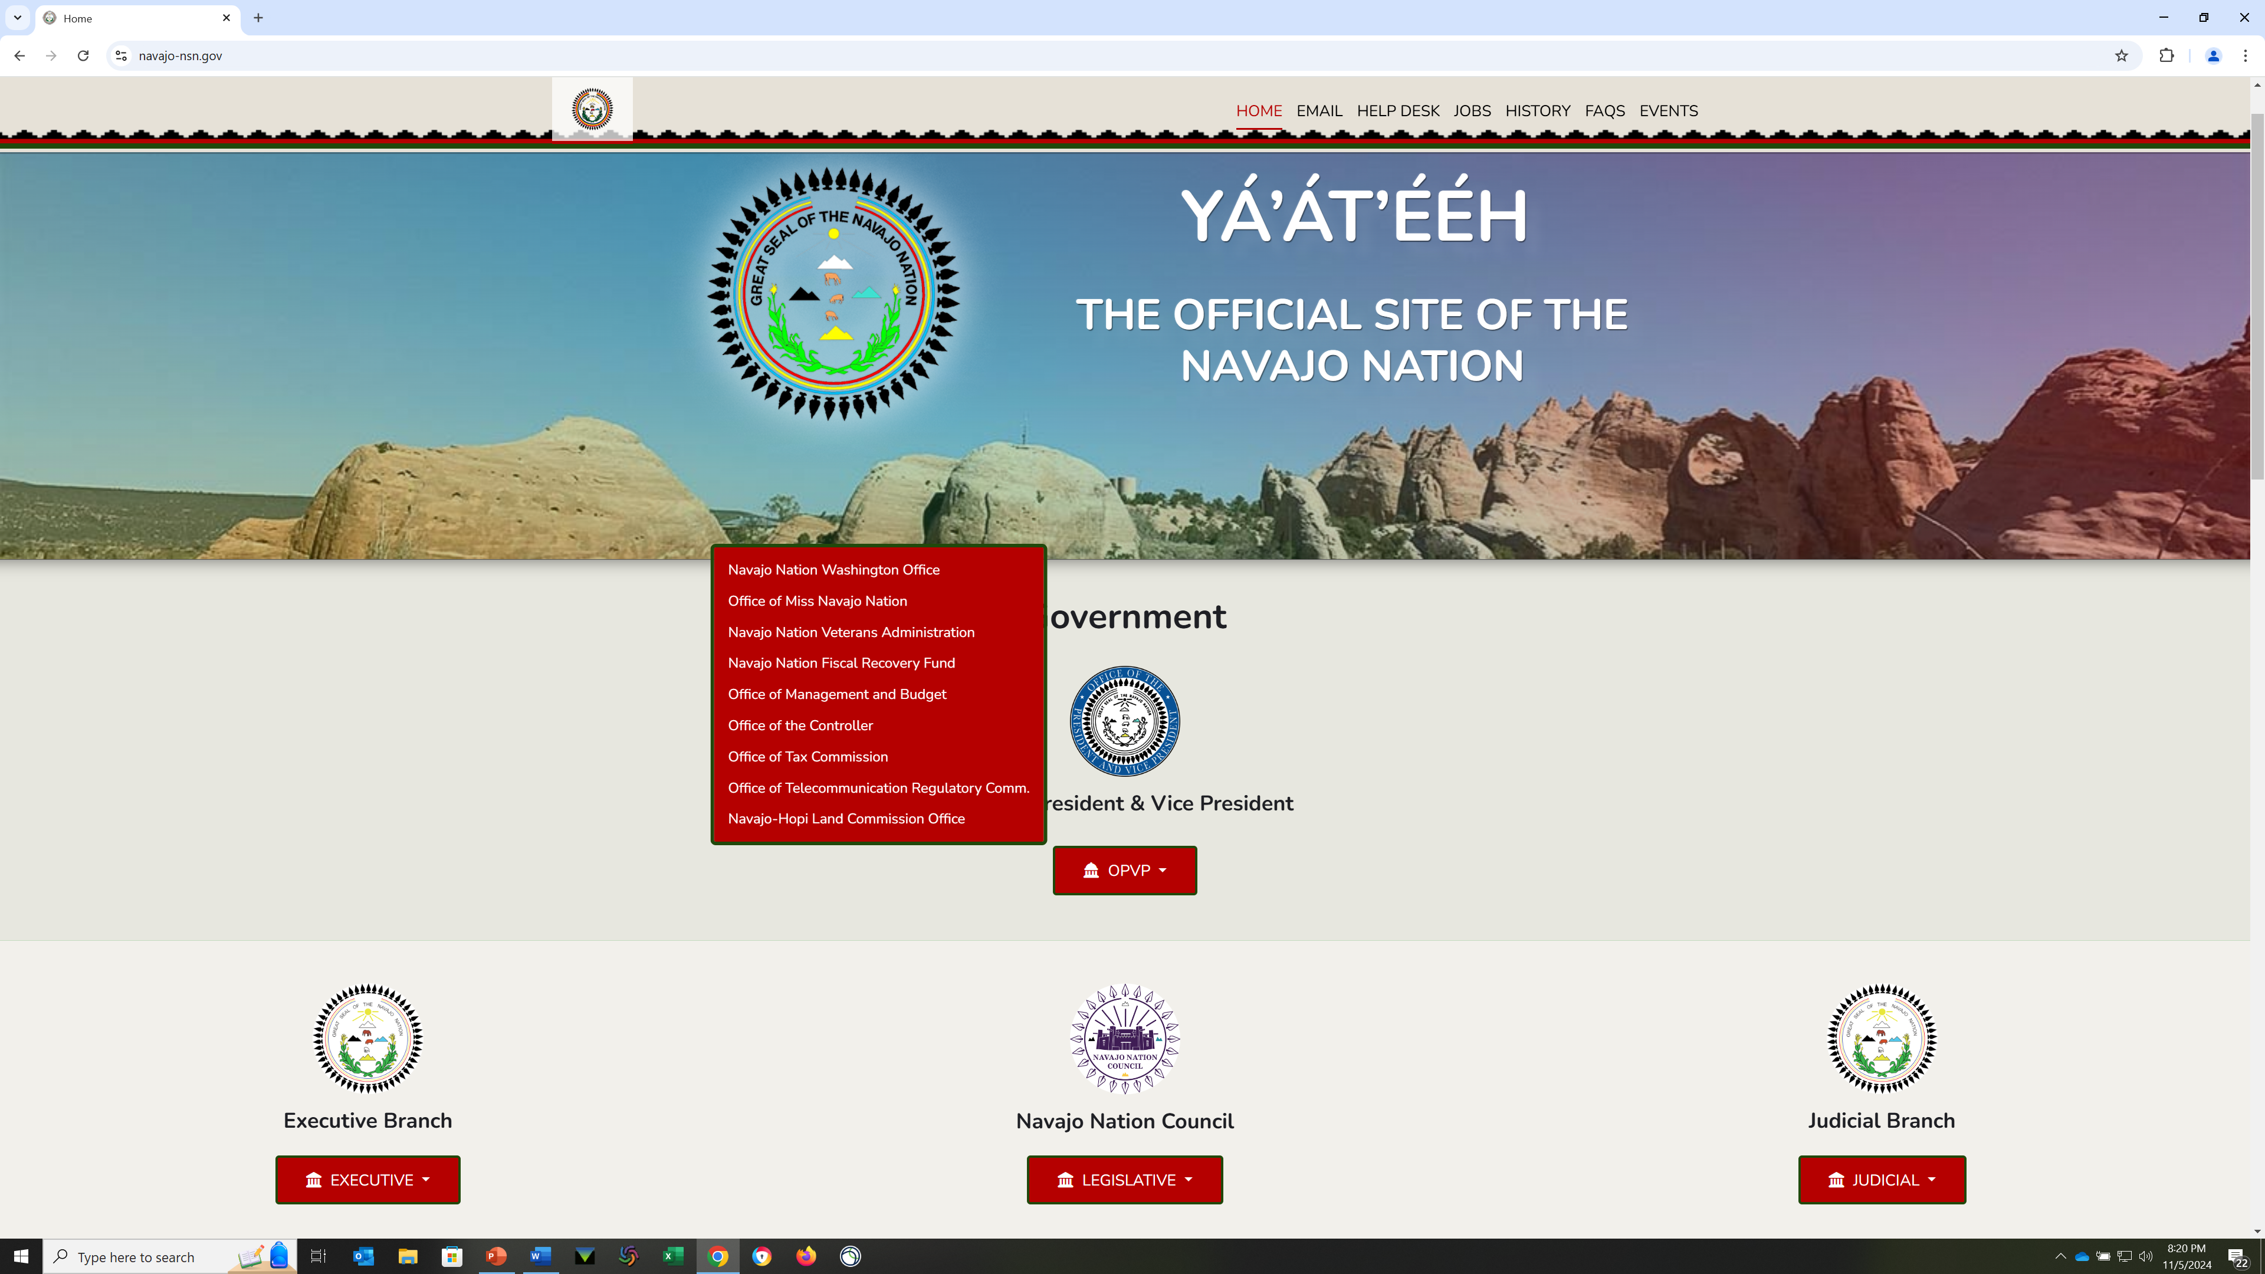
Homepage of the Navajo Nation

Slide 83
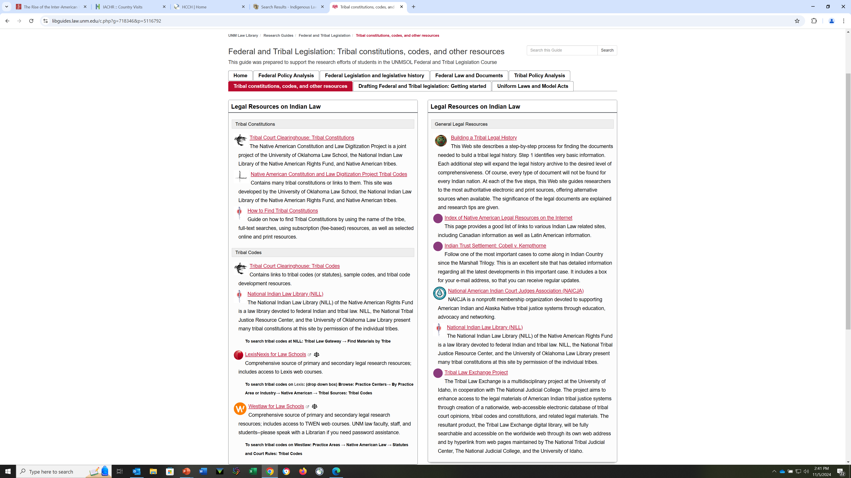
University of New Mexico
Notes:
This page has sources for tribal Constitutions, Codes, and general Legal Resources
Tribal Court Clearing house, Tribal Constitutions
Native American Constitution and Law Digitization Project: Tribal Codes

Slide 84
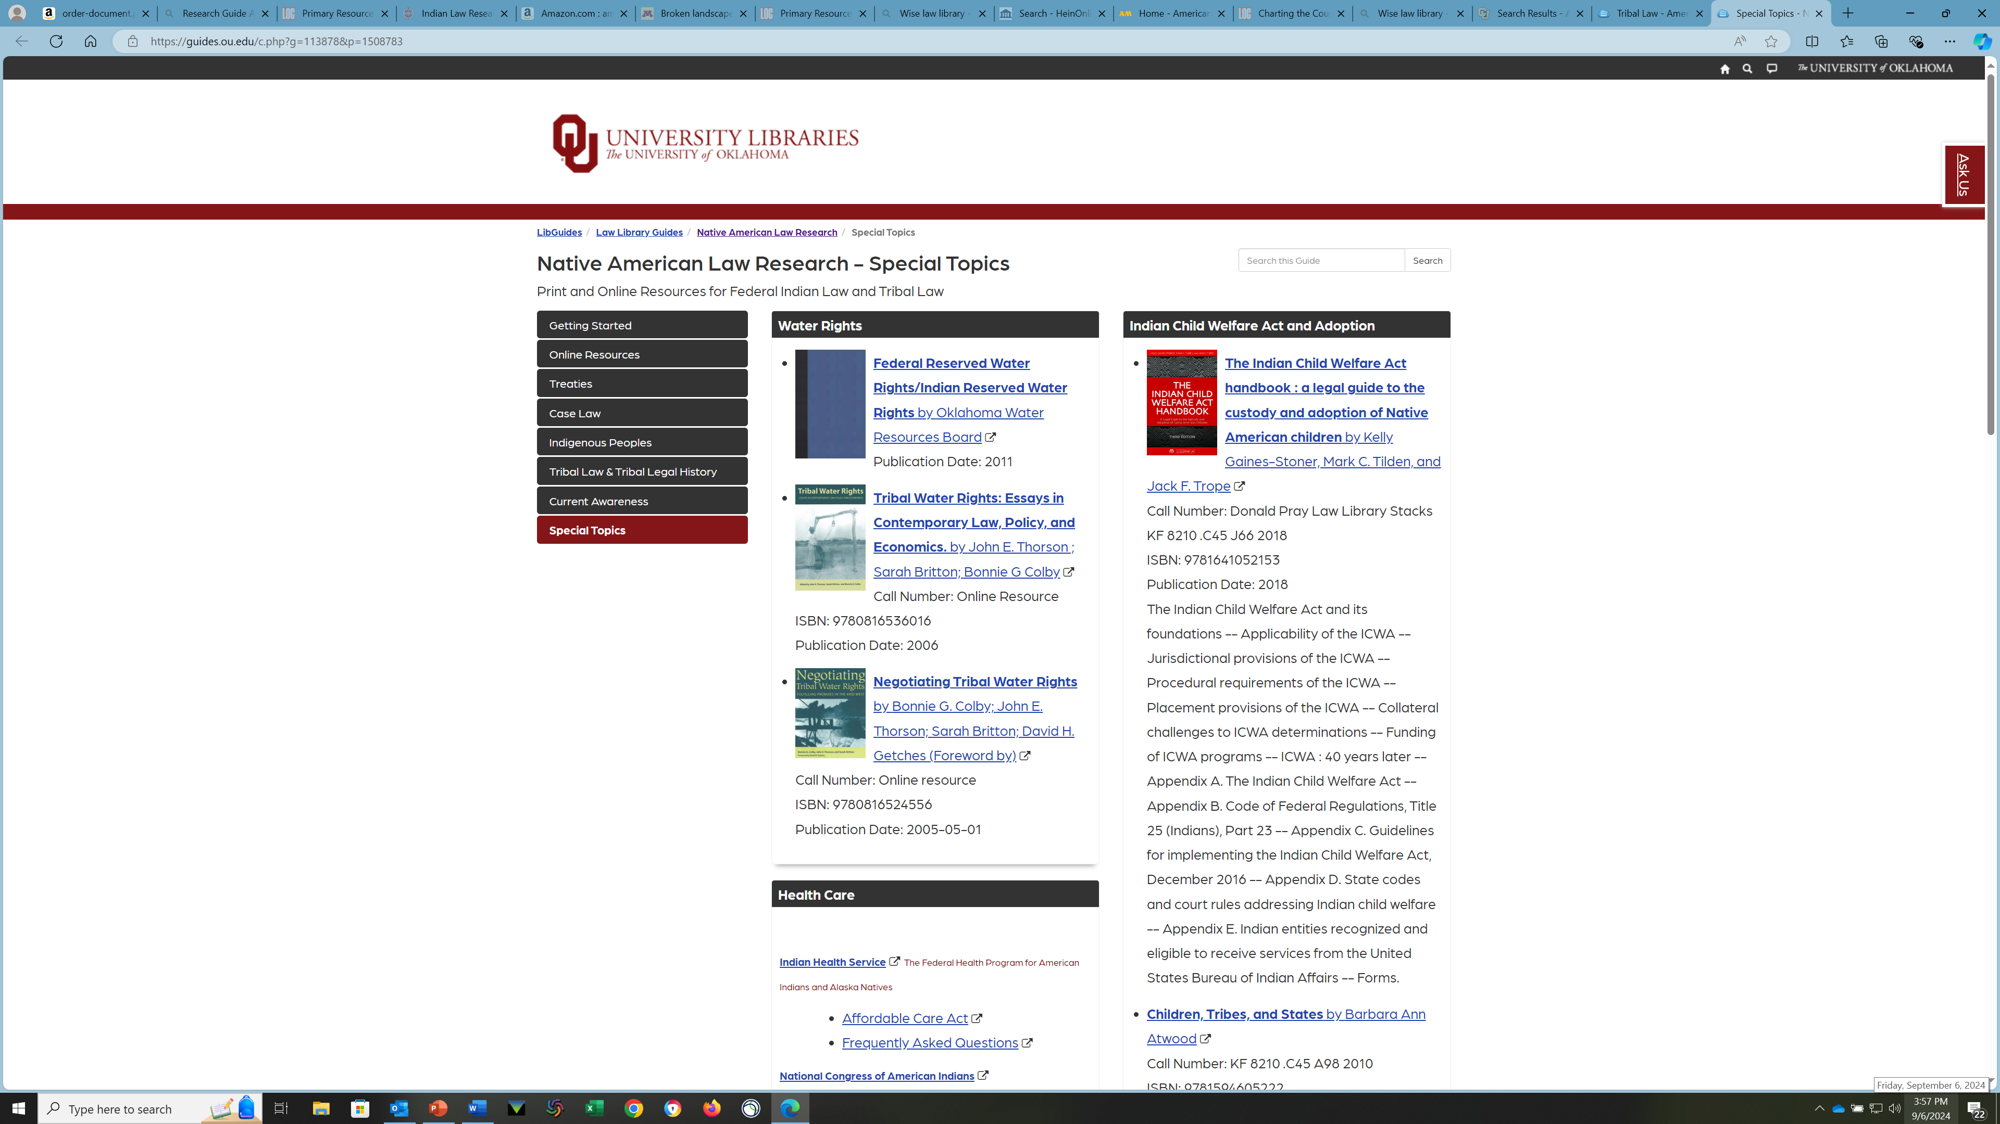
University of Oklahoma

Slide 85
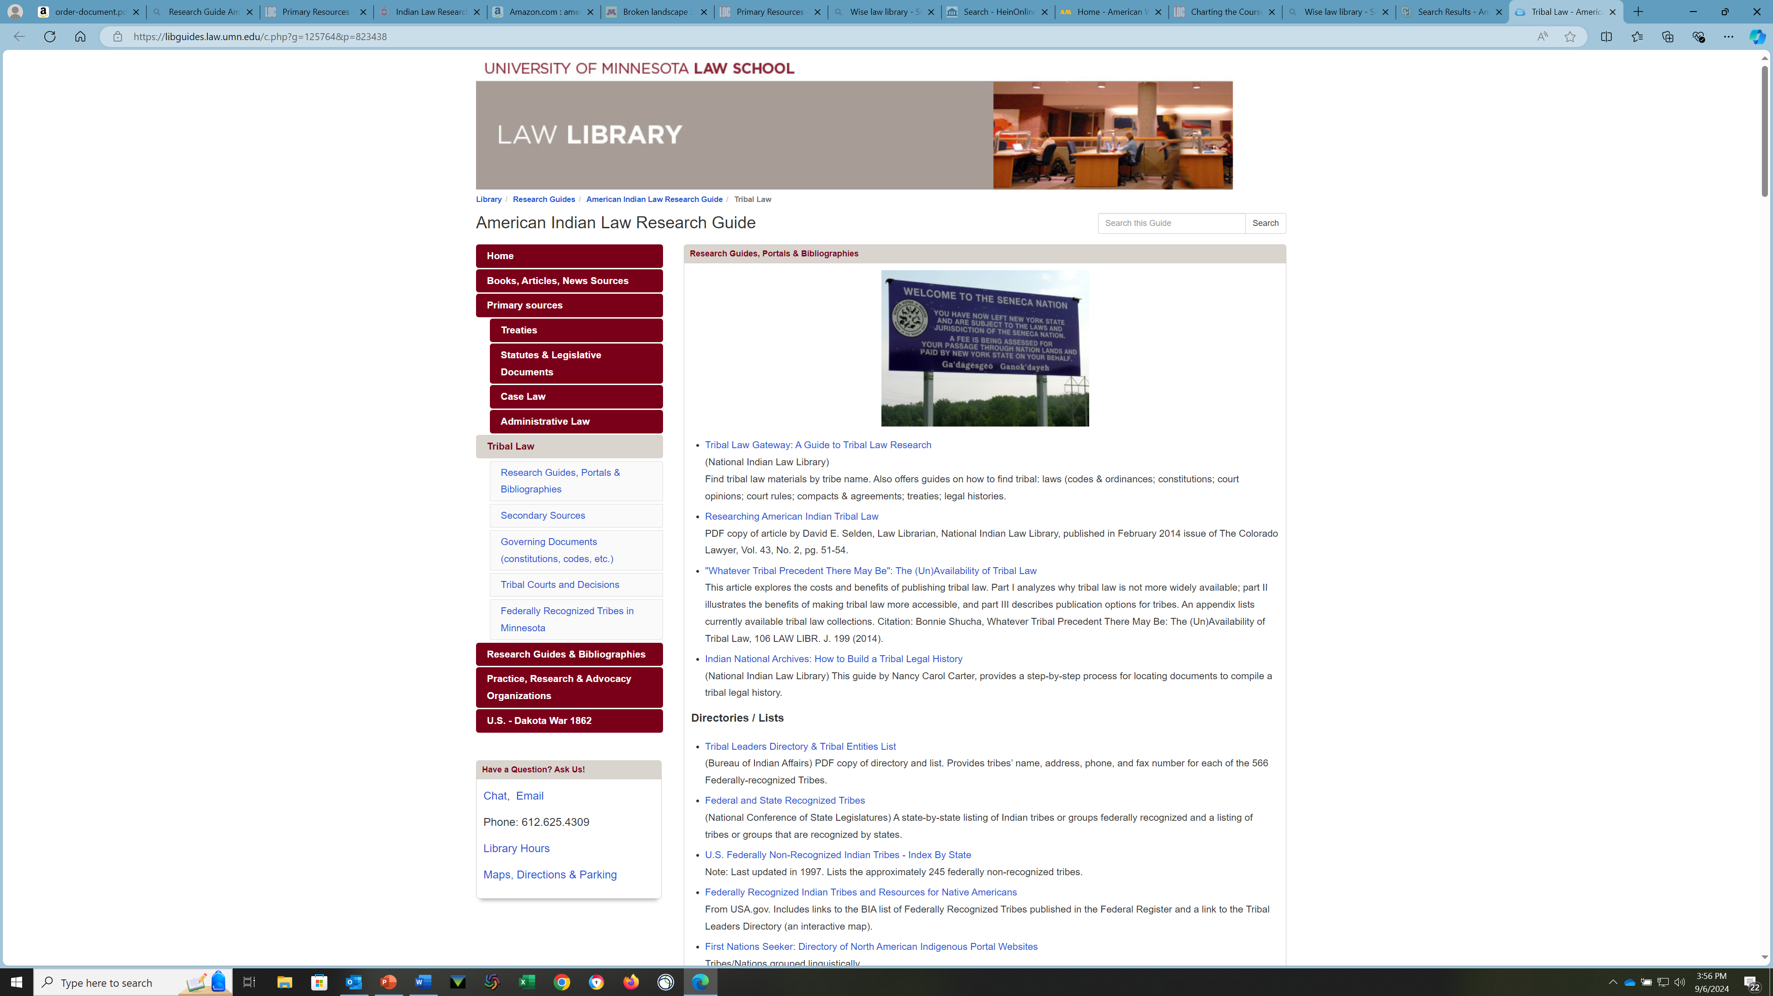
University of Minnesota Research Guide
Notes:
U of Minn Frequently cited treaties

Slide 86
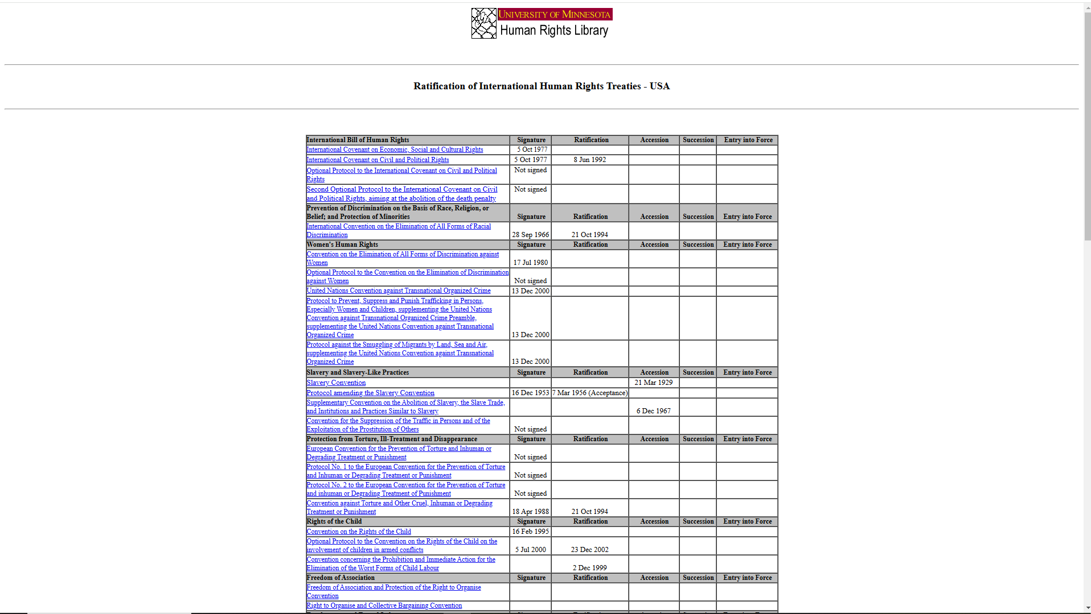
Ratification of International Human Rights Treaties - USA

Slide 87

Frequently-Cited Treaties & Other International Instruments

Slide 88

University of Washington

Slide 89

Northwestern University

Slide 90

Native American Law Guide: Federal Indian Law & Tribal Law Materials

Slide 91
And more Government Websites +
Bureau of Indian Affairs
Fedsys.com
USA.gov
Data.gov
Regulations.gov
Organizations
  National Congress of American Indians
  National Indian Youth Council
  Native American Rights Fund / National Indian Law Library
Royce Maps Historical Maps - American Indian Law Resources - Pritzker Legal Research Center at Northwestern Pritzker School of Law
Serial Set

Slide 92
Staying up to date
Turtle Talk
ICT News
Indianz.com
Cultural Survival
American Society of International Law
European Society of International Law
Organizations relevant to particular topics
  American Indian Library Association
  Indian Law Bars and publications

Slide 93

Oak Flat
Cert Denied
Notes:
OAK FLAT – Apache Stronghold
A place/issue to watch
Cert was Denied on 11/5/24 - yesterday

Slide 94
Journals/ Newspapers
Articles about American Indians and Indian Law
These law journals are specific to Indian Law.
Tribal Law Journal
American Indian Law Review
American Indian Law Journal
Federal Indian Law
Indian Country Today
NARF Legal Review
These databases can help you find articles about American Indians in scholarly journals, periodicals, and newspapers.
Bibliography of Indigenous Peoples in North America
Good starting point for articles. Provides citations for books, essays, journal articles, and government documents organized around many aspects of native North American culture, history, and life, including archaeology, multicultural relations, gaming, governance, legend, and literacy.
Notes:
Northwestern University Legal Research Guide

Slide 95
Newspapers
Newspaper Source Plus (EBSCO)
Types:
Newspapers
Vendors: Ebsco
Digital collection of the world's major news content. It includes millions of articles from newspapers, newswires and news magazines. In addition, it offers television and radio transcripts and ongoing daily updates from popular news sources.
NewspaperArchive
Alternate Name(s):NewspaperArchive.com, Newspaper Archive
Types:
Newspapers
Online historical newspaper database, fully searchable by keyword and date, covering 1607 to present.
New York Times: Online Access
Alternate Name(s):NYTimes; NY Times
The New York Times online.
Access note: Log in required. Register for a free account with your colorado.edu email address. Students will have access until graduation date; staff and faculty must renew account every 364 days.

Slide 96
Research Guides
Think of the major institutions that specialize in American Indian Law
  University of Michigan (Matthew Fletcher)
  University of Arizona (Robert A. Williams, Keith A. Richotte, Rebecca Tsosie, Heather Whiteman Runs Him, José Francisco "Pancho" Calí Tzay)
  University of New Mexico
  University of Oklahoma
  UCLA
Library of Congress
National Indian Law Library

Slide 97
Globalex Guide
Evaluate- https://www.nyulawglobal.org/globalex/researching_indigenous_peoples_international_law1.html
2.2. A Brief History
Several centuries ago, the European nations settled in areas known today as North and South America, and eventually other areas would be inhabited including Australia and South Africa.[6] The native residents would be subject to slaughter, enslavement, and disease, and those who survived would endure a long history of discrimination at the hands of their new rulers.[7] Many nations, including the United States, would grant rights through case law and statutes to protect indigenous peoples living within their borders as well as their culture. Gradually it became apparent that this was an issue that needed to be dealt with at the international level. The international community has progressed in the recognition of indigenous human rights, as well as the protection of their right to maintain a separate culture, community, and tradition from the majority citizens.
In 1957, the International Labor Organization (ILO) Convention No. 107 viewed the plight of indigenous peoples within the concept of protecting individual rights, and not as a community.[8] This treaty was ratified by and remains in force for 18 countries. In 1989, a new treaty, The Indigenous and Tribal Peoples Convention, 1989 (No. 169), provided greater protections for indigenous peoples than the earlier convention by considering issues such as education, health, land rights, and employment.[9] Convention No. 169 is designed specifically to defend indigenous peoples by improving their living conditions, while preserving the identity and culture of the group as a whole.[10] The United Nations Declaration on the Rights of Indigenous Peoples was passed by the United Nations Human Rights Council on June 29, 2006 and was adopted by the United Nations General Assembly, stipulating extensive safeguards for indigenous peoples (especially in comparison with any other treaty previously) and further emphasizing the importance of protecting their identity as a group.[11]
2.3. Indigenous Populations
The following is a list of indigenous groups that a researcher will likely encounter, but it is important to keep in mind that there are numerous groups throughout the world, many which are not defined or even recognized by their state of residence. This list is by no means exhaustive.
Notes:
This is a test – Please provide a critique of this
2.2
“several years ago” ??? “inhabited” “native residents”? States are ‘nations’ but in chart that follows, the indigenous peoples, called ‘groups’ are not….”grant rights through case law”? To Protect???? OMG Last sentence is so condescending (although probably not meant that way)
2.3
The word “plight” is condescending. The date that the UNHRC passed the DRIP is not useful for the date of the actual GA resolution (Sept. 13, 2007)… Protecting identity????
The chart (not pictured here) sublimates the rights of the indigenous peoples named.

Slide 98
Thank you!
joan.policastri@colorado.edu

