Slide 1
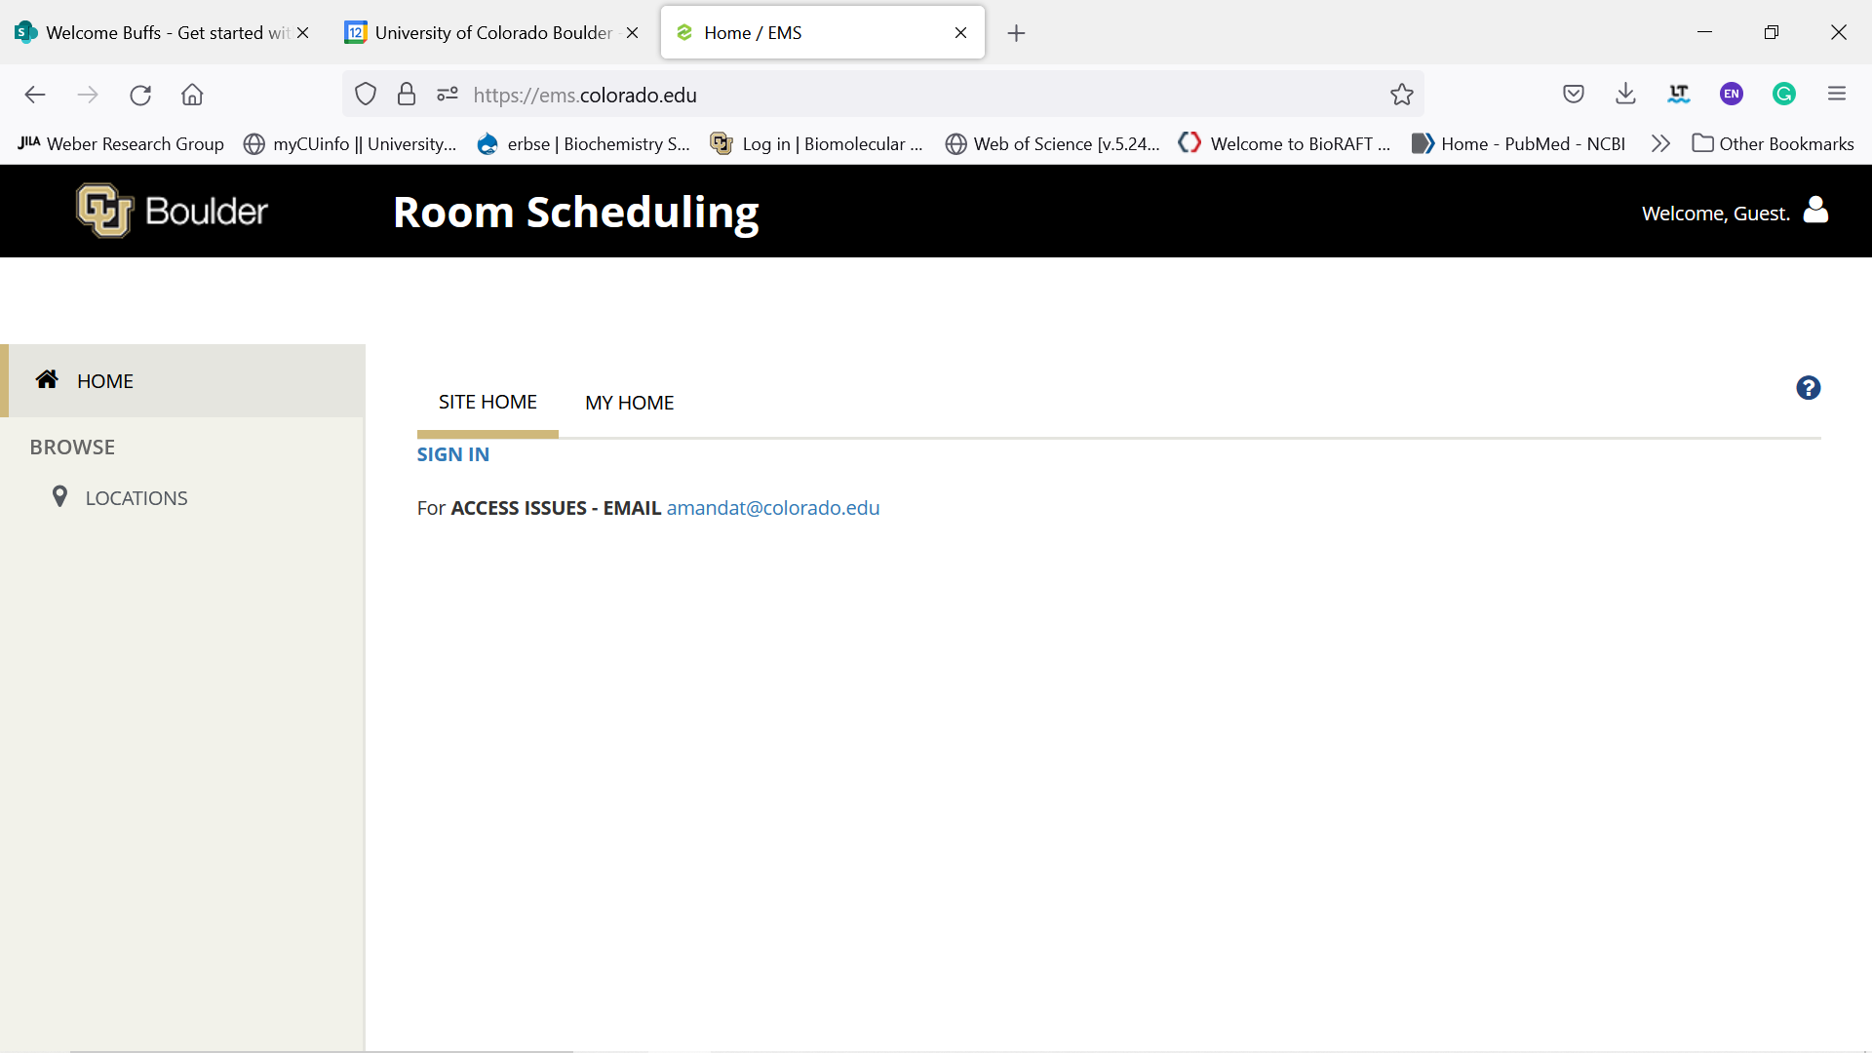
Go to: https://ems.colorado.edu/
Click : Sign In

Slide 2
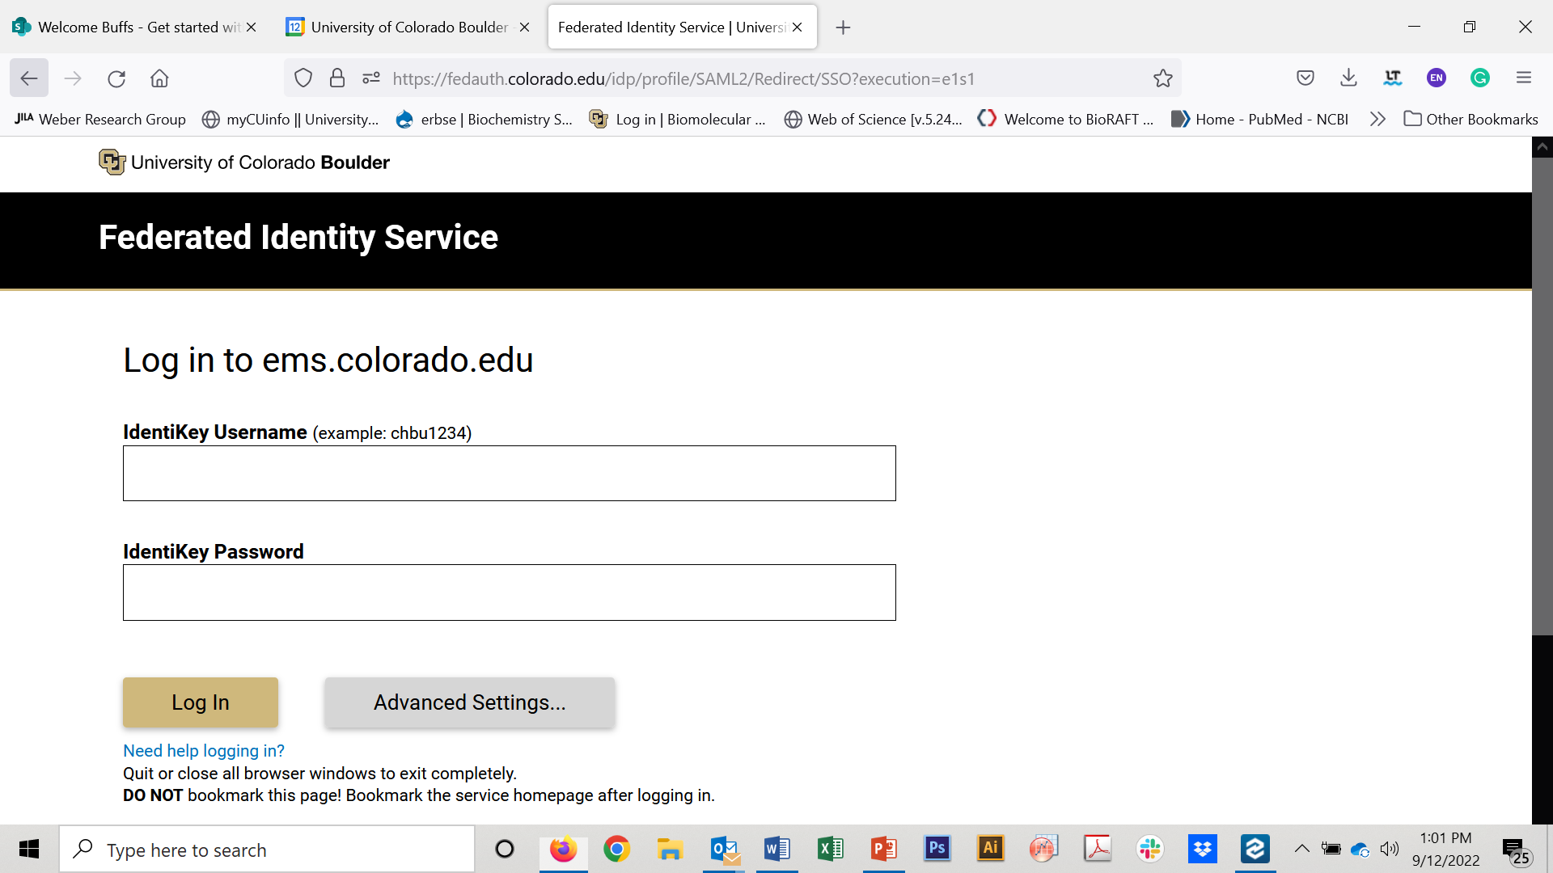
Sign in
If this step doesn’t work, you have not been added to the EMS system yet.
Please email umc-emsstudent at umcemsstudent@colorado.edu to request access to the system. Your email must include your location (JSCBB), your Identikey (not your password) and CU email.

Slide 3
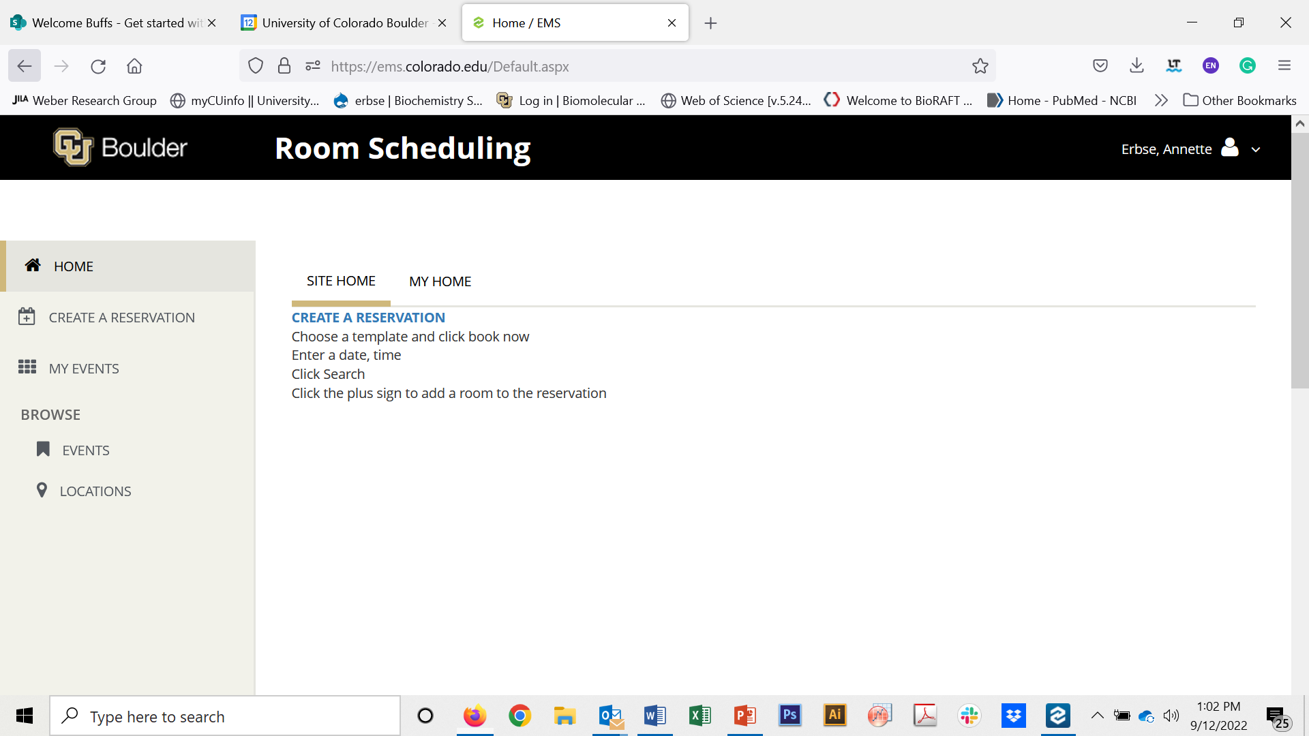
Click “Create Reservation”

Slide 4
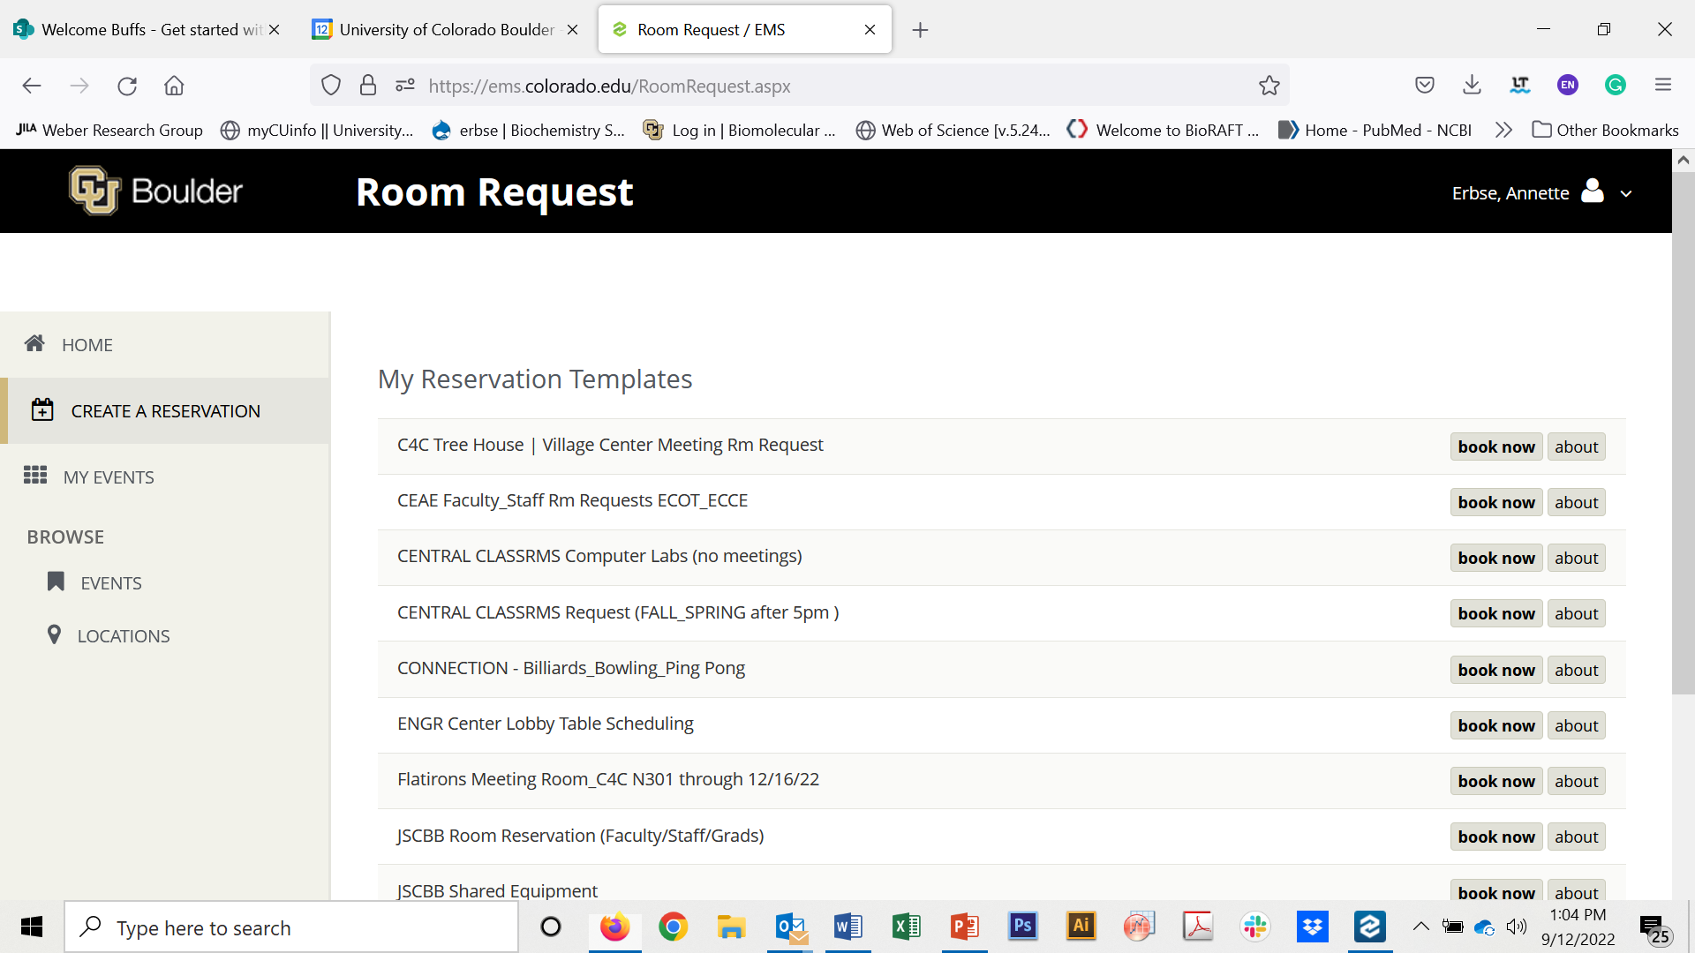
Click “Book Now” next to “JSCBB Shared Equipment”
If you can’t see JSCBB Shared Equipment in the list you have not been added to the JSCBB list yet.
Email Mariah Caba at Mariah.Caba@colorado.eduwith your Identikey (not the password) and whose lab you are in and she can manually add you to it.

Slide 5
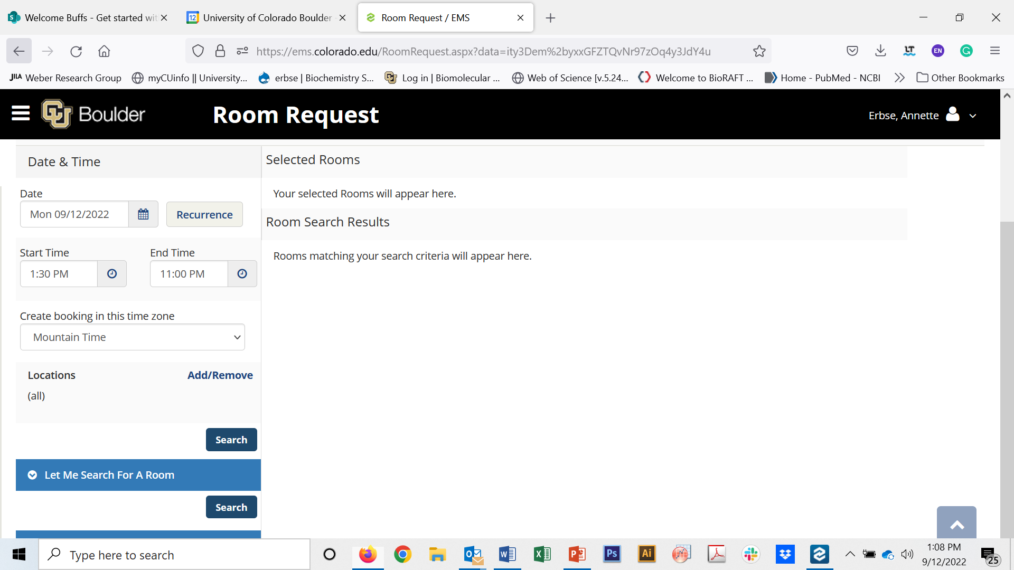
Click : “Search” above “Let me search for a room”

Slide 6
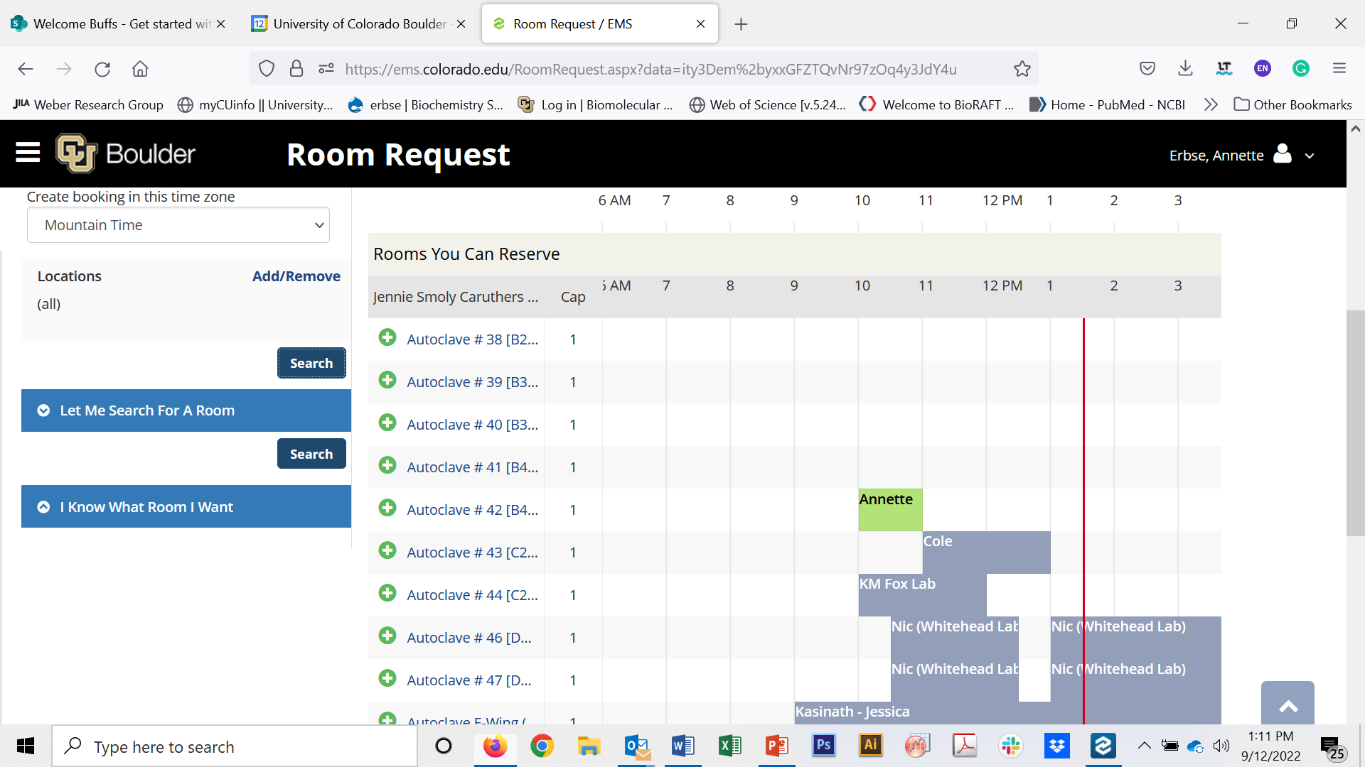
Scroll to the instrument you want to book
Click the Plus sign next to the instrument.

Slide 7
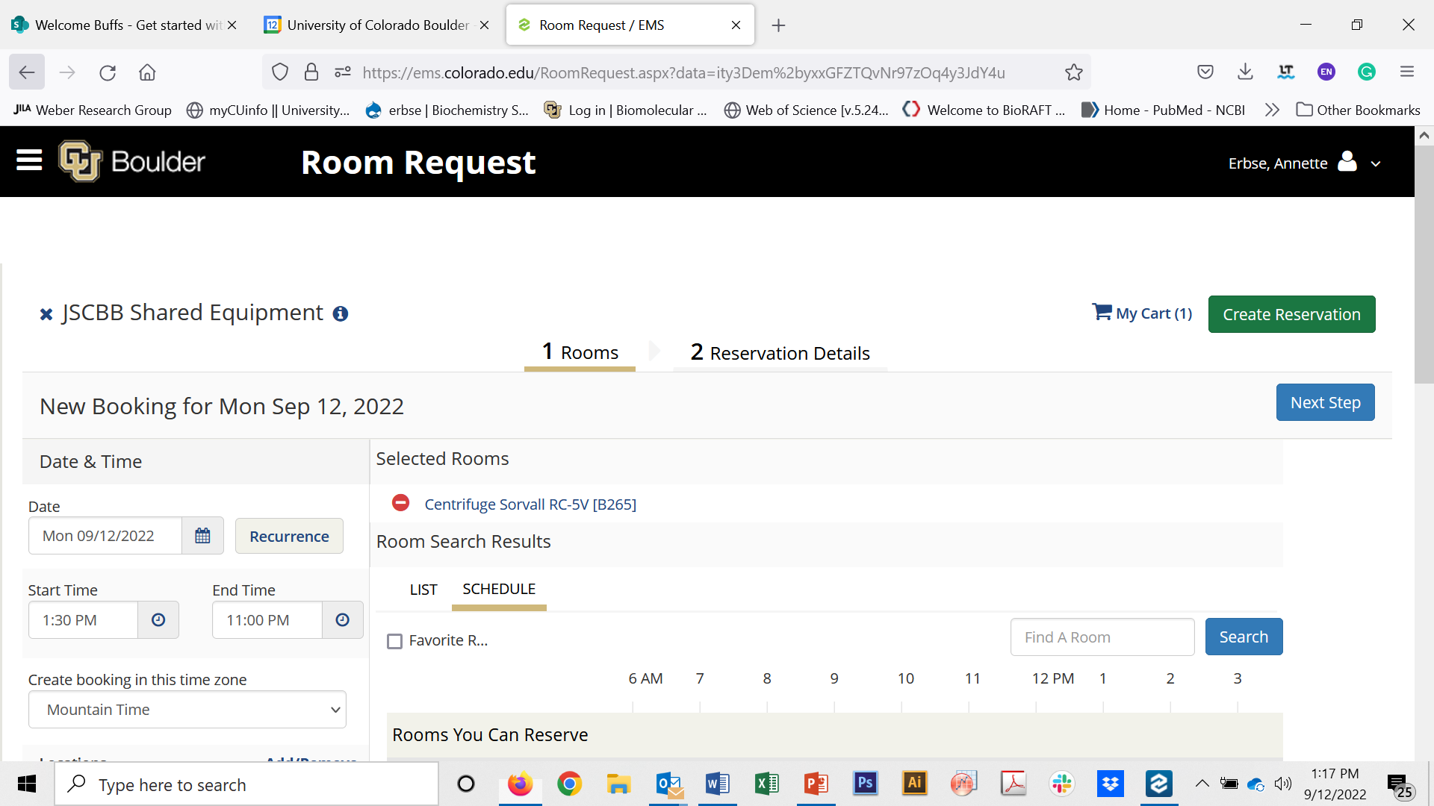
The instrument will now be listed under “Selected Rooms”
Adjust time as needed (pay attention to am/pm)
Click “Next Step”

Slide 8
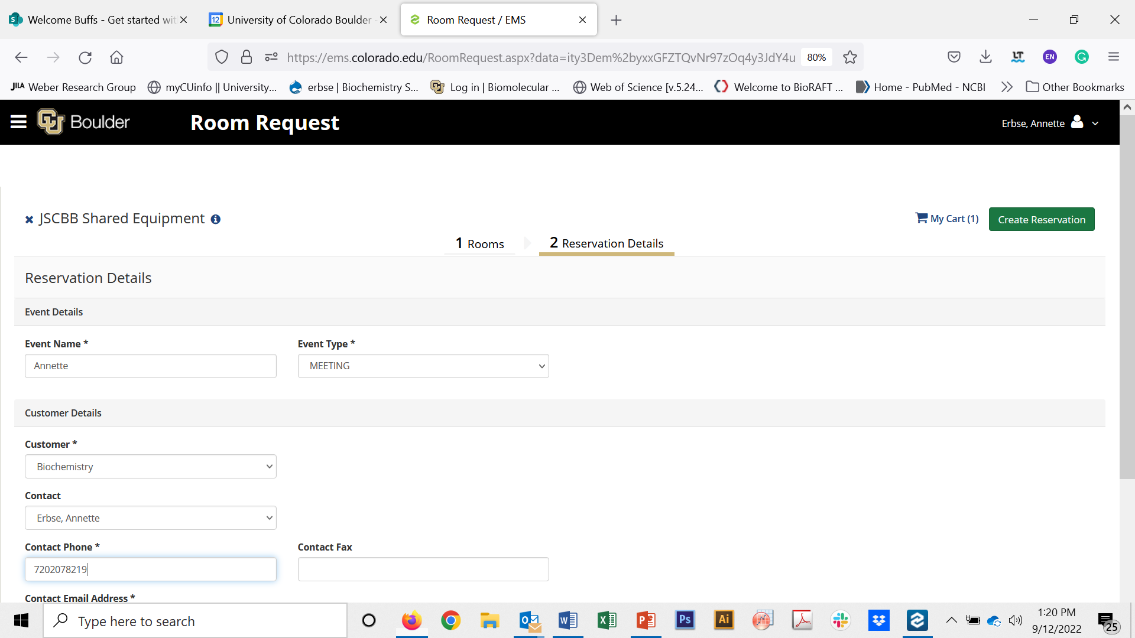
Fill in the information.
For Contact find your name in the drop-down list.

Slide 9
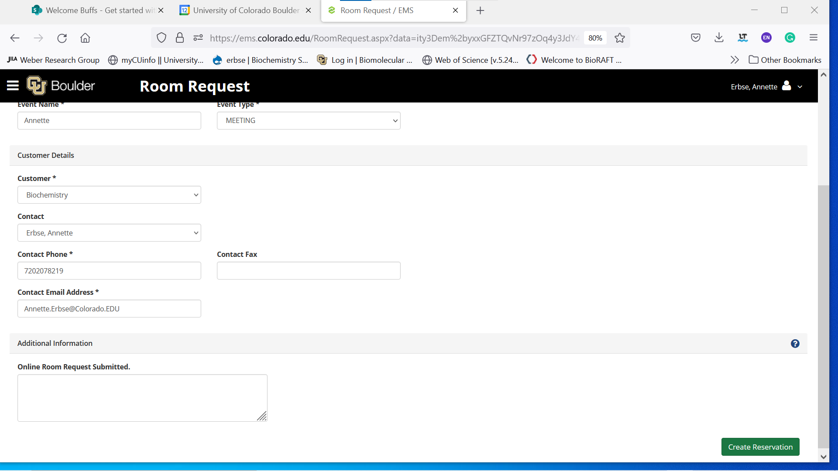
Scroll to the end of the page.
Click “Create Reservation”.

