Slide 1
Work-Life Balance Through Mindfulness: Recreate Your Work-Life Balance
Esther Horowitz, MA. LPC Candidate. FSAP Staff counselor and intake coordinator.
Bilingual Spanish/English

Slide 2
House-keeping/Logistics
You may have your videos on or off
Feel free to eat, lay down, walk around
Worksheets – hard copy or on computer
Chat for Alyssa or myself
We will have time to share our ideas/experiences out loud
5 minutes to fill out a quick evaluation of the workshop at the end

Slide 3
Faculty and Staff Assistance Program (FSAP)
Free & Confidential
Services via Telehealth
Individuals, families and couples
7 counseling sessions per rolling year (case by case)
Referral List
Bilingual Spanish/English counseling
4 female identified counselors and 1 male identified counselor. (Family will be growing soon!)
Trainings/workshops

Slide 4
Overview
Create a work-life balance that better suits your life.
Recognize what is currently working and not working
Identify changes you would like to make
Apply quick practices to better your work-life balance
- Educational
- Hands on
- Community Building
Learn some mindfulness techniques
Integration

Slide 5
What we have been told so far:
Take Breaks
Make a schedule
Stick to your schedule as much as you can (especially when living with children)
Exercise regularly
Eat healthy food
Sleep
Connect with loved ones
Go outside
Can we come up with something new together?
Lets come up with something new together

Slide 6
Bringing mindfulness into what is here today
This is a big deal!
I did not sign up for this!
Uncertainty may lead us and others to act, think, and feel in ways that may be new, old, or curious to us. – Nervous System
Yes, we are all in this together, but no one experience is the same as someone else’s.
Look at how I have come to feel a little more comfortable, and settled with life now.
Can I give myself space to just be?

Slide 7
Initial questions
Why am I here today?
What am I struggling with the most when it comes to work-life balance?
What questions do I have about work-life balance?

Slide 8
Pie Chart activity Use the circle in your worksheets to show what your work-life currently looks like

Slide 9
Values: What is important to me?
Use your worksheet to write down what is important to you.

Slide 10
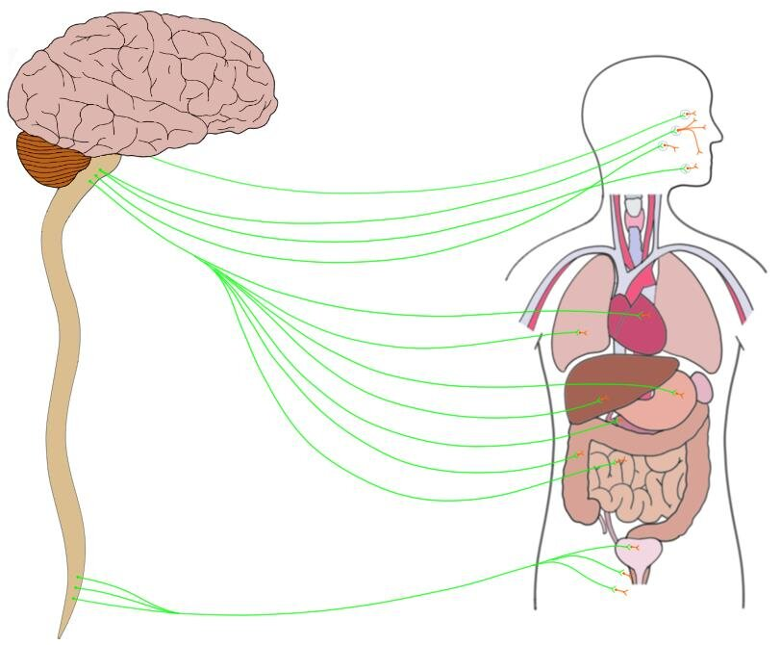
Sewing mindfulness and work-life balance:
Create a routine
Take care of your nervous system
How do I encounter the things I have to do?
Breathing
Slowing down / Movement
Mantra
Sleep
Food
Exercise
Transitions
Rest
What keeps me on my path – what brings me back to my path?
What is my path (think of values)
Will act as a container =Safety

Slide 11
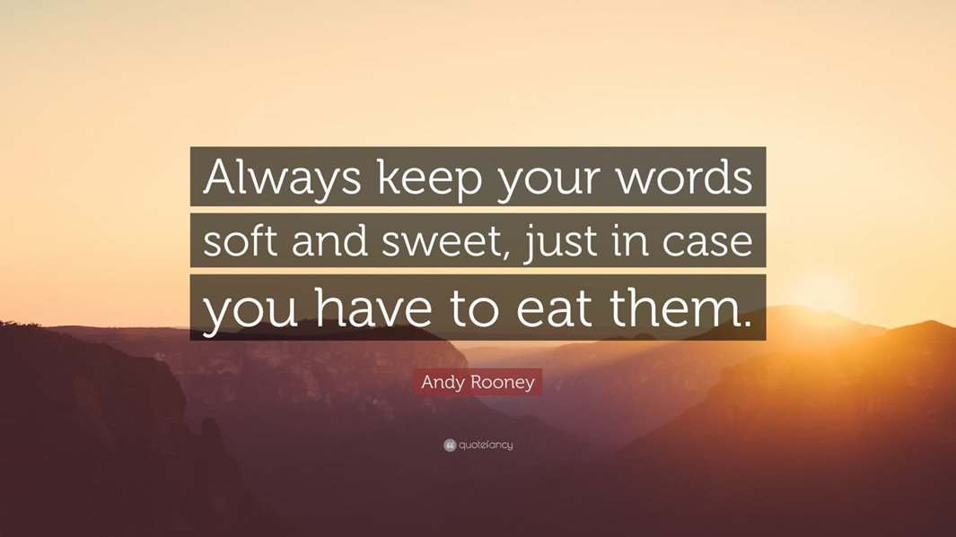
Sewing mindfulness and work-life balance:
Narrate
Acknowledge
How do I speak to myself?
Do I accompany myself? “I”, “you”, “us”
What is my intention behind this?
Who am I doing this for? – Stay curious
That I am not a robot
I am part of nature – I am organic
Bring in compassion
Ask for help
Accept help
Take time to understand and get to know what I need

Slide 12
Mindfulness exercise
Mindfulness video: https://www.youtube.com/watch?v=kO5I0p3IuiQ
Make a note of what you would like to apply to your own life
You may have your eyes open or closed, you may choose to open them at any time, or close them at any time.
You may turn your videos off.

Slide 13
What am I aware of now?
Looking back at your pie chart, notice where you would like to make changes, and what type of changes these would be.

Slide 14
IN CLOSING
Take care of your nervous system – Think in terms of safety
Create a routine that works for you (create a container that feels safe)
Communicate with yourself – accompany yourself
Practice mindfulness (soon you will catch yourself doing something mindfully)
What am I making time for? What am I not taking time for?
Observe, take mental notes, make changes, repeat
Stay curious
Work-life balance video:
https://www.youtube.com/watch?v=MPR3o6Hnf2g

Slide 15
Authors/Theories you may want to look into:
Jack Kornfield
Stephen Porges
Deepak Chopra
Clarissa Pinkola Estes
Don Miguel Ruiz
Don Miguel Ruiz Jr
Stan Tatkin
Gabor Mate
Prochaska & DiClemente’s Stages of Change
S.M.A.R.T Goals

Slide 16
ABC Me. (2018, july 7). What is mindfulness? / The mindfulness toolkit. (Video). YouTube. Https://www.Youtube.Com/watch?App=desktop&v=ko5i0p3iuiq The School of Life. (2015). Work-Life Balance. (Video). YouTube. https://www.youtube.com/watch?app=desktop&v=MPR3o6Hnf2g

Slide 17
Thank You!
Esther.Horowitz@Colorado.edu
fsapintake@Colorado.edu

