Slide 1
BAM Program Information
Ginny McNellis and Jen Shurley
The Graduate School
Amber Maneth
Office of the Registrar
Visit website:
https://www.colorado.edu/registrar/students/degree-planning/bam-program
Notes:
Ginny

Slide 2
Bachelor’s-Accelerated Master’s (BAM) Programs
Approved combination between an existing and approved bachelor’s degree at CU Boulder and an existing and approved master’s degree at CU Boulder
Beneficial pathway to graduate school, logistically and financially
Structure has changed since inception in the late 90s from “Concurrent” to “Bachelor’s-Accelerated Master’s”
Notes:
What are BAM programs? Xxxx Structur has changed since inception… I mention this only because students during that time were subject to different polices, processes, procedure. You may receive queries from past students or see transcripts of BAM students that appear different.

Slide 3
BAM Basics
Students are admitted around the junior year
Admitted at UG status, UG policies and standards apply
Students may take up to 12 credits while at UG status which can be used toward the master’s degree
A limited number of those credits can be double counted between both degrees
The bachelor’s degree is awarded upon completion of requirements
Students finish master’s degree requirements at graduate status, GR policies and standards apply
Identified with R09 service indicator and subplan (C-XXXX)

Slide 4
Applying to a BAM Program
Students apply with BAM intent application around the junior year
Student initiated OnBase form
Students provide expected graduation term for bachelor’s degree
Form directed to program in OnBase workflow for review and approval
Basic requirements enforced (3.0 GPA), students can attach any documentation required by program
Program decision for full BAM program at this point
ISSS approval is required for international students
Upon approval/processing- subplan, service indicator, expected bachelor’s grad term applied to record

Slide 5
Change from Undergraduate to Graduate Status
Early in the semester in which bachelor’s degree requirements are complete, students must:
Apply to graduate with bachelor’s degree in Buff Portal
Complete the master’s continuation form
Work with advisors to complete BAM supplement form
Notes:
February 1, March 1, October 1

Slide 6
Master’s Continuation Form Details
Student initiated Slate form, student will:
Identify current undergraduate and anticipated graduate program
Identify bachelor’s degree graduation term
Identify master’s degree start term- must be within 3 semesters
ISSS approval required for international students, including proof of funding for change of level
No department review at this stage, 3.0 GPA requirement enforced
Notes:
So, if graduate May 2023 with Bachelor’s, can start Summer 23, Fall 23, or Spring 22. So no Leave of Absence between but can select start term within 3 semester timeframe of LoA
Query can be run to view student submissions

Slide 7
Master’s Continuation Form Matriculation Issues
Select correct term of UG graduation and correct master’s start term
Graduation term: Must select semester of UG degree award and apply to graduate for corresponding semester in Buff Portal
Start term: Must select the semester they plan to take first master’s class (summer if applicable [including Augmester])
Must then register in selected start term (including summer), to avoid discontinuation
If plan for graduation or continuation changes, student must re-submit form (and reapply to graduate if applicable)
Select the graduate program to which initially admitted
Must select correct current UG program and the corresponding master’s program approved in intent application
Selecting different master’s program creates a mismatch in codes
Any change to plan should be discussed with the program and updated accordingly
change to subplan code at UG level
change in plan and subplan after advancement to graduate status

Slide 8
BAM Supplement Form Details
Student initiated OnBase form
Used to identify courses being used toward master’s degree and those being double counted toward both degrees
Graduate courses taken at UG status will populate on form for selection
Undergraduate advisor and graduate program assistant must approve
Form stored in student’s OnBase record for future review
Degree Audit Team uses approved form to make exceptions in audits
Reminder: careful planning for the 12 graduate credits/double counting credits and advancement to graduate status is essential

Slide 9
Status and Financial Information
At undergraduate status, prior to receiving bachelor’s degree and beginning master’s program:
Students are assessed undergraduate tuition rates
Students are eligible for financial aid at the undergraduate level
Students are eligible for undergraduate scholarships/grants etc.
At graduate status, after beginning the master’s program:
Students are assessed graduate tuition rates
In-state students are assessed resident graduate tuition but do not receive COF
Students are eligible to hold graduate level appointments (TA/RA)
Students are eligible for different types of financial aid (primarily offered student loans)
Students are eligible for graduate scholarships/grants etc.

Slide 10
Update BAM Program Status
BAM program change/discontinuation form available for students at undergraduate status who need to:
Change expected bachelor’s degree graduation term
Discontinue their BAM program and leave with the bachelor’s degree
Students at graduate status with one completed semester may participate in Leave of Absence as usual
Students at graduate status should withdraw per the normal withdraw process

Slide 11
How to view BAM Student Forms
Intent form, BAM supplement form, BAM program change form (out of workflow):
View in student’s OnBase file through Campus Solutions
On the student services admin view page, student center tab, right click the SID
Select “search DMO all student docs”
Review the list of documents and select BAM docs to open in new window
Master’s Continuation form:
Use Query built-in Slate (see administrator guide on faculty/staff facing BAM site)
Reach out to Jen with any requests or questions about the Slate query

Slide 12
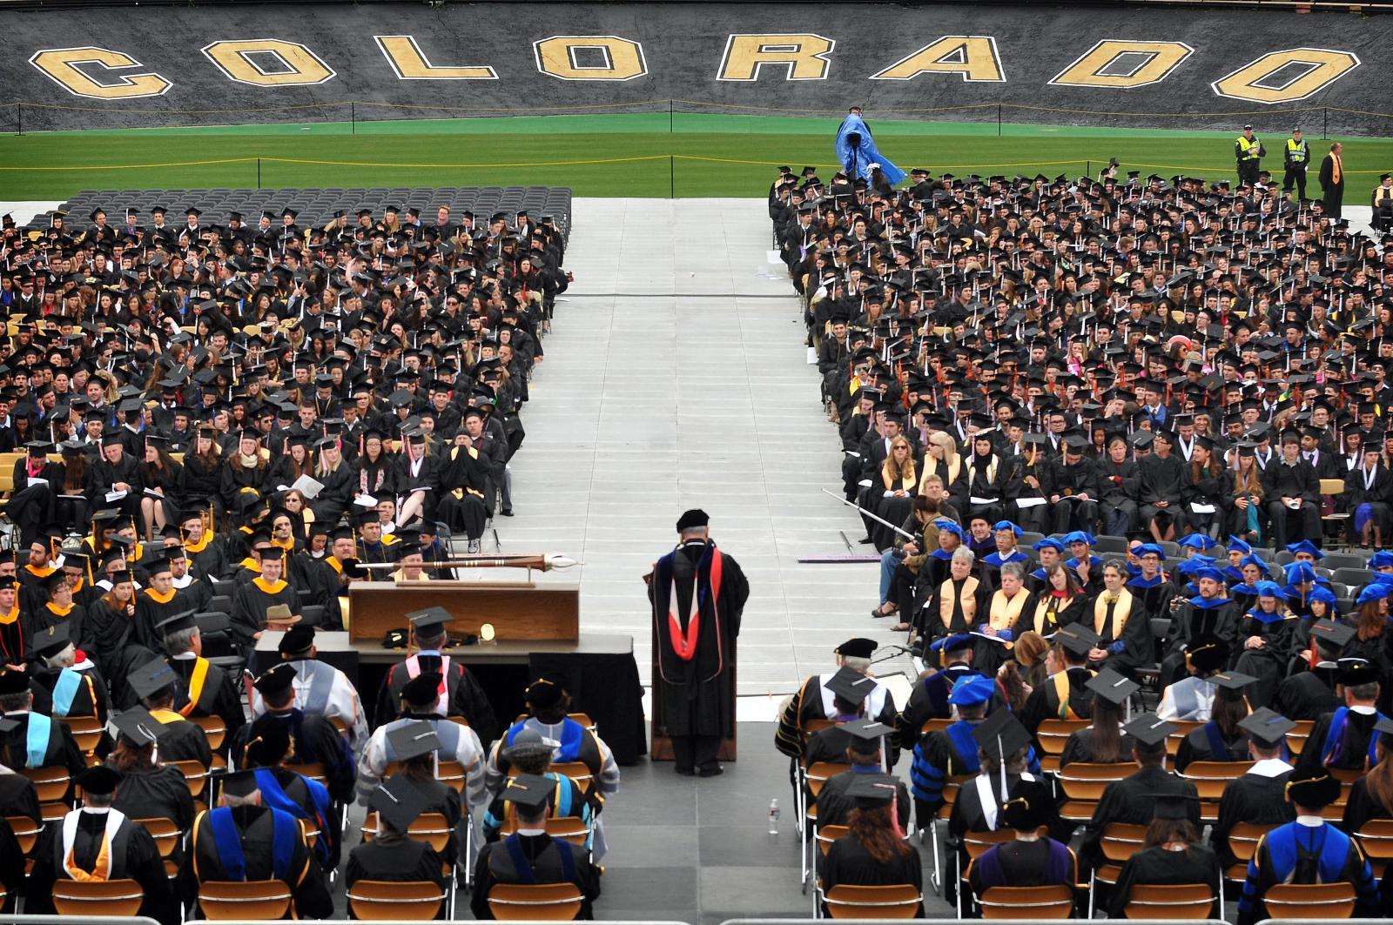
Helpful BAM Resources
Student facing BAM website
Information and forms to apply, change status, withdraw
Faculty/Staff facing BAM website
Forms, policies, recently updated FAQs
Resources section includes administrator guides
BAM report available through CU Data
Join the BAM google group
Contacts: Jennifer.Shurley@colorado.edu, cubamprogram@colorado.edu

Slide 13
Questions?

