Slide 1
Career Planning 101
How to prepare early on
Dr. sarah tynen
The graduate school

Slide 2

The Professor Is In
Dr. Karen Kelsky
Buy her book!
Read her blog!

Slide 3
4 major tasks
Networking
Skill-building, especially technical skills (e.g., coding, GIS)
Publishing
Grant writing

Slide 4
Dr. Karen’s advice
From pages 55-56 in her book, The Professor Is In
Attend conferences
Read the job ads in your field
Maintain your CV
Apply for grants
Seek mentors widely
Strategize your writing projects to ensure your own first-authored publication by the time you go on the job market.

Slide 5
Six attributes of a tenure track candidate
Productivity: Major publications
Professionalism: How carry and present yourself
Autonomy: You have your own projects
Self-Promotion: You have connections outside your PhD institution
Collegiality: Good inter-personal skills
A plan: You have a 5-year plan

Slide 6
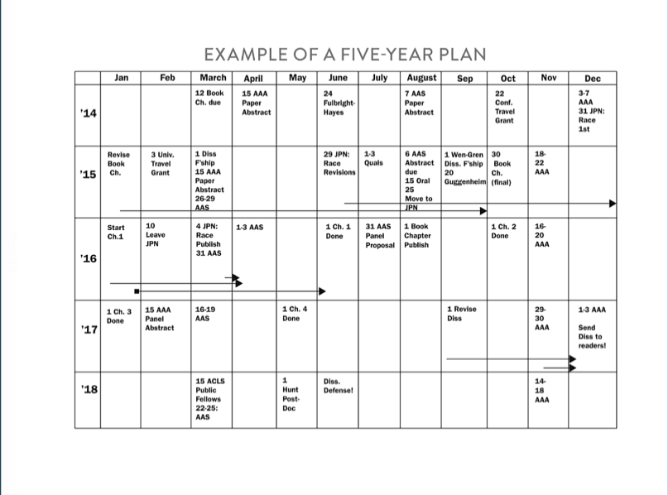

Slide 7
Questions?

