Slide 1
One week.
One prize.
Seven really weird challenges.
Source: Control Freaks book jacket
This Book Introduction developed by B. Dalton for CU Boulder’s Children’s Book Festival 2023, Open Education Resource, Creative Commons. Available colorado.edu/event/bookfest

Slide 2
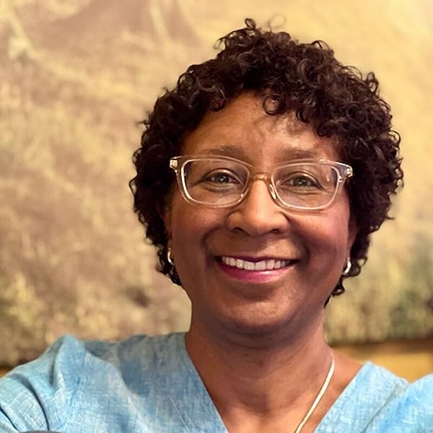
By Colorado author
J.E. Thomas!
Did you know that Thomas grew up in Colorado?
She wrote Control Freaks while working at the same school she attended as a child.
Thomas has met almost all of the Star Wars actors!
Book Jacket Info
“J.E. Thomas grew up near Colorado’s Front Range mountains. She spent her early summers stuffing grocery bags with books at the local library, reading feverishly, then repeating the process week after week. J.E has bachelor’s degrees in Mass Communication and Political Science, as well as a master’s degree in Public Communications. She wrote Control Freaks while working as an administrator at the same independent school she attended as a child. “

Slide 3
Photos of book jacket introduction

Slide 4
Meet Doug and his Team of Misfits
Will Doug succeed in turning this team of misfits into winners of the steam competition?
What is a misfit, anyway? Do misfits have special talents and superpowers?

Slide 5
The Team: TravLiUeyPadgeZezz
Frederick Douglass Zezzmer
Huey Linkmeyer
Padgett Babineaux
Travis Elizabeth Cod (The Shark)
Liam Murphy

Slide 6
Frederick Douglass Zezzmer
7th grader
Desperate to attend GadgetCon
Has a 57-step strategy to become World’s Greatest Inventor
Lives with Mom and Stepdad; afraid his famous athlete Pops will make him go to sports summer camp
Leader (sometimes) of the team

Slide 7
Huey Linkmeyer
7th grader
Amazing card trick player
Best friends with Doug
Lives in a complicated parents situation
Panics at the big finish – suffers from stage fright
Tries to live by Grandpa’s advice: “Jest beats stress!”

Slide 8
Travis Elizabeth Cod (AKA The Shark)
“I AM
An
Astronaut-in-training”
“BUT I keep getting rejected from space camp!!!!
They tell me my
body is too small to be with big kids
brain is too big to be with little kids…
I don’t work well in teams”
6th grader
“I’m going to use this stupid STEAMS competition to prove that I do know how to work in teams…even if I have to drag them…”
Mom died of COVID. Doesn’t want to talk about it
Quotes: p 85-89, Control Freaks

Slide 9
Padget Babineaux
8th grader
Creative technology wizard who sometimes gets into trouble hacking
Very quiet
Takes care of her Grammy…even during school by sending her reminder text messages

Slide 10
Liam Murphy
8th grader
Athlete who sometimes stumbles, fumbles and bumbles
Trying to figure out his best sport so he can be a winner

Slide 11
You’ve met the team. Make a prediction: How will they do on these challenges?
Challenge 1: Create team name that expresses something important about your group
Challenge 2: Fill a balloon with water and make a device to transport the balloon across the pond
Challenge 3: Solve Stump ‘Em logic word problems
Challeng 4: Find coding error, solve it to unlock door padlock
Challenge 5: Run obstacle course
If you could join the team for one challenge, which one would you choose? Why?

Slide 12
Reading Options
Start at page 1 and go full blast to the end
If time is a crunch, share the reading –
Each person reads a chapter or two and does a retelling for the class (in sequence).
Form book groups and each group focuses on reading one of the challenges to retell to the class. Have one group do an opening and one group do the closing.
Make your retelling lively for the class, and include some fun questions and things to think about…maybe try out a challenge or design a new challenge!

