Slide 1
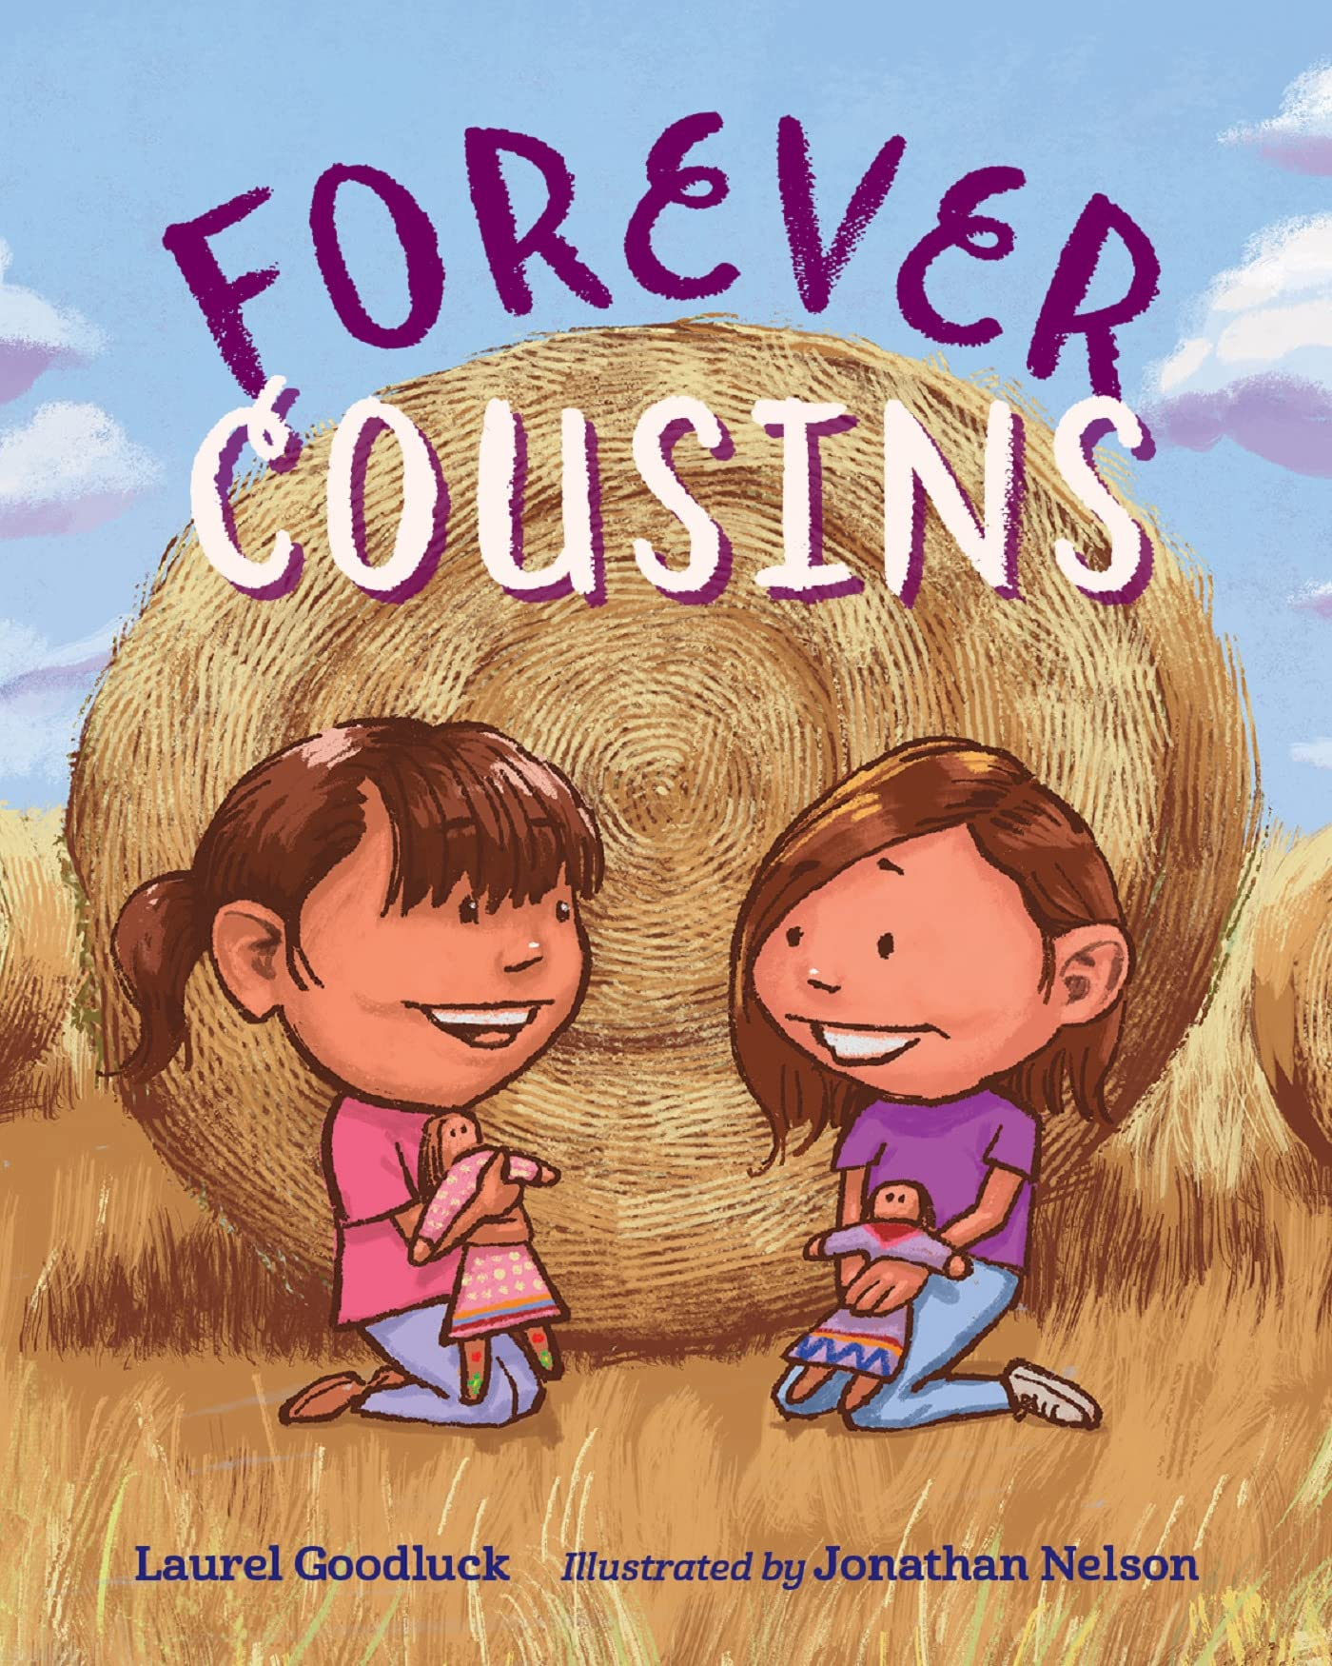
Book Discussion Guide by Mia Bost and Kayleigh Webb, for the University of Colorado Boulder’s Children’s Book Festival 2022, Open Education Resource, Creative Commons. Available colorado.edu/event/bookfest
Suggested Audience: Grades K-2nd Grade (4-7 years old)
About the Book:
Two Native American cousins, Amanda and Kara, grew up together doing everything with each other. They would share laughs, cries, and their dolls. One day, when Kara moves away from the city to the Reservation (the Rez), they have to learn how to love each other from afar, with some challenges along the way. When they meet again, they feel only nerves–until one moment brings them together and helps them learn how to continue their strong love from a distance.
Forever Cousins
By: Laurel Goodluck
Illustrator: Jonathan Nelson
Publication October 4th, 2022

Slide 2
Discussion Questions:
1. In Forever Cousins, Amanda and Kara have different favorite colors, even though they share so many favorite things. What is your favorite color? Why is it important to you?
2. Have you ever had a doll or another object that has a special meaning to you? If so, what is it?
3. In the story, both Kara and Amanda go on long car journeys. Have you ever been on a road trip? If so, where and what was it like?
4. Has your best friend ever moved away? If so, how did you cope with that change?
5. What was your favorite part of the book? Why?
6. Before Amanda and Kara met again, they were extremely nervous. Do you think you would have been just as nervous as both Amanda and Kara? What do you do when you're nervous?
7. Did you like the illistruations the author used? Which page stood out to you most?
Look at the last page of the book. How do you think Forrest feels? How do the illustrations show the family in the book?
Did the pictures make you feel a certain way?
How did you like the colors that were used?

Slide 3
Extension Activity
In-class activity: ask the students what their favorite doll is and why; have students could share with the class. Then give students a piece of paper and to draw their favorite doll and share it with the class. Hang the drawings on the classroom walls!
At home: have a student write a letter to someone they miss or someone they love that they haven’t seen in a while. This letter could also contain photos to show what they have been doing.
A project a teacher could assign is assigning two students together and at home these students would draw their favorite doll and write why it is and why they wanted to draw that specific doll and when it is due the students would switch their drawings.

