Slide 1
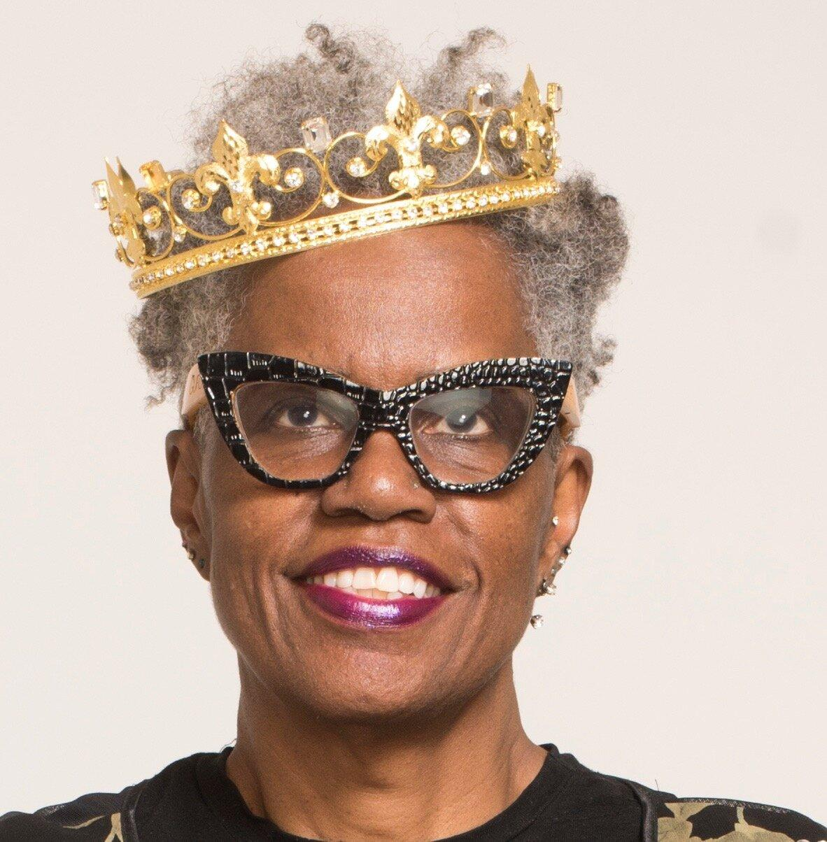
Authors guide
Tricia Elam Walker
Author of Nana Akua Goes to School
2
1
Created by: Maddie Seesdorf & Elizabeth Etzler

Slide 2
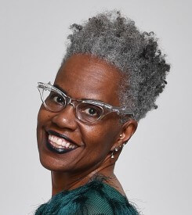
About the Author
Tricia Elam Walker is an-award winning author, attorney, and educator. Tricia is from MA and received her J.D. from Northeastern University School of Law and her MFA from University of Maryland. She is an Assistant Professor of Creative Writing at Howard University in Washington D.C. She published her first book in 2001 titled Breathing Room, has one picture book titled Nana Akua Goes to School. She has a new picture book coming out in November titled Dream Street. 3
4

Slide 3
“I’m interested in writing about difficult topics for children because while the voice and language must be different from adult books, all children don’t have easy lives and we can’t forget them.” - Tricia Elam Walker 5 https://www.scbwi.org/members-public/tricia-elamwalker

Slide 4
Tricia talks about the reality of many children’s lives across the world. Many children struggle with race, culture, and identity, Tricia’s goal is for these children to know they are not going through the struggles they may be encountering alone. Tricia Elam Walker felt she wanted to challenge all children’s books out there by writing stories children will relate to about difficult topics they may face every day.

Slide 5
Interview with the Author 6
In this interview with Tricia Elam Walker and DC Public Library discusses a virtual talk that included passages from Nana Akua Goes to School, discusses major themes, and has a conversation about children’s literature.
3:58-15:00
Read aloud of Nana Akua Goes To School
18:30-20:17
How and why Tricia wrote Nana Akua Goes To School
30:45- 32:17
Renee a co presenter on the interview call discusses a powerful scene in the book Nana Akua Goes to School and the meaning behind it

Slide 6
Awards & Appearances
Tricia won the writer award for 2021 Ezra Jack Keats award (award is shown in photo on the cover of the book) 7
“Her work has appeared in The Washington Post, The Baltimore Sun, Essence and other publications. She has provided commentary for NPR, CNN, the BBC and more. Tricia’s short stories are included in the O.Henry Prize Stories, New Stories from the South and other anthologies and her essays are published in Father’s Songs, Dream Me Home Safely, It’s All About Love and more.” 8
12

Slide 7
Nana Akua Goes to School
Written as her second book, Tricia writes Nana Akua Goes to School in celebration of cultural diversity (celebrating people from different backgrounds). A shy girl brings her West-African grandmother--whose face holds markings from her ancient tribal customs--to meet her classmates. This is a beautifully written story about African-American culture and history.
11

Slide 8
Tricia’s Other Books...

Slide 9
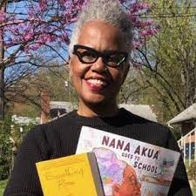
Nana Akua Goes To School + Breathing Room
Tricia Elam Walker has published two books, Nana Akua Goes To School and Breathing Room.
13

Slide 10
New book- Dream Street
Tricia has her third book coming out in November, Dream Street.
10

Slide 11
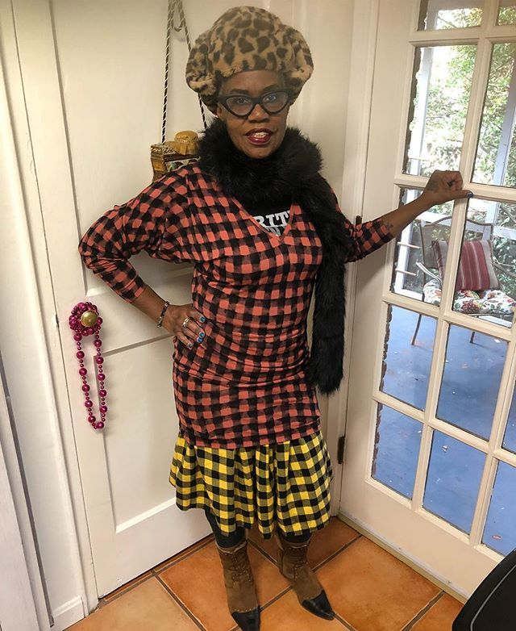
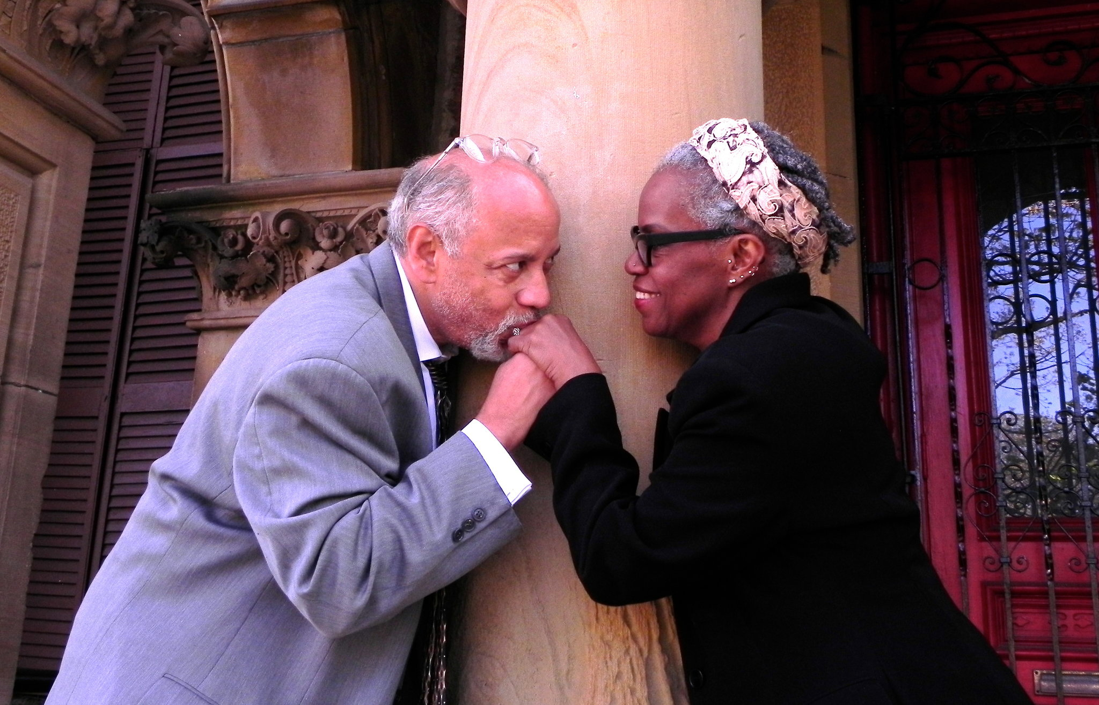
Fun Facts
Currently, you can find Tricia home working on short stories, essays, children's books, and plays.
Tricia has her own blog: blackpumpsnotebook.com
Has three adult children
Lives with her husband in Maryland
8
9

Slide 12
Sources
1,3,8:https://www.triciaelamwalker.com/
2: https://images-na.ssl-images-amazon.com/images/I/A17XazZT6rL.jpg
4:https://www.google.com/url?sa=i&url=https%3A%2F%2Fprofiles.howard.edu%2Fprofile%2F45891%2Fpatricia-elamwalker&psig=AOvVaw3aqRmkT0rFbw02gS5iN1Xy&ust=1633554990016000&source=images&cd=vfe&ved=0CAsQjRxqFwoTCMjovdmYtPMCFQAAAAAdAAAAABAD
5: https://www.scbwi.org/members-public/tricia-elamwalker
6: https://www.youtube.com/watch?v=w9M4fHLLQlY
7: https://www.slj.com/?detailStory=tricia-elam-walker-and-heidi-woodward-sheffield-win-ezra-jack-keats-awards
8:https://www.google.com/url?sa=i&url=https%3A%2F%2Ftwitter.com%2Ftriciabreathing%2Fstatus%2F1072925619976065026&psig=AOvVaw1nScydUJDBfBw9ffel7XmG&ust=1633726046157000&source=images&cd=vfe&ved=0CAsQjRxqFwoTCNiOqfiVufMCFQAAAAAdAAAAABAD
9:https://www.google.com/url?sa=i&url=https%3A%2F%2Fwww.nytimes.com%2F2013%2F05%2F12%2Ffashion%2Fweddings%2Fpatricia-elam-charles-walker-weddings.html&psig=AOvVaw1YZMt-moIT4qKzDvKOQGXk&ust=1634763291763000&source=images&cd=vfe&ved=0CAsQjRxqFwoTCLDkyf2t1_MCFQAAAAAdAAAAABAD
10:https://www.google.com/url?sa=i&url=https%3A%2F%2Fwww.amazon.com%2FDream-Street-Tricia-Elam-Walker%2Fdp%2F0525581111&psig=AOvVaw011igKUkOf8jQzF4MNzrwx&ust=1634764621535000&source=images&cd=vfe&ved=0CAsQjRxqFwoTCMjpgPey1_MCFQAAAAAdAAAAABAD
11: https://books.google.com/books/about/Nana_Akua_Goes_to_School.html?id=sOO3DwAAQBAJ&source=kp_book_description
12: https://www.ezra-jack-keats.org/ejk-awards/2021-ejk-award-winners/
13:https://www.google.com/url?sa=i&url=https%3A%2F%2Fwww.worldtribune.org%2F2021%2F04%2Fdreaming-big%2F&psig=AOvVaw2LrRu_37_UPAtYB19OHKnJ&ust=1634764899914000&source=images&cd=vfe&ved=0CAsQjRxqFwoTCPCTn_uz1_MCFQAAAAAdAAAAABAE

