Slide 1
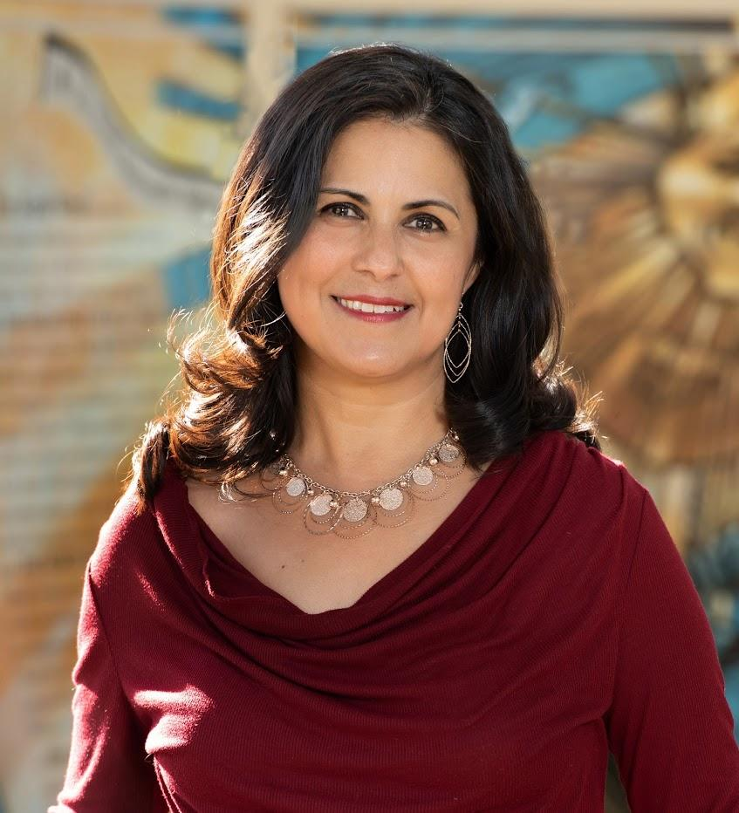
Alda P. Dobbs
Prepared by: Meghan and Iliana
Open Education Resource created for CU Boulder’s Children’s Book Festival, 2022. Available https://www.colorado.edu/event/bookfest/

Slide 2
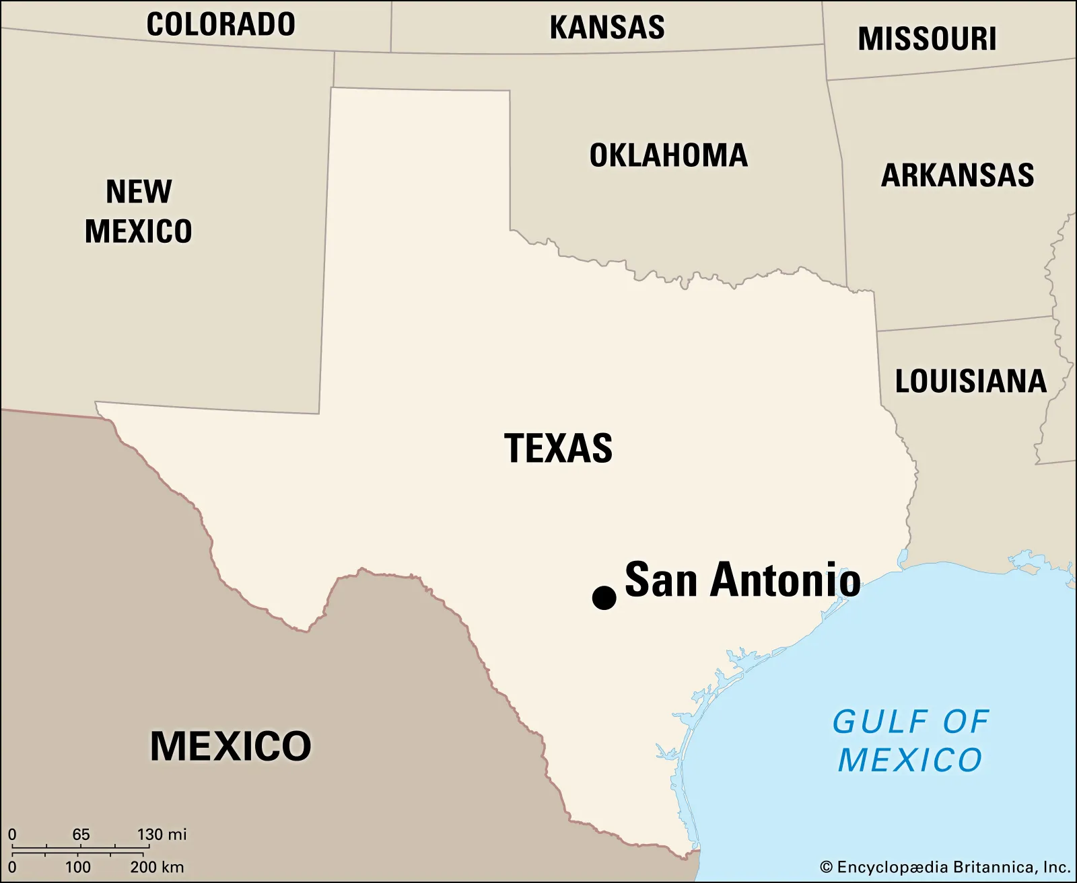
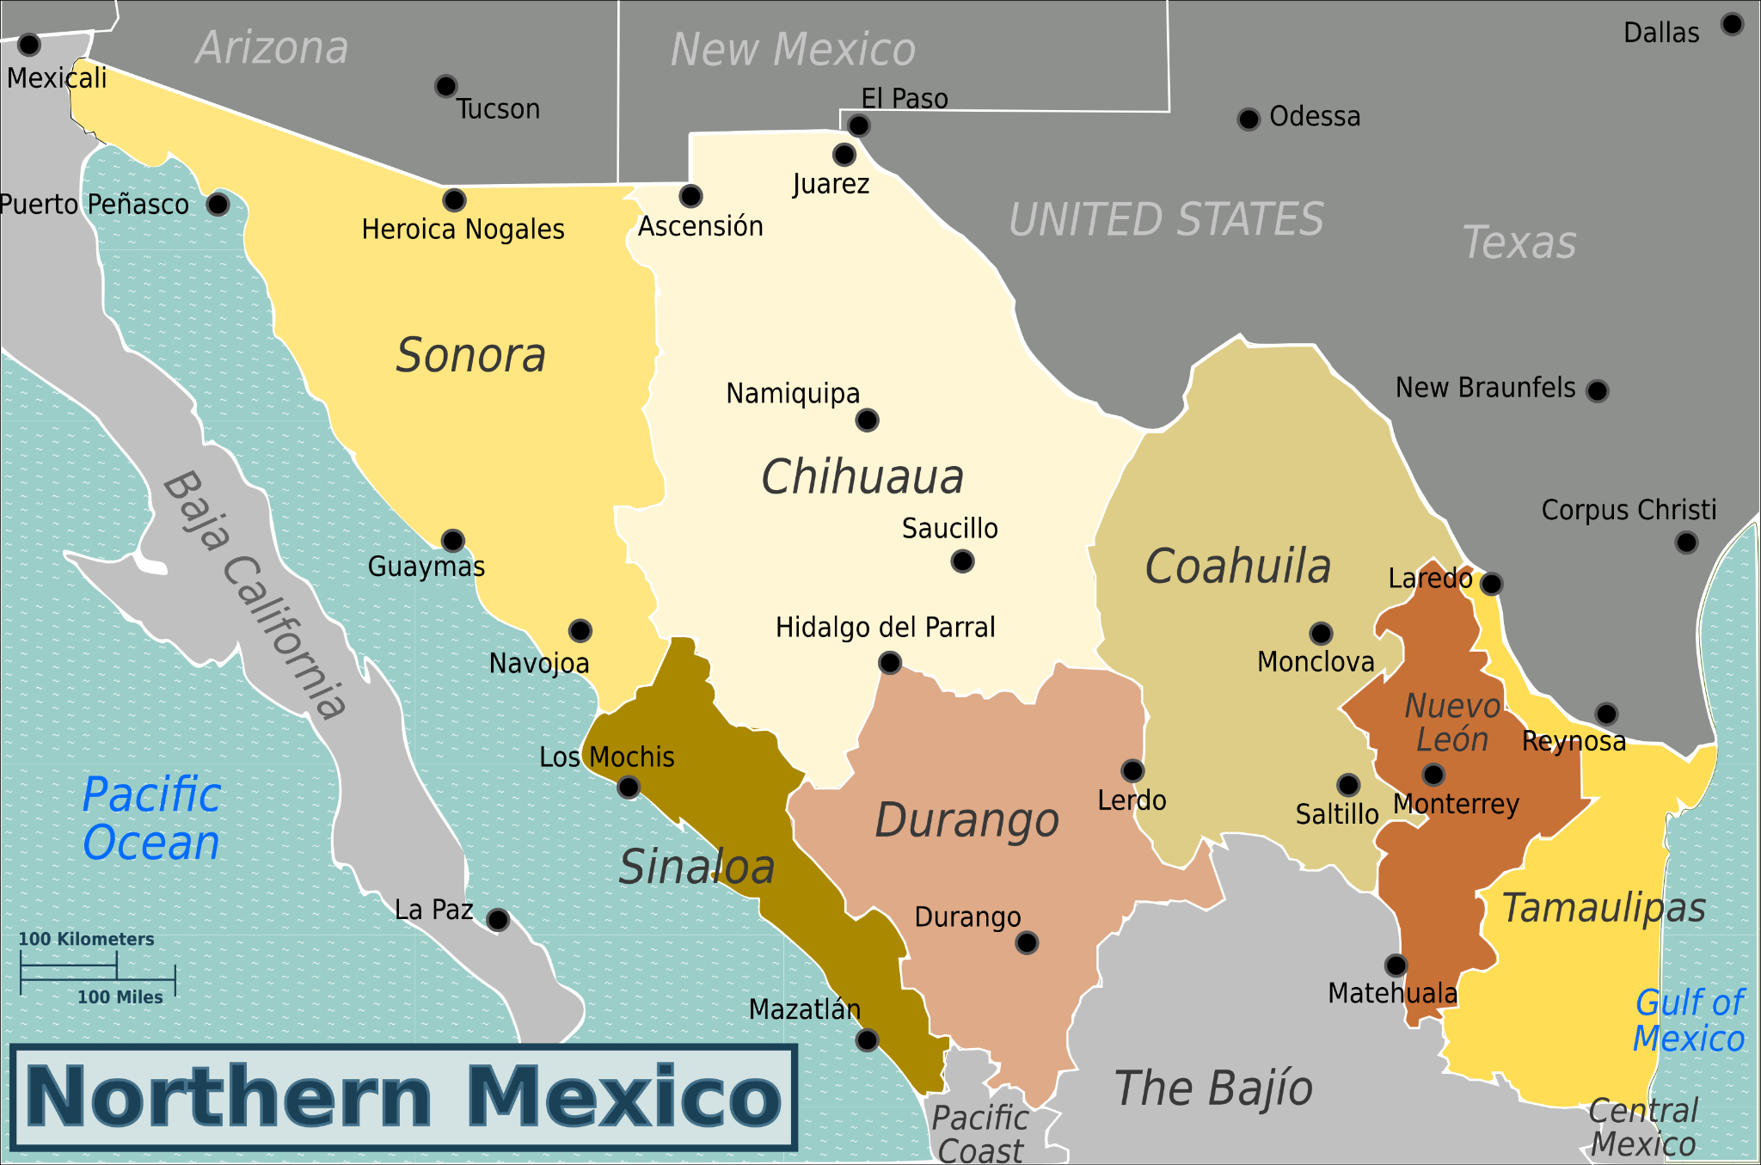
About the Author
Alda was born in a small down in northern Mexico but moved to San Antonio, Texas.
Before starting her writing career Dobbs …
Served in the US Air Force
Studied physics
Worked as a civil engineer.
Why Dobs started writing…
“She’s as passionate about connecting children to their past, their communities, different cultures and nature as she is about writing” (do2010.com, 2020)

Slide 3
Summary
After escaping the Federales at 12 years old, Petra has to navigate leaving her extended family and home in Mexico. Petra has to support her abuelita, little sister and baby brother, on their journey to San Antonio, Texas. Along the way Petra has to lead her family through a refugee camp with a case of smallpox. With a ton of hard work Petra manganes to help her family finally reach San Antonio. Feeling excited for the new city Petra is hit with the harsh reality of what it is like to be an immigrant in America.

Slide 4
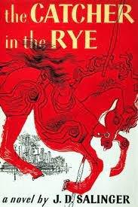
Fun Facts
01.
02.
03.
Alda P. Dobbs didn’t start speaking until she was 4 years old.
Alda was a STEM major in college and worked in physics and engineering prior to becoming a storyteller; however, her desire to tell stories was still present during this time of her life.
English was Alda P. Dobbs’s second language. She had a very rocky relationship with learning English that influenced her to rebel against it. It wasn’t until she found the book Catcher in the Rye, by J.D. Salinger, that her urge to tell her stories was ignited. (KidLitt411, 2021)

Slide 5
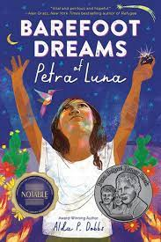
Awards Won
Award
1
2
Award
In 2022, Alda P. Dobbs was the recipient of the Pura Belpré Award.The Pura Belpré Award is a recognition presented to a Latino or Latina author and illustrator whose work best portrays the Latinx cultural experience in a work of literature for children or youth.
Her story telling earned her the awards “Barbara Deming Memorial Fund Award, the Joan Lowry Nixon Award, and the Sustainable Arts Foundation Grant.”

Slide 6
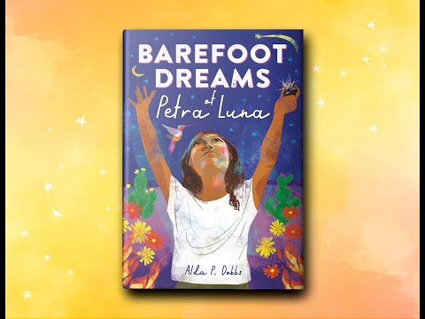
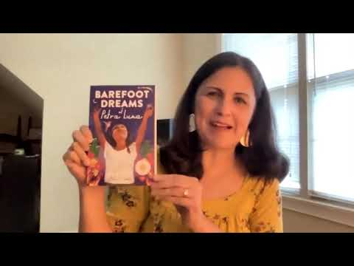
Interviews with Alba P. Dobbs

Slide 7
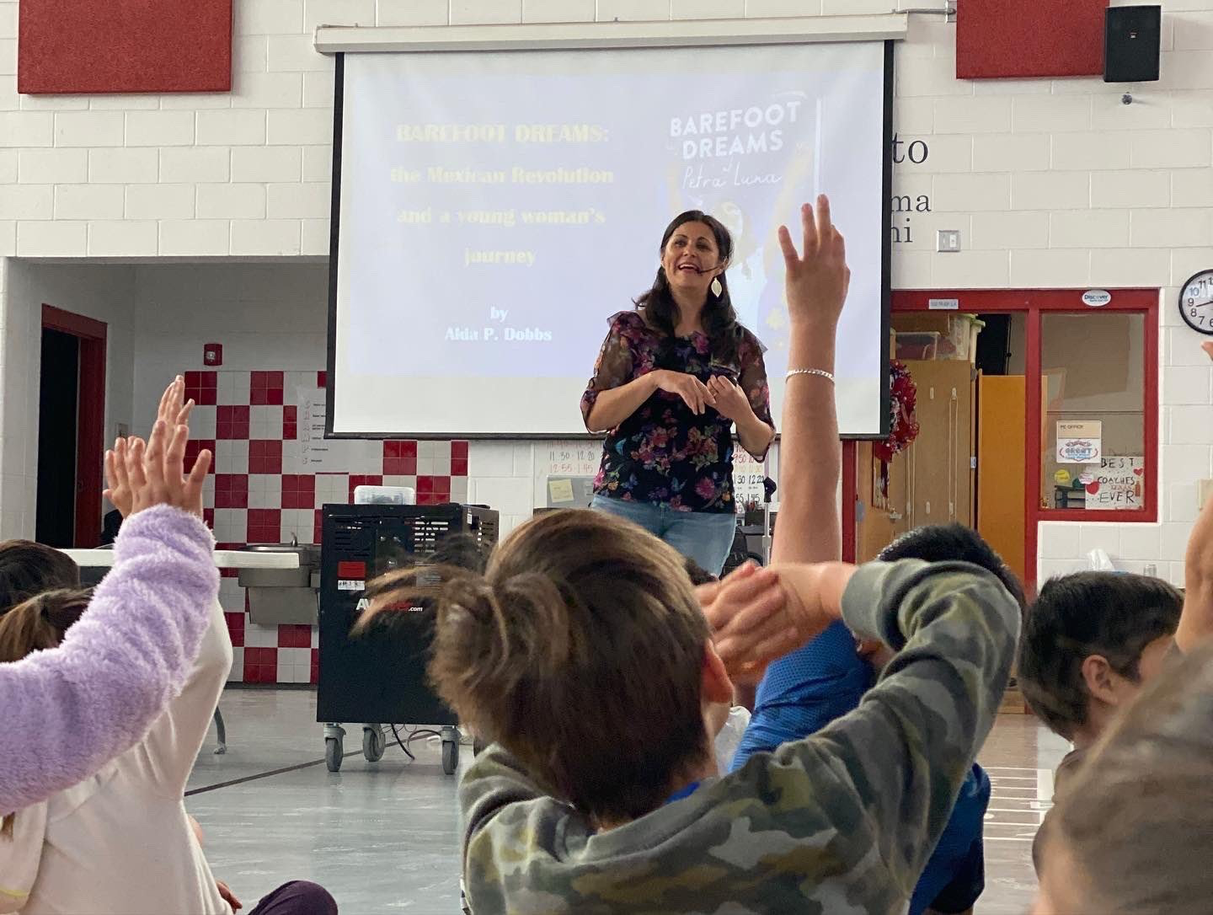
—Alda P. Dobbs
"
“What advice would you give to your younger self? Is this the same you'd give to aspiring authors?
I’d say to be patient with yourself. Understand that writing takes time to learn, and the publishing business is not a swift one. Hang in there. But also keep in mind that once the contract is signed, things move VERY fast.” (Alda P. Dobbs, KidLit411)
"

Slide 8
To learn more about Alda P. Dobbs visit https://www.aldapdobbs.com/

Slide 9
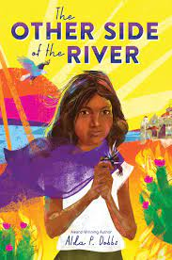
Sources
https://www.aldapdobbs.com/about
https://static1.squarespace.com/static/5eb716e0863bca1e3322510f/t/5fd64e8dd654060362c4dd7b/1607880334185/BIO.pdf
http://www.kidlit411.com/2021/08/Kidlit411-author-Alda-P-Dobbs.html
1504216812-1504216812_goodreads_misc.png
Northern_Mexico_WV_map_PNG.png
San-Antonio-Texas.jpg
9.jpg
-vector-id1146540178

