Slide 1
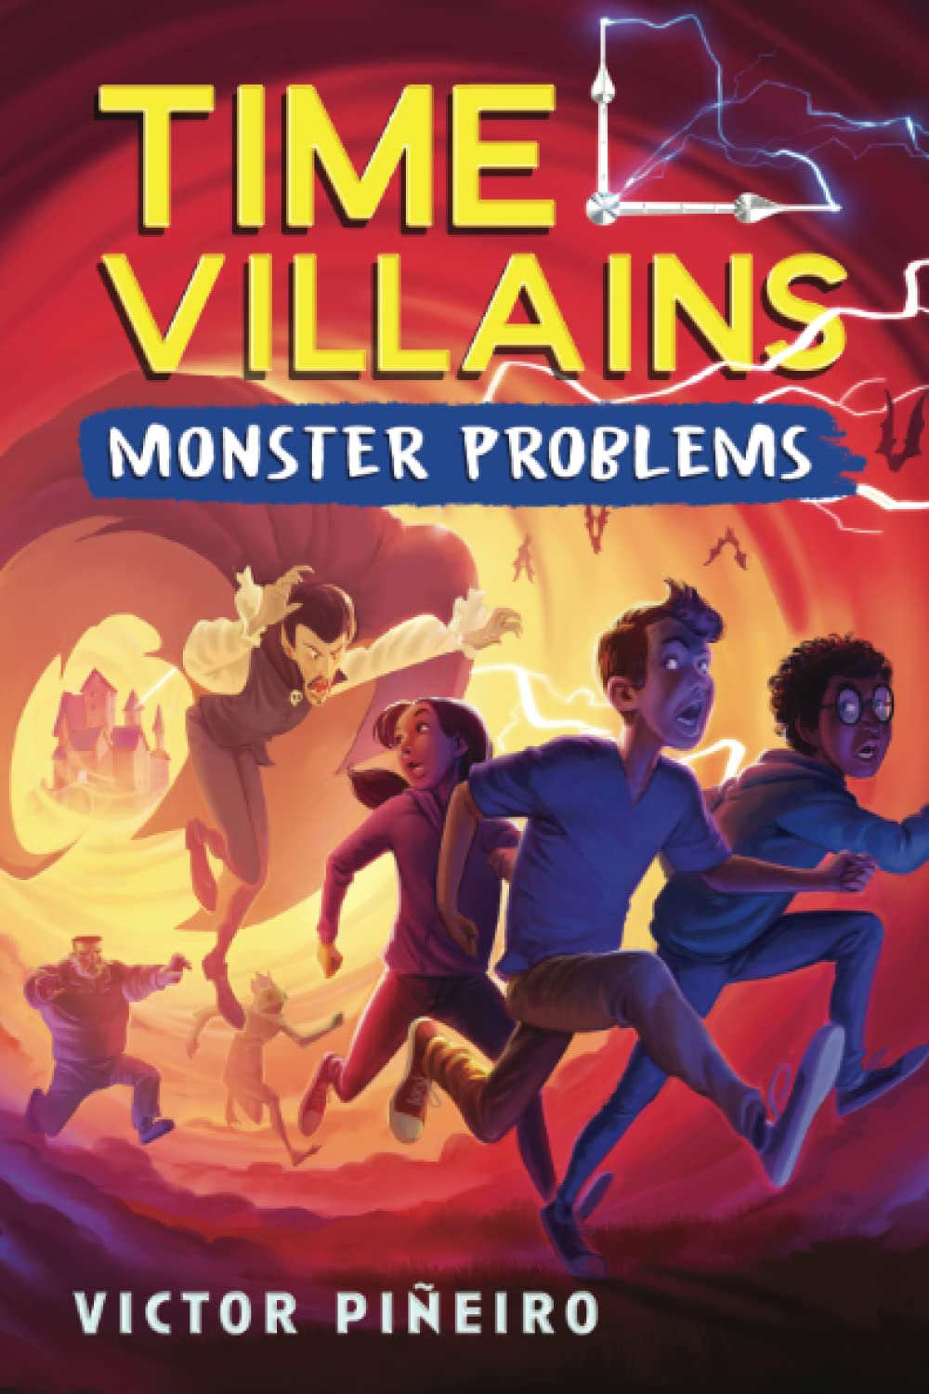
Soundtrack
Time Villians: Monster Problems
By: Victor Piñeiro
Created by: Sophie Hall and Maya Kwiatkowski

Slide 2
A story through songs
Welcome to Javi’s personalized mixtape! This collection of tracks follows Javi’s personal journey throughout the book Time Villains: Monster Problems. Click the title to listen to each song and get a glimpse into the mind and experiences of Javi, as well as his wicked cool battle with some monsters!

Slide 3
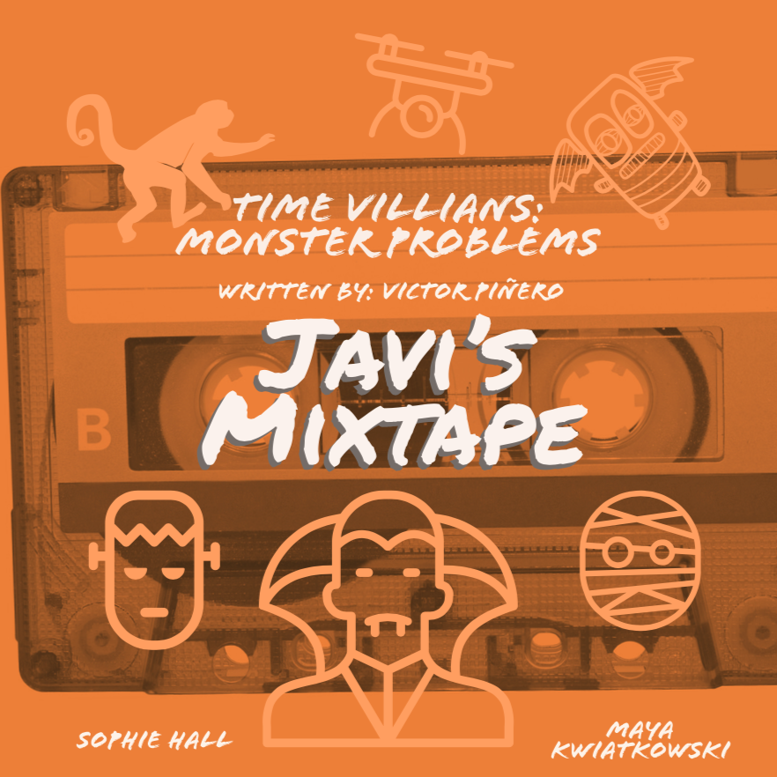
Track List
I’m Just a Kid-Simple Plan
Javi struggles initially with constantly feeling like a ‘C-’ kid. This song describes his feeling of not feeling like he is enough.
You’re My Best Friend-Queen
Javi’s best friend, Wiki, is his perfect sidekick. They’re best friends forever!
Notes:
All song videos are ‘embedded’ within the title!

Slide 4
Track List
Coqui Frogs and Forest sounds (Only listen to part of it)
Connects to Javi’s Puerto Rican culture and gives an example of the coqui whistle that Dr. D uses to mind control people.
How Far I’ll Go-Lin-Manuel Miranda, performed by Auli’i Cravalho
Javi is constantly trying to find his purpose in life and school. He’s trying to prove to himself that he’s more than a ‘C- student’

Slide 5
Track List (continued)
Track List
Monster Mash-Bobby Boris Pickett
The monsters take over the school with the help of Dr. D, and Javi and his gang must help save the school. Relating to the spooky parts of this book.

Slide 6
Track List
Ghostbuster-Ray Parker Jr
Javi and his friends must defeat the monsters that are intending to destroy his fellow classmates and school before it’s too late!
Imagine-John Lennon
Javi and his friends are fighting the evil that is trying to take over his school. Javi also accepts the monsters for who they truly are.

Slide 7
Track List
Born this Way-Lady Gaga
Javi finally accepts himself for who he is. He realizes that he is not just average. He understands that his friends and monsters are all unique and just born this way.
We are the Champions-Queen
Javi and his gang finally beat Dr. D. They are the champions.

Slide 8
Track List
Don’t You (Forget About Me)-Simple Minds
We must not forget about what Javi and his gang did for the school. They saved their teachers, family and friends from Dr. D. Javi and his friends live on as the heroes for their school and protected their classmates!

