Slide 1
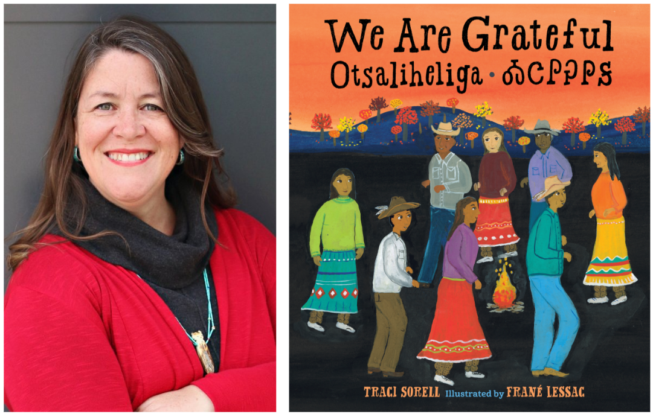
Traci Sorell Author Guide
By Drew Wilke and CJ Armitage

Slide 2
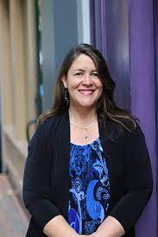
About the Author
Traci Sorell was raised in the Cherokee Nation (in a rural area) where she currently resides
Traci grew up hearing stories about her ancestors and looking through their photos with her grandmother
As a child, Traci loved to explore the outdoors and her environment with her younger brother and sister. They often created games with the supplies that were available to them

Slide 3
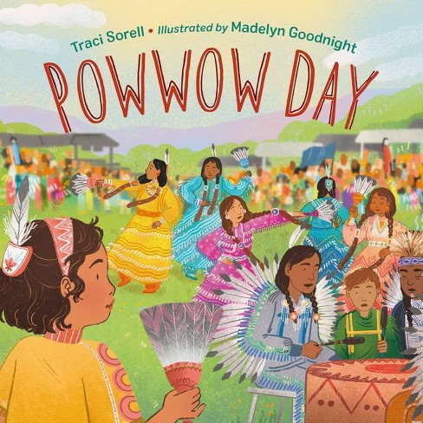
Fun Facts
Traci is learning Cherokee
Her second language is Spanish
Traci lived in Madrid, Spain for a year in college
She has kept all of her favorite childhood books
She tried out for the movie “Annie” in 1982
Traci cannot whistle
For more information visit: https://www.tracisorell.com/about

Slide 4
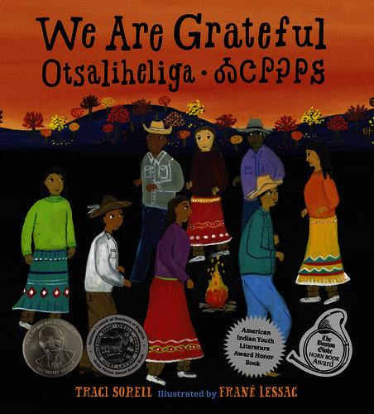
We Are Grateful: Otsaliheliga
This book is about a family of Cherokee people and their rituals as the seasons pass. This book also teaches about important words in the Cherokee language, such as “elisi”, which means grandmother, and “gola” which means winter. In the fall the Cherokee people celebrate the Great New Moon Ceremony and the Cherokee New Year. During the winter families come together to eat food and teach children how to make traditional toys and instruments. During the spring Cherokee families harvest and plant crops. During summer they celebrate the Green Corn Ceremony, the Cherokee National Holiday, and also play stickball.

Slide 5
Cherokee Holidays
The Great New Moon Festival happens in October and actually marks the beginning of the Cherokee New Year. During these ceremonies gifts are exchanged and grudges are let go of. Overall, the gathering celebrates friendships and turning over new leaves.
The Green Corn Ceremony is a celebration of the corn being ripe to harvest. This usually happens in August. People come together to fast and pray for 6 days. Afterwards a large party is held where people eat corn and dance.
The Cherokee National Holiday celebrates the reinstatement of the Cherokee Government after the signing of the Cherokee Nation Constitution in 1839 after they were removed from their land in the South East.

Slide 6
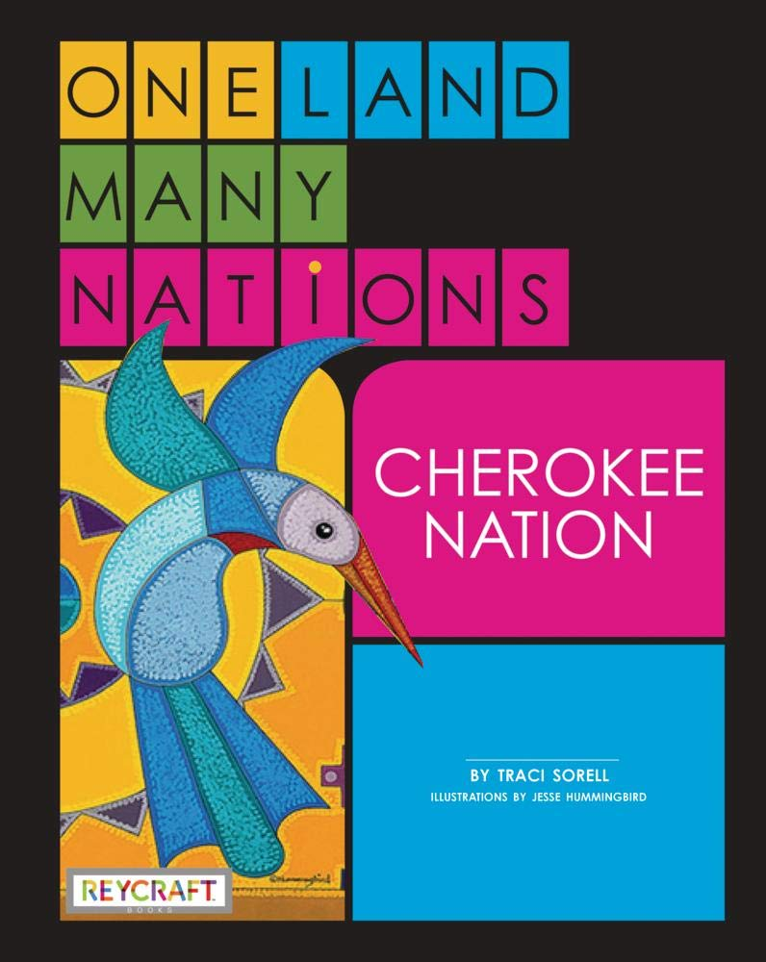
Some Books Written by Traci Sorell
We Are Still Here: Native American Truths Everyone Should Know
One Land, Many Nations Vol. 1
Classified: The Secret Career of Mary Golda Ross
Other Books Include: At The Mountains Base, Indian No More

Slide 7
Common Themes
Native American culture “to celebrate nulistanidov, history, and listen to our tribal leaders speak at Cherokee National Holiday”
Family “as older children teach the younger ones how to make corn-husk dolls and make cane flutes”
Being grateful and expressing their gratitude “when showers fill streams and shoots spring up, we say otsaliheliga”
Representing indigenous people and minorities “to remember our ancestors who suffered hardship and loss on the Trail of Tears”
Being a part of a team, and community “while men sing, asking for thunder and lightning’s protection of the emerging sprouts that women attend”

Slide 8
Nominations and Awards
At The Mountain’s Base: 2020 Best Picture Book (nomination)
Indian No More: 2020 Best Middle Grade Book
We are Grateful: 2020 Best Picture Book (nomination), 2019 Sibert Honor Book, 2019 Orbis Pictus Honor Book, 2018 Book Launch Award (SCBWI), Kirkus Reviews Best Books of 2018, School Library Journal Best Books of 2018, 2018 JLG selection, 2019 Reading the West Picture Book

Slide 9
Questions for Traci
How was it different growing up in rural Oklahoma compared to Southern California?
What things does modern media get wrong about Native American lifestyle?
How do you feel about #ourvoices (What authors use to help spread diversity amongst themselves)?
How can others help stop stereotypes about Native Americans?
What are things that you still remain curious about?
Learn more about #ourvoices here: https://www.simonandschuster.com/books/Our-Stories-Our-Voices/Amy-Reed/9781534409002

Slide 10
Discussion Questions for Teachers
How could you implement one of Traci’s books in your classroom?
What are the biggest takeaways from Traci as an educator?
How can Traci help students and teachers remain curious and help them want to be learners?
How can Traci’s examples of diversity help represent minorities in the classroom?

Slide 11
Interviews
Traci stated that she wanted to represent great people from history who do not get notices (inspired Classified)
Her grandparents played a big part in her wanting to learn about who she was and where she came from
Traci loves to learn from writing and her process of writing: “One (of the most enjoyable parts) is what I learn in the process of writing and about the book’s subjects”
She thinks that the hardest part about telling stories is figuring out how she wants to deliver stories to her audience

Slide 12
Sources
https://www.tracisorell.com/about
https://en.wikipedia.org/wiki/American_Indian_Youth_Literature_Awards
https://lernerbooks.blog/2021/03/classified-an-interview-with-author-traci-sorell.html
https://www.amazon.com/Are-Grateful-Otsaliheliga-Traci-Sorell/dp/158089772X
https://fractalenlightenment.com/40555/culture/seven-sacred-ceremonies-cherokee
https://www.cherokee.org/about-the-nation/cherokee-national-holiday/

Slide 13
Image Sources
Slide 1:
https://charlesbridge.blogspot.com/2018/09/charlesbridge-unplugged-11-traci-sorell.html
Slide 2:
https://wernickpratt.com/client/traci-sorell/
Slide 3:
https://www.target.com/p/powwow-day-by-traci-sorell-hardcover/-/A-83975693
https://www.penguinrandomhouse.com/books/652007/we-are-still-here-by-traci-sorell-author-frane-lessac-illustrator/
Slide 4:
https://www.booksource.com/Products/We-Are-Grateful--Otsaliheliga__9781580897723.aspx
Slide 5:
https://images-na.ssl-images-amazon.com/images/I/61ccggoTTXL.jpg
https://images-na.ssl-images-amazon.com/images/I/91lNloZ27rL.jpg
https://images-na.ssl-images-amazon.com/images/I/51VeOy1hBkL._SY445_SX342_QL70_ML2_.jpg
Slide 7:
https://www.kobo.com/us/en/ebook/indian-no-more
https://www.booksource.com/Products/We-Are-Grateful--Otsaliheliga__9781580897723.aspx
https://mayasbooknook.com/2019/09/18/beyond-the-book-at-the-mountains-base/

