Slide 1
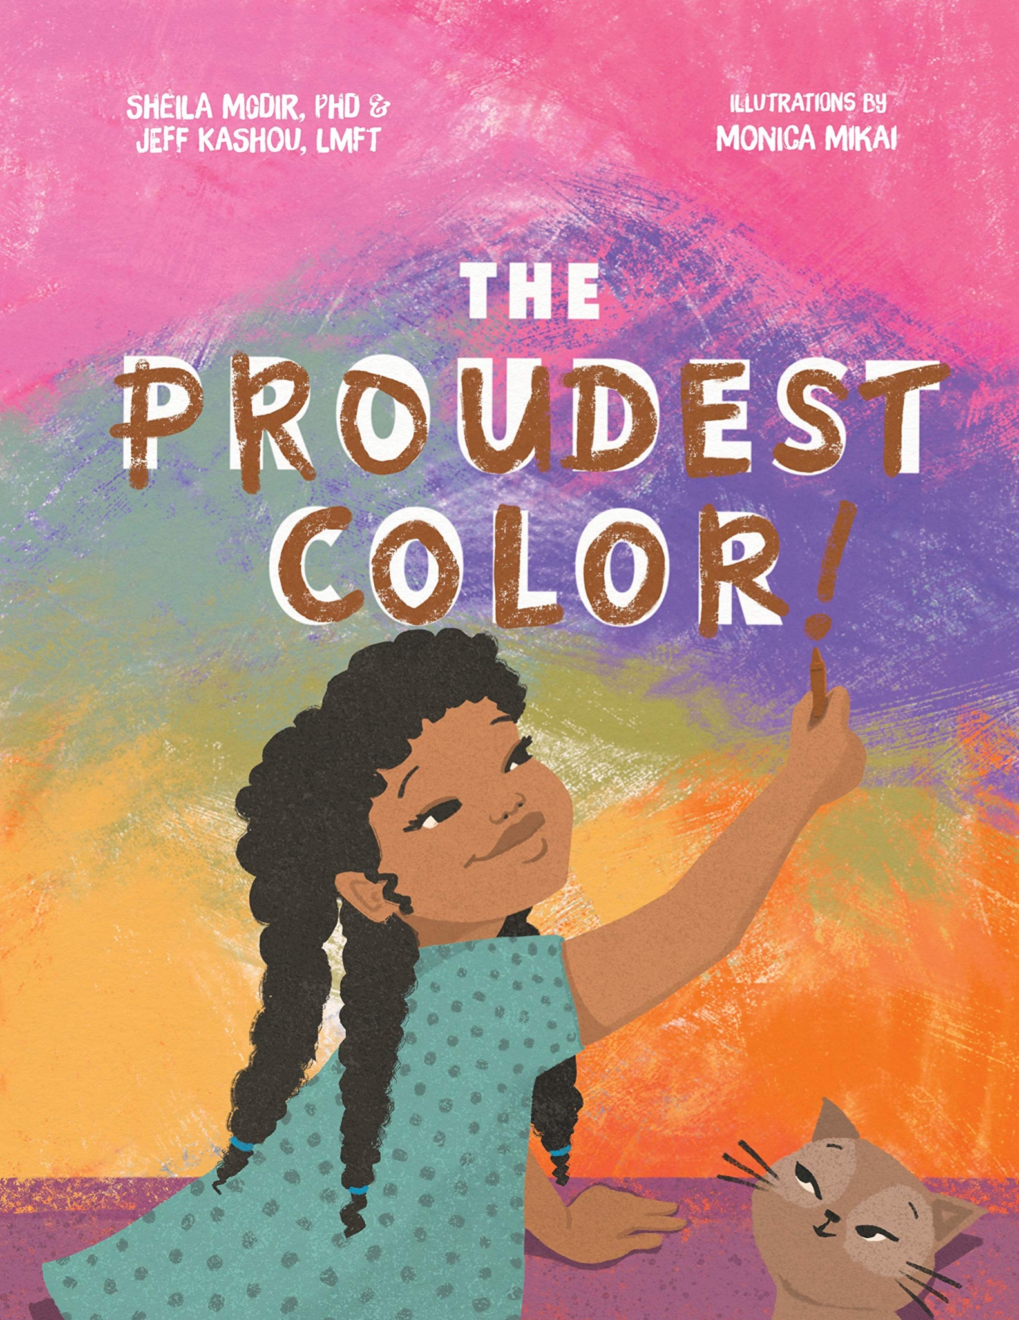
Sheila Modir and
Jeffrey Kashou:
The Proudest Color
Author’s Guide
By Lily Lederer and Lily Barlow

Slide 2
About the Authors
Sheila Modir:
Works as a pediatric psychologist at Children’s Hospital of Orange County, CA
She received a combined doctoral degree in Clinical, Counseling, and School Psychology at the University of California, Santa Barbara, and her master’s degree in social welfare at UCLA
She identifies as Middle Eastern American (Iranian)

Slide 3
About the Authors
Jeffrey Kashou:
Works as a marriage and family therapist and is a manager of clinical product and service design for a mental health tech company
He identifies as Middle Eastern American (Palestinian)
Received his bachelors in Psychology from UCLA
Was a graduate teaching assistant at Pepperdine University

Slide 4
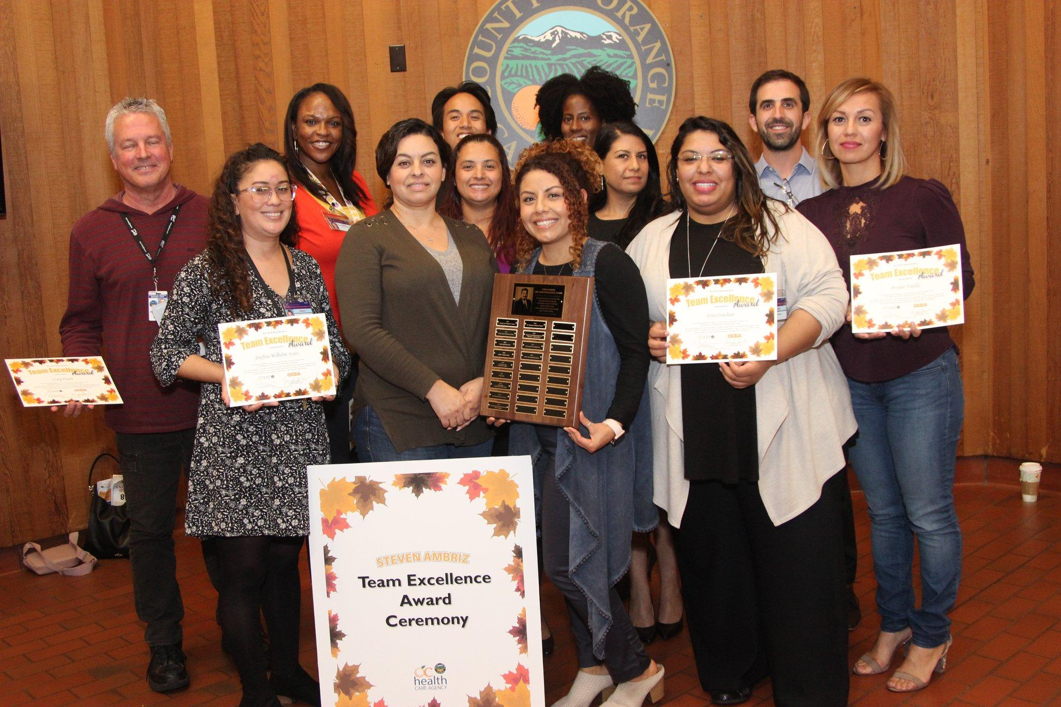
Awards
They have yet to receive any awards for The Proudest Color because it is Sheila Modir and Jeffrey Kashou’s first book!
Although, apart from their literature, Kashou has received the Steve Ambriz Team Excellence Award at the Orange County Health Care Agency in October of 2018.

Slide 5
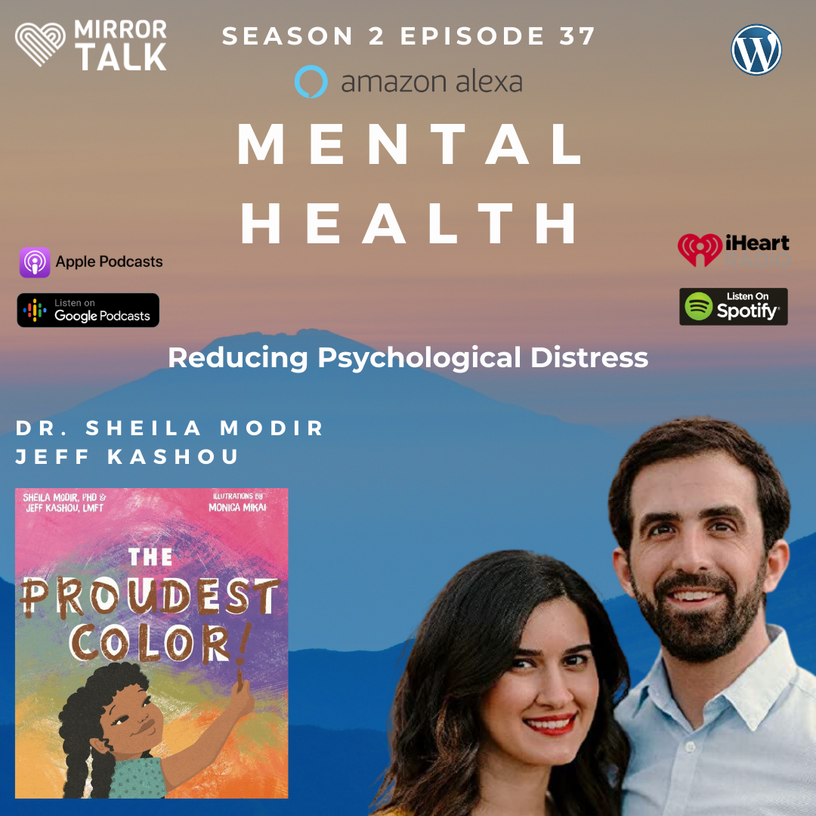
Fun Facts
The Proudest Color is their first book and came out September 14th, 2021
Together they advocate for better mental health care policies and did international work at a Red Cross Refugee Asylum in Belgium
Sheila Modir and Jeffrey Kashou are working with Disney and FreeForm on how to portray mental health in a responsible way in the media.
https://mirrortalkpodcast.com/2021/09/09/dr-sheila-modir-jeff-kashou-on-mental-health-and-reducing-psychological-distress/
This is a good resource for learning about the importance of mental health and taking care of yourself

Slide 6
About their Books
Use their book(s) to advocate for diversity, equity, and inclusion and work toward promoting resilience in children by:
Analyzing the impact of racial trauma on mental health, and how the media can portray mental health in a responsible, informative way
Giving strategies on how to reduce psychological stress and improve overall well-being of each person
The Proudest Color is about a young black girl who tackles how to feel about the color of her skin because she is different from some other kids, but she finds racial pride as her mother encourages her to be proud of her skin color.

Slide 7
The Proudest Color
Written to help parents and caregivers teach their children how to handle and respond to negative discriminatory messages
Works on instilling cultural pride
Teaches children about racism, race, and identifying emotions
Helps readers feel confident in themselves even if they are different from those who surround them, helping tackle racial discrimination and how to handle it
Advocatesfor diversity, equity, and inclusion and works toward promoting resilience in children

Slide 8
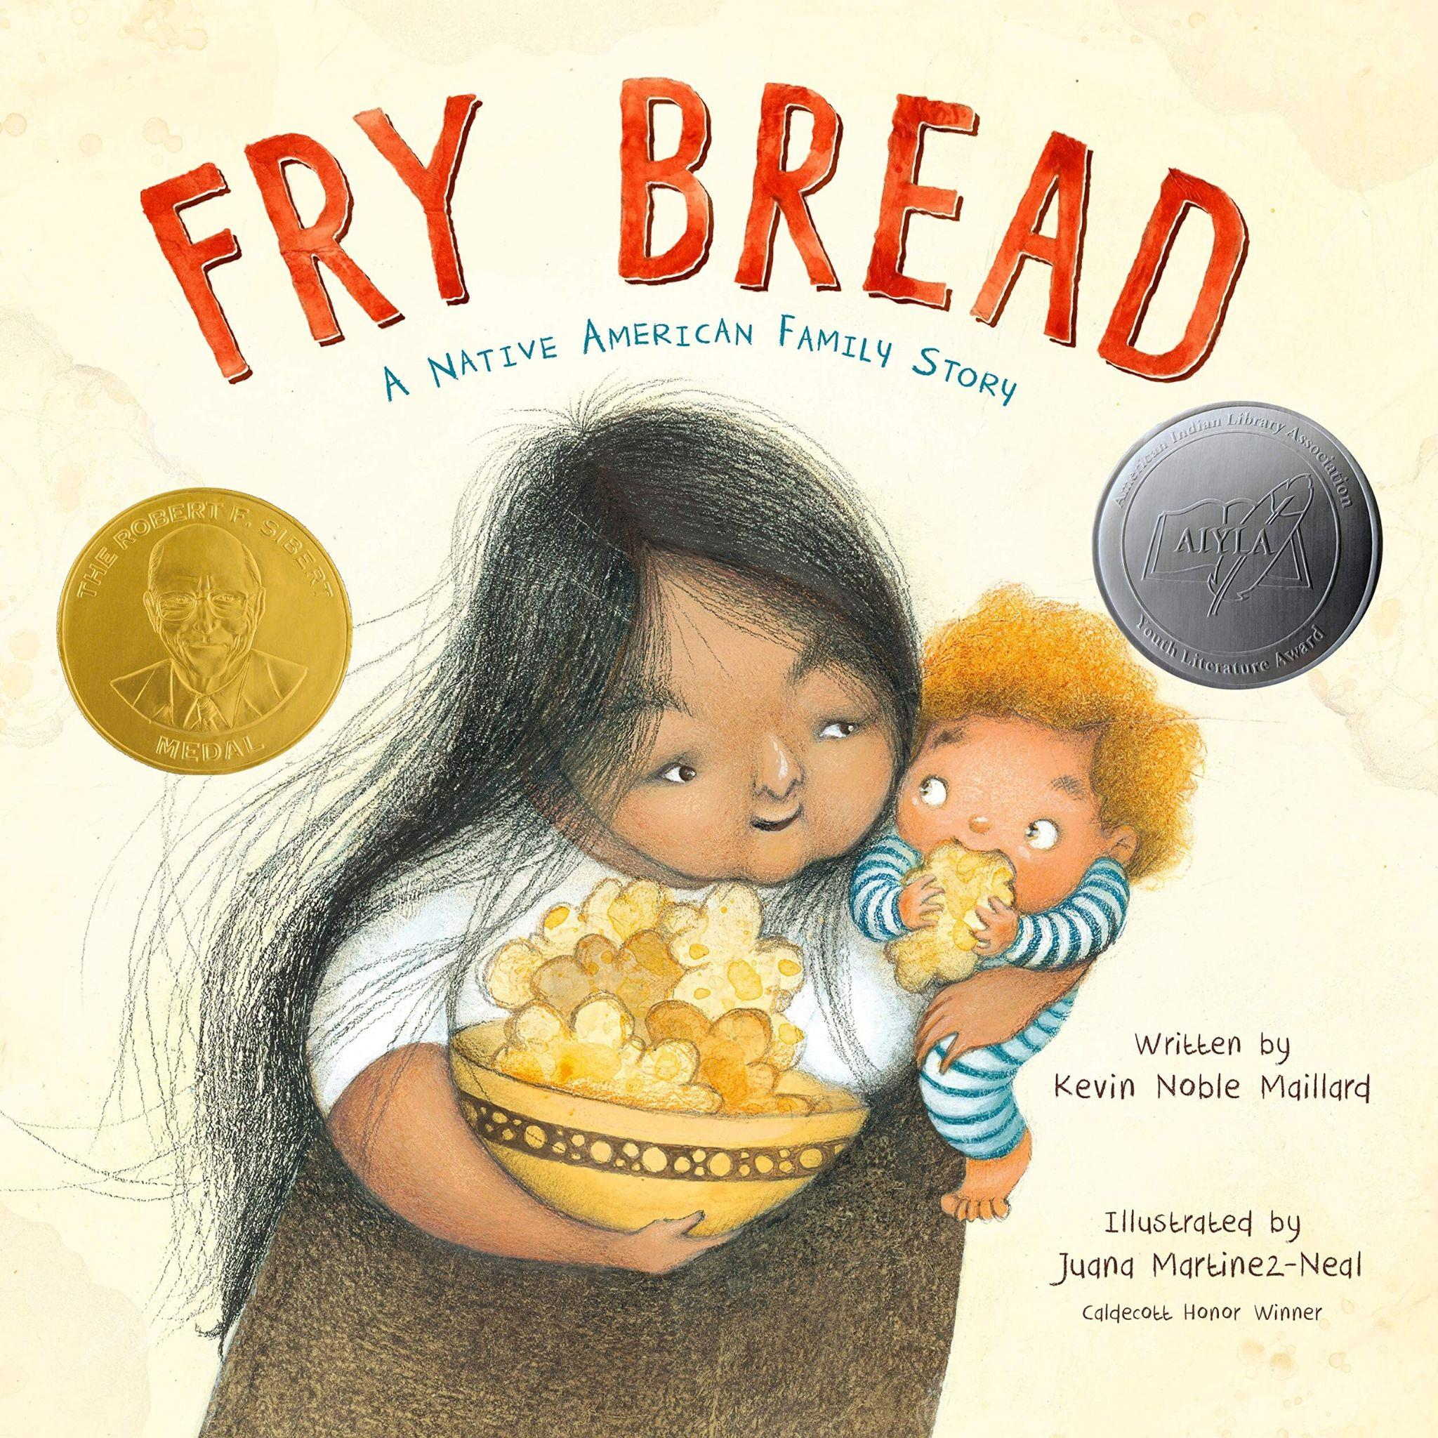
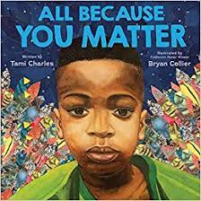
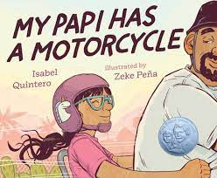
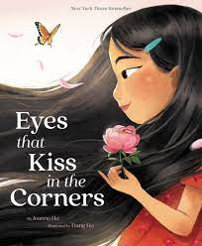
The Proudest Color
https://theproudestcolor.com/
Website includes many helpful resources for parents on how to go about talking to children about race, discrimination, and racial bias.
Articles about how to talk to children about racism
Anti racism parenting and family resources
Anti racist children’s books
100% of author proceeds from The Proudest Color are being donated to the American Civil Liberties Union ACLU and other organizations that promote diversity, equity, inclusion, and social justice.

Slide 9
Reviews on the Book
“This book is so special and I'm so happy I purchased it. Are you wondering how to talk to your child about discrimination without scaring them? How to talk about self-love and being comfortable with their skin and culture in a society that tells them they're less than? Not only does this book help children connect to their feelings, it presents options for parents who want to help their children understand the world around them while loving who they are!”
"This book provides a helpful jumping-off point for exploring facts, thoughts, and feelings behind racial identity, awareness, and pride. The attractive illustrations are full of personality in vignettes that flesh out the story’s text...A useful tool for digging deeper"
Kirkus Reviews
"This text is a timely and welcome addition to early childhood classrooms that can be used in lessons on skin color, feelings, kindness, and how words can hurt others."
An amazon review from a mother
Booklist

Slide 10
Why should students read this book?
-Teaches about racism, race, and identifying emotions in a way that is open and allows readers to connect their feelings to personal experiences with racism
-Confidence in being different from other students, and confidence in themselves
-Provides a helpful starting point for students to explore facts, thoughts, and feelings associated with racial identity, racial awareness, and the student’s pride in their race
- Accurate representation of a young black girl and her experiences allows for students to connect and identify with her becoming confident in being black.

Slide 11
Discussion Questions
How do you think we could engage with this book in a classroom setting to analyze the ideas of racism without making students (especially students of color) uncomfortable?
What activities could be done to help the students understand the themes behind this text?
How can students connect to this text if they are not students of color or familiar with the experiences of racism?

Slide 12
Sources:
https://mirrortalkpodcast.com/2021/09/07/dr-sheila-modir-jeff-kashou-on-the-proudest-colour-learning-how-to-counteract-negative-and-harmful-messages-of-discrimination/
https://soundcloud.com/550ktrs/sheila-modir-jeff-kashou-talking-race-with-kids
https://theproudestcolor.com/

