Slide 1
Jewell Parker Rhodes
Author Guide
Work by Abigail Bonanotte and Grace Garnich

Slide 2
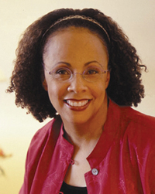
About Jewell Parker Rhodes
Jewell Parker Rhodes was born in 1954 in Pittsburgh, Pennsylvania. She had received her Bachelors of Arts in Drama Criticism, a Master of Arts in English, and a Doctor of Arts in English from Carnegie Mellon University. She has published 7 children's novels and 6 adult novels throughout her career. Today Jewell lives in Seattle, Washington, with her Toy Aussie Sheepdogs.
Notes:
http://jewellparkerrhodes.com/children/meet-jewell/

Slide 3
Rhode’s Books
Ghost Boys
Towers Falling
Ninth Ward
Black Brother, Black Brother
Bayou magic
Paradise on Fire
Voodoo Dreams
Magic City
Sugar
Douglass’ Women
Voodoo Season

Slide 4
Rhode’s Books Cont.
Free within Ourselves
The African American Guide to Writing
Yellow Moon: A Novel
The Marie Laveau Mystery Trilogy
Hurricane
Porch Stories
Proverbs for the People

Slide 5
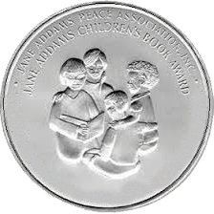
Awards
Jewell Parker Rhodes has won over 30 Awards, including...
American Book Award
The Black Caucus of the American Library Award for Literary Excellence
The Jane Addams Peace Association Book Award
Golden Kite Award for Middle Grade Fiction
Walter Dean Myers
Notes:
https://jewellparkerrhodes.com/adult/about/

Slide 6
Common Themes
Rhodes mainly centers her books around discrimation and racism.
Rhodes believes that we need more diversity in books so others can stand up on their feet and feel comfortable in saying “I am”.

Slide 7
Paradise On Fire
Paradise on Fire is a bestselling novel by Jewell Parker Rhodes published on September 14, 2021. The book is about a young girl named Addy who has been haunted by a tragic wildfire in which she had lost her parents. She is left to live in the Bronx with her grandmother, who enrolls her in a summer wilderness program. She goes on to spend a summer in the wilderness with five other Black city kids. There they learn many new skills and learn a lot about each other as well. They are then faced with a huge problem, a wild fire. Addy has to fight her fears to try and save herself and her new friends from this devastating fire.

Slide 8
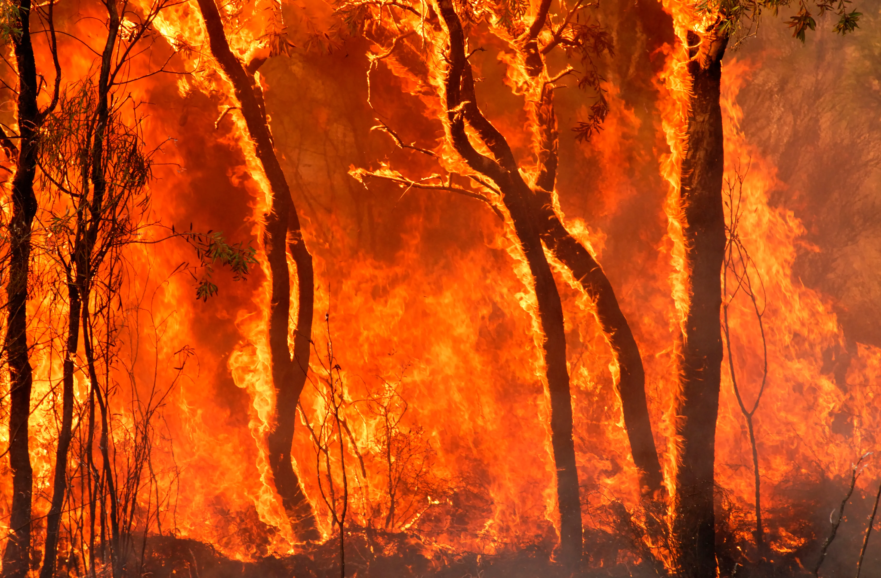
Themes in Paradise on Fire
Rhodes incorporates themes such as race and climate change into her book “Paradise on Fire”.
The book centers on six, Black, Brooklyn Native teenagers that go to the wilderness. There, they are taught about nature, something they have never been exposed to before.
Rhodes also shows the effects of climate change with forest fires on the west coast.

Slide 9
Reviews
“…rooted in the power of nature and community to bring us back to ourselves when we fear all is lost…Rhodes makes sure her readers will feel her landscapes and encourages them to then go out and engage with their own.”
Los Angeles Times
“The book does heroic work in connecting global forces to local reality…Addy is a heroine any reader might aspire to be, a teenager who learns to trust her own voice and instincts, who realizes that fire can live within someone, too.”
The New York Times

Slide 10
Discussion Questions to Spark Conversation
How was Addy seen as an eagle and why is this an important theme in the book?
How did Addy grow in the book and who/what helped her?
How did Rhodes incorporate modern issues into the book and why do you think she did?

Slide 11
Sources
-http://jewellparkerrhodes.com/children/jewell-parker-rhodes-on-diversity-and-character-driven-stories/
https://elenareads.com/2020/07/23/discrimination-racism-are-central-themes-in-jewell-parker-rhodes-books/#:~:text=Discrimination%2C%20Racism%20Are%20Central%20Themes%20In%20Jewell%20Parker%20Rhodes%20Books,-Posted%20by%20elenareads&text=Dr.,even%20started%20writing%20her%20own!
https://diversebooks.org/qa-with-dr-jewell-parker-rhodes-paradise-on-fire/
http://jewellparkerrhodes.com/children/books/paradise-on-fire/

Slide 12
Image Sources
Image 1 https://www.publishersweekly.com/images/data/ARTICLE_PHOTO/photo/000/031/31838-1.JPG
Image 2
https://images-na.ssl-images-amazon.com/images/I/61+PwRjuTIL.jpg
Image 3
https://i.gr-assets.com/images/S/compressed.photo.goodreads.com/books/1513608390i/34647324._UY630_SR1200,630_.jpg

Slide 13
Image Sources
Image 4
https://images-na.ssl-images-amazon.com/images/I/51IKhcfqoBS._SX342_BO1,204,203,200_.jpg
Image 5
https://images-na.ssl-images-amazon.com/images/I/81-F0n9yrML.jpg
Image 6
https://images.axios.com/Q4FvBVZEXSpUrXypRjJc8dVQOOE=/0x190:1920x1270/1920x1080/2018/11/10/1541822005727.jpg

