Slide 1
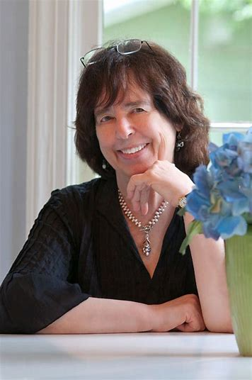
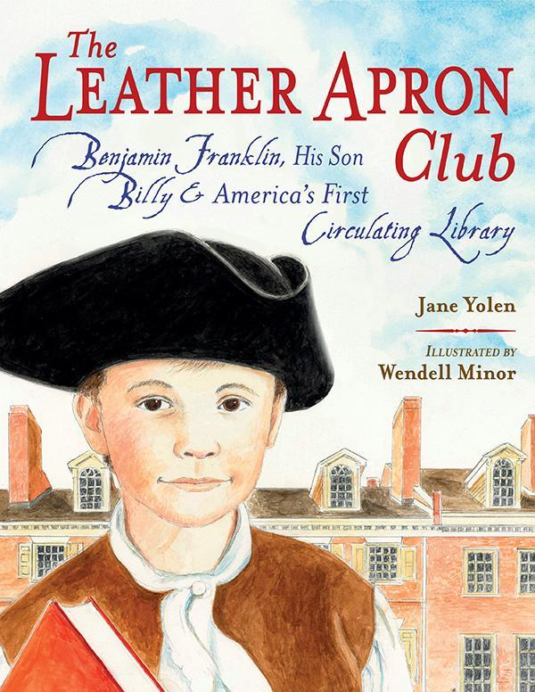
Jane Yolen
The Leather Apron Club
By: Olivia McCall & Isabel MacLean

Slide 2
About the Author
Jane Yolen
Jane was born in 1939 in New York, NY
She attended University of Massachusetts Amherst and Smith College
At her time at Smith College, Jane was president of the press board, won the journalism award, and all of the poetry awards.
On her 22nd birthday, Jane sold her first children's book- Pirates in Petticoats
Jane has worked on over 400 books that include a variety of children and adult books.

Slide 3
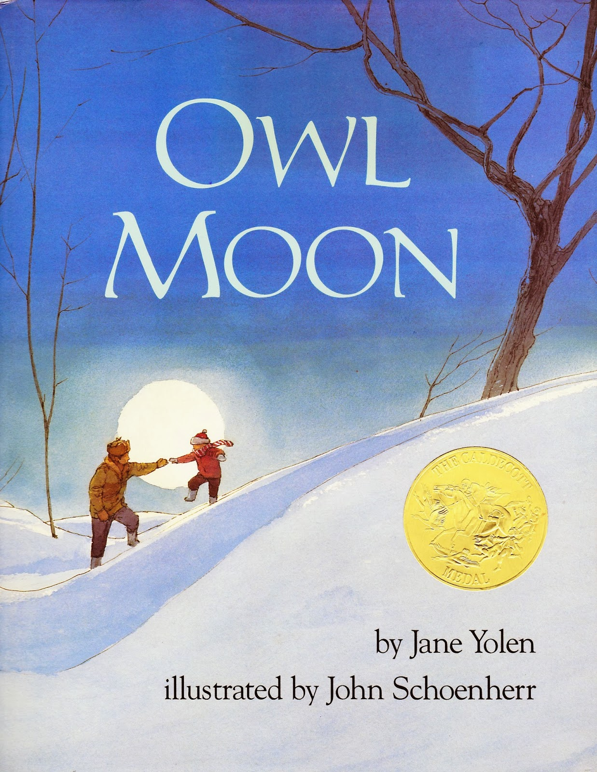
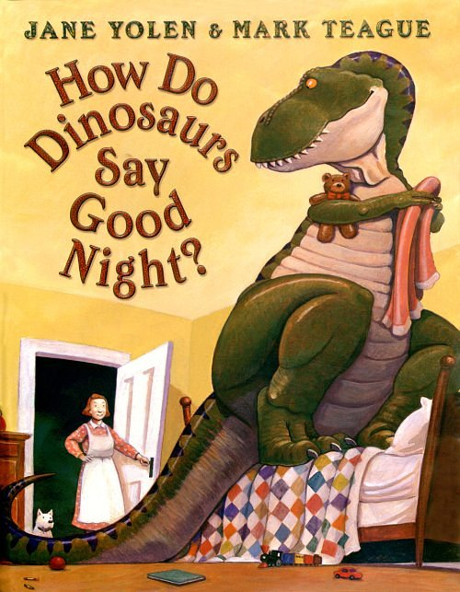
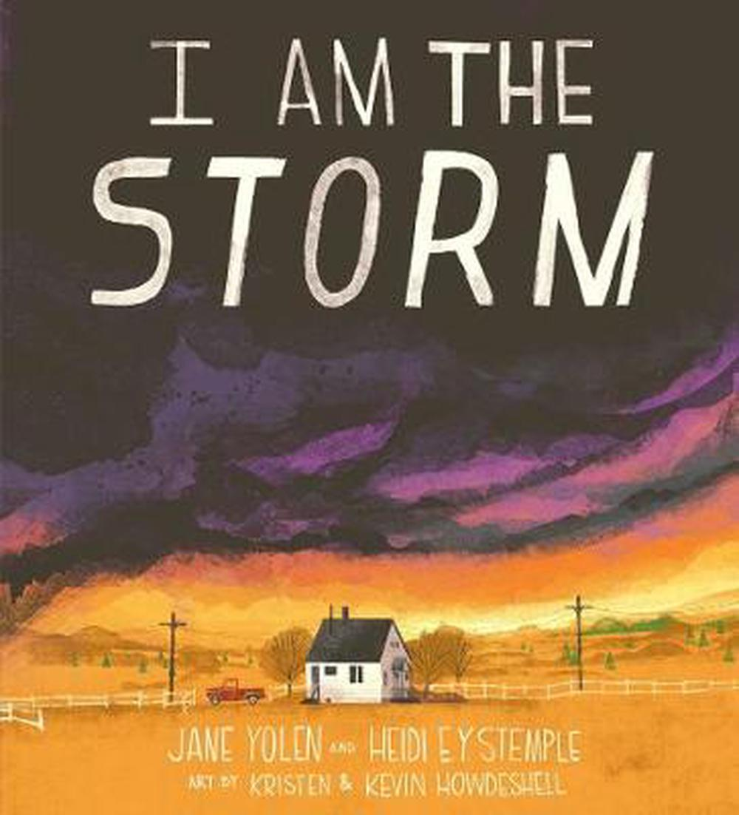
Other Books by Jane Yolen
Owl Moon
How do Dinosaurs say Goodnight
Wizard’s Hall
I am the Storm

Slide 4
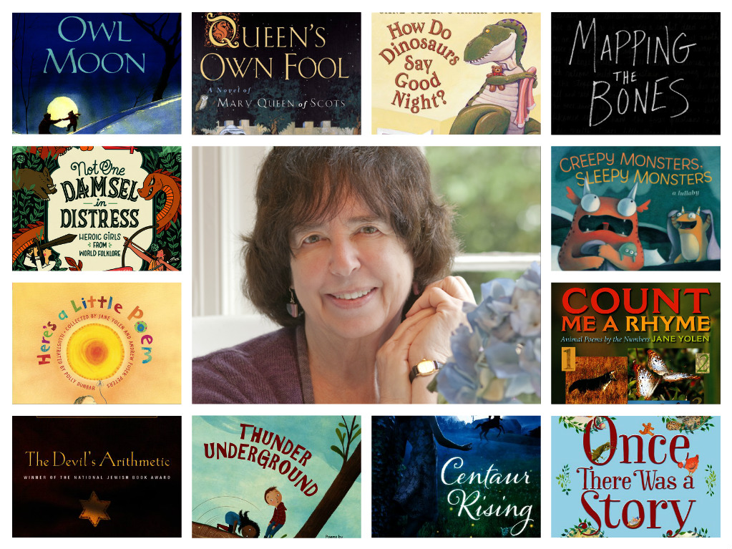
Common Themes in Jane Yolen’s Books
Jane Yolen writes mostly children’s books
Magic
Myths
Folklore
Tends to use animals or inanimate objects
Some include powerful goddesses and heroines
Has some historical books as well
The Holocaust
The Leather Apron Club

Slide 5
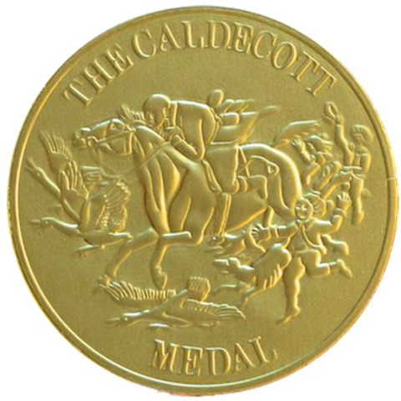
Awards
Caldecott Medal
Two Nebula Awards
Two Christopher Medals
Three World Fantasy Awards
Three Mythopoeic Fantasy Awards
Two Golden Kite Awards
The Jewish Book Award
The Massachusetts Center for the Book award

Slide 6
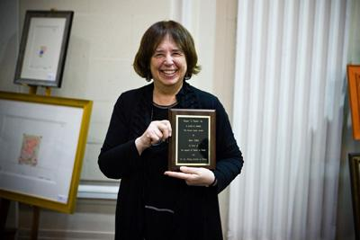
Awards Continued
World Fantasy Association’s Lifetime Achievement Award World Fantasy Association’s Lifetime Achievement Award
The Science Fiction Writers of America’s Grand Master Award
Science Fiction Poetry Associations Grand Master Award
Association of Jewish Libraries Award
Catholic Libraries Medal
DuGrummond Medal
Kerlan Award
Ann Izard storytelling award

Slide 7
Caldecott Medal
Jane has won an incredible number of awards, including the notable Caldecott Medal
Owl Moon features a young girl and her father on an expedition to see an owl. Although the girl was warned she might not be able to spot an owl, she luckily gets the opportunity to see one.

Slide 8
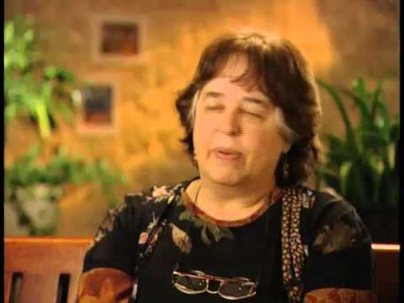
Interview
“For me, folktales became great stories and they've become so recognized as great stories that people have continued to tell them and retell them and we shape them to fit our lives.” (2:44)
“One of the things I’ve done for years is to recount or retell these stories in other ways so children can see that there is more to these stories than Walt Disney” (4:24)

Slide 9
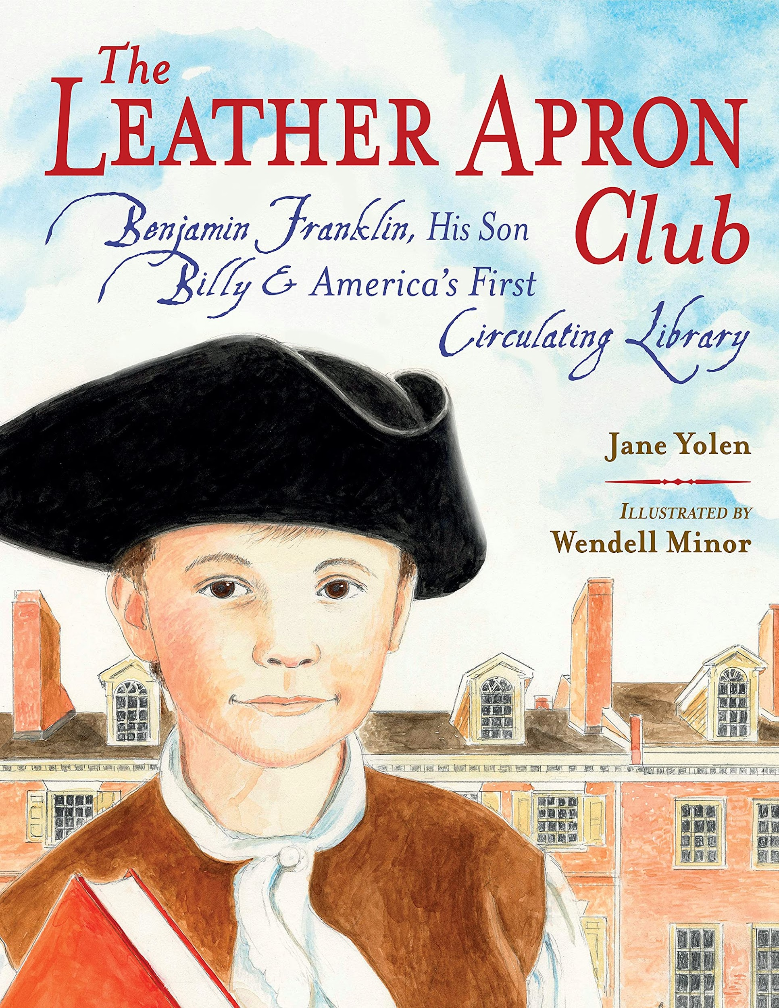
The Leather Apron Club
The Leather Apron Club features two young boys, Billy and James, who seem more interested in playing and being outside than learning and reading. When Billy’s father, Benjamin Franklin, tells the boys that they will be getting a tutor, they are immediately uninterested. Although they start out uninvolved with what their tutor is reading with them, Billy very soon after becomes enthralled with the story.

Slide 10
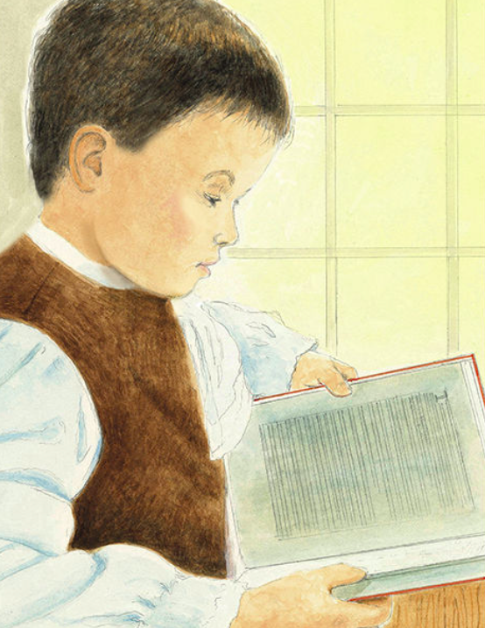
Summary Continued
Billy becomes obsessed with books and reading and how it opens him up to worlds previously unknown to him. Although his friend remains uninterested with books, Billy decides that it is too important to him to give up. He dreams about joining “the leather apron club,” a club with his father and others where he gets to read and talk about books with people who are just as interested as he is.
Notes:
Double check if image use is okay for copyright purposes

Slide 11
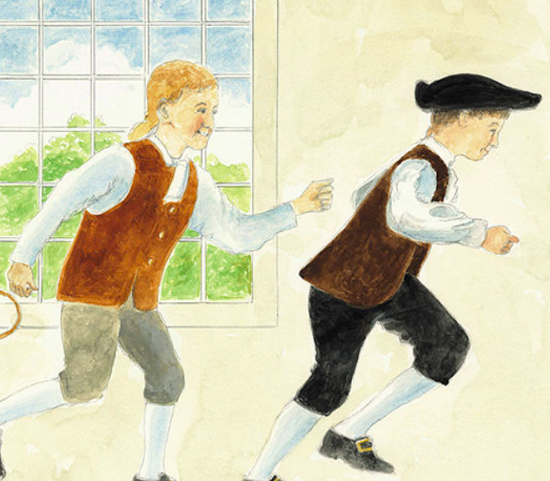
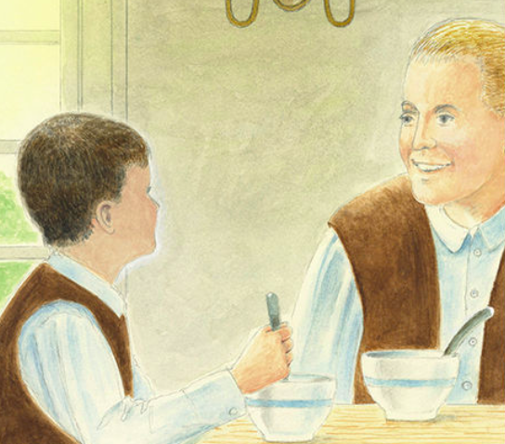
The Leather Apron Club Themes
Changing Friendships: Billy and James start out as friends and soon come to find out that their differing interests create tension
---------------------------------------------------
Family Relationships: Relationship between Billy and his father, the famous Ben Franklin, shows great connections and similarities, while Billy and his stepmother are not as close
-------------------------------------------------

Slide 12
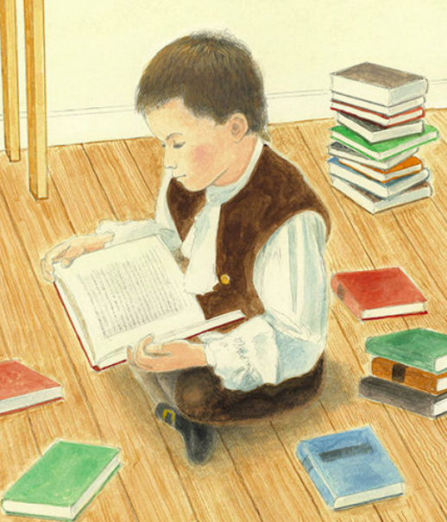
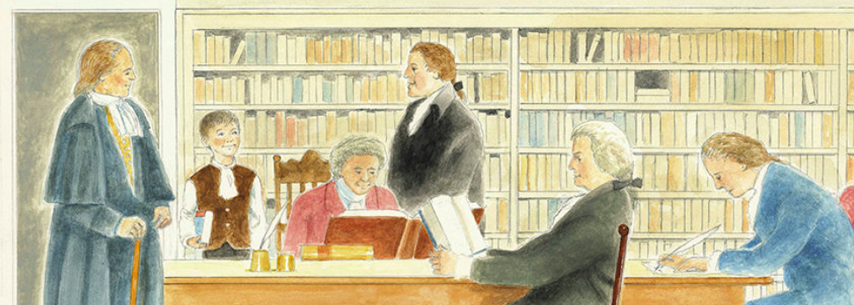
The Leather Apron Club Themes
Growth in Education: Billy learns to love books and finding knowledge
-------------------------------------------------
Maturity: Billy went from playing all day and not taking anything too seriously, to having a tutor and reading. He finds that he genuinely enjoys the new way of life that was introduced to him.
-------------------------------------------------
History: Benjamin Franklin and the first library established during colonial times

Slide 13
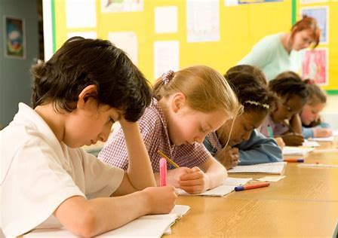
Why Students Should Read The Leather Apron Club
To learn the history of Benjamin Franklin and the first library
Billy matured and faced growth when he found his love for reading
When reading this book children can learn about the doors that reading can open to the imagination and the importance of education
The Leather Apron club is a good historical story that can help readers understand the time and learn about the various topics

Slide 14
Sources
The Leather Apron Club
caldecott medal - Bing images
elementary school student studying - Bing images
how do dinosaurs say goodnight - Bing images
https://bagfullofbooks.com/2015/10/01/owl-moon-by-jane-yolen/
https://www.amazon.com/Leather-Apron-Club-Benjamin-Circulating/dp/1580897193
https://www.janeyolen.com/awards/
https://www.janeyolen.com/biography/
https://www.wired.com/2013/01/geeks-guide-jane-yolen/
i am the storm yolen - Bing images

Slide 15
Sources
jane yolen accepting an award - Bing images
jane yolen - Bing images
jane yolen book collage - Bing images
Jane Yolen - YouTube
leather apron club - Bing images
owl moon - Bing images ,
The Leather Apron Club: Benjamin Franklin, His Son Billy & America's First Circulating Library by Jane Yolen (goodreads.com)
Wizard's hall - Bing images

