Slide 1
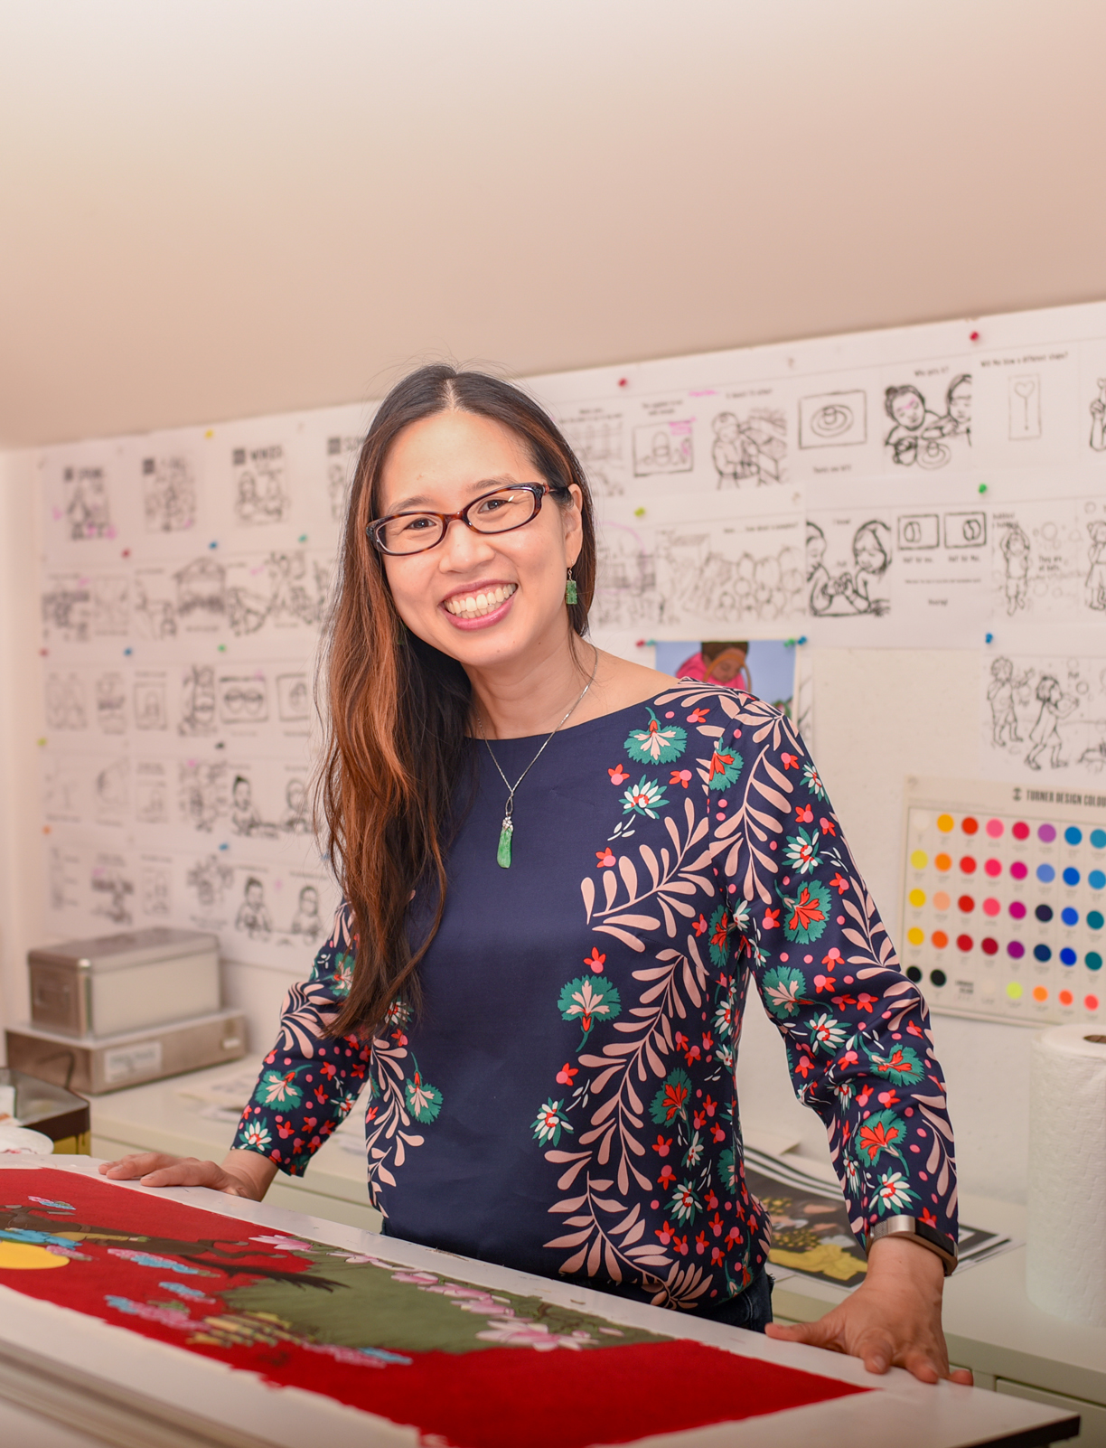
Grace Lin
Children’s Author and Illustrator
By: Cora Weitzel, Grace Denniston, and Hannah Vest

Slide 2
“A book can show you the world but it can also show you a reflection of yourself.” - Grace Lin
(“A Video Interview With Grace Lin”, 2020)
Notes:
A Video Interview with Grace Lin.” Reading Rockets, 19 Feb. 2020, www.readingrockets.org/books/interviews/lin.

Slide 3
About Grace Lin
Grace Lin has had a passion for creating children's books since elementary school. She grew up in upstate New York with her older 3 sisters and parents. She attended Rhode Island School of Design, where she studied and created art. She used her artwork to publish her very first book “The Ugly Vegetables” in 1999. Grace Lin has made it her mission to write books that represent her Asian heritage and culture because she is trying to “capture the culture she didn't learn when she was younger and trying to recapture the things she didn’t know”.
(“A Video Interview With Grace Lin”, 2020)
Notes:
A Video Interview with Grace Lin.” Reading Rockets, 19 Feb. 2020, www.readingrockets.org/books/interviews/lin.

Slide 4
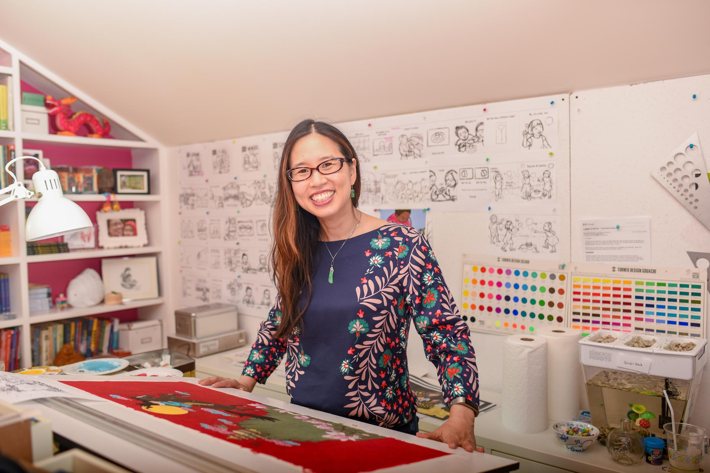
About Her Books
Writes books that encompass her culture and heritage
She believes that "Books erase bias, they make the uncommon everyday, and the mundane exotic. A book makes all cultures universal." (“Press Kit”, para.5)
Picture Books
A big Bed for a Little Snow
A Big Mooncake for a Little Star
The Ugly Vegetables
Early readers
Ling and Ting Series
Novels
Year of the Dog
The Year of the Rat
Dumpling Days
Photo by: Danielle Tait

Slide 5
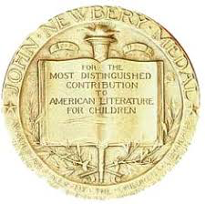
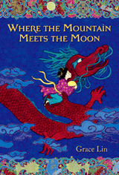
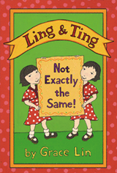
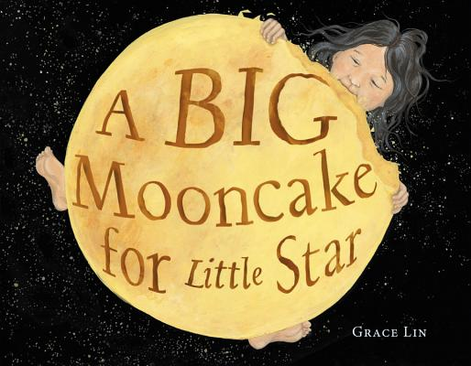
Awards
Awards
The Ugly Vegetables
Growing Good Kids Book Award CLASSIC
Where the Mountain Meets the Moon
2010 Newbery Honor
Chosen for Al Roker's Today Show Kid's Book Club
NY Times Bestseller
Ling & Ting
Theodor Geisel Honor in 2011
A Big Mooncake for a Little Star
Caldecott Honor
Nominations
The Ugly Vegetable
California Young Reader Children's Choice Award
The Year of the Dog
TX Bluebonnet list

Slide 6
"Hey, these drawings are pretty good. Maybe I'll be an artist."
(“Fun Facts”, para. 2)
Grace originally dreamed of being a figure skater when she was a child. She drew pictures of herself spinning and skating on the ice. When she looked at these pictures she said:
This led her to pursue her dream and become an illustrator and an author!

Slide 7
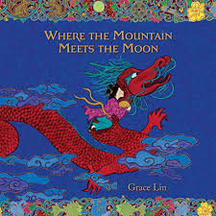
A book that has cultural meaning
“Where the Mountain Meets the Moon” is incredibly important to the growth in multicultural literature. The book is often compared to the Wizard of Oz which we all know and love. In this book Grace Lin tried to come up with both characters and culture that we do not see often in children's books. This book was published in 2007 and the lack of multicultural literature was even worse than it is today. “Where the Mountain Meets the Moon” was able to introduce kids to characters that were people of color, without making them into a stereotype.

Slide 8
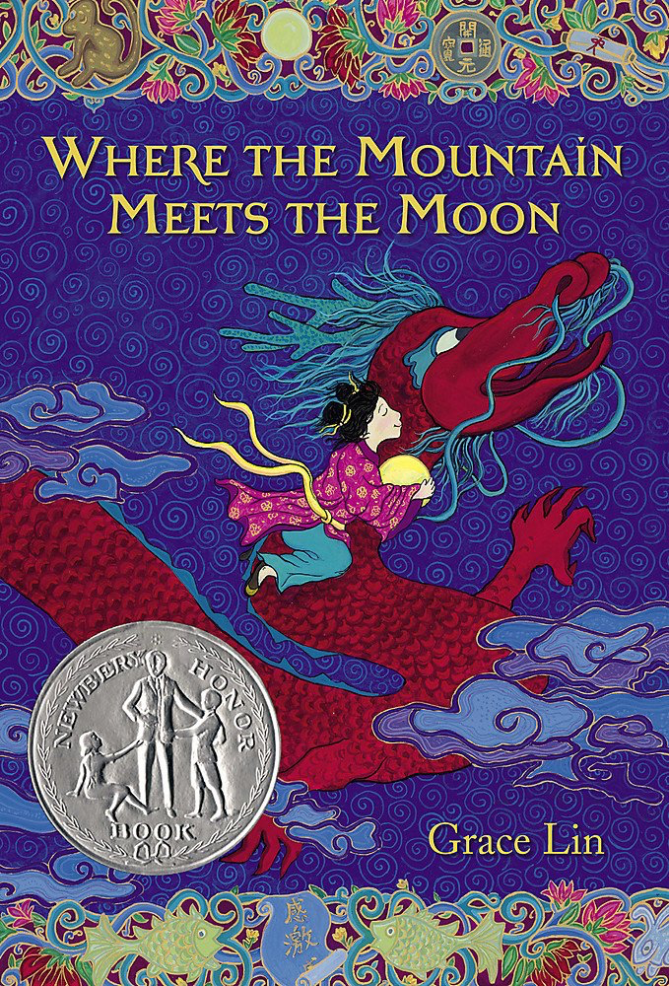
“If you make happy those that are near, those that are far will come.”
-Grace Lin, Where the Mountain Meets the moon
This book tells the story of Minli and her journey to find the Old Man on the Moon. She wants to ask him how she can change her family’s fortune.

Slide 9
A Big Mooncake for a Little Star
Published: 2018
Little Star, and her mom make a big mooncake and hang it in the sky to cool. Little Star eats the big mooncake night after night, until all that is left are crumbs in the sky. This is shown with the phases of the moon, as Little Star eats, the moon wanes.

Slide 10
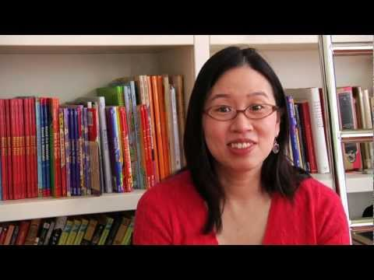
Interview with Grace Lin
“Always write or draw something that is important to you”

Slide 11
Discussion Questions!
Which book from the presentation stood out to you? Are there any that you would like to read?
How can you relate to Grace Lin’s story?
Why is Grace Lin significant in multicultural literature?

Slide 12
Bibliography
Tait, Danielle. Grace Lin, Aug. 2019, www.gracelin.com/media/press/instudio_photo.jpg.
“A Video Interview with Grace Lin.” Reading Rockets, 19 Feb. 2020, www.readingrockets.org/books/interviews/lin.
Grace Lin: Videosforeducators, www.gracelin.com/content.php?page=videosforeducators.
Press Kit. (n.d.). Retrieved October 08, 2020, from http://www.gracelin.com/content.php?page=presskit

