Slide 1
Mental Health and Student Wellbeing: An Overview of CAPS Services
Rachel LaHoda, PsyD
Shannon Peters, PhD
Counseling and Psychiatric Services

Slide 2

“Wellness must be a prerequisite to all else. Students can’t be intellectually proficient if they are physically or mentally unwell”
Ernest Boyer

Slide 3
Why Focus On Student Wellbeing?
Psychological distress is related to academic functioning (Choi, et.al. 2010)
Mental health and wellbeing is linked to GPA and academic success (Eisenberg, Golberstein, & Hunt, 2009)
Depressed students more likely to miss class and exams (Hysenbegasi et al., 2005)
Psychosocial issues are primary cause of drop-out after financial ones (Schwartz,2013)

Slide 4

Barriers to Student Success
Stress
Sleep problems
Cold & Flu
Anxiety
Depression
Work
Internet use
Family concerns
Relationship problems
Alcohol use

Slide 5
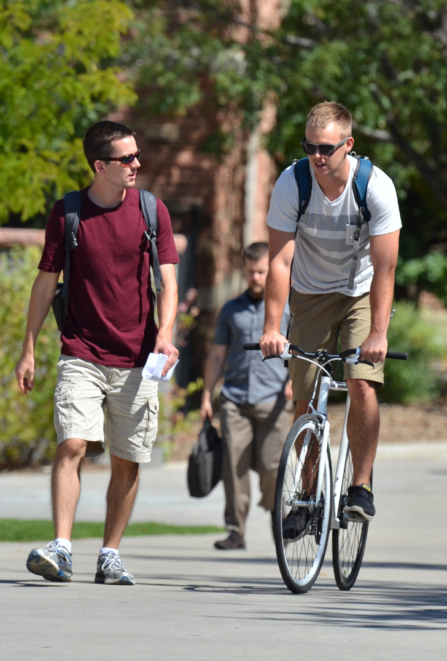
Understanding CU Students
47.4% felt so depressed they had difficulty functioning this past year
66.2% felt overwhelming anxiety in the past year
68.8% felt very lonely
14% seriously considered suicide
11.6% intentionally harmed themselves
NCHA Survey, CU Data, 2019
Notes:
Updated using 2019 NCHA data. This was over 600 students with slightly higher first-year and graduate student representation. Data not weighted in order to include our students identifying as non-binary in the sample.

Slide 6
Mental Health in College
Over time the mental health needs of college students have increased
  ADA
  Access to psychotropic medications
  Reduced stigma of mental health needs
  Greater recognition of mental health issues
Students arrive to college with a range of mental health statuses
Nationally, students are reporting high levels of stress and there is increased use of mental health services.
Healthy/
well-adjusted
Serious and persistent mental health concerns
Notes:
Normalizing difficulties during transition to college. Students can be really successful with good support systems.

Slide 7

Signs of Students in Distress
Significant behavioral or emotional change
Peculiar or bizarre behavior, thoughts, or speech
Isolation and withdrawal
Change in hygiene or appearance
Substantive decline in academic performance
Alcohol or drug abuse
Excessive or inappropriate anger
Overly argumentative or agitated
Veiled or direct threats
Intimidating emails or troubling essays

Slide 8
How to Support a Student
Avoid temptation to ignore the problem
Arrange a private time to talk and let the student know you are concerned
Be supportive & respectful while avoiding argument
Acknowledge their distress and let them know you are willing to help
Assess for self-harm
Be honest with the student about the limits of your time, ability, expertise, and/or objectivity
State that you believe the student would be supported by assistance form another source
Normalize getting help – lots of students seek support!
Assist the student in choosing the best resource
Help the student know what to expect when following through on the referral
Please walk the student to CAPS if needed

Slide 9

CAPS is Here to Support Students
Comprehensive mental health services for students
Main Site: Center for Community, 3rd Floor
Diverse staff of licensed mental health professionals
Psychotherapy, group and couples counseling, psychiatric medication, substance abuse assessment, workshops, and crisis care

Slide 10
Services for All CU Students
    Access care through Walk-in service: 10 am to 3:30 pm
    Monday through Friday
    After-hours phone crisis line for student or consultation to you
    Pre-paid mental health visits covered through the Mental Health Fee at no-cost to the student
    Psychotherapy and psychiatric medication management
    Groups and topic-focused workshops
    Campus-wide mental health screenings & outreach educational program
    In a crisis situation, you can always walk a student over to the closest CAPS location

Slide 11
Additional CAPS Services
Feel Better Fast & Anxiety Toolbox - Mental Health Education
Sleep Skills
Relationship Hacks- communication, patterns in relationships, boundaries
Feel Good Fridays – Guided Meditation
Behavioral Health Consultation in Medical Clinic
Health Promotions- Bounce Back

Slide 12
ADHD/LD Walkin Screening Appointments
Similar to walkin procedure, or can be scheduled in advance if have received CAPS services previously
Brief discussion of symptoms and psychoeducation
Referral to community psychological assessment, medication providers, CAPS workshops, etc.
Notes:
Walkin provider may be able to provide ideas on tips/strategies
Tip- come in earlier in semester/earlier in day for more availability

Slide 13

Outreach Support
    Managed by Health Promotion
    https://www.colorado.edu/health/outreach
HP offerings cover a variety of topics in various formats, including but not limited to:
  Alcohol and other drugs and recovery
  Mental health
  Nutrition
  Relationship wellness
  Sexual health
  Sleep
  Stress and anxiety
  Suicide prevention
  Trauma

Slide 14
Other Key Campus Resources
Office of Victim Assistance (OVA) in C4C: free counseling & advocacy for all at CU
Student Support and Case Management in Dean of Students Office (C4C): case managers, SOCT
Office of Student Conduct and Conflict Resolution in C4C: referral, complaints & consultation regarding disruptive students
Faculty/Staff Assistance Program in ARC: free individual therapy, workshops, referrals
911: For immediate danger or if you need an immediate response

Slide 15


Slide 16
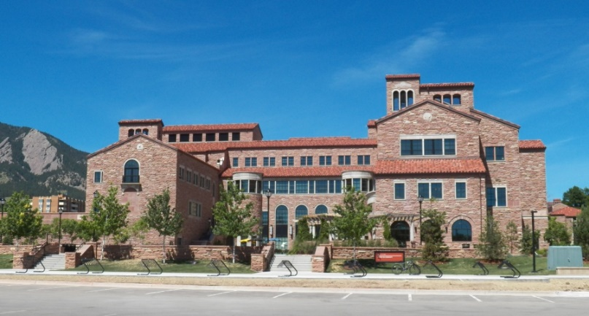
Counseling and Psychiatric Services
CAPS-C4C, Room N352
24-hour phone support available
303-492-CAPS (2277)
www.colorado.edu/health/counseling
You are not alone! The staff of CAPS is here to help you support student success.

