Slide 1
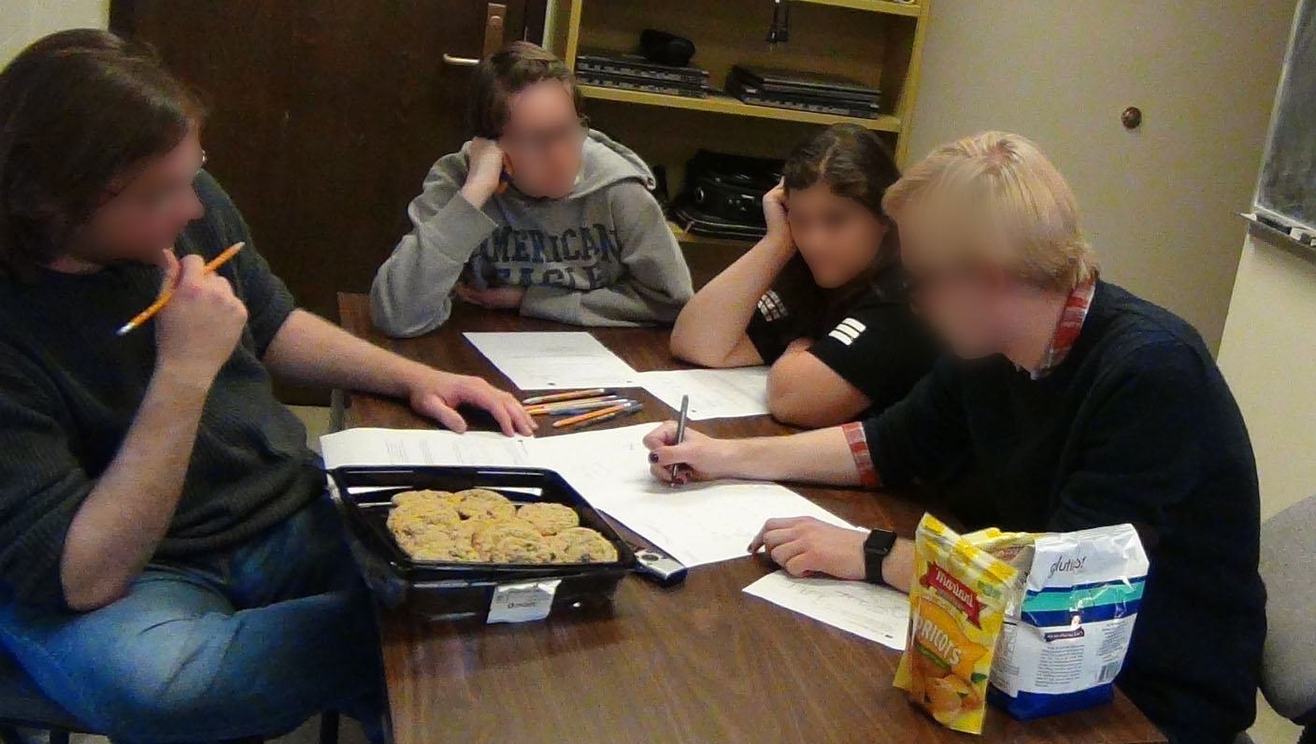
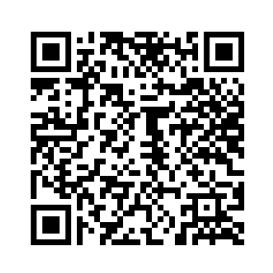
Epistemology, Sense Making, and Social Dynamics in Group Work
Jessica R. Hoehn, Julian D. Gifford, and Noah D. Finkelstein
University of Colorado Boulder
Group work is good
…but not always
Epistemic stances toward group work
Misalignment of epistemic stances contributes to, and is reinforced by, social positioning of students
Stances about what group work looks like and how it should function to generate knowledge
Many curricula [1]
Benefits student learning [1]
Can be isolating or harmful [2-3]
Call to attend to social dynamics
Implementation matters
Collective Consensus Building
Explainer - Explainee
Motivating observation
In a focus group…
Generate and make sense of ideas collectively
Think out loud and build on one another’s ideas
Individuals come to understand ideas
Individuals explain to others
Implications
One student guides the sense making in a group and is simultaneously positioned as less knowledgeable
For instruction…
Externalize goals
Attend to how group work plays out
Teach students to engage in productive and equitable group work
Penny
Predominantly aligned with
Collective consensus building
Morgan/Cam
Predominantly aligned with
Explainer - Explainee
Case study analysis
Penny
Sarah
Tentative
Invites others to weigh in
Speaks slowly
Thinking out loud
Question asker/prompter
Authoritative/certain
Pointing
Speaks quickly
Didactic
Explainer
For research…
Morgan
Conceptually productive ≠ equitable
Epistemic stances toward group work a useful construct
Attend to multiple dimensions of epistemic agency
Study how group work happens to inform implementation
Cam
Modern Physics students
Quantum mechanics problem-solving
Discourse analysis to infer epistemic stances toward group work & social positioning of students
Explainer - explainee stance dominates
Penny guides sense making but is positioned as less knowledgeable
References
[1] S. Freeman, et al., Proc. Natl. Acad. Sci. 111 (2014).
[2] S. L. Eddy, et al., CBE Life Sci. Educ., 14 (2015).
[3] K. M. Cooper and S. E. Brownell, CBE Life Sci. Educ. 15 (2016).
Jessica.Hoehn@colorado.edu
This project supported by NSF #1625824, #1322734, #1548924 and a Graduate Research Fellowship
Notes:
Things to change/consider:
Wording of research questions?
Background to include other than the Redish square? Or just stick with the square?
I will add color to the Redish diagram once we have annotated the transcript. I think we need to add some sort of explanation to the Redish square…how we are using it/thinking about it...add the curved arrows?
Refine MSM definition. Not sure how exactly to incorporate the productivity language, while keeping it brief and digestible
Need to add to/refine list of MSM processes (change the label?)
What else to add to methods? Blurred out photo of a group to show setting?
Need to annotate clip (with color and arrows going to the triangle and square diagrams)
Add picture of the student work accompanying the clip
Add a counter example on the right (will it fit?) YES!
Think about print outs of other transcripts
Will fill in NSF info and add QR code in bottom right square

