Slide 1
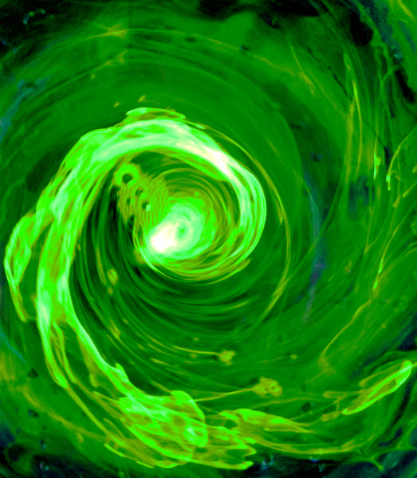
Aesthetics and Expanding Perception in Fluid Physics
Katherine Goodman, PhD
Professor Jean Hertzberg
Professor Noah Finkelstein
University of Colorado Boulder
Jeff Byrne (2012). A bathtub vortex dyed with highlighter ink.

Slide 2
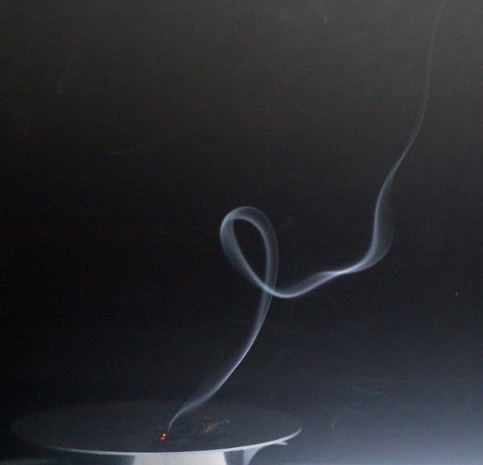
Flow Visualization
3-credit Technical Elective
Create aesthetically pleasing, scientifically useful images of fluid flows
Write papers about the creating the image, forces in the image
Comprised of 1/4 art students
Jose Orozco (2013). A buoyant plume of incense smoke forms a curl.

Slide 3
Example of Transformative Experience
Sent: Tuesday, July 21, 2015 9:07 AM
Subject: Cool Flow Vis
Hey Professor Hertzberg,
I took Flow Vis about a year ago and it was a great class. Now every time I see cool fluid phenomenon in real life, I think about you and that class, so I thought I'd share this with you! I cracked my phone screen a few weeks ago and over that time, the air has started to creep between two plates in the screen. It's making a pretty neat Hele-Shaw Cell in only one direction instead of the typical radial style that you see.
Thanks for a great class,
David Zilis
(Photo, name, and email used with permission.)
Notes:
Note that fluids will be a main content area for discussing TE

Slide 4
Transformative Experience (TE) Qualities
Motivated Use using Knowledge, Skills and Abilities outside of the original (classroom) setting
Expanded Perception also called transfer, awareness, or activation of resources
Affective Value positive emotional responses
(Pugh 2011)
Notes:
Motivated Use as true goal of ed, expanded perception in line with this, affective value (should instructors care?) – but hard to measure!

Slide 5
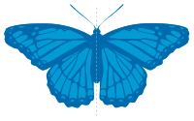
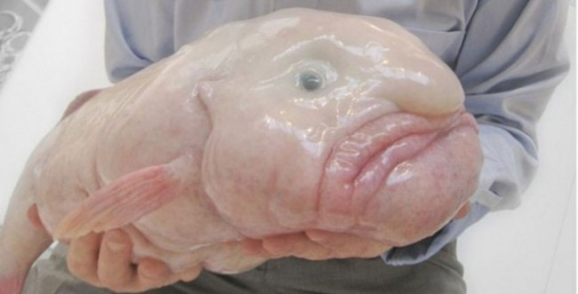
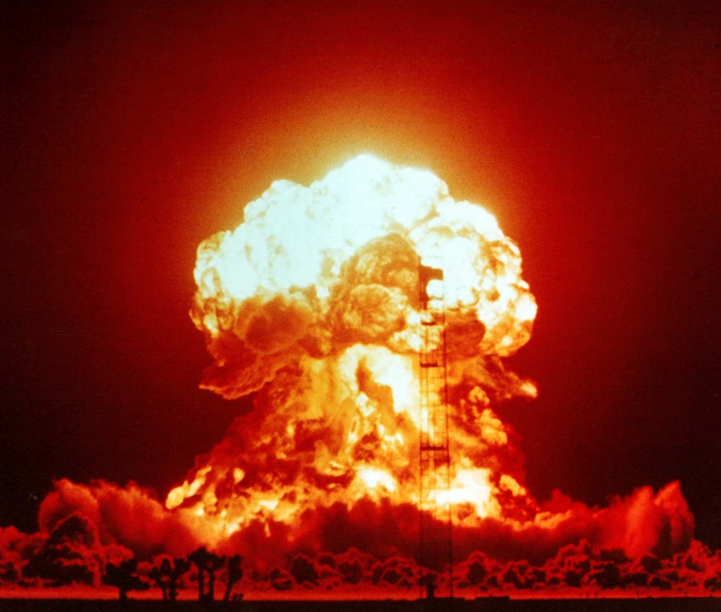
What do we mean by Aesthetics?
The artistic appeal of an object or experience:
Does not have to be “pretty”
Symmetry
Destruction or Power
Oddness or Grotesque
Notes:
Read Palmer, Schloss *yum to yuck*

Slide 6
What do we mean by Aesthetics?
Another way of thinking:
Aesthetics as psychological measure of affect, “the study of those mental processes that underlie disinterested evaluative experiences” (Palmer, Schloss, Sammartino 2011)
Oh wow! That’s wonderful! I love it!”
“Oh yuck! That’s awful! I hate it!”
Notes:
Read Palmer, Schloss *yum to yuck*

Slide 7
What do we mean by Aesthetics?
A guiding algorithm to find more of what you like
Oh wow! That’s wonderful! I love it!”
“Oh yuck! That’s awful! I hate it!”
Notes:
Read Palmer, Schloss *yum to yuck*

Slide 8
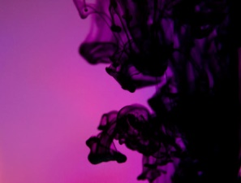
What’s unusual about Flow Vis?
Heterogeneous mix of students – about ¼ the students are film, design, or photography students
Resource Teams – teammates as support; students still produce individual work
Aesthetics – equal emphasis with the scientific
Creativity – novel images valued more
Choice – open-ended assignments
Public presentation and critique
For Engineers
Michael Souchek (2013)
Notes:
Taking the practices of an art course and merging with the practices of an engineering projects course; would not have worked with strict grading rubric or required eng. talk in class; major downside is filling class with easy A people – avoid with scare letter, with public presentation

Slide 9
What’s unusual about Flow Vis?
We ask engineers to act more like artists
We ask artists to act more like engineers or scientists
Michael Souchek (2013)
Notes:
Taking the practices of an art course and merging with the practices of an engineering projects course; would not have worked with strict grading rubric or required eng. talk in class; major downside is filling class with easy A people – avoid with scare letter, with public presentation

Slide 10
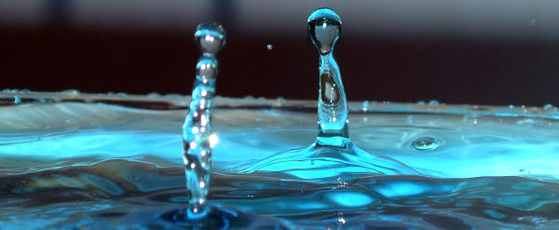
Data Collection
Surveys
Validated in 2012 study (Hertzberg, Leppek and Gray 2012)
2013 & 2014 (2 semesters)
Pre- and Post- course
Closed & Open Response Questions
Water Talks Chris Bonilha (2009).

Slide 11
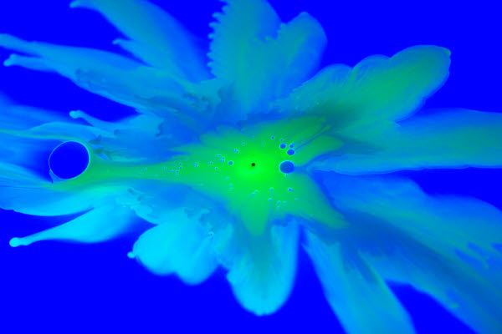
Data Collection
Interviews
Spring 2014
Pre- and post-course
Semi-structured
Engineering or Artistic Identity
Collaborative Experiences
Expectations of the course (pre)
Were expectations met? (post)
Steven Hendricks, Austin Edwards, Andrew Bornstein, Tyler Coffey, Matthew Phee (2011).
Notes:
I had not yet tagged TE before I did this

Slide 12
Data Collection
 | Flow Vis Spring 2013 | Flow Vis Spring 2014
Surveys | 33 (all) 30 (eng only) | 31 (all) 26 (eng only)
Interviews | -- | 3 (engineer) 5 (art)

Slide 13
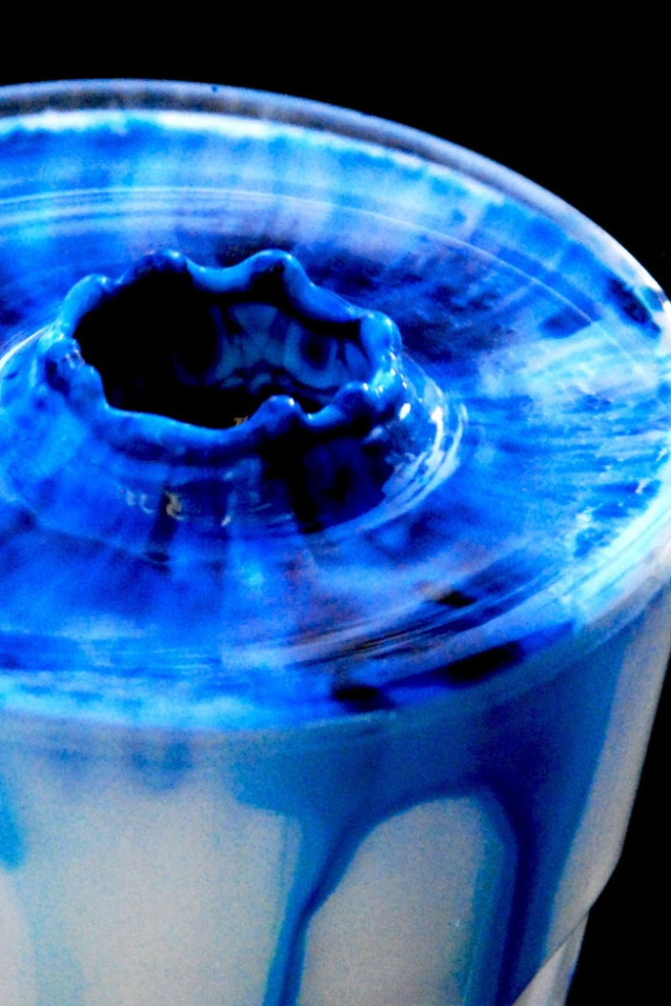
General Positive Impacts
Teamwork fostered Mutual Respect
Paper required Reflection, deeper conceptual understanding
Expanded Perception in both Engineers and Artists
Amanda Barnes (2007). Impact crater from a droplet of blue food dye into milk.

Slide 14
I learned to investigate texturally … It’s right under your nose, bubbles in the dishwasher, water under your feet by the creek… it opened up a more microscopic kind of beauty. –Art student (Sub 16, int 2)
Clay Corbett, Sarah Robinson (2004)

Slide 15
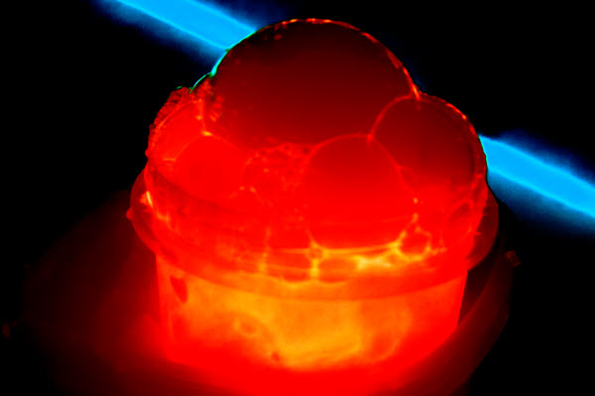
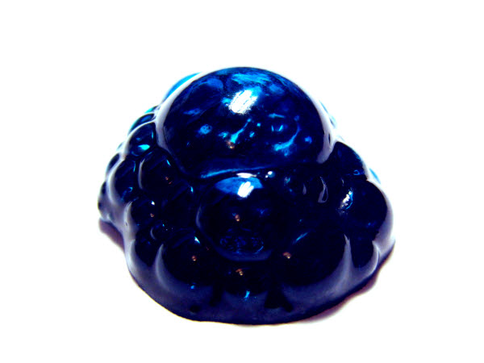
Do our engineers act like artists?
One of my projects, I noticed I can do this [post processing] and it will look much more interesting. I spent three times as long. I didn’t even know it.
–Eng. student (Sub 03, int 2)
I started to push myself toward no editing or post processing of the images... be a purist and take a photograph that is all settings, and don’t do anything after that.
–Eng. student (Sub 09 int 2)
Jake Anderegg 2012
Devin Ohmart 2012
Notes:
Motivation of application to theory rather than theory to application (more science, rather than engineering – direction) (also can’t ignore anything to make math easier, so they have to deal with all factors here)

Slide 16
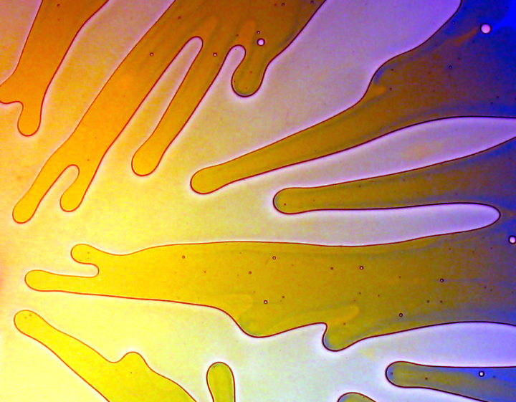
Do our artists act like engineers?
[Experimental film] is such a lofty term and it’s used a lot, [but] here we were truly experimenting, which is the most beautiful part about it. You are producing something through experiment.
–Art student (Sub 16, int 1)
Laurel Swift, Kari Hausmann, Josh Grages (2004)

Slide 17
Influence from Aesthetics
Allows for their choice of application
[Flow Vis] is like Fluids 2. Now that you know the basics, you can apply them to making cool artistic pictures.
– Eng. student (Sub 01, int 1)
Notes:
Core concepts – this is not about cognitive “gains” and checkboxes – we are aiming for knowledge as practice (Sfard 1998) – add the spectrum of knowledge as thing to knowledge as practice, and how we are proposing aesthetics as being toward the end of practice

Slide 18
Influence from Aesthetics
Allows for their choice of application.
That choice means they can explore what they prefer; they are motivated to pursue their own vision.
Notes:
Core concepts – this is not about cognitive “gains” and checkboxes – we are aiming for knowledge as practice (Sfard 1998) – add the spectrum of knowledge as thing to knowledge as practice, and how we are proposing aesthetics as being toward the end of practice

Slide 19
Influence from Aesthetics
Allows for their choice of application.
That choice means they can explore what they prefer; they are motivated to pursue their own vision.
Aesthetic goals have multiple solutions.
Notes:
Core concepts – this is not about cognitive “gains” and checkboxes – we are aiming for knowledge as practice (Sfard 1998) – add the spectrum of knowledge as thing to knowledge as practice, and how we are proposing aesthetics as being toward the end of practice

Slide 20
Aesthetic goals have multiple answers:
Everything is an experiment … If you mess up, make a thing out of what you messed up on. I kind of liked how the messed up image looked, so then I wrote in the paper about the physics of why it messed up.
–Art Student (Sub 05 int 2, emphasis added)

Slide 21
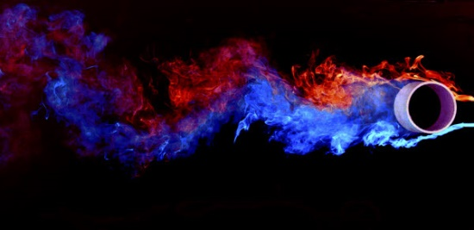
Conclusions:
Aesthetic focus allows for subjective exploration – use the “mess” and iterate
Aesthetic tasks ask students to develop an “eye” for what they prefer, aiding expanded perception
Kyle Manhart, Gregory Kana, Jared Hansford, Matthew Campbell, Andrew Scholbrock(2011)
Notes:
Expand on aes as inherently motivating – toward the beginning, so “by definition” isn’t hanging out there, what doesn’t work (Stephanie’s question about disasters, why these features for this course.

Slide 22
Final Thoughts
Aesthetics is an under-utilized way of creating deeper connection to the content
Other engineering domains have equivalent senses of aesthetics and visual tasks.
Laurel Swift, Kari Hausmann, Josh Grages (2004)

Slide 23
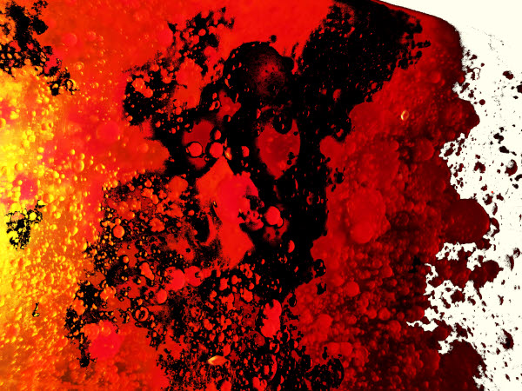
Thank you
Questions?
Jonathan Fritts(2013)

Slide 24
Flow Vis Student Work
Water Talks (left) Chris Bonilha (2009). Droplet splashes rebound into Worthington jets.
Steven Hendricks, Austin Edwards, Andrew Bornstein, Tyler Coffey, Matthew Phee (2011). Fluorescent laundry detergent displaced by diluted highlighter ink displays a Saffman-Taylor fingering instability
Amanda Barnes (2007). Impact crater from a droplet of blue food dye into milk.
Notes:
Example images, highlight that FV walks line between art and science, rare for ENG students

Slide 25
We need to view knowledge as both Acquisition and Participation
Acquisition |  | Participation
Individual Enrichment | Goal of Learning | Community of Building
Acquisition of a thing | Learning | Becoming a participant
Recipient, consumer, constructor | Student | Peripheral participant, apprentice
Provider, Facilitator, mediator | Teacher | Expert participant, preserver of practice
Property, possession, commodity | Knowledge/ concept | Aspect of a practice / activity
Having, possessing | Knowing | Belonging, participating, communicating
(Sfard, 1998)

Slide 26
Mutual Respect:
There were a lot of things that [the film maker] pointed out that I wouldn’t have thought of when taking photographs, certain angles, certain lighting… all this art technical stuff. I had no idea what he was talking about.
– Eng. student (Sub 03, int 2)
[The engineer’s explanation] went whoosh, right over my head. I didn’t understand the physics and mathematics, but I understood why that reaction occurred in simple terms.
–Art student (Sub 02, int 2)

Slide 27
Reflection Deepens Understanding:
I think I have a better understanding about what the Reynolds number actually means from [writing the papers]. After my fluids class, you think it's just this number. It can actually tell you a lot.
–Eng. Student (Sub 09, int 2)
[the paper] backs the image up, gives a secondary way to understand what is going on, maybe more in depth. Maybe the video brings you and makes you want to understand it, and then you can read that and figure out what you just watched.
– Art Student (Sub 05, int 2)

Slide 28
Influence from Aesthetics
[Flow Vis] is like Fluids 2. Now that you know the basics, you can apply them to making cool artistic pictures.
– Eng. student (Sub 01, int 1)
Every single time we talk about photographic technique, or develop a flow product or a combustion project, those are all backed up with examples from the real world…. It’s not just this is a problem from the book or ‘ignore friction here’. All these things are real applications, all factors are considered.
–Eng. student (Sub 03, int 1)
Notes:
Core concepts – this is not about cognitive “gains” and checkboxes – we are aiming for knowledge as practice (Sfard 1998) – add the spectrum of knowledge as thing to knowledge as practice, and how we are proposing aesthetics as being toward the end of practice

Slide 29
Motivating:
I feel like I’m out of my element, which is fun and exciting.
–Eng. student (Sub 01, int 1)
I just had a blast. I was really proud of what I did…. I’m excited to see [the final exhibit]. My family is going to come.
–Art student (Sub 07, int 2)
One of my projects, I noticed I can do this and it will look much more interesting. I spent three times as long. I didn’t even know it.
–Eng. student (Sub 03, int 2)
Notes:
Motivation of application to theory rather than theory to application (more science, rather than engineering – direction) (also can’t ignore anything to make math easier, so they have to deal with all factors here)

Slide 30
Benefits to Art Students:
[Experimental film] is such a lofty term and it’s used a lot, [but] here we were truly experimenting, which is the most beautiful part about it. You are producing something through experiment.
–Art student (Sub 16, int 1)

Slide 31
Benefits to Art Students:
In terms of appreciating flows and keeping a keen eye out for it, that’s totally improved drastically… I don’t want to make another film without including one flow vis.
–Art student (Sub 07, int 2)
I learned to investigate texturally … It’s right under your nose, bubbles in the dishwasher, water under your feet by the creek… it opened up a more microscopic kind of beauty.
–Art student (Sub 16, int 2)

Slide 32
Aesthetic goals have multiple answers:
[in other courses] you create such a rigid thought process rather than a really flexible, dynamic space.
–Eng. student (Sub 09, int 1)
You can modify your pathway [in Flow Vis]. In math there’s only one way, but in [Flow Vis] it was more along the lines of this experiment is how you choose to direct it.
–Eng. student (Sub 03, int 2)

