Slide 1
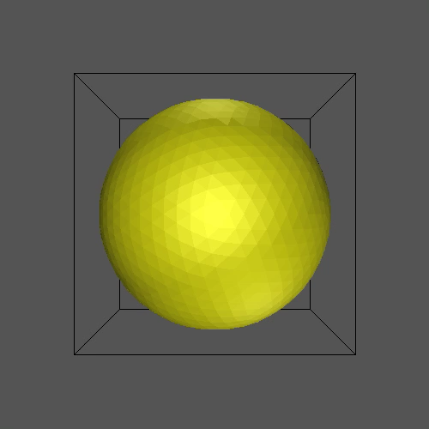
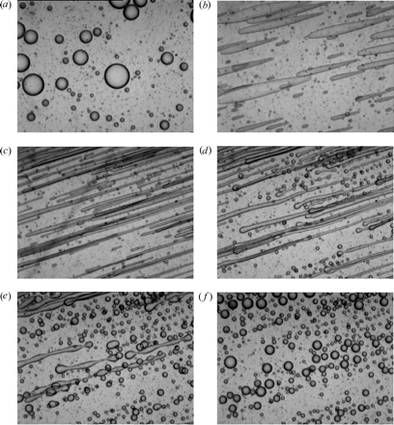
Complex fluids: Interfaces
no shear
flow started
Petia M. Vlahovska
Northwestern University
flow stopped
Iza&Bousmina (2000)
Notes:
https://www.taylorfrancis.com/chapters/edit/10.1201/b18633-4/chemical-physics-colloid-systems-interfaces-peter-kralchevsky-krassimir-danov

Slide 2
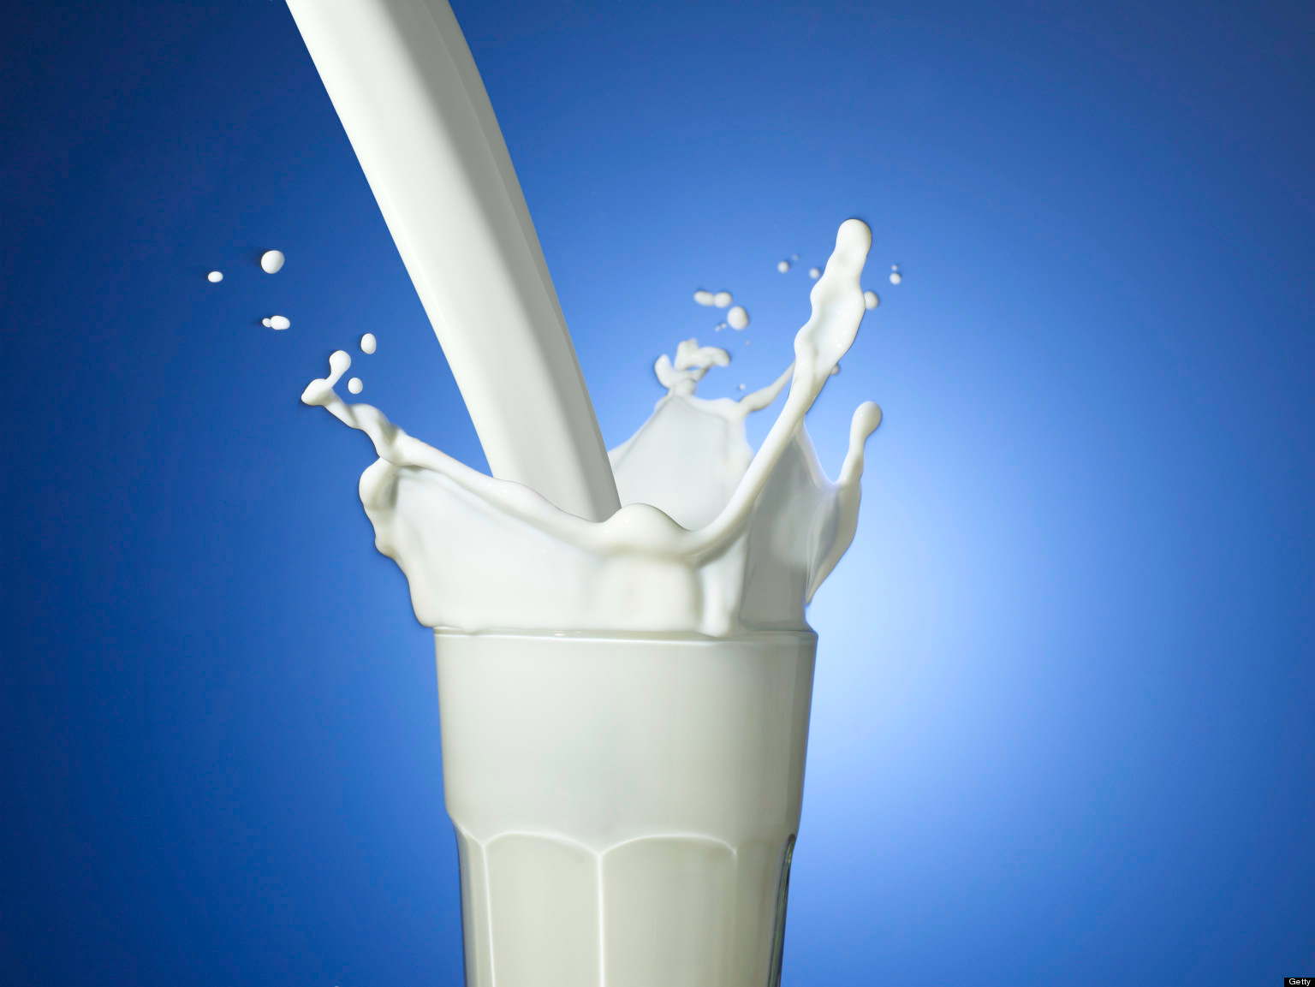
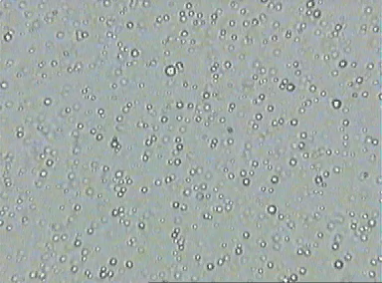
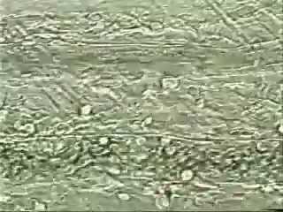
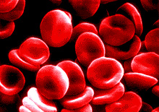
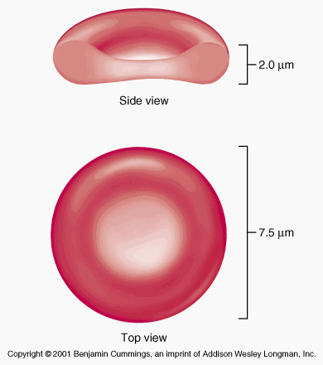
Complex fluids/soft materials are structured
Zoom x 1000
drop size ~ microns
Drops ( spherical)
milk
RBCs (biconcave disks)
blood
Blood dense suspension:
RBC volume fraction ~ 40-45%

Slide 3
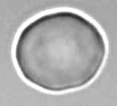
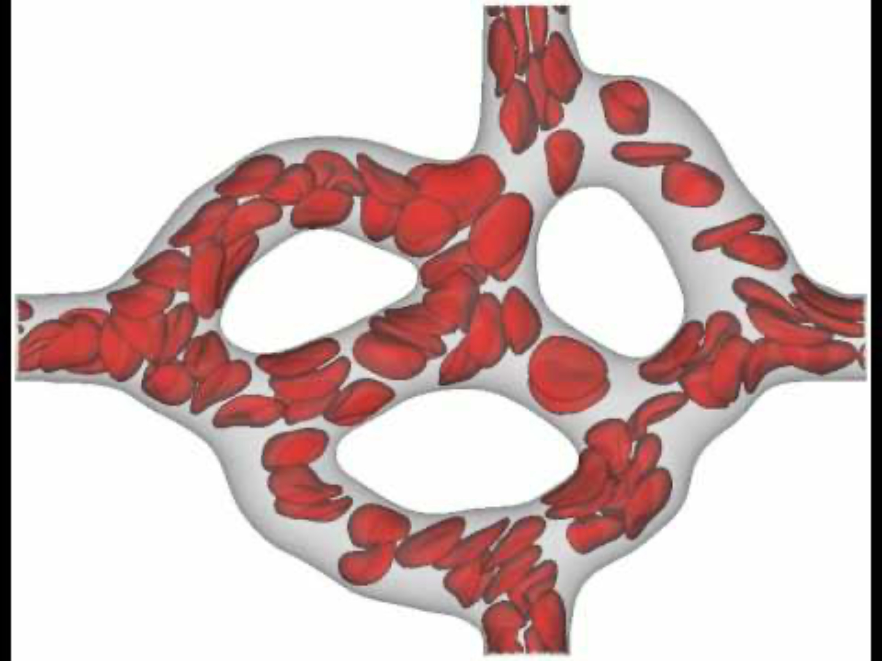
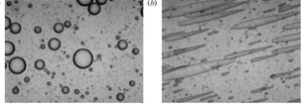
thermal noise is important
large surface to volume ratio
Brownian motion, fluctuations
unstable
example: Take a sphere, chop it in N spheres, same volume but area increases ?? fold
https://www.youtube.com/watch?v=VwhNLaRCD-4
video Timo Betz
Turlier et al. Nature Physics (2016)
deformable microstructure
nonlinear response
(viscoelasticity,
non-Newtonian fluid mechanics, nonlinear elasticity)
blood flow in the microcirculation
no shear
shear
Iza&Bousmina (2000)
(mayonnaise spreading)

Slide 4
Interfaces: simple and complex, statics and dynamics
“simple” interfaces: surface tension, capillarity
“complex interfaces”: surfactants, biological membranes, charged interfaces

Slide 5
Typical Length Scales, Energies, Forces:
Length:
1 nm = 10⁻⁹ m, red blood cells ~10 μm = 3-5*10⁻⁶ m
average cell in our body: approx. 50 μm
Energy:
Thermal energy
1 k_{B}T =4.16×10⁻²¹ J
  ≈ 0.6 kcal/mol ≈ 0.6 * 4.1868 kJ/mol
  = 2.5 kJ/mol (298K)
  = 4.1 pN nm
  Boltzmann constant k_{B}=1.38*10⁻²³JK⁻¹
Force:
1 pN = 10⁻¹² N
C-C bond: approx. 100 k_{B}T stable at room temperature
H-bond: approx. 10 k_{B}T
Surface tension:
water/oil 10⁻³ N/m~ 25 k_{B}T/nm²
“SOFT”

Slide 6
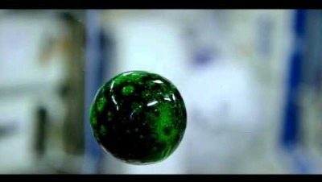
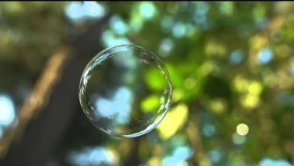
What is the shape of a soap bubble?
surface tension keeps drops and bubbles spherical
What is surface tension?
How do describe and determine shapes?
Notes:
Why is the shape sphere?
Why is it vibrating? Bubbles on earth don’t vibrates
What keep the shape spherical -surface tension

Slide 7
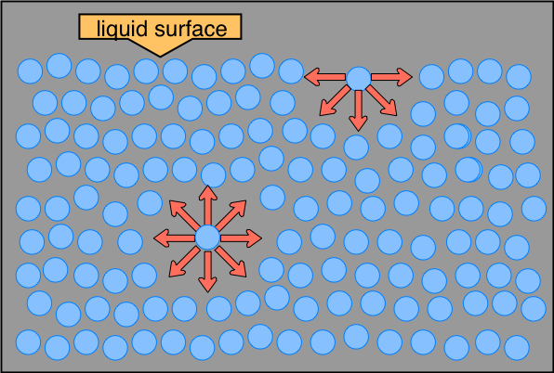
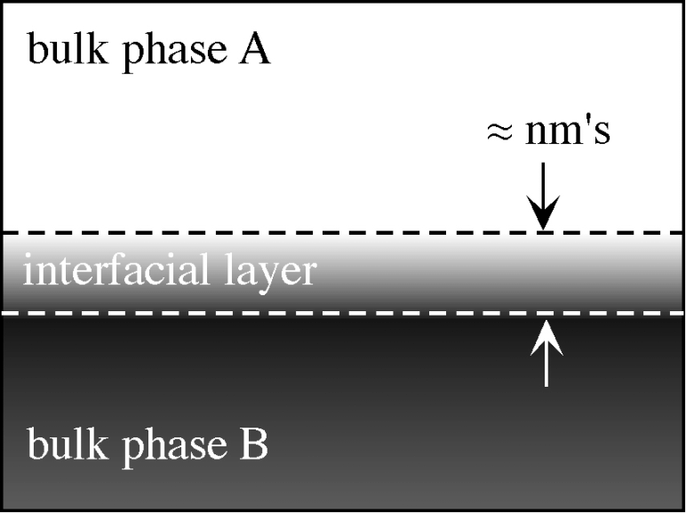
Surface tension
Surface tension can be interpreted both as surface energy per unit area (thermodynamic definition) and as a force per unit length (mechanical definition)
Surface tension as unbalanced intermolecular force
Surface tension as pressure deficit in the interfacial layer
Interfaces are not sharp
(discuss Gibbs dividing surface)
in the bulk: no net force on a molecule
at the surface: imbalance
=>stretched-membrane effect
For a flat surface
water/air =70mN/m
Hamaker constant
(Bakker equation)
molecule size

Slide 8
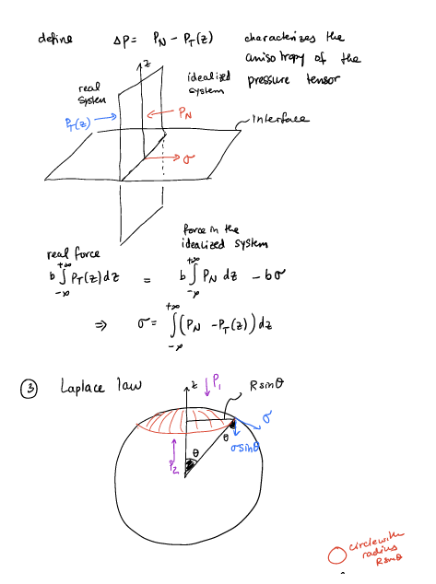
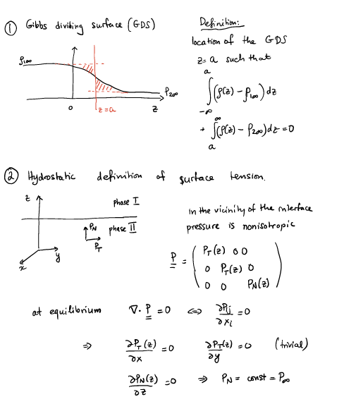
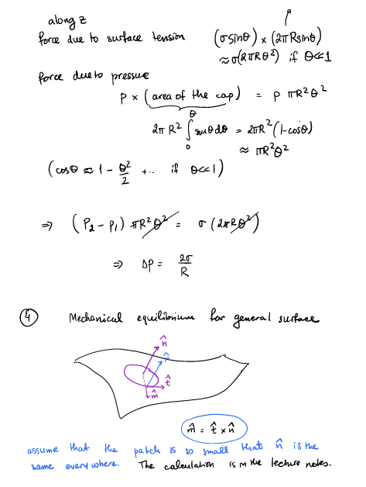
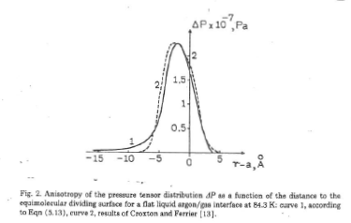

Slide 9
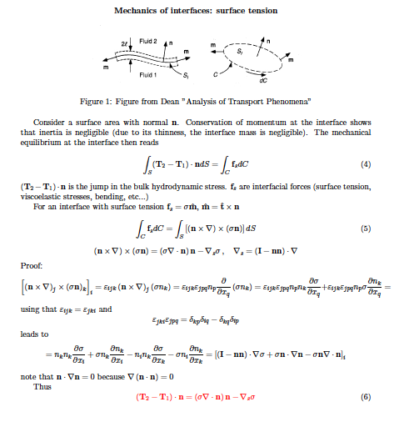
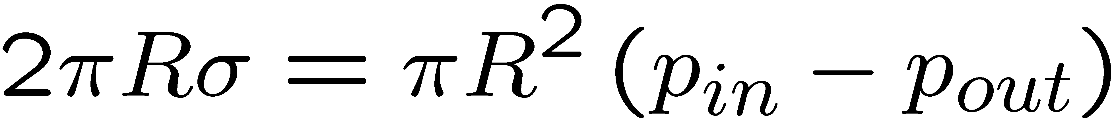
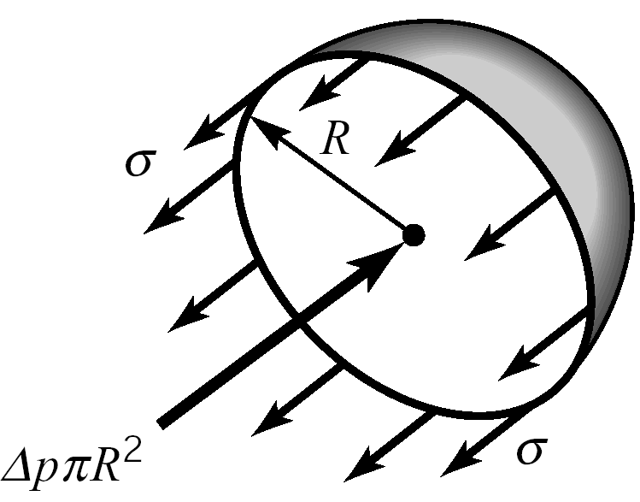
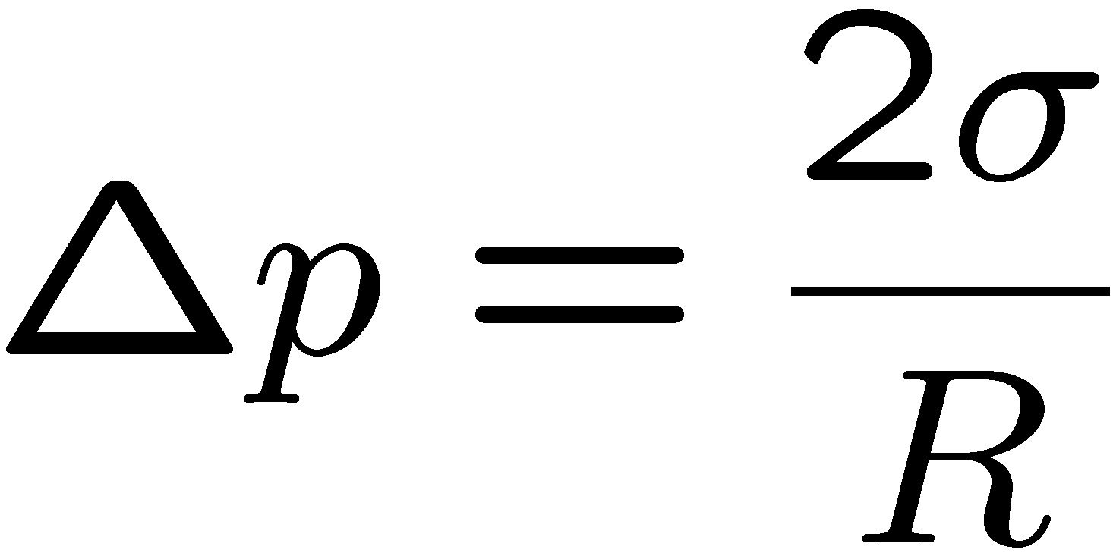
curved interface:
Laplace’s law
What if the interface is not a sphere?????
fluid 2
fluid 1
This local force is balanced by the
jump in hydrodynamic traction,
note: normal points into 2
Notes:
{\bf{f}} ds=\sigma(s+ds){\bf{t}}(s+ds)-\sigma(s) {\bf{t}}(s)
{\bf{f}} =\frac{d}{ds}\left(\sigma{\bf{t}}\right)
{\bf{f}} +\left({\bf{T}}_2-\bf{T}_1\right)\cdot {\bf n}=0
\frac{d{\bf{t}}}{ds}=-H {\bf{n}}
The minus sign appears because, as you move along the curve, the tangent rotates toward the interior, while the outward normal points in the opposite direction
Because $n$ points outward, the force f points inward: surface tension always acts to shrink the interface. This is why the outward-normal convention is commonly adopted in continuum mechanics and in membrane mechanics
Note that this convention is opposite to the one used in many differential geometry textbooks.

Slide 10
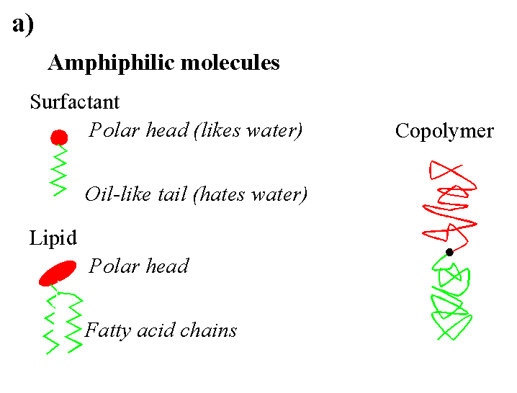
Note: at equilibrium surface tension is uniform, and there are no gradients. If surface tension is nonuniform (e.g. due to temperature or surfactant nonuniformities) this drives flow
Surfactants: adsorb at interfaces and lower surface tension

Slide 11
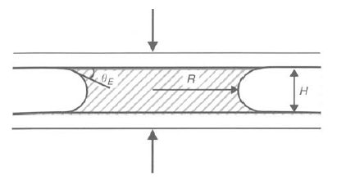

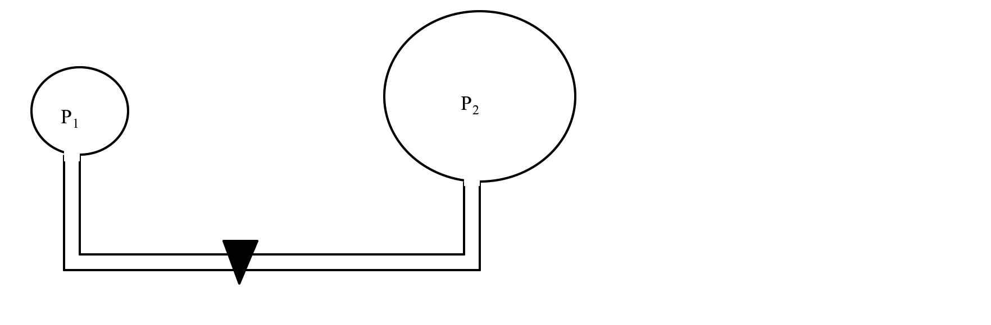
Questions:
Capillary adhesion: Two wetted surfaces can adhere strongly if the liquid wets both surfaces. Estimate the force
Two bubbles are connected by a tube. What happens when you open the valve?
Self -propelling drop. (see paper by Lorenceau and Quere “Drops on a conical wire" , J. Fluid Mech. 2003 )
An asymmetric capillary device may prompt spontaneous drop propulsion. An example of such
motion is illustrated in the Figure. A drop of silicone oil is deposited on a conical copper wire (mean radius of 250 um), whose radius increases from the right to the left with a gradient dr/dz of the order of 1 %. Note that silicone oil totally wets copper. Four successive photographs are taken. The time interval between two snapshots is about 1 second.
In which direction does the drop move?

Slide 12
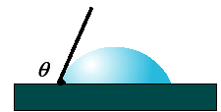
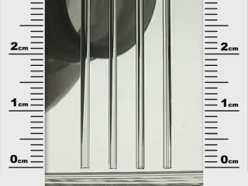
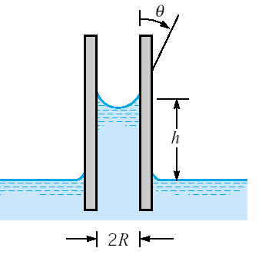
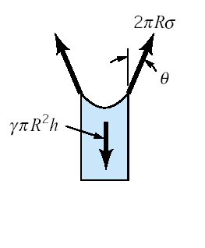
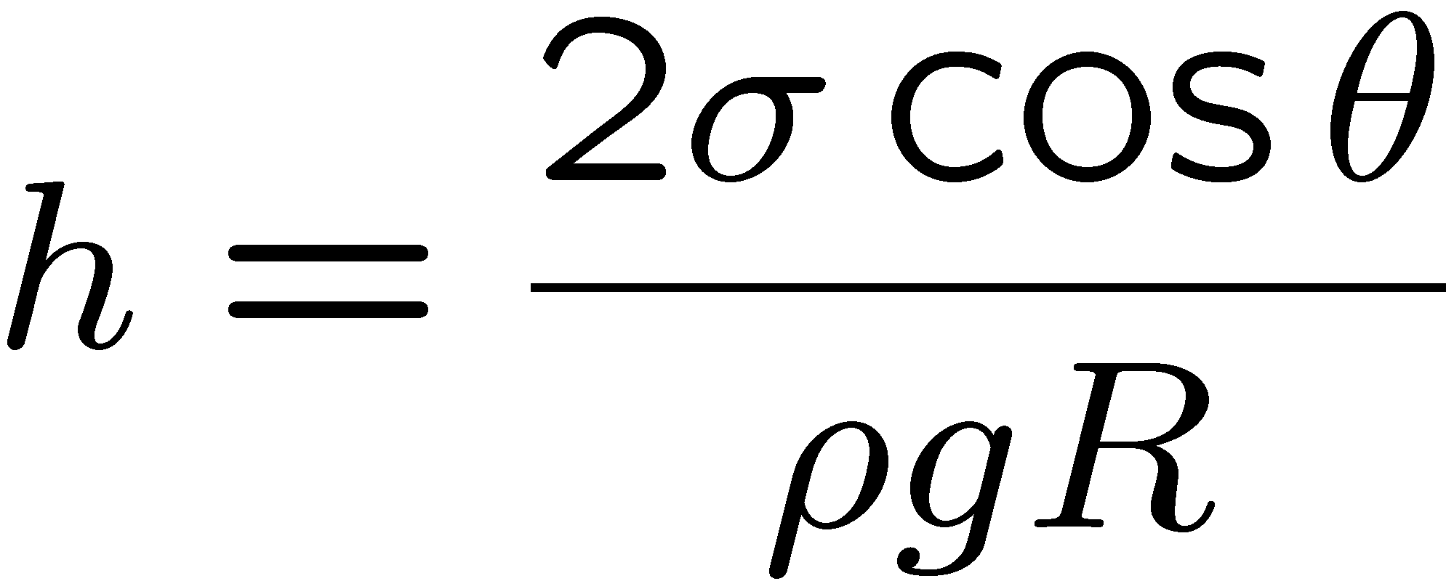
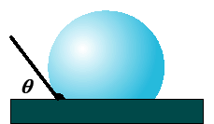
What if the liquid is nonwetting?
but why is the interface curved?

Slide 13
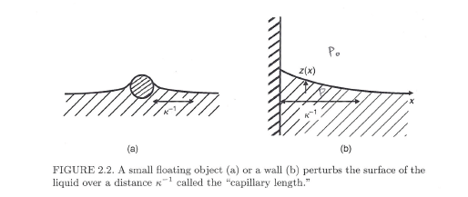
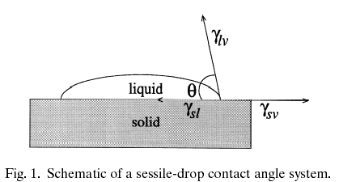


Wetting and contact angle
(de Gennes book)
Show that
Kwok and Neumann, 1999
(in axisym geometry – Bessel functions!)
Young’s relation

Slide 14
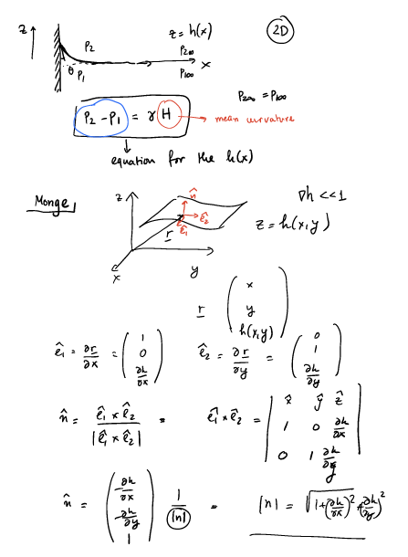
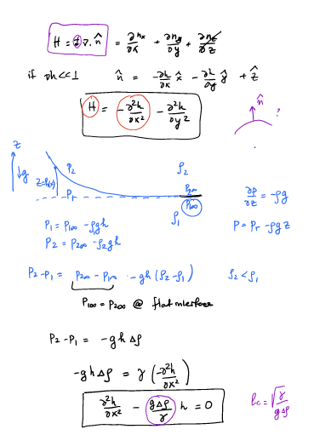
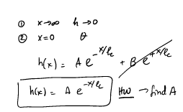
https://www.cmu.edu/biolphys/deserno/pdf/meniscus.pdf
tension is denoted by 𝛾

Slide 15
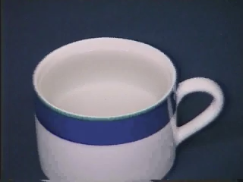
Q: The razor blade is heavier than the water. Why does it float?

Slide 16

The cheerios effect
Notes:
https://www.youtube.com/watch?v=mbKAwk-OG_w

Slide 17
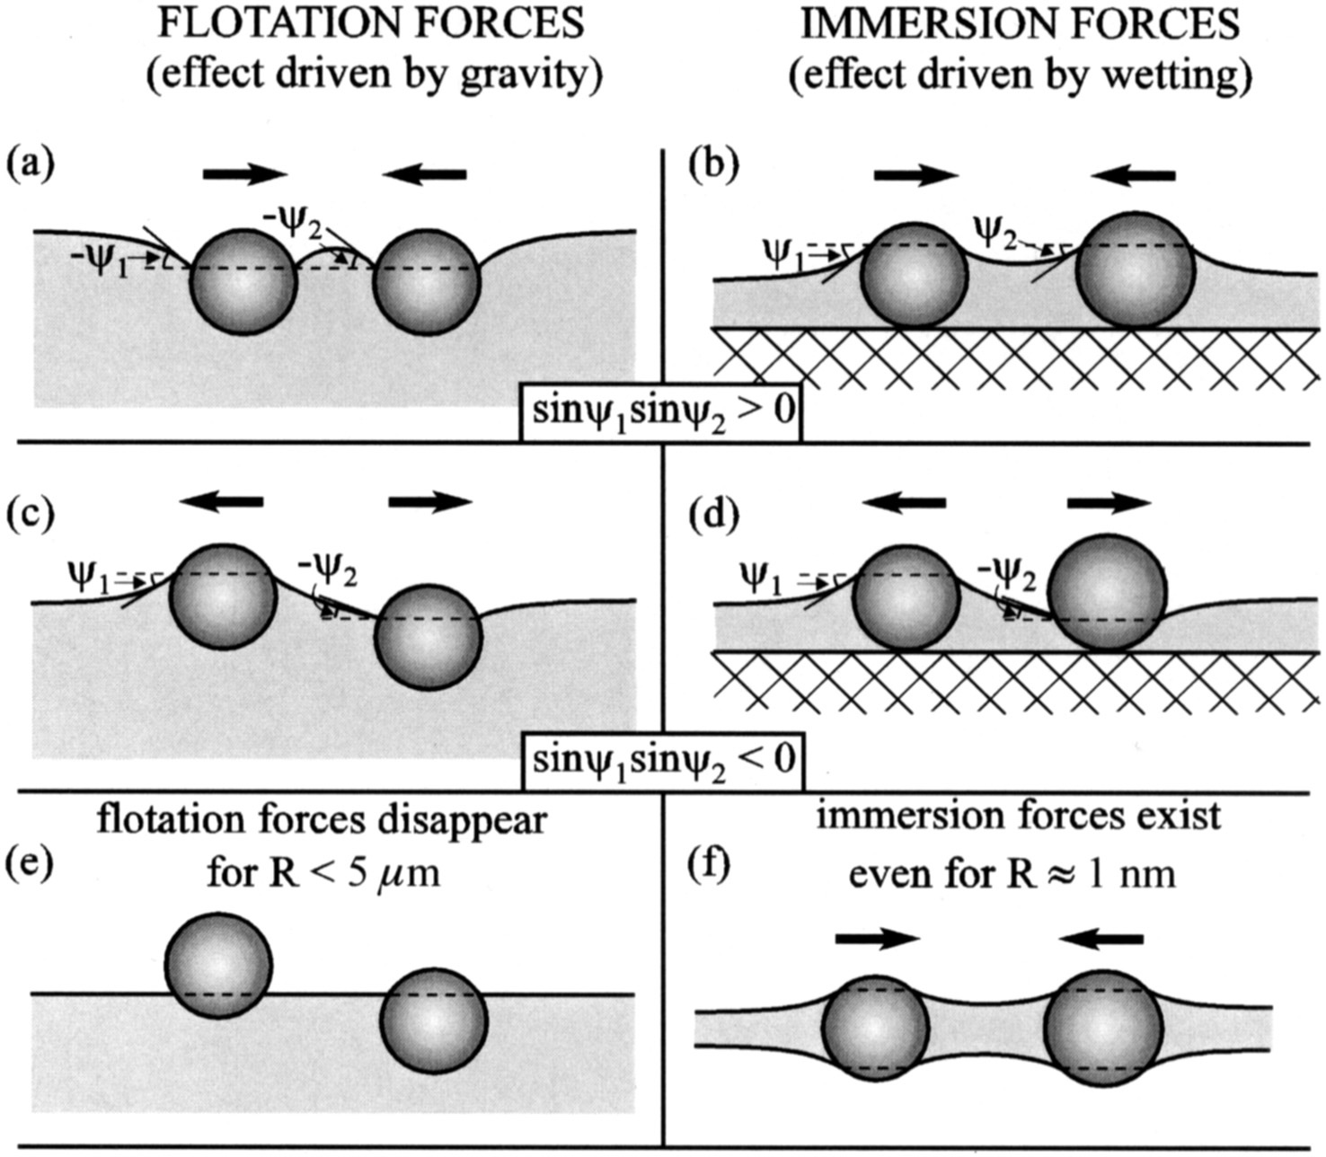
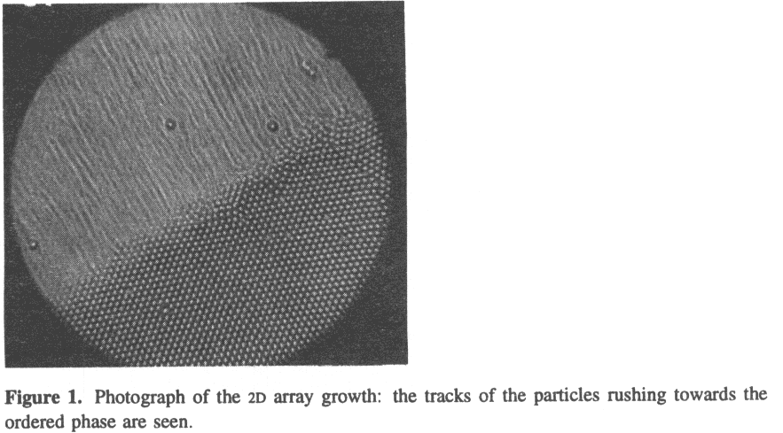
P.A. Kralchevsky, K. Nagayama “Advances in Colloid and Interface Science” 85 (2000) 145-192
https://www.youtube.com/watch?v=NIcNrsTlbVU
Denkov, N.; Velev, O.; Kralchevsky, P.; Ivanov, I.; Yoshimura, H.; Nagayama, K. (1992). "Mechanism of formation of two-dimensional crystals from latex particles on substrates". Langmuir 8: 3183
Notes:
the origin of the lateral capillary forces is the deformation of the liquid surface, which is supposed to be flat in the absence of particles. The larger the interfacial deformation created by the particles, the stronger the capillary interaction between them

Slide 18
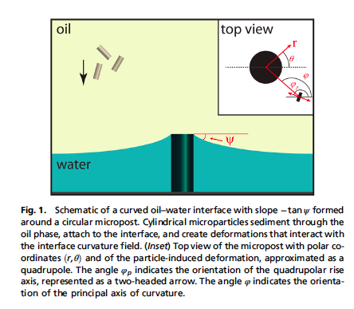
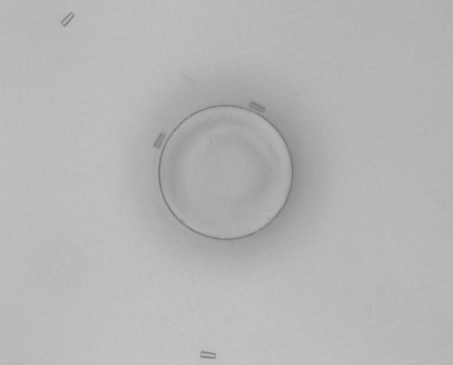
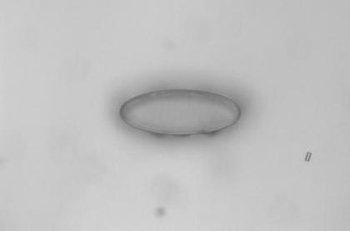
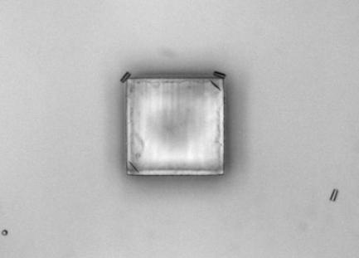
Cavallaro et al Curvature-driven capillary migration and assembly of rod-like particles PNAS 2011

Slide 19
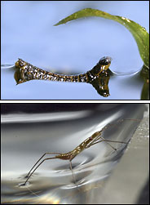
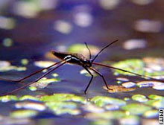

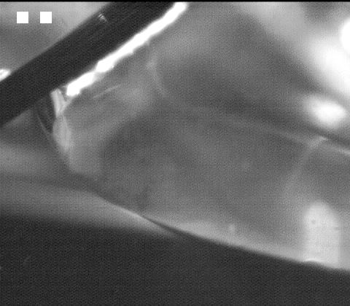
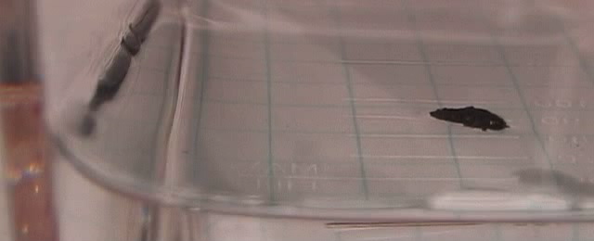
http://www.nature.com/nature/journal/v424/n6949/abs/nature01793.html

Slide 20
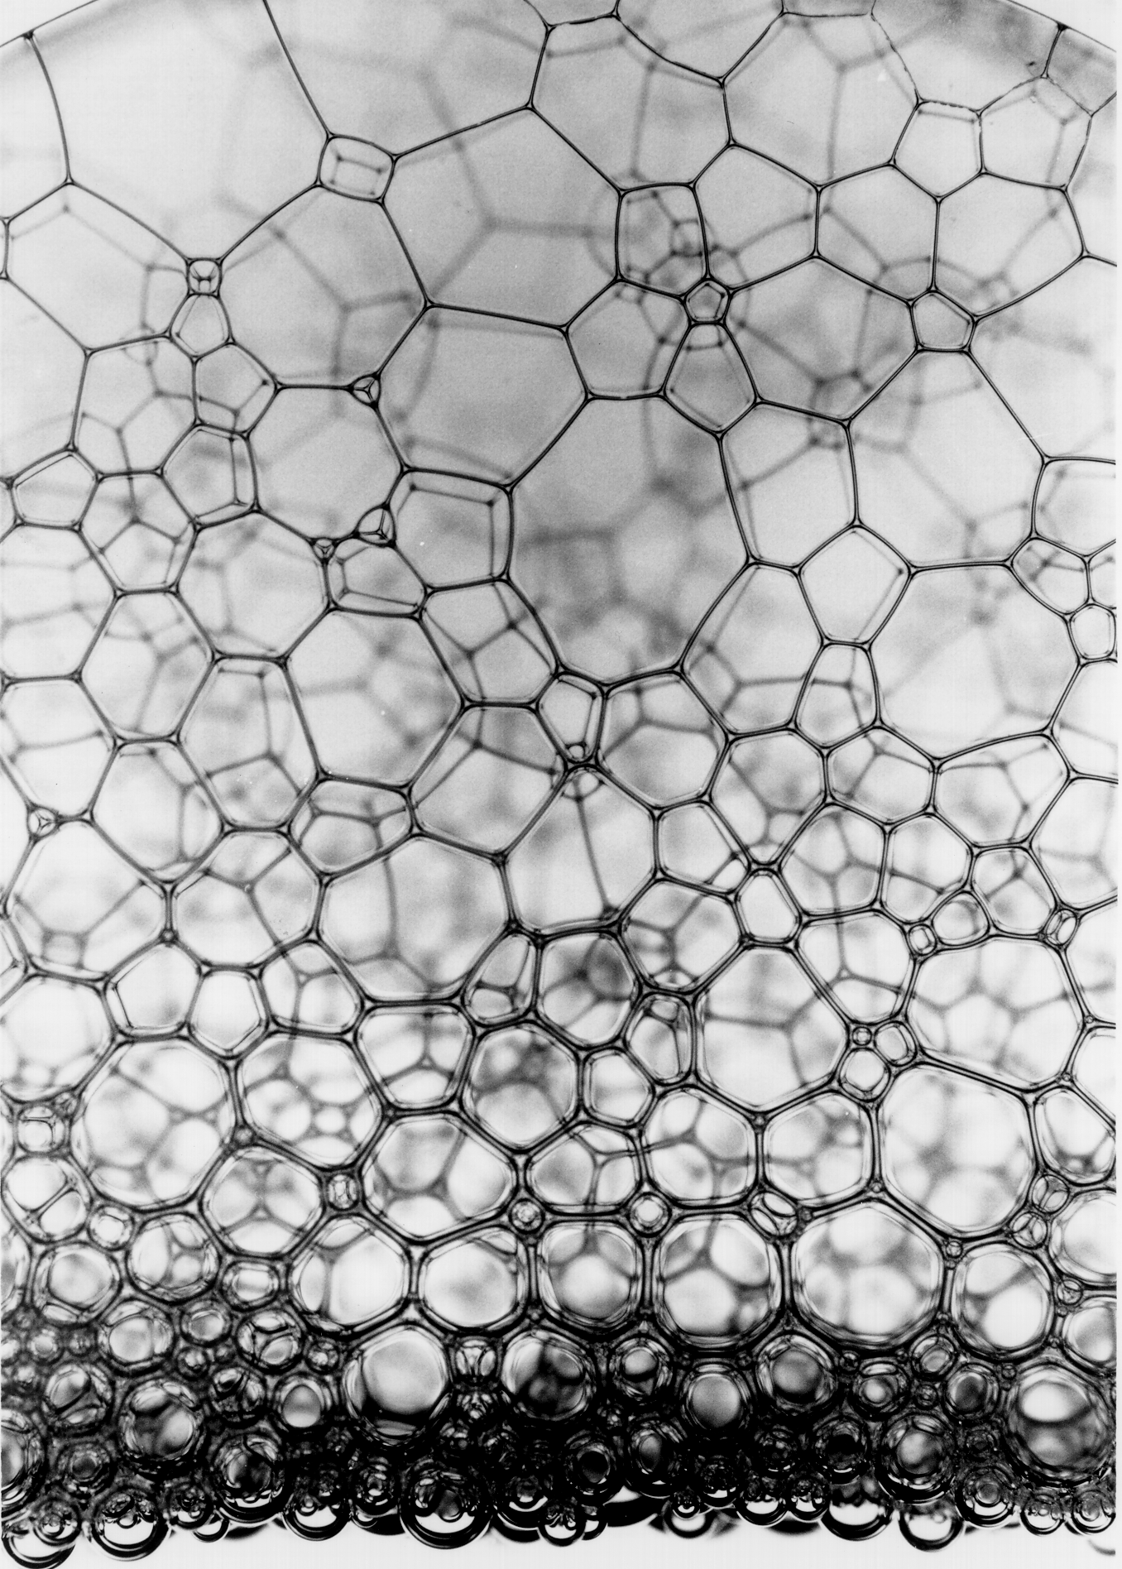
Liquid interfaces are under tension
”Shape” of foam
For the intersection of soap film lamellae in a foam all tensions are the same, hence the angle is 120
Fruit fly eye
Physical modeling of cell geometric order in an epithelial tissue
Hilgenfeldt et al, PNAS 2008

Slide 21
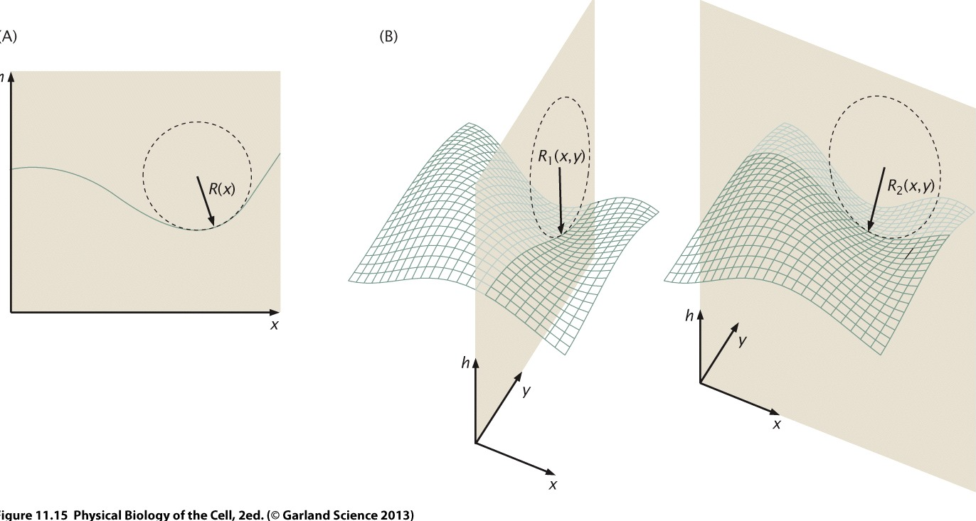
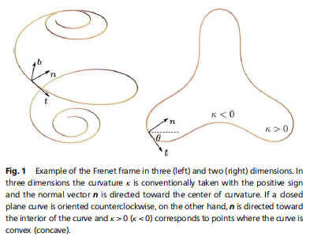

Note on geometry:
Giomi, 2013 review

